Slide 1
Current

Slide 2
What is Current?
Current is the flow of electrons through a circuit.

Slide 3
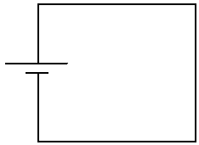
Why do Electrons Move?
An electrochemical cell (battery) uses chemical reactions to move electrons. This creates a “potential difference” between the ends of the battery.
Positive terminal is positively charged
Negative terminal is negatively charged and has an excess of electrons

Slide 4
Why do Electrons Move?
When a circuit connects the two ends of the cell, current flows through the wire.
Electrons are repelled by the negative terminal and are attracted by the positive terminal.
Electrons cannot move through air (insulator) but they can definitely move through a wire (conductor)!

Slide 5
When scientists discovered electric current, they assumed that positive charges were moving.
This is called conventional current
defined as the direction positive charges move in a circuit
from positive to negative
we now know this isn’t the way it actually works.

Slide 6
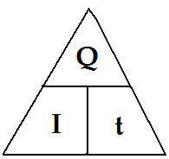
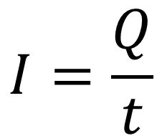
Calculating Current
Current is the amount of charge that passes a point in a circuit every second:
$$I=\frac{Q}{t}$$
I: is the symbol for current, measured in amperes (A)
Q: is the symbol for charge, measured in coulombs (C)
t: is time, measured in seconds (s)

Slide 7
Example #1
What is the current in a wire if 25 C of charge passes by a point in 5 seconds?
$$I=\frac{Q}{t}=\frac{25C}{5s}=5A$$

Slide 8
Example #2
If the current in a wire is measured to be 12 A, how much charge passes by a point in the circuit every minute?
$$Q=I×t$$
$=12A×60s$
$=720C$

Slide 9
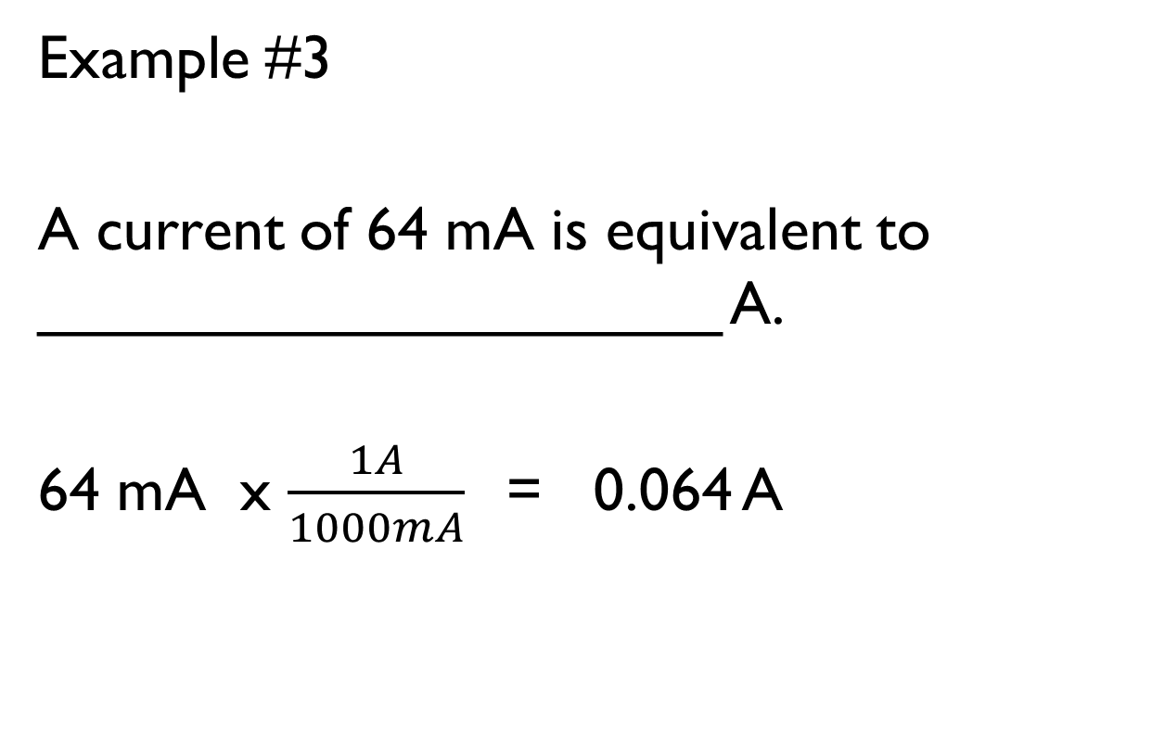
Example #3
A current of 64 mA is equivalent to ____________________ A.
64 mA x $\frac{1A}{1000mA}$= 0.064 A

Slide 10
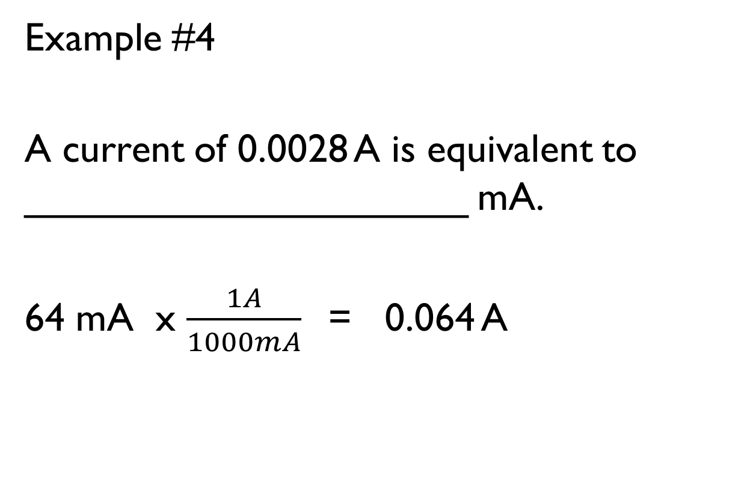
Example #4
A current of 0.0028 A is equivalent to ____________________ mA.
64 mA x $\frac{1A}{1000mA}$= 0.064 A

Slide 11
Current is measured by a device called an ammeter.
Typical amounts of current:
In a light bulb is 1A
In a TV is 4A
In a car starter is 500 A

Slide 12
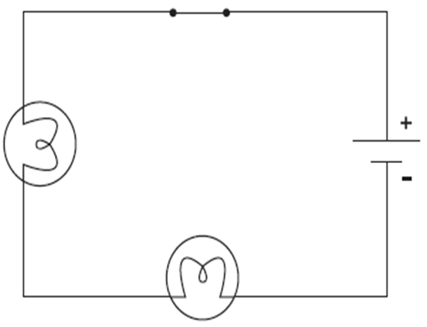
Series vs. Parallel
In a circuit, devices (such as light bulbs or batteries) can be placed in two different ways.
1. SERIES
When devices are placed in series, the current goes through a single path through all devices.
In this circuit, there is only one path and the current goes through the two light bulbs in the series.

Slide 13
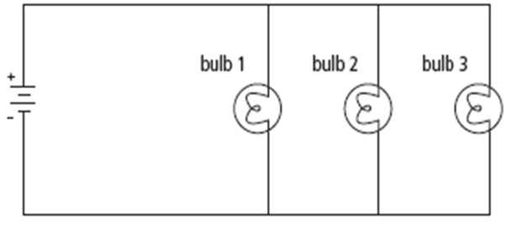
2. PARALLEL
When devices are placed in parallel, there are 2 or more paths that the current can take
Current splits: some electrons go through one device, and some go through the other(s).

Slide 14
Decide whether each circuit is Series, Parallel, or a Combination of the two.
SERIES
PARALLEL
SERIES
PARALLEL
SERIES
PARALLEL
SERIES
SERIES
SERIES
PARALLEL

Slide 15
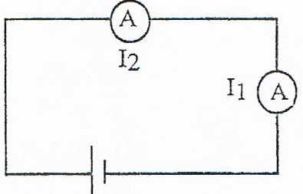
Calculating Current in SERIES
Current (I)
Measured in Amperes (A)
When you place an Ammeter in SERIES the current stays the same
Series:
$$I_{Total}=I_{1}=I_{2}$$

Slide 16
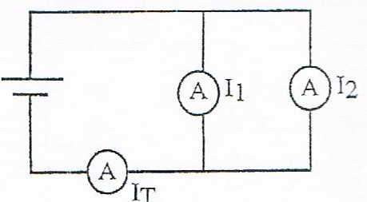
Calculating Current in PARALLEL
Current (I)
Measured in Amperes (A)
When you place an Ammeter in PARALLEL, you add the current to find a total.
Parallel:
$I_{Total}=I_{1}+I_{2}$+…

Slide 17

Example #4
Find the total current for the following circuit.
10 A
12 A
$$I_{Total}=I_{1}+I_{2}$$
$$=10 A+12 A$$
$$=22 A$$

Slide 18
Example #5
12 A
Find the total current for the following circuit.
$$I_{Total}=I_{2}=I_{1}=12A$$

Slide 19


Example #6
How long does it take 40 C of charge to pass by a point if the current in the circuit is 0.76 A ?
$$t=\frac{Q}{I}$$
$$=\frac{40C}{0.76A}$$
$$=52.6s$$

