Slide 1
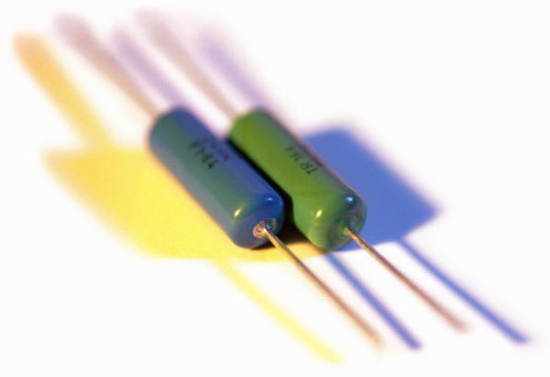
Resistance

Slide 2
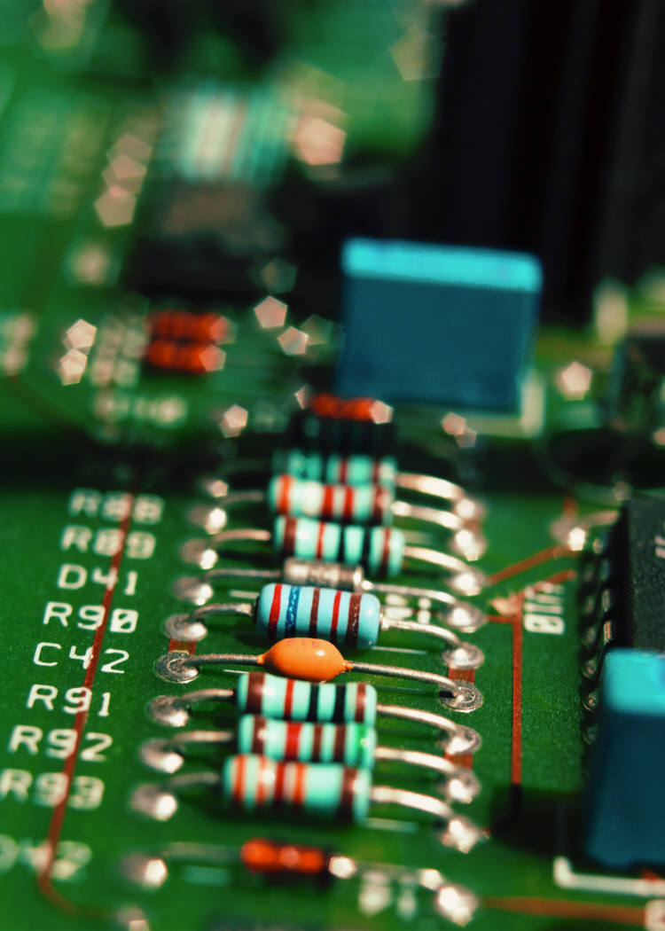

What are Resistors?
A resistor is part of an electric circuit that resists the flow of electric current.
Symbol for a resistor:
We put resistors in a circuit in order to control the amount of energy going into different parts of a device.

Slide 3
Cell Phone Case Study

Slide 4
Cell Phone Case Study
E.g. All the electrical components in your cell phone are powered by a single 3.8V battery!!
But different parts (i.e., speaker vs. screen) have different power requirements!!
So we need to put resistors in part of the circuit to consume the extra energy!!

Slide 5
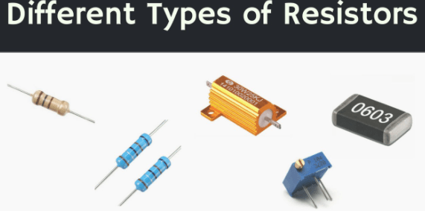

Slide 6
What are Resistors?
As current flows through a device/resistor, some of the electrical energy is transformed into another form, such as light or heat energy.
Every device in a circuit has some amount of resistance, even the WIRE!!

Slide 7
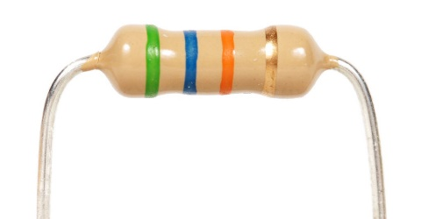
Resistance and the Ohm (Ω)
Resistance is expressed using ohms (Ω).
The higher the value, the greater the resistance.
(E.g. 10 Ω will resist current more than 2 Ω.)
When a resistor is connected to an electric cell, the amount of current that flows through the circuit depends on the amount of resistance
Some of the electrical energy gets converted into “heat” energy!

Slide 8
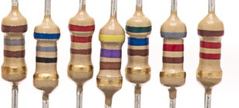
Resistor Colour Code
Each resistor has a 4-band colour code that indicates resistance.
Resistance can be determined from the three non-metallic colours.
1: 1st digit
2: 2nd digit
3: multiplier
4: metallic (ignore)
Notes:
Sometimes can be more than 4. Depends on the resistor.
(Note to self: which side do you read from? Often, the digits and multiplier will be grouped closer together. The metallic is always the ‘tolerance’/’accuracy’ colour, which we are ignoring in science 9. Always read from left to right, with the grouped bands on the left and the metallic band on the right.)

Slide 9
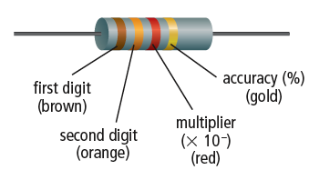
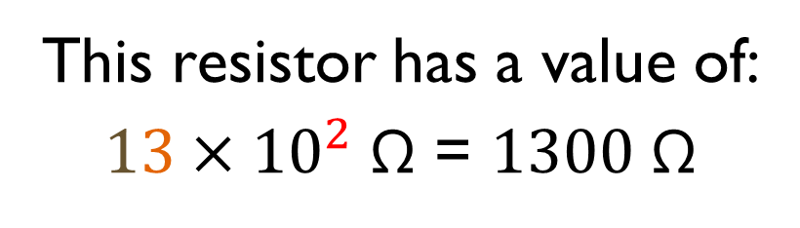
Resistor Colour Code
Colour | Value
Black | 0
Brown | 1
Red | 2
Orange | 3
Yellow | 4
Green | 5
Blue | 6
Violet | 7
Grey | 8
White | 9
This resistor has a value of:
$13×{10}^{2} \text{Ω}$ = $1300 \text{Ω}$

Slide 10
Give the value of each resistor indicated by the colour bands.
6500 Ω
700 000 Ω
560 Ω
12 Ω
87 000 Ω
2100 Ω

Slide 11
Example #1
The value of a resistor is 230 Ω. What are the first three bands of colour on this resistor?
red, orange, brown
The value of this resistor is 6400 Ω. What are the first three bands of colour on this resistor?
blue, yellow, red
Example #2

