Slide 1
Ohm’s Law
The relationship between voltage, current and resistance is given by Ohm’s Law:
Voltage (V) = Current (I) x Resistance (R)
Volts (V) amps (A) ohms (Ω)
The greater the resistance, the lower the current.
The lower the resistance, the higher the current.
V = IR

Slide 2
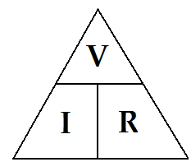

Ohm’s Law
You can rearrange the formula to calculate resistance and current:
$resistance=voltage÷current$ or $R=\frac{V}{I}$
$current=voltage÷resistance$ or $I=\frac{V}{R}$

Slide 3
Fill in the following table and calculate Resistance.
2.4 Ω
2.65 Ω
2.4 Ω
2.5 Ω
2.4 Ω

Slide 4
Example #1
A current of 2.5 mA flows through a resistor when connected to a 16 V power supply.
What is the value of this resistor?
$$R=\frac{V}{I}$$
$$=\frac{16 V}{0.0025 A}$$
$=6400$ Ω

Slide 5
Example #2
What is the current produced by a potential difference of 240 volts through a resistance of 0.2 ohms?
$I=\frac{V}{R}$
$=\frac{240 V}{0.2 \text{Ω}}$
$=1200A$

