Slide 1
Make-a-slide
What are some examples of living things?
Human, geese, yeast, ducks, trees, plants, flowers, insects, crocodiles, kangaroo, Melissa, flamingo, octopus, coral, succulents, kiwi, mold
How can you tell if something is alive?
Does it eat food?
Is it breathing?
Does it ingest oxygen?
Does it grow?
Does it have a soul?
Does it have health/heart?
Is it moving?
Is it sentient (aware of its surroundings)?

Slide 2
1.1: Characteristics of Living Things
Science 8

Slide 3
1) Living things are made of cells
https://www.youtube.com/watch?v=M1wdIdCOk-Y&ab_channel=FuseSchool-GlobalEducation
https://www.youtube.com/watch?v=gFuEo2ccTPA&ab_channel=FrankGregorio

Slide 4
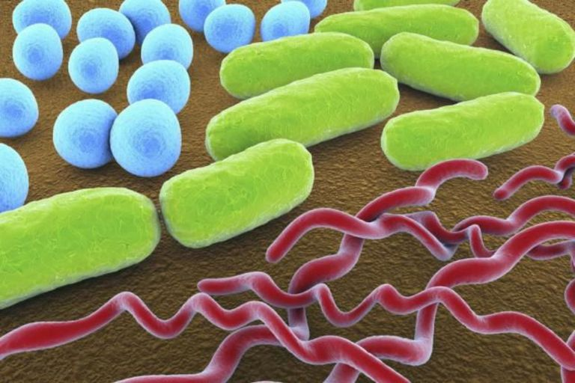
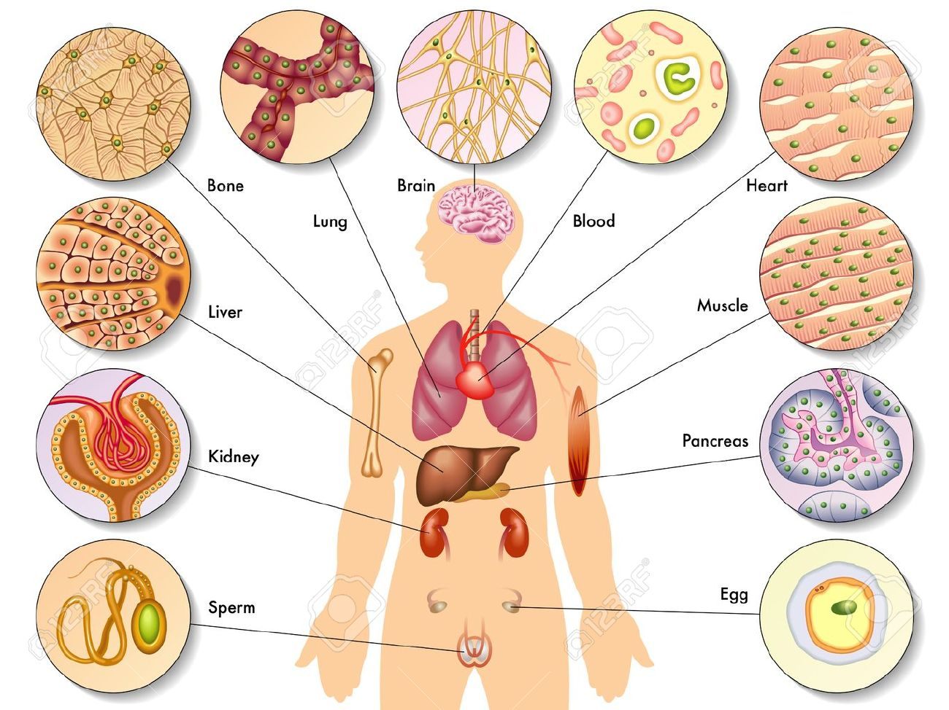
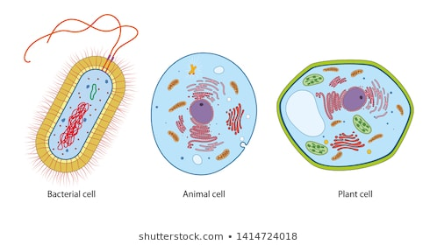
1) Living things are made of cells
Images from thoughtco.com, shutterstock.com

Slide 5
1) Living things are made of cells
How big are cells?
https://htwins.net/scale2/

Slide 6
1) Living Things are Made of cells
Cells are the smallest unit (“building blocks”) of all living things
Cells are very small (could fit 10-10,000 cells in 1 mm)
A cell is like a ‘bag’ filled with water and other structures
Notes:
Average prokaryotic cell: 0.1-5 um
Average eukaryotic cell: 10-20 um (human egg cell is 1 mm)

Slide 7
1) Living things are made of cells
Unicellular organisms are made of a single cell only
(Examples: bacteria, yeast, algae)
Multicellular organisms are made of multiple cells
(Examples: shrimp, human, tree)

Slide 8
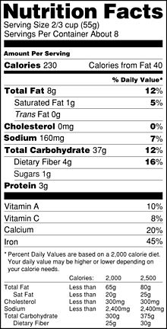
2) Living things Take in Nutrients
Nutrients: substances that living things need but cannot make for themselves
Examples:
Vitamins, minerals
Fiber
Water
Note: a nutrient for one species may not be a nutrient for another! (e.g. oxygen is a nutrient for humans; carbon dioxide is a nutrient for plants.)

Slide 9
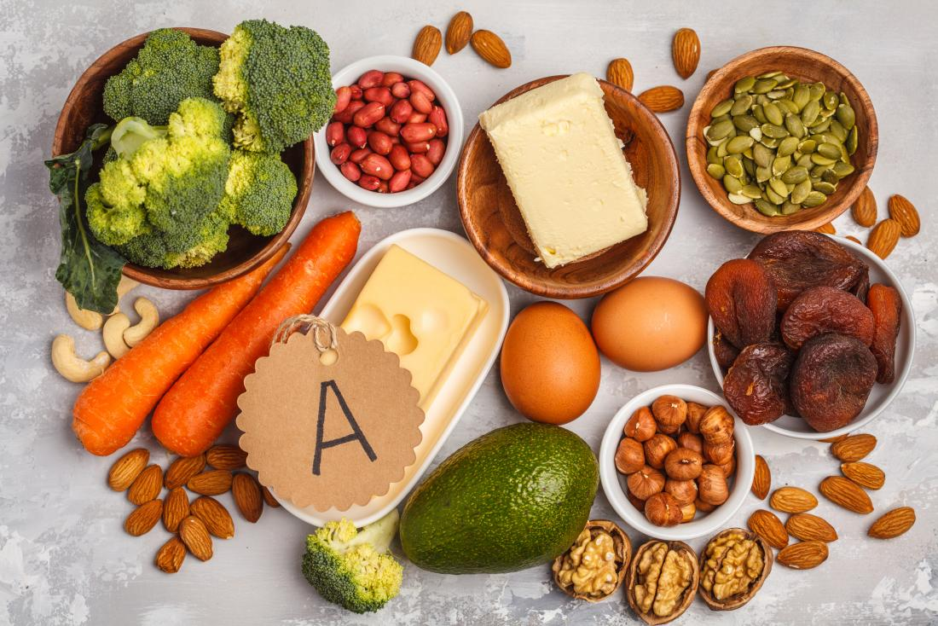
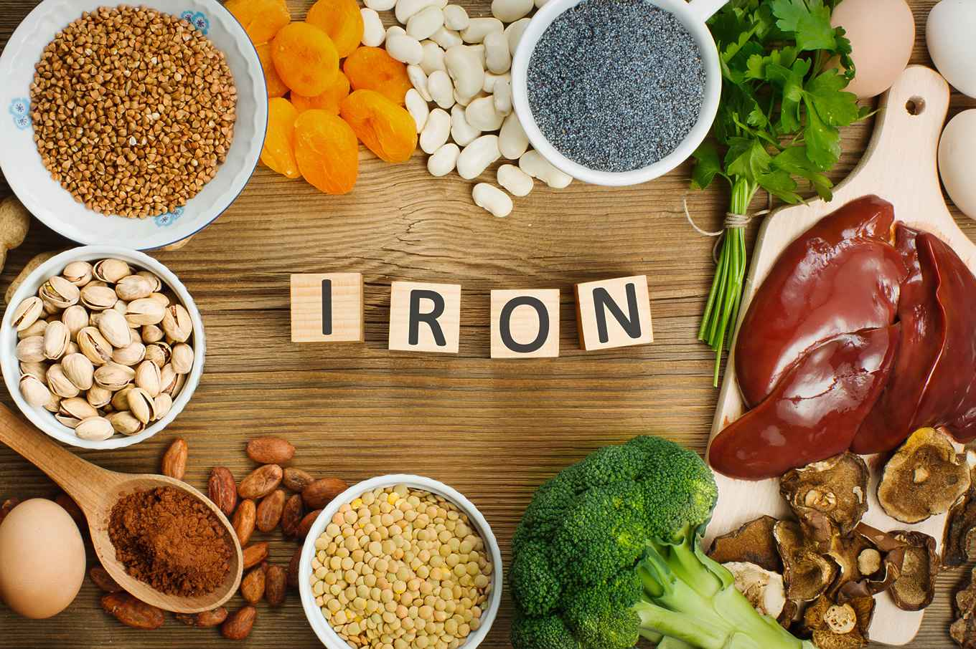
2) Living things Take in Nutrients

Slide 10
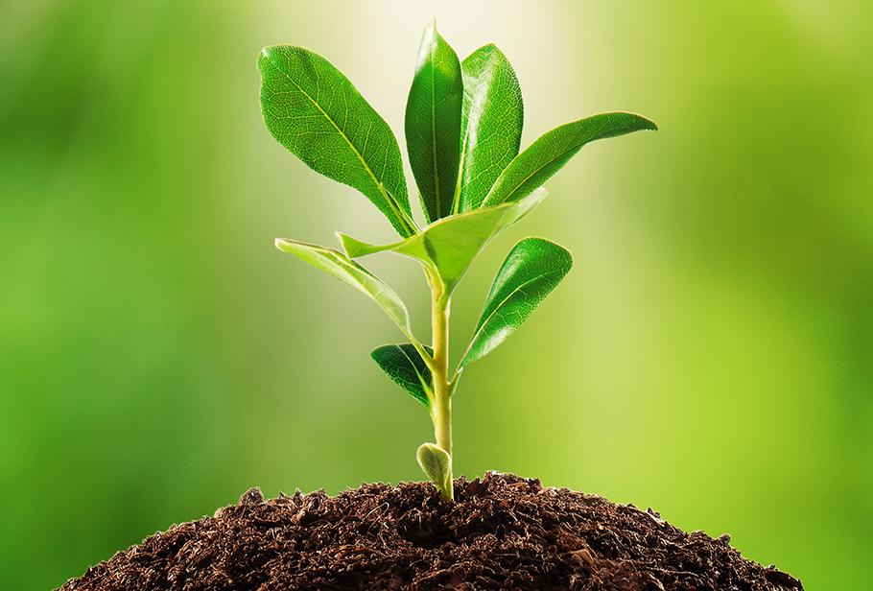
2) Living things Take in Nutrients
Consumers: get their nutrients and energy by eating food (e.g. hamster, human)
Producers: can make their own food using the Sun’s energy and nutrients from their surroundings (e.g. plants)

Slide 11
3) Living things Use Energy
Living things need energy (from nutrients) to power their daily activities.
Examples:
Physical activity
Thinking/learning
Manipulating our environments
Talking
Sleeping
Making a TikTok video

Slide 12
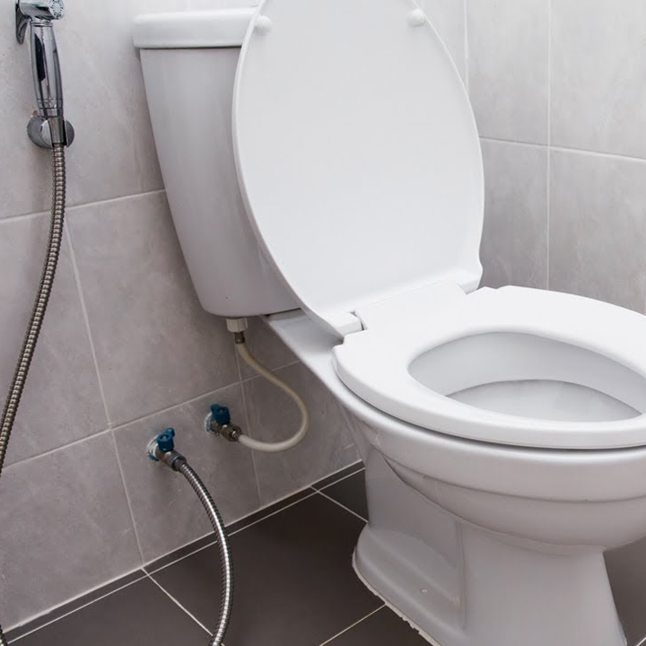
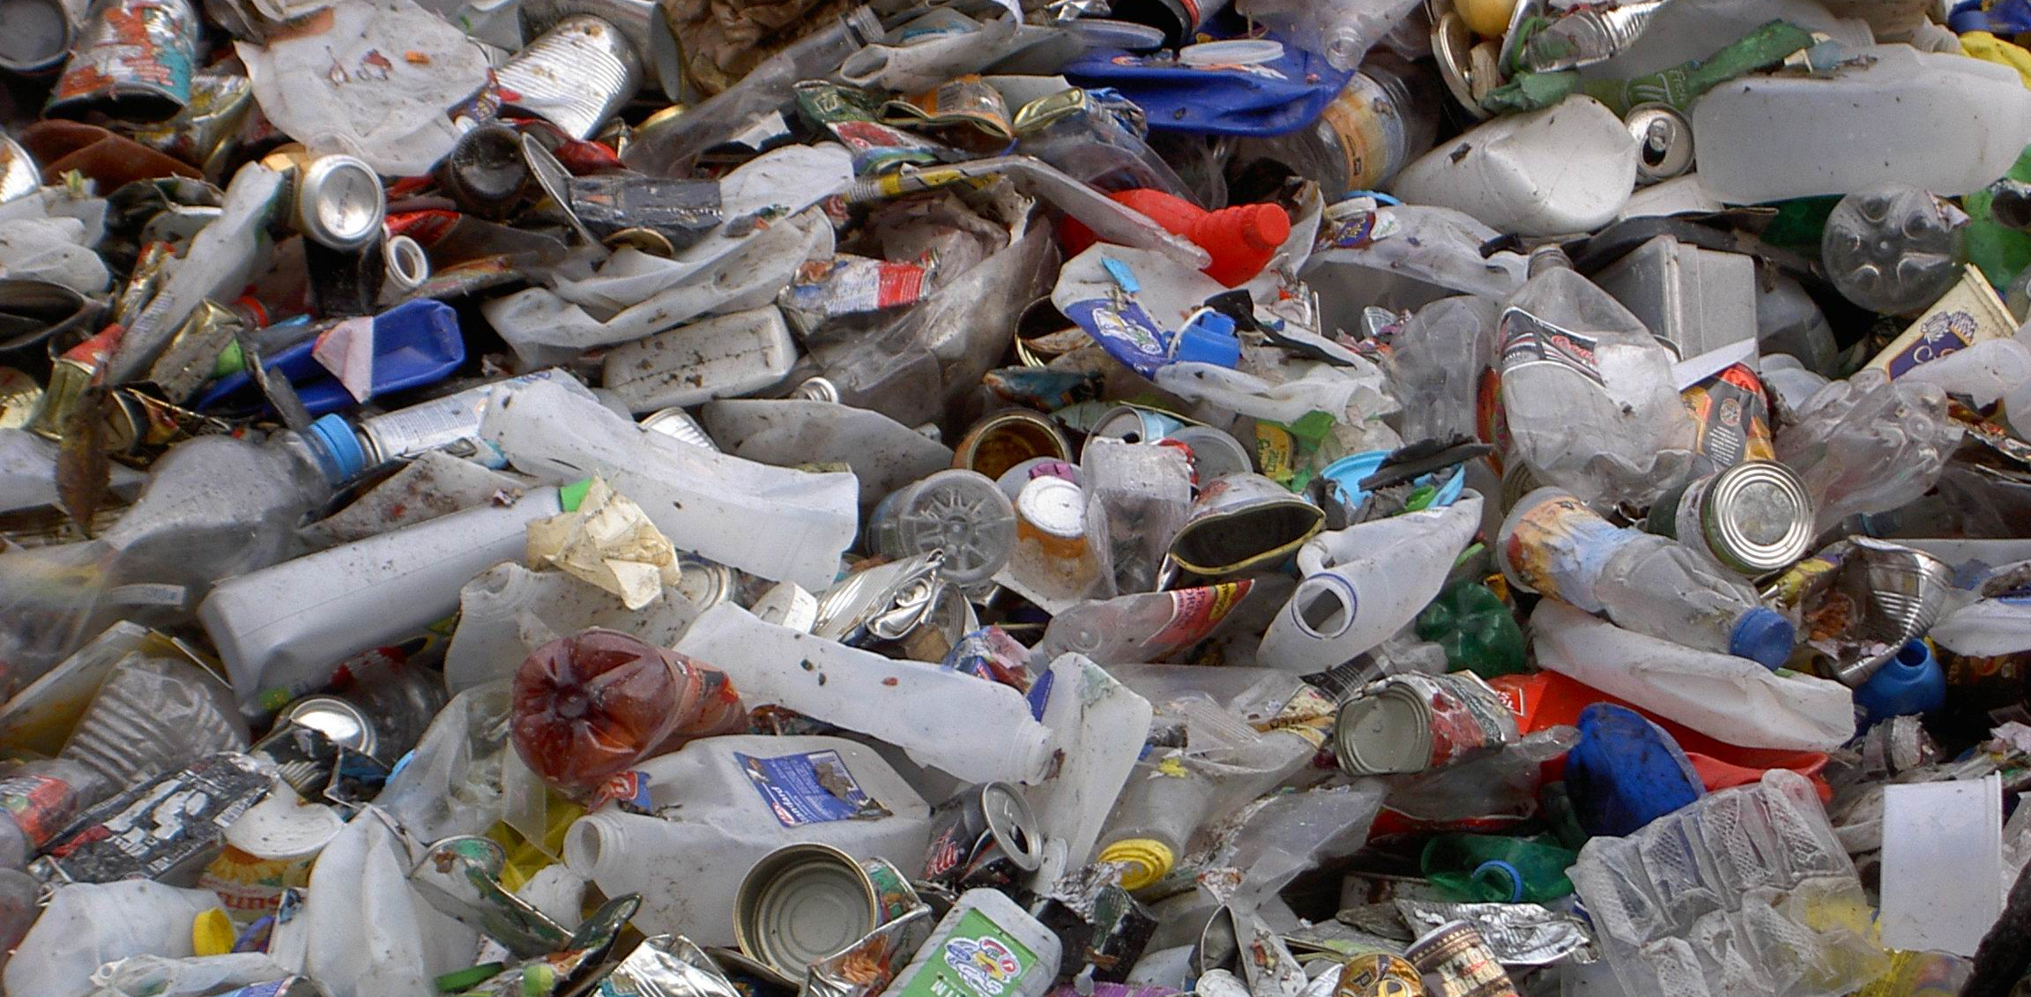
4) Living things Produce Waste
Waste: substances that living things produce and need to get rid of
Examples:
Excretions (urine, feces)
Exhaled gases
Materials that are shed or left behind (e.g. trash, shed skin, food remnants)

Slide 13
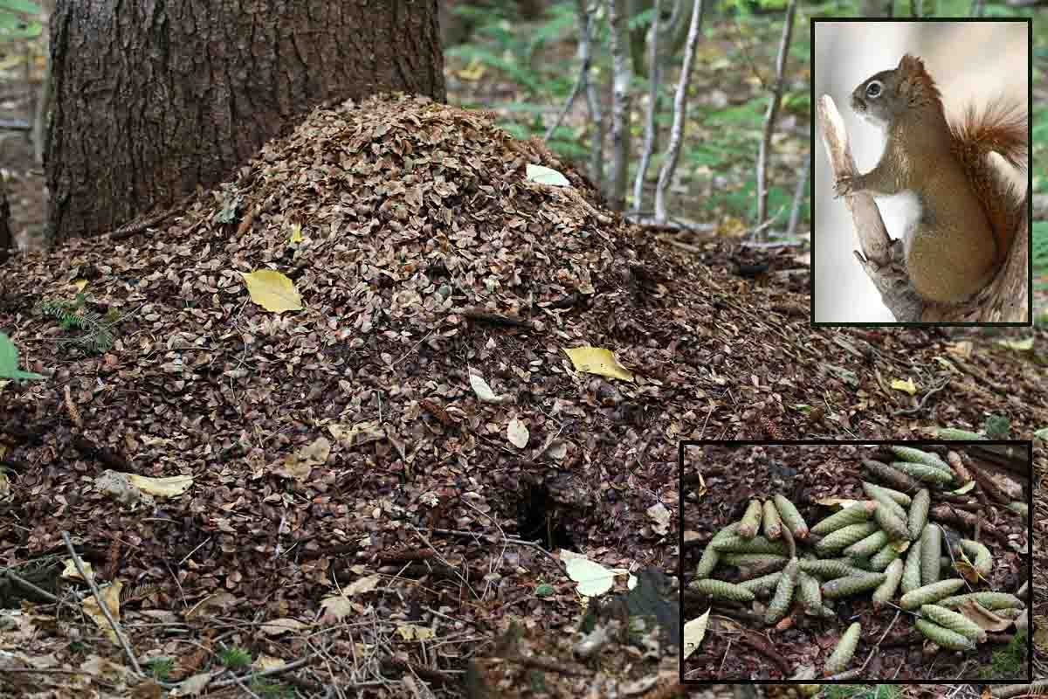
Fun fact: Squirrels make “middens”, piles of discarded cones after their seeds/nuts have been eaten.
They can get territorial over their favourite snack spots!

Slide 14
Practice (tb pg. 9)
How are multicellular and unicellular organisms the same or different?
Why do living things need energy, and where do they get it?

Slide 15
5) Living things Respond to Stimuli
Stimulus (pl. stimuli): anything that causes a living thing to respond in a certain way
Internal stimulus: information about your body (e.g. hunger, tiredness, pain)
External stimulus: information about your environment (e.g. smell, taste, touch, vision)

Slide 16
5) Living things Respond to Stimuli
Practice: internal or external stimulus?
Practice: internal or external stimulus?
Colour
Sound of the bell ringing
Feeling sleepy
Being angry
Feeling the wind on your face
Feeling jetlagged
Tickling
Seeing a red stop sign
Feeling the urge to cough or sneeze
Being thirsty
Getting poked on the finger
Feeling the warmth from a hot cup of chocolate
Leg falling asleep
Colour
Sound of the bell ringing
Feeling sleepy
Being angry
Feeling the wind on your face
Feeling jetlagged
Tickling
Seeing a red stop sign
Feeling the urge to cough or sneeze
Being thirsty
Getting poked on the finger
Feeling the warmth from a hot cup of chocolate
Leg falling asleep
What other stimulus examples can you think of? Are they internal or external?

Slide 17
Brain Break!
Activity:
One hand raised in air; other index finger touching nose. Then try to touch tip of thumb.
Alternate hands after each touch.
- Now try while wiggling the fingers of your raised hand.

Slide 18
Proprioception
Sense of body position
Activity: Try writing the word “proprioception” on your sheet of paper. Then write it again, but with your eyes closed. What do you notice?
Is proprioception an internal or external stimulus?

Slide 19
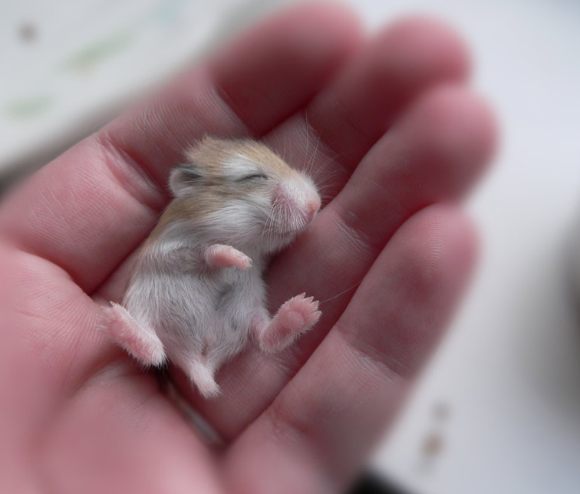
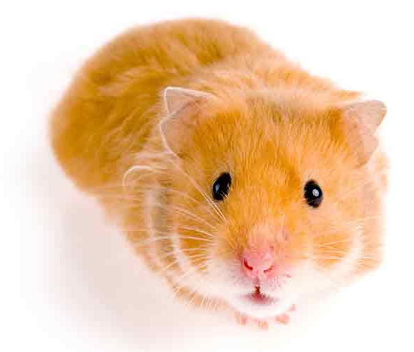
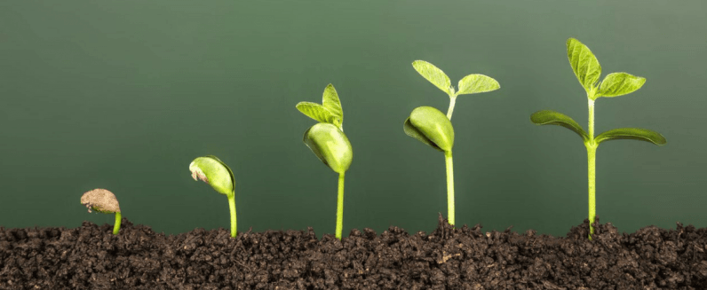
6) Living Things Grow and develop
Increase in size and/or number of cells
Heal (repair wounds)
Become more complex over time (includes learning)

Slide 20
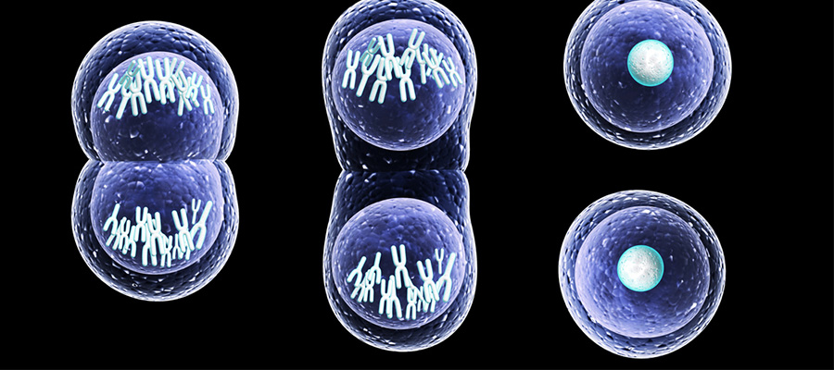
6) Living Things Grow and develop
Increase in size and/or number of cells
Heal (repair wounds)
Become more complex over time

Slide 21
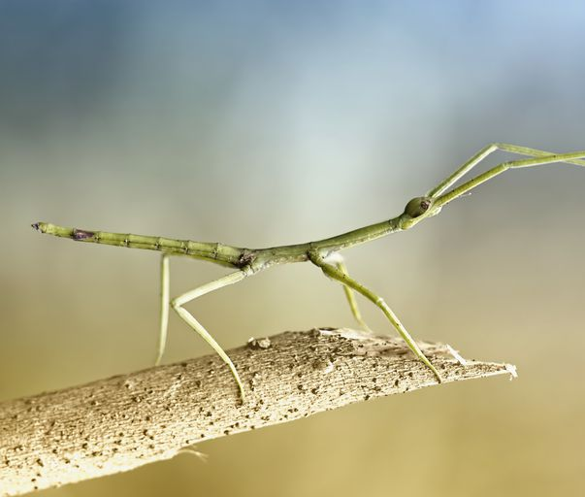
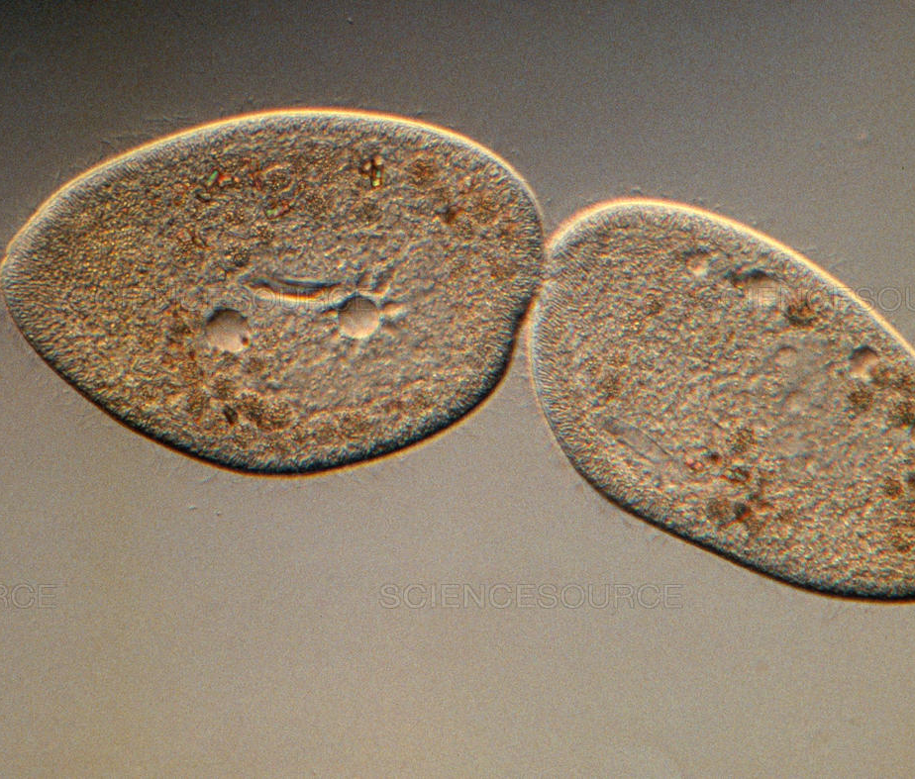
7) Living Things Reproduce
Reproduce: produce more copies of themselves (e.g. trees make seedlings, humans make babies, bacteria split to make two bacteria)
Many different reproduction strategies exist.
Question: How are growth and reproduction similar? Different?

Slide 22
Practice
 | Made of Cells | Take in Nutrients | Use Energy | Produce Waste | Respond to Stimuli | Grow | Repro-duce | Living? (Y/N)
Wood | x |  |  | x
Rock
Frog
…
wood, rock, frog, leaf, worm, safety pin, cactus, door, paper, grass, tree, jail, T-shirt, tennis shoe, bicycle, car, human, book, water

Slide 23
More Practice!
Workbook pg. 4, 5

Slide 24
https://www.youtube.com/watch?v=cQPVXrV0GNA&vl=en

Slide 25
“Is wood alive? Explain”
Sample Answer | Mark + Reason
No, wood is not alive, because although it is made of cells and produces wastes, it does not take in nutrients, use energy, respond to stimuli, grow or reproduce.
Developing.
Correct: wood is not alive.
Does not explain any of the words used…student could have an inaccurate understanding of concepts and it would be hard to tell
Vocabulary used [mostly] correctly.
If examples are given, some of them may be incorrect.

Slide 26
“Is wood alive? Explain”
Sample Answer | Mark + Reason
Yes, wood is alive, because it has cells and uses energy. It grows and reproduces.
Emerging.
Incorrect: wood is not alive
Does not explain any of the words used…student could have an inaccurate understanding of concepts
Vocabulary used incorrectly: wood does not use energy, grow, or reproduce.

Slide 27
“Is wood alive? Explain”
Sample Answer | Mark + Reason
No, wood is not alive, because although it is made of cells (which you can see under a microscope), produces wastes (such as pieces of wood that fall off and are not needed anymore), and reproduces (because other plants grow from it), it does not use energy, take in nutrients, or grow.
Proficient
Correct: wood is not alive.
Explains some, but not all, of the words used.
Vocabulary used correctly overall...maybe one or two minor mistakes. Student mostly has a good understanding.
“Reproduces” was explained incorrectly, but the student recognizes that new living things are formed during reproduction.

Slide 28
“Is wood alive? Explain.”
Sample Answer | Mark + Reason
No, wood is not alive. It is made of cells (as shown in Robert Hooke’s microscope slides), and it produces waste (because as it breaks down, pieces of bark and wood fall off and are used as nutrients for other animals). But it does not have all 7 characteristics of living things. It does not take in any nutrients, it does not use energy, it does not respond to stimuli (if you ‘cut the wood’, the wound will not heal). It also does not grow in size or in cell number (in contrast, wood will only deteriorate over time), and does not reproduce (because wood cannot make new copies of itself.) Therefore, wood is not a living thing.
Extending.
Correct: wood is not alive.
Explains all the words used. Gives examples and counterexamples to show a sophisticated understanding.
Uses all vocabulary accurately.
Goes above and beyond (e.g. recognizes that the “waste” of the wood can be used as nutrients for other living things”)

