Slide 1
1.2: Where do Living Things come from?
Science 8

Slide 2
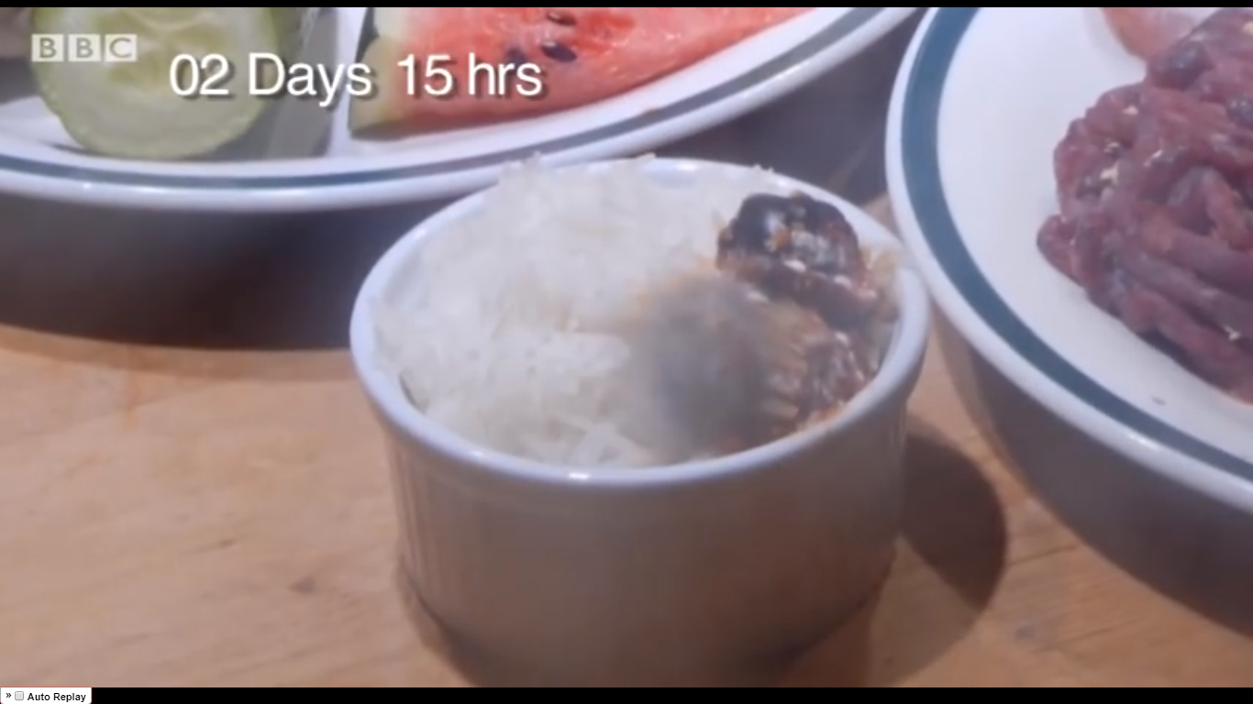
https://www.youtube.com/watch?v=EwTCdcs8gGg&ab_channel=CalumScottVEVO

Slide 3
Investigating the Origin of Life
1. What questions do you have about where the maggots came from?
2. What hypothesis could you come up with to investigate this?
3. Design an experiment to test your hypothesis.

Slide 4
Spontaneous Generation (pre-1600s)
Observations:
Maggots on rotting food
Mold on bread
Mushrooms from dead tree stumps
“Spontaneous generation theory”: all life arose from non-living things!
What might have happened in the 1600s to overturn this idea?

Slide 5
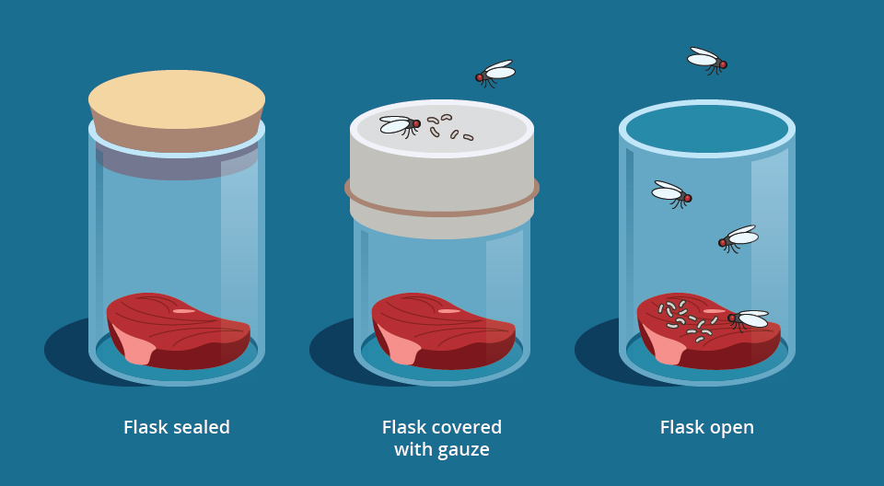
Testing Spontaneous Generation

Slide 7
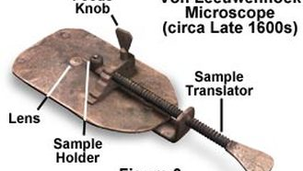
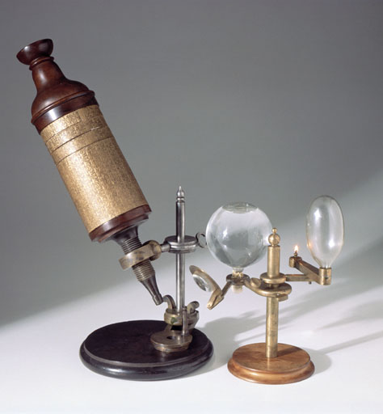
The Microscope
Microscope:
- Invented in 1600s by Anton van Leeuwenhoek
Robert Hooke:
British scientist
Pioneer in microscopy
Discovered cells in tree tissue

Slide 8
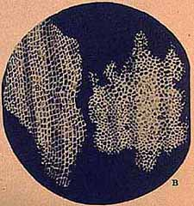

Slide 9
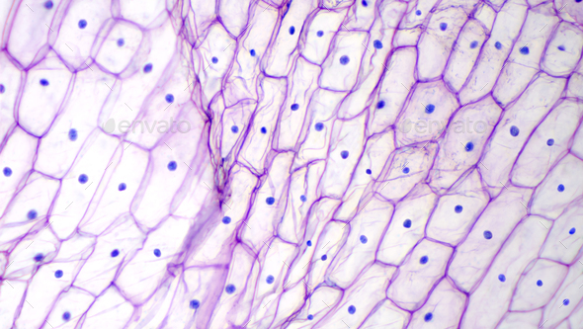
Cell Theory
The cell is the basic unit of life.
All new cells come from pre-existing cells.
All living things are made up of one or more cells.

Slide 10
1) The cell is the basic unit of life
Cells exhibit the 7 characteristics of living things:
Made of cells
Use nutrients
Require energy
Produce waste
Grow and develop
Reproduce
Respond to stimuli

Slide 11
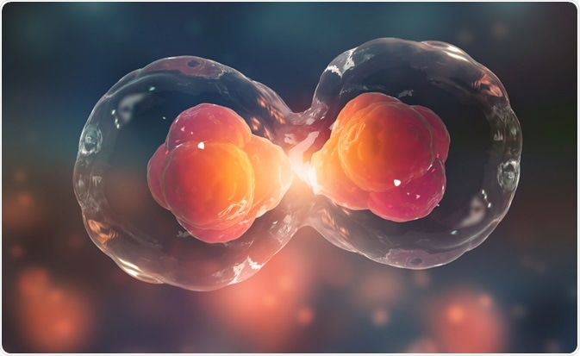
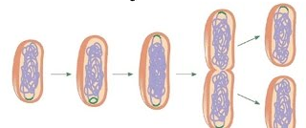
2) All new cells come from pre-existing cells
Cells divide to make new cells
All the cells in your body were produced through cell division
Notes:
Developmental diagram: human. From Wikipedia.

Slide 12
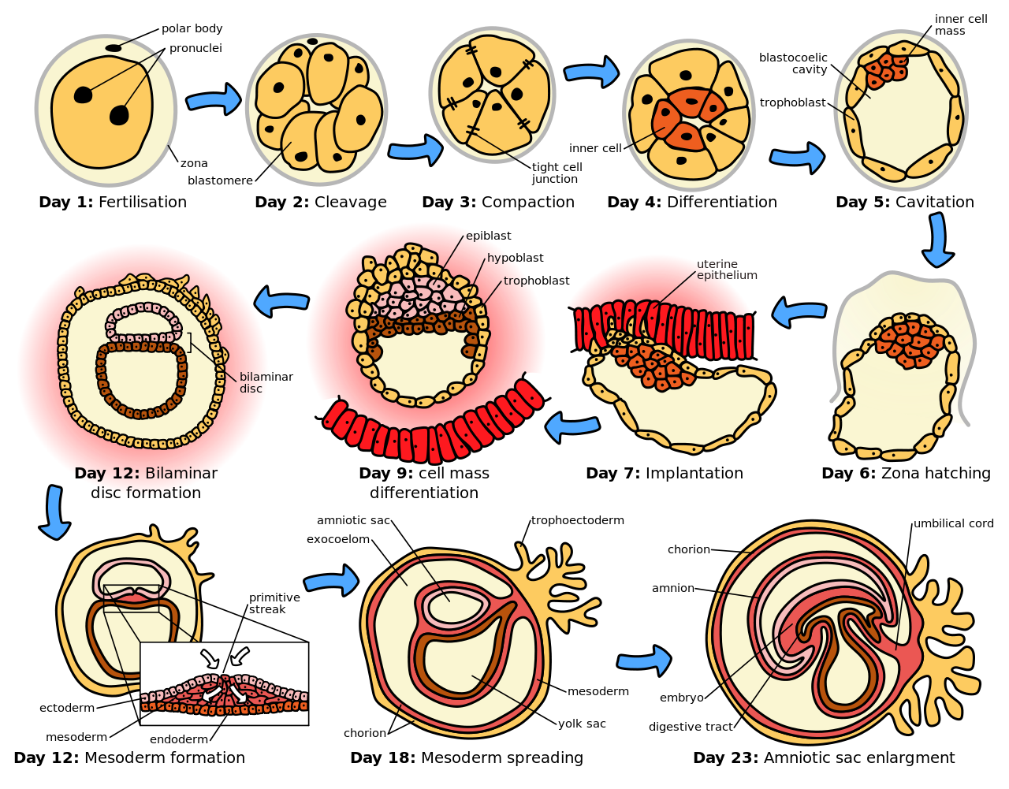
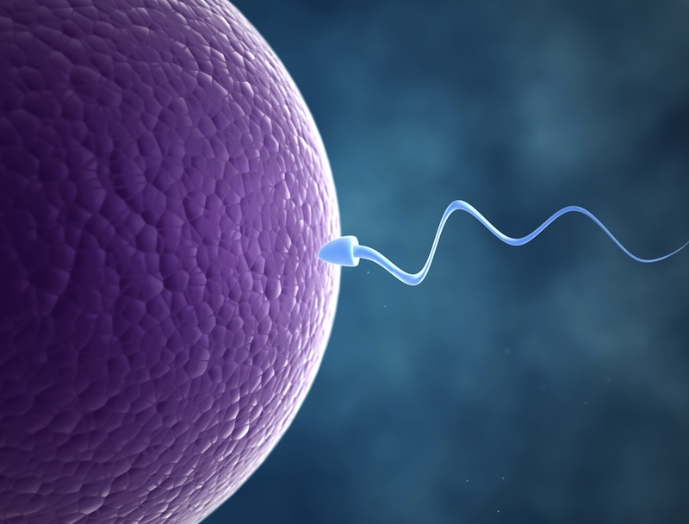
Notes:
Developmental diagram: human. From Wikipedia.

Slide 13
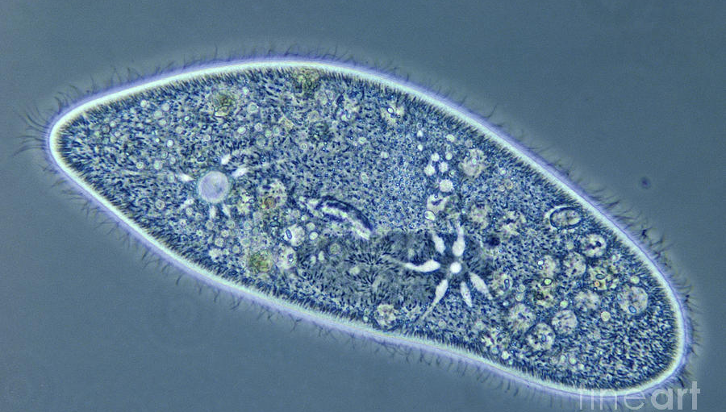
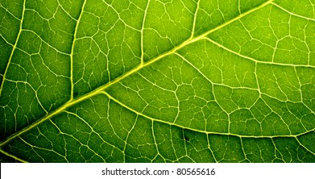
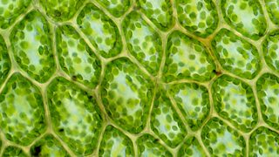
3) All living things are made up of one or more cells
Review! Living things can be:
Unicellular (made of one cell)
Multicellular (made of multiple cells)

Slide 14
Practice
Complete workbook pg. 11: we will go over the answers all together.

