Slide 1
Kingdom Plantae

Slide 2
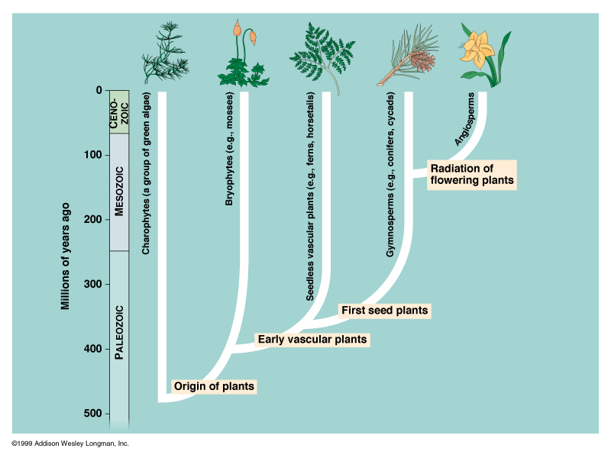

Slide 3
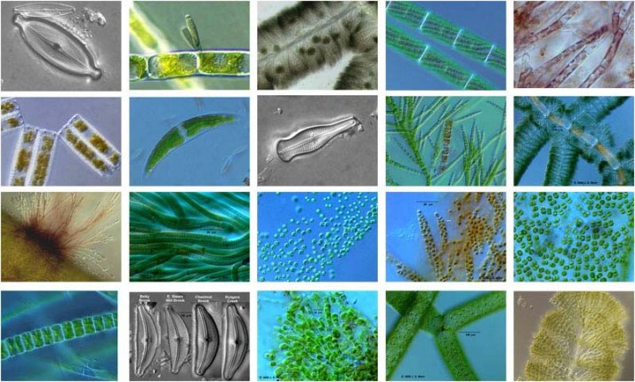
Algae
Chapter 20; based on tb

Slide 4
Characteristics of Algae (20-1)

Slide 5
Key Characteristics
Photosynthetic, have chlorophyll a (and sometimes other photosynthetic pigments)
Eukaryotic
Unicellular or multicellular
Aquatic
Classification debated; no clear definition on what ‘algae’ are

Slide 6
Adaptations for Aquatic Living
Thin leaf-like structures; exchange gases and nutrients directly with surroundings
No vascular system to transport water
No stem structure (water provides sufficient support)

Slide 7
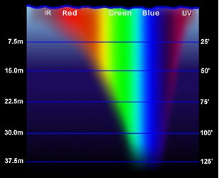
Chlorophyll and Accessory Pigments
All algae have chlorophyll a, which uses red and violet light (scarce underwater)
Algae often use different forms of chlorophyll (b, c, d) and/or accessory pigments to use other wavelengths of light

Slide 8
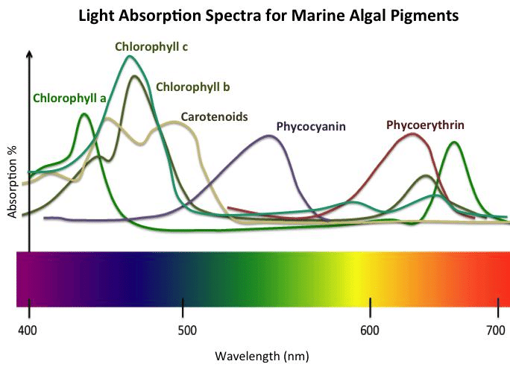
Chlorophyll and Accessory Pigments
Absorption spectra for various photosynthetic pigments.
E.g. chlorophyll a uses violet and red light; phycocyanin uses green light.
Note: if a colour is absorbed, that algae will not appear that colour. Most plants are green because chlorophyll a absorbs the least green light.

Slide 9
Groups of Algae (20-2)

Slide 10
Groups of Algae Intro
Chlorophyta (green algae)
Phaeophyta (brown algae)
Rhodophyta (red algae

Slide 11
Chlorophyta (green algae)
Have chlorophylls a and b
Colour: green
Store food as starch
Habitat: moist terrestrial, freshwater, ocean
Solitary or colonies

Slide 12
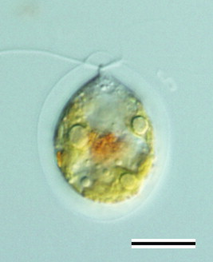
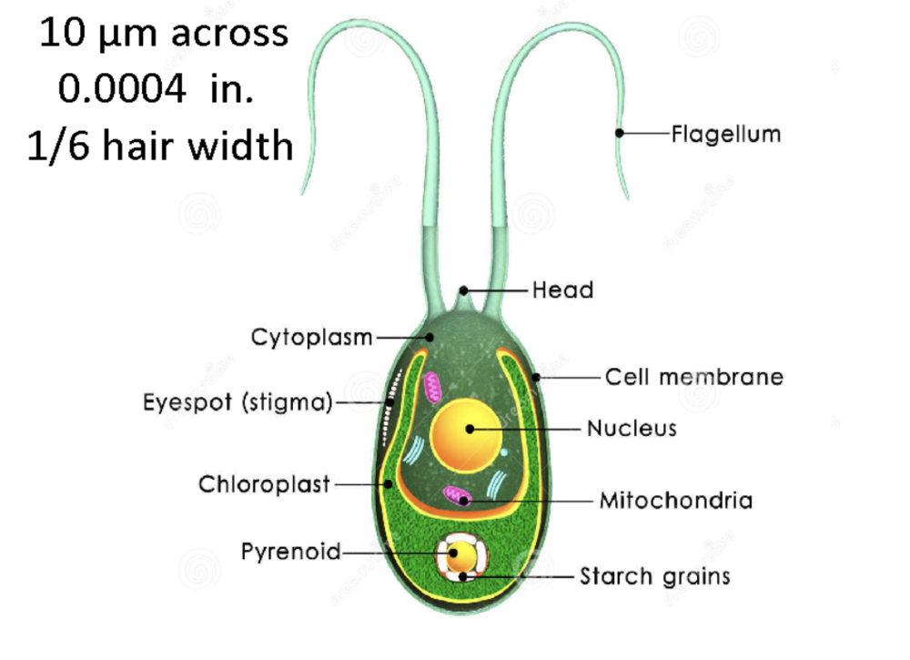
Chlamydomonas
Single-celled green algae
Two flagella
Eyespot: senses light and dark
Single large chloroplast
Notes:
Is a type of green algae…in chlorophyta

Slide 13
Colonial Green Algae
Colony: group of cells joined together that live together, though each individual cell functions independently
Notes:
Colonies give us an idea of how multicellularity may have evolved. Though, nothing is certain because algae are soft and do not leave fossils

Slide 14
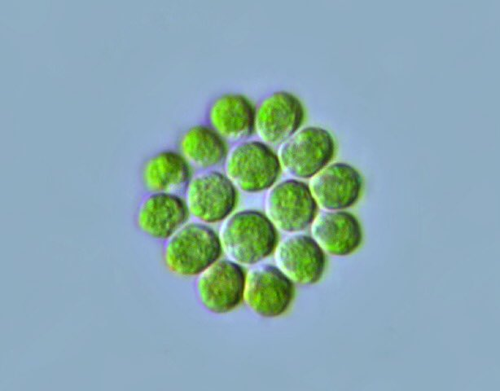
Colonial Green Algae
Gonium: colonial alga made of 4-32 cells; if colony splits up, each cell can form its own colony
Notes:
Colonies give us an idea of how multicellularity may have evolved. Though, nothing is certain because algae are soft and do not leave fossils

Slide 15
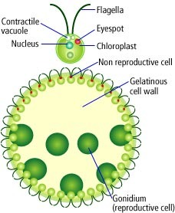
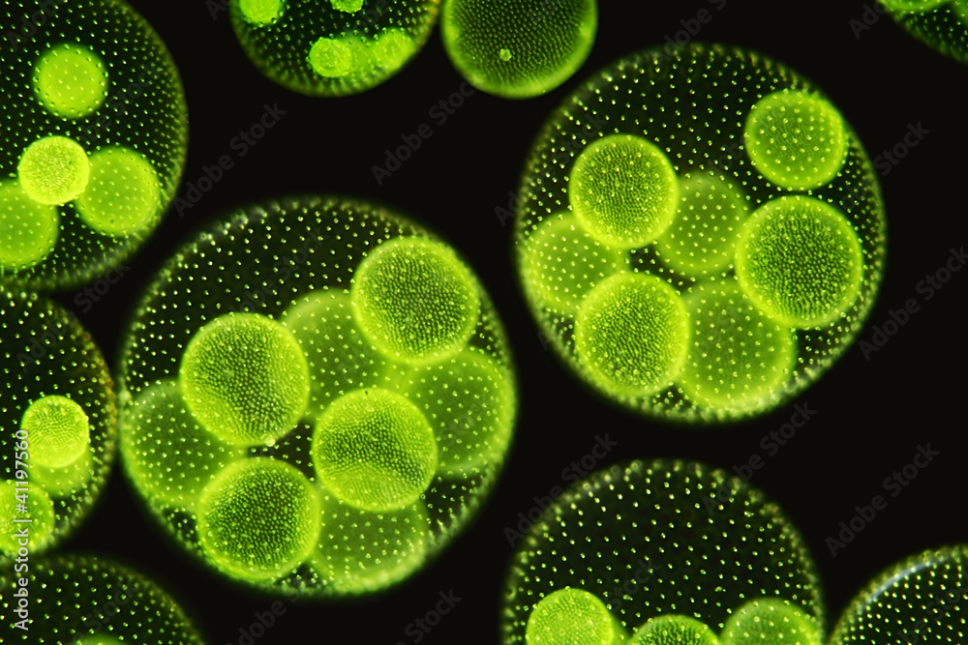
Colonial Green Algae
Volvox: colonial alga made of 500-50,000 cells
Cells connected by strands of cytoplasm, can communicate (essential for coordinated locomotion)
Some specialized cells; some produce gametes only
Notes:
Colonies give us an idea of how multicellularity may have evolved. Though, nothing is certain because algae are soft and do not leave fossils

Slide 16
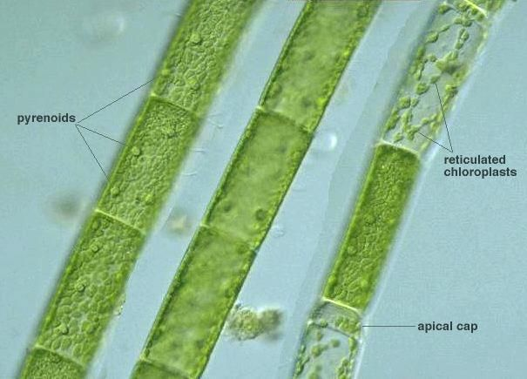
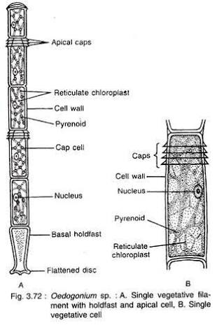
Threadlike Green Algae
Long threadlike colonies called filaments
Some species exhibit cell specialization
Notes:
Oedogonium has specialized reproductive cells
Oedogonium filament attached to bottom of lake/pond by a specialized cell called holdfast

Slide 17
Discussion
Algae are a diverse group with unicellular and multicellular members. Why are colonial and threadlike (filamentous) algae so important in helping us understand the evolution of multicellularity as a strategy for living things?

Slide 18
Brown Algae (Phaeophyta)
“Seaweeds”
Chlorophylls a and c, accessory pigment fucoxanthin
Colour: brown
Store food as starch and oil
Habitat: cool shallow coastal waters, arctic areas
Can grow to very large in size (60 meters!), with complex structures

Slide 19
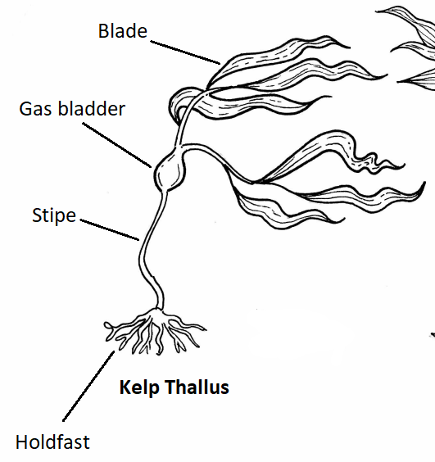
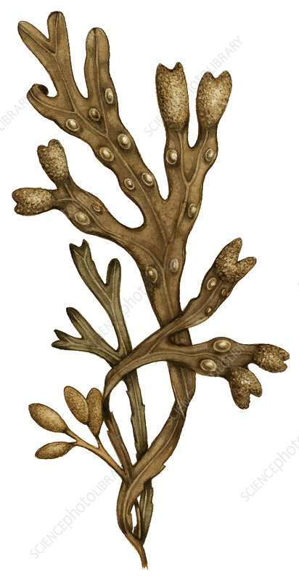
Brown Algae: Fucus Anatomy
Blade: used for photosynthesis
Gas bladder: filled with gas for flotation
Holdfast: anchors algae down to rock or other substrate

Slide 20
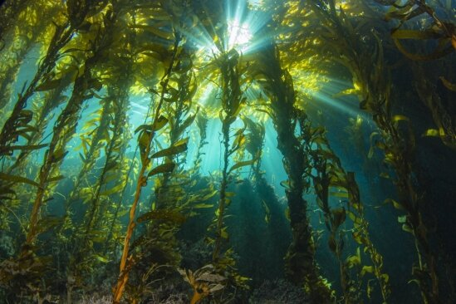
Brown Algae: Importance (ecology)
Kelp forests are an important source of food and habitat for many species

Slide 21
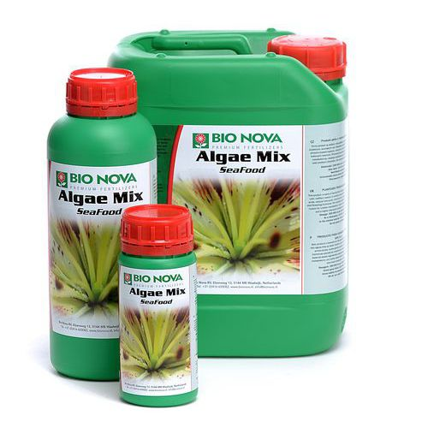
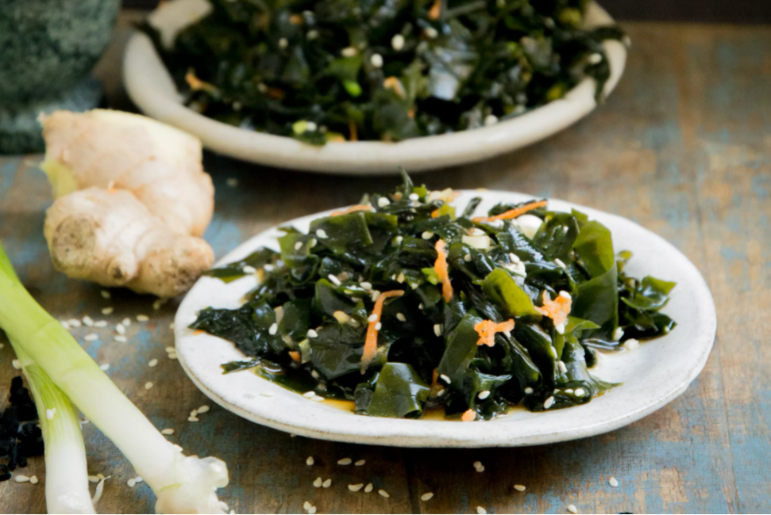
Brown Algae: Importance (economic)
Alginic acid harvested from brown algae and used for various purposes (stabilizing ice cream and cosmetics, batteries, pharmaceuticals)
Fertilizer
Eaten as “seaweed” in some cultures

Slide 22
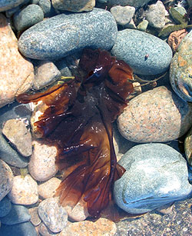
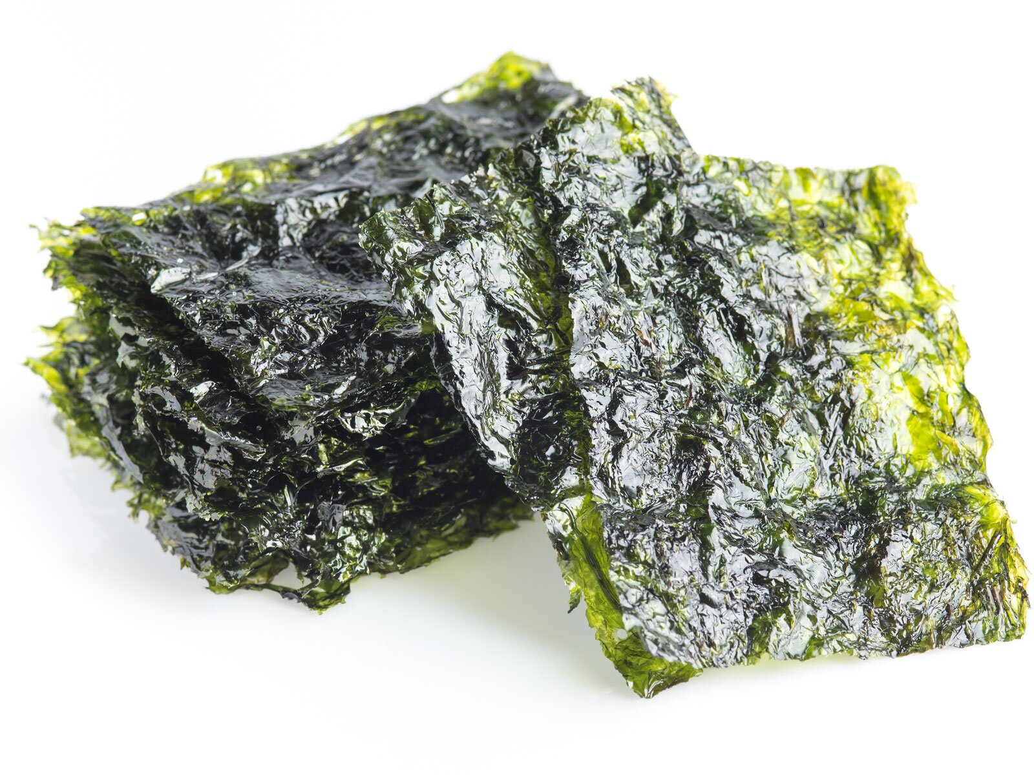
Rhodophyta (Red Algae)
Chlorophyll a (and sometimes d), accessory pigment phycobilin (absorbs blue light)
Colours: pink, red, purple, or black
Live at greater depths than other algae (up to 170m)
Store food as starch
E.g. Porphyra (Japanese nori – sushi)

Slide 23
Where Algae Fit into the World (20-4)

Slide 24
Where Algae Fit Into the World
Unicellular algae – food for most aquatic life
Habitat for other animals (e.g. kelp)
Photosynthesis (50-75% of all oxygen production)
Food industry (food source, ingredient for ice cream, soup, cosmetics)
Pharmaceuticals
Industrial uses (plastic, paints, baking ingredients, agar to grow bacteria, etc. )

Slide 25
Reproduction in Algae (20-3)

Slide 26
Introduction
Draw the “life cycle of a human”. Include the following words:
Meiosis
Mitosis
Sperm
Egg
Zygote
Baby
Review the concept of ploidy with your teacher. Now, add “haploid” and “diploid” to your diagram.

Slide 27
Review: Reproduction Concepts

Slide 28
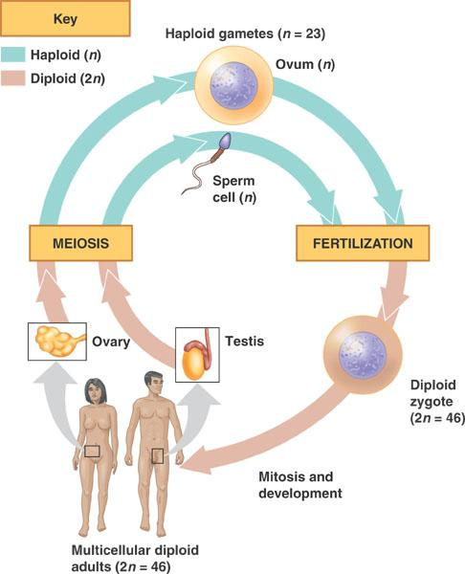

Slide 29
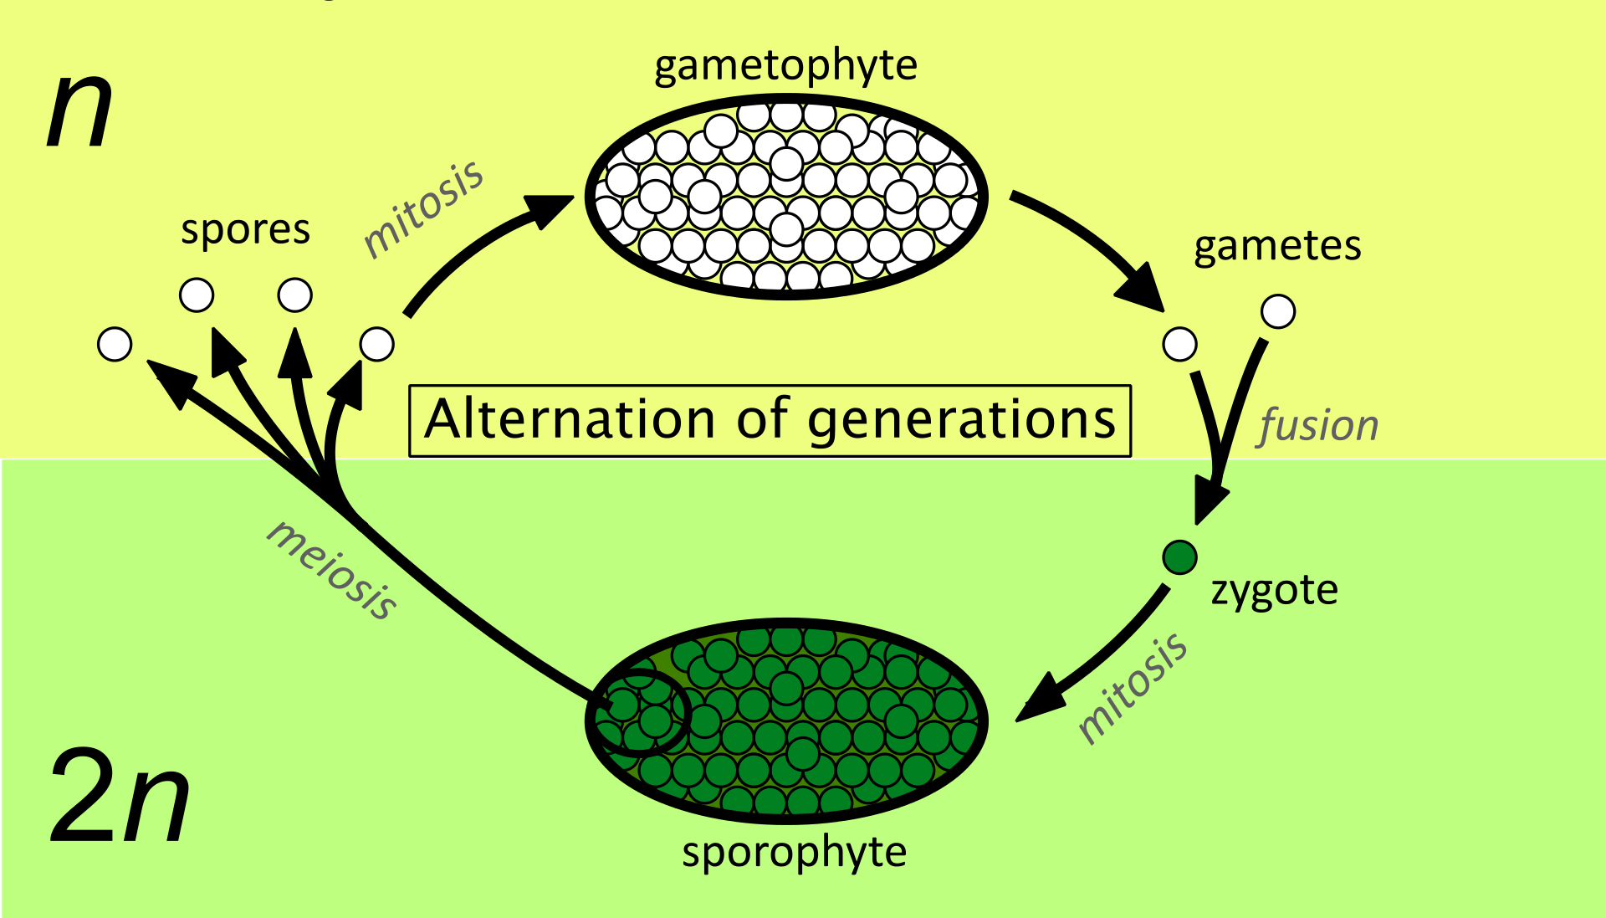
Alternation of Generations
Kingdom Plantae
Life cycle alternates between two distinct forms:
Haploid (n) gametophyte generation, creates haploid gametes through mitosis
Diploid (2n) sporophyte generation, creates haploid spores through meiosis
Notes:
* Sometimes, they are not called ‘gametophyte’ or ‘sporophyte’…they may have other names

Slide 30
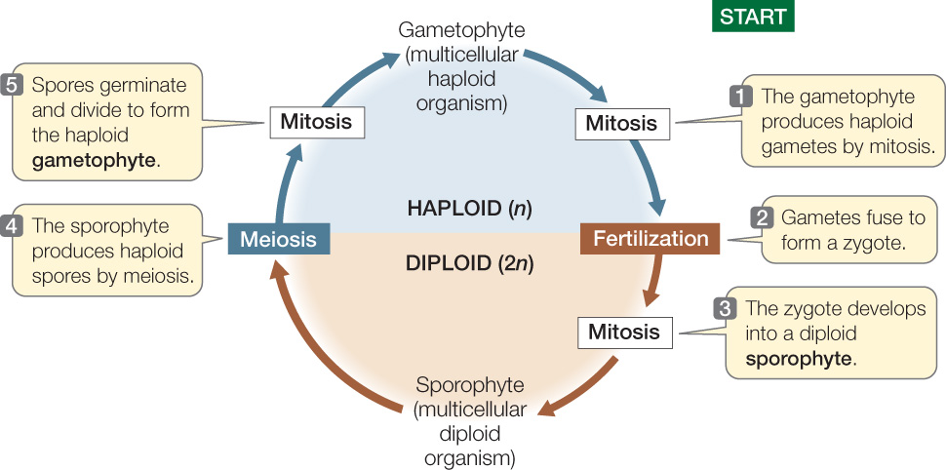
Alternation of Generations

Slide 31
Discussion Questions
How does reproduction in Kingdom Plantae differ from reproduction in Kingdom Animalia? (Note: humans are animals.) Which steps/stages are similar? Which steps/stages are unique to Plantae?
2. Imagine you are a plant (diploid sporophyte generation).
How would your family tree look? Include your theoretical children in this family tree.
If asked the question “Who do you look the most like: mom or dad?” how would you respond as a plant? Explain your answer.

Slide 32
Chlamydomonas
Unicellular green algae
Reproduces asexually (mitosis) under favourable conditions
Poor environmental conditions:
Mitotic production of gametes (+ or -)
Fusion into diploid zygote with thick outer wall → dormant
When conditions become favourable, zygote grows and undergoes meiosis (produce 4 haploid cells)
Notes:
Note: the gamete forms look identical to us. Is not like sperm and egg. They look the same but are in strains of + and – depending on the type that they are.

Slide 33
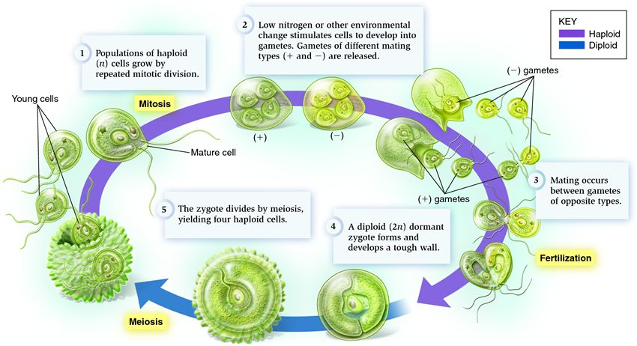
Chlamydomonas

Slide 34
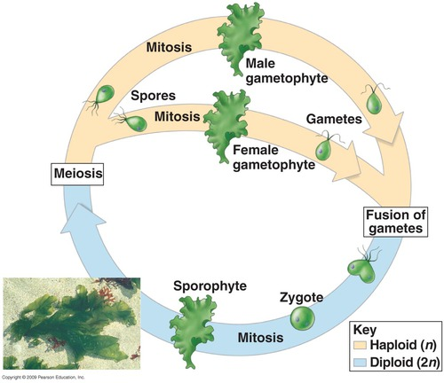
Ulva
Diploid sporophyte and haploid gametophyte generations are both multicellular and look almost identical
No dormant stage
Notes:
In ulva, the types of gametes look different. More similar to sperm and egg

Slide 35
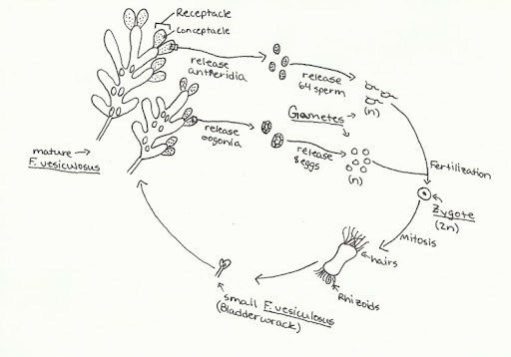
Fucus
Multicellular diploid sporophyte
Unicellular haploid gametophyte (on the tips of the Fucus blades) produces eggs or sperm
Life cycle of Fucus spp. Note: a single diploid sporophyte will produce both male and female gametophytes.
Notes:
Note: sporophyte do not have sexes (i.e. male vs female). Rather, a single sporophyte plant will have blades with male gametophytes and blades with female gametophytes. On some species, the sporophyte plant will have blades with containers containing both the female and male gametophytes.

Slide 36
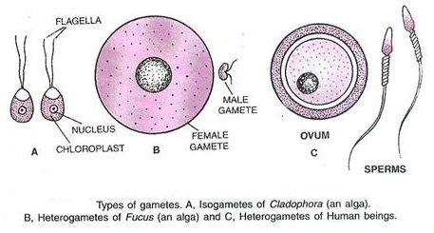
A Note on Gametes
Isogamy: where both types of gametes appear identical (e.g. Chlamydomonas)
Heterogamy: where both types of gametes appear different (e.g. Fucus with distinct sperm and egg)

