Slide 1
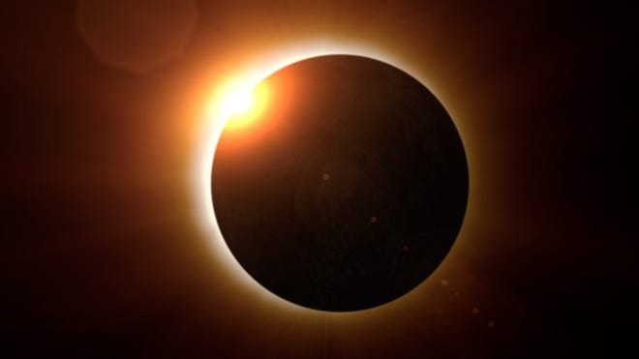
Lunar Phases and Eclipses

Slide 2
Eclipses: What Are They?
Earth’s revolution around Sun
Moon’s revolution around Earth
Lunar phases
Angular size of Sun and Moon as viewed from Earth

Slide 3
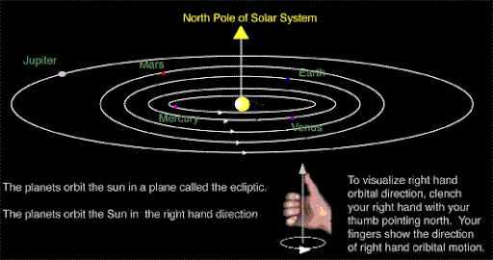
Earth’s Revolution
Earth revolves around the Sun once every 365 days, 6 hours, 9 minutes.
Earth revolves in a counterclockwise direction (right hand rule)
Notes:
Julian calendar:
Leap year every 4 years (February has 29 d instead of 28 like normal.)
Gregorian calendar:
Leap years every 4 years
If the year is divisible by 100 but not by 400, then you skip the leap year.
Gregorian is pretty good and will keep us happy until a couple of thousand years from now.
Short article that could be read in class https://www.britannica.com/topic/Gregorian-calendar

Slide 4
How Long is a Year?
Julian Calendar (Julius Caesar, 45 B.C.)
365.5 days long (leap year every 4 years)
Gregorian Calendar (Pope Gregory XII, 1582)
365.2425 days long (leap year every 4 years except in years that are divisible by 100 but not by 400…1700, 1800, 1900 not leap years but 2000 was)
Easter: “the first Sunday after the day with the first full moon after the spring equinox of the year”

Slide 5
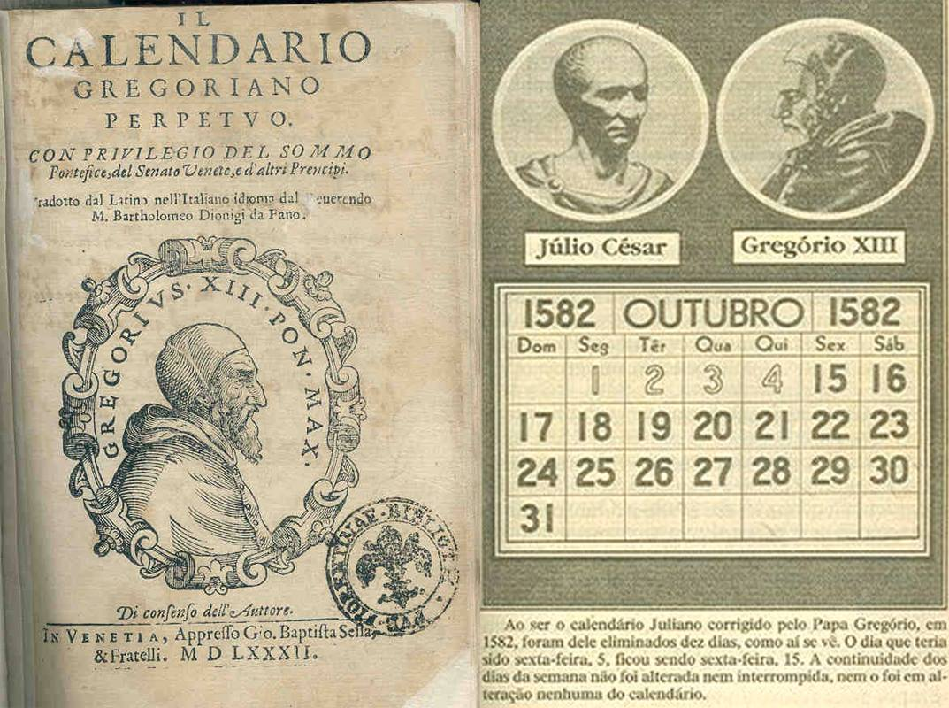

Slide 6
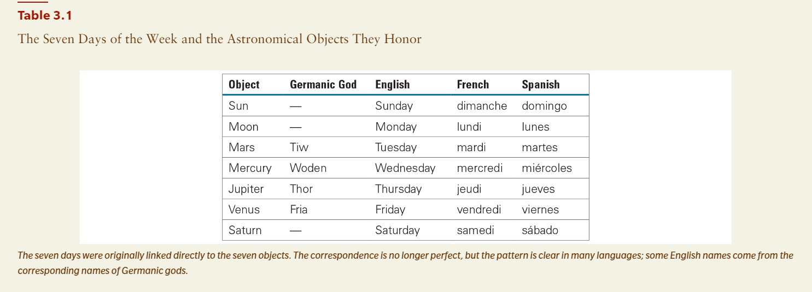

Slide 7
Moon’s Revolution
Moon revolves around the Earth once every 27.3 days
Moon revolves in a counterclockwise direction
As viewed from Earth, the Moon undergoes cycles of Lunar Phases
29.5 days from New Moon to New Moon

Slide 8
Activity
Experience the lunar phases for yourself.
Hold the stick between your fingers at arm’s length. The ‘ball’ will be the moon, and your head will be the Earth.
Stand with the ball directly in the way of the light (“New Moon”). Then, rotate your arm/body in a counterclockwise direction and observe how the appearance of the Moon changes.
What side of the moon becomes visible (lit up) first?
Draw the appearance of the moon every 1/8th of a rotation.
Video: https://www.youtube.com/watch?v=SDhlPEMkiOo

Slide 9
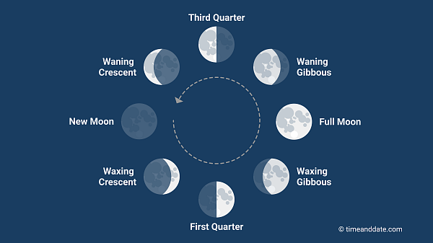
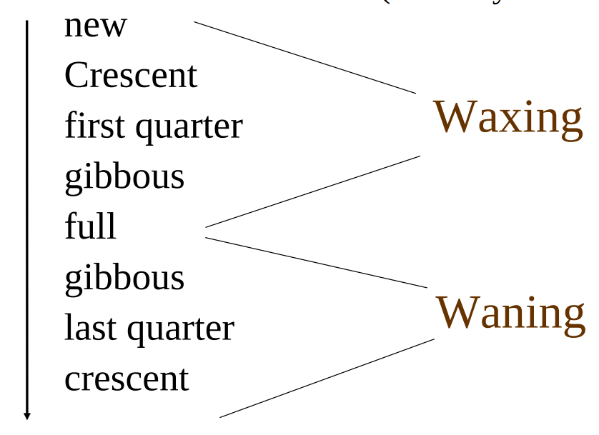

Slide 10
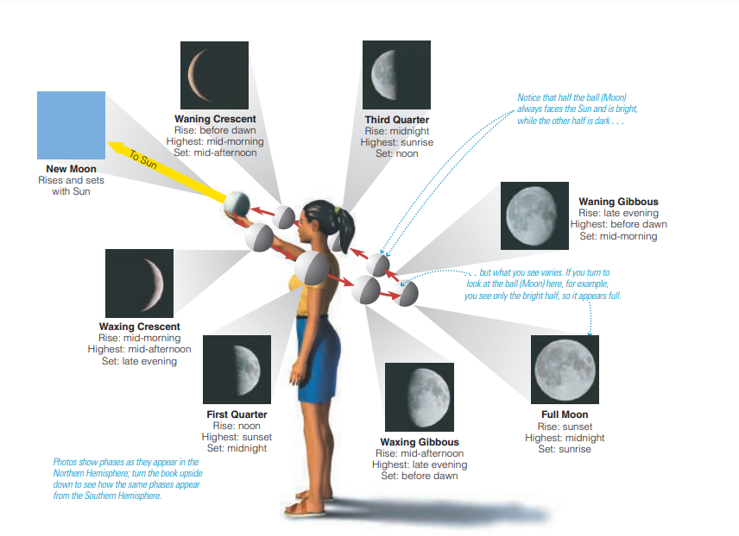

Slide 11
Moon’s Revolution
Moon revolves around the Earth once every 27.3 days
Moon revolves in a counterclockwise direction
As viewed from Earth, the Moon undergoes cycles of Lunar Phases
29.5 days from New Moon to New Moon
Why 29.5 days vs 27.3 days? Discuss.

Slide 12
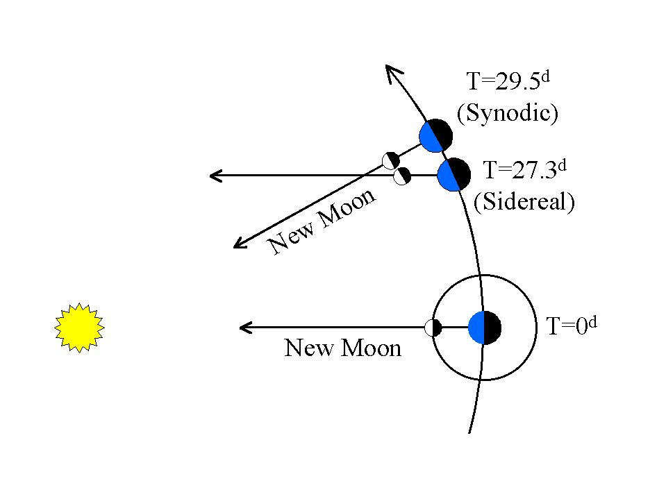
Moon’s Revolution
Demonstration
Rotate a full turn in place, but then take a step about 1/12th of the way around the Sun. Are you facing the Sun?

Slide 13
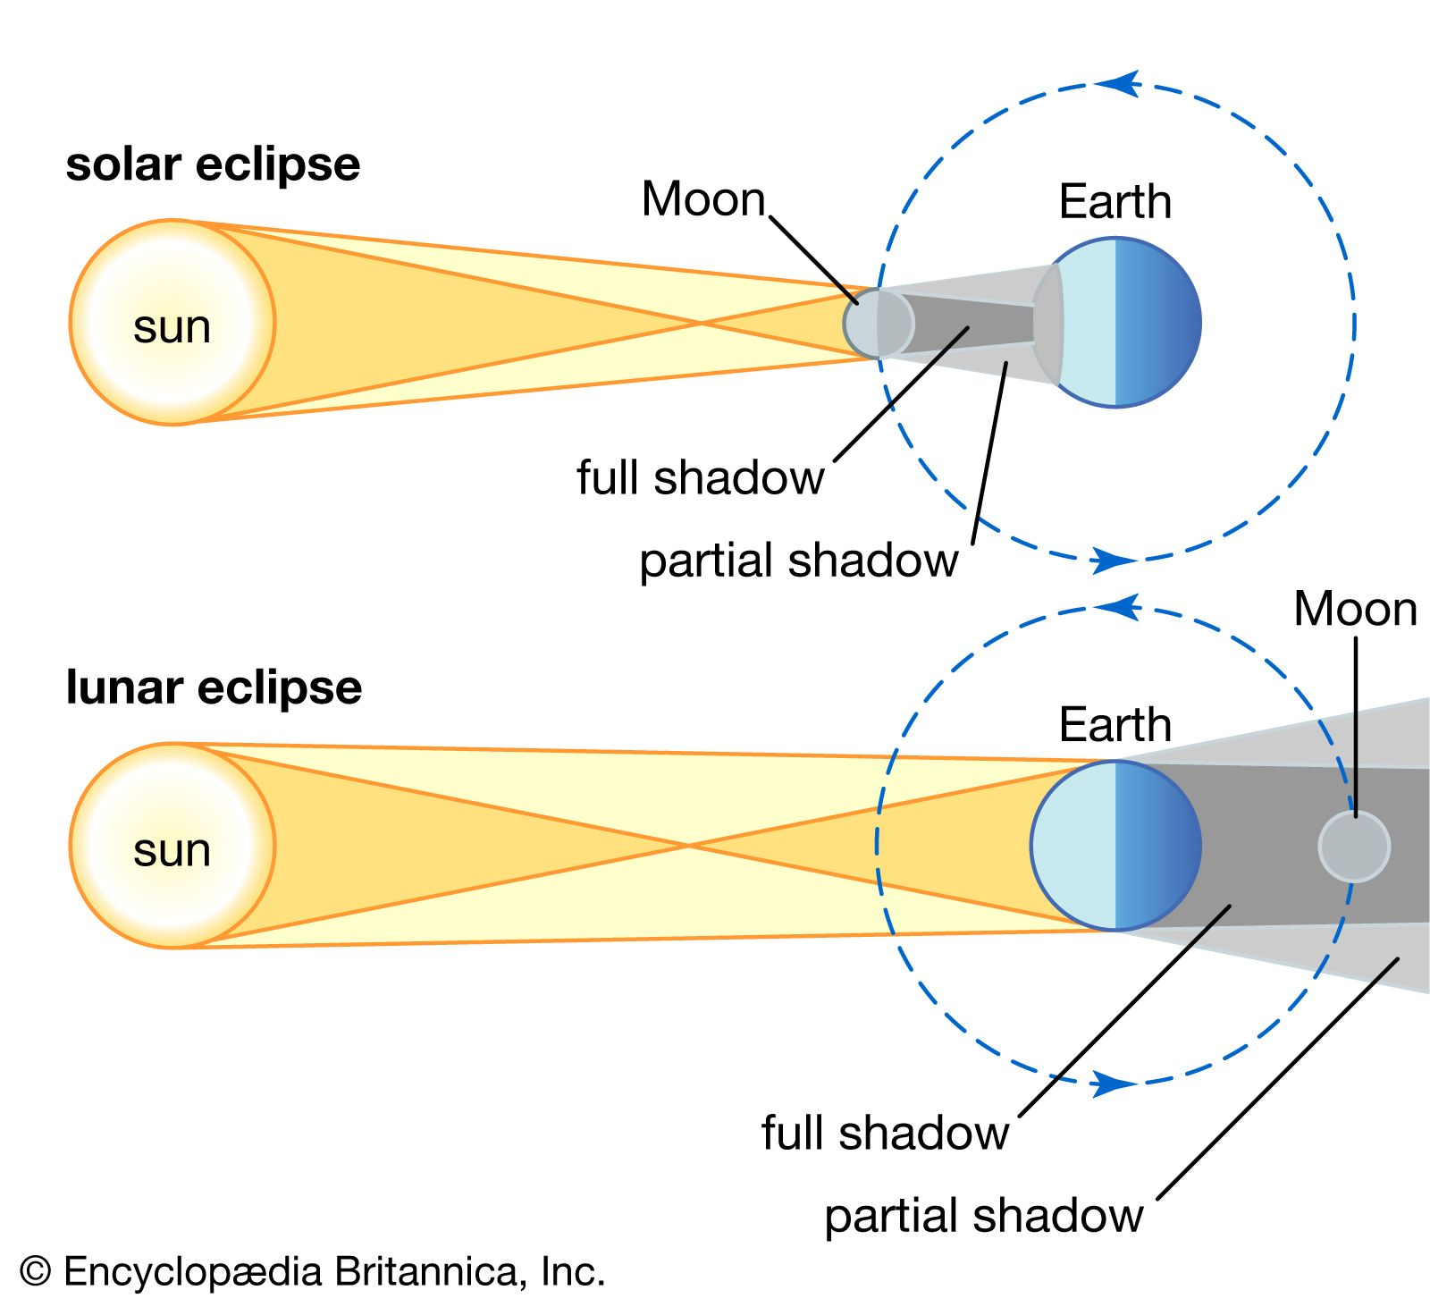
What is an eclipse?
A solar eclipse occurs when the Moon blocks the Sun when viewed from Earth.
A lunar eclipse occurs when the Earth is in between the Sun and Moon and blocks the ability of sunlight to light up the Moon.
Umbra: area of full shadow
Penumbra: area of partial shadow
Notes:
Simulation: “Earth space lab eclipse simulation”

Slide 14
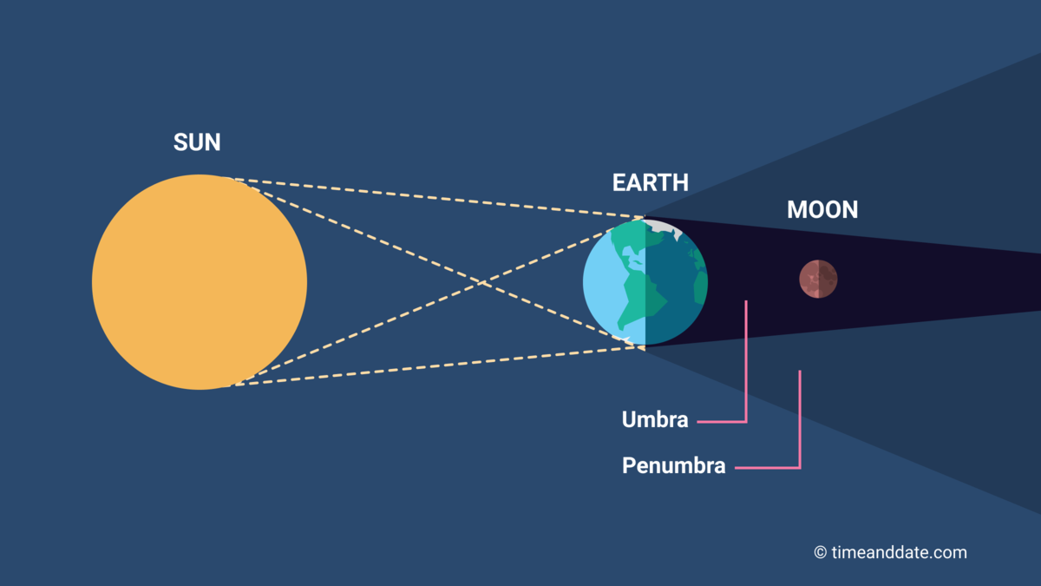
Eclipses Overview
Umbra: area of full shadow
Penumbra: area of partial shadow
Notes:
Simulation: “Earth space lab eclipse simulation”

Slide 15
Solar Eclipses are Awesome

Slide 16
Solar Eclipses are Awesome

Slide 17
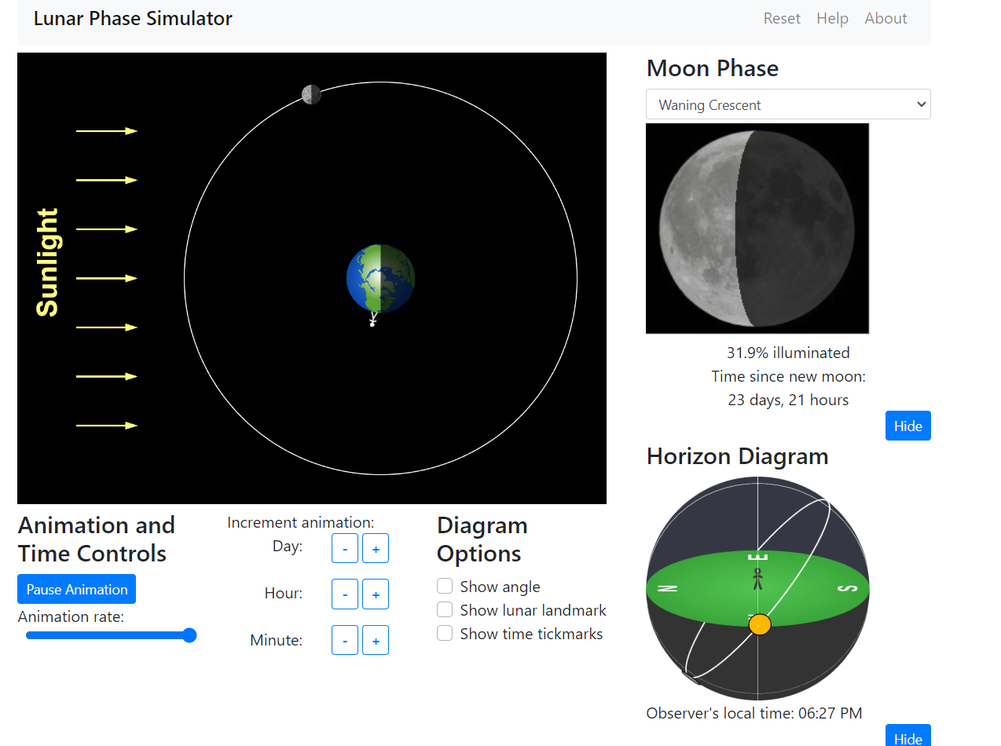
The timing of eclipses
Discuss: What moon phases are required for solar eclipses? Lunar eclipses?
Optional simulation https://ccnmtl.github.io/astro-simulations/lunar-phase-simulator/
So…why don’t we get an eclipse every month?
Simulation: https://www.earthspacelab.com/app/eclipse/#google_vignette
Notes:
Simulation: “lunar phase simulator github”
Simulation: “Earth space lab eclipse simulation”

Slide 18
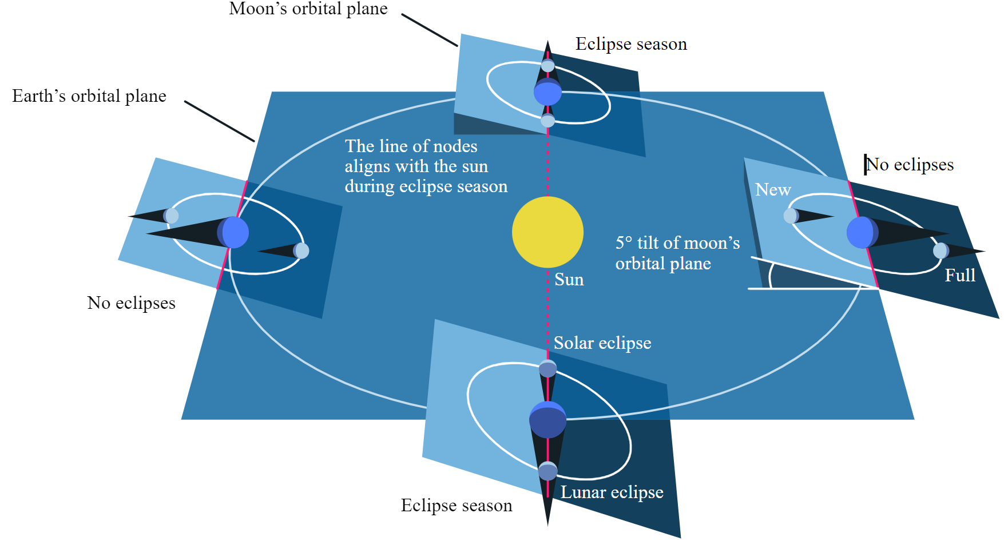
The Saros Cycle
Notes:
Simulation: “Earth space lab eclipse simulation”

Slide 19
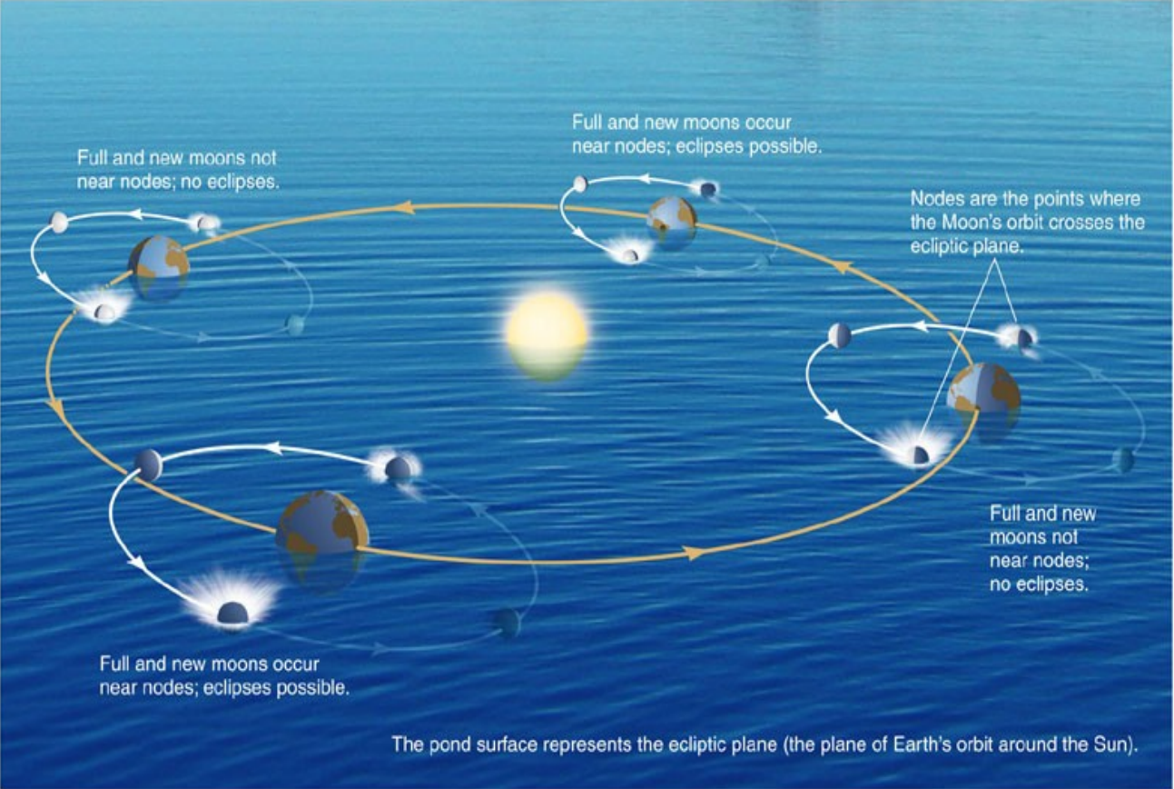
The Saros Cycle
Notes:
Simulation: “Earth space lab eclipse simulation”

Slide 20
The timing of eclipses
Notes:
The earth revolves around the sun
The earth rotates
The night sky changes throughout the year because the sun’s location goes ‘through’ the ecliptic
The moon revolves around the sun (and rotates)
The moon has phases that result from the relative orientation of the sun, earth, and moon. https://ccnmtl.github.io/astro-simulations/lunar-phase-simulator/ (also sort of shows eclipses)
At new moon, solar eclipses can occur. (earth’s shadow on sun)
At full moon, lunar eclipses can occur. (earth’s shadow on moon)
Why don’t we see one solar and one lunar eclipse every month?
Plane of moon’s revolution is different from the plane of earth’s revolution around the sun. Eclipses can only be seen at nodes.
Why don’t we see one solar and one lunar eclipse every six months?
We do. Sort of. “eclipse seasons” (40 solar eclipses per 18 years, so roughly six months) Table of eclipses until 2050 https://www.astrologyzone.com/eclipse-dates/
Unfortunately, the moon wobbles in 18-year Saros cycles. Result: each ‘type’ of solar eclipse only repeats once every 18 years…and when they do repeat, they have shifted in location approximately 1/3 of the way across the globe.
Types of eclipses
Annular
Partial
Total
https://skyandtelescope.org/astronomy-news/how-did-the-ancients-predicted-eclipses-the-saros-cycle/

Slide 21
The timing of eclipses
Eclipses can only occur at the ‘nodes’ between the Moon’s plane of revolution and the Earth’s plane of revolution, approximately once every six months.
Every six months is an ‘eclipse season’ where there is usually one lunar and one solar eclipse.
Eclipses until 2050 https://www.astrologyzone.com/eclipse-dates/
Problem: Because of the interaction between Earth’s elliptical orbit, the Saros cycle, and other factors, total solar eclipses are very rare!!!!

Slide 22
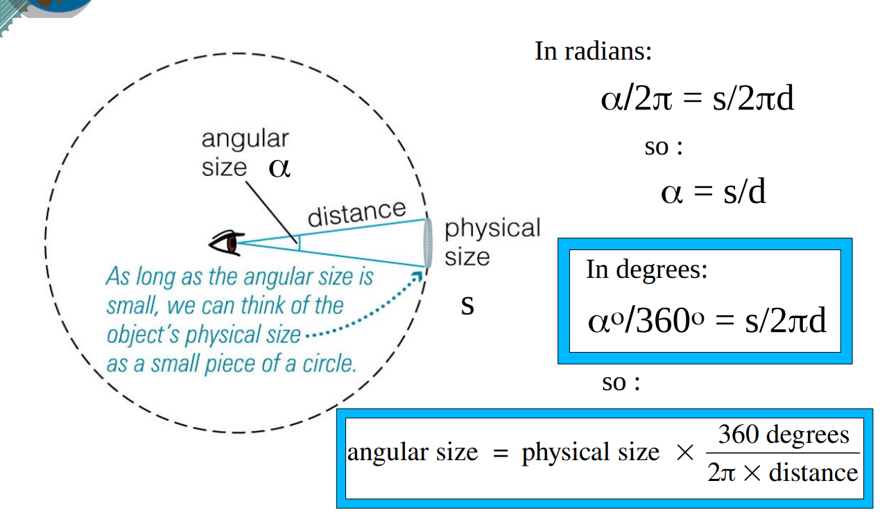
Why solar eclipses are special
Solar eclipses require the Moon and Sun to appear roughly the same size as viewed from Earth…
Let’s try some trigonometry:
Sun is 150,000,000 km away.
Sun is 1,392,700 km diameter.
Moon is 384,000 km away.
Moon is 3,475 km diameter.
What is the angular size of the Moon and Sun?

Slide 23
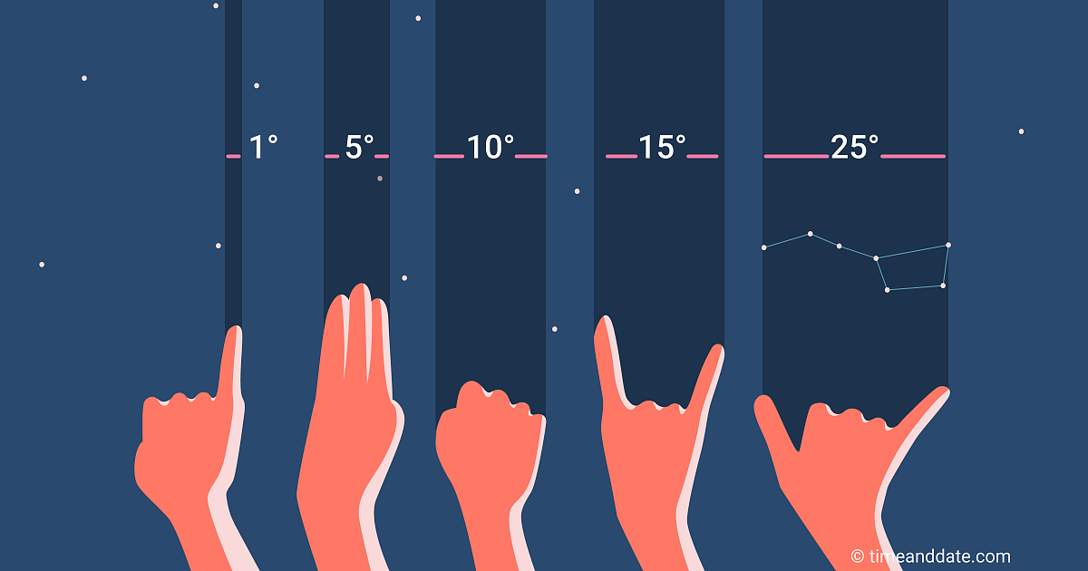
Notes:
Angular size of sun = angular size of moon in our sky.
Sun is 150,000,000 km away. Sun is 1,392,700 km diameter.
Moon is 384,000 km away. Moon is 3,475 km diameter.
Do a bit of simple trigonometry … the angles are very similar (108 vs 110). But they won’t be! The moon is gradually spiralling away from the earth, 3.8 cm a year. (due to tides…effect of moon’s gravity on earth. Moon’s gravity is slowing down the spin of the earth; because of conservation of angular momentum, the moon must speed up…speeding up corresponds to a larger and larger orbital distance.) so right now eclipses can only occur bc of similar angular size of moon and sun. however…would take billions of years for moon to escape completely, and before then (5 billion years) the sun will have gone supernova and we’ll be wiped out anyways.

Slide 24
Why solar eclipses are special
Solar eclipses require the Moon and Sun to appear roughly the same size as viewed from Earth…
The Moon and Sun both have an angular size of approximately 0.5 degrees.
But the Moon is slowly spiralling away from Earth (because of physics reasons); eventually, the Moon will appear too small to completely block the Sun.
More reading: https://eos.org/features/the-end-of-the-eclipse

Slide 25
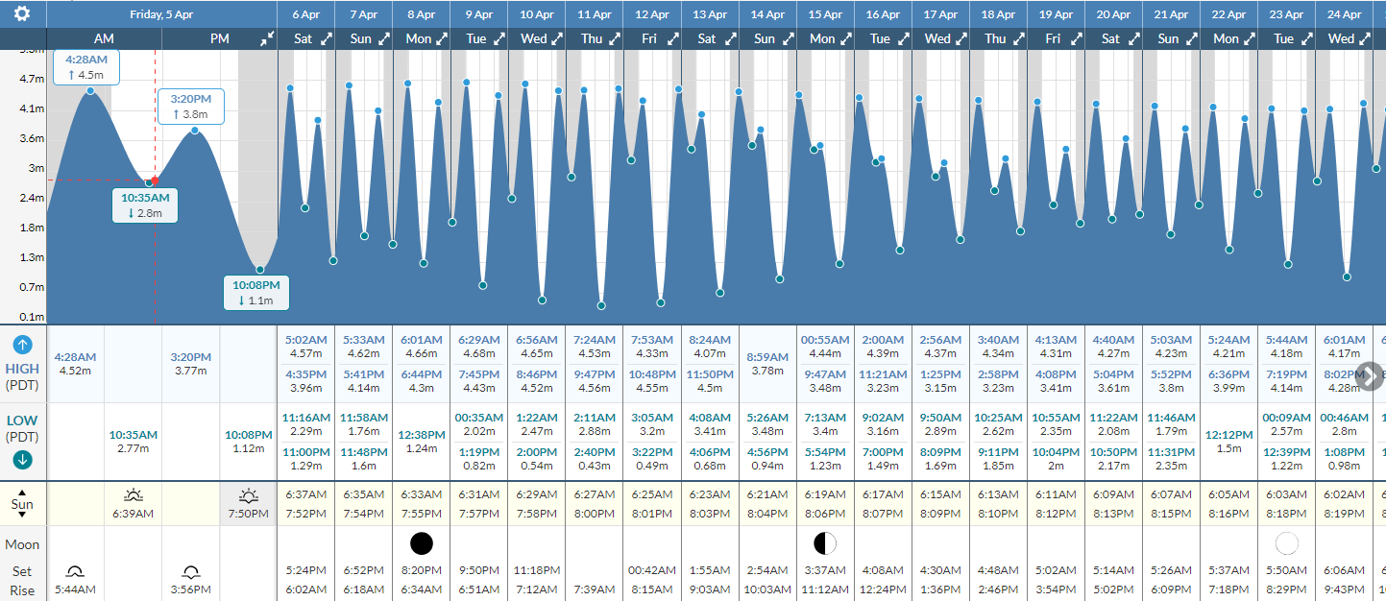
Tides
Discuss: What are tides? Why do they occur?
https://www.tide-forecast.com/locations/Vancouver-British-Columbia/tides/latest

Slide 26
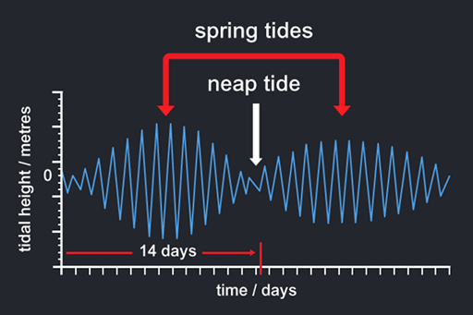
Tides
The Earth, Moon, and Sun all pull on each other with gravitational force. This results in tides.
Tide: the rising and falling of water levels (usually twice a day)
Spring tides: very dramatic; when the gravity of the Moon and Sun pull in the same direction
Neap tides: weak; when the Moon and Sun pull in different directions

Slide 27
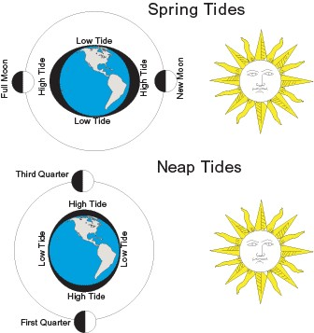
Tides
The Earth, Moon, and Sun all pull on each other with gravitational force. This results in tides.
Tide: the rising and falling of water levels (usually twice a day)
Spring tides: very dramatic; when the gravity of the Moon and Sun pull in the same direction
Neap tides: weak; when the Moon and Sun pull in different directions

Slide 28
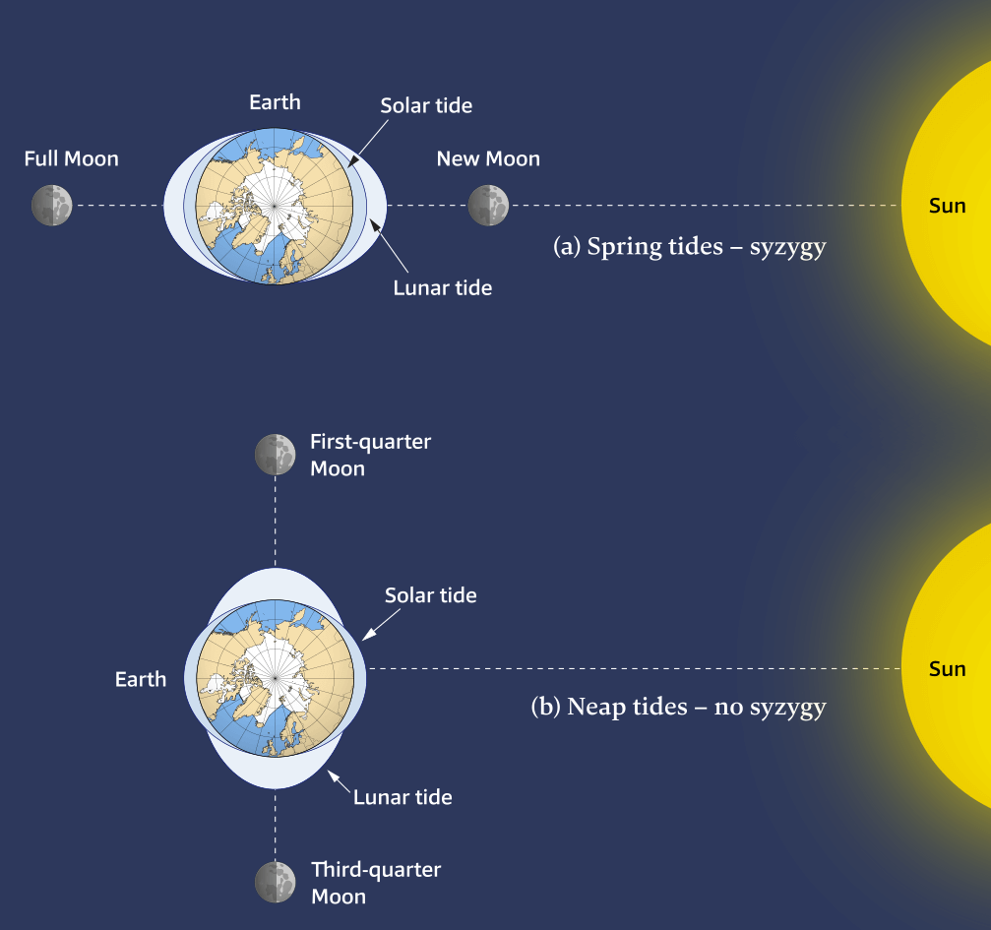
Tides
The Earth, Moon, and Sun all pull on each other with gravitational force. This results in tides.
Tide: the rising and falling of water levels (usually twice a day)
Spring tides: very dramatic; when the gravity of the Moon and Sun pull in the same direction
Neap tides: weak; when the Moon and Sun pull in different directions

Slide 30
