Slide 1

BC Science Connections 8

Slide 2
UNIT 1
Life processes are performed at the cellular level
TOPIC 1.5
How does the body protect us from pathogens?

Slide 3
Topic 1.5: How does the body protect us from pathogens?
The H1N1 influenza virus first appeared in people in 2009
  Originally only infected birds or pigs, but changed into a new virus that infected humans
  Canada: 45 000 cases and 505 deaths
Why do you think most of these people are wearing masks?

Slide 4
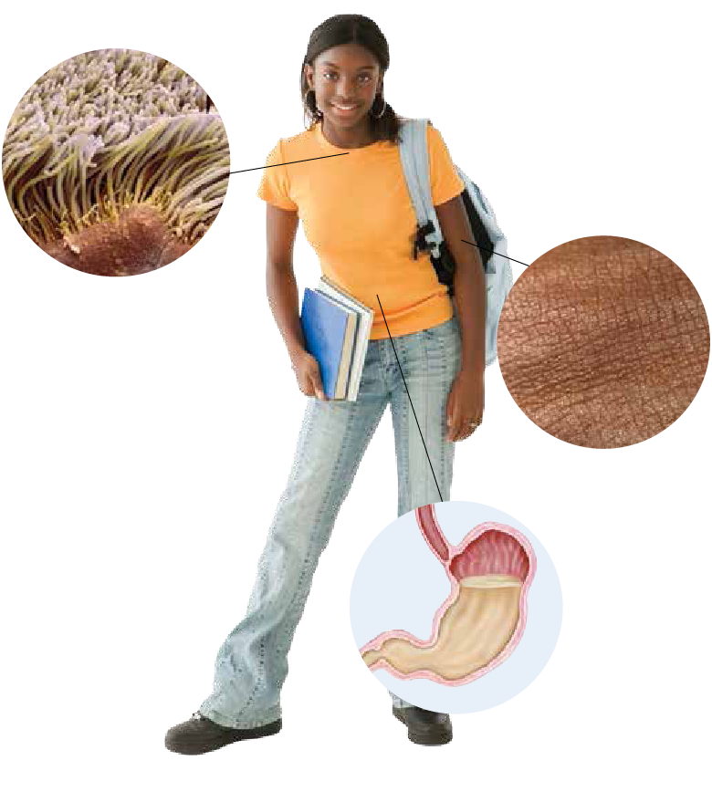
Concept 1: The immune system helps protect us from pathogens and infection.
Immune system:
  The body system that defends against pathogens and infection
  Has three lines of defence to protect us from pathogens
Figure 1.18: The three lines of defence of the immune system.
Notes:
Why do you suppose the immune system needs multiple lines of defense?

Slide 5
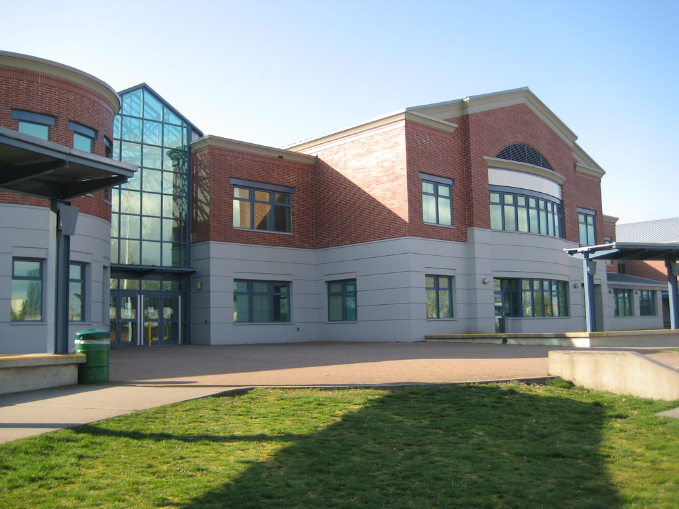


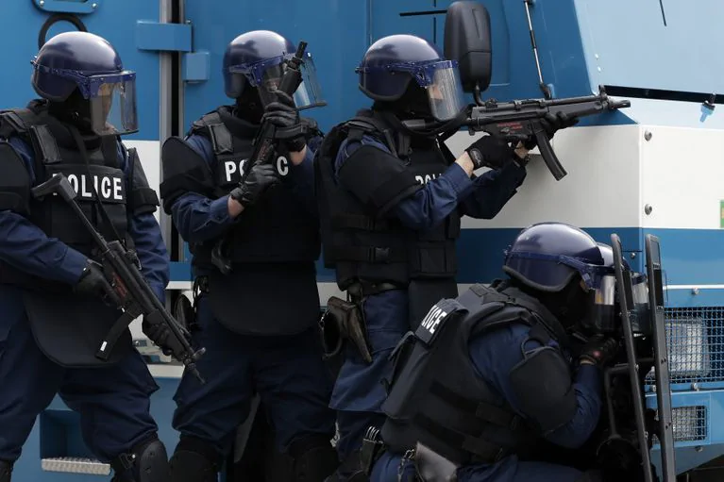
1st Line of Defense
2nd Line of Defense
3rd Line of Defense

Slide 6
The First Line of Defence
Skin and linings of internal body systems

Slide 7
The First Line of Defence
Skin
  Skin is a physical barrier to keep pathogens from entering body
  Sweat and natural body acids: kill pathogens on skin surface
Figure 1.18: Skin is waterproof, so you can easily wash pathogens from it.

Slide 8
The First Line of Defence
Linings of the respiratory system
  Hairs in your nose and throat: trap pathogens and move them back out of your body
  Mucus: pathogens get caught in sticky mucus, and are removed from your body when you cough, sneeze, and swallow
Figure 1.18: Hairs and hair-like structures of the respiratory system
Notes:
Tickle in your throat when you are about to be sick: postnasal drip. First signs of a viral infection. Is mucus dripping down the back of your throat.

Slide 9
The First Line of Defence
Contents and linings of the digestive system
  Strong acids in your stomach: kill many types of pathogens
  Mucus: traps pathogens that are then removed by vomiting
Figure 1.18: Your digestive system can help stop you from getting sick.
Notes:
Stomach acid approx. pH 2

Slide 10
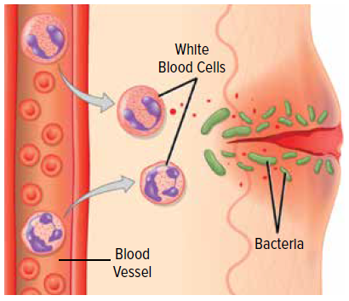
The Second Line of Defence
White blood cells and inflammation

Slide 11
The Second Line of Defence
White blood cells (WBCs):
  Surround and kill pathogens that get through the first line of defence
  Some WBCs release chemicals that make it easier for other WBCs to kill pathogens
Figure 1.19: A white blood cell (blue) engulfs a bacteria (yellow)

Slide 12
The Second Line of Defence
Inflammation:
  A process that causes a part of the body to become red and swollen
  Occurs if you have an injury or infection
  Increased blood flow → white blood cells move into the affected area and kill pathogens
Figure 1.20: Inflammation
Notes:
inflammation: a process that causes a part of the body to become red and swollen
Damaged cells (from trauma, heat, bacteria, etc) release chemicals into the local area. These chemicals:
Cause swelling (blood leaks fluid into area to isolate it from further contact with body tissues…slow down foreign invaders) and attract white blood cells.
Make the blood vessels leaky. Lets platelets, clotting factors, wbcs leave the blood vessels and enter the infection
Increased blood flow to the area: is why is so hot. Need platelets, clotting things
Can you think of any other body process that causes inflammation?
(allergies: histamines. Is the same chemical that causes immune system inflammation)
Autoimmune diseases like arthritis…inflamed even though there are no invaders
Fever: increase in body temperature which slows bacterial growth and reproduction

Slide 13
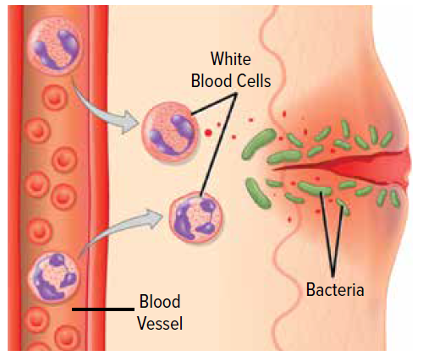
The Second Line of Defence
Figure 1.20:
When a part of the body is inflamed, it becomes hot and red as blood flow increases.
It becomes swollen as fluid floods the tissues.
And it becomes painful as nerve endings are stimulated.

Slide 14

The Second Line of Defence
White blood cells video

Slide 15
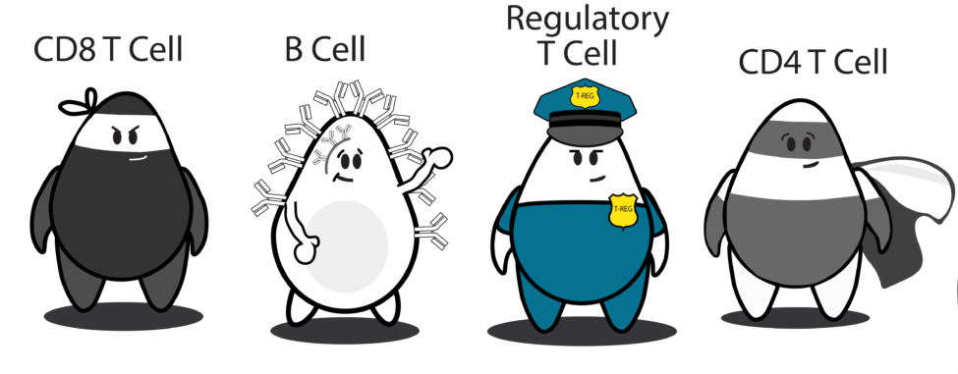
The Third Line of Defence
Specialized white blood cells that ‘remember’ pathogens and can fight re-infections more effectively; antibodies

Slide 16

The Third Line of Defence
Specialized white blood cells (T cells, B cells)
  Recognize pathogens that they have previously fought
  If the same pathogen enters the body in the future, they respond quickly so you don’t get sick again

Slide 17
The Third Line of Defence
T cells: directly kill infected cells
B cells: produce antibodies
(Antibodies: particles in the bloodstream that detect proteins produced by pathogens and infected cells; attach to and neutralize pathogens and infected cells)
*Disclaimer: This slide presents a very simplified version only.

Slide 18
Classify each of the following statements as the first, second, or third lines of defence.
Mucus can trap pathogens.
Specialized white blood cells, called T cells and B cells, allow your body to develop an immune response that prevents further infection.
The skin and the linings of internal body systems stop many pathogens.
Inflammation causes a part of the body to become red and swollen as blood cells move into the area.
Acids given off by the body can kill some pathogens.
White blood cells can surround and kill pathogens keeping infection from spreading.
The immune system defends against pathogens and infection.
Notes:
Note: phagocytosis is specifically second line of defence. It gets complicated why this is the case.

Slide 19
Classify each of the following statements as the first, second, or third lines of defence.
Mucus can trap pathogens. (1)
Specialized white blood cells, called T cells and B cells, allow your body to develop an immune response that prevents further infection. (3)
The skin and the linings of internal body systems stop many pathogens. (1)
Inflammation causes a part of the body to become red and swollen as blood cells move into the area. (2)
Acids given off by the body can kill some pathogens. (1)
White blood cells can surround and kill pathogens keeping infection from spreading. (2)
The immune system defends against pathogens and infection. (1, 2, 3)
Notes:
Note: phagocytosis is specifically second line of defence. It gets complicated why this is the case.

Slide 20
Workbook break (pg. 38-39)

Slide 21
Discussion Questions
How could washing your hands regularly protect you from pathogens?

Slide 22
Activity
Devise (and draw) an analogy for the immune system lines of defence.
Extension: Draw a comic strip to trace the path of a pathogen that encounters and gets by the first line of defence but is successfully killed by the second line of defence.

Slide 23
Immune system: very complex!
Video: FYI only (not testable)
- https://www.youtube.com/watch?v=zQGOcOUBi6s
“The Immune System Explained I – Bacteria Infection”

Slide 24
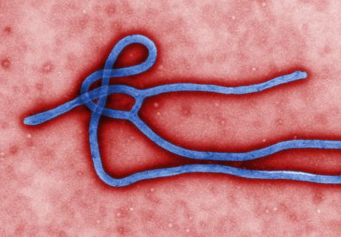
Concept 2: Outbreaks of disease can have an impact on populations.
Ebola virus disease (EVD)
  Largest and longest outbreak occurred in 2014 in West Africa
  Symptoms: Fever, muscle pain, diarrhea, vomiting, internal bleeding
  Transmission: Direct contact with an infected person
  30 000 cases were reported; 12 000 people died in six countries
Ebola virus

Slide 25
Table 1.4: Terms Used to Describe Disease Occurrence
Epidemic | Outbreak | Pandemic
the occurrence of disease cases above the normal amount expected for a population in a defined area | same definition as an epidemic often used to refer to a limited geographic area Fewer cases, smaller area than epidemic | an epidemic that has spread over several countries or continents, or around the world
Was Ebola virus disease (EVD) an outbreak, epidemic, or pandemic?

Slide 26
The Effects of Epidemics and Pandemics on Human Populations
HIV:
  Killed more than 25 million people since 1984
SARS, H1N1, measles, typhoid:
  More than 1 million people have died in the first two decades of the 21st century
Figure 1.21: HIV: social impact, economic impact, or both?

Slide 27
The Effects of Epidemics and Pandemics on Human Populations
Bird flu:
  50 million chicken and turkeys had to be killed in 2015
  Price of eggs increased
  Farmers lost millions of dollars
Figure 1.21: Bird flu: social impact, economic impact, or both?

Slide 28
The Effects of Epidemics and Pandemics on Human Populations
Flu:
  Causes people to take sick days
  Results in losses of half a billion dollars a year to the Canadian economy
Figure 1.21: Flu: social impact, economic impact, or both?

Slide 29
The Effects of Epidemics and Pandemics on Human Populations
Extra precautions due to disease outbreaks:
  Can lead to fear and panic
  Causes government to restrict travel and importation of certain foods
Figure 1.21: Extra precautions due to disease outbreaks: social impact, economic impact, or both?

Slide 30
Preventing Disease Transmission
Think-pair-share:
What are some ways we can prevent disease transmission?
Notes:
Diseases spread: touch, vector (mosquito), airborne
Hand washing
Sneeze/cough into your elbow
Vaccine immunization
Disinfection
Don’t share personal items
Don’t go to school when sick

Slide 31
Video
Ted-ed “How Pandemics Spread”

Slide 32
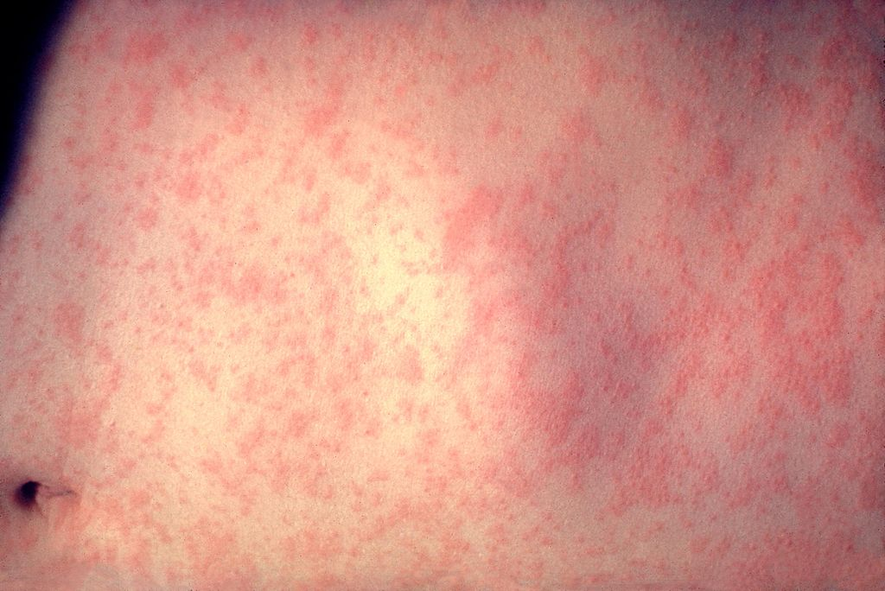
Different Populations Have Different Immunities
Measles and smallpox: many outbreaks in Europe over hundreds of years
  Over time, populations of people in Europe built up immunity to these diseases
Skin of a patient with measles (Centers for Disease Control and Prevention)

Slide 33
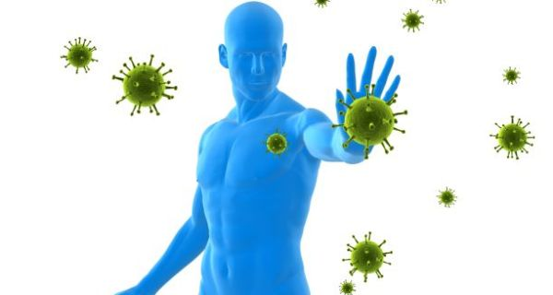
Different Populations Have Different Immunities
Immunity: the ability of a living thing to resist a particular infection or toxin by the action of white blood cells
  What line(s) of defense are involved in immunity?
    2nd: same response every time
    3rd: response can be developed/trained

Slide 34
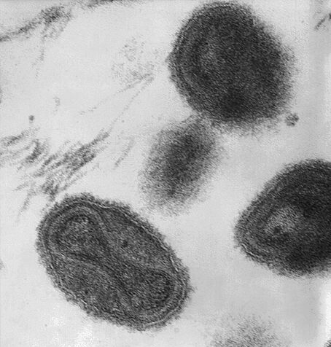
Different Populations Have Different Immunities
Europeans brought pathogens that caused measles and smallpox to North and South America
  People in the Americas had never been exposed to these pathogens
  Large numbers of First Peoples died when exposed to these pathogens
Smallpox virus (Centers for Disease Control and Prevention)

Slide 35
Natural Immunity in Human Populations
Remote community in the Peruvian rain forest
  About 10% of people have natural immunity to rabies, which is fatal if untreated
Gabon (west-central Africa)
  Small population with natural immunity to Ebola
Figure 1.22: Vampire bats in the Peruvian rain forest carry rabies.

Slide 36
Discussion Questions
Give examples of a disease with a social impact and an economic impact.
Explain how a population can develop immunity to a disease.

Slide 37
Summary: How does the body protect us from pathogens?
The immune system helps protect us from pathogens and infection.
Outbreaks of disease can have an impact on populations.
Different populations have different immunities.

