Slide 1

BC Science Connections 8

Slide 2

UNIT 2
The behaviour of matter can be explained by the kinetic molecular theory and atomic theory
TOPIC 2.1
How does matter affect your life?

Slide 3
Topic 2.1: How does matter affect your life?
What does the word “chemical” mean to you?
  Chemicals are not necessarily dangerous
  “Chemical” means the same as “matter”

Slide 4
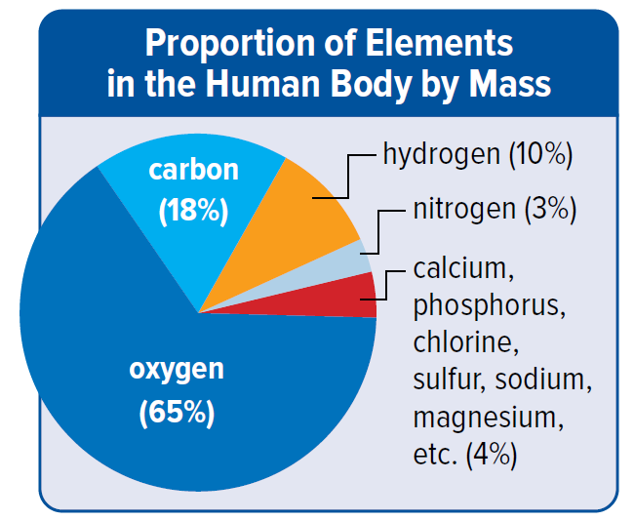
Concept 1: Everything—including you—is made up of chemicals.
You are made up of mostly four types of chemicals called elements:
  Oxygen
  Carbon
  Hydrogen
  Nitrogen
Figure 2.1 Where do we get the chemicals we need for our bodies?

Slide 5
Concept 1: Everything—including you—is made up of chemicals.
When people use the word “chemical”, they are talking about “matter”
  Matter: anything that takes up space and mass
Everything is made up of matter.

Slide 6
Discussion Questions
In your own words, define the term “matter.”
What kinds of misunderstanding can result when people use the word “chemical” when talking about issues involving health and the environment?

Slide 7


Concept 2: Chemicals in your daily life have characteristics that make them useful, hazardous, or both.
Some types of matter that you use everyday can be hazardous
  Information labels give you information about how to properly handle matter

Slide 8
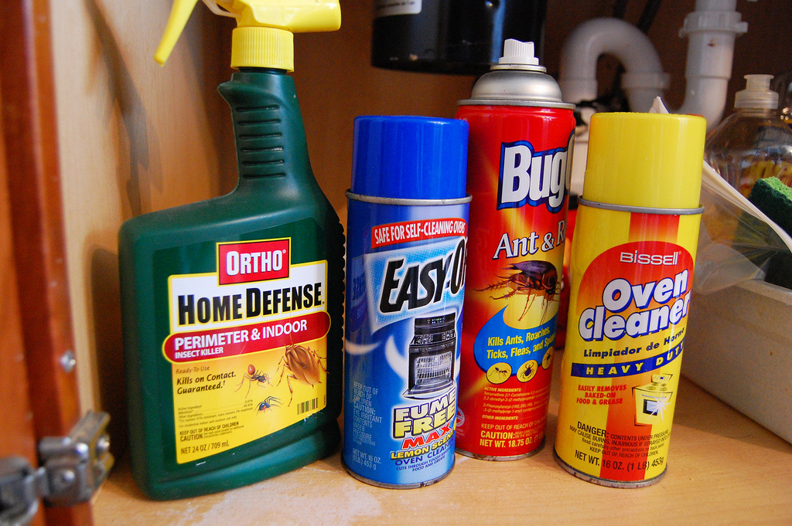
Brainstorm
Brainstorm objects in your household that could be hazardous.

Slide 9


Chemical Safety Around the House
Hazardous Household Products Symbols (HHPS)
  Each symbol has two types of warnings:
    Whether the hazard is the container or contents
    The type of hazard

Slide 10
HHPS: The Borders
Dangerous Container
  Border looks like a traffic yield sign
  Container is dangerous

Slide 11

HHPS: The Borders
Dangerous Product
  Border looks like a traffic stop sign
  Contents of the container are dangerous
Think of a memory device/connection that will help you remember the difference between these borders.

Slide 12
HHPS: The Hazards
Explosive
  Container can explode
  If punctured or heater, pieces can cause serious injuries

Slide 13
HHPS: The Hazards
Corrosive
  Product inside the container will burn the throat or stomach if swallowed
  Burn skin or eyes or contact

Slide 14
HHPS: The Hazards
Flammable
  Product will catch on fire easily if near sparks, flames, or heat

Slide 15

HHPS: The Hazards
Poisonous
  Product will cause illness or death if you eat or drink it
  Smelling or licking the product may be enough to cause harm

Slide 16
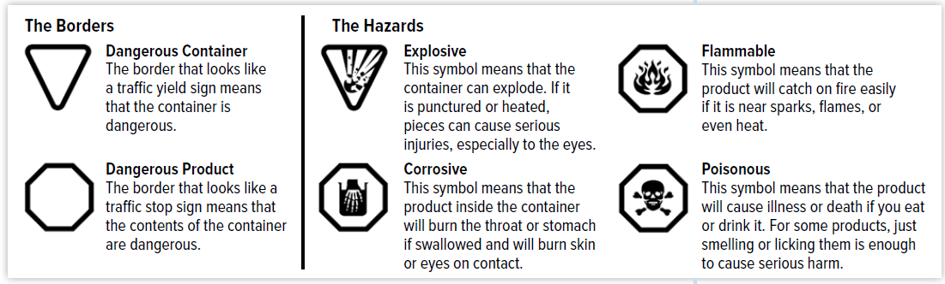
HHPS: Household Hazardous Product Symbols
Figure 2.2 Household hazardous product symbols (HHPS).
Name two products with HHPS on their containers.

Slide 17
Discussion Questions
What is the HHPS system? Why is it used?
Which HHPS would be on spray paint?

Slide 18
Concept 3: Handling chemicals and equipment safely is important at school and at work.
By law, everyone in the workplace, including school, must:
  Know about the chemicals they use
  Know how to handle the chemicals safely
Canada: Workplace Hazardous Materials Information System (WHMIS)

Slide 19
WHMIS: Workplace Hazardous Materials Information System
WHMIS:
  Provides information about how to store, handle, and dispose of chemicals
  Also provides first aid information

Slide 20


WHMIS 2015
WHMIS Symbol | Description
 | Exploding bomb (explosion and reactivity hazards)
 | Gas cylinder (gases under pressure)

Slide 21


WHMIS 2015
WHMIS Symbol | Description
 | Health hazard (may cause or is suspected of causing serious health effects)
 | Flame (fire hazards)

Slide 22


WHMIS 2015
WHMIS Symbol | Description
 | Corrosion (corrosive damage to metals, as well as skin, eyes)
 | Exclamation mark (may cause less serious health effects or damage the ozone layer)

Slide 23


WHMIS 2015
WHMIS Symbol | Description
 | Flame over circle (oxidizing hazards)
 | Skull and crossbones (can cause death or toxicity with short exposure to small amounts)

Slide 24

WHMIS 2015
WHMIS Symbol | Description
 | Biohazardous infectious materials (organisms or toxins that can cause disease in people or animals)

Slide 25
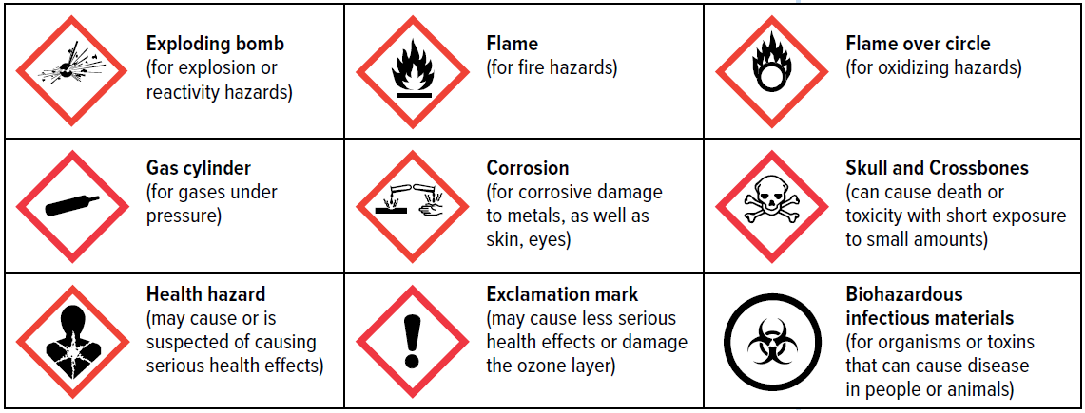
WHMIS 2015
Figure 2.3: WHMIS 2015 safety symbols.
Which WHMIS symbols would you find on a container that contains a flammable gas stored under pressure?

Slide 26
Discussion Questions
What is WHMIS and what role does it play in laboratory safety?
Why is it important to have a common set of safety labels and icons for hazardous chemicals in all workplaces and schools?

Slide 27
Summary: How does matter affect your life?
Everything—including you—is made up of chemicals.
Chemicals in your daily life have characteristics that make them useful, hazardous, or both.
Handling chemicals and equipment safely is important at school and at work.

