Slide 1

BC Science Connections 8

Slide 2
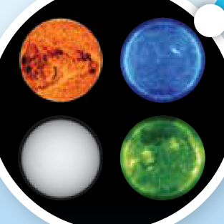
UNIT 3
Energy can be transferred as both a particle and a wave
TOPIC 3.1
How does electromagnetic radiation shape your world?

Slide 3
Discuss:
What is energy?
What are some forms of energy we interact with in our everyday lives?

Slide 4
Topic 3.1: How does electromagnetic radiation shape your world?
Electromagnetic radiation is a form of energy.
  Given off by different sources on Earth and in the universe (most comes from the Sun)
  Some types of are harmful, and other types are essential to survival of life on Earth
Images of the Sun taken with telescopes that detect a different type of electromagnetic radiation. (Clockwise, from top left: infrared, x-ray, ultraviolet, optical)
Notes:
physical property:

Slide 5
Concept 1: Electromagnetic radiation is an important part of your world.
Seven different types of electromagnetic radiation:
  Radio wave
  Microwave
  Infrared
  Visible light
  Ultraviolet
  X-ray
  Gamma-ray
Image of the Sun taken with an ultraviolet telescope.

Slide 6
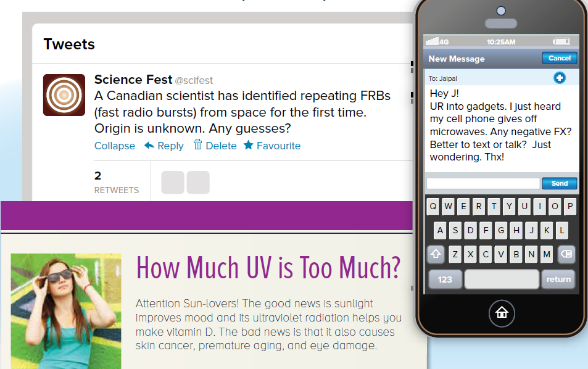
Figure 3.1: Electromagnetic radiation is often discussed online and covered by the news.

Slide 7
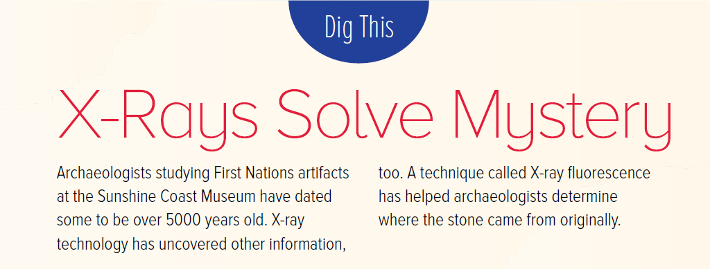
Figure 3.1: Electromagnetic radiation is often discussed online and covered by the news.

Slide 8
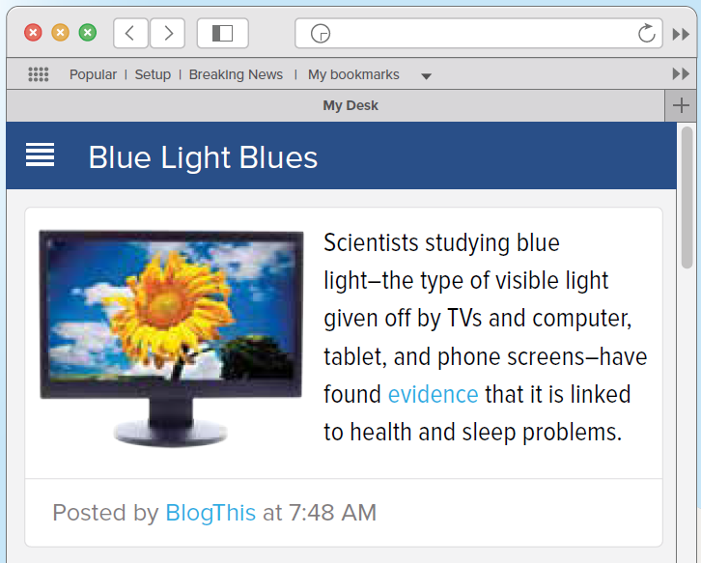
Figure 3.1: Electromagnetic radiation is often discussed online and covered by the news.

Slide 9
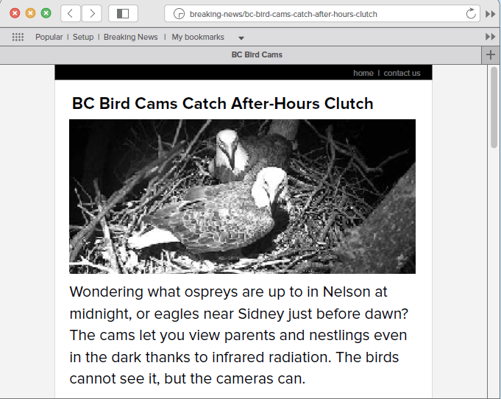
Figure 3.1: Electromagnetic radiation is often discussed online and covered by the news.

Slide 10
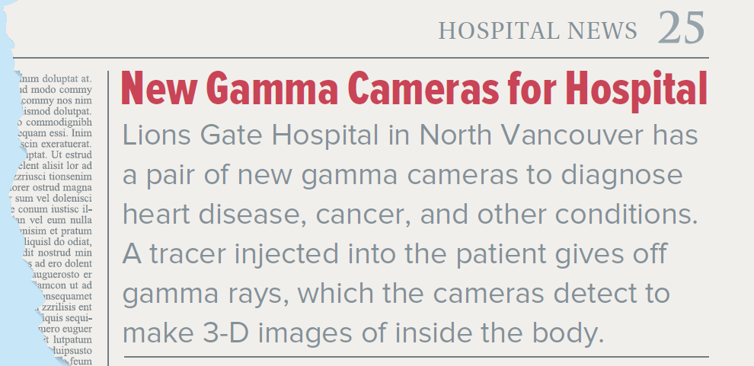
Figure 3.1: Electromagnetic radiation is often discussed online and covered by the news.

Slide 11
Discussion Questions
Why do you think sunglasses have special lenses that filter out ultraviolet light?
Why might you want to limit the amount of time you spend in front of an electronic screen at night?

Slide 12
Concept 2: Sources of electromagnetic radiation are all around you.
Many different sources of electromagnetic radiation:
  Some sources are artificial (cell phones, light bulbs)
  Some sources are living organisms (humans)
The Sun is a source of all types of electromagnetic radiation.

Slide 13
The Sun: A Source of All Types of Electromagnetic Radiation
The Sun: gives off all types of electromagnetic radiation.
Energy carried by radiation is produced by nuclear fusion
  Hydrogen nuclei collide and combine to form helium
  Fusion of 1 g of hydrogen atoms: reaction releases 65 billion kJ of energy (50 000 pieces of pizza!)
  500 trillion grams of hydrogen fuse in the Sun every second
The large amount of energy released by the Sun supports life on Earth.

Slide 14
Chemical Reactions in Living Organisms: A Source of Visible Light
Chemical reactions give off visible light.
Some reactions occur in living organisms
  Female anglerfish have a lure that gives off visible light to attract prey
  Bacteria in the lure produce the light
Female anglerfish have a lure that gives off visible light

Slide 15
Heated Materials: A Source of Visible Light and Infrared Radiation
All objects, including you, give off infrared radiation.
As objects get hotter: give off more infrared radiation (sensed as heat)
If objects are very hot: give off visible light and infrared radiation
Light bulbs give off infrared radiation and visible light. When the bulb is turned on, the wire inside gets very hot and gives off light.

Slide 16
Telecommunications: A Source of Microwaves and Radio Waves
Cell phones are a source of microwaves.
  Microwaves carry information from the cell phone to nearby cell phone tower
  Cell phone towers create microwaves that carry the information to another cell phone
Cell phone towers create microwaves that carry information from cell phone to cell phone.

Slide 17
Telecommunications: A Source of Microwaves and Radio Waves
Communication systems (fire, police, emergency systems) and radio stations generation radio waves
  Send signals to radio receivers that convert them into sound

Slide 18
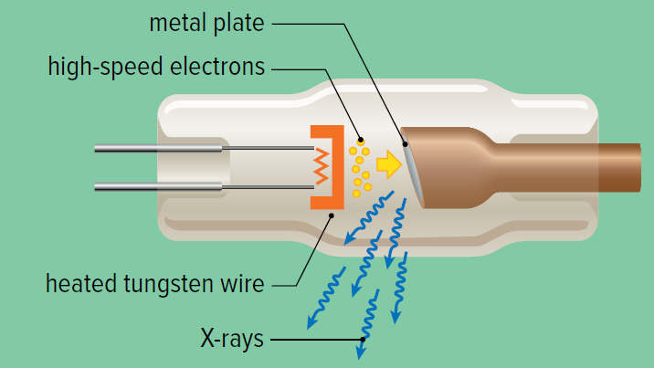
X-ray Tubes: A Source of X-rays
X-rays are produced are produced in an x-ray tube.
High-speed electrons are released from a heated tungsten wire
Electrons collide with metal surface that stops them
The sudden change in speed of the electrons generates x-rays
X-rays are produced in x-ray tubes. X-rays can be used to create images of teeth and bones.

Slide 19
Radioisotopes: A Source of Gamma Rays
Gamma rays are produced by unstable nuclei of certain atoms.
Atoms with unstable nuclei are called radioisotopes.
  Radioisotopes have too much energy
  To become stable, they give off energy in different forms, including gamma rays
A gamma camera image of a thyroid gland injected with radioactive iodine. The brighter area has taken up more iodine, so the camera detects more gamma rays.

Slide 20
Radioisotopes: A Source of Gamma Rays
Iodine-131 is a radioisotope that gives off gamma rays
  Used to treat thyroid cancer
  When a patient swallows it, it will go to the thyroid gland to kill the cancer cells
A gamma camera image of a thyroid gland injected with radioactive iodine

Slide 21
Discussion Questions
What type or types of electromagnetic radiation are given of by the following sources?
  a halogen light bulb
  the Sun
  iodine-131
  you

Slide 22
Discussion Questions
Identify three sources of electromagnetic radiation that you interacted with this week.
A type of starfish uses electromagnetic radiation to warn predators that it does not taste good. What type of electromagnetic radiation is most likely given off by the starfish?

Slide 23
Concept 3: Electromagnetic radiation enhances how we sense our world.
You are an electromagnetic radiation detector.
  Skin: special cells sense infrared radiation, and send a message to your brain that is interpreted as heat
  Eyes: sense visible light to see brightness, objects, and colour
Electromagnetic radiation and technology lets us “see” in a new way

Slide 24
Solving Crimes
Electromagnetic radiation helps uncover evidence.
Luminol:
  Used to find blood
  Undergoes a reaction with iron in blood to give off visible light
Figure 2.3: Luminol is sprayed at a crime scene to test for blood.

Slide 25
Solving Crimes
Infrared photography:
  Senses temperature differences
  Used to find hidden evidence (weapons) within walls
X-ray, infrared, ultraviolet radiation:
  Used to uncover art forgeries by identifying varnishes, pigments, brushstrokes
Figure 2.3: Luminol is sprayed at a crime scene to test for blood.

Slide 26
Diagnosing Disease
Electromagnetic radiation is used to identify medical problems.
Magnetic resonance imaging (MRI)
  Radio waves and magnets work together
  Signals are used to create an image of tissues
Figure 2.4: This MRI image shows a cross-section of a human abdomen. It has been coloured to help show the different organs.

Slide 27
Diagnosing Disease
X-ray imaging:
  Used to diagnose broken bones and cavities in teeth
  X-rays are absorbed by bones and teeth, but pass through most other body tissues
X-ray of bones

Slide 28

Diagnosing Disease
Blue light cancer detection:
  B.C. Cancer Agency developed a device that shines blue light into the mouth to detect cancer
  Under blue light or ultraviolet radiation:
    Normal tongue will glow
    Cancerous tissue will look dark

Slide 29
Seeing Earth from Space
Satellites use different types of electromagnetic radiation to gather information about Earth (remote sensing).
Weather satellites:
  Use visible light and infrared radiation from Earth to monitor weather conditions
  Can detect movement of clouds and amount of moisture in atmosphere
Figure 3.5: Satellite image of Earth

Slide 30
Seeing Earth from Space
LANDSAT satellite:
  Measures visible light and infrared radiation from Earth’s land surface to map it
  Helps with monitoring and observing land use (examples: loss of rainforests, finding near-shore shipwrecks)
Figure 3.5: Satellite image of Earth

Slide 31
Viewing the Universe
Electromagnetic radiation is being used to study the universe.
Hubble Space Telescope:
  Uses mirrors to collect and focus visible light
  Other instruments on the telescope sense ultraviolet and infrared radiation
Figure 3.6: This image of a supernova (exploding star) combines data from telescopes sensing different kinds of electromagnetic radiation.

Slide 32
Viewing the Universe
Very Large Array radio telescope:
  Largest radio telescope on Earth
  27 receivers work together to sense radio wave radiation from space
Figure 3.6: This image of a supernova (exploding star) combines data from telescopes sensing different kinds of electromagnetic radiation.

Slide 33
Discussion Questions
Describe how you are an electromagnetic radiation detector.

Slide 34
Summary: How does electromagnetic radiation shape your world?
Electromagnetic radiation is an important part of your world.
Sources of electromagnetic radiation are all around you.
Electromagnetic radiation enhances how we sense our world.

