Slide 1

BC Science Connections 8

Slide 2
UNIT 3
Energy can be transferred as both a particle and a wave
TOPIC 3.3
How does light behave when it encounters different materials and surfaces?

Slide 3
Light is weird.
What questions do you have based on observations you make in the following pictures?

Slide 4
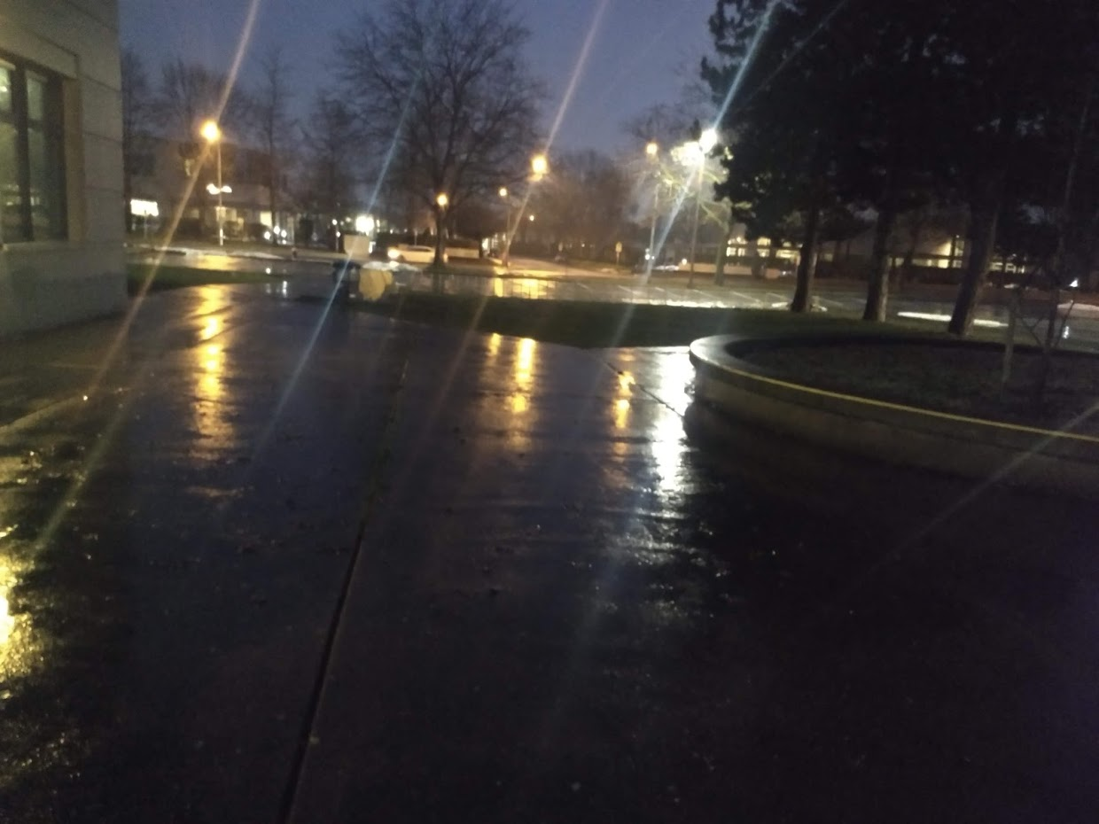

Slide 5
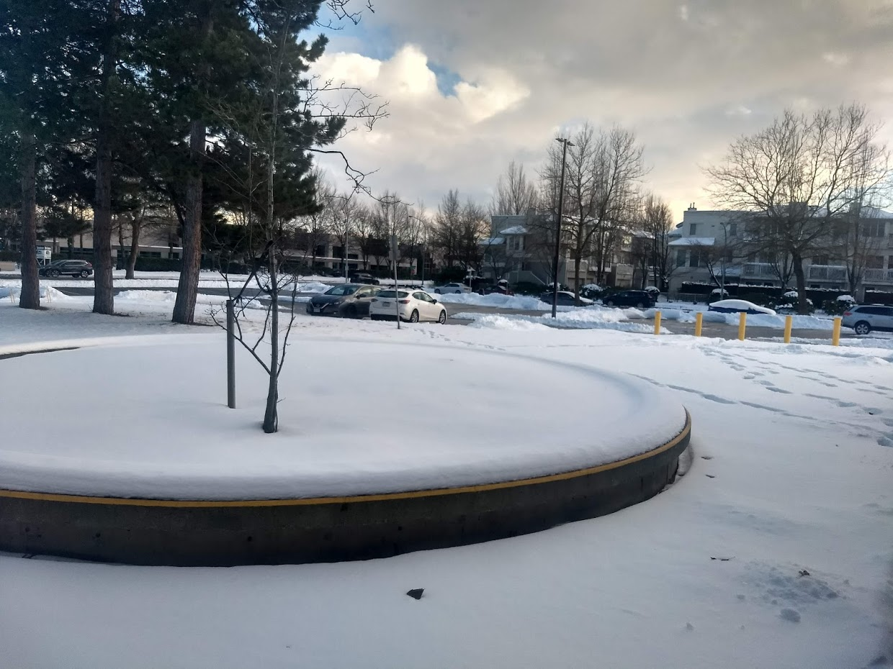

Slide 6
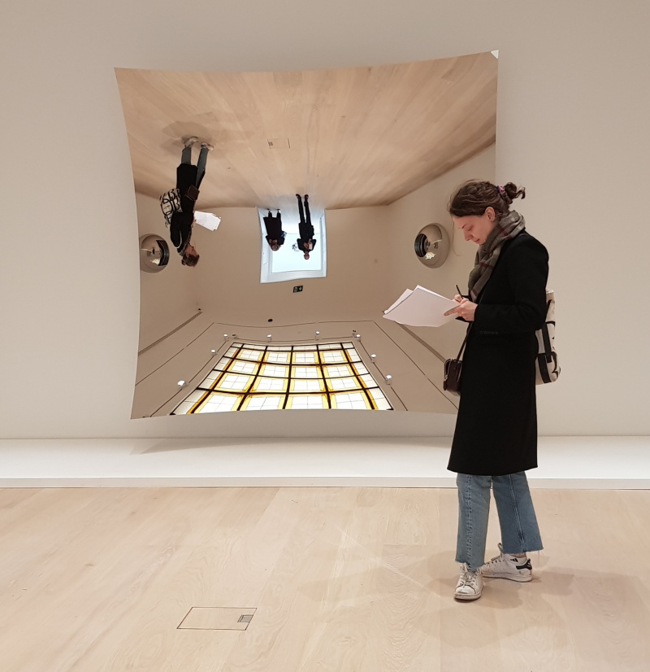
Notes:
https://www.cobosocial.com/dossiers/anish-kapoor-on-the-power-of-concave-mirrors/

Slide 7
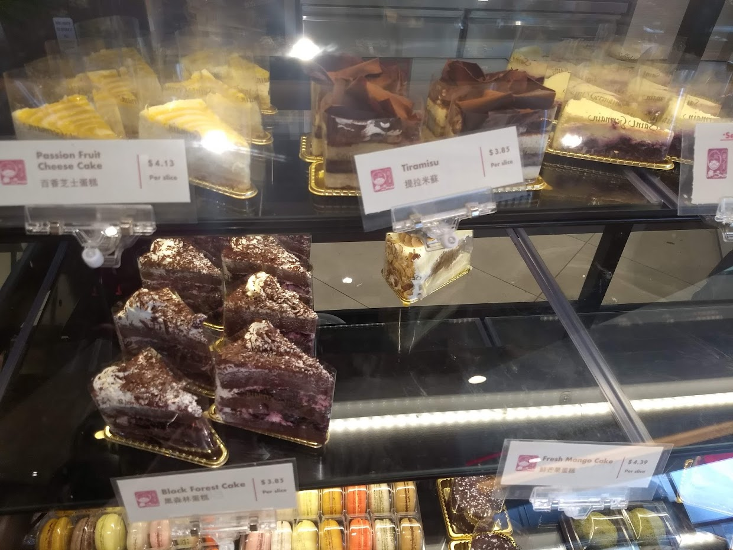

Slide 8
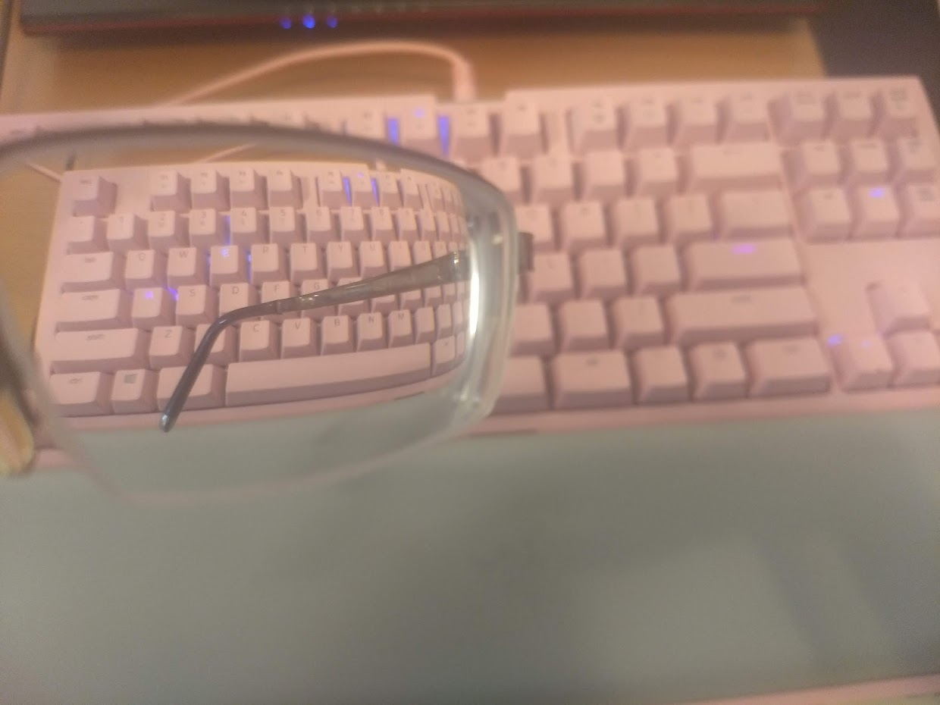

Slide 9
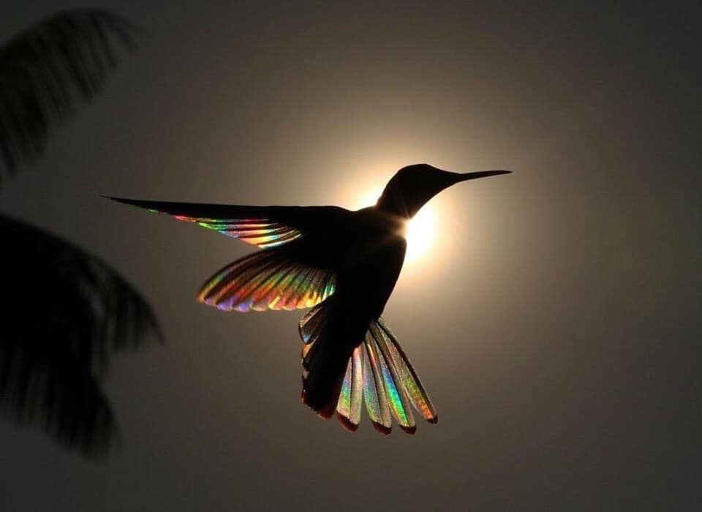
Notes:
Credits: posted by Science Page (facebook) August 31

Slide 10
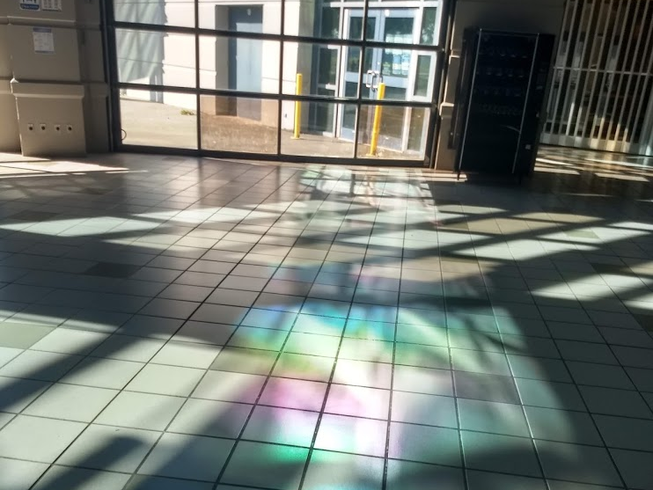

Slide 11
Topic 3.3: How does light behave when it encounters different materials and surfaces?
Light can be reflected, absorbed, transmitted, or refracted.
Light behaves in different ways when it encounters different materials.
Light from a lighthouse needs to be visible through dense fog.
Notes:
physical property:

Slide 12
Concept 1: Light can be reflected, absorbed, transmitted, or refracted.
Light can be:
  Reflected
  Absorbed
  Transmitted
  Refracted
Light is being reflected, refracted, absorbed, and transmitted in this photo of Elk Lakes Provincial Park.

Slide 13
Reflection: Light Bounces Off
Reflection:
Process in which light “bounces off” a surface and changes direction
Two types of reflection:
  Reflection off an extremely smooth surface
  Reflection off a rough surface
Figure 3.17: Emerald Lake in Yoho National Park has an extremely smooth surface in which an image is visible.
Notes:
reflection: the process in which light “bounces off” the surface of an object and travels in another direction

Slide 14
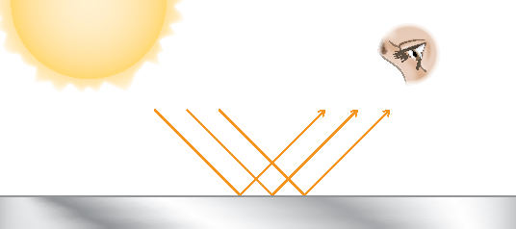
Reflection Off an Extremely Smooth Surface
Examples: mirrors, a very still body of water
  When they reflect light, the pattern of reflected rays are similar to the pattern of the incoming rays
  This similarity lets you see an image when the light reaches your eye (example: your “reflection” in a mirror)
Figure 3.18: Lights rays reflecting off a smooth surface have a pattern similar to incoming rays.

Slide 15
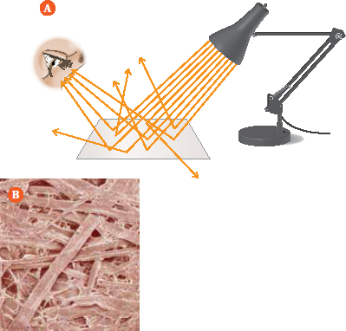
Reflection Off a Rough Surface
Example: Paper
  When reflected rays hit the rough surface of the paper, they scatter in different directions
  Pattern of reflected rays is not similar to incoming rays, so no image appears
  Some reflected rays reach your eyes, which make the paper visible
Figure 3.19: (A) When light hits a rough surface, it reflects in many directions. (B) Magnified image of paper, showing rough surface

Slide 16
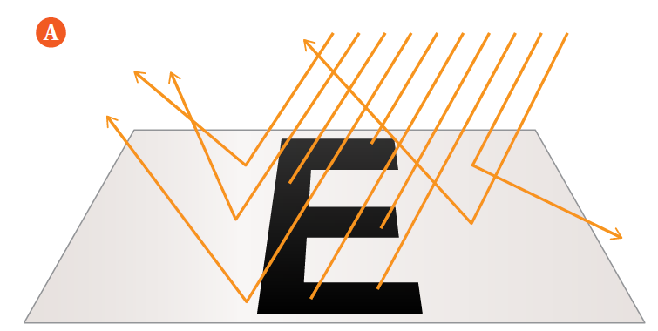
Absorption: Light Energy is Trapped
Absorption: the process in which light energy is trapped in an object as heat
Example 1: a printed black letter on a piece of paper
  Reflection off a rough surface (paper) lets you see the paper
  Printed letter is made up of black ink that absorbs the incoming light
  No rays reflect off the letter, so it looks black
Figure 3.20A: Rays that hit the black letter are absorbed, so the letter looks black.
Notes:
absorption: the process in which light energy is trapped in an object as heat

Slide 17
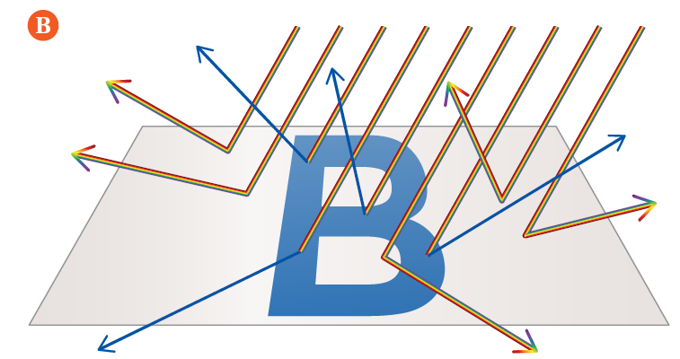
Absorption: Light Energy is Trapped
Example 2: a printed blue letter on a piece of paper
  Reflection off a rough surface (paper) lets you see the paper
  Printed letter absorbs all colours except blue
  Blue wavelengths are reflected from the letter into your eyes, so it looks blue
Figure 3.20B: The blue letter absorbs all wavelengths of light except blue. Only the blue light reaches your eye.

Slide 18
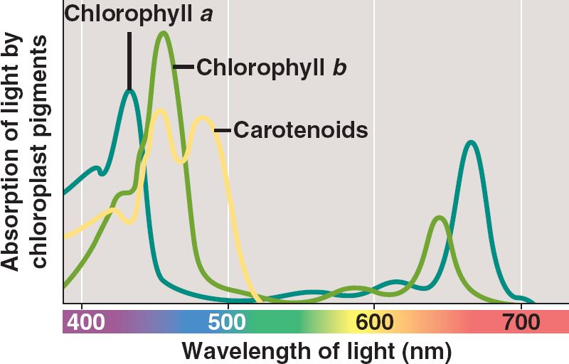
Case Study: Chlorophylls
Leaves get their colour from pigments inside them. The absorption spectrum shows which wavelengths these pigments absorb.
Use the absorption graph to explain why chlorophyll appears green, and carotenoids appear yellow or red.

Slide 19
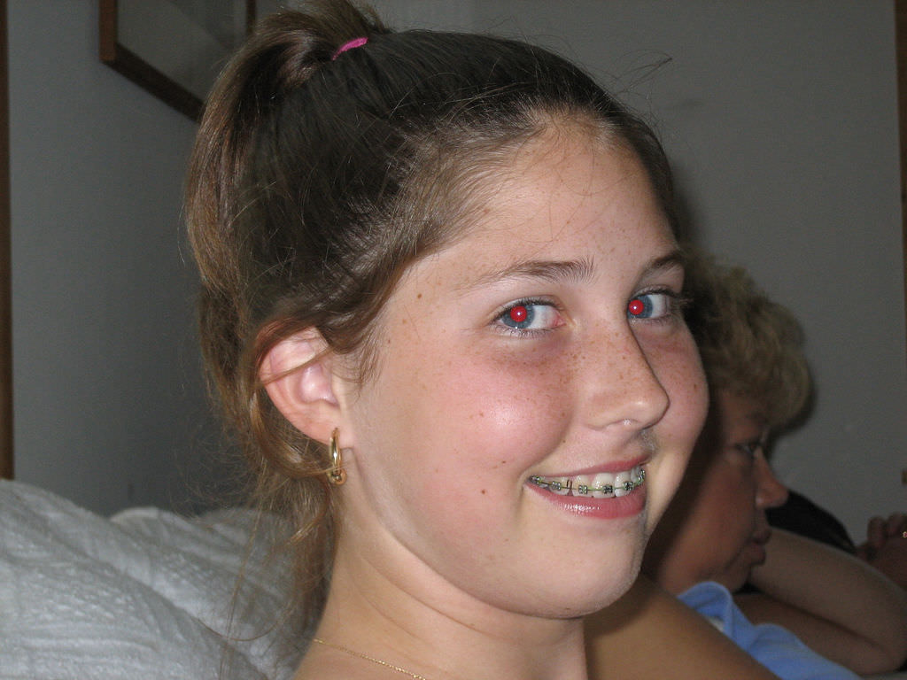
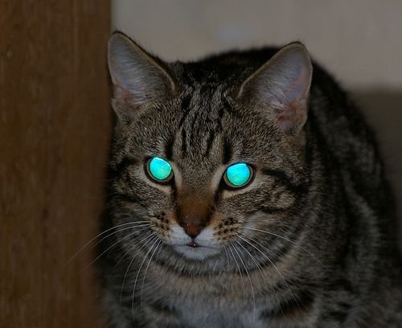
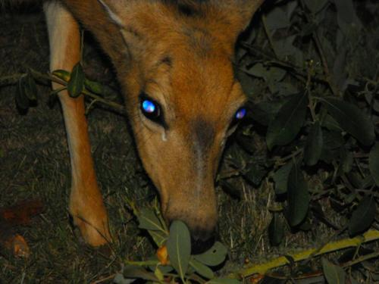
Case Study: Glow-in-the-dark Eyes
What is happening here? Make a prediction using the vocabulary and concepts we learned about today.

Slide 20
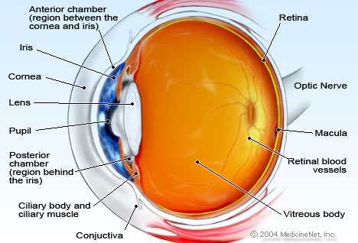
Case Study: Glow-in-the-dark Eyes
Red-eye in humans:
“Flash” of photography happens too quickly for iris to contract and block out light
Light reflects off retina
Retina is orange-red because of blood vessels

Slide 21
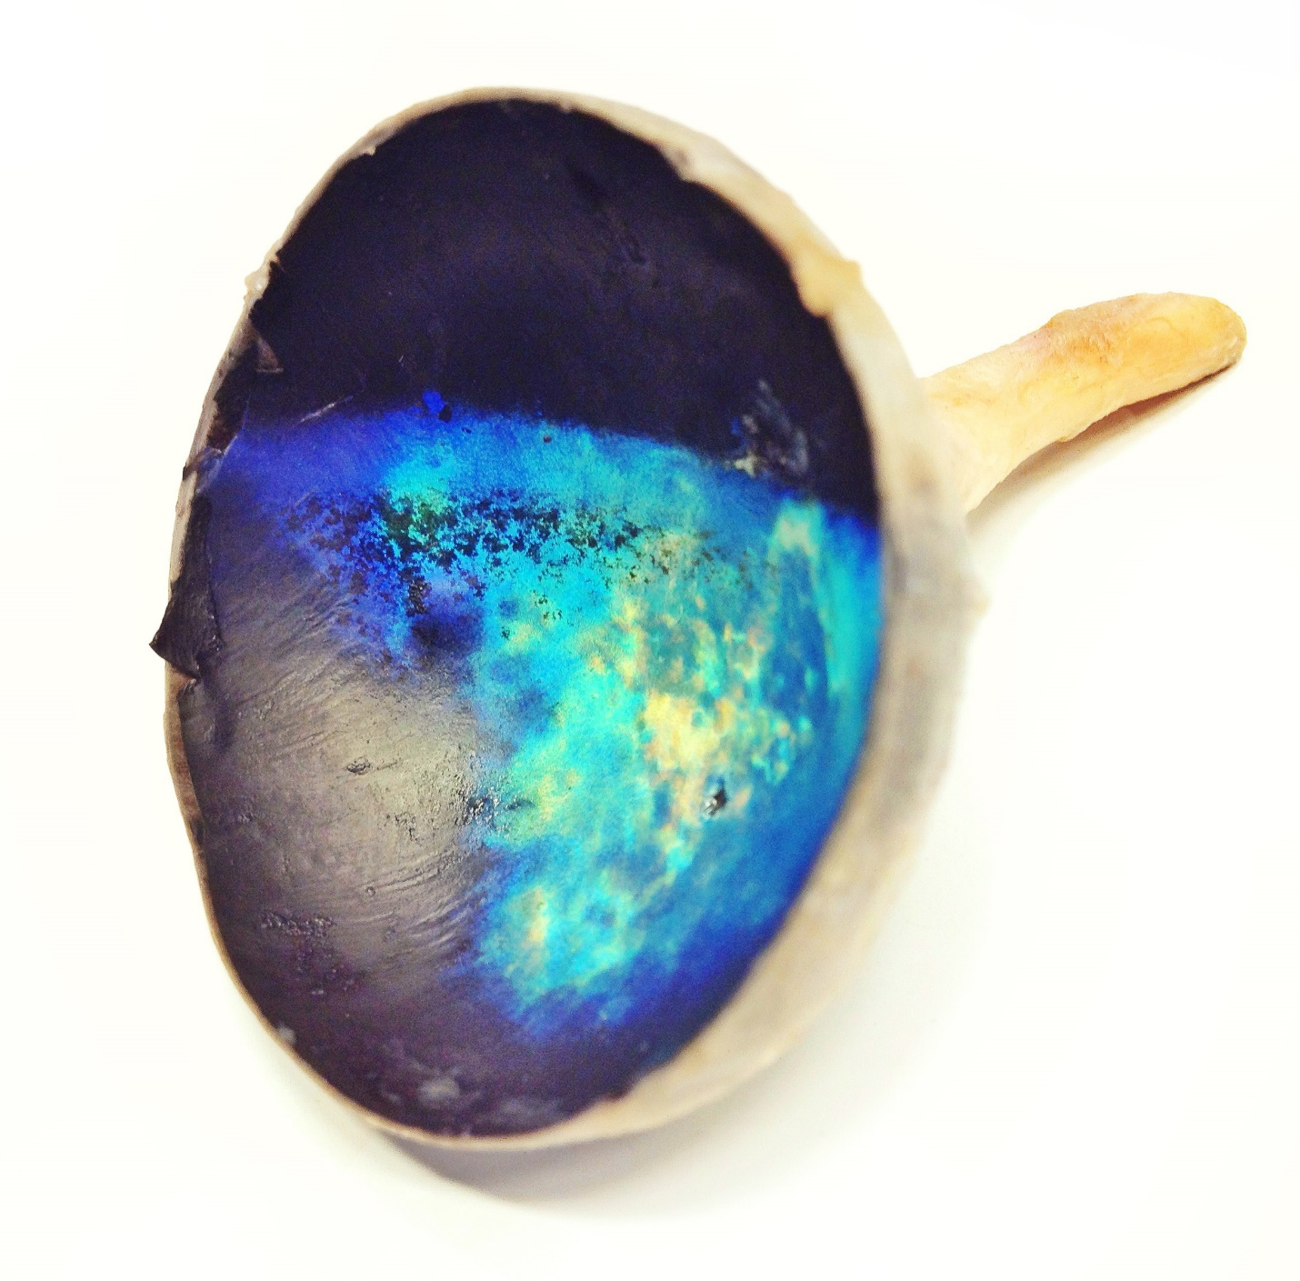
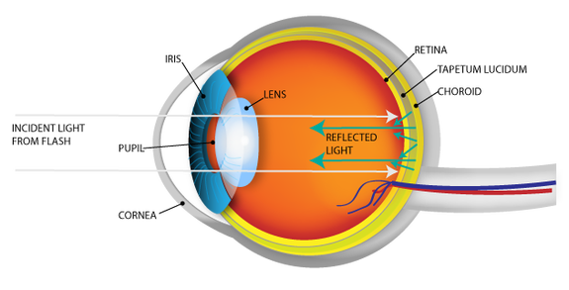
Case Study: Glow-in-the-dark Eyes
Tapetum in deer, cats, cows, etc:
Tapetum = reflective layer behind retina
Reflects light so that it travels through retina twice, is more likely to be detected
Night vision

Slide 22
Transmission: Light Passes Through
Transmission: the process in which light passes through a medium and keeps travelling
  When light passes through a material, that material is called a medium
  Different materials transmit different amounts of light
  Example: clear glass window transmits more light than a sheet of paper
Notes:
transmission: the process in which light passes through a medium and keeps travelling

Slide 23
Refraction: The Path of Light Bends
Refraction: the process in which light changes direction when it moves from one medium to another
Example: Light bends as it moves from air to water
Figure 3.21: The beam of red light allows you to see the path of light bend as it enters and leaves the water.
Notes:
refraction: : the process in which light changes direction when it moves from one medium to another

Slide 24
Discussion Questions
Use a flowchart to describe what can happen to light when it strikes an object.
The Moon is not a source of visible light. Why does it seem to glow brightly at night?

Slide 25


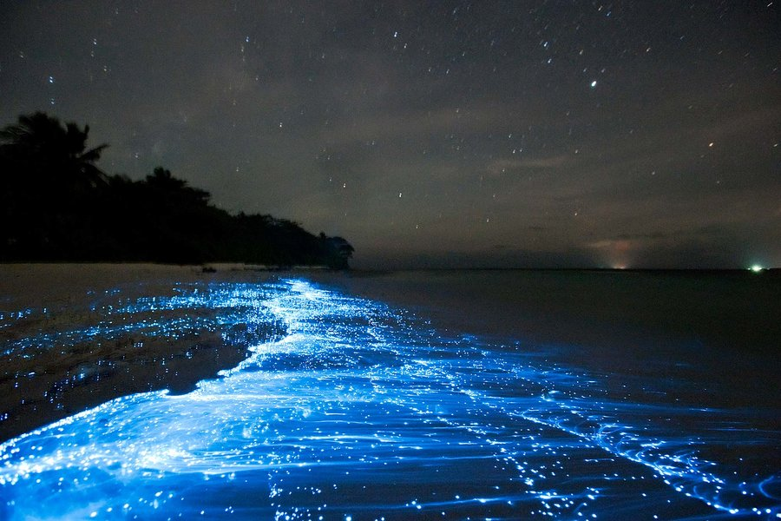
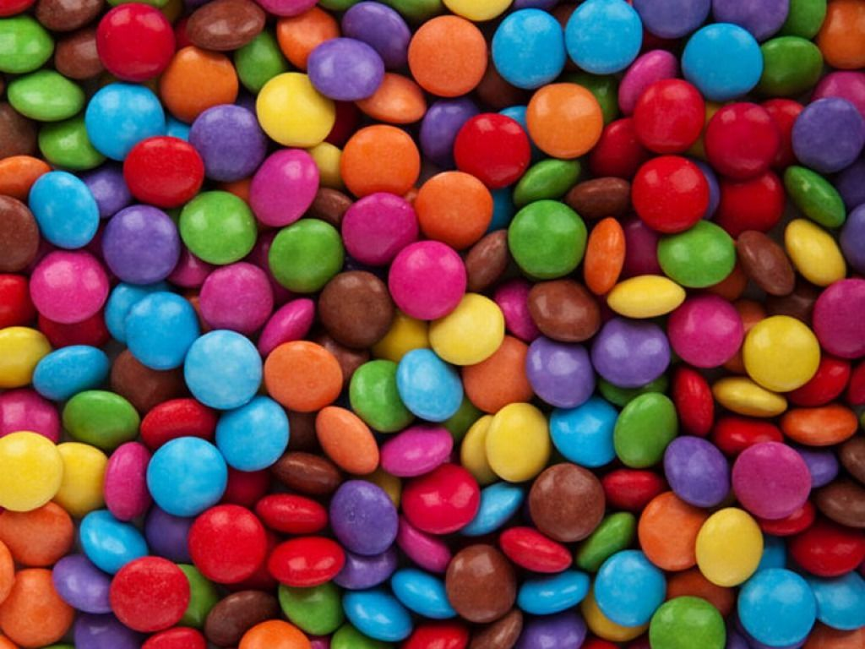
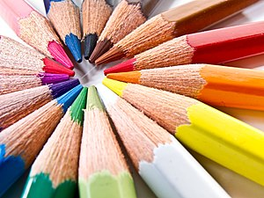
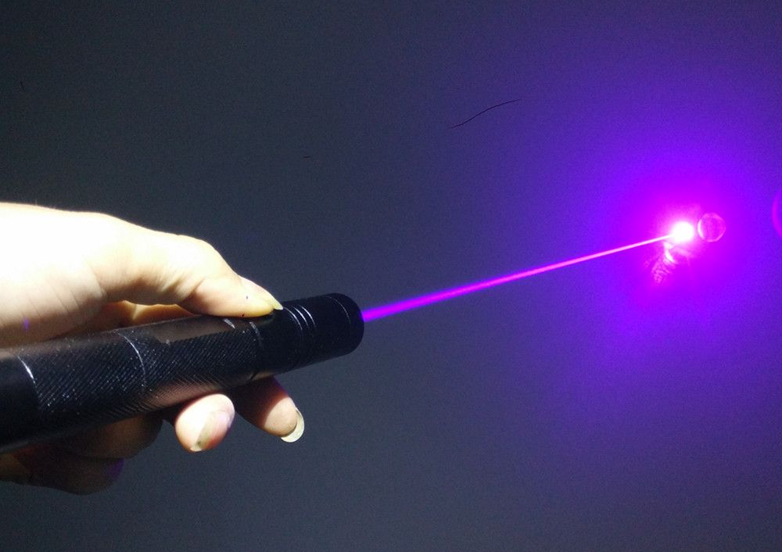
Classifying Colour
How would you describe the different types of colour that exist in our world?

Slide 26
Classifying Colour
In general, there are two ways that colour is produced.
Light sources:
  Produce light on their own
  E.g. firework, laser pointer, sun, bioluminescence
Absorb/reflect light:
  Need to be illuminated to see colour
  When illuminated by light, absorbs some wavelengths and reflects others
  E.g. flowers, hair, candy, most everyday objects
What other examples can you think of?

Slide 27
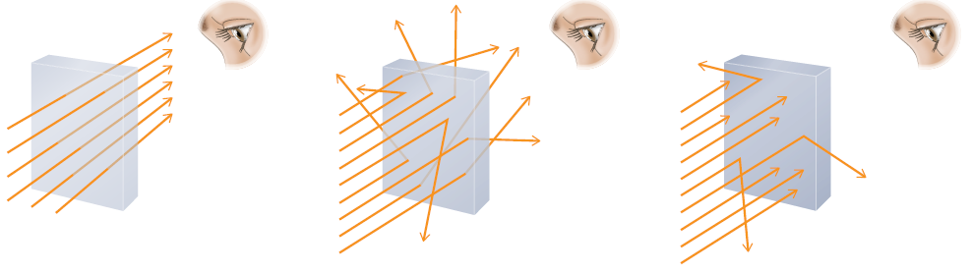
Concept 2: Light behaves differently when it encounters transparent, translucent, or opaque materials.
A material can be transparent, translucent, or opaque depending on:
  How much light it lets pass through
  How the light behaves
  If you can see through it
Figure 3.23: Light interacts with different materials in different ways.

Slide 28
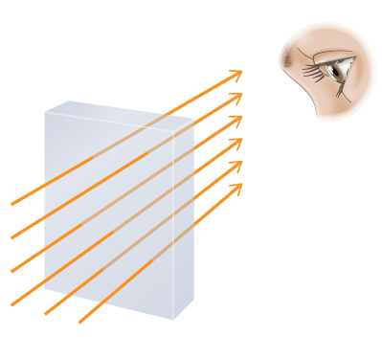
Transparent Materials Transmit Light
Transparent materials:
  Transmit almost all light rays
  Objects can be seen clearly through them
  Examples: clear glass, plastic, water, air

Slide 29

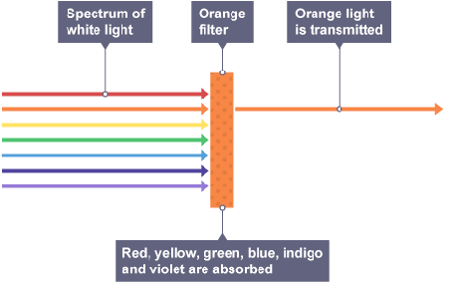
Transparent Materials Transmit Light
E.g. orange ski goggles:
  Orange light is transmitted but other colours are absorbed
  Considered transparent because image is clear, not blurry

Slide 30
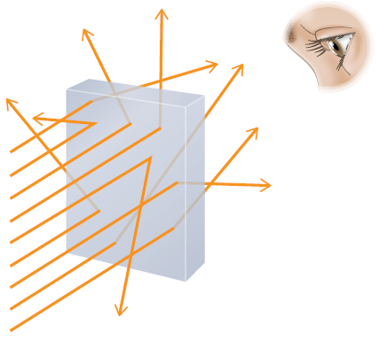
Translucent Materials Scatter Light
Translucent materials:
  Allow most light to pass through them
  Light is scatters in many directions as it passes through
  Objects seen through them are blurry
  Examples: frosted plastic, waxed paper

Slide 31
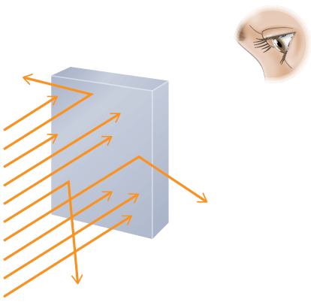
Opaque Materials Reflect and Absorb Light
Opaque materials:
  Reflect and absorb light
  Do not allow any light to pass through them
  Objects cannot be seen through them
  Examples: wood, metal, stone

Slide 32
Discussion Questions
Choose a material from your daily life.
  Is the material transparent, translucent, or opaque? How could you confirm your decisions?
  Explain how the material’s interaction with light is related to its function.

Slide 33
Discussion Questions
Some jellyfish are transparent. How might this affect their ability to survive?

Slide 34
Summary: How does light behave when it encounters different materials and surfaces?
Light can be reflected, absorbed, transmitted, or refracted.
Light behaves different when it encounters transparent, translucent, or opaque materials.

