Slide 1
BC Science Connections 9
Unit 1: The continuity of life depends on cells being derived from cells

Slide 2
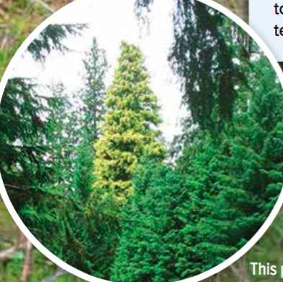
Topic 1.2: What are different ways that living things reproduce asexually?
Bacteria reproduce by binary fission.
All eukaryotic cells reproduce by the cell cycle.
Yeasts reproduce by budding.
Moulds reproduce using spores.
Plants have many ways to reproduce asexually.

Slide 3
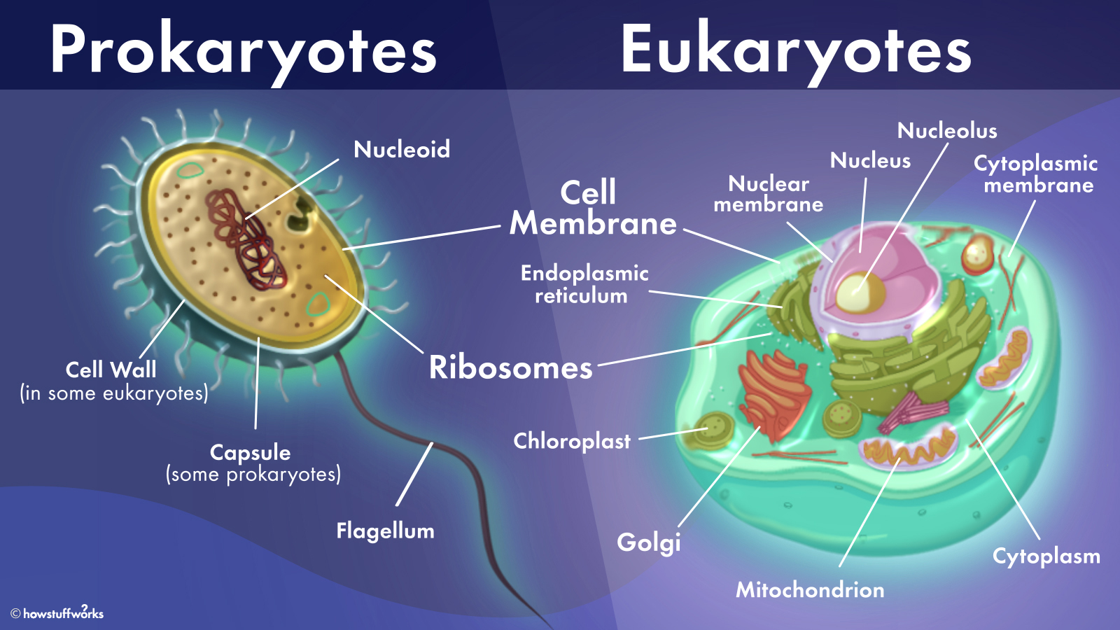
Review
What is a prokaryotic vs eukaryotic organism?

Slide 4
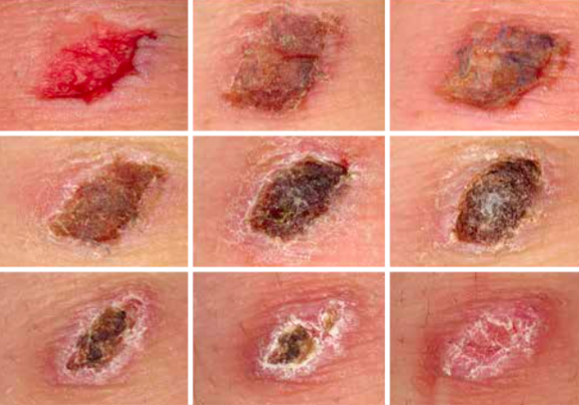
Concept 2: All eukaryotic cells reproduce by the cell cycle.
Purpose of cell division:
Replace older cells
Replace damaged cells
Produce new offspring in single-celled organisms (amoebas)
Figure 1.8: A scab forms as some of the remaining skin cells beneath the wound reproduce repeatedly to form a new skin layer to replace what was scraped away.

Slide 5
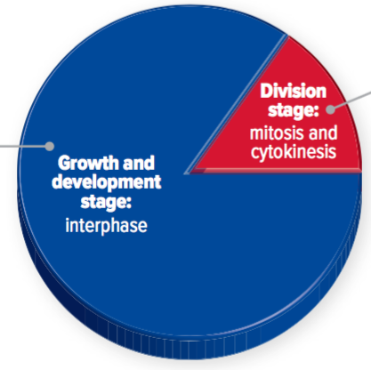
Reproduction and the Cell Cycle
The cell cycle has two stages:
1. Growth and development
Interphase (replication of DNA, regular cell activities)
2. Cell division
Mitosis (division of nucleus)
Cytokinesis (division of cytoplasm and cell membrane)
Figure 1.10: The cell cycle.

Slide 6
https://www.youtube.com/embed/gcz1FOWw0Cg?start=0&end=241

Slide 8
Chromosomes Elaborations (not in textbook)
Each chromosome has one centromere.
Chromosomes look different depending on whether DNA has been copied yet.
sister chromatids
centromere
1 Chromosome
1 chromosome before replication
1 chromosome after replication
https://microbenotes.com/chromosome-structure-types-and-functions/

Slide 9
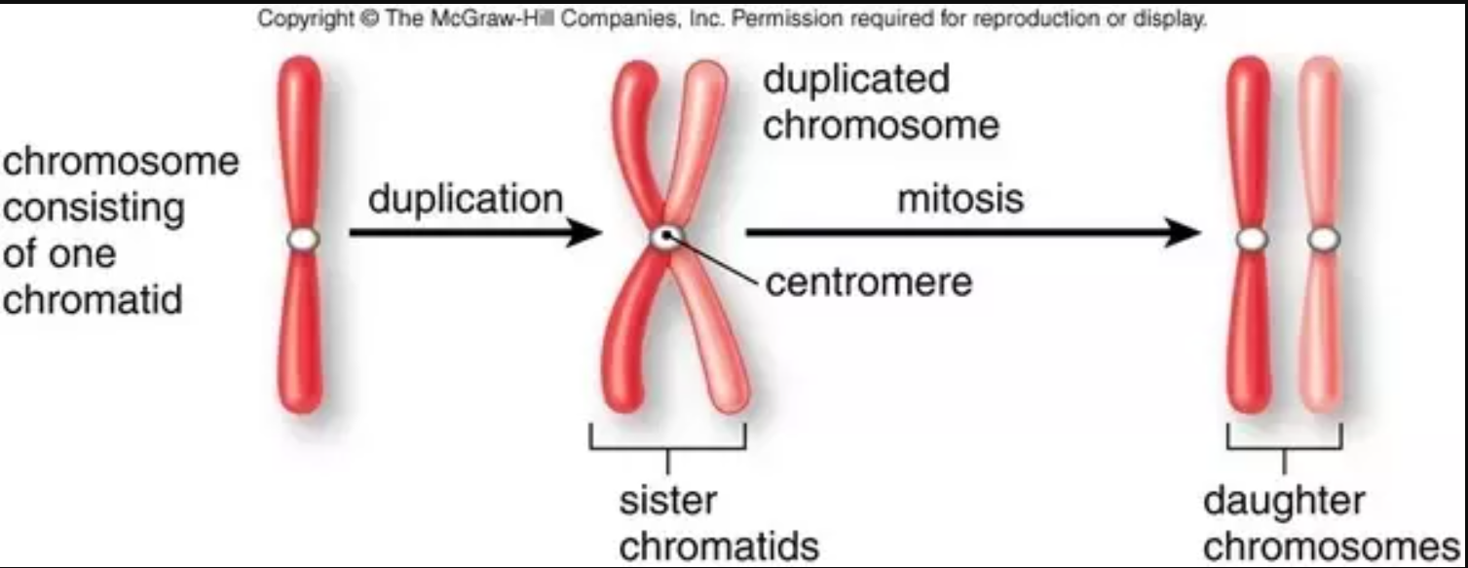
Chromosomes Elaborations (not in textbook)
Chromatid: a complete (double helix) copy of the DNA sequence that is on one chromosome
Sister chromatids: identical chromatids (same DNA sequence); formed by replication during interphase
How many chromosomes in each stage? How many chromatids?

Slide 10
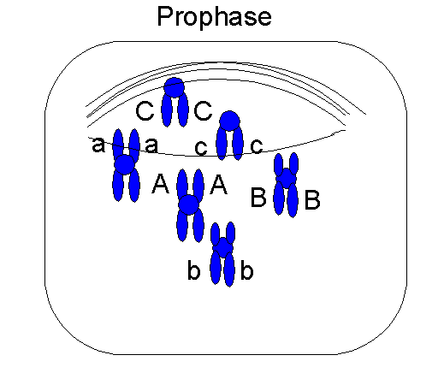
What phase? How many chromosomes? How many chromatids?
Prophase*
6 chromosomes
12 chromatids

Slide 11
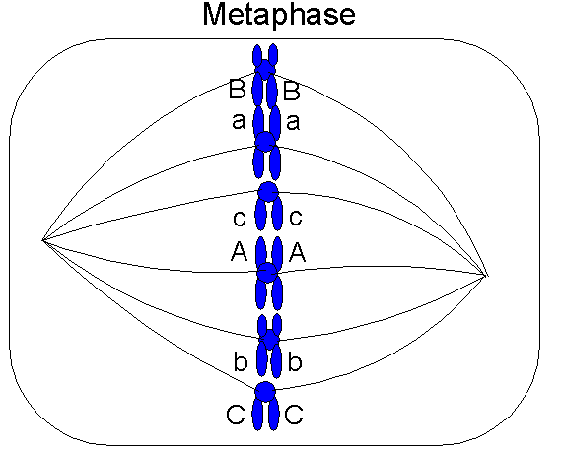
What phase? How many chromosomes? How many chromatids?
Metaphase
6 chromosomes
12 chromatids
https://datbootcamp.com/biology-strategy/chromosome-and-chromatid-numbers-during-mitosis-and-meiosis/

Slide 12
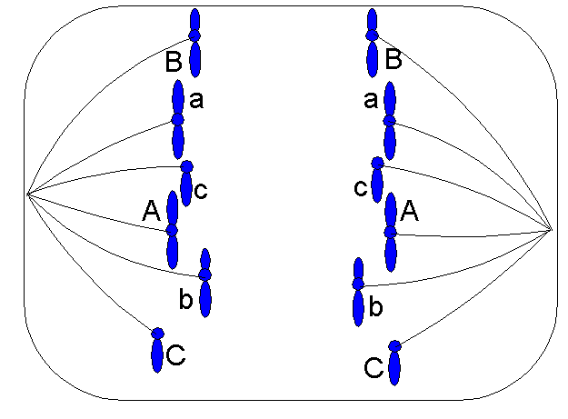
What phase? How many chromosomes? How many chromatids?
Anaphase
12 chromosomes
12 chromatids
https://datbootcamp.com/biology-strategy/chromosome-and-chromatid-numbers-during-mitosis-and-meiosis/

Slide 13
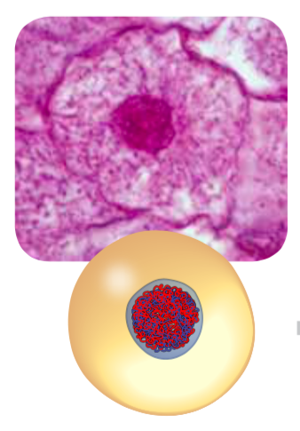
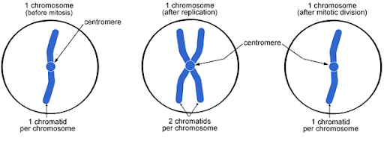
Growth and Development: Interphase
Regular cell processes (growth, number of organelles increases)
DNA (chromatin) is copied

Slide 14
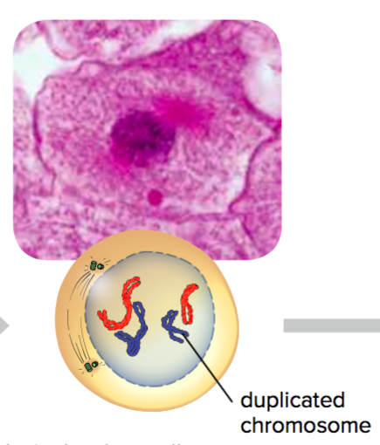
Cell Division: Phase 1 of Mitosis (Prophase)
Nuclear membrane begins to disappear
DNA condenses into chromosomes
Note about diagram: Red chromosomes from mom; blue chromosomes from dad
Each pair of chromosomes with the same shape and length contains the same gene locations: they are a homologous pair of chromosomes.

Slide 15
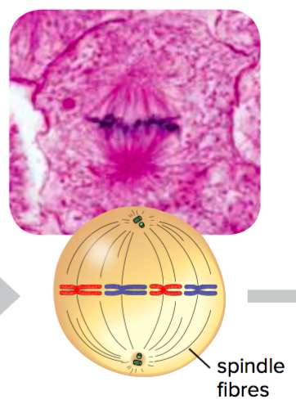
Cell Division: Phase 2 of Mitosis (Metaphase)
Spindle fibres attach to chromosome centromeres
Spindle fibers pull chromosomes to the middle of the cell

Slide 16
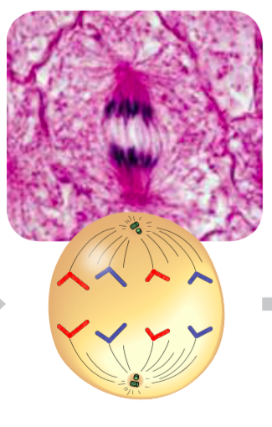
Cell Division: Phase 3 of Mitosis (Anaphase)
Spindle fibers pull chromosomes apart
Sister chromatids go to each end of the cell

Slide 17
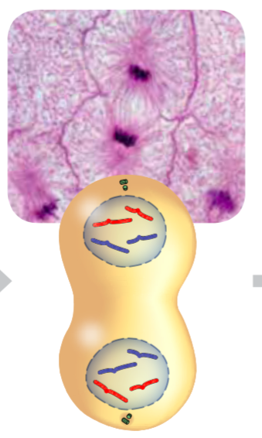
Cell Division: Phase 4 of Mitosis (Telophase)
New nuclear envelopes form around each set of chromosomes

Slide 18
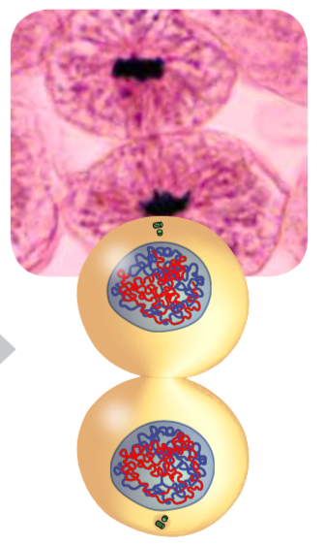
Cell Division: Cytokinesis
Cytoplasm and organelles are divided
New cell membrane (and cell wall in plant cells) forms between daughter cells
DNA unravels to form chromatin, as the cell enters interphase

Slide 19
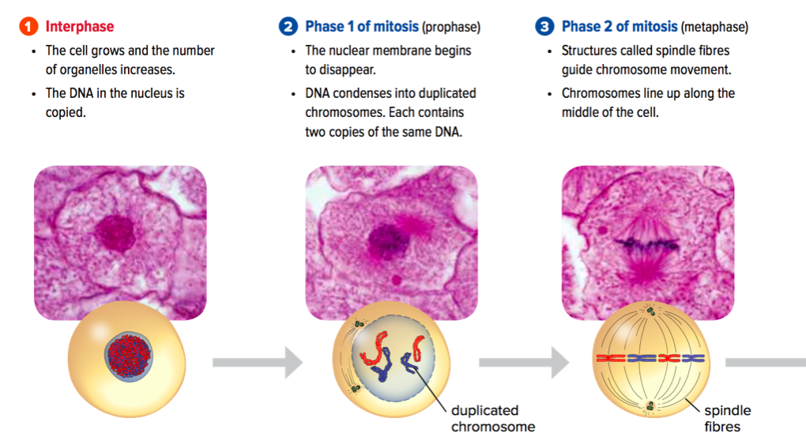
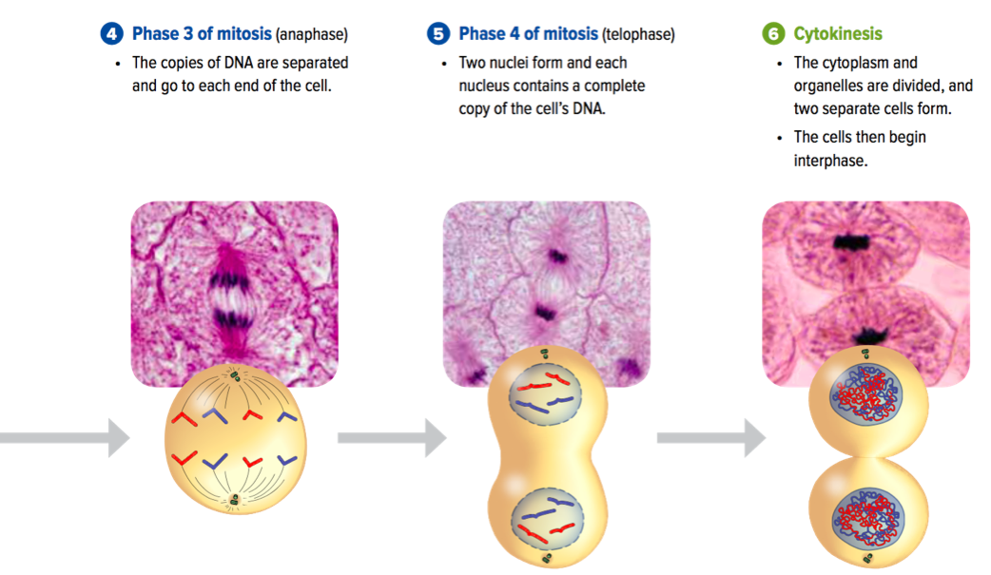
Cell Cycle Summary: Overall
Figure 1.9: Cell reproduction by mitosis results in daughter cells that are genetically identical to each other and to the parent cell.
http://cyberbridge.mcb.harvard.edu/mitosis_2.html

Slide 20
Cell Cycle Summary: Nucleus
Stage of the Cell Cycle | Nucleus
Interphase | ✓
Mitosis: Prophase | Breaks down
Mitosis: Metaphase | ✘
Mitosis: Anaphase | ✘
Mitosis: Telophase | Reforms (2 nuclei)
Cytokinesis | ✓

Slide 21
Cell Cycle Summary: DNA
Stage of the Cell Cycle | DNA Appearance | Extra Notes
Interphase | Chromatin | DNA replicates
Mitosis: Prophase | DNA condensing | 2 chromatids per chromosome
Mitosis: Metaphase | Chromosome | /
Mitosis: Anaphase | Chromosome | Sister chromatids separate; 1 chromatid per chromosome
Mitosis: Telophase | Chromosome | /
Cytokinesis | Chromatin | Each nucleus has a complete set of DNA

Slide 22
Discussion Questions
What happens to the DNA in a cell during interphase? Why is this step important for the reproduction process?
In two or three sentences, describe what the cell cycle is.

Slide 23
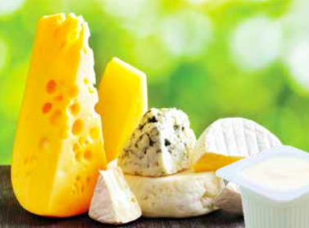
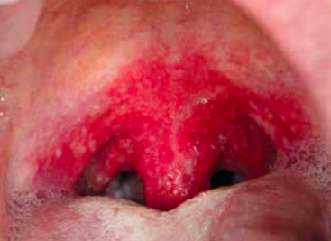
Concept 1: Bacteria reproduce by binary fission.
Bacteria: Micro-organisms that exist as single prokaryotic cells
Reproduce asexually by a process called binary fission
Note: binary fission occurs in both eukaryotic and prokaryotic organisms, but in eukaryotic organisms the process is simple mitosis.
Figure 1.6: Bacteria are in, on, and all around us. Bacteria is used in food production (left) and can cause disease, such as strep throat (right).
Notes:
binary fission: a type of asexual reproduction in which a cell splits into two daughter cells that have identical genetic information (DNA)

Slide 24
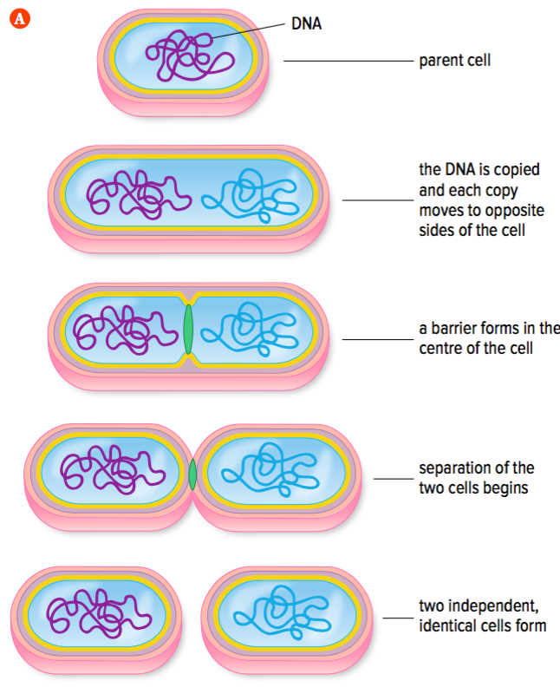
Reproduction by Binary Fission
Binary fission
Type of asexual reproduction
A parent cell splits into two individual, identical cells (daughter cells)
Daughter cells have identical genetic information (DNA)
Figure 1.7: Binary fission
Notes:
binary fission:

Slide 25
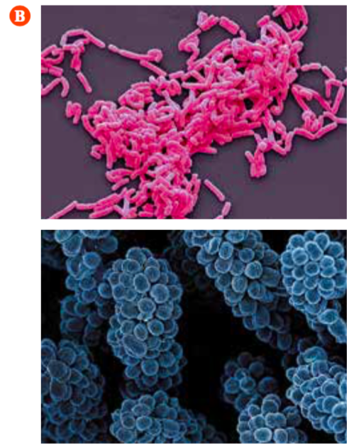
Reproduction by Binary Fission (continued)
Figure 1.7: (A) Binary fission. (B) Many types of bacteria are found as chains and clusters.
Notes:
binary fission:

Slide 26
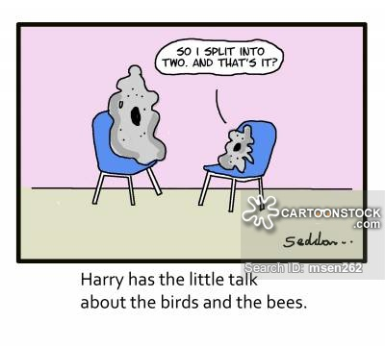
Reproduction by Binary Fission (continued)
Notes:
binary fission:

Slide 27
Discussion Questions
What key piece of evidence tells you that bacteria reproduce asexually?

Slide 28
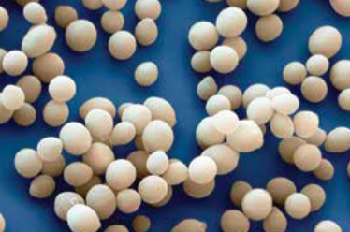
Concept 3: Yeasts reproduce by budding.
Yeasts are unicellular eukaryotic micro-organisms
Commonly used to make dough, bread, pretzels, soy sauce, cheese, vinegar
Reproduce by asexual reproduction: budding
Figure 1.11: Yeast
Notes:
budding: a type of asexual reproduction that involves the formation of an outgrowth, or bud, from a parent cell

Slide 29
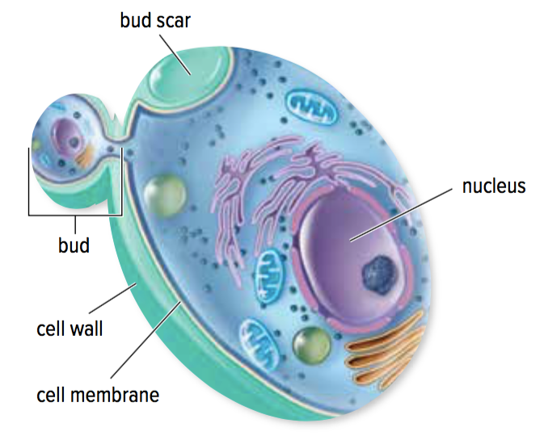
Asexual Reproduction in Yeast: Budding
Budding:
Yeast cell grows a bud that pinches off to become a separate cell
New cell is smaller than original cell at first
Eventually grows to the same size as other yeast cells
Figure 1.11: Yeasts reproduce asexually by budding.

Slide 30
Discussion Questions
In what ways is reproduction in yeasts and bacteria similar? In what ways is it different?
Why is a daughter yeast cell identical to the parent cell?

Slide 31
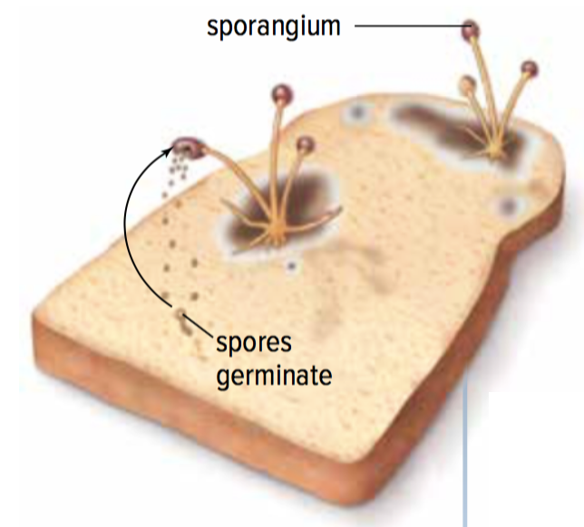
Concept 4: Moulds reproduce using spores.
Moulds are composed of many eukaryotic cells
Reproduce by asexual reproduction using spores
Figure 1.12: Moulds reproduce using spores.
Notes:
spore: a structure that produces a new organism by asexual reproduction

Slide 32
Asexual Reproduction in Moulds: Spores
Spores are released into the air from a specialized structure
When a spore lands in a favourable environment (warm, moist), it grows and divides by mitosis and cytokinesis
Figure 1.12: Moulds reproduce using spores.

Slide 33
Discussion Questions
What role do spores play in the asexual reproduction of moulds?

Slide 34
Concept 5: Plants have many ways to reproduce asexually.
Plants reproduce sexually and asexually
Asexual reproduction: Vegetative propagation
New plants grow from a portion of the roots, stems, or leaves from an existing plant
New plants are clones (copies) of the parent plant
Notes:
vegetative propagation: asexual reproduction of a plant form a part of its roots, stems, or leaves
clone: an exact copy of a cell or organism

Slide 35
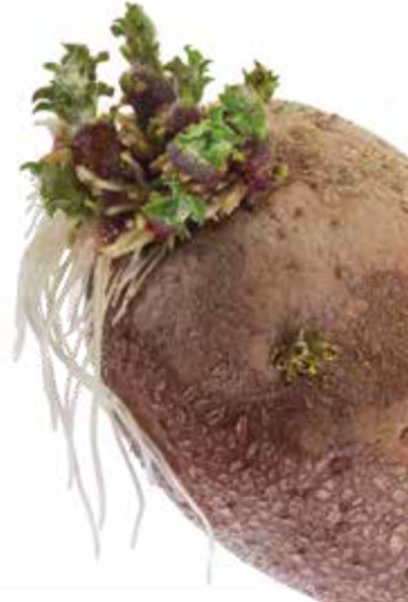
Vegetative Propagation: Example
Potatoes:
New roots and shoots grow from the eyes of a potato
If you plant a potato with this new growth, a potato plant will develop
The new plant will be identical to the parent plant
Figure 1.13

Slide 36
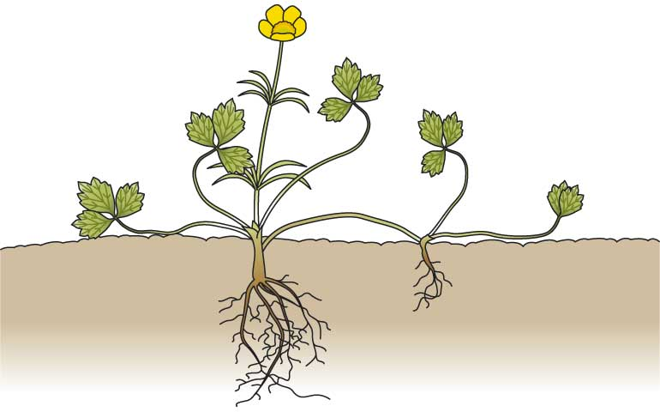
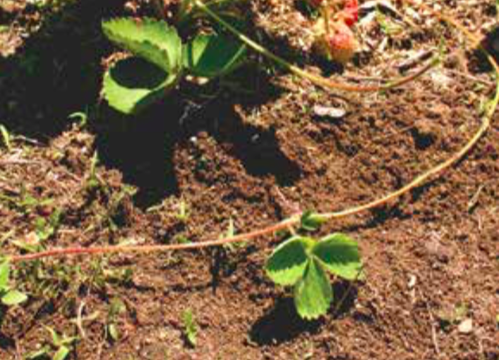
Vegetative Propagation: Example
Runners are horizontal stems that give rise to new plants
E.g. strawberries, buttercup, clover
Figure 1.13: If you look closely at a field of strawberry plants, you will see smaller plants growing near a larger plant. These smaller plants are new plants that grow along runners. Runners are like stems that grow horizontally, above the ground, from a full-grown plant. Eventually runners die, leaving independent, identical plants.
Notes:
Top: creeping buttercup
Bottom: strwaberry

Slide 37
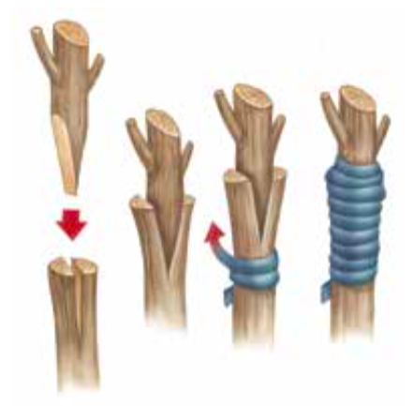
Artificial Vegetative Propagation
Artificial vegetative propagation uses techniques to produce plants with specific characteristics
Example: Grafting
A bud, stem, or root is cut from one plant and joined to another
Used to produce trees with high-quality fruit or resistance to disease

Slide 38
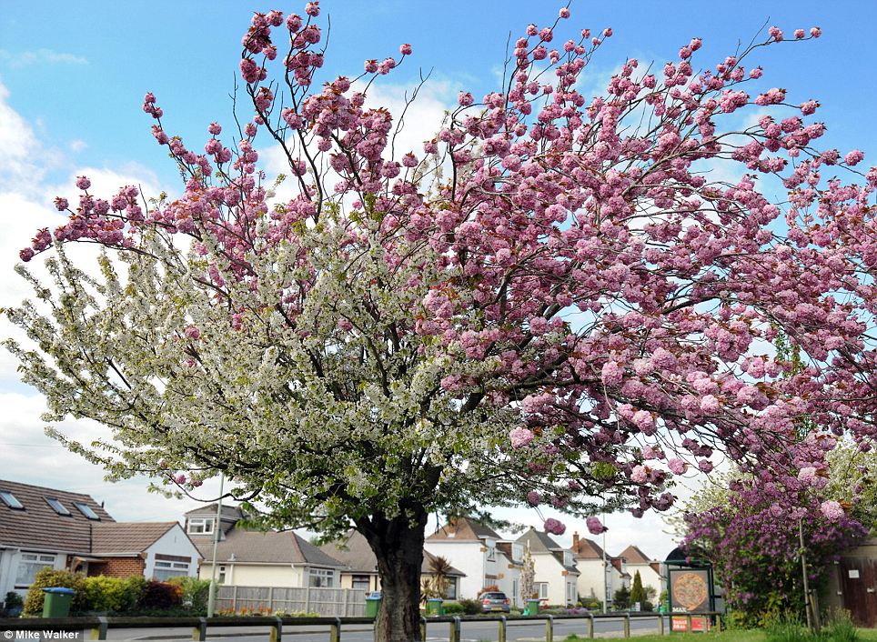

Slide 39
Discussion Questions
Describe an example of vegetative propagation.
Why are new strawberry plants that form from runners identical to the parent plant?

Slide 40
Topic 1.2 Summary: What are different ways that living things reproduce asexually?
Bacteria reproduce by binary fission.
All eukaryotic cells reproduce by the cell cycle.
Yeasts reproduce by budding.
Moulds reproduce using spores.
Plants have many ways to reproduce asexually.

Slide 41
Chromosomes Elaborations (not in textbook)
DNA is replicated during interphase.
Chromatid: a complete (double helix) copy of the DNA sequence that is on one chromosome.
Before replication, each chromosome is one chromatid.
After replication, each chromosome is made of two identical sister chromatids connected by a single centromere.

Slide 42
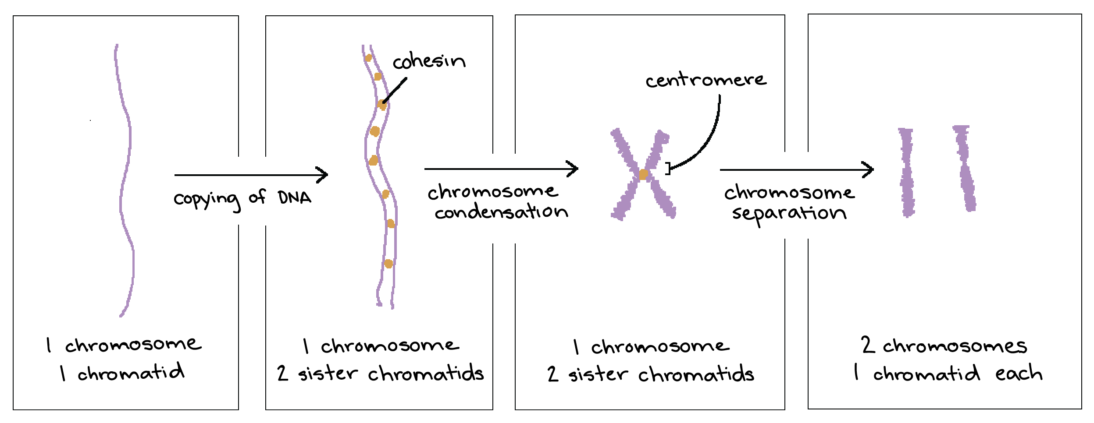
Chromosomes Elaborations (not in textbook)
https://www.khanacademy.org/science/high-school-biology/hs-reproduction-and-cell-division/hs-chromosome-structure-and-numbers/a/dna-and-chromosomes-article

Slide 43
Chromosomes Elaborations (not in textbook)
Sister chromatids
Chromosomes come in different shapes and sizes.
Each chromosome has one centromere.
Centromere
Chromosome
https://microbenotes.com/chromosome-structure-types-and-functions/

Slide 44
Chromosomes Elaborations (not in textbook)
DNA is replicated during interphase.
https://www.khanacademy.org/science/high-school-biology/hs-reproduction-and-cell-division/hs-chromosome-structure-and-numbers/a/dna-and-chromosomes-article
Notes:
Number of chromosomes remains the same
What changes is the amount of DNA

Slide 45
Chromosomes Elaborations (not in textbook)
Note: sister chromatids have exactly the same DNA sequence.
(This is different from homologous chromosomes, which will differ slightly from each other. Stay tuned.)

