Slide 1
BC Science Connections 9
Unit 1: The continuity of life depends on cells being derived from cells

Slide 2
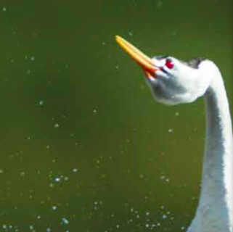
Topic 1.3: How do living things sexually reproduce?
Male and female reproductive cells combine to produce a zygote.
Reproductive cells are formed by meiosis.
Development of the human zygote occurs in stages.
Sexual reproduction takes many forms.

Slide 3
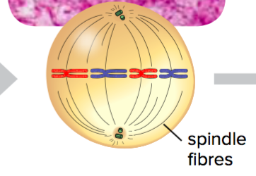
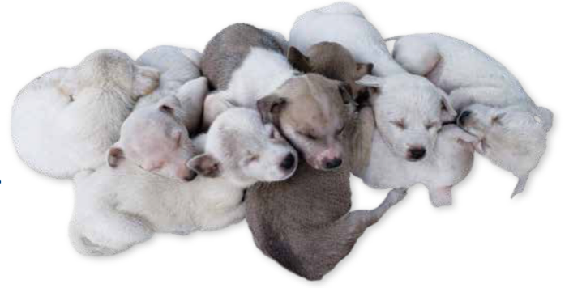
Concept 1: Male and female reproductive cells combine to produce a zygote.
Animals and many other living things reproduce sexually
Half of an offspring’s DNA is from the female parent
Other half is from the male parent
Figure 1.14: In sexual reproduction, each of the two parents contributes characteristics to the offspring. What do you think the male and female parents of this litter might look like? What is your reasoning?

Slide 4
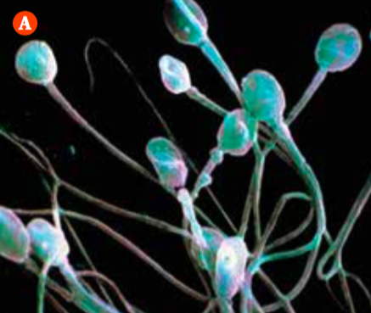
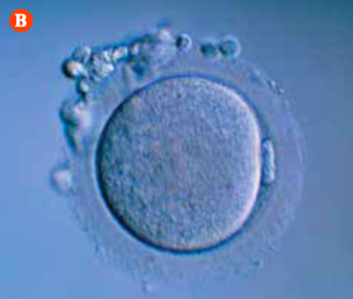
Sex Cells: Gametes
Sex cells (gametes):
Male or female reproductive cells; the cells that combine during sexual reproduction
Male gamete: sperm cell produced in testes
Female gamete: egg cell (ovum) produced in ovaries
Figure 1.15: A) Sperm cells have a unique look, with their long “tails” or flagella. B) Egg cells are much bigger than sperm cells and lack flagella. What does the presence or absence of flagella on sex cells tell you about their mobility?
Notes:
gamete: male or female reproductive cell

Slide 5
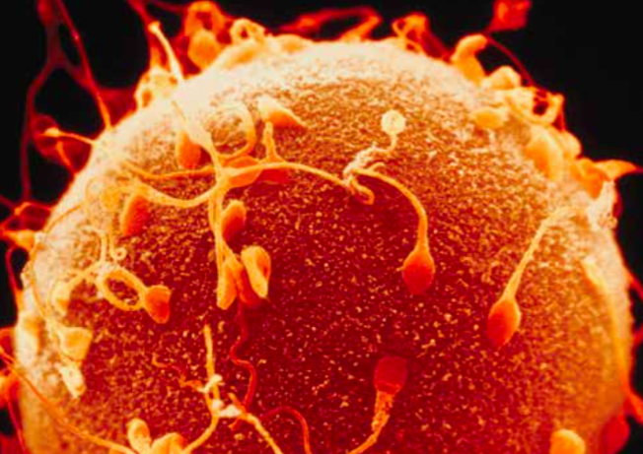
Sex Cells: Gametes (continued)
Central event of sexual reproduction:
Contact between the gametes (sperm and egg)
Sperm and egg (and their genetic information) combine to produce a new single cell that develops into an offspring
Figure 1.16: Of the many sperm that approach and surround an egg, only one can fertilize the egg.

Slide 6
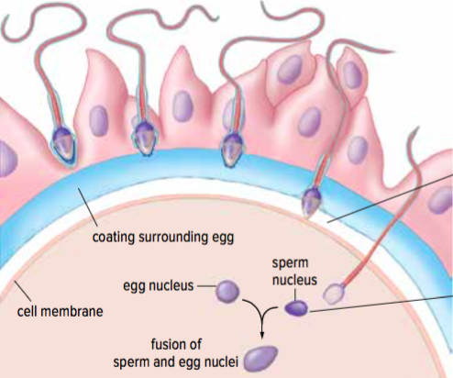
Fertilization
Fertilization: the process in which male and female gametes combine
Nuclei of two gametes fuse together to form a single cell called a zygote
Zygote contains genetic information from the sperm cell and egg cell
Figure 1.17: When a sperm cell fertilizes an egg cell, the two nuclei fuse and a zygote forms.
Notes:
fertilization: the process in which male and female gametes combine

Slide 7
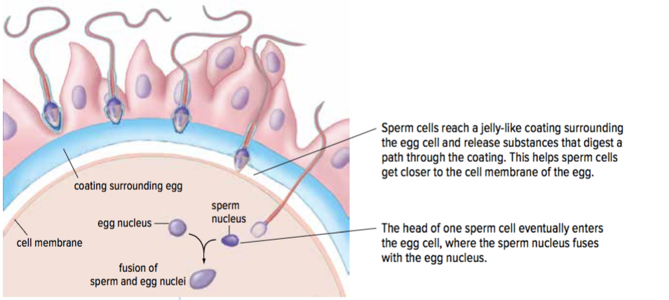
Fertilization (continued)
Figure 1.17: When a sperm cell fertilizes an egg cell, the two nuclei fuse and a zygote forms.

Slide 8
Discussion Questions
How does the process of fertilization occur?
What is needed for fertilization to occur?

Slide 9
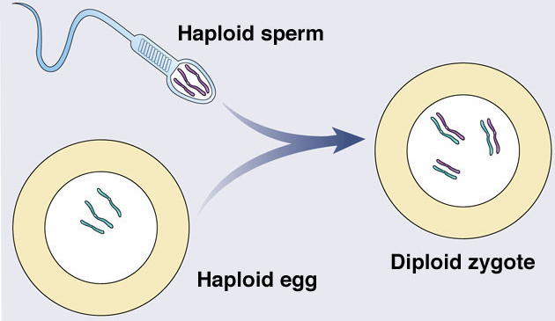
Warm-up
What process is shown here?
What do you suppose ‘haploid’ and ‘diploid’ mean?

Slide 10
Number of Chromosomes in Cells: Haploid and Diploid
Haploid (n): cells with half the normal number of chromosomes (e.g. gametes)
Diploid (2n): cells with the normal number of chromosomes (all other body cells: e.g. skin cells, brain cells, etc.)

Slide 11
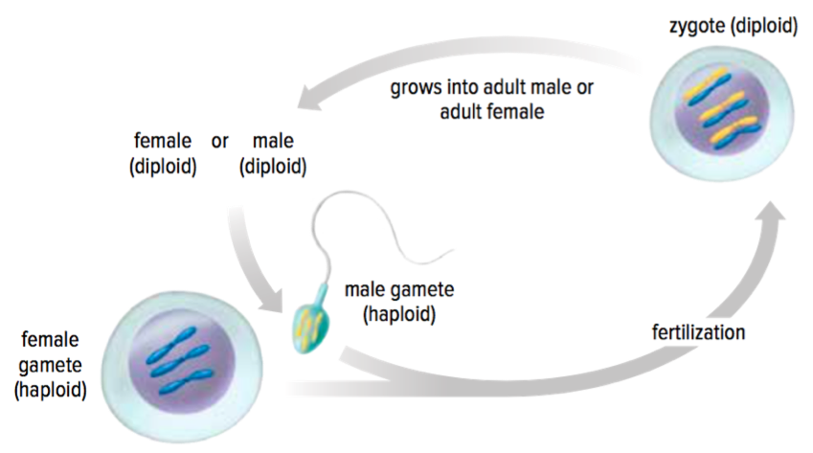
Number of Chromosomes in Cells: Haploid and Diploid
In fertilization, two haploid gametes fuse into a diploid zygote which undergoes mitosis.
The result is a human with [mostly] diploid cells.

Slide 12
Number of Chromosomes in Cells: Haploid and Diploid
Different species have different numbers of chromosomes.
The diploid number of chromosomes is always twice that of the haploid number. The haploid number of chromosomes is always half that of the diploid number.
Extra Practice/Research:
Workbook pg 25
How many chromosomes does your favourite living organism have?
Research triploid, tetraploid, etc. organisms.

Slide 13
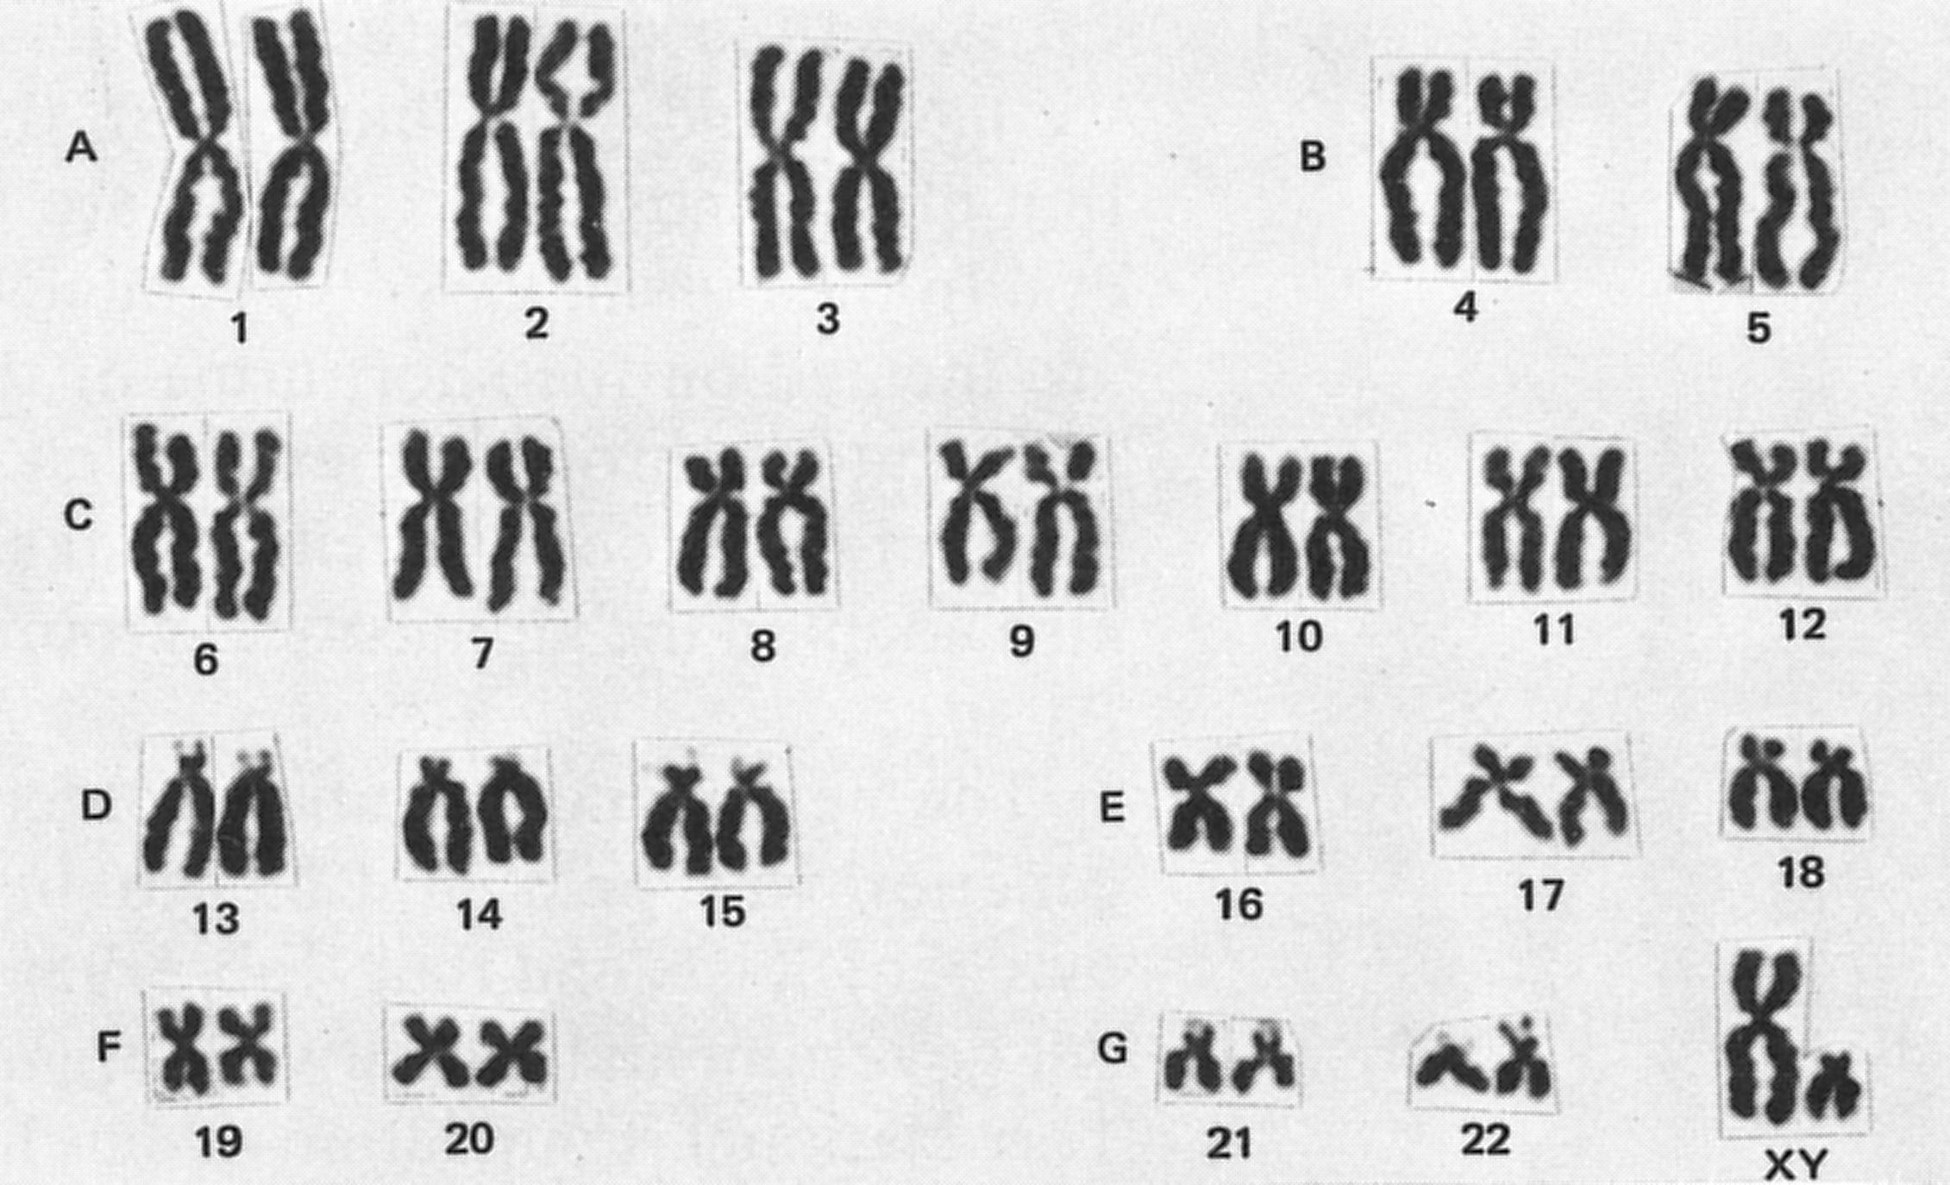
Chromosome Organization
How many chromosomes do humans have? How have chromosomes been paired up in this karyotype (picture of all chromosomes)?

Slide 14
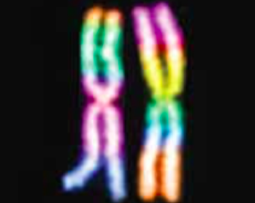
Chromosome Organization
Humans have 46 chromosomes (23 pairs)
Paired chromosomes are called homologous chromosomes
During fertilization, each parent contributes one chromosome of each pair
Figure 1.18: In a pair of homologous chromosomes, the female parent contributes one chromosome, and the male parent contributes the other.

Slide 15
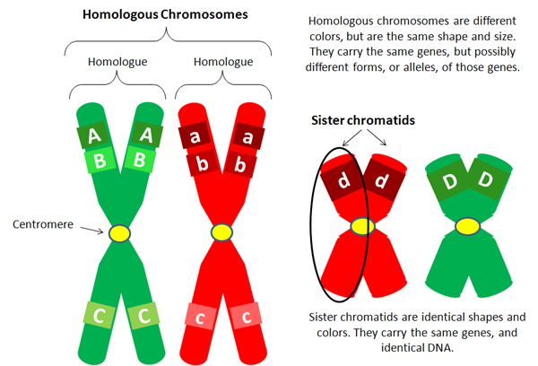
Chromosome Organization
Homologous chromosomes share:
Same chromosome length
Same centromere position
Very similar (but not identical) genetic information
How are homologous chromosomes and sister chromatids different?
https://en.wikiversity.org/wiki/File:Homologous_chromosomes.png
Notes:
haploid: a cell with half the number of chromosomes as the parent cell
diploid: a cell with a complete set of chromosomes

Slide 16
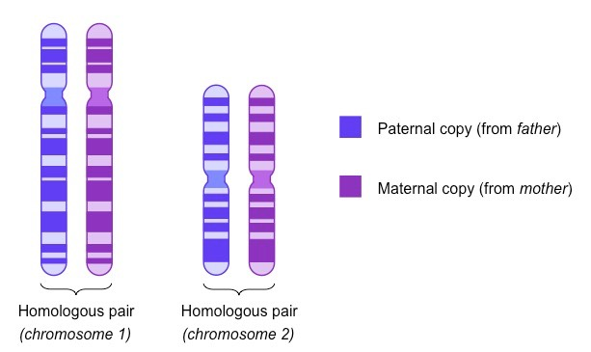
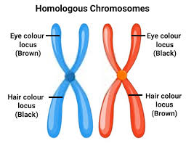
Chromosome Organization
https://www.toppr.com/content/story/amp/chromosomes-397/
https://ib.bioninja.com.au/standard-level/topic-3-genetics/32-chromosomes/homologous-pairs.html

Slide 17
Practice!
At what stage(s) of the cell cycle is DNA in the form of chromatin?
Draw and label:
One replicated chromosome (circle one of the sister chromatids)
One unreplicated chromosome
One pair of homologous chromosomes, replicated

Slide 18
Practice!
At what stage(s) of the cell cycle is DNA in the form of chromatin?
interphase
Draw and label:
One replicated chromosome (circle one of the sister chromatids)

Slide 19
Practice!
Draw and label:
One unreplicated chromosome
One pair of homologous chromosomes, replicated

Slide 20
Practice: Chromosomes
Draw homologous chromosomes using the diagrams below as guides. Label chromatids, sister chromatids, and centromeres. a) b)
What is wrong with this picture?
Sister chromatids and homologous chromosomes are often confused. How will you remember the difference?
https://microbenotes.com/chromosome-structure-types-and-functions/

Slide 21
Practice: Chromosomes
Draw homologous chromosomes using the diagrams below as guides. Label chromatids, sister chromatids, and centromeres. a) b)
What is wrong with this picture?
Sister chromatids and homologous chromosomes are often confused. How will you remember the difference?
sister chromatids
centromere
chromatid
sister chromatids
In a replicated chromosome, the two copies need to be identical sister chromatids. This picture uses different colours for the copies, suggesting that they are homologous, which makes no sense. If they are connected with a centromere, they must have the same DNA sequence…same colour, same length, same genes.
Answers will vary.
Homologous chromosomes are a pair of chromosomes (two centromeres). They are very similar but their DNA sequences are not identical. They contain important differences that affect biodiversity (e.g. why your siblings look different).
They make up a single replicated chromosome (one centromere). Sister chromatids have identical DNA sequences. During mitosis, sister chromatids split and form two identical chromosomes…one for each of the identical daughter cells.
https://microbenotes.com/chromosome-structure-types-and-functions/

Slide 22
Pause!
Make sure you have the following words in your notes, and are able to define, differentiate, and identify them.
DNA
Chromatin
Chromatid
Chromosome
Centromere
Homologous chromosome
Replicated chromosome

Slide 23
https://www.youtube.com/watch?v=mBq1ULWJp_M

Slide 24
Meiosis

Slide 25
Number of Chromosomes in Cells: Haploid and Diploid (continued) (RECAP)
Figure 1.19: When haploid gametes combine together, they form the diploid zygote.
How do diploid organisms produce haploid gametes?
Notes:
Remember that in mitosis, you end up with exactly the number of chromosomes you began with.

Slide 26
Meiosis Produces Unique Gametes
Cells that produce gametes undergo a type of cell division called meiosis
Meiosis: a diploid cell divides twice to produce four haploid cells
Meiosis I: separates homologous pairs to produce two haploid cells
Meiosis II: separates sister chromatids to produce four haploid cells (looks similar to mitosis)
Result: each gamete is unique; offspring produced by sexual reproduction are unique

Slide 27
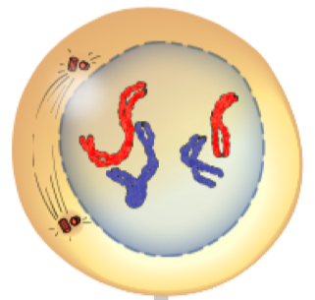
Meiosis: Prophase I
Nuclear membrane begins to disappear
DNA condenses into duplicated chromosomes
Homologous chromosomes are paired

Slide 28
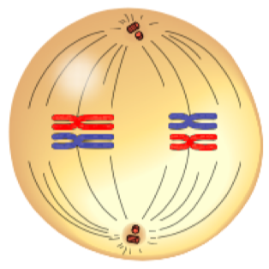
Meiosis: Metaphase I
Spindle fibres guide chromosome movement
Homologous chromosome pairs line up along the middle of the cell

Slide 29
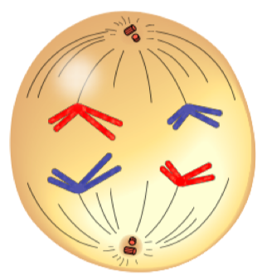
Meiosis: Anaphase I
Homologous chromosome pairs separate and go to each end of the cell

Slide 30
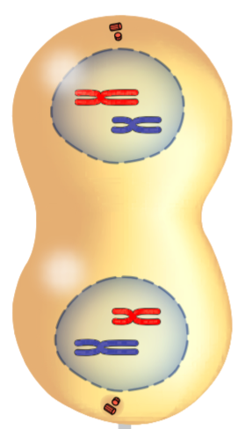
Meiosis: Telophase I
Two nuclei form
Each nucleus contains one set of chromosomes (haploid)
Cell divides, forming two cells

Slide 31
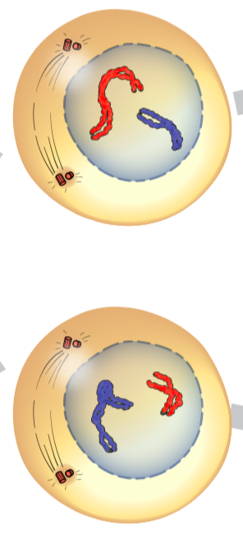
Meiosis: Prophase II
Nuclear membrane begins to disappear
DNA exists as chromosomes

Slide 32
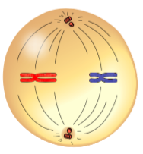
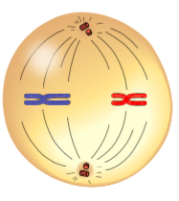
Meiosis: Metaphase II
Chromosomes line up along the middle of the cell

Slide 33
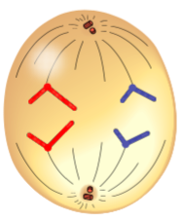
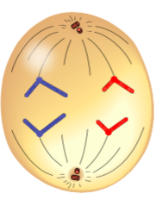
Meiosis: Anaphase II
Copies of DNA are separated and go to each end of the cell

Slide 34
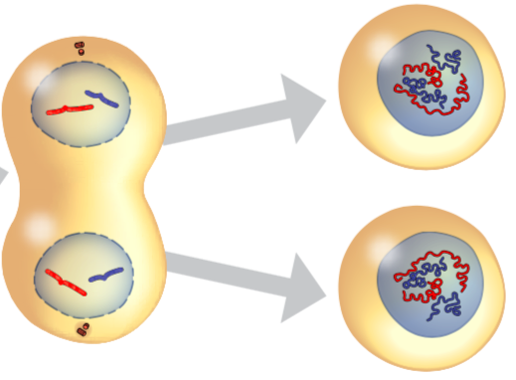
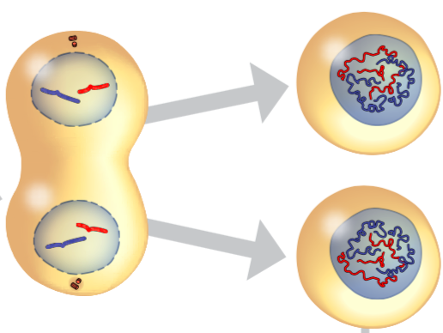
Meiosis: Telophase II
Four nuclei form
Cell divides, forming four new cells

Slide 35
Meiosis: First Cell Division Summary
Figure 1.20: Meiosis produces four haploid cells from one diploid cell. These haploid cells are the gametes that take part in sexual reproduction.

Slide 36
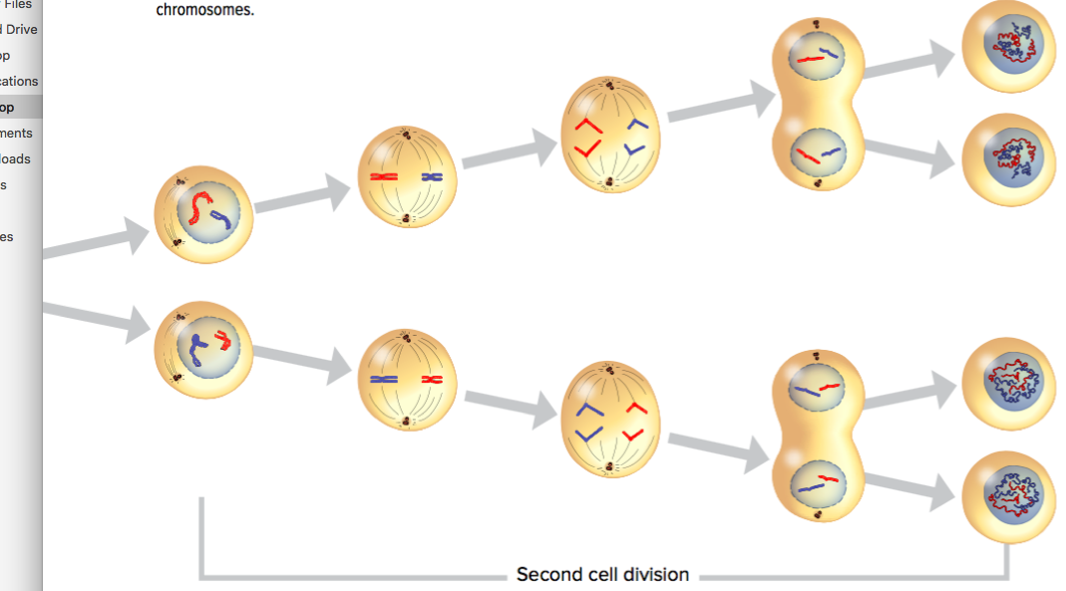
Meiosis: Second Cell Division Summary
Figure 1.20: Meiosis produces four haploid cells from one diploid cell. These haploid cells are the gametes that take part in sexual reproduction.

Slide 37
Discussion Questions
What role does meiosis play in sexual reproduction?
Use a graphic organizer to show how meiosis is similar to and different from mitosis.

Slide 38
Concept 3: Development of the human zygote occurs in stages.
Human prenatal (before birth) development begins when fertilization occurs
Within 30 hours: Zygote divides by mitosis
Cell division continues rapidly
Mass of dividing cells travels and implants to the lining of the uterus
Figure 1.21: In the first stages of cell division, the overall size of the zygote stays the same.

Slide 39
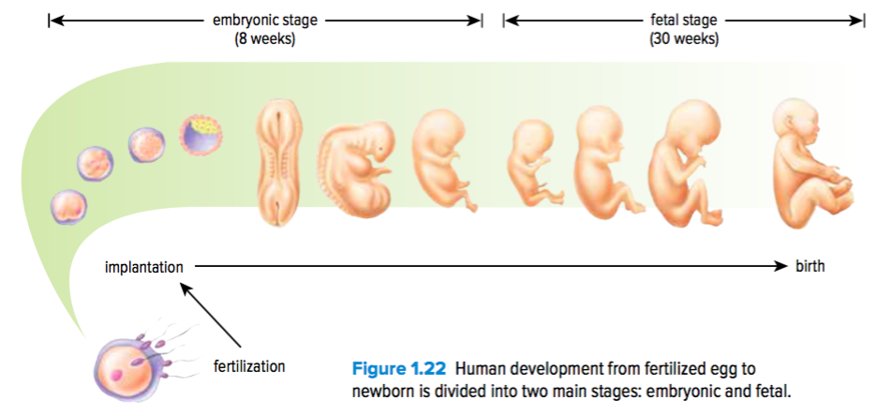
Human Prenatal Development: Embryonic and Fetal Stages
Embryonic stage: 8 weeks
Fetal stage: 30 weeks
Total: 38 weeks from fertilization to birth
Figure 1.22: Human development from fertilized egg to newborn is divided into two main stages: embryonic and fetal.

Slide 40
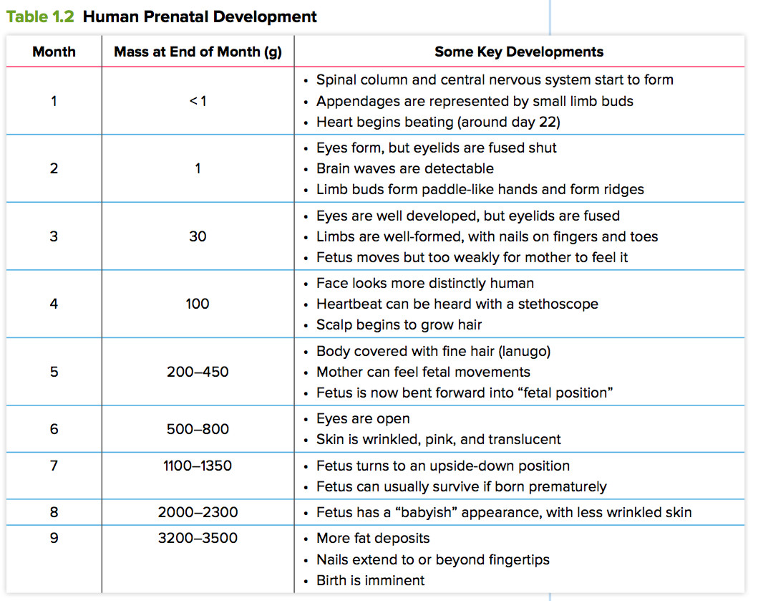
Human Prenatal Development: Summary

Slide 41
Discussion Questions
During which part of human development are cells dividing by meiosis? by mitosis?
On page 52, the words divides and multiplies are both used in describing prenatal development. Explain why this isn’t as confusing as it might seem at first.

Slide 42
Concept 4: Sexual reproduction takes many forms.
Sexual reproduction can vary based on:
Reproductive behaviours
Methods of fertilization
Ways that offspring develop

Slide 43
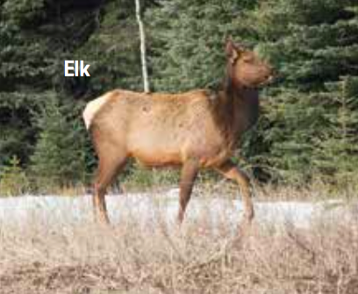
Sexual Reproduction Features: Mammals
Development from fertilized egg to offspring occurs inside the female
Female is also source of nourishment

Slide 44
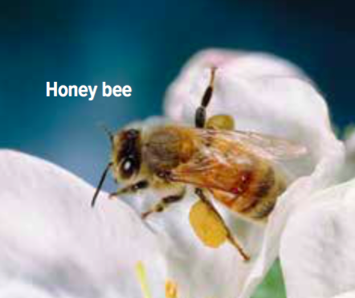
Sexual Reproduction Features: Insects
Reproduction in insects is usually sexual
Some insects (bees) develop without fertilization:
Unfertilized eggs become males
Fertilized eggs become females

Slide 45
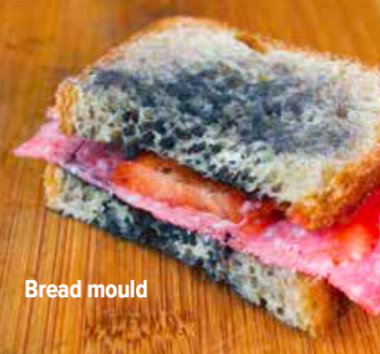
Sexual Reproduction Features: Fungi
Fungi (yeasts, moulds) reproduce sexually and asexually

Slide 46
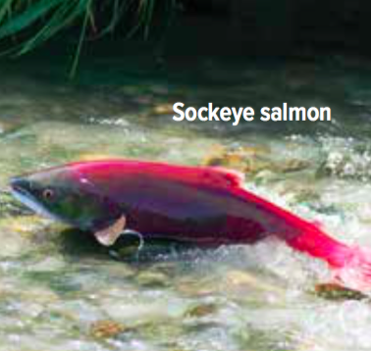
Sexual Reproduction Features: Fish, Frogs, and Birds
Fertilized eggs develop offspring outside the female’s body
Offspring are released when eggs hatch

Slide 47
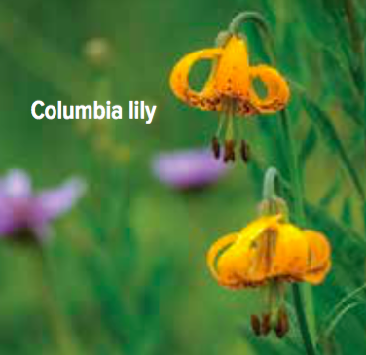
Sexual Reproduction Features: Plants
Plants the grow from seeds require pollination for fertilization
Pollen can be transferred by the wind or by animals (bees, birds)

Slide 48
Discussion Questions
Identify three ways that sexual reproduction differs in different organisms.
What do all forms of sexual reproduction have in common?

Slide 49
Topic 1.3 Summary: How do living things sexually reproduce?
Male and female reproductive cells combine to produce a zygote.
Reproductive cells are formed by meiosis.
Development of the human zygote occurs in stages.
Sexual reproduction takes many forms.

