Slide 1
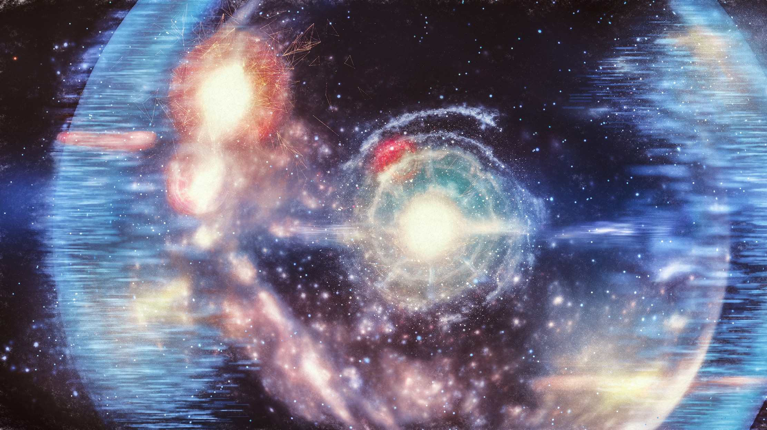
The Big Bang Theory

Slide 2
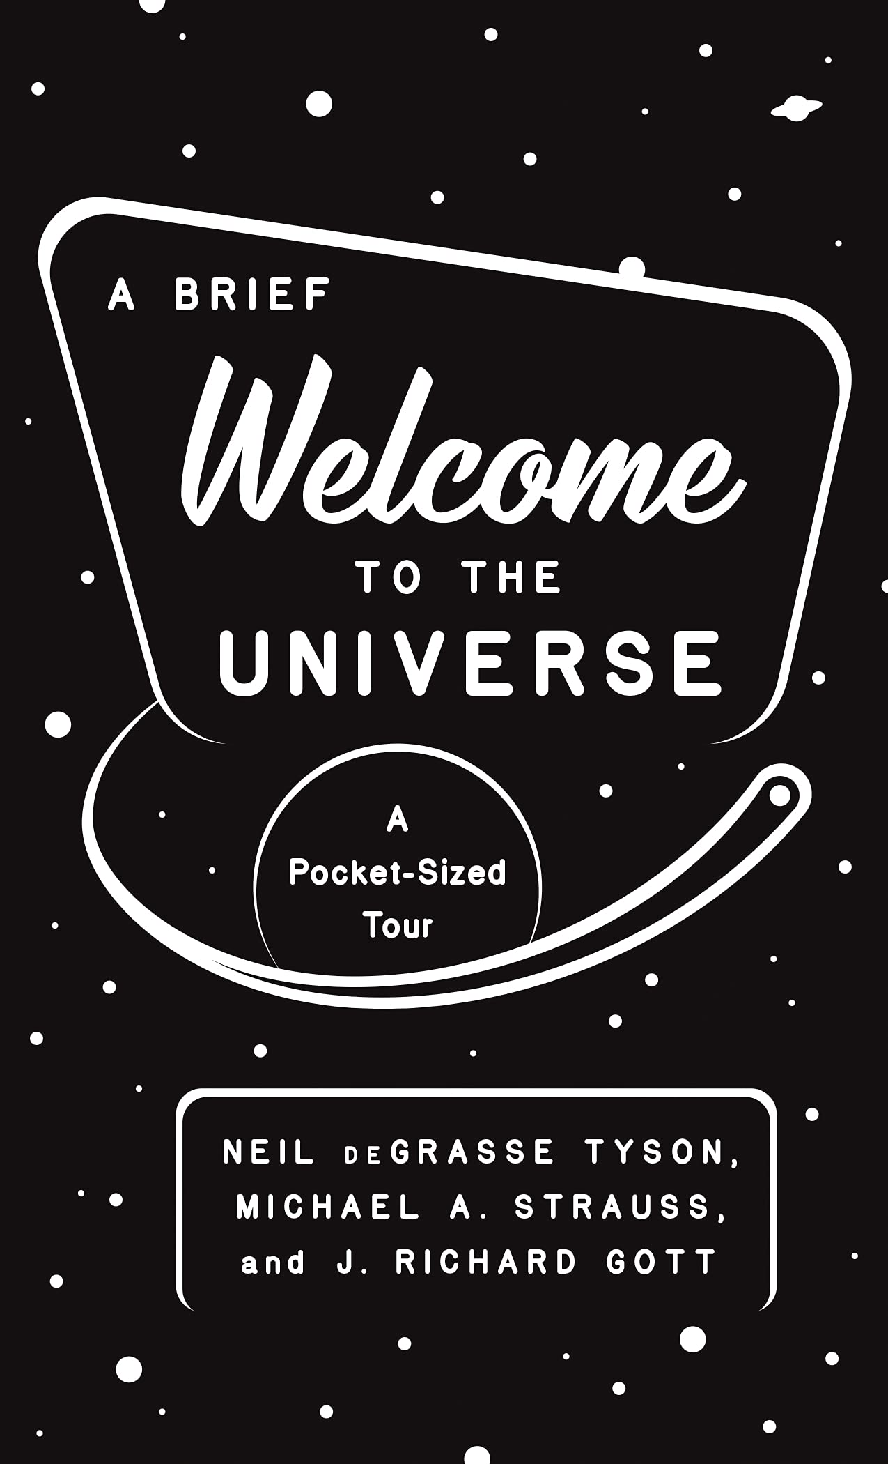
Brought to you by…
A really good read! I thoroughly enjoyed chapters 1-6 in particular (not a fan of 7-8…sorry JRG); this powerpoint is based on chapter 6: “Galaxies and the Big Bang” by Michael A. Strauss

Slide 3
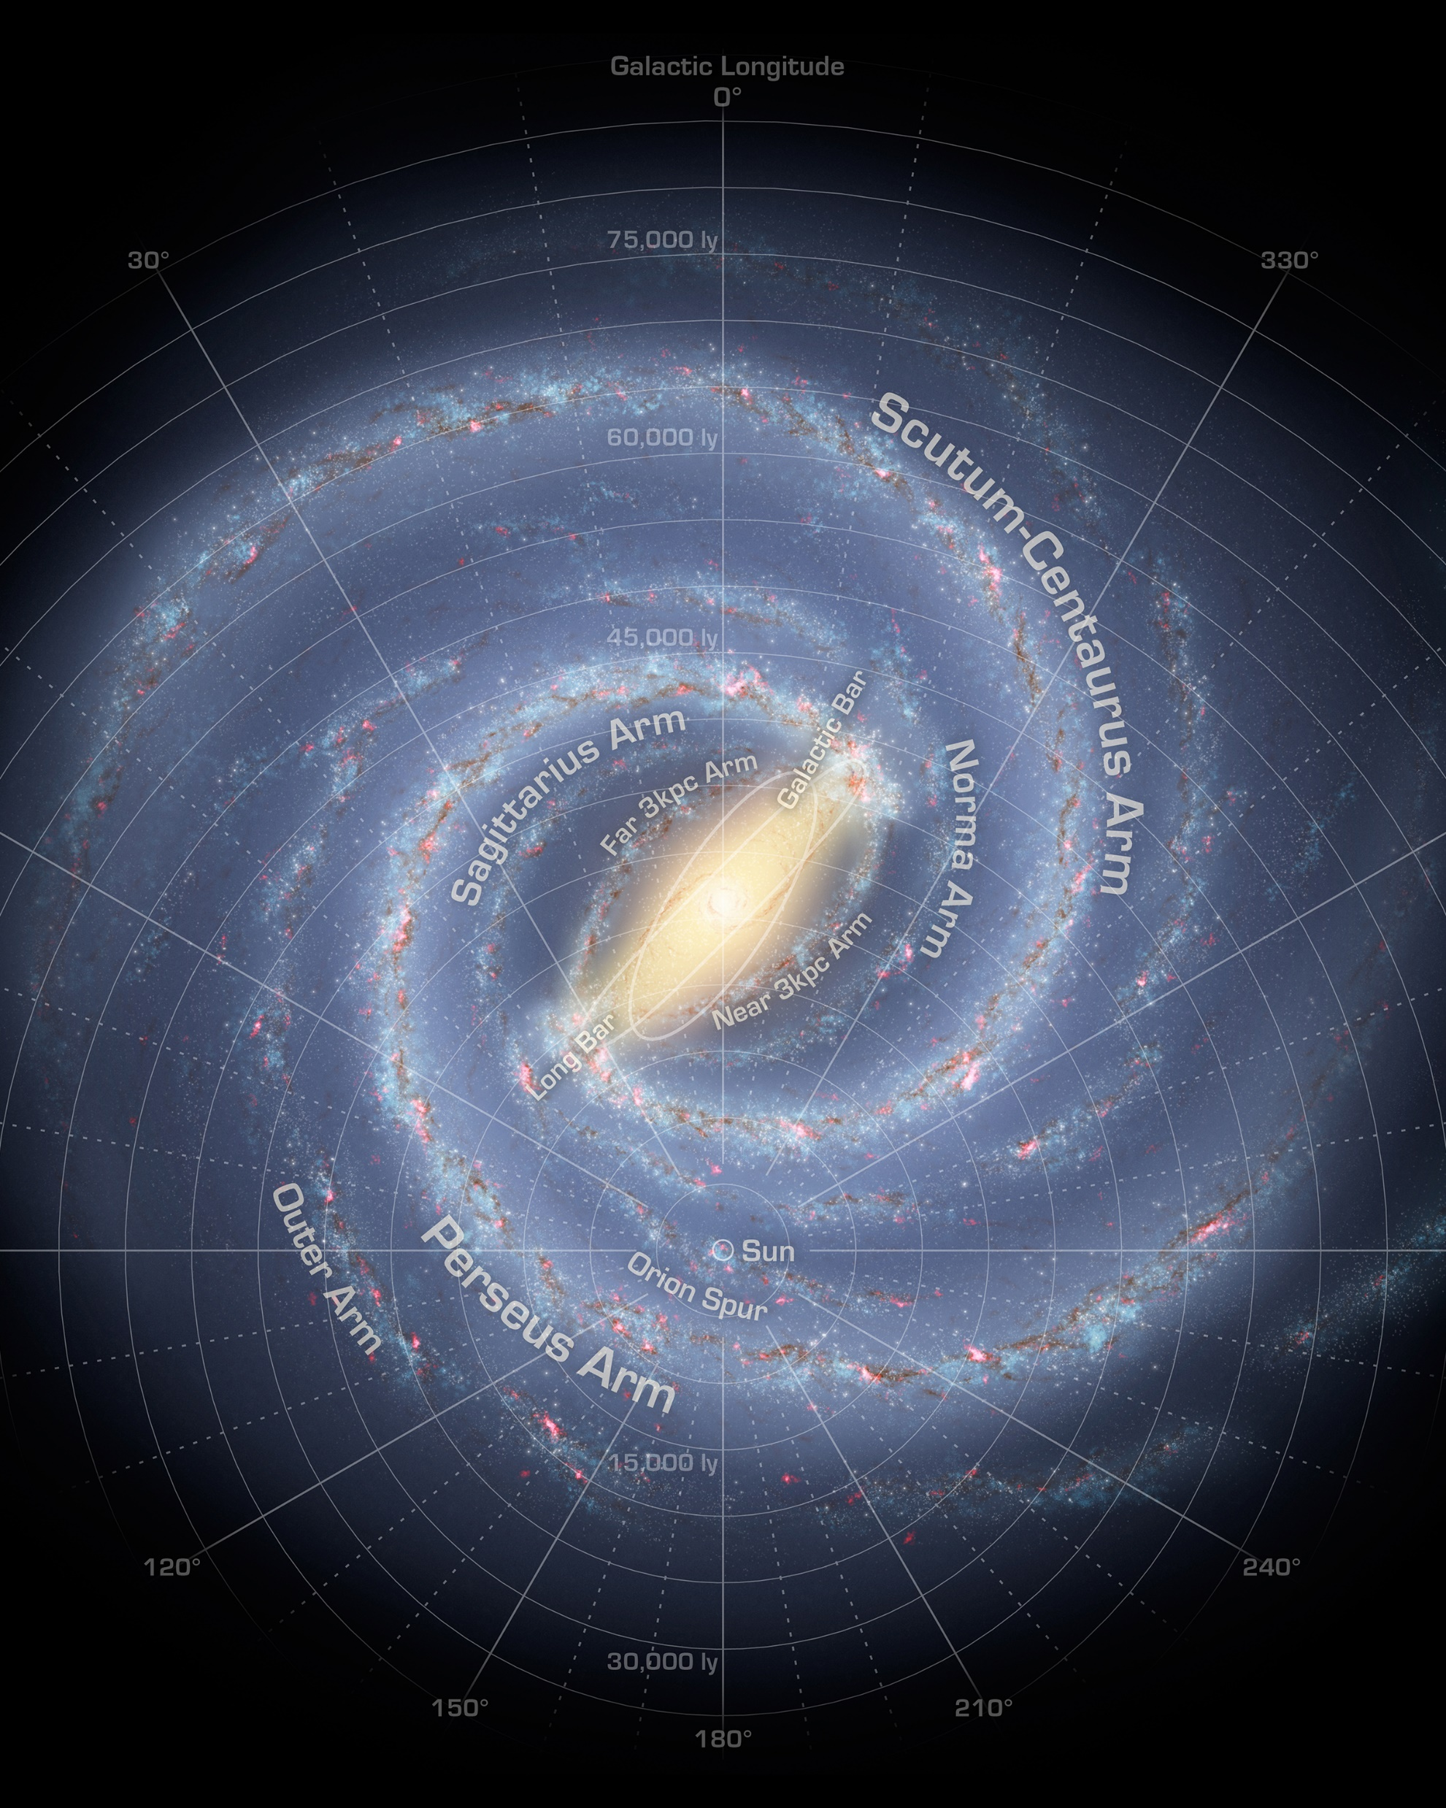
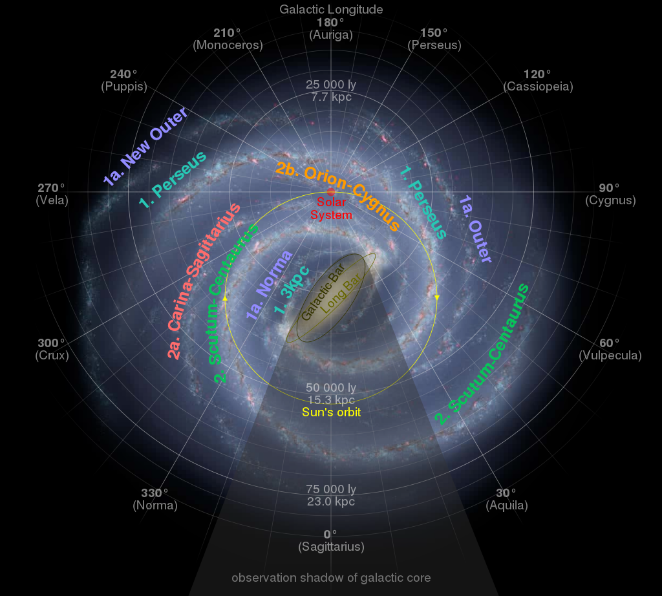
The Milky Way: One Galaxy Among Many

Slide 4
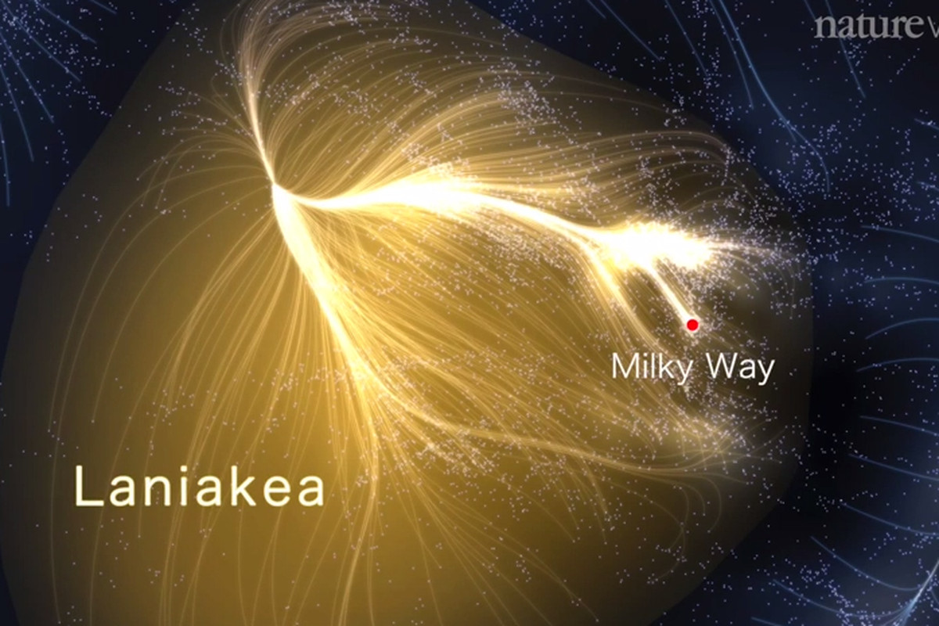
The Milky Way: One Galaxy Among Many
4-minute video:
https://www.youtube.com/watch?v=rENyyRwxpHo&ab_channel=naturevideo

Slide 5
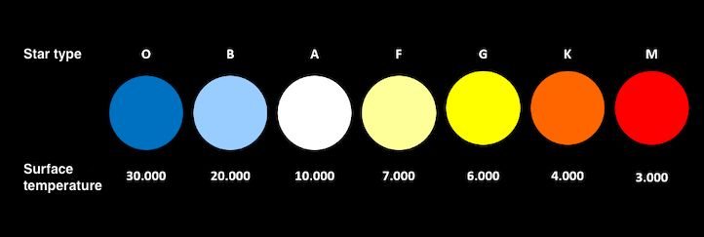
Colour and Temperature of Stars
The colour of a star indicates how hot its surface temperature is.

Slide 6
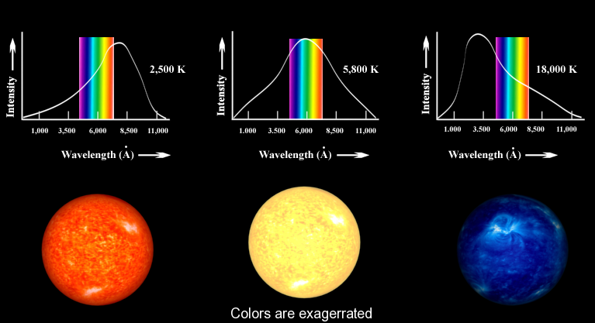
Colour and Temperature of Stars

Slide 7
Composition of Stars
A spectroscope is used to analyze the light given off by stars to determine their elemental composition.
Each element has a unique spectrum.
Figure 4.31: Each element is uniquely identified by its spectrum.

Slide 8
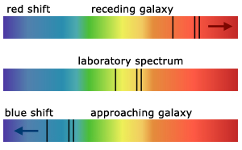
Light from the Universe is Redshifted (1915)
Scientists studied the light from distant galaxies and stars
They observed that the light from almost all galaxies is redshifted, meaning they are are moving away from us!
Red-shift Explanation Videos:
https://www.youtube.com/watch?v=ikgRZt1BSyk&ab_channel=Astronomic
https://www.youtube.com/watch?v=RO4i_g6gSMU&ab_channel=magipics
Notes:
Note: first video explains very well what red-shift means by comparing it to sound doppler effect. Second video actually physically shows the shift in galaxy lines, though it’s a bit redundant with the image that is now here.
Note: could very well do a demo of Doppler by having someone run (e.g. in the hallway, outside) with a constant tone sound.
Note: Andromeda galaxy is the only exception. Andromeda’s light is blueshifted because Andromeda and the Milky Way are actually spiralling towards each other. In some time in the far future, they will actually ‘collide’ (or really just move through) each other.

Slide 9
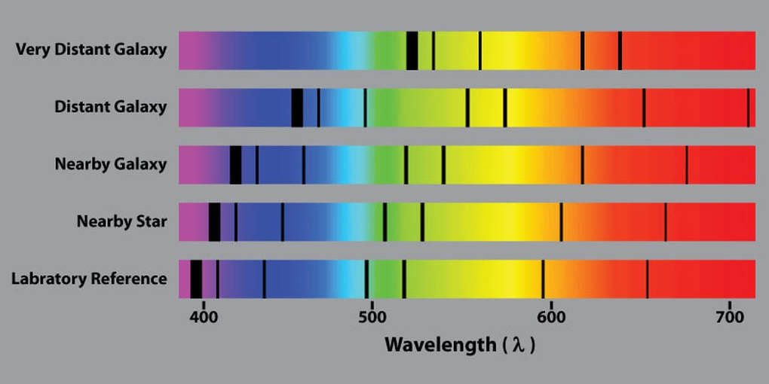
Light from the Universe is Redshifted (1915)
Distant celestial objects are moving away faster than nearby objects.
Conclusion: The universe is expanding!
Notes:
Note: first video explains very well what red-shift means by comparing it to sound doppler effect. Second video actually physically shows the shift in galaxy lines, though it’s a bit redundant with the image that is now here.
Note: could very well do a demo of Doppler by having someone run (e.g. in the hallway, outside) with a constant tone sound.
Note: Andromeda galaxy is the only exception. Andromeda’s light is blueshifted because Andromeda and the Milky Way are actually spiralling towards each other. In some time in the far future, they will actually ‘collide’ (or really just move through) each other.

Slide 10
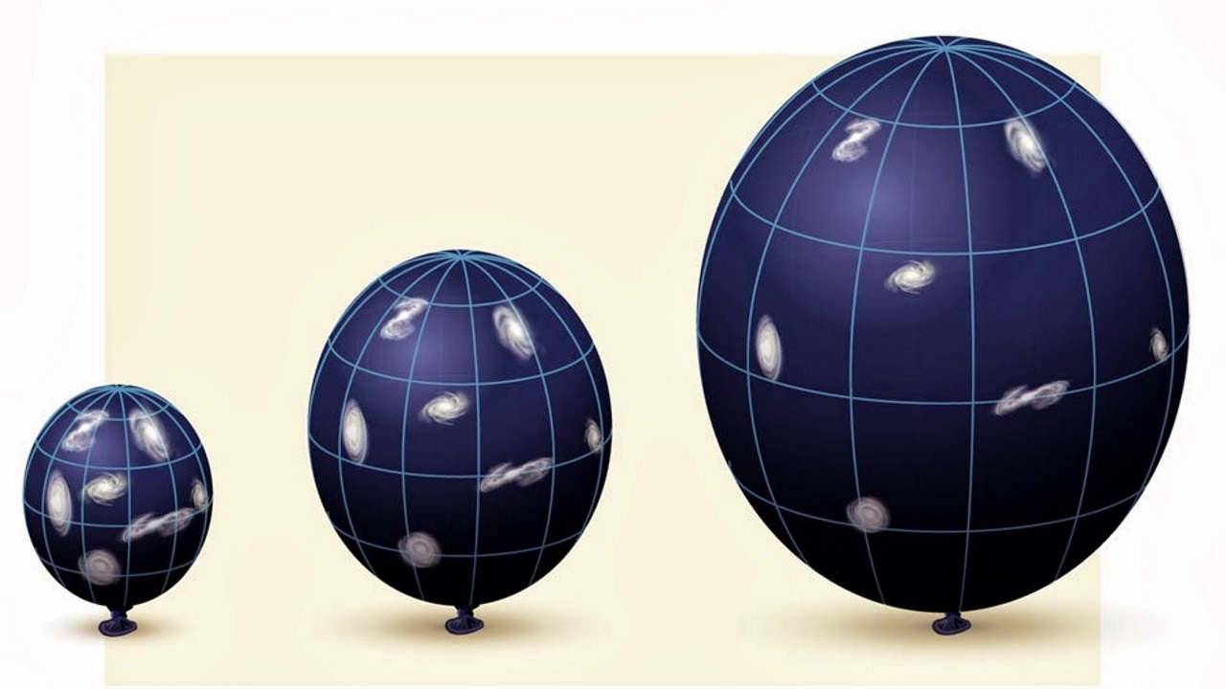
The Universe is Expanding
The spaces between celestial objects are expanding at a predictable rate, like in this balloon model
Notes:
Found using math

Slide 11
The Big Bang Theory is Born
Extrapolation of universal expansion: At some point in the distant past (approx. 14.6 billion years ago), all the galaxies originated from a single point in space. This is the Big Bang Theory.
Okay…but I’m not convinced. More evidence needed!

Slide 12
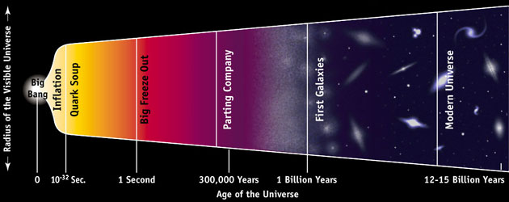
The Big Bang Theory is Born
Research from 1948: what would the universe have looked like in its earliest moments?

Slide 13
The Baby Universe (1 second old)
Very compressed
Very, very hot (10¹⁰ Kelvins hot)
25 million times the boiling temperature of water
Too hot for atoms, molecules, or even atomic nuclei to form. Quark Soup.
Notes:
10^10 K is 25 million times hotter than boiling temperature of water.

Slide 14
The Baby Universe (2.5 minutes)
The universe expands and cools.
At 150 seconds, the universe has cooled to 10⁹ Kelvins.

Slide 15
The Baby Universe (2.5 minutes)
The hypothesized ratio of subatomic particles under these conditions is 7 protons for every 1 neutron.
This temperature is cool enough for nuclear fusion: neutrons stick to protons to form deuteron (nucleus of heavy water).

Slide 16
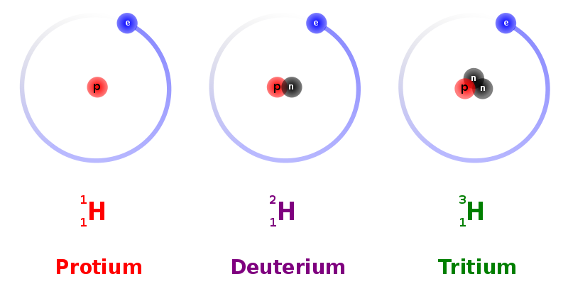
n
p
n
p
p
p
p
n
p
n
p
p
n
p
n
p
p
p
p
p
p
p
p
p
p
p
p
p
p
p
p
p
p
p
p
p
p
neutrons stick to protons to form deuterium nucleus (easier than proton + proton)
p
p
p
p
p
p
p
p
p
p
p
2 neutrons: 14 protons
helium nucleus forms

Slide 17
So What?
Data: stars are 90% hydrogen and 8% helium. This exactly matches this model of the Big Bang.
Stars make helium too, but very slowly. (It would take billions of years for a typical star to convert even 10% of its hydrogen into helium. Our universe is only 14.6 billion years old!) The “stars-only” explanation does not account for the large amount of helium we see.
Stars are incapable of making deuterium. Yet, we see deuterium in trace amounts everywhere in the universe. It must have come from the Big Bang!
Notes:
Note about #2: it was people who were actually trying to disprove the big bang (and develop a different scientific explanation) that found this was a thing. So they accidentally ended up finding proof for the very theory that they were trying to overturn!

Slide 18
The Big Bang Theory is Born

Slide 19
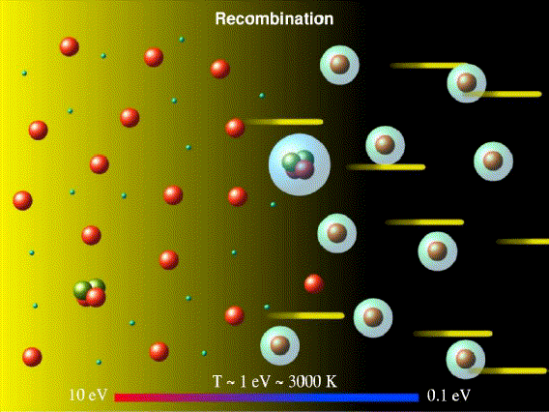
The Next 380,000 years
The universe continues to cool and expand.
Universe is a plasma consisting of atomic nuclei, electrons, and many high-energy photons of light.

Slide 20
The Next 380,000 years
Photons and electrons do not get along:
Atoms do not exist. If an electron happens to collide with a nucleus, it gets knocked off by a photon immediately.
Photons bump into free electrons wherever they go. Visibility is very low because photons (light) cannot get out.

Slide 21
A Slightly Older Universe (380,000+ years)
Universe has now cooled to 3,000K.
Photons no longer have enough energy to prevent electrons from sticking to nuclei and forming atoms.
Fewer electrons in the way means photons are free to go! Universe becomes transparent.

Slide 22
A Slightly Older Universe (380,000+ years)
Prediction: photons should have shot off in all directions with an energy equivalent to the temperature of 3,000K. Where did they go?

Slide 23
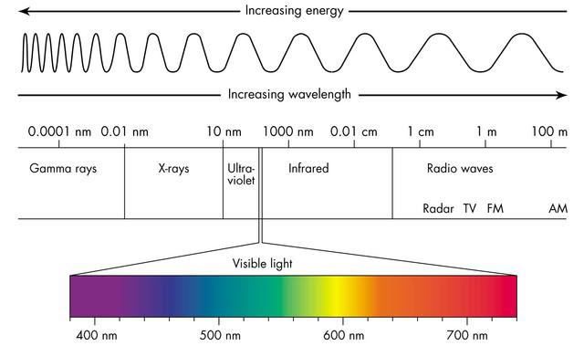
The Modern Universe
Remember, light is a wave (3,000K light has a wavelength of 0.001 mm) and the universe has continued to expand.
Prediction (1948): light has red-shifted into microwaves (wavelength of 1 mm) with a temperature of 5K.

Slide 24
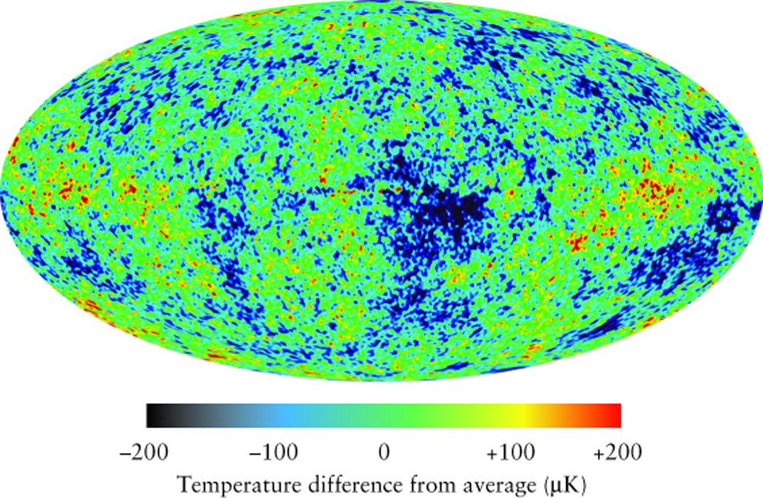
The Modern Universe and Cosmic Background Radiation

Slide 25
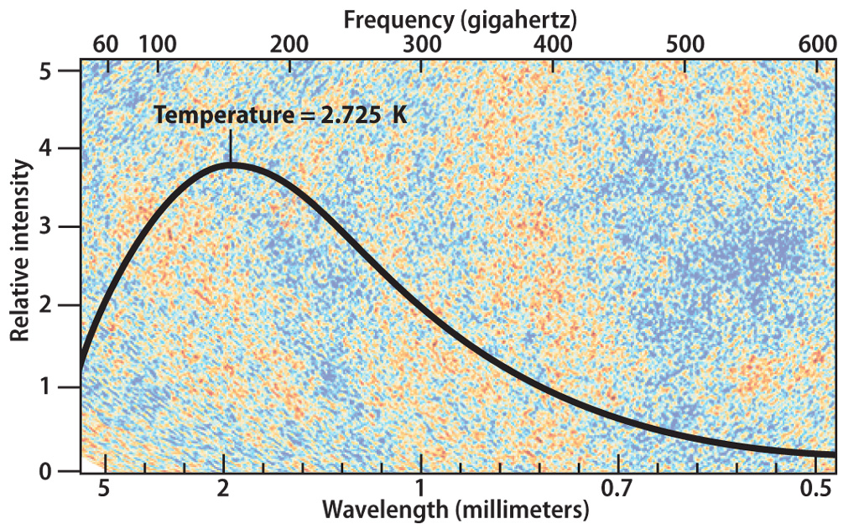
The Modern Universe and Cosmic Background Radiation
1965: Arno Penzias and Robert Wilson discovered cosmic microwave background radiation (CMB) – radiation leftover from the Big Bang that had an average temperature of 2.725K…very close to the prediction!
Penzias and Wilson awarded Nobel Prize in Physics in 1978.

Slide 26
A Conundrum
Problem:
At 380,000 year point, matter in universe was evenly dispersed and the spaces constantly expanding.
Uniform expansion from 380,000 yr old universe would have resulted in a uniform universe, without galaxies, planets, etc.
Notes:
Note: at this point, my ability to comprehend the evidence gets a little dicey. But I have done my best to summarize the remainder of the Big Bang chapter here.
mass = increased gravity = pulls other matter towards it = increases mass = increases gravity

Slide 27
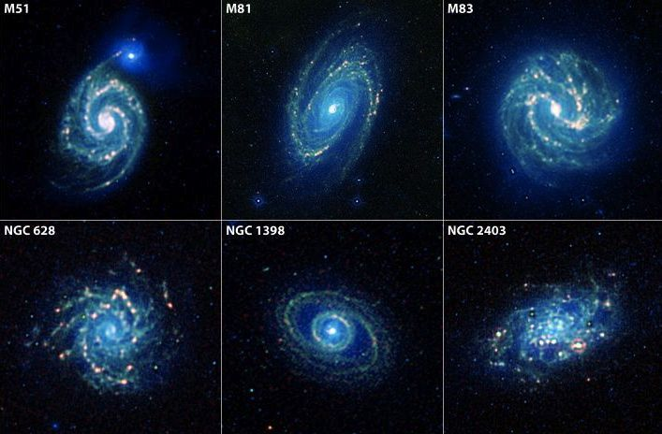
A conundrum
Reality:
Fluctuations in CMB (far greater than under uniform universe expansion)
Galaxies exist!

Slide 28
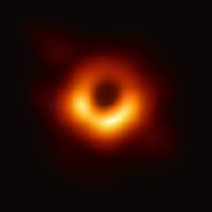
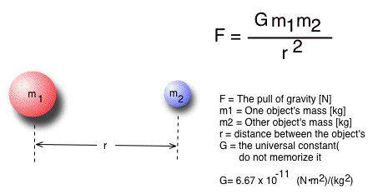
A conundrum
Scientific Fact:
To pull matter together (to make planets, galaxies, etc.), you need gravity. And gravity needs mass. (↑ mass → ↑ gravity → ↑ mass etc.)
Where did this mass come from?

Slide 29
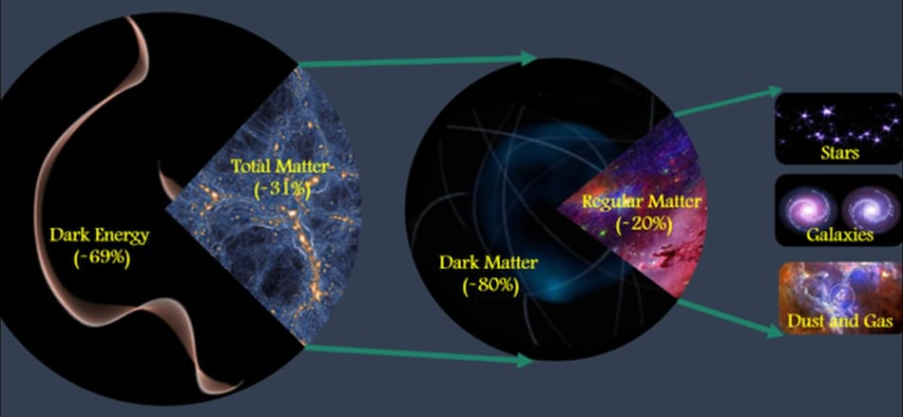
Dark Matter
We know it exists, but don’t know much about it
Has mass and volume, but does not interact with photons, unlike ‘normal’ matter
Notes:
More reading on dark matter: https://sitn.hms.harvard.edu/flash/2018/seeing-invisible-short-history-scientific-evidence-dark-matter/

Slide 30
A Solution to our conundrum
Review: matter was evenly distributed at the 380,000 year mark because photons kept interrupting the formation of larger particles
But what about dark matter?

Slide 31
A Solution to our conundrum

Slide 32
A Solution to our conundrum
Dark matter, by definition, is unaffected by light (photons)
Slight discrepancies in dark matter distribution at the moment of the Big Bang would have had higher gravity, pulling in more dark matter. After the 380,000 year mark, this uneven distribution of dark matter would then have pulled in bits of regular matter, giving galaxies and other celestial bodies a chance to form.
Scientists are still investigating dark matter ☺

Slide 33
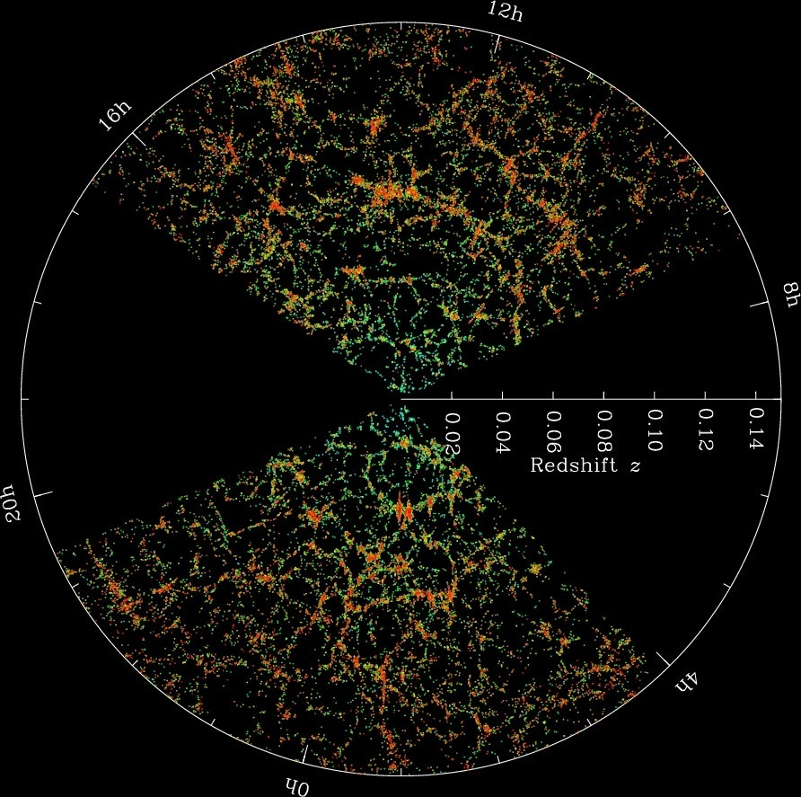
This is Really Complicated…
Sloan Great Wall
But it’s also beautiful.
Our observable universe is not random. There are sections that are arranged in non-random structures (e.g. Sloan Great Wall, 1.37 billion light-years long, a giant wall of galaxies) that are predicted under computer simulations that take into account dark matter and all the other elements of modern Big Bang Theory.
Notes:
Note: the observable universe is this weird hourglass-shaped thing because of light pollution from the milky way; we can only see clearly above and below the ‘spiral disc’ that is the milky way…it is hard to look right along the plane.
Note: pretty sure that’s the proper label for the great wall? Looks the right shape.

Slide 35
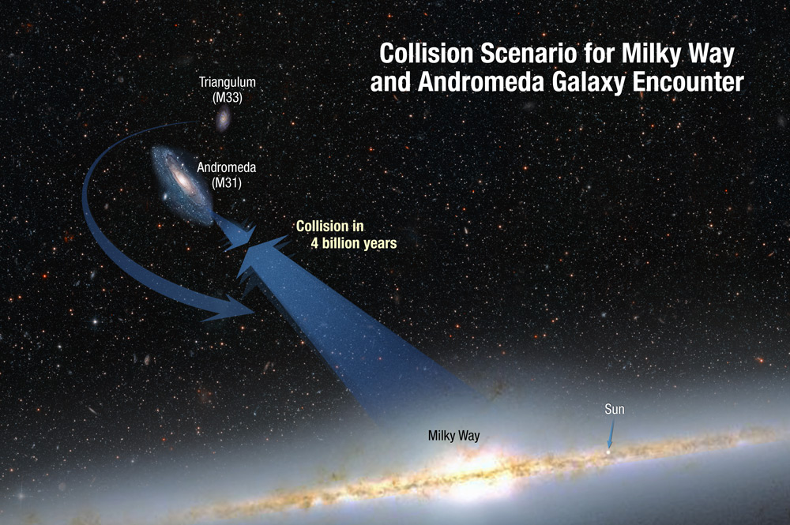
Andromeda Blue-shift

