Slide 1
Kingdom Plantae

Slide 2
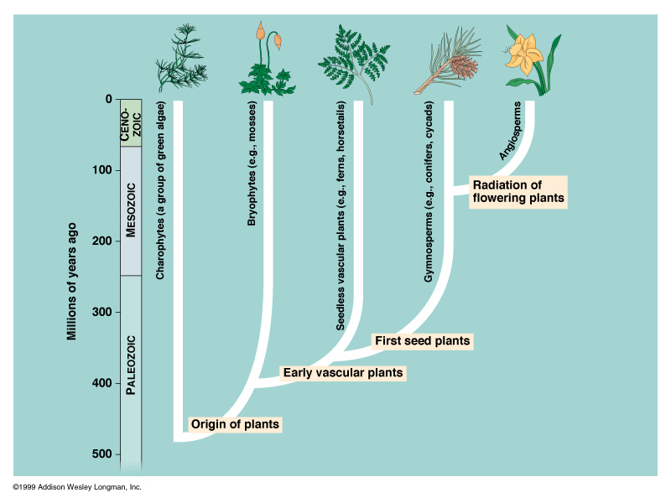

Slide 3
Reproduction in Algae (20-3)

Slide 4
Introduction
Draw the “life cycle of a human”. Include the following words:
Meiosis
Mitosis
Sperm
Egg
Zygote
Baby
Review the concept of ploidy with your teacher. Now, add “haploid” and “diploid” to your diagram.

Slide 5
Review: Reproduction Concepts

Slide 6
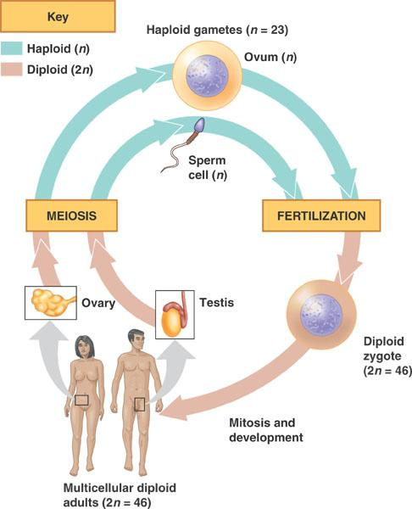

Slide 7
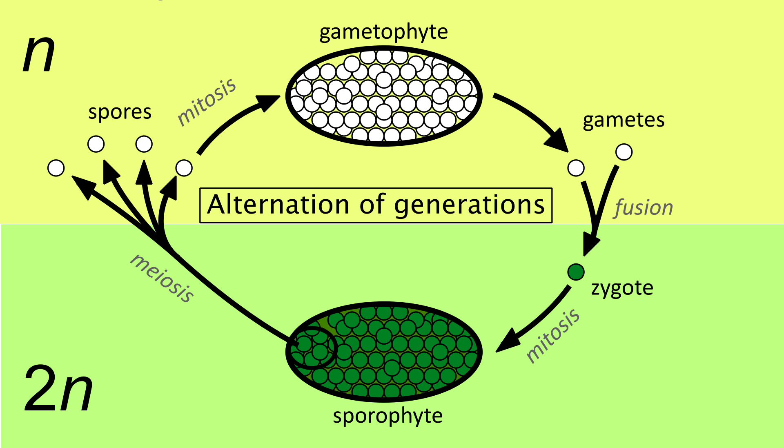
Alternation of Generations
Kingdom Plantae
Life cycle alternates between two distinct forms:
Haploid (n) gametophyte generation, creates haploid gametes through mitosis
Diploid (2n) sporophyte generation, creates haploid spores through meiosis
Notes:
* Sometimes, they are not called ‘gametophyte’ or ‘sporophyte’…they may have other names

Slide 8
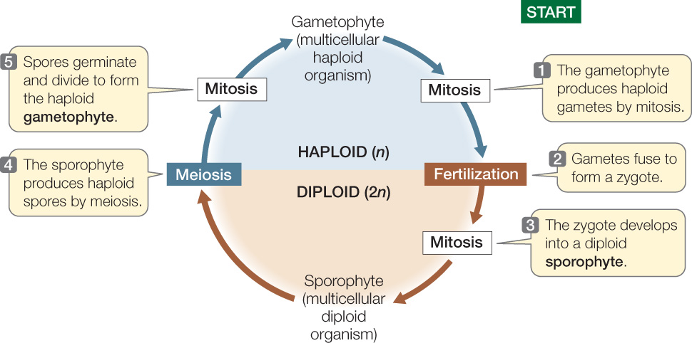
Alternation of Generations

Slide 9
Discussion Questions
How does reproduction in Kingdom Plantae differ from reproduction in Kingdom Animalia? (Note: humans are animals.) Which steps/stages are similar? Which steps/stages are unique to Plantae?
2. Imagine you are a plant (diploid sporophyte generation).
How would your family tree look? Include your theoretical children in this family tree.
If asked the question “Who do you look the most like: mom or dad?” how would you respond as a plant? Explain your answer.

Slide 10
Chlamydomonas – not testable
Unicellular green algae
Reproduces asexually (mitosis) under favourable conditions
Poor environmental conditions:
Mitotic production of gametes (+ or -)
Fusion into diploid zygote with thick outer wall → dormant
When conditions become favourable, zygote grows and undergoes meiosis (produce 4 haploid cells)
Notes:
Note: the gamete forms look identical to us. Is not like sperm and egg. They look the same but are in strains of + and – depending on the type that they are.

Slide 11
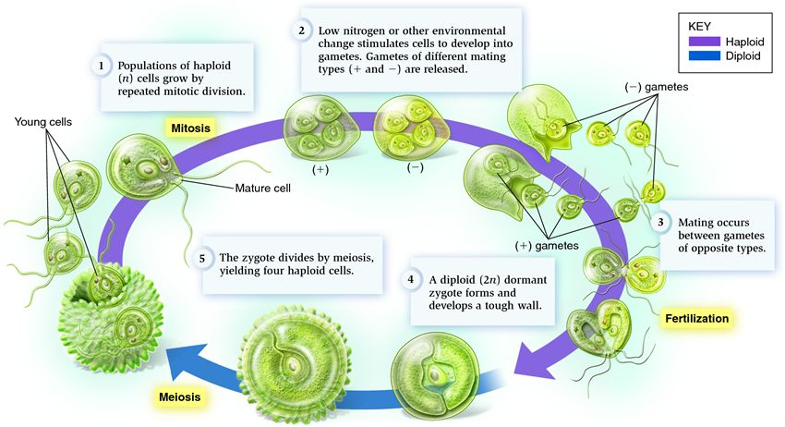
Chlamydomonas

Slide 12
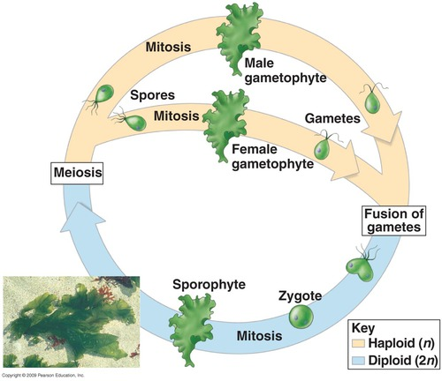
Ulva – not testable
Diploid sporophyte and haploid gametophyte generations are both multicellular and look almost identical
No dormant stage
Notes:
In ulva, the types of gametes look different. More similar to sperm and egg

Slide 13
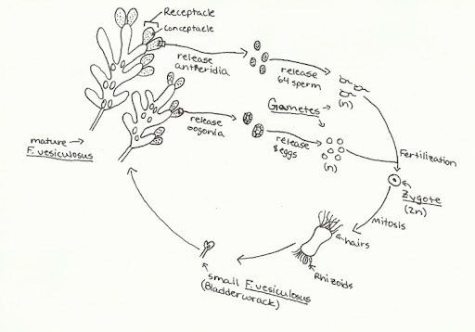
Fucus – not testable
Multicellular diploid sporophyte
Unicellular haploid gametophyte (on the tips of the Fucus blades) produces eggs or sperm
Life cycle of Fucus spp. Note: a single diploid sporophyte will produce both male and female gametophytes.
Notes:
Note: sporophyte do not have sexes (i.e. male vs female). Rather, a single sporophyte plant will have blades with male gametophytes and blades with female gametophytes. On some species, the sporophyte plant will have blades with containers containing both the female and male gametophytes.

Slide 14
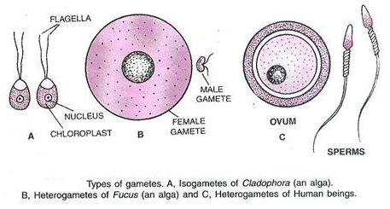
A Note on Gametes
Isogamy: where both types of gametes appear identical (e.g. Chlamydomonas)
Heterogamy: where both types of gametes appear different (e.g. Fucus with distinct sperm and egg)

Slide 15
Mosses and Ferns
Chapter 21

Slide 16
Plants Invade the Land (21-1)

Slide 17
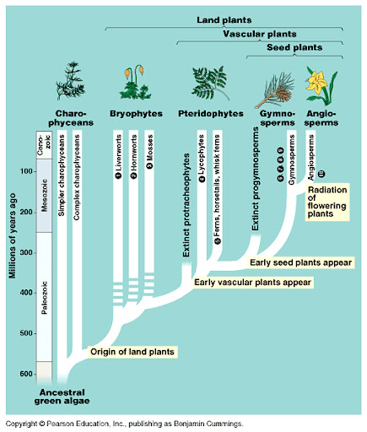
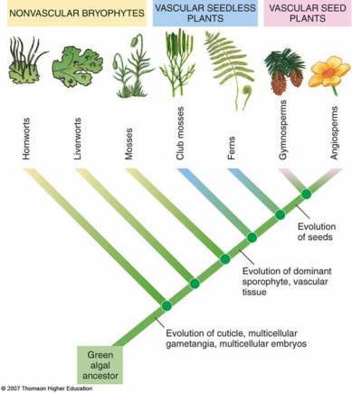
A History Lesson

Slide 18
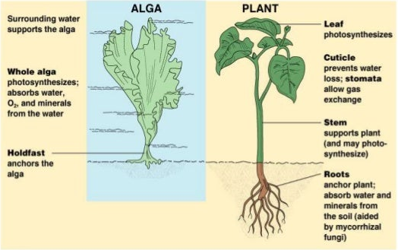
Demands of Life on Land (pg 450-451)
Avoid dehydration from evaporation
Structural support (expose leaves to sun)
Transport water and nutrients to cells
Reproduction without water to swim in

Slide 19
A History Lesson (Testable Dates)
Algae are thought to have evolved up to 1 billion years ago
Approx 550 mya: algae that could live out of water part-time
Approx 450 mya: land plants split into two groups:
Bryophyta (mosses, liverworts, hornworts)
Tracheophyta (ferns, vascular plants)
Notes:
Note: fossil record is pretty spotty at the beginning…algae don’t leave good fossils because they are so soft and because they started off as unicellular

Slide 20
Bryophyta (Mosses, Liverworts, Hornworts) (21-2)

Slide 21
Key Characteristics
Alternation of generations: gametophyte is dominant*
Live only in wet or moist areas (swamps, marshes, rainforests, near streams)
Monoecious: a single individual produces both male and female gametes
*This distinguishes Bryophytes from Tracheophytes, where the sporophyte generation is dominant.
Notes:
Distinct from tracheophytes because in tracheophytes it is the sporophyte that is the most conspicuous or dominant

Slide 22
Key Characteristics (Cont.)
No vascular system: rely on osmosis and capillary action; bryophytes are small
No protective surface covering to prevent evaporation
Bryophytes require water for sexual reproduction (sperm have flagella and need to swim to eggs)

Slide 23
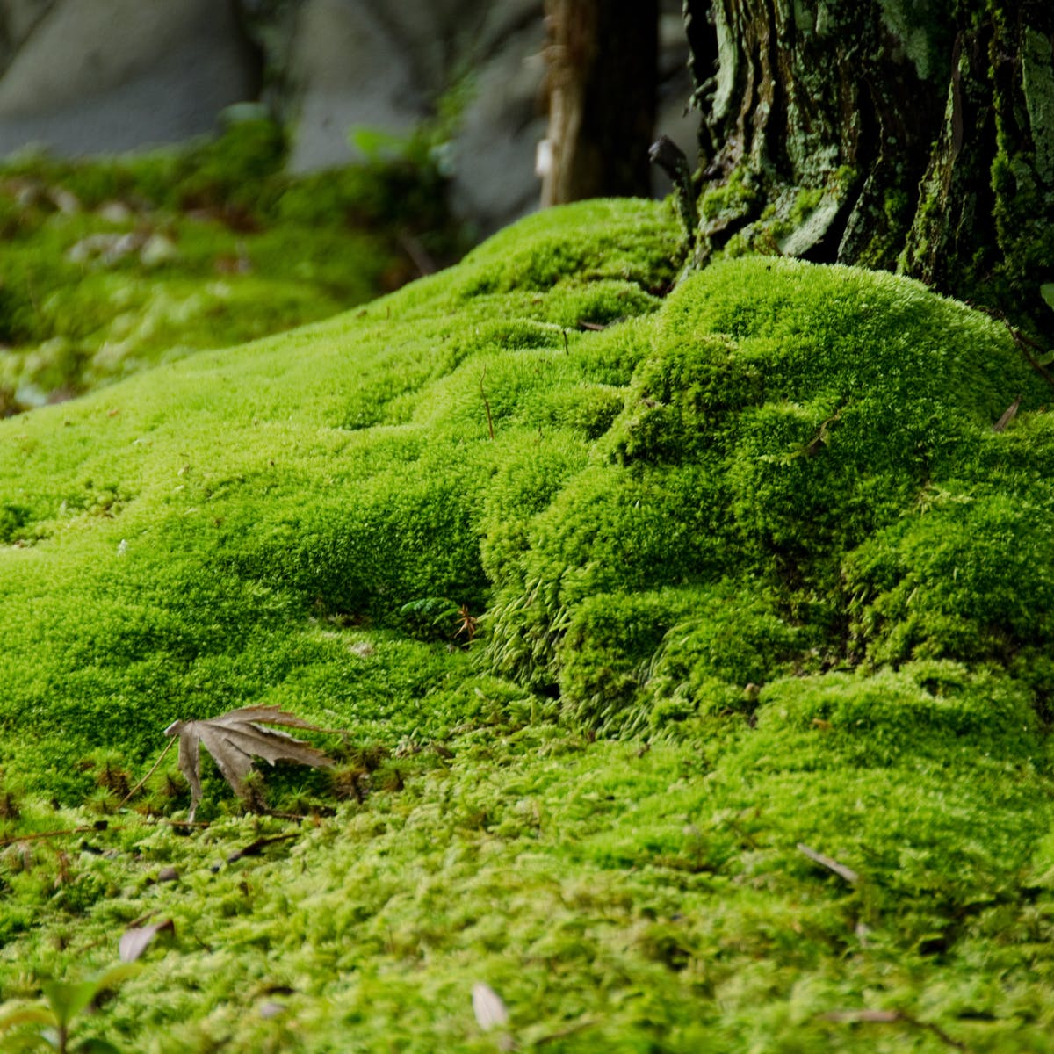
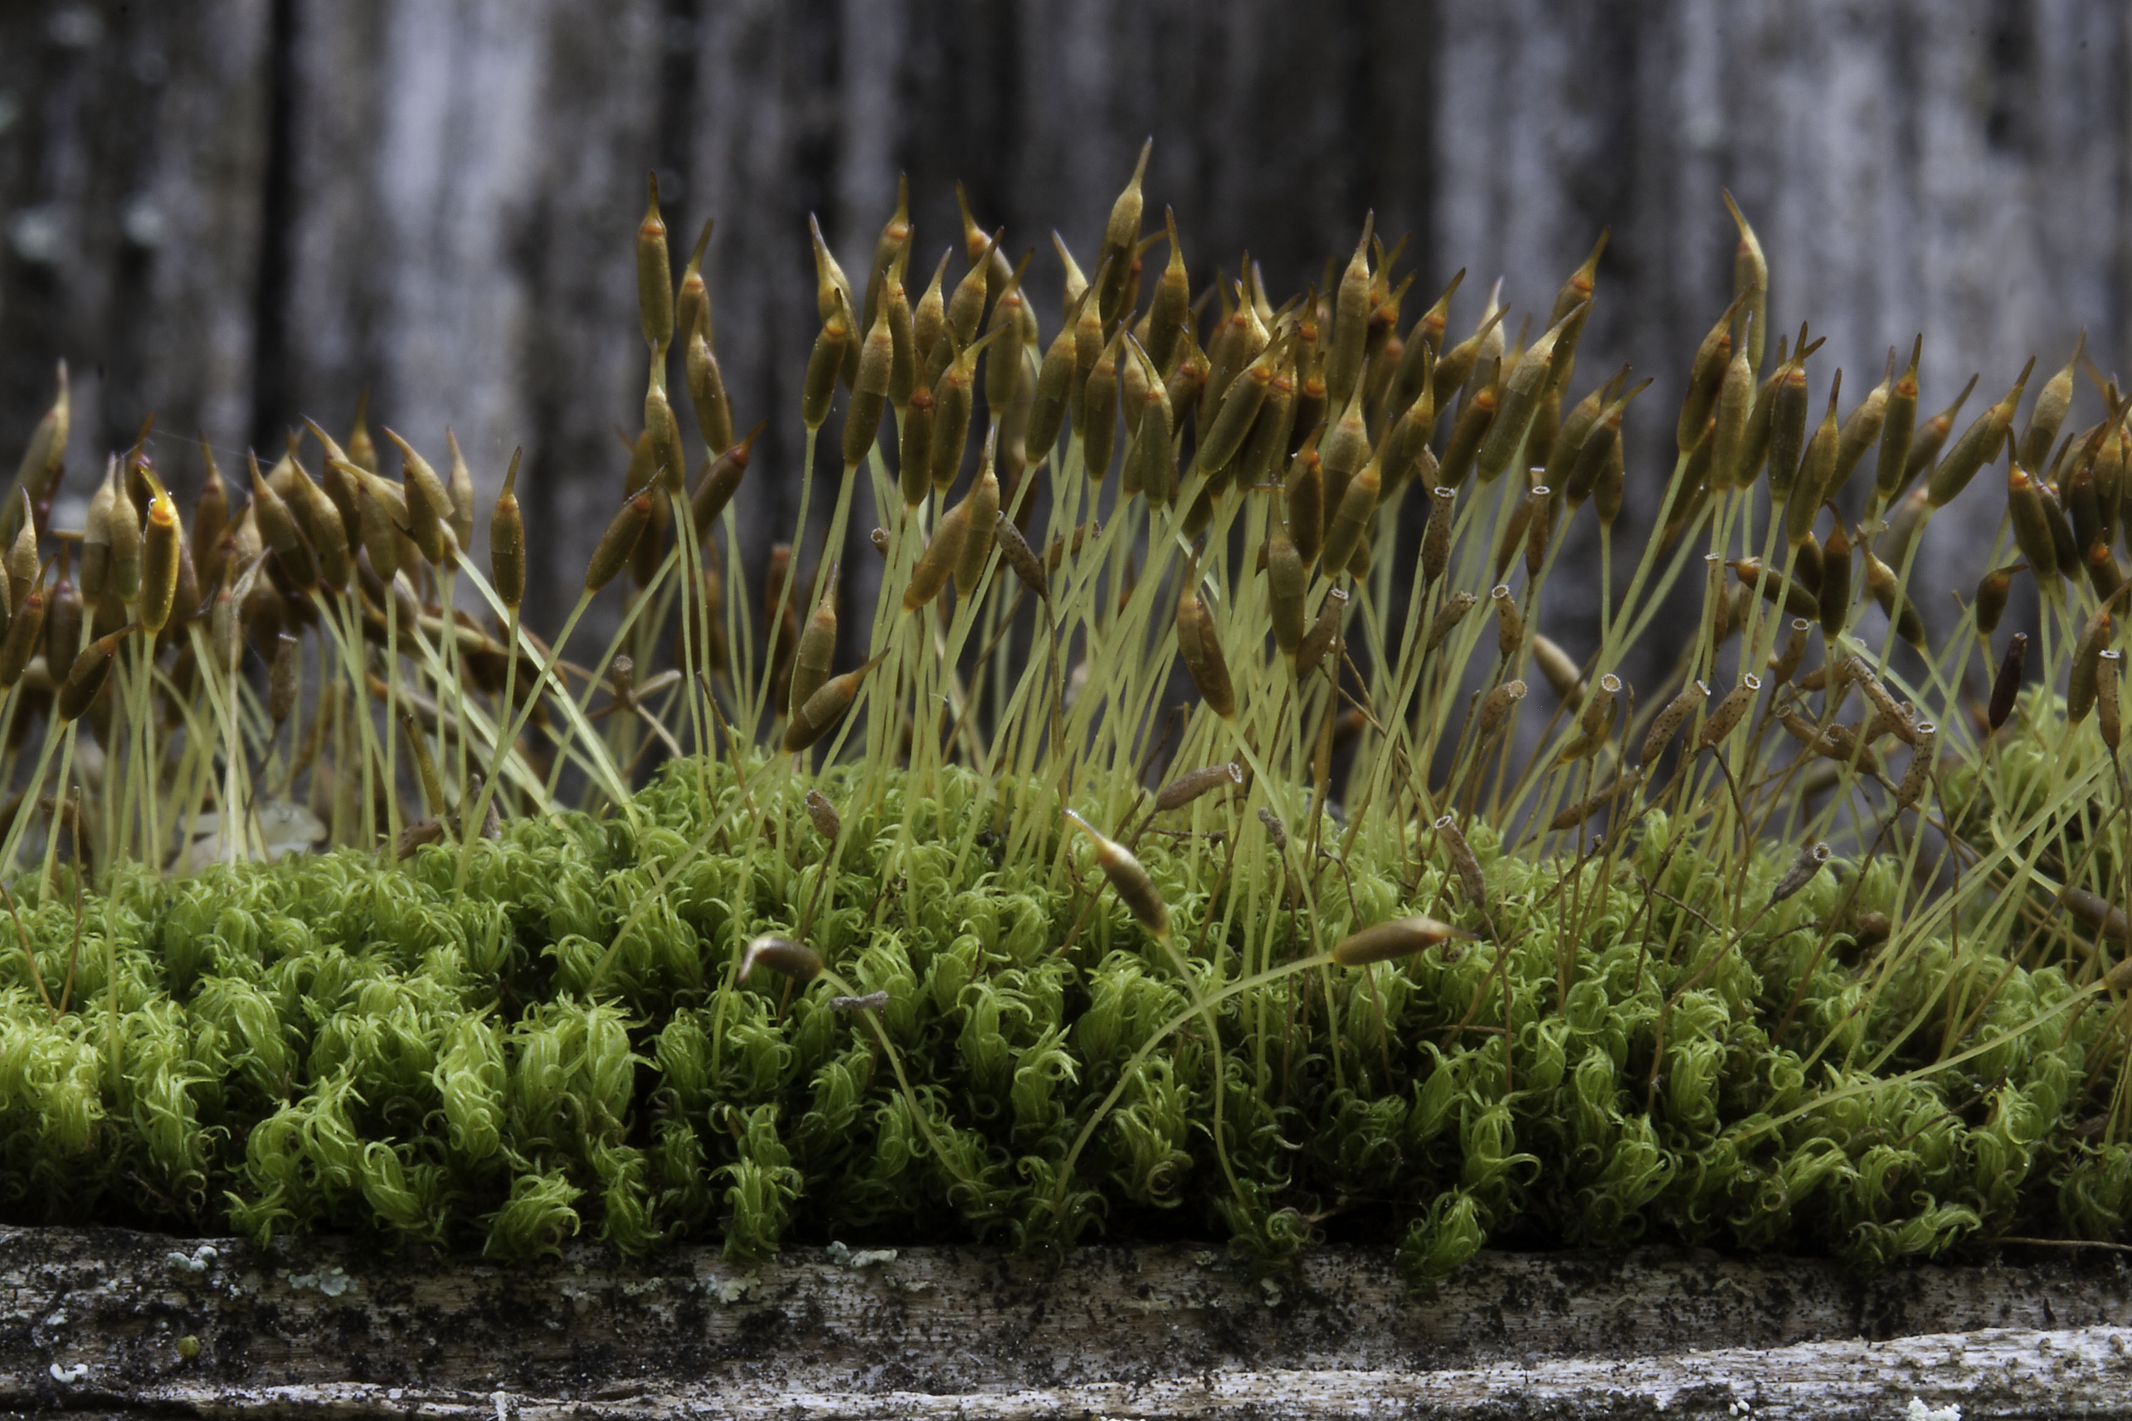
Mosses
Note: textbook compares mosses, liverworts, hornworts. You are not required to know the differences.

Slide 24
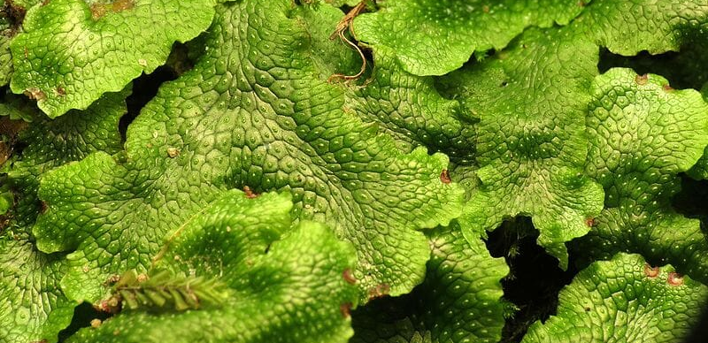
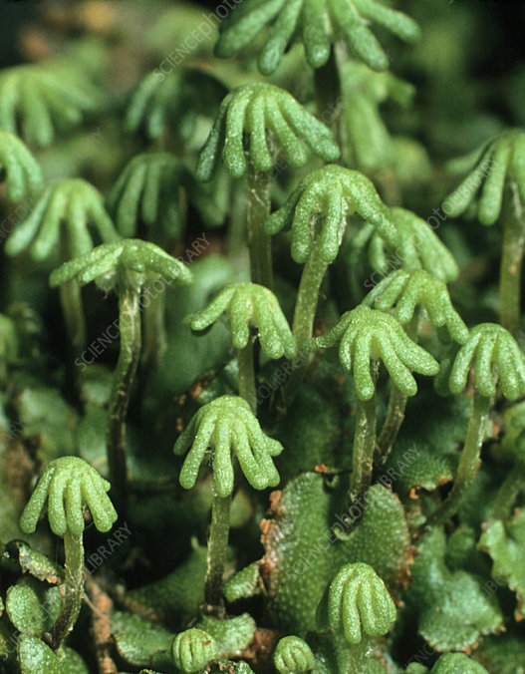
Liverworts
Notes:
Liverworts are rarer than mosses; look like flat green leaves on the ground
Mature gametophytes produce ‘umbrellas’ that carry structures that make gametes

Slide 25
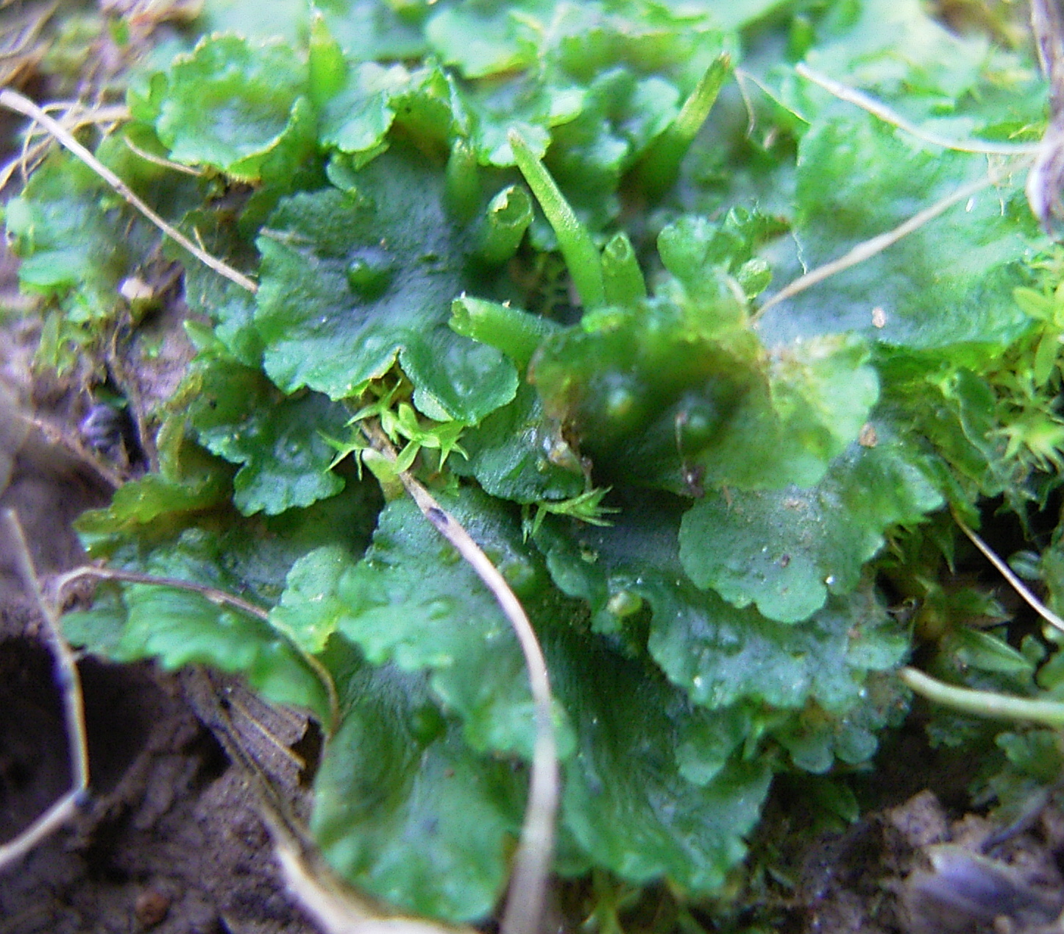
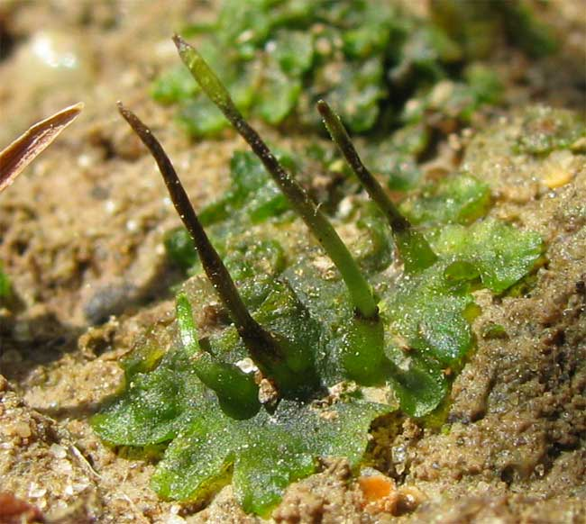
Hornworts
Notes:
Gametophytes look like gametophytes of liverworts (i.e. flat leaves on ground). But sporophyte looks like a horn instead of an umbrella

Slide 26
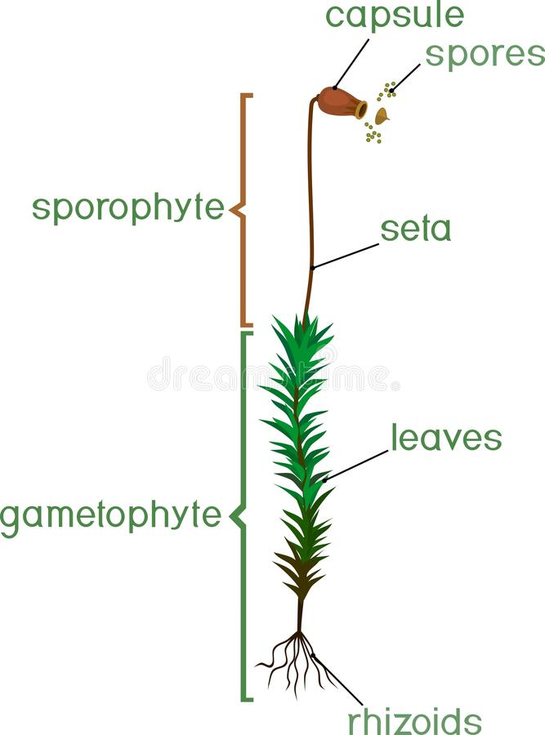
Bryophyte Anatomy
Small: only a few cm tall
Thin upright ‘stem’ with ‘leaves’*
Rhizoids: anchor bryophyte to ground**
* Not true leaves because lacking vascular tissue
** Rhizoids are not considered roots because they do not play a role in absorption and transport of water and minerals

Slide 27
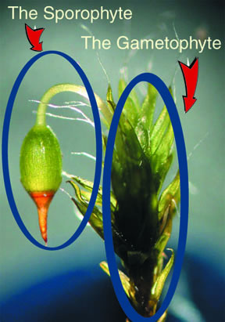
Bryophyte Life Cycle
Haploid gametophyte – dominant form
Antheridium (pl. antheridia): male gametophyte, produces sperm
Archegonium (pl. archegonia): female gametophyte, produces eggs
Reminder: water is required for sexual reproduction in bryophytes.
Notes:
https://www.whfreeman.com/BrainHoney/Resource/6716/SitebuilderUploads/Hillis2e/Student%20Resources/Animated%20Tutorials/pol2e_at_2101_Life_Cycle_of_a_Moss/pol2e_at_2101_Life_Cycle_of_a_Moss.html
https://www3.botany.ubc.ca/bryophyte/mossintro.html#:~:text=MORPHOLOGY%20AND%20DEVELOPMENT%20OF%20THE%20MOSSES&text=In%20vascular%20plants%20the%20dominant,only%20one%20set%20of%20chromosomes).

Slide 28
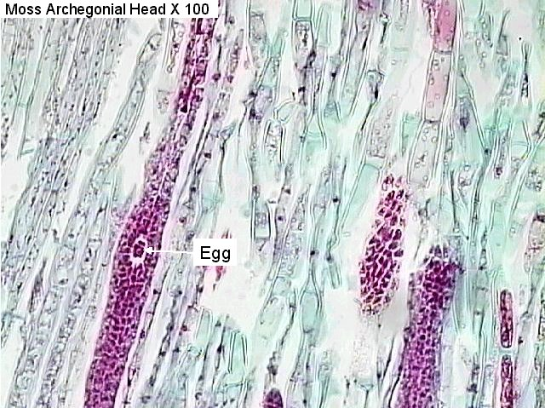
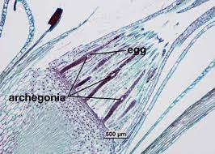
Bryophyte Life Cycle
Notes:
Note: each egg is surrounded by a sterile jacket

Slide 29
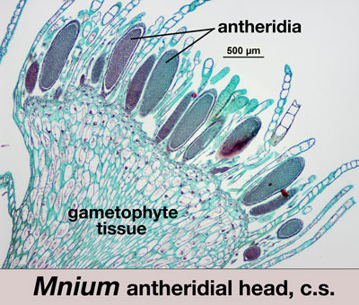
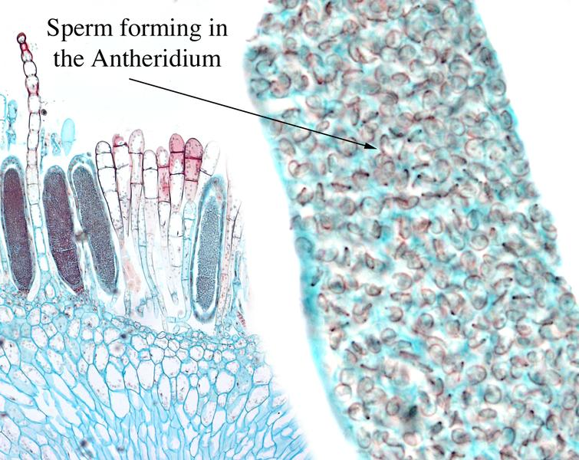
Bryophyte Life Cycle

Slide 30
Bryophyte Life Cycle
After fertilization and germination, diploid sporophyte forms:
Supplied with water and nutrients from gametophyte
Capsule contains spores; stalk connects it to gametophyte
Forms spores asexually that are carried off by water and wind to form a new gametophyte
Notes:
https://www.whfreeman.com/BrainHoney/Resource/6716/SitebuilderUploads/Hillis2e/Student%20Resources/Animated%20Tutorials/pol2e_at_2101_Life_Cycle_of_a_Moss/pol2e_at_2101_Life_Cycle_of_a_Moss.html
https://www3.botany.ubc.ca/bryophyte/mossintro.html#:~:text=MORPHOLOGY%20AND%20DEVELOPMENT%20OF%20THE%20MOSSES&text=In%20vascular%20plants%20the%20dominant,only%20one%20set%20of%20chromosomes).

Slide 31
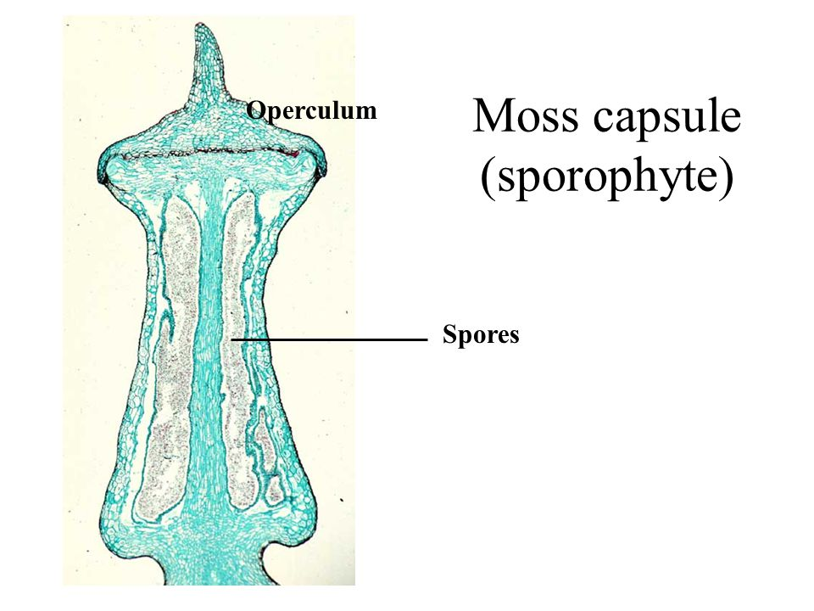
Bryophyte Life Cycle

Slide 32
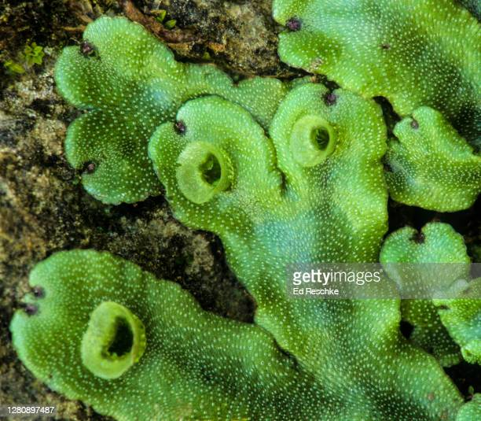
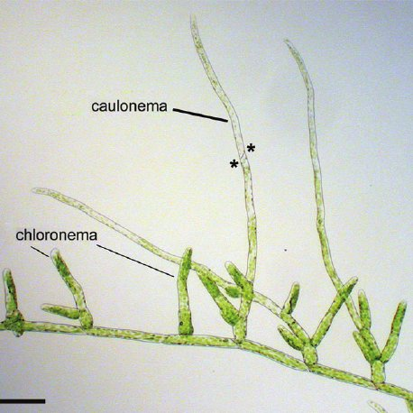
Bryophyte Fun Facts
Splash cups in some species: distribute sperm from gametophytes when raindrops hit
Bryophyte spores germinates to form a protonema, which resembles a filamentous green algae → evolutionary origins?
Notes:
https://www.anbg.gov.au/bryophyte/splash-cups.html

Slide 33
Questions
List the characteristics of bryophytes.
What is the name of the structure that anchors bryophytes down? Why are these not considered true roots?
Give three reasons why bryophytes require water.
What does alternation of generations mean?
Define gametophyte. Define sporophyte. (Include: ploidy, what it makes and how it makes it.)
During which months would we expect to see the most sporophytes? The least? Explain briefly.

Slide 34
Moss Videos
Moss Life Cycle: has some extra, untestable material but provides a good visual https://www.youtube.com/watch?v=2kY7uzeYWFc&ab_channel=NookNattapon
“The Hidden Superpowers of Moss”: FYI only https://www.youtube.com/watch?v=SS2vTGeME3Y&ab_channel=SciShow
Notes:
Scishow video mostly focuses on healing powers of moss

Slide 35
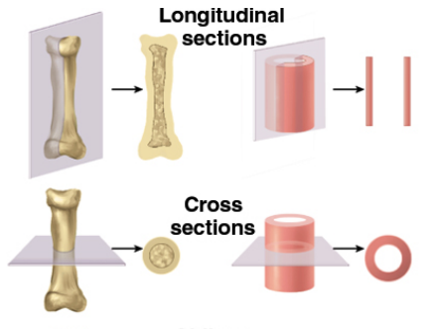
Cross Section vs Longitudinal Section
On slides, you will often see “c.s.” (cross section) or “l.s.” (longitudinal section). These terms refer to how the slide was prepared: by cutting a slice along the longest direction (l.s.), or perpendicular to this (c.s.).

Slide 36
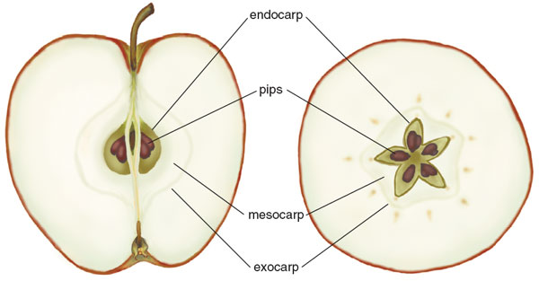
Cross Section vs Longitudinal Section
These are slices of an apple.
Which is the cross section? Which is the longitudinal section?

Slide 37
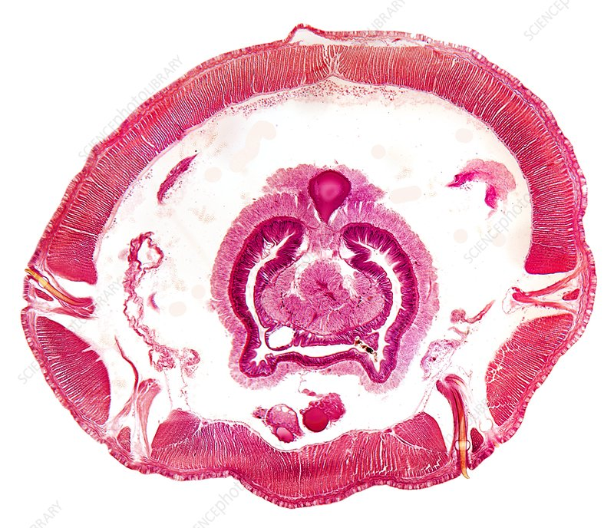
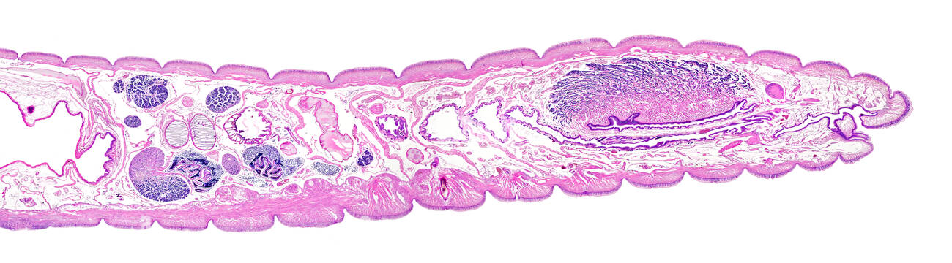
Cross Section vs Longitudinal Section
These are slides of an earthworm.
Which is the cross section? Which is the longitudinal section?

Slide 38
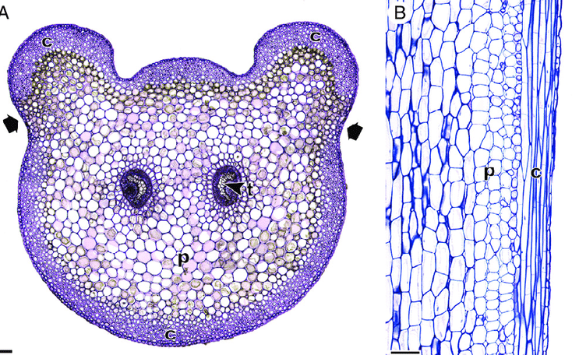
Cross Section vs Longitudinal Section
These are slides of a plant stem. Which is the cross section? Which is the longitudinal section?

Slide 39
Microscopy Follow-up Questions
Explain how the Mnium female gametophyte differs from the male gametophyte. How do these structural differences relate to the function of each? (i.e. How is the male gametophyte well suited to transport sperm in the presence of water? How is the female gametophyte well suited to receive sperm, then to protect the developing embryo?)
You viewed a longitudinal section of a Polytrichum sporophyte. Draw your prediction of what the cross section would look like.

Slide 40
Tracheophytes: (First Vascular Plants) (21-3a)

Slide 41
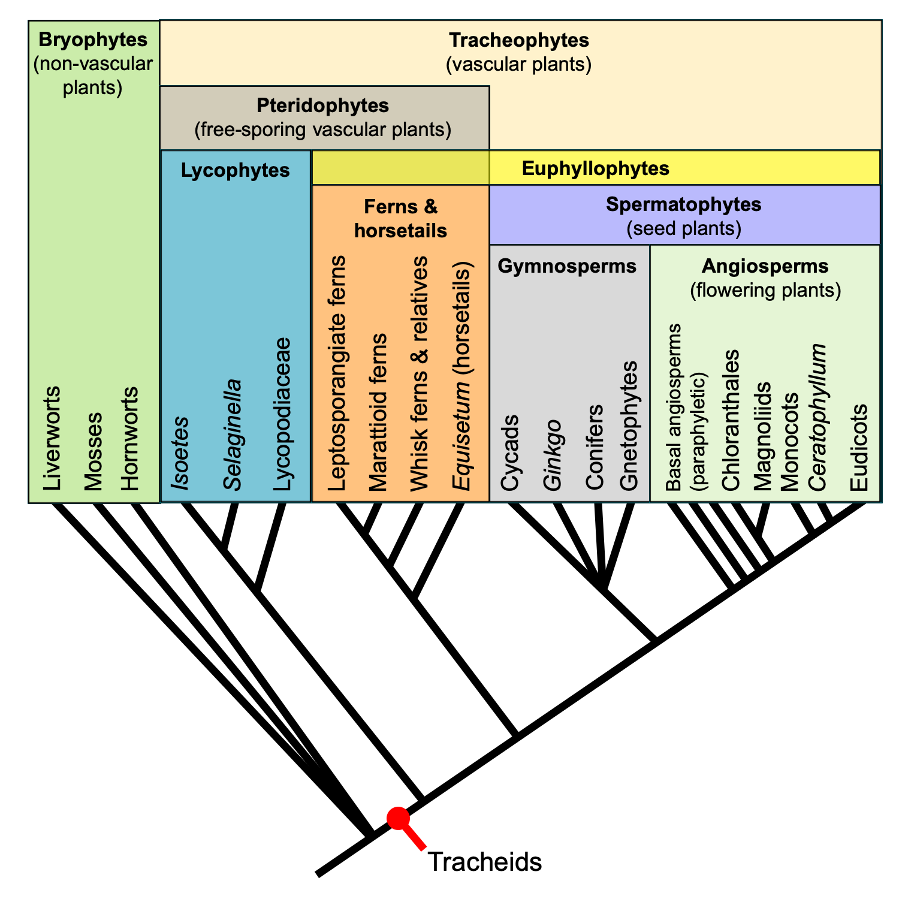

Slide 42
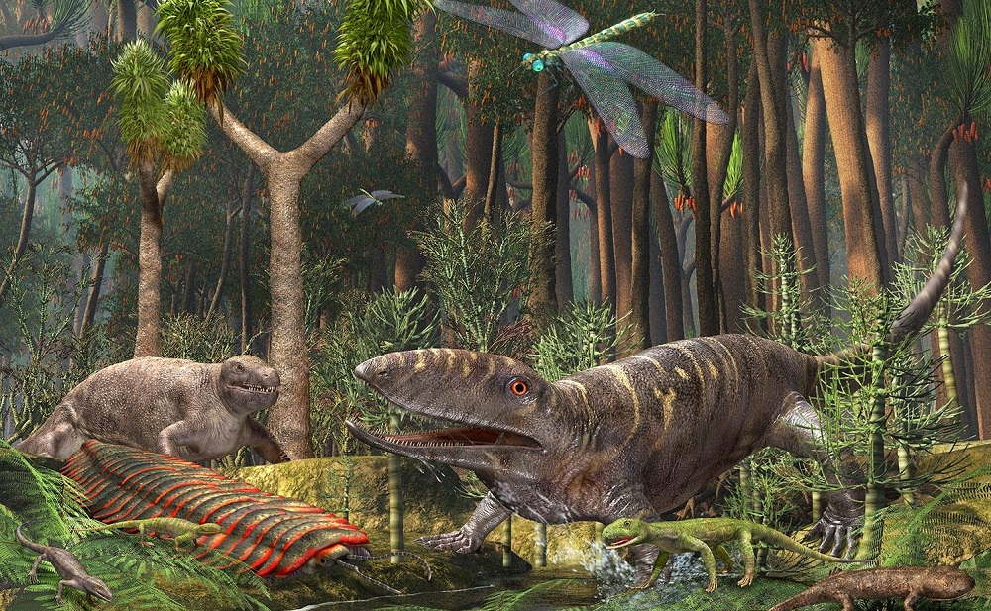
A History Lesson (Testable Dates)
Ancient tracheophytes (400 mya): huge trees that made up Earth’s first forests
Fossilized remnants became coal and fossil fuels in Carboniferous period (360-300 mya)
Notes:
Aside: this is before the evolution of dinosaurs…which evolved 245 mya.

Slide 43
Coal and Fossil Fuels: a Non-Renewable Resource
It took 100 million years after tracheophyte evolution for fungi and other decomposers to evolve the ability to break down lignin and cellulose. This is why coal and fossil fuels are a non-renewable resource.
Article: https://www.nationalgeographic.com/science/article/the-fantastically-strange-origin-of-most-coal-on-earth

Slide 44
Key Characteristics
Varied terrestrial habitats: not dependent on wet environment
Vascular tissues (xylem, phloem, tracheid cells)
True roots
True leaves with a waxy cuticle
Monoecious

Slide 45
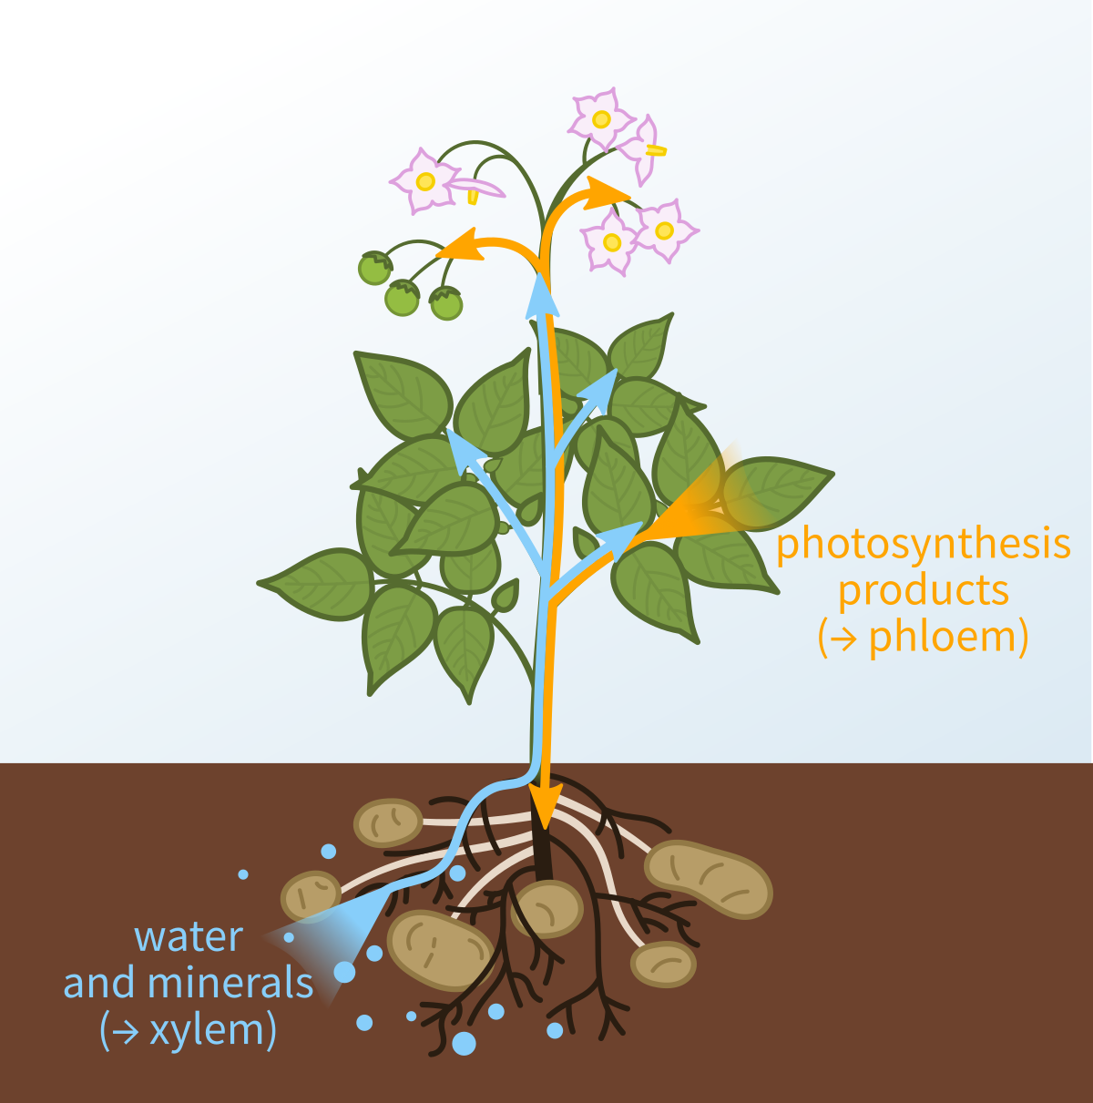
Vascular Tissues: a brief overview
Vascular tissues:
Transport water and the products of photosynthesis throughout the plant
Includes xylem and phloem

Slide 46
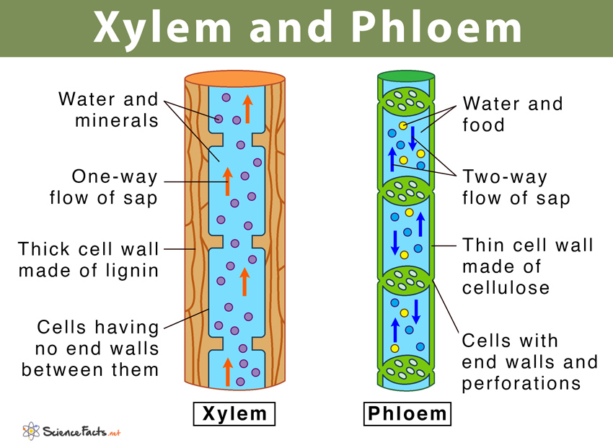
Vascular Tissues: a brief overview

Slide 47
Vascular Tissues: a brief overview
Xylem: moves water and minerals from the roots to other parts of the plant
Tracheid cells:
Carry water
Have thick, strong cell walls strengthen plant stems
Notes:
https://www.shmoop.com/study-guides/biology/plant-biology/plant-tissues#:~:text=Tracheids%20are%20long%2C%20narrow%20cells,allow%20water%20to%20move%20laterally.

Slide 48
Vascular Tissues: a brief overview
Phloem: movement of nutrients and the products of photosynthesis

Slide 49
Vascular Tissues: Recap
Why are vascular tissues important? How did the development of vascular tissues allow the rapid diversification and evolutionary success of tracheophytes?
Summarize the differences between xylem and phloem.
What is a tracheid cell? What does it do?

Slide 50
Types of Tracheophytes
Club Mosses and Horsetails
Ferns
[Note, gymnosperms and angiosperms are also considered tracheophytes…will be taught later]

Slide 51
A History Lesson

Slide 52
Club Mosses (Lycophytes) and Horsetails (Sphenophytes)
Few species
Descendants of ancient tracheophytes: as the climate changed, they were out-competed by other land plants
Small plants, live in moist woodlands and near streams and marshes
+ All the basic characteristics of Tracheophytes

Slide 53
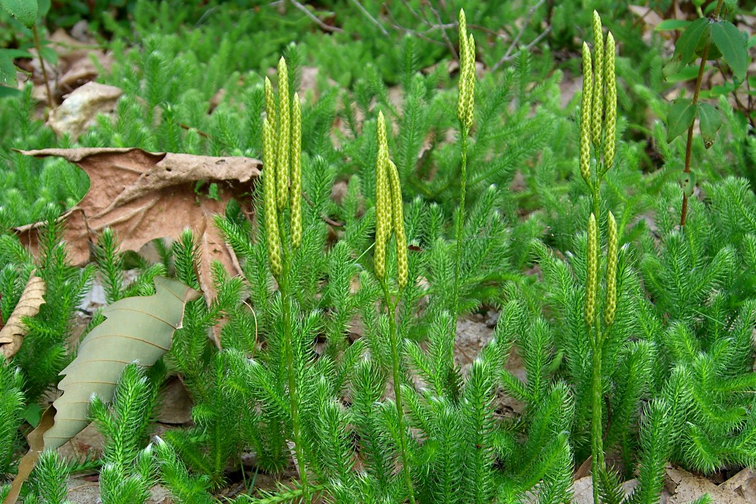
Lycopodium (club moss example)
Notes:
Aka ground pine
Tiny pine tree only 9 cm tall

Slide 54
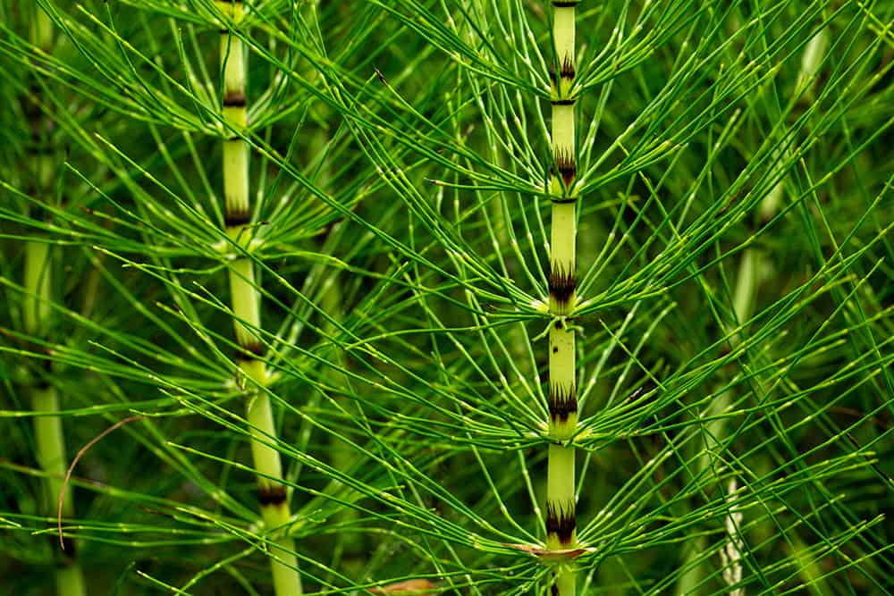
Equisetum (horsetail example)
Common name: ‘horsetail’ or ‘scouring rush’; can scrape pots and pans
Common weed

Slide 55
A History Lesson

Slide 56
Ferns
11,000 extant species
Evolved 400 mya (from ancient tracheophytes)
Well-developed anatomy: true vascular tissues, roots, rhizomes, fronds
Up to a meter tall
Most abundant in wet habitats, e.g. rainforests
+ All the basic characteristics of Tracheophytes

Slide 57
Fern Life Cycle: Overview
Alternation of generations: diploid sporophyte is dominant
Sexual reproduction requires standing water for sperm to swim to eggs
Notes:
Discussion question: what other clade are ferns similar to in that they both require standing water? (bryophytes)

Slide 58
Notes:
Discussion question: what other clade are ferns similar to in that they both require standing water? (bryophytes)

Slide 59
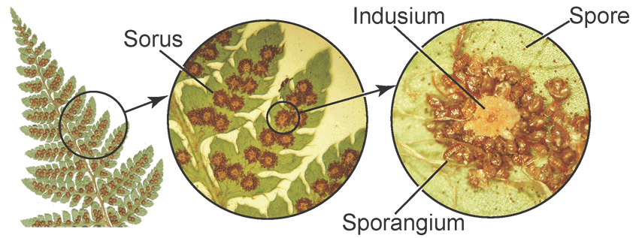
Fern Life Cycle (Spores)
Sporophytes have sori on underside of fronds
Sori contain spore-producing structures
Spores are carried large distances by wind and water
Notes:
Note: spores may be carried by wind or water great distances

Slide 60
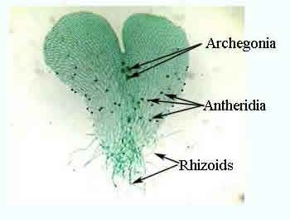
Fern Life Cycle (Gametophyte)
Spore germinates into gametophyte called prothallium
Prothallium is tiny, lacks vascular tissues, grows only in moist areas
Prothallium has archegonia and antheridia which produce eggs and sperm, respectively
Notes:
Note: spores may be carried by wind or water great distances

Slide 61
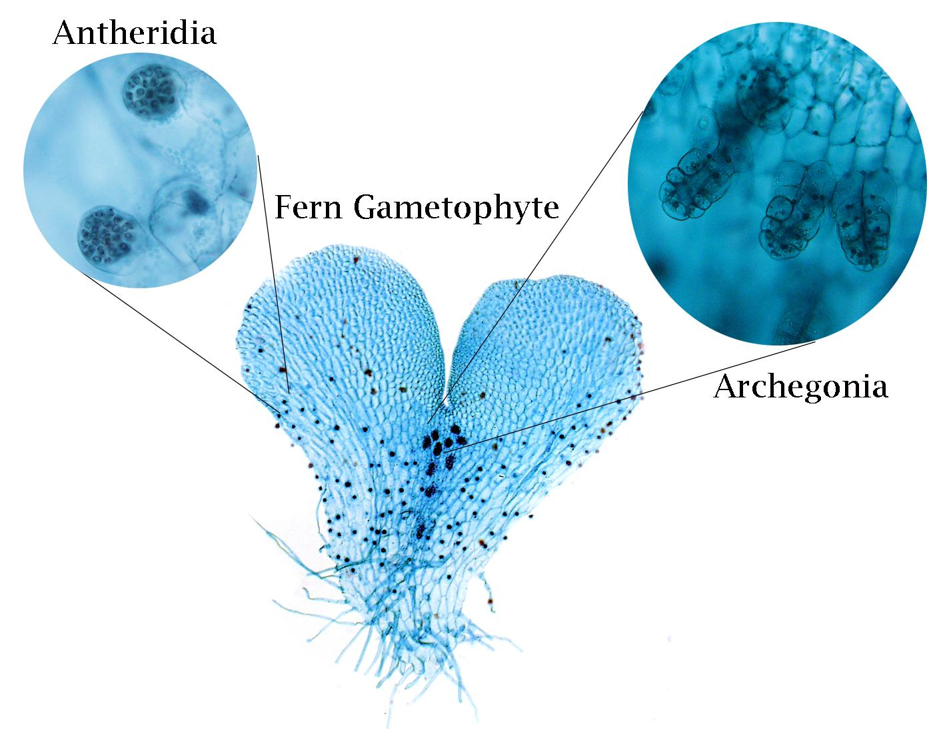
Why are archegonia more centralized, while antheridia are located towards the outside?
How do archegonia and antheridia differ from the same structures in bryophytes?
Notes:
Note: spores may be carried by wind or water great distances

Slide 62
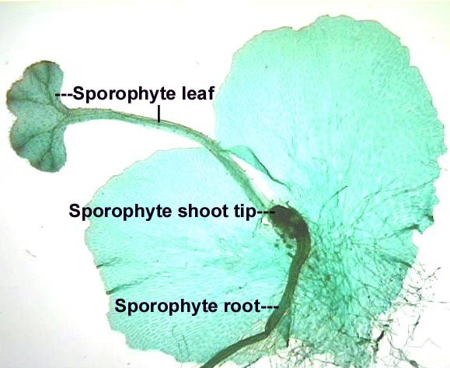
Fern Life Cycle (Sporophyte)
Fertilization → diploid zygote grows into new sporophyte plant and gametophyte withers
Notes:
Note: spores may be carried by wind or water great distances

Slide 63
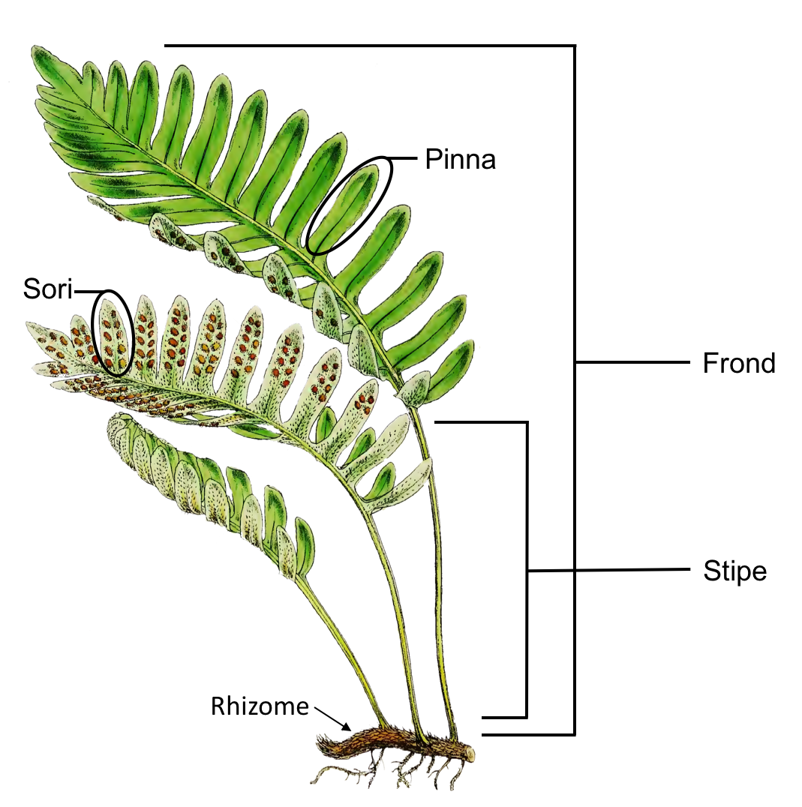
Fern Anatomy: Sporophyte
Blade
the expanded, leafy part of the frond
the whole fern leaf: blade and stipe
the stalk below the blade
I’m sori about all the vocabulary…
Rhizome
underground, creeping horizontal stem
Roots

Slide 64
Discussion Questions
What is vascular tissue? Name and briefly describe the types of vascular tissue.
How are ferns adapted to life on land?
What generation in ferns is most obvious? What substance is needed by ferns to reproduce sexually?
Compare and contrast ferns and bryophytes. (life cycle, anatomy)
Even though ferns survive under many of the same environmental conditions as mosses, ferns are able to grow much larger than mosses. Why is this so?
Which parts of the fern sporophyte are visible? Which are below ground?

Slide 65
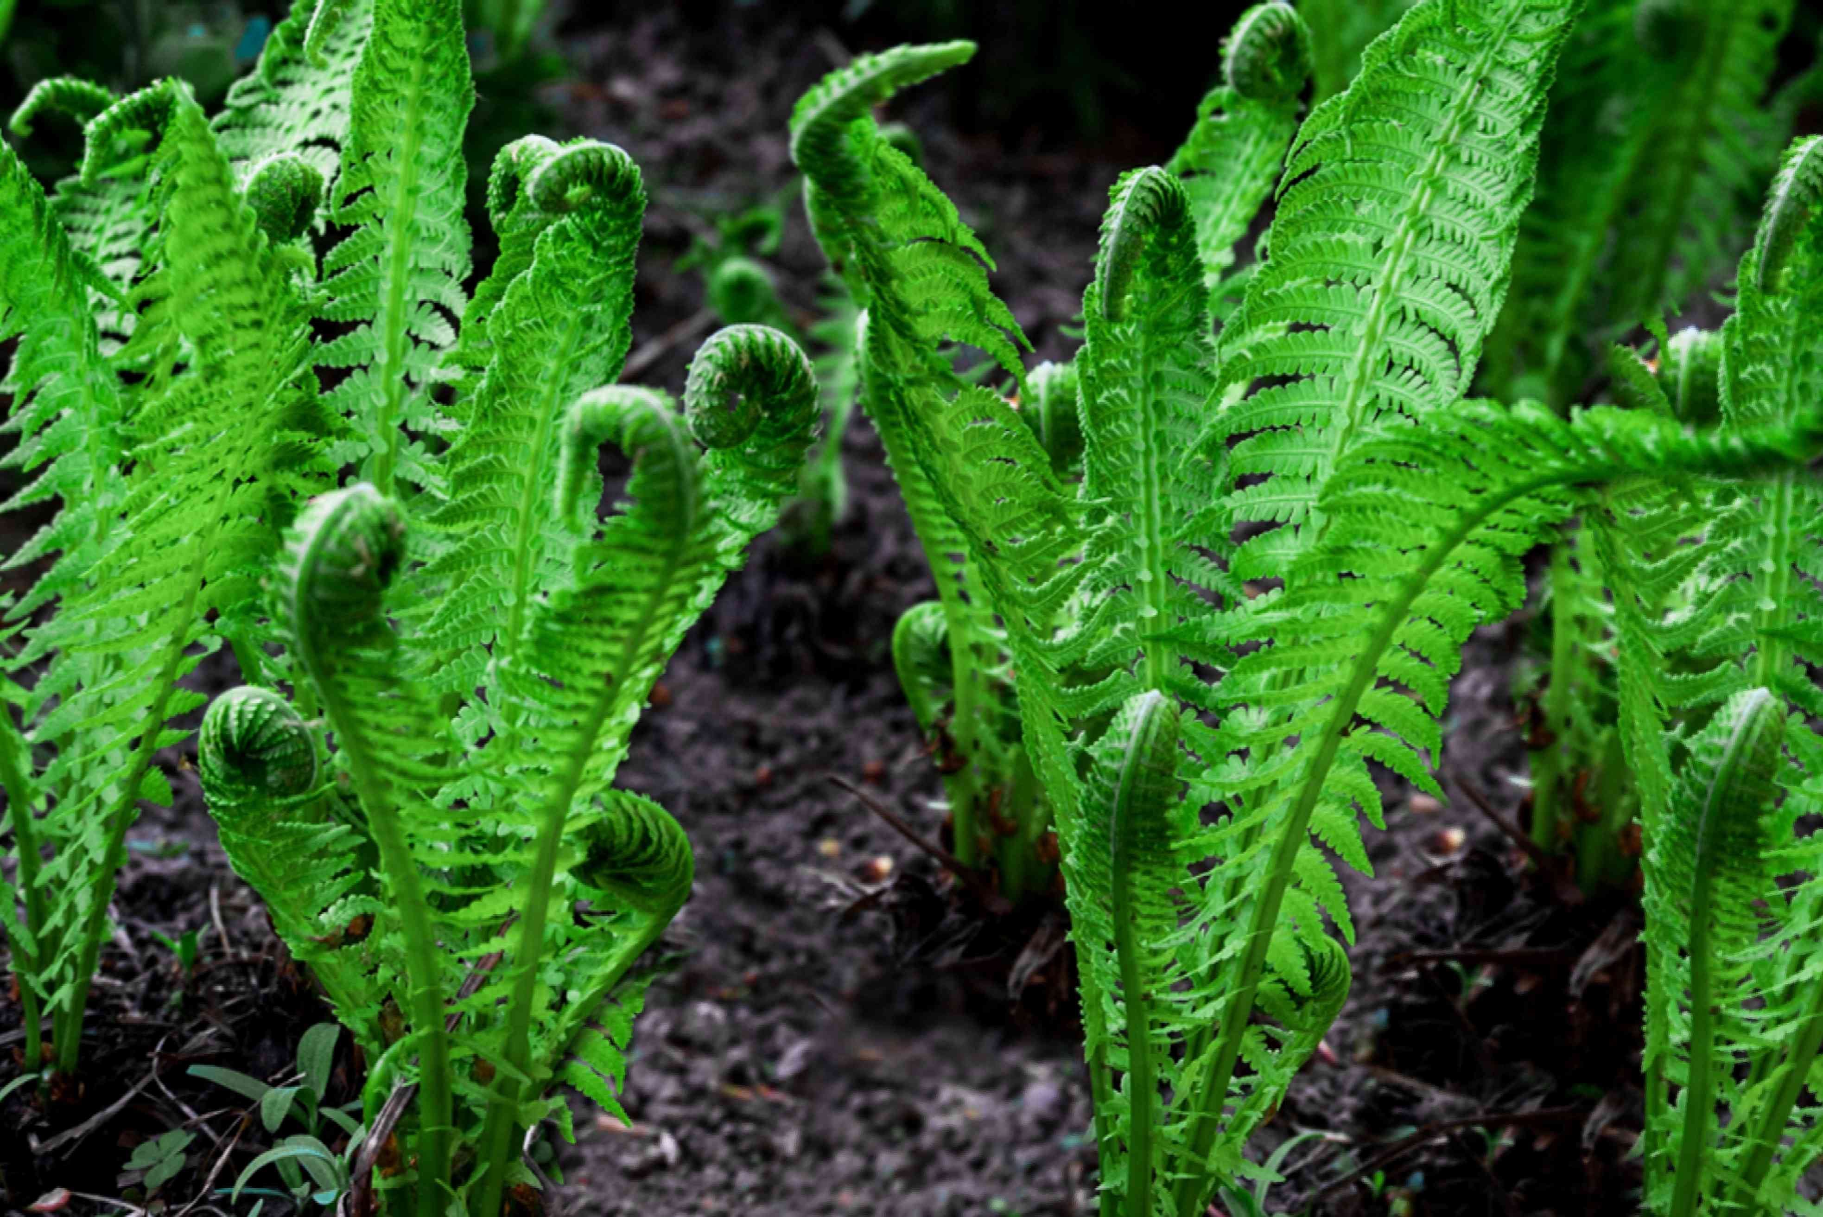
Where Mosses and Ferns Fit Into the World (21-4)
Well adapted to specific habitats:
Mosses: damp areas
Ferns: shadows of forests (can thrive with little light)
Medicinal (treat burns, bruises)
Food: eat fiddleheads (young fern fronds)

Slide 66
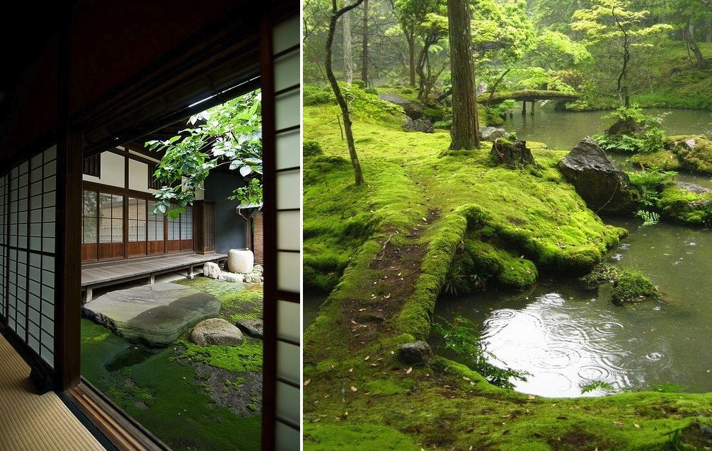
Where Mosses and Ferns Fit Into the World, continued (21-4)
Gardening:
Decorative mosses and ferns
Add moss to garden soil (improves ability to retain water, increases soil acidity)

