Slide 1
Today’s lesson was brought to you by…
https://youtu.be/YibPUJTnrGk?t=42
Notes:
Only watch to 1:18…end of speech and Hail Hydra

Slide 2
Brainstorm
1) What do you think of when you think of “jellyfish”? What are some of its key characteristics?
2) What might a jellyfish be related to? Any other groups of animals you can think of?

Slide 3
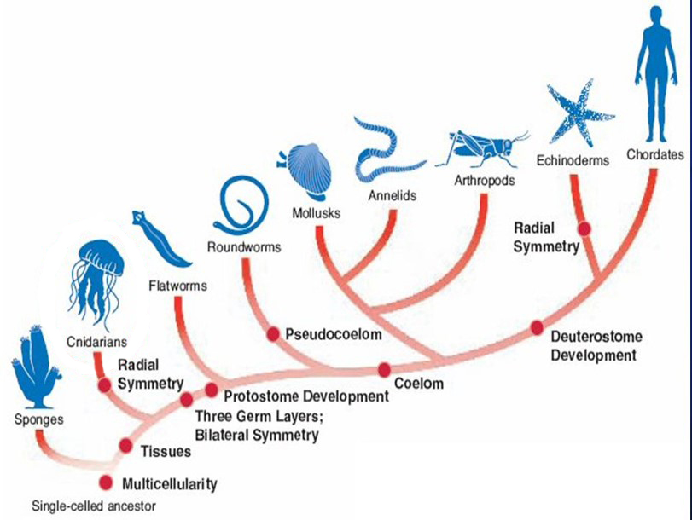

Slide 5
Cnidarians: overview
Includes sea anemones, coral, jellyfish, hydras
Over 10,000 species, mostly marine
Carnivores with specialized stinging cells called cnidocytes
First appearance of true tissues and germ layers; have a central gastrovascular cavity (GVC or ‘gut’)
Two body forms: polyp and medusa

Slide 6
Cnidarians: key characteristics
(Eukaryotic, Multicellular)
Radial symmetry
Two germ layers: endoderm and ectoderm
Two alternating forms: polyp & medusa
Feeding: incomplete gut, cnidocytes
Nervous system: nerve net and rhopalia
Skeleton:
Hydrostatic skeleton
Exo- and endoskeletons
Epitheliomuscular cells

Slide 7
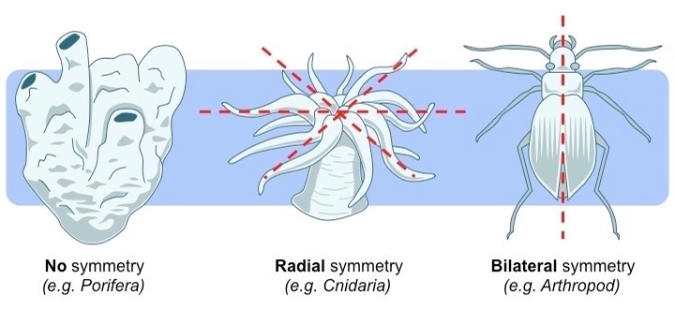
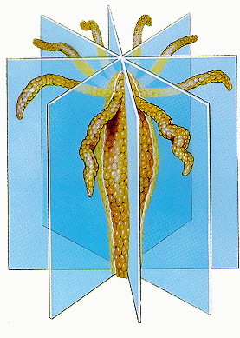
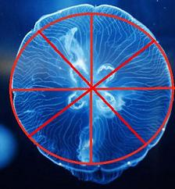
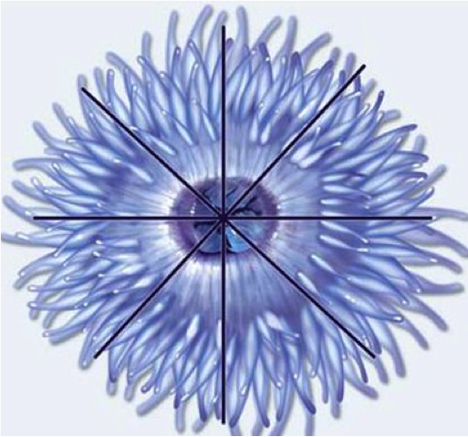
Cnidarians have radial symmetry

Slide 8
Cnidarians have radial symmetry

Slide 9
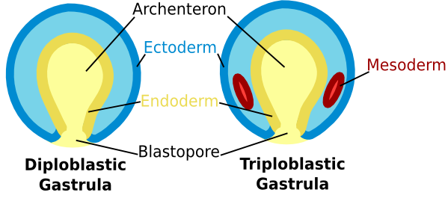
Germ Layers
Germ layer:
Group of cells that develop together in the embryo
Each layer will develop into certain structures

Slide 10
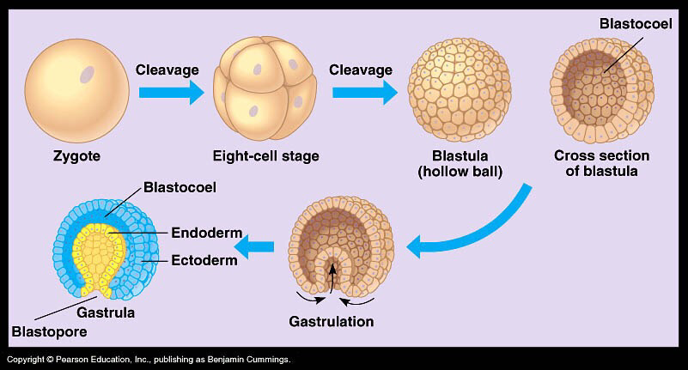

Slide 11
Germ Layers
Video
Ectoderm:
Outermost germ layer
External organs: e.g. skin, nervous system
Mesoderm: (absent in Cnidaria)
Middle germ layer
Muscles, heart, blood, bones
Endoderm:
Innermost germ layer
Internal organs: e.g. gut (GVC), lungs
Cnidarians have a diploblastic gastrula; humans (and many other animal groups) have a triploblastic gastrula.

Slide 12
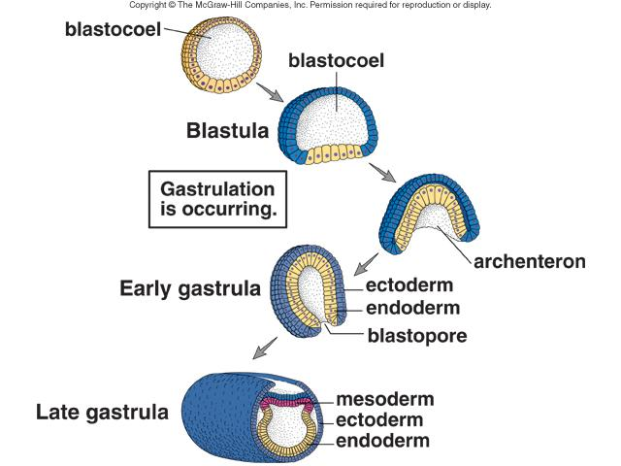
Germ Layers

Slide 13
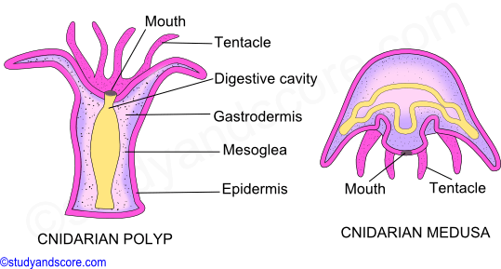
Life Cycle: Polyp
Polyp:
Sessile, attached to ocean floor
Mouth facing upward
Reproduces asexually by budding
Asexual reproduction requires 1 parent and produces offspring that are identical to the parent.
Sexual reproduction requires 2 parents (sperm, egg) and produces offspring that are different from the parents.

Slide 14
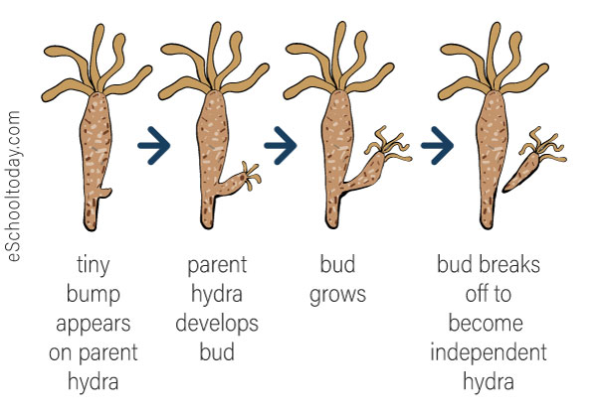
Life Cycle: Polyp Reproduction

Slide 15
Life Cycle
Corals, hydra and anemones have polyp stage only
Jellyfish alternate between two life forms: polyp and medusa

Slide 16
Life Cycle of Jellyfish
Medusa:
Free-floating
Mouth facing downward
Reproduces sexually

Slide 17
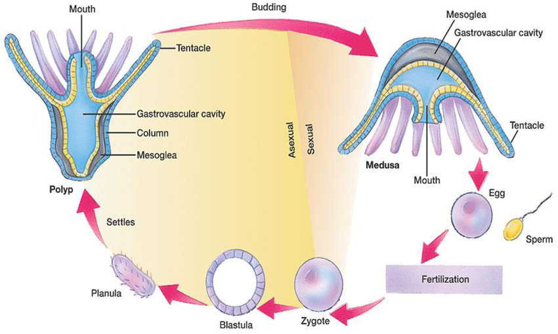
Life Cycle of Jellyfish

Slide 18
Cnidarian Anatomy
Epidermis: (ectoderm)
Outermost layer (‘skin’)
Contains cnidocytes and nerve net in both polyp and medusa
Mesoglea:
Between epidermis and GVC
Mostly non-living jelly
Involved in hydrostatic skeleton
Gastrovascular cavity (GVC): (endoderm)
Digests and processes food
Incomplete gut: single hole is mouth and anus
Notes:
Polyp: epidermis, mesoglea, GVC, tentacle, basal plate
Medusa: epidermis, mesoglea, GVC, tentacle

Slide 19
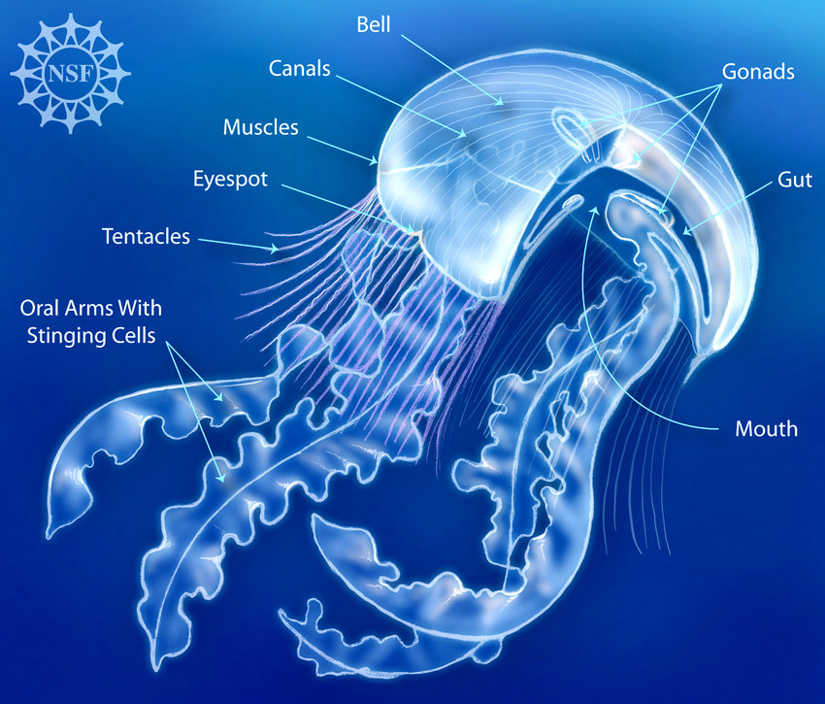
Notes:
Oral arm (not testable)
Present on ‘true’ jellies (i.e. Medusozoa)
Located near mouth
Brings food to mouth

Slide 20
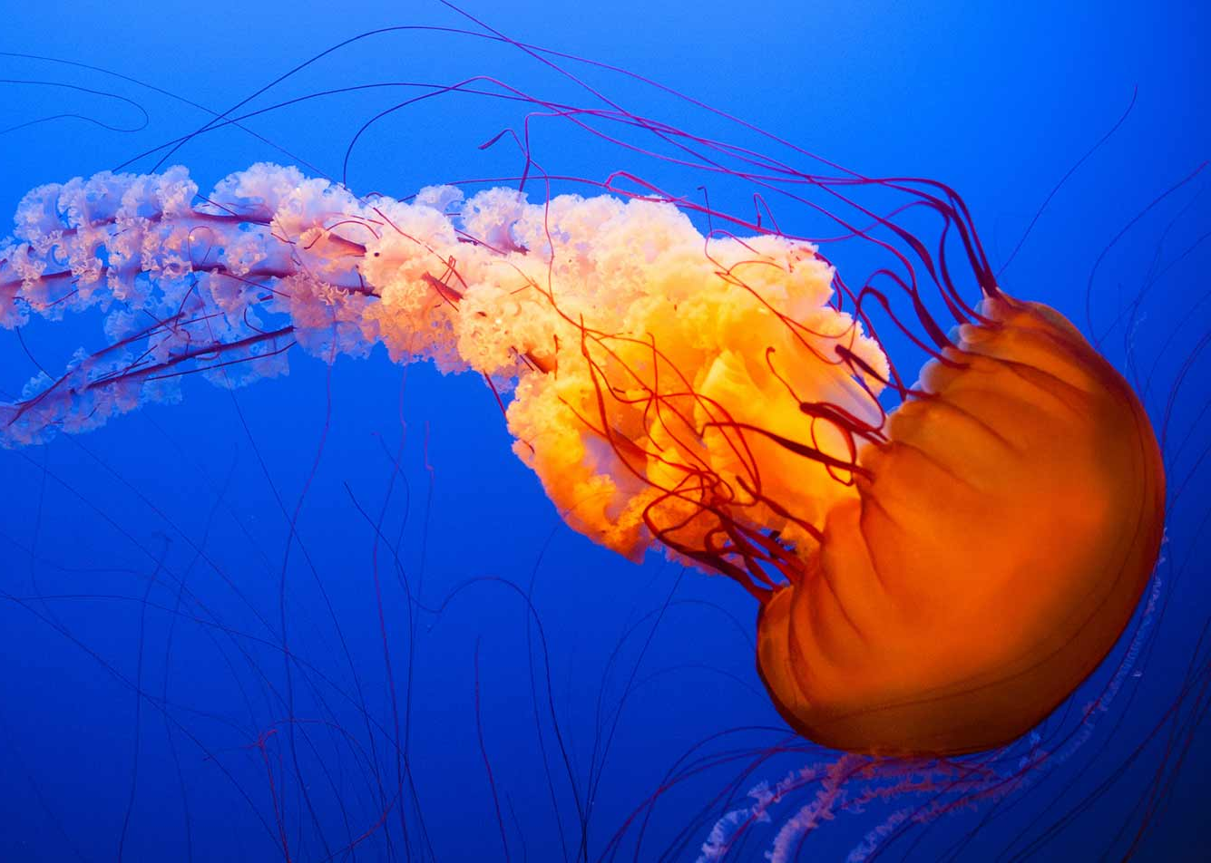
Cnidarian Anatomy
Tentacle:
Used to capture food, deter predators
Has cnidocytes on surface
In sea anemone, can be retracted into body

Slide 21
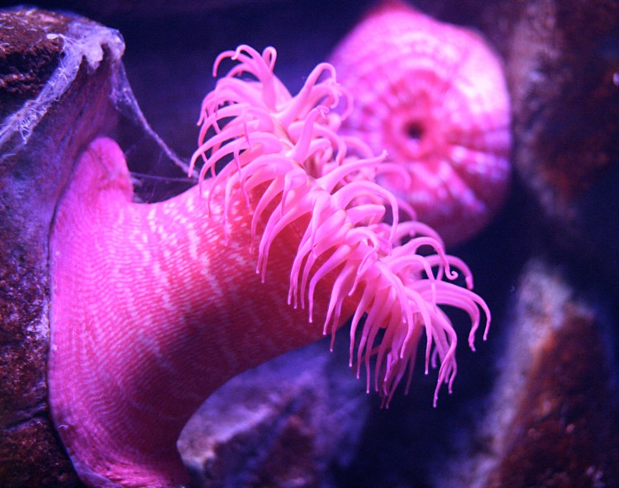
Cnidarian Anatomy
Basal plate
In polyp form only
Attaches organism to ocean floor

Slide 22
Feeding and Digestion
Cnidarians are carnivores
Cnidarians only have one opening into their gastrovascular cavity (GVC): it is their mouth AND anus!

Slide 23
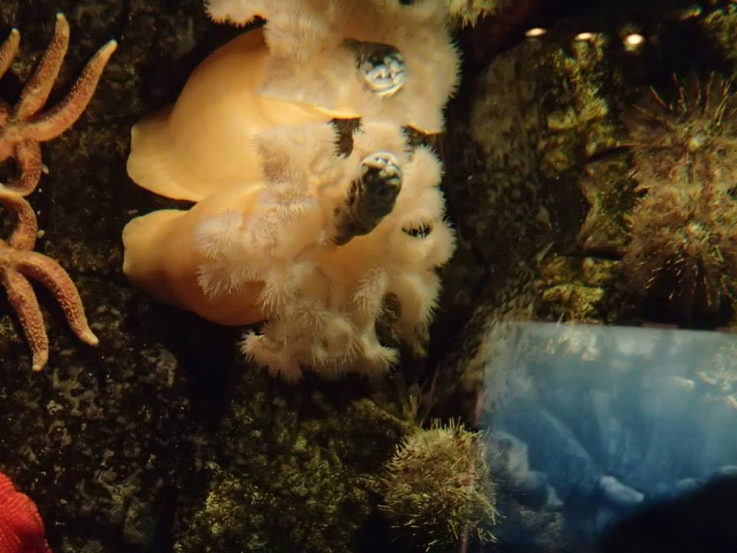
Feeding and Digestion

Slide 24
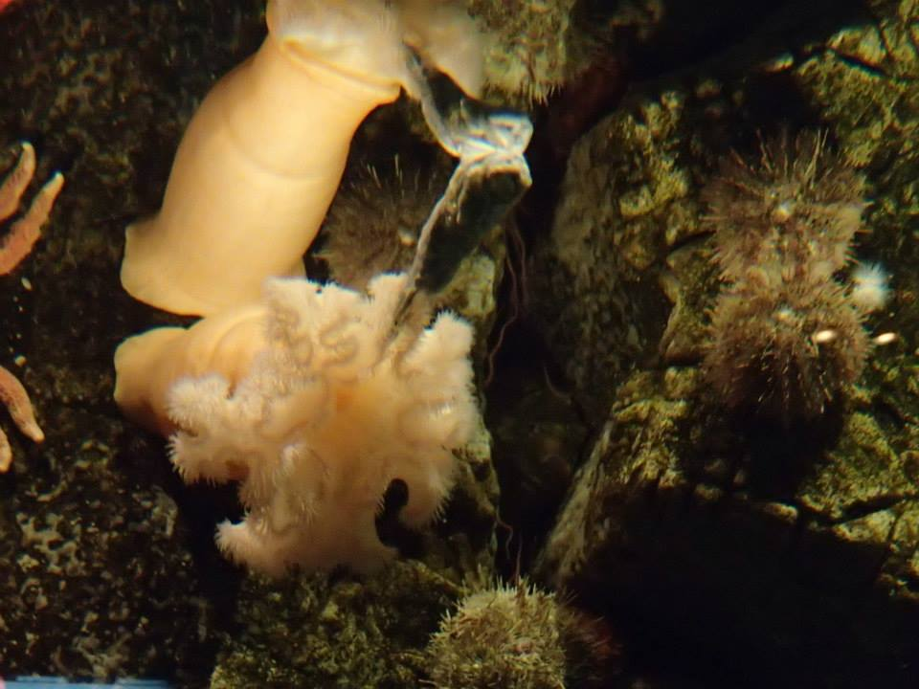
Feeding and Digestion

Slide 25
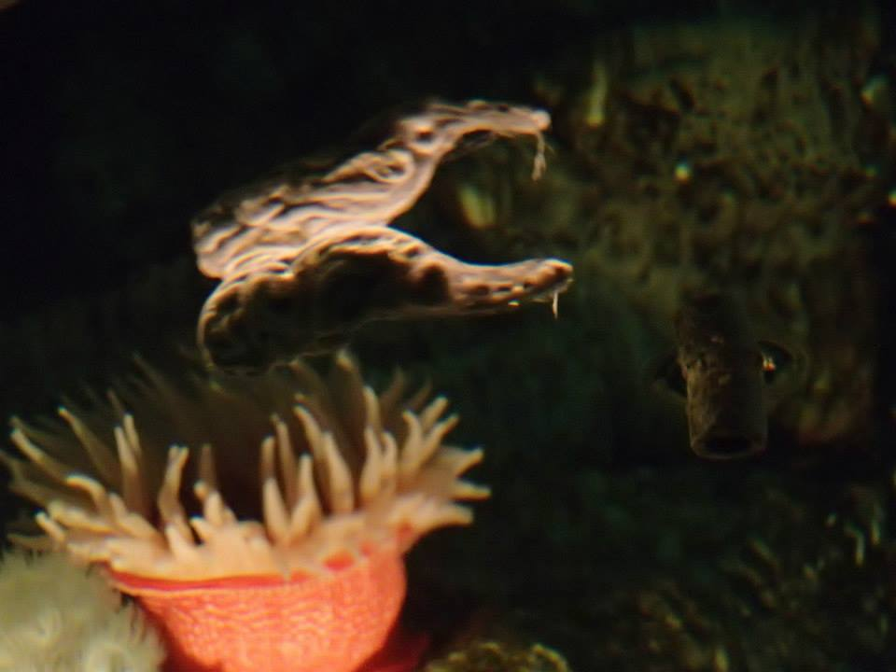
Feeding and Digestion

Slide 26
Feeding and Digestion
Cnidarians are carnivores
Cnidarians only have one opening into their gastrovascular cavity (GVC): it is their mouth AND anus!
They capture and consume prey by stinging it with cells on their tentacles called cnidocytes.

Slide 27
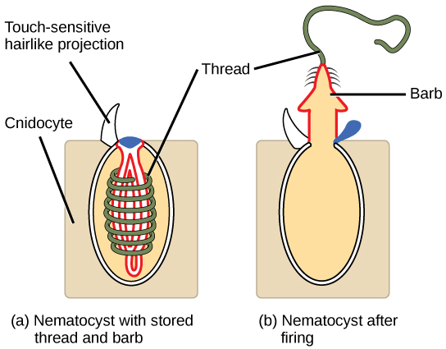
Specialized Cells: Cnidocytes
Cnidocyte (stinging cells)
Found on tentacle epidermis
For capturing prey or self-defense
Contains barbed thread that releases on contact
Video: https://www.shapeoflife.org/video/cnidarians-anemones-fight

Slide 28
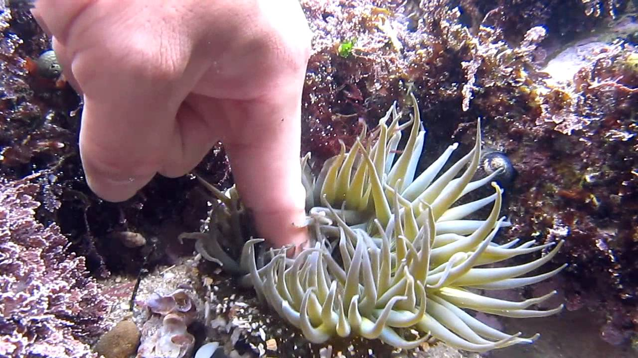
What do you expect to happen when you touch a sea anemone with your finger?
If you leave your finger in the clutches of the anemone, after a while, it starts to tingle and feel itchy. Why is this?

Slide 29
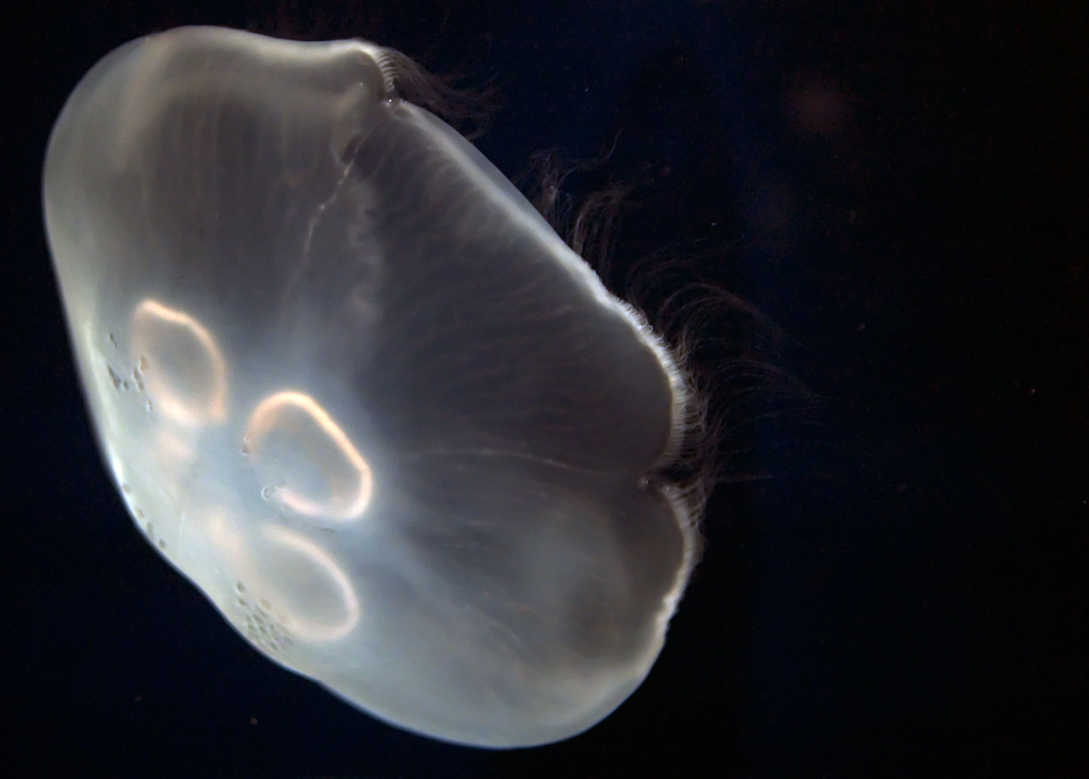
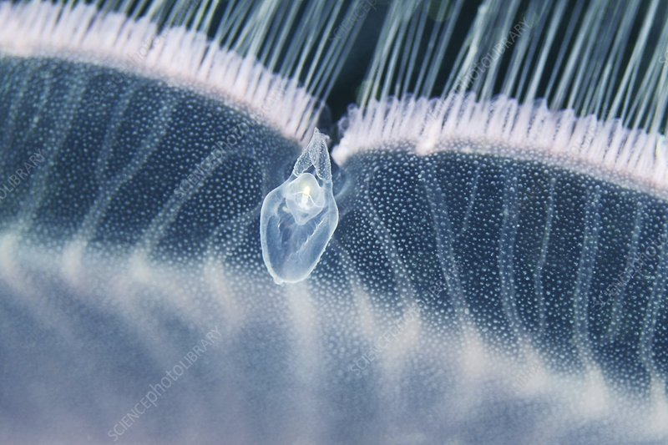
Nervous System
Rhopalium: cluster of sensory structures in jellyfish medusae

Slide 30
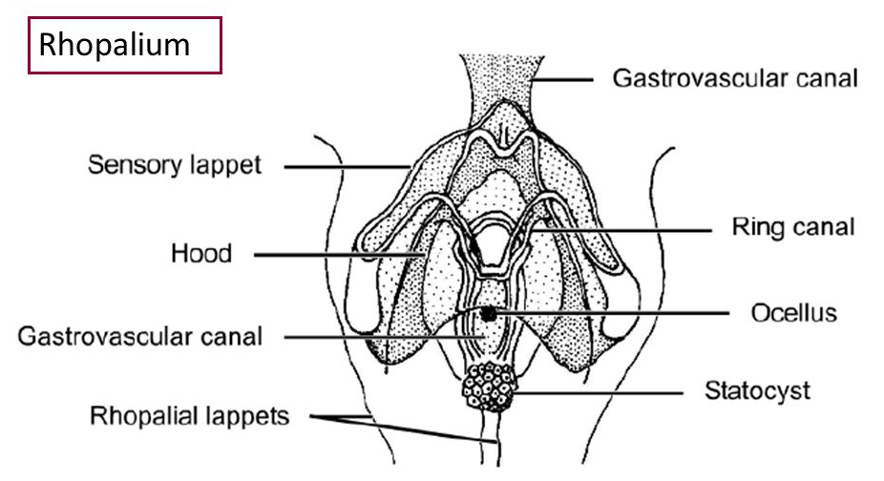
Nervous System
Rhopalium: cluster of sensory structures in jellyfish
Eye spot: senses light
Chemoreceptor (not shown): detects chemicals (taste, smell)
Statocyst: senses gravity (which way is up?)
Eye spot

Slide 31
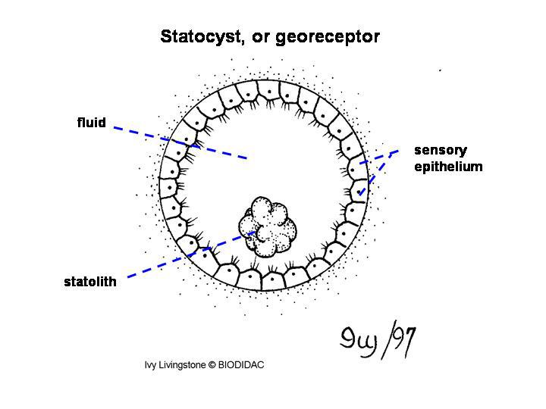
Nervous System
How does the statocyst work?
Rock in fluid surrounded by cells with cilia (hairs)
When the rock touches a cilium, this is detected
The cnidarian can always tell which way it is facing!

Slide 32
Nervous System
Neurons relay sensory information to nerve net from rhopalia
Nerve Net:
Found in animals with radial symmetry
Interconnected neurons without a brain or central nervous system
Neurons are cells of the nervous system. They transmit signals and make decisions.
Notes:
What is the nervous system in a cnidarian made of: endoderm, [mesoderm], or ectoderm? Why?

Slide 33
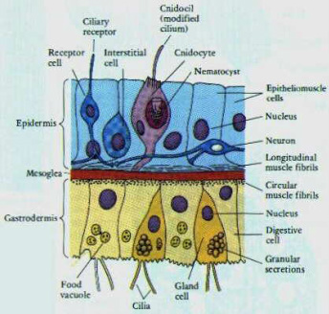
Specialized cells by germ layer
Ectoderm:
Cnidocyte
Neuron
Epitheliomuscular cell
Endoderm:
Digestive cells*
* won’t go into detail

Slide 34
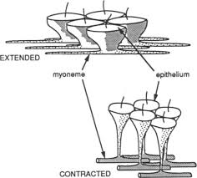
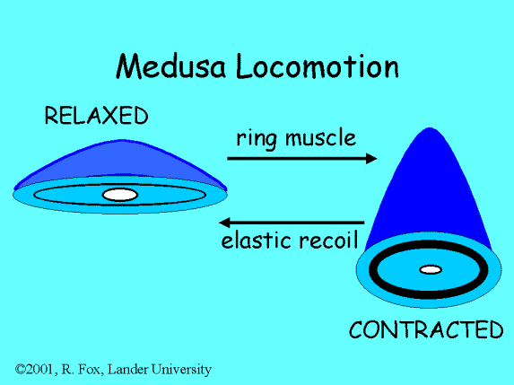
Specialized Cells: Epitheliomuscular cells
Cnidarians lack mesoderm and true muscles.
Epitheliomuscular cells are modified epidermis cells that work together to allow movement.
See jellyfish swimming https://www.youtube.com/watch?v=aJUuotjE3u8&ab_channel=Zzx4k
Notes:
Exotic jellyfish video showing movement. No commentary. https://www.youtube.com/watch?v=aJUuotjE3u8&ab_channel=Zzx4k

Slide 35
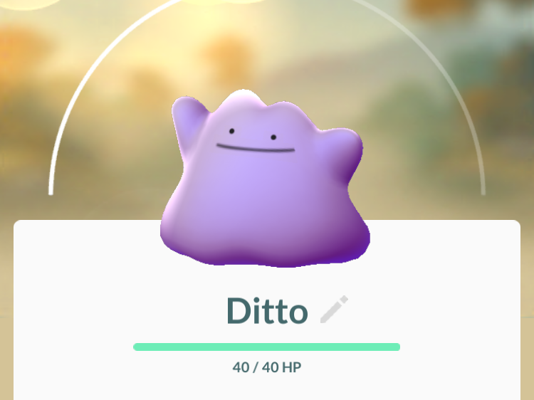
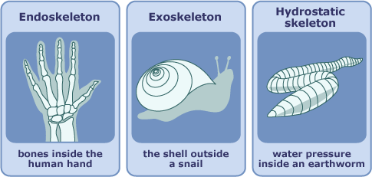
Skeleton Types
Animal cells are squishy and lack cell walls
Purpose of skeleton:
Support animal
Works with muscular system to allow for movement
Review: What type of skeleton do sponges have?
Notes:
Answer: sponges have an endoskeleton (spicules). [Hydrostatic skeleton is inappropriate here because hydrostatic skeletons are typically associated with movement and a deal of plasticity in shape and appearance…sponges always look the same and are only capable of movement in response to wave action.]

Slide 36
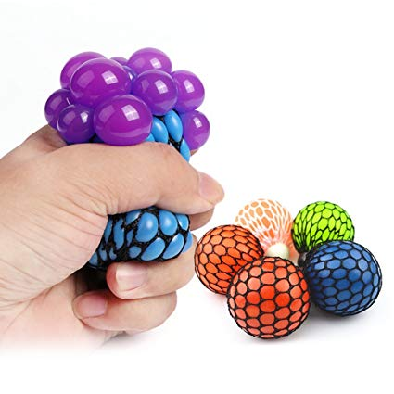
Hydrostatic Skeleton (all cnidarians)
“Hydro” = water; “static” = not in motion
Mesoglea exerts outward pressure and provides support for cnidarian body
This is just like the insides of a grape, or water in a water balloon: both are surprisingly difficult to ‘pop’!

Slide 37
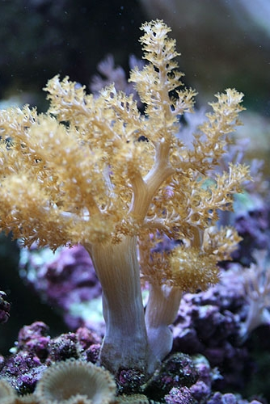
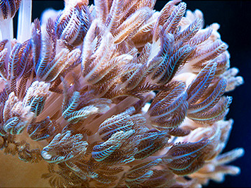
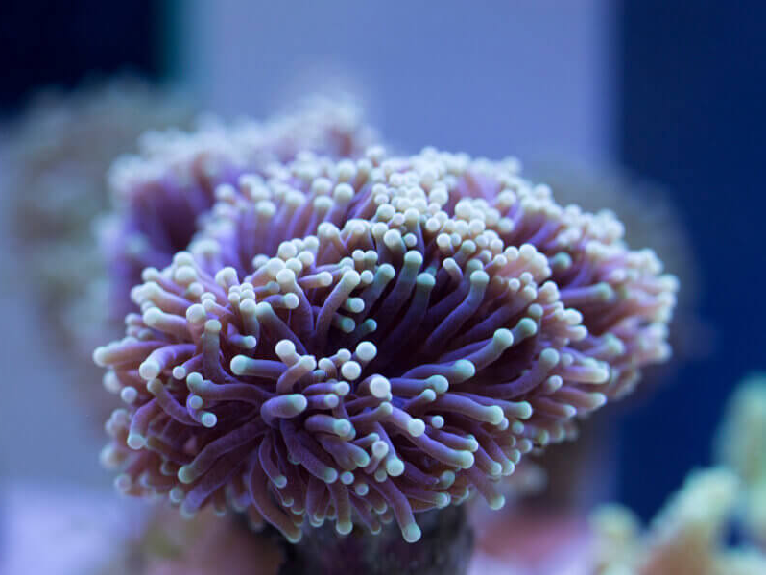
Endoskeleton (corals only)
Some corals have hardened components embedded inside their tissue (much like Poriferan spicules)

Slide 38
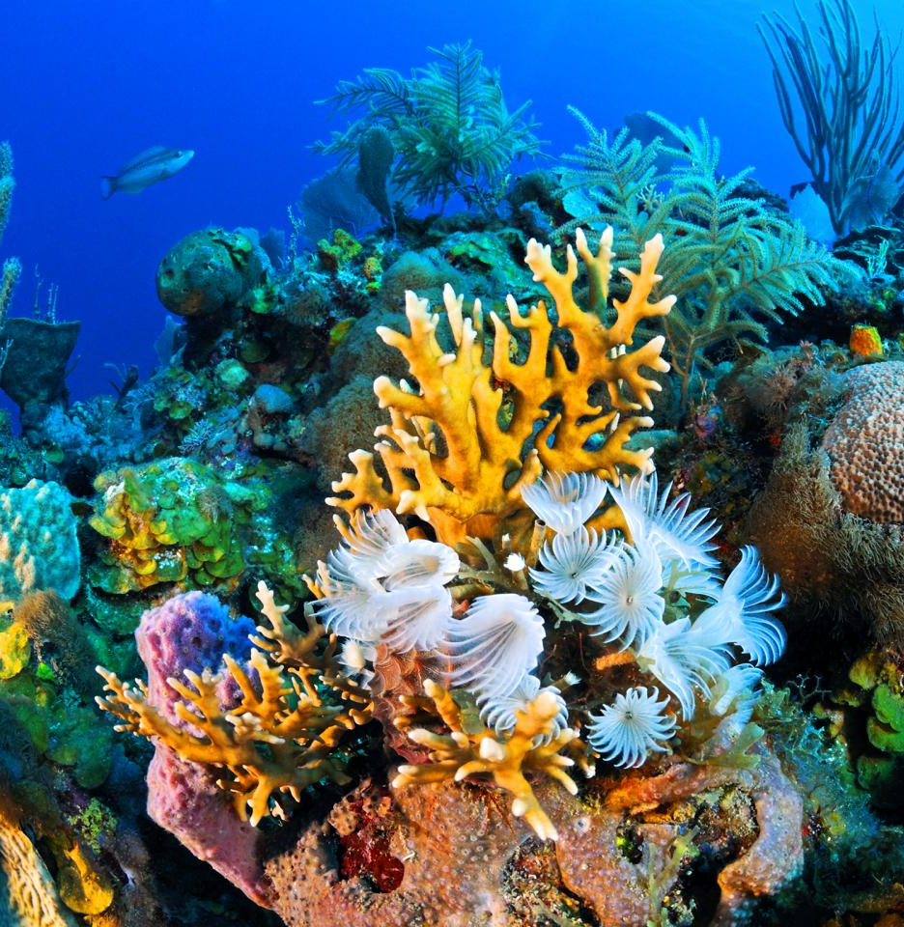
Exoskeleton (corals only)
Hard outer layer made of CaCO₃ (calcium carbonate)
Is left behind when coral dies
Affected by ocean acidification

Slide 39
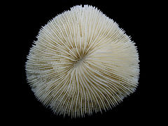
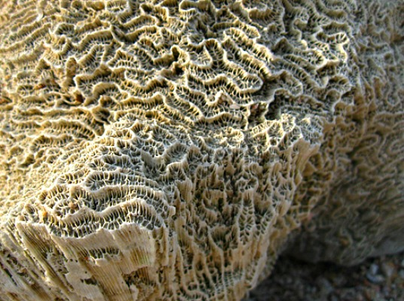
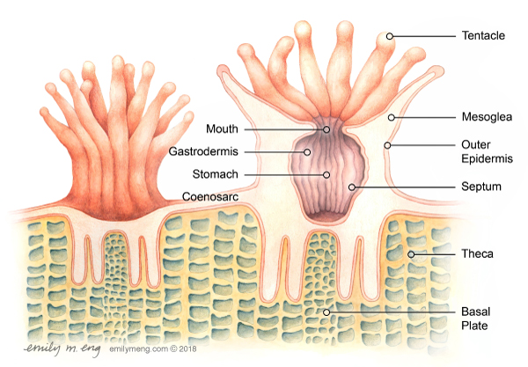
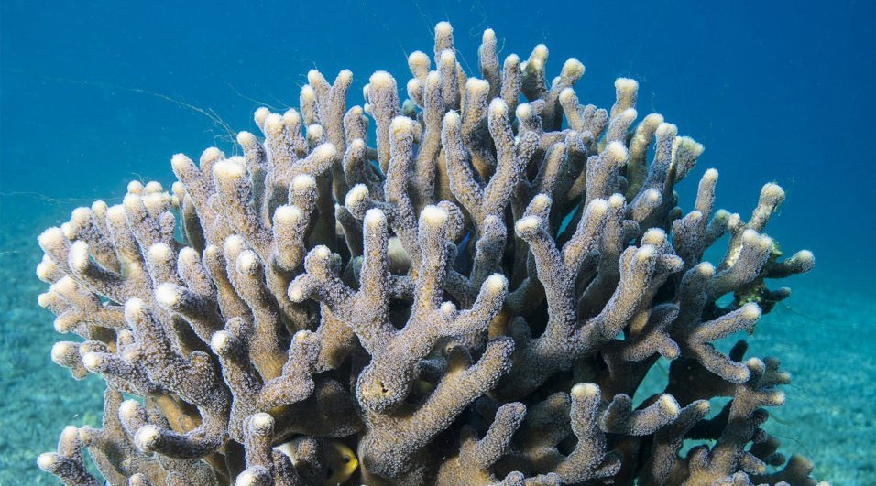

Slide 40
Research Activity
What is ocean acidification?
What human activities cause ocean acidification?
How are corals (and other species) affected?
How can humans address the issue of ocean acidification?
Video on ocean acidification (alternate video)
Video on making cement
NasDaily Video

Slide 41
Major Cnidarian Taxa

Slide 42
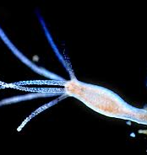
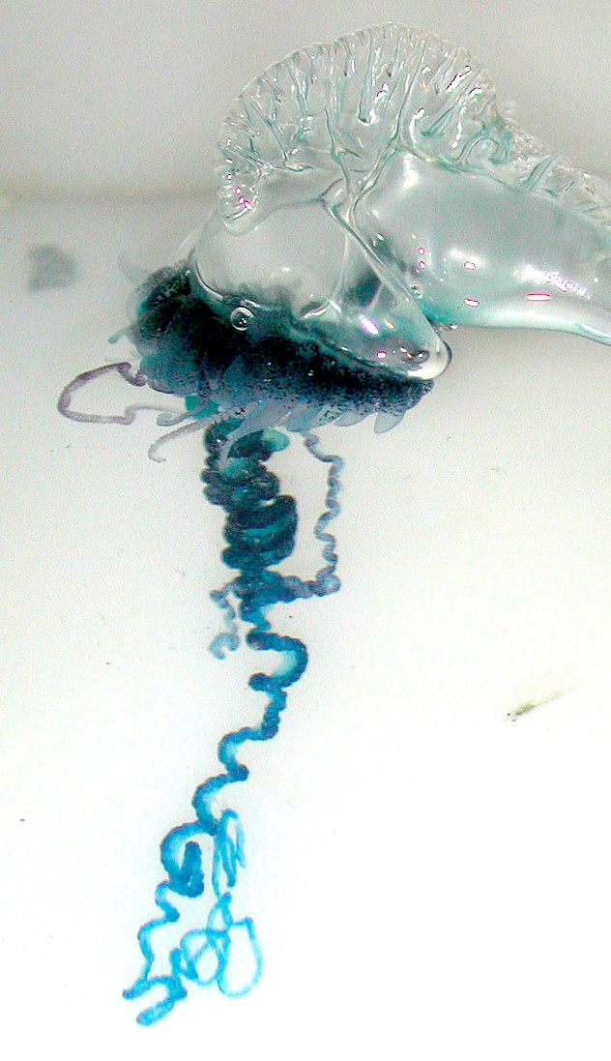
Hydra (Hydrozoa)
Polyp stage only
Freshwater (live in lakes, ponds)
Notes:
Man-o-war (not testable)
Symbiotic relationship between many specialized hydra polyps

Slide 43
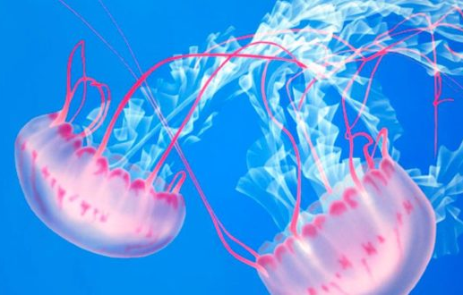
Jellyfish (Scyphozoa)
Polyp and medusa stages
GFP fluorescent protein derived from jellyfish → used to make living things glow in the dark!
Notes:
Fun jellyfish video. Not much instructional content but it’s pretty cool https://www.youtube.com/watch?v=9z8ujpPgUjI&ab_channel=NatGeoWILD

Slide 44
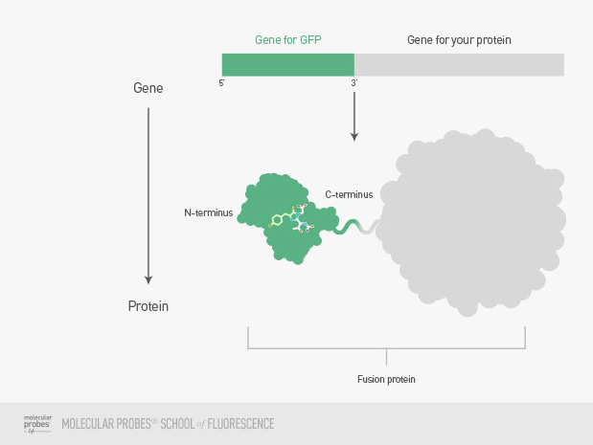
Notes:
Cool facts about scyphozoa (not testable)
Sea turtles often eat plastic bags, mistaking them for jellyfish
Bioluminescence (also in corals) (GFP derived from jellyfish)

Slide 45
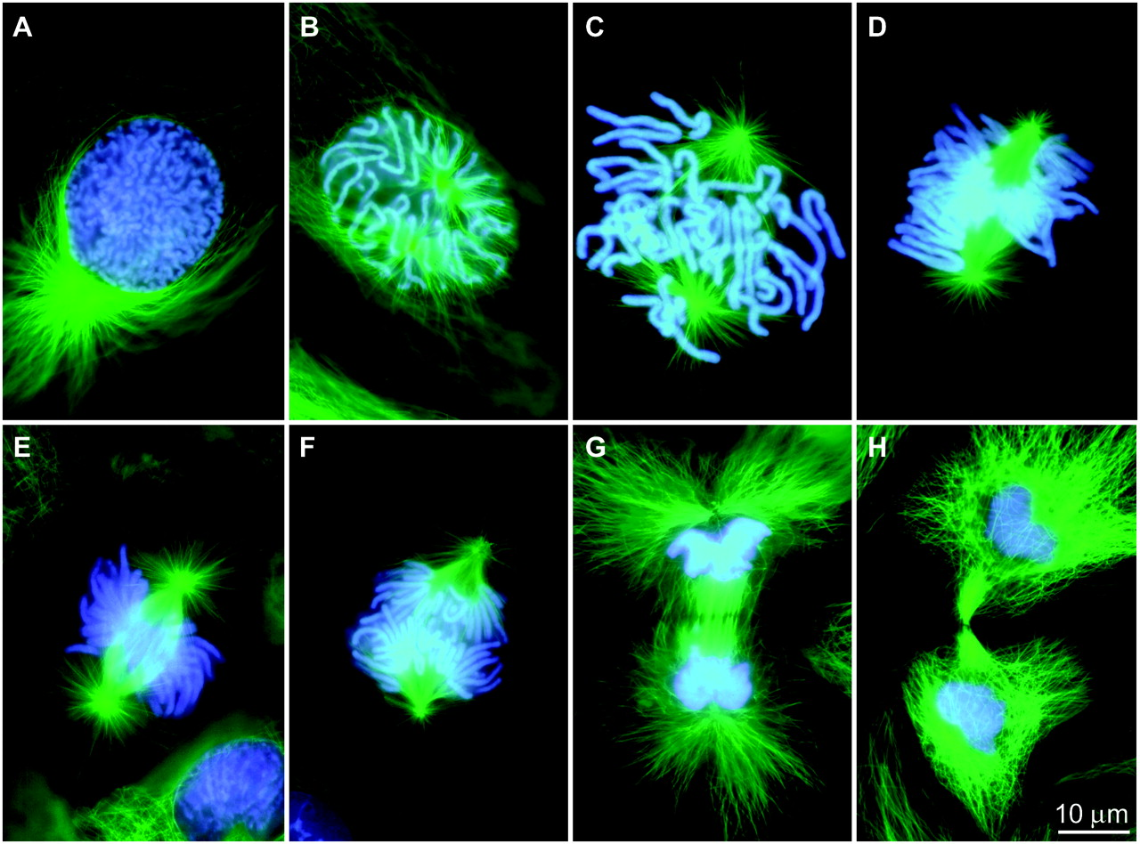

Slide 46
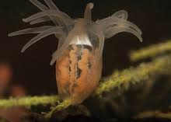
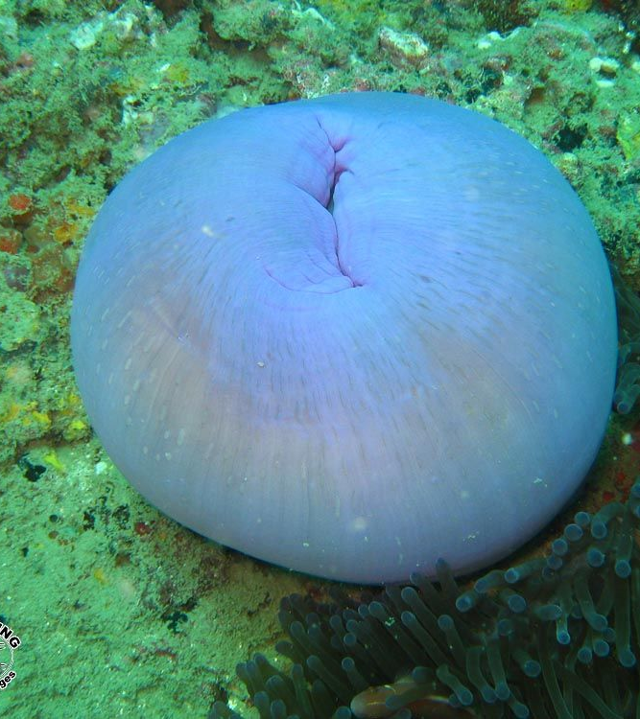
Sea Anemones (Anthozoa)
Polyp stage only
Can retract tentacles into body

Slide 47
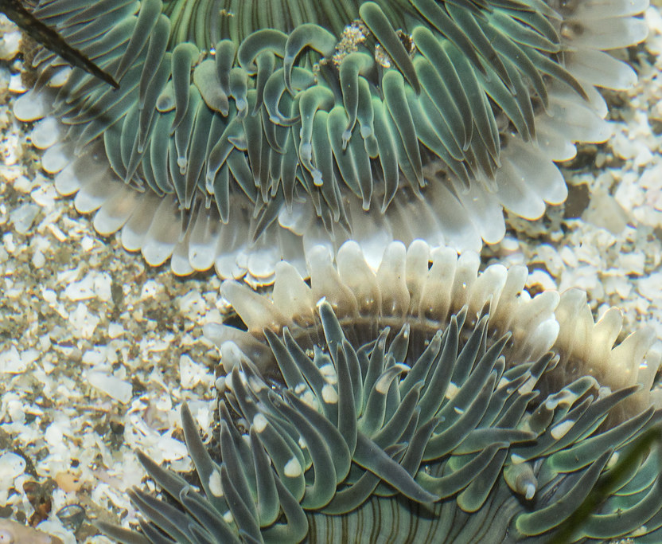
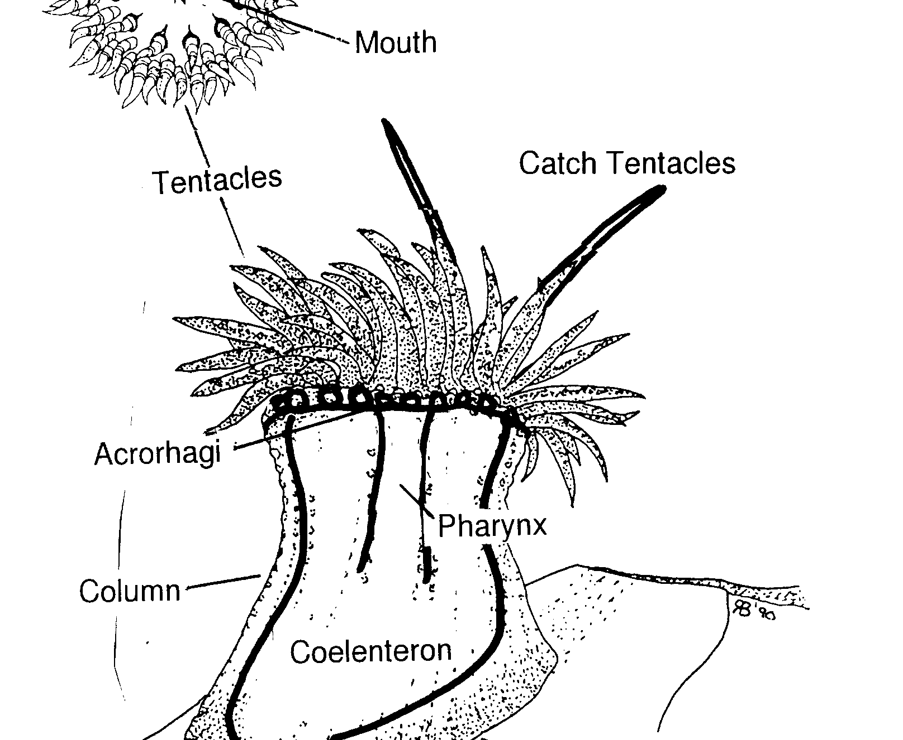
Sea Anemones (Anthozoa)
Adaptations:
Sessile, but basal plate can ‘walk’ slowly on ocean floor. Or, can detach, float with current, attach elsewhere.
Can fight off nearby anemones using acrorhagi: bulbs that are densely packed with cnidocytes
What are the benefits of sea anemones fighting each other? Drawbacks?
Notes:
Sea anemones fighting video https://www.shapeoflife.org/video/cnidarians-anemones-fight

Slide 48
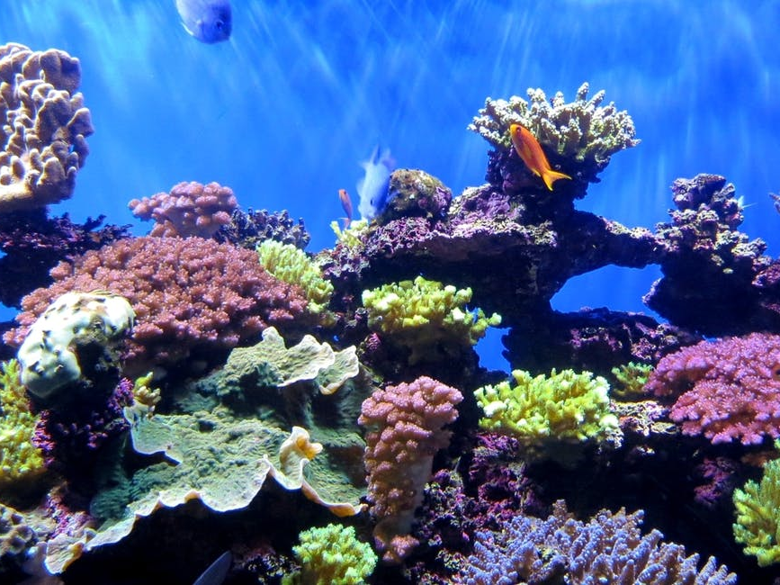
Coral (Anthozoa)
Polyp stage only
Coral colonies made of many polyps
Endo and exoskeletons made of CaCO₃ (calcium carbonate)
Build coral reefs (depended upon by many species)
Affected by ocean acidification

Slide 49
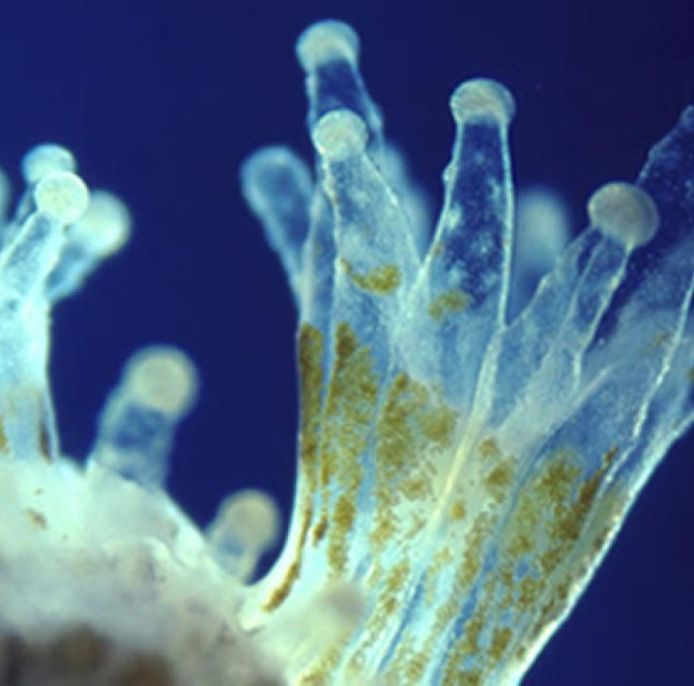
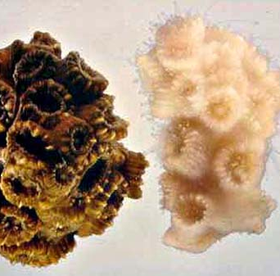
Coral (Anthozoa)
Symbiosis with photosynthetic algae
Algae gets protection, nutrients
Coral gets oxygen, nutrients
Coral colour comes from symbiotic relationship: if algae die, ‘bleaching’ occurs
Further reading (stop at “First author…”): https://www.princeton.edu/news/2016/11/02/when-corals-met-algae-symbiotic-relationship-crucial-reef-survival-dates-triassic

Slide 50
Key vocabulary
Cnidaria
Coral, Sea anemone, Jellyfish, Hydra
Radial symmetry
Germ layer
Endoderm, (Mesoderm), Ectoderm
Polyp
Medusa
(Sessile)
Epidermis
Mesoglea
Gastrovascular cavity (GVC)
Tentacle
Basal plate
Cnidocyte
Rhopalium, Eye-spot, Statocyst
Nerve net
Endoskeleton, Exoskeleton, Hydrostatic skeleton
Ocean acidification
Epitheliomuscular cells
Acrorhagi
Symbiotic relationship

Slide 51
Review Activity
Make a chart that shows the major features of each of the 4 groups of Cnidaria.

