Slide 1
Chemical Compounds
Bond Formation, Nomenclature, and Modelling

Slide 2
Reference
Non-metal Element | “-ide” Ending
N, nitrogen | Nitride
O, oxygen | Oxide
F, fluorine | Fluoride
P, phosphorus | Phosphide
S, sulfur | Sulfide
Non-metal Element | “-ide” Ending
Cl, chlorine | Chloride
Se, selenium | Selenide
Br, bromine | Bromide
I, iodine | Iodide
H, hydrogen | Hydride
Non-metal Element | “-ide” Ending
As, arsenic * | Arsenide
Te, tellurium * | Telluride
At, astatine * | Astatide
* uncommon

Slide 3
Overview
Review: atoms and subatomic particles, ions
Modelling Atoms and Compounds
Counting Atoms
Bohr Models
Lewis Diagrams
IUPAC Naming and Writing Formulas
Balanced Chemical Equations

Slide 4
IUPAC Nomenclature
(not covered in textbook)

Slide 5
Chemical Nomenclature (Naming)
It is important to have one system to name chemical compounds. Why?
Scientists can communicate with each other and the public, even in different languages
Every compound has a unique name
Information/records are accurate and consistent
IUPAC (International Union of Pure and Applied Chemistry) came up with a naming scheme that is used around the world.

Slide 6
Ionic Compound Nomenclature
(not covered in textbook)

Slide 7
Intro to Ionic Compound Nomenclature
Cation comes first; anion comes second.
Names of ionic compounds tell you which ions are in the compound.
e.g. “sodium chloride” has Na⁺ and Cl⁻ ions.
e.g. “titanium(IV) dichromate” has Ti⁴⁺ and Cr₂O₇²⁻ ions.
Chemical formulae tell you how many of each ion are in the compound, using subscripts.
e.g. “CaCl₂” has 1 Ca²⁺ ion and 2 Cl⁻ ions.
e.g. “Mn(OH)₂” has 1 Mn⁴⁺ ion and 2 OH⁻ ions.

Slide 8
Naming Ionic Compounds
Write the cation, first.
For metals that can only form one ion (monovalent metals), do not write the ion charge.
For multivalent metals, determine the ion charge through charge balancing. Then, put the ion charge in Roman numerals, in brackets.
If the cation is polyatomic, write it exactly the way it is written in the table.
Write the anion with “–ide” ending (unless it is polyatomic).

Slide 9
Naming Ionic Compounds
Write the cation, first.
For metals that can only form one ion (monovalent metals), do not write the ion charge.
For multivalent metals, determine the ion charge through charge balancing. Then, put the ion charge in Roman numerals, in brackets.
If the cation is polyatomic, write it exactly the way it is written in the table.
Write the anion with “–ide” ending (unless it is polyatomic).

Slide 10
Naming Ionic Compounds
Write the cation, first.
Write the anion with “–ide” ending.
Chemical Formula | Periodic Table | Name
NaCl |  | sodium chloride
MgBr₂ |  | magnesium bromide

Slide 11
Your Turn!
Name the following ionic compounds with monovalent metals.
KI potassium iodide
Be₃P₂ beryllium phosphide
ZnO zinc oxide
BaF₂ barium fluoride
AlBr₃ aluminium bromide

Slide 12
Naming Ionic Compounds
Oh no! Chromium is multivalent. Charge balancing is used to find the charge of a multivalent metal ion.
Write the cation, first.
Write the anion with “–ide” ending.
Chemical Formula | Periodic Table | Name
Cr₂O₃ |  | ???
CrO |  | ???

Slide 13
Naming Ionic Compounds
Write the cation, first.
For metals that can only form one ion (monovalent metals), do not write the ion charge.
For multivalent metals, determine the ion charge through charge balancing. Then, put the ion charge in Roman numerals, in brackets.
Write the anion with “–ide” ending.

Slide 14
Charge Balancing (to find the charge of a multivalent metal ion)
Write out all the ions you have. Leave the charge blank on the multivalent metal.
Rule: The total number of positive charges in an ionic compound must equal the total number of negative charges. Determine the charge on the metal ion.
Write the compound name. Specify the ion charge on the multivalent metal using brackets and Roman numerals.

Slide 15
Charge Balancing Part 1: Determining Charges of Multivalent Metals
Cr₂O₃:
1) Write out all the ions you have. Leave the charge blank on the multivalent metal.
2) The total number of positive charges in an ionic compound must equal the total number of negative charges. Determine the charge on the metal ion. | Total: 6 negative charges. Must have 6 positive to balance the charges. Divide by # of chromium ions (2). Therefore, each Cr ion must have a 3+ charge.
3) Write the compound name. Specify the ion charge on the multivalent metal using brackets and Roman numerals. | chromium(III) oxide
O²⁻
Cr?
We know there are 2 chromium ions and 3 oxygen ions from the subscripts in the formula.
O²⁻
Cr?
O²⁻

Slide 16
Charge Balancing Part 1: Determining Charges of Multivalent Metals
CrO:
1) Write out all the ions you have. Leave the charge blank on the multivalent metal.
2) The total number of positive charges in an ionic compound must equal the total number of negative charges. Determine the charge on the metal ion. | Total: 2 negative charges. Must have 2 positive to balance the charges. Divide by # of chromium ions (1). Therefore, each Cr ion must have a 2+ charge.
3) Write the compound name. Specify the ion charge on the multivalent metal using brackets and Roman numerals. | chromium(II) oxide
Cr?
O²⁻
We know there is 1 chromium ion and 1 oxygen ion from the subscripts in the formula.

Slide 17
Your Turn!
Name the following ionic compounds with multivalent metals.
TiO₂ titanium(IV) oxide
Mo₂S₃ molybdenum(III) sulfide
Hg₃P mercury(I) phosphide
MnSe₂ manganese(IV) selenide
SnI₂ tin(II) iodide

Slide 18
Your Turn!
Name the following ionic compounds. Make sure you do charge balancing for ionic compounds with multivalent metals only.
1) Who wants to take a Na₃P?
2) Better FeS up.
3) Is your name Be₃N₂?
4) What about AmI₆?
5) “Vegetable” in Chinese is CaI₂.

Slide 19
Naming Ionic Compounds
Write the cation, first.
For metals that can only form one ion (monovalent metals), do not write the ion charge.
For multivalent metals, determine the ion charge through charge balancing. Then, put the ion charge in Roman numerals, in brackets.
If the cation is polyatomic, write it exactly the way it is written in the table.
Write the anion with “–ide” ending (unless it is polyatomic.)

Slide 20
Polyatomic Ions
Note: Become familiar with these names so you can recognize them quickly in the future.

Slide 21
Naming with Polyatomic Ions: Examples
Chemical Formula | Periodic Table | Name
Mg(OH)₂
(NH₄)₂S
magnesium hydroxide
ammonium sulfide

Slide 22
Naming with Polyatomic Ions: Examples
Chemical Formula | Periodic Table | Name
Sc(HSO₃)₃
scandium hydrogen sulfite OR
scandium bisulfite
scandium hydrogen sulfite, bisulfite

Slide 23
Naming with Polyatomic Ions: Examples
Ti₂(CrO₄)₃:
1) Write out all the ions you have. Leave the charge blank on the multivalent metal.
2) The total number of positive charges in an ionic compound must equal the total number of negative charges. Determine the charge on the metal ion.
3) Write the compound name. Specify the ion charge on the multivalent metal using brackets and Roman numerals. Spell the polyatomic ion exactly as it is spelled in the reference sheet.
Ti?
CrO₄²⁻
CrO₄²⁻
Ti?
CrO₄²⁻
Total: 6 negative charges. Must have 6 positive to balance the charges.
Divide by # of titanium ions (2). Therefore, each Ti ion must have a 3+ charge.
titanium(III) chromate

Slide 24
Writing Formulas of Ionic Compounds
(not covered in textbook)

Slide 25
Intro to Ionic Compound Nomenclature
Names of ionic compounds tell you which ions are in the compound. The cation comes first; the anion comes second.
To write a chemical formula of an ionic compound, you must find out how many of each ion is involved, through charge balancing.
Rule: The total number of positive charges in an ionic compound must equal the total number of negative charges.

Slide 26
Writing Formulas of Ionic Compounds (v1)
Write down each ion with its charge.
Add more of the ions to balance the charges: the total number of positive and negative charges must be equal.
Write your formula with subscripts.
To indicate more than one of a polyatomic ion, use brackets with the subscript outside.

Slide 27
Writing Chemical Formulas: Examples (v1)
calcium phosphide
1) Write down each ion with its charge.
2) Add more of the ions to balance the charges: the total number of positive and negative charges must be equal.
3) Write your formula with subscripts.
Ca²⁺
P³⁻
Ca²⁺
P³⁻
Ca²⁺
Ca₃P₂

Slide 28
Writing Chemical Formulas: Examples (v1)
chromium(II) hydroxide
1) Write down each ion with its charge.
2) Add more of the ions to balance the charges: the total number of positive and negative charges must be equal.
3) Write your formula with subscripts.
Cr²⁺
OH⁻
OH⁻
Cr(OH)₂

Slide 29
Writing Formulas of Ionic Compounds (v2)
Write down each ion with its charge.
Write the chemical formula by writing the cation first and the anion second. Then, “criss-cross” the charges to become the subscripts.
Reduce the subscripts if both divisible by the same number.

Slide 30
Writing Chemical Formulas: Examples (v2)
calcium phosphide
1) Write down each ion with its charge.
2) Write the chemical formula by writing the cation first and the anion second. Then, “criss-cross” the charges to become the subscripts.
3) Reduce the subscripts if both divisible by the same number.
Ca²⁺
P³⁻
Ca₃P₂
2 and 3 do not have a common factor. Therefore, Ca₃P₂ is our final answer.

Slide 31
Writing Chemical Formulas: Examples (v2)
chromium(II) hydroxide
1) Write down each ion with its charge.
2) Write the chemical formula by writing the cation first and the anion second. Then, “criss-cross” the charges to become the subscripts.
3) Reduce the subscripts if both divisible by the same number.
Cr²⁺
OH⁻
Cr(OH)₂
1 and 2 do not have a common factor. Therefore, Cr(OH)₂ is our final answer.

Slide 32
Writing Chemical Formulas: Examples (v2)
magnesium carbonate
1) Write down each ion with its charge.
2) Write the chemical formula by writing the cation first and the anion second. Then, “criss-cross” the charges to become the subscripts.
3) Reduce the subscripts if both divisible by the same number.
Mg²⁺
CO₃²⁻
Mg₂(CO₃)₂
2 and 2 are both divisible by 2. Rewrite formula as MgCO₃.

Slide 33
Writing Chemical Formulas: Examples (v2)
manganese(IV) sulfate
1) Write down each ion with its charge.
2) Write the chemical formula by writing the cation first and the anion second. Then, “criss-cross” the charges to become the subscripts.
3) Reduce the subscripts if both divisible by the same number.
Mn⁴⁺
SO₄²⁻
Mn₂(SO₄)₄
4 and 2 are both divisible by 2. Rewrite formula as Mn(SO₄)₂.

Slide 34
Naming and Writing Formulas: Covalent Compounds
(not covered in textbook)

Slide 35
Naming Binary Covalent Compounds
Binary covalent compound: a covalent compound containing only two elements
Names and formulas of covalent compounds both tell you:
Which elements?
How many atoms of each element?
Example: dichlorine monoxide is Cl₂O

Slide 36
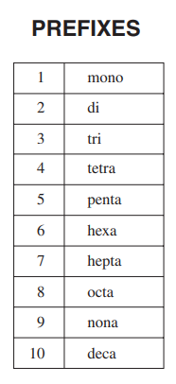
Prefixes Reference
Arabic Numeral | Prefix | Arabic Numeral | Prefix
1 | mono | 6 | hexa
2 | di | 7 | hepta
3 | tri | 8 | octa
4 | tetra | 9 | nona
5 | penta | 10 | deca

Slide 37
Naming Binary Covalent Compounds
Write the first element.
Write the second element with “–ide” ending.
Add prefixes to show how many of each element there is.
Do not add “mono-” to first element.
If adding “mono-” to “-oxide”, write “monoxide” instead.
e.g. O₂F₂
di
oxygen fluoride
di
Note: All compound names (covalent and ionic) are lowercase.
tri
e.g. PF₃
phosphorus fluoride
e.g. N₂O
di
mon
nitrogen oxide

Slide 38
More Practice: Binary Covalent Compounds
Chemical Formula | Compound Name
S₂O₅ | disulfur pentaoxide
Cl₃O₇ | trichlorine heptaoxide
CBr₂ | carbon dibromide
NO | nitrogen monoxide
CCl₄ | carbon tetrachloride
P₂S₆ | diphosphorus hexasulfide

Slide 39
Naming Binary Covalent Compounds
Covalent compounds with special names (must memorize):
NH₃ = ammonia
H₂O = water
CH₄ = methane
NH₄⁺ (ammonium ion) and NH₃ (ammonia) are not the same!!!

Slide 40
Chemical Formulas of Binary Covalent Compounds
Identify the elements involved. Write their symbols.
Use the prefixes to determine the number of each element in the compound. Write as subscripts.
e.g. tetraphosphorus pentaoxide
P O
₄
₅
e.g. nitrogen triiodide
N I
₃
e.g. selenium difluoride
Se F
₂

Slide 41
More Practice: Binary Covalent Compounds
Chemical Formula | Compound Name
NO₃ | nitrogen trioxide
P₃O₄ | triphosphorus tetraoxide
IF₅ | iodine pentafluoride
C₃S₂ | tricarbon disulfide
BI₃ | boron trifluoride
XeF₆ | xenon hexafluoride

Slide 42
Resources
Naming and Writing Chemical Formulas
Tyler DeWitt Videos https://www.youtube.com/user/tdewitt451/videos
Mr. Carman’s Blog (generates quizzes) https://www.kentschools.net/ccarman/cp-chemistry/practice-quizzes/compound-naming/
Mr. Eisley (list of other resources to practice http://www.mreisley.com/nomenclature-practice.html
ChemFiesta (worksheets with answers) https://chemfiesta.org/2015/01/13/naming-worksheets/
Balancing Chemical Equations
TemplateLAB (explanations and many worksheets with answers) https://templatelab.com/balancing-equations-worksheet/

Slide 43
Example: chlorine atom
Cl
17p, 19n

Slide 44
Practice
Classify as ionic or covalent. Then, name the following compounds:
Try to classify as ionic or covalent. How are these compounds different from what we have seen so far?
Formula | Name
CO₂ | carbon dioxide
Na₂O | sodium oxide
CrF₃ | chromium(III) fluoride
N₂Br₃ | dinitrogen tribromide
MnO₂ | manganese(IV) oxide
Formula | Name
MgCO₃ | magnesium carbonate
Ca(CH₃COO)₂ | calcium acetate
NH₄Br | ammonium bromide
KCN | potassium cyanide
Whenever you have more than 2 elements in your ionic compound, you are dealing with a polyatomic ion. Polyatomic ions are almost always anions (except NH₄⁺).

Slide 45
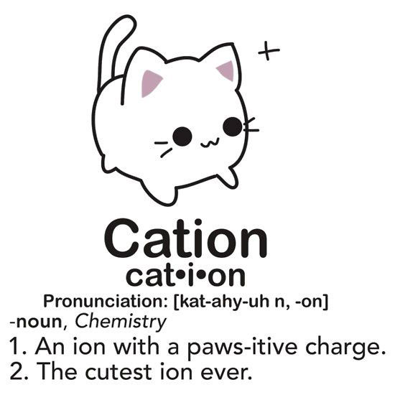
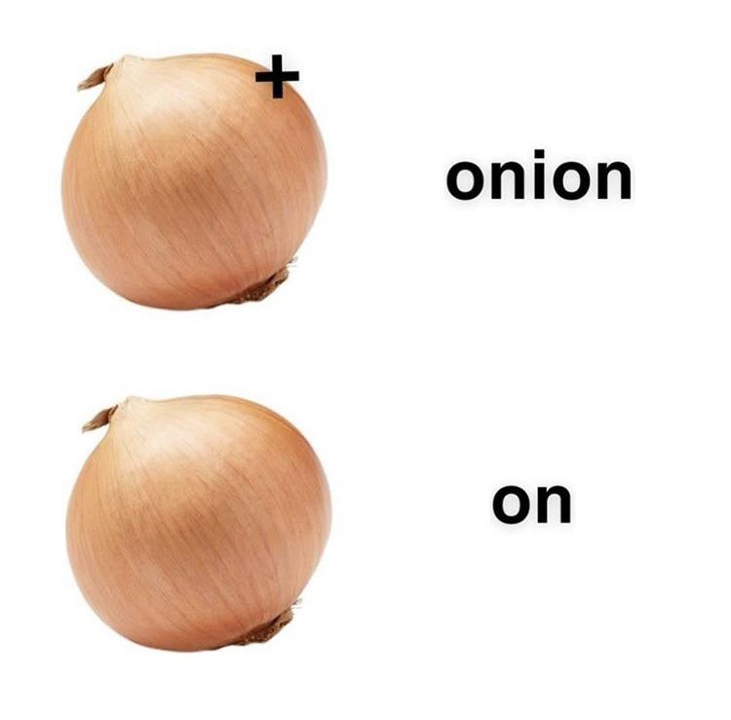
Ionic Compound Formation
(This is a joke. Not to be confused with mnemonic on previous page.)
https://www.reddit.com/r/chemistrymemes/comments/ccsxov/high_iq_meme/
https://www.chemistryjokes.com/jokes/cation/

Slide 46
Subscripts

Slide 47
Subscripts in Chemical Compounds
Subscripts are small numbers written on the bottom right of an element or ion to show how many are in that compound.
No subscript means there is only one of that element or ion.
A subscript outside a bracket applies to the entire polyatomic ion inside the bracket (multiply subscripts!).
Cu + 2AgNO₃ → Cu(NO₃)₂ + 2Ag
subscripts

Slide 48
Subscripts in Chemical Compounds
Chemical Formula | How Many Atoms?
N₂O₃ | 2 nitrogen 3 oxygen
PF₄ | 1 phosphorus 4 fluorine
Li₂O | 2 lithium ions 1 oxygen ion
Ni₂S₃ | 2 nickel ions 3 sulfur ions
Important! If there is no subscript, this means there is only one of that element or ion.

Slide 49
Subscripts in Chemical Compounds
Chemical Formula | How Many Atoms?
H₂O | 2 hydrogen 1 oxygen
CCl₄ | 1 carbon 4 chlorine
CaCO₃ | 1 calcium 1 carbon 3 oxygen
NaOH | 1 sodium 1 oxygen 1 hydrogen
Practice!
Chemical Formula | How Many Atoms?
Co₂S₃ | 2 cobalt 3 sulfur
PF₄ | 1 phosphorus 4 fluorine
MgBr₂ | 1 magnesium 2 bromine
Be₃N₂ | 3 beryllium 2 nitrogen
Link to subscripts in polyatomic ions

Slide 50
Extra slides

Slide 51
Achieving Stability Through Nobility
N
O
F
Ne
Na
Mg

Slide 52
Achieving Stability Through Nobility
3-
2-
1-
N
O
F
Ne
7p, 7n
8p, 8n
9p, 10n
10p, 10n
1+
2+
3+
Atoms form ions to have a full valence shell, just like the noble gases have.
Na
Mg
Al
11p, 12n
12p, 12n
13p, 14n

Slide 53
Achieving Stability Through Nobility
3-
2-
1-
N
O
F
7p, 7n
8p, 8n
9p, 10n
1+
2+
3+
Na
Mg
Al
11p, 12n
12p, 12n
13p, 14n
Compare the Bohr models. What do they have in common? What is different?

Slide 54
Drawing Bohr Models of Atoms and Ions
Calculate the number of protons, neutrons, electrons.
 | protons | neutrons | electrons
Atom | atomic number | rounded atomic mass minus atomic number | atomic number
Ion | atomic number | rounded atomic mass minus atomic number | atomic number minus ionic charge
If the tenths place is a 4 or lower, round down. | 32.1 → 32 65.4 → 65
If the tenths place is a 5 or higher, round up. | 10.8 → 11 35.5 → 36

Slide 55
What are chemical compounds? Why do they form?

Slide 56
Achieving Stability Through Nobility
Activity:
Draw the Bohr model for one of the following ions.
Compare your Bohr model with other students in the class. What do they have in common? What is different?
N³⁻
Na⁺
O²⁻
Mg²⁺
F⁻
Al³⁺
Notes:
Sci9PW: haven’t learned ions yet, so that part will not be review.

Slide 57
Review: Drawing Bohr Models of Atoms and Ions
Calculate the number of protons, neutrons, electrons.
 | protons | neutrons | electrons
Atom | atomic number | atomic number minus rounded atomic mass | atomic number
Ion | atomic number | atomic number minus rounded atomic mass | atomic number minus ionic charge
 | p | n | e
Na | 11 | 23-11=12 | 11
Na⁺ | 11 | 23-11=12 | 11-(+1)=10
Mg | 12 | 24-12=12 | 12
Mg²⁺ | 12 | 24-12=12 | 12-(+2)=10
O | 8 | 16-8=8 | 8
O²⁻ | 8 | 16-8=8 | 8-(-2)=10
Cl | 17 | 36-17=19 | 17
Cl⁻ | 17 | 36-17=19 | 18
10
10
10
How come so many of the ions have the same number of electrons? What is an ion, anyways?
Notes:
Sci9PW: haven’t learned ions yet, so that part will not be review.

Slide 58
Polyatomic Ions
Polyatomic ions: ions made of multiple atoms bonded covalently together. They have special names.
“hydroxide” or “OH⁻” is made of an oxygen and hydrogen atom bonded together. Altogether, the structure has a charge of 1-.
e.g. sodium hydroxide: NaOH
1-
O
H
3-
“phosphate” or “PO₄³⁻” is made of one phosphorus atom and four oxygen atoms bonded together. Altogether, the structure has a charge of 3-.
e.g. sodium phosphate: Na₃PO₄ chromium(II) phosphate: Cr₃(PO₄)₂
O
O
P
O
O

Slide 59
Polyatomic Ions
To indicate more than one of a polyatomic ion in a compound, use brackets and subscripts.
Chemical Formula | Simplified Model
A subscript outside a bracket applies to the entire polyatomic ion inside the bracket.
Be²⁺
Be²⁺
Be²⁺
Be₃(PO₄)₂
O
O
O
O
P
P
O
O
O
O
3-
3-

Slide 60
Polyatomic Ions
To indicate more than one of a polyatomic ion in a compound, use brackets and subscripts. Treat polyatomic ions as single entities when naming, incl. counting atoms.
Chemical Formula | Cation | Anion | Atom Count
NaOH | Na⁺ | OH⁻ | Na:1 O:1 H:1
Mg(OH)₂ | Mg²⁺ | OH⁻ x2 | Mg:1 O:2 H:2
Be₃(PO₄)₂ | Be²⁺ x3 | PO₄²⁻ x2 | Be:3 P:2 O:8
Ti₂(CrO₄)₃ | Ti³⁺ x2 | CrO₄²⁻ x3 | Ti:2 Cr:3 O:12

Slide 61
Rules for Naming Ionic Compounds (FINAL)
Write the cation, first.
For metals that can only form one ion (monovalent metals), do not write the ion charge.
For multivalent metals, determine the ion charge through charge balancing. Then, put the ion charge in Roman numerals, in brackets.
If the cation is polyatomic, write it exactly the way it is written in the table.
Write the anion with “–ide” ending (unless it is polyatomic.)

