Slide 1
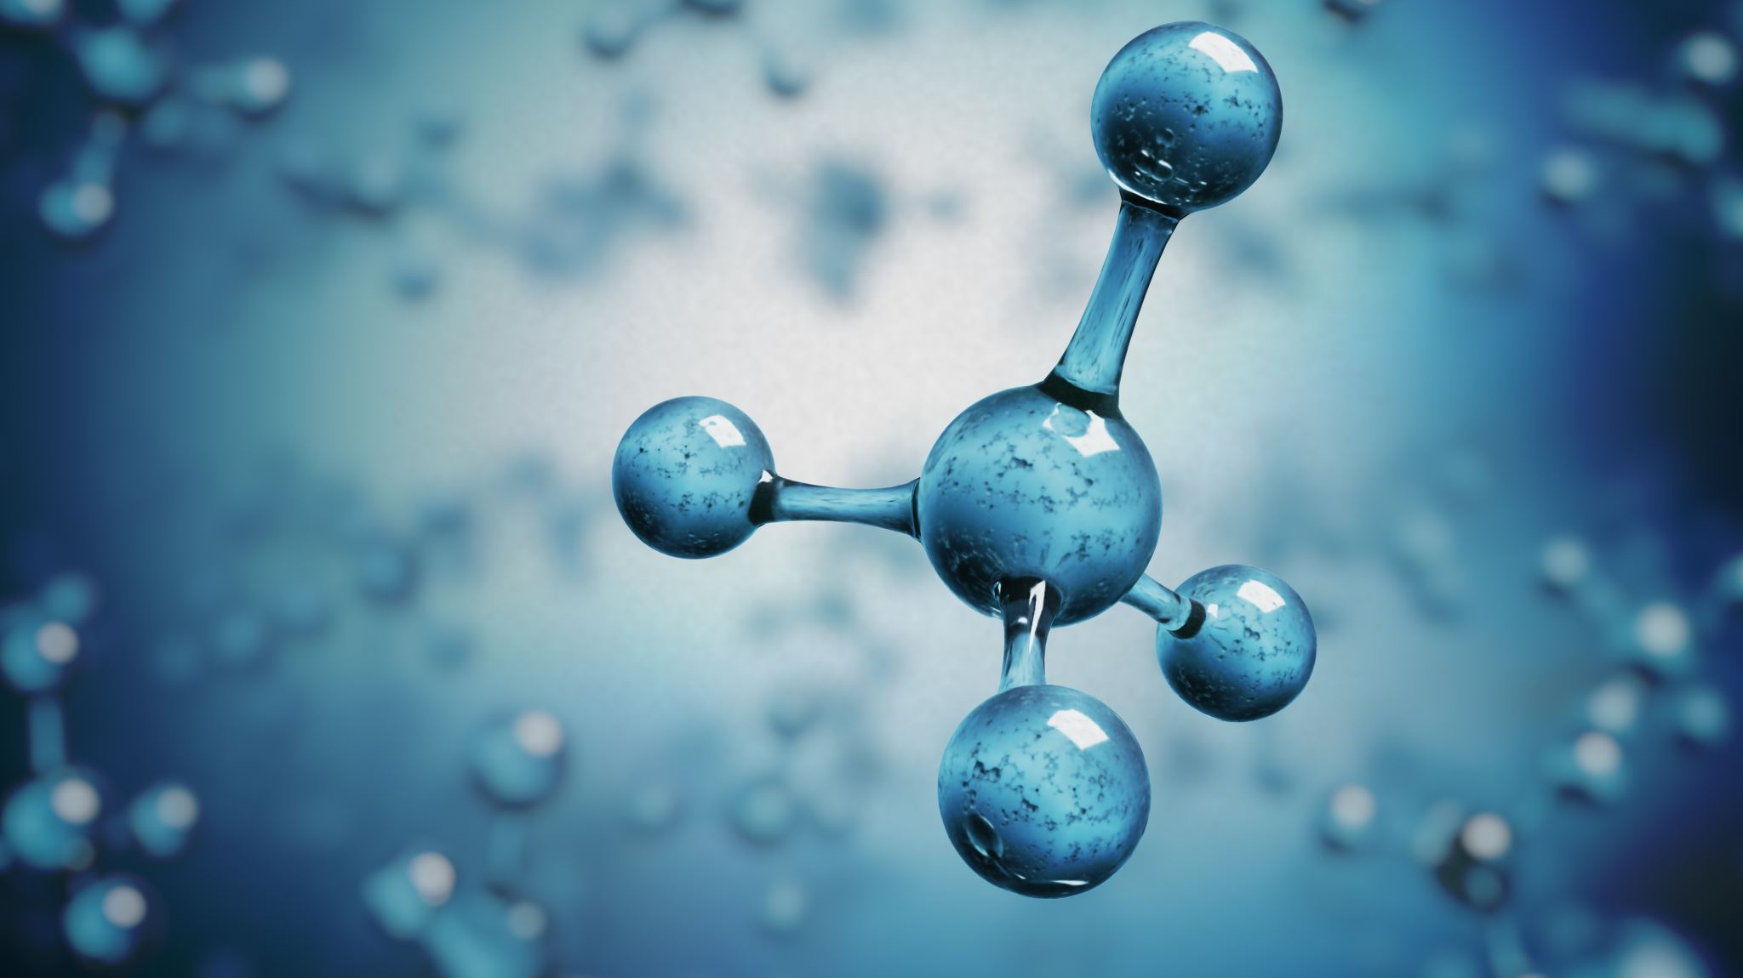
Chemical Compounds
Bond Formation, Nomenclature, and Modelling

Slide 2
Overview
Review: atoms and subatomic particles, ions
Modelling Atoms and Compounds
Counting Atoms
Bohr Models
Lewis Diagrams
IUPAC Naming and Writing Formulas
Balanced Chemical Equations

Slide 3
Section 4: Balancing Chemical Equations
(textbook pgs 125-133)

Slide 4
Chemical Equation Vocabulary
Reactants: what goes into the reaction; on the left side of reaction arrow
Products: what comes out of the reaction; on the right side of reaction arrow
Zn + HCl → ZnCl₂ + H₂

Slide 5
Chemical Equation Vocabulary
Word equation: uses words to describe reactants and products
zinc + hydrogen chloride → zinc chloride + hydrogen
Skeleton equation: uses chemical formulas to describe reactants and products
Zn + HCl → ZnCl₂ + H₂
Tip: When converting between word and skeleton equations, remember your diatomic elements!

Slide 6
Chemical Reaction Vocabulary
Balanced chemical equation: uses coefficients and chemical formulas to describe reactants and products in their correct proportions
Zn + 2HCl → ZnCl₂ + H₂

Slide 7
Chemical Reaction Vocabulary (FYI only)
In chemical equations, you will sometimes see information about the state that a chemical substance is in.
E.g. 2Mg_{(s)} + O_{2(g)} → 2MgO_{(s)}
(g): Gas
(l): Liquid
(s): Solid
(aq): Aqueous solution (substance is dissolved in water)

Slide 8
Fruit Tart Case Study
You are making fruit tarts for a party. You have a certain number of each ingredient. How many tarts can you make? What is left over?
12
8
4
??
raspberries
blackberries
fruitless tarts
https://www.mypetitejoys.com/no-bake-blackberry-mini-tarts/
https://leaf.nutrisystem.com/recipes/skinny-mini-fruit-tart/
https://www.youtube.com/watch?v=mfGNSkXOUHo

Slide 9
Fruit Tart Case Study
You are making fruit tarts for a party. Unfortunately, after you are finished, you see an Instagram picture that makes you want to rearrange your fruit tarts. You need 3 finished raspberry/blackberry tarts in total. How many of each tart will you start with? What will you be left with?
2 raspberries + 1 blackberry each
6 raspberries each
1 blackberry each
https://www.mypetitejoys.com/no-bake-blackberry-mini-tarts/
https://leaf.nutrisystem.com/recipes/skinny-mini-fruit-tart/
https://www.youtube.com/watch?v=mfGNSkXOUHo

Slide 10
Fruit Tart Case Study
You are making fruit tarts for a party. Unfortunately, after you are finished, you see an Instagram picture that makes you want to rearrange your fruit tarts. You need 3 finished raspberry/blackberry tarts in total. How many of each tart will you start with? What will you be left with?
1
3
3
1
2 raspberries + 1 blackberry each
fruitless tart
6 raspberries each
1 blackberry each
Discuss: approaches and strategies in completing this problem
https://veenaazmanov.com/homemade-mini-tart-shells/
https://www.mypetitejoys.com/no-bake-blackberry-mini-tarts/
https://leaf.nutrisystem.com/recipes/skinny-mini-fruit-tart/
https://www.youtube.com/watch?v=mfGNSkXOUHo

Slide 11
Fruit Tart Case Study
2 raspberries + 1 blackberry each
fruitless tart
6 raspberries each
1 blackberry each
1
3
3
1
__Rb₆T + __BbT → __Rb₂BbT
+ __T
Legend
Rb = “raspberry” element
Bb = “blackberry” element
T = “tart” element
Follow-up: Now, suppose that you need 12 tarts instead of 3. How many raspberry and blackberry tarts do you start with?
https://veenaazmanov.com/homemade-mini-tart-shells/
https://www.mypetitejoys.com/no-bake-blackberry-mini-tarts/
https://leaf.nutrisystem.com/recipes/skinny-mini-fruit-tart/
https://www.youtube.com/watch?v=mfGNSkXOUHo

Slide 12
Balancing Chemical Equations
Why balance?
Chemical “recipes”: how much do you put in? how much do you expect to yield?
Conservation of mass: no atoms are ever created or destroyed
https://www.budgetbytes.com/

Slide 13
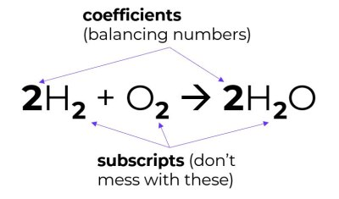
Balancing Chemical Equations: Vocabulary
Balancing chemical formulas involves adding coefficients in front of elements and compounds until the total number of atoms of each element in the reactants equals the products.

Slide 14
Balancing Chemical Equations: Vocabulary
Balancing chemical formulas involves adding coefficients in front of elements and compounds until the total number of atoms of each element in the reactants equals the products.
Reactants: what goes into the reaction
Products: what comes out of the reaction
Zn + 2HCl → ZnCl₂ + H₂

Slide 15
PhET Simulation
https://phet.colorado.edu/sims/html/balancing-chemical-equations/1.1.0/balancing-chemical-equations_en.html
Google: “Phet Balancing”
Do Introduction first
Move on to Game and progress through the levels when you are ready
Discuss strategies you used.

Slide 16
Balancing Chemical Equations: Tips
Goal: the number of atoms of each element in the reactants equals the products.
Change coefficients only. Never add or change subscripts.
Balance atoms in compounds first. Save elements for last.
If the same polyatomic ion appears in the reactants and products, you can often treat it as a group of atoms instead of splitting it up.
At the end, reduce all coefficients to lowest whole-number terms.
Note: Do not write a coefficient if there is only “1” of that element or compound.
Balancing can be frustrating at first. Practice, practice, practice!

Slide 17
Balancing Examples (easy)
3
2
Note: Do not write a coefficient if there is only “1” of that element or compound.
___ N₂ + ___ H₂ → ___ NH₃
___ NaCl + ___ F₂ → ___ NaF + ___ Cl₂
___ Ag₂O → ___ Ag + ___ O₂
___ P + ___ O₂ → ___ P₂O₅
2
2
2
4
4
5
2

Slide 18
Balancing Examples (medium)
Treat polyatomic ions as groups if they appear in reactants and products (e.g. #2 & #3 but not #5)
2
2
___ NaBr + ___ CaF₂ → ___ NaF + ___ CaBr₂
___ FeCl₃ + ___ NaOH → ___ Fe(OH)₃ + ___ NaCl
___ H₂SO₄ + ___ NaNO₂ → ___ HNO₂ + ___ Na₂SO₄
___ CO₂ + ___ H₂O → ___ C₆H₁₂O₆ + ___ O₂
___ HCl + ___ CaCO₃ → ___ CaCl₂ + ___ H₂O + ___ CO₂
3
3
2
2
6
6
6
2

Slide 19
Balancing Examples (hard)
5
3
4
___ C₃H₈ + ___ O₂ → ___ CO₂ + ___ H₂O
___C₆H₁₄ + ___ O₂ → ___ CO₂ + ___ H₂O
___ C₈H₁₈ + ___ O₂ → ___ CO₂ + ___ H₂O
2
19
12
14
Make sure to balance the element (O₂) last!
2
25
16
18

Slide 20
Trick for Combustion Reactions (e.g. #10-12)
Balance every atom except oxygen.
Find out how many oxygen atoms you need the __O₂ to contribute. Divide that number by 2. This is your temporary coefficient for O₂.
You are not allowed to have fractional coefficients in your final answer. Multiply all the coefficients by 2.
6
7
___C₆H₁₄ + ___ O₂ → ___ CO₂ + ___ H₂O
$$\frac{19}{2}$$
6CO₂ has 12 oxygen atoms.
7H₂O has 7 oxygen atoms.
In total, there are 19 oxygen atoms in the products.
6
7
___C₆H₁₄ + ___ O₂ → ___ CO₂ + ___ H₂O
2
19
12
14
___C₆H₁₄ + ___ O₂ → ___ CO₂ + ___ H₂O

Slide 21
Resources
Naming and Writing Chemical Formulas
Tyler DeWitt Videos https://www.youtube.com/user/tdewitt451/videos
Mr. Carman’s Blog (generates quizzes) https://www.kentschools.net/ccarman/cp-chemistry/practice-quizzes/compound-naming/
Mr. Eisley (list of other resources to practice http://www.mreisley.com/nomenclature-practice.html
ChemFiesta (worksheets with answers) https://chemfiesta.org/2015/01/13/naming-worksheets/
Balancing Chemical Equations
TemplateLAB (explanations and many worksheets with answers) https://templatelab.com/balancing-equations-worksheet/

Slide 22
Example: chlorine atom
Cl
17p, 19n

Slide 23
Practice
Classify as ionic or covalent. Then, name the following compounds:
Try to classify as ionic or covalent. How are these compounds different from what we have seen so far?
Formula | Name
CO₂ | carbon dioxide
Na₂O | sodium oxide
CrF₃ | chromium(III) fluoride
N₂Br₃ | dinitrogen tribromide
MnO₂ | manganese(IV) oxide
Formula | Name
MgCO₃ | magnesium carbonate
Ca(CH₃COO)₂ | calcium acetate
NH₄Br | ammonium bromide
KCN | potassium cyanide
Whenever you have more than 2 elements in your ionic compound, you are dealing with a polyatomic ion. Polyatomic ions are almost always anions (except NH₄⁺).

Slide 24
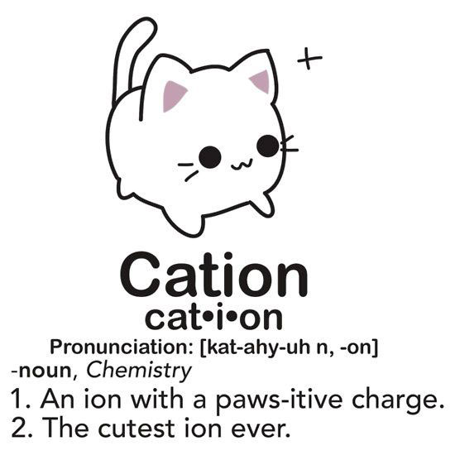
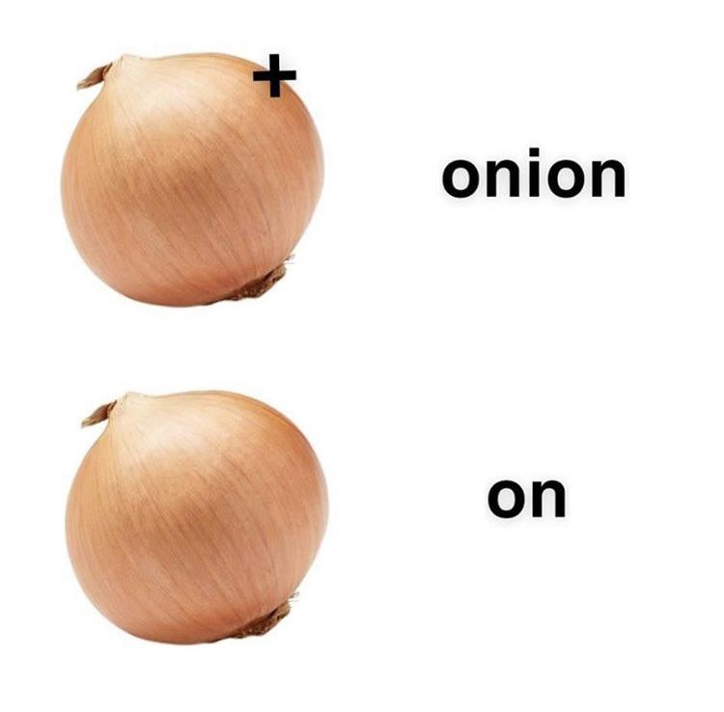
Ionic Compound Formation
(This is a joke. Not to be confused with mnemonic on previous page.)
https://www.reddit.com/r/chemistrymemes/comments/ccsxov/high_iq_meme/
https://www.chemistryjokes.com/jokes/cation/

Slide 25
Subscripts

Slide 26
Subscripts in Chemical Compounds
Subscripts are small numbers written on the bottom right of an element or ion to show how many are in that compound.
No subscript means there is only one of that element or ion.
A subscript outside a bracket applies to the entire polyatomic ion inside the bracket (multiply subscripts!).
Cu + 2AgNO₃ → Cu(NO₃)₂ + 2Ag
subscripts

Slide 27
Subscripts in Chemical Compounds
Chemical Formula | How Many Atoms?
N₂O₃ | 2 nitrogen 3 oxygen
PF₄ | 1 phosphorus 4 fluorine
Li₂O | 2 lithium ions 1 oxygen ion
Ni₂S₃ | 2 nickel ions 3 sulfur ions
Important! If there is no subscript, this means there is only one of that element or ion.

Slide 28
Subscripts in Chemical Compounds
Chemical Formula | How Many Atoms?
H₂O | 2 hydrogen 1 oxygen
CCl₄ | 1 carbon 4 chlorine
CaCO₃ | 1 calcium 1 carbon 3 oxygen
NaOH | 1 sodium 1 oxygen 1 hydrogen
Practice!
Chemical Formula | How Many Atoms?
Co₂S₃ | 2 cobalt 3 sulfur
PF₄ | 1 phosphorus 4 fluorine
MgBr₂ | 1 magnesium 2 bromine
Be₃N₂ | 3 beryllium 2 nitrogen
Link to subscripts in polyatomic ions

Slide 29
Extra slides

Slide 30
Achieving Stability Through Nobility
N
O
F
Ne
Na
Mg

Slide 31
Achieving Stability Through Nobility
3-
2-
1-
N
O
F
Ne
7p, 7n
8p, 8n
9p, 10n
10p, 10n
1+
2+
3+
Atoms form ions to have a full valence shell, just like the noble gases have.
Na
Mg
Al
11p, 12n
12p, 12n
13p, 14n

Slide 32
Achieving Stability Through Nobility
3-
2-
1-
N
O
F
7p, 7n
8p, 8n
9p, 10n
1+
2+
3+
Na
Mg
Al
11p, 12n
12p, 12n
13p, 14n
Compare the Bohr models. What do they have in common? What is different?

Slide 33
Drawing Bohr Models of Atoms and Ions
Calculate the number of protons, neutrons, electrons.
 | protons | neutrons | electrons
Atom | atomic number | rounded atomic mass minus atomic number | atomic number
Ion | atomic number | rounded atomic mass minus atomic number | atomic number minus ionic charge
If the tenths place is a 4 or lower, round down. | 32.1 → 32 65.4 → 65
If the tenths place is a 5 or higher, round up. | 10.8 → 11 35.5 → 36

Slide 34
What are chemical compounds? Why do they form?

Slide 35
Achieving Stability Through Nobility
Activity:
Draw the Bohr model for one of the following ions.
Compare your Bohr model with other students in the class. What do they have in common? What is different?
N³⁻
Na⁺
O²⁻
Mg²⁺
F⁻
Al³⁺
Notes:
Sci9PW: haven’t learned ions yet, so that part will not be review.

Slide 36
Review: Drawing Bohr Models of Atoms and Ions
Calculate the number of protons, neutrons, electrons.
 | protons | neutrons | electrons
Atom | atomic number | atomic number minus rounded atomic mass | atomic number
Ion | atomic number | atomic number minus rounded atomic mass | atomic number minus ionic charge
 | p | n | e
Na | 11 | 23-11=12 | 11
Na⁺ | 11 | 23-11=12 | 11-(+1)=10
Mg | 12 | 24-12=12 | 12
Mg²⁺ | 12 | 24-12=12 | 12-(+2)=10
O | 8 | 16-8=8 | 8
O²⁻ | 8 | 16-8=8 | 8-(-2)=10
Cl | 17 | 36-17=19 | 17
Cl⁻ | 17 | 36-17=19 | 18
10
10
10
How come so many of the ions have the same number of electrons? What is an ion, anyways?
Notes:
Sci9PW: haven’t learned ions yet, so that part will not be review.

Slide 37
Polyatomic Ions
Polyatomic ions: ions made of multiple atoms bonded covalently together. They have special names.
“hydroxide” or “OH⁻” is made of an oxygen and hydrogen atom bonded together. Altogether, the structure has a charge of 1-.
e.g. sodium hydroxide: NaOH
1-
O
H
3-
“phosphate” or “PO₄³⁻” is made of one phosphorus atom and four oxygen atoms bonded together. Altogether, the structure has a charge of 3-.
e.g. sodium phosphate: Na₃PO₄ chromium(II) phosphate: Cr₃(PO₄)₂
O
O
P
O
O

Slide 38
Polyatomic Ions
To indicate more than one of a polyatomic ion in a compound, use brackets and subscripts.
Chemical Formula | Simplified Model
A subscript outside a bracket applies to the entire polyatomic ion inside the bracket.
Be²⁺
Be²⁺
Be²⁺
Be₃(PO₄)₂
O
O
O
O
P
P
O
O
O
O
3-
3-

Slide 39
Polyatomic Ions
To indicate more than one of a polyatomic ion in a compound, use brackets and subscripts. Treat polyatomic ions as single entities when naming, incl. counting atoms.
Chemical Formula | Cation | Anion | Atom Count
NaOH | Na⁺ | OH⁻ | Na:1 O:1 H:1
Mg(OH)₂ | Mg²⁺ | OH⁻ x2 | Mg:1 O:2 H:2
Be₃(PO₄)₂ | Be²⁺ x3 | PO₄²⁻ x2 | Be:3 P:2 O:8
Ti₂(CrO₄)₃ | Ti³⁺ x2 | CrO₄²⁻ x3 | Ti:2 Cr:3 O:12

Slide 40
Rules for Naming Ionic Compounds (FINAL)
Write the cation, first.
For metals that can only form one ion (monovalent metals), do not write the ion charge.
For multivalent metals, determine the ion charge through charge balancing. Then, put the ion charge in Roman numerals, in brackets.
If the cation is polyatomic, write it exactly the way it is written in the table.
Write the anion with “–ide” ending (unless it is polyatomic.)

