Slide 1
Human Reproduction
Probe 9 textbook Chapter 4
Notes:
Note to self: better term for “biological male” or “biological female” is AMAB or AFAB…assigned male/female at birth

Slide 2
General Vocabulary
Gametes:
Sperm in males
Egg in females
Primary sexual characteristics:
Structures that produce gametes (e.g. ovary, testes)
Structures that enable gametes to meet (e.g. penis, vagina, vas deferens, etc.)

Slide 3
General Vocabulary
Secondary sexual characteristics:
Not necessary for sexual reproduction
Help outwardly distinguish males from females
Develop alongside primary characteristics during puberty
Puberty: developmental period where human becomes sexually mature and able to reproduce (usually begins age 11-13; continues until age 18)
Males | Females
Growth spurt Facial, underarm, pubic hair Deepening voice | Growth spurt Breasts (mammary glands) Underarm and pubic hair Widening of hips

Slide 4
General Vocabulary
Secondary sexual characteristics:
Puberty: developmental period where human becomes sexually mature and able to reproduce (usually begins age 11-13; continues until age 18)
Males | Females
Growth spurt Facial, underarm, pubic hair Deepening voice | Growth spurt Breasts (mammary glands) Underarm and pubic hair Widening of hips

Slide 5
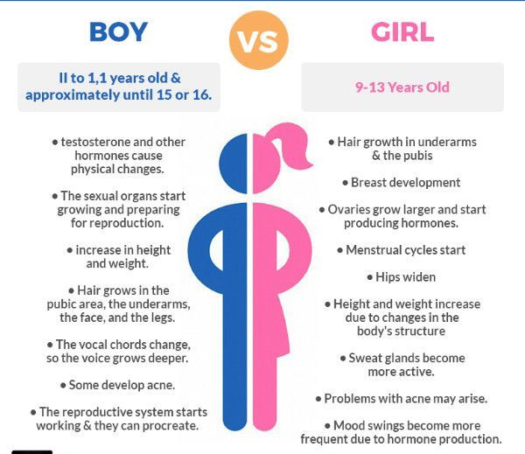

Slide 6
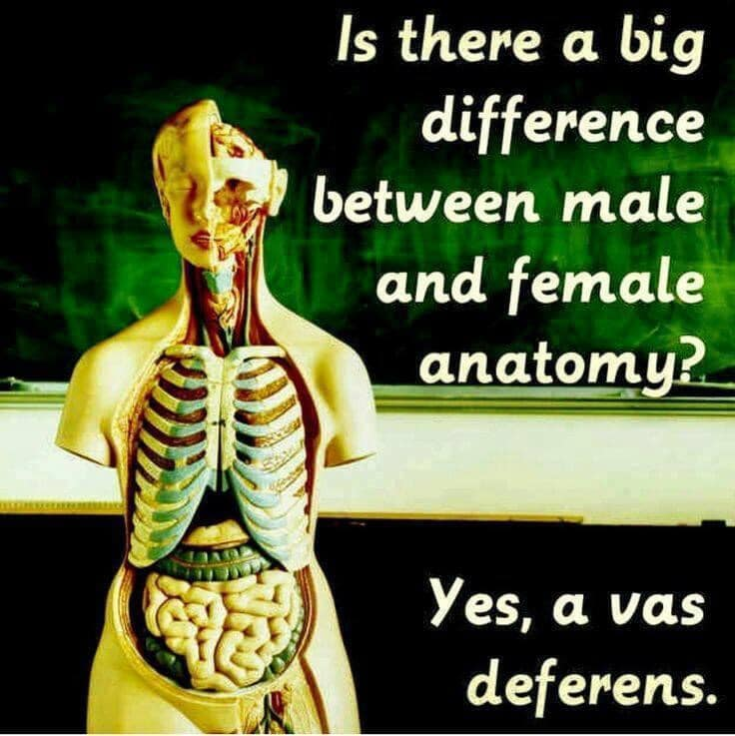
Science Page: Facebook

Slide 7
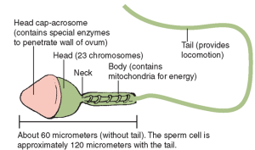
Sperm Structure
Very small: 120 μm
Specialized for swimming
Flagellum is a whip-like tail that allows sperm to swim
Each sperm has 50-75 mitochondria; swimming takes a lot of energy!

Slide 8
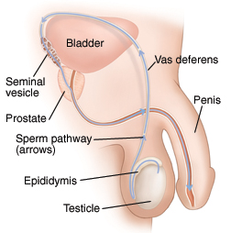
Male Primary Reproductive Structures
Testicle (aka testis or pl. testes): produces and nourishes developing sperm
Epididymis: where mature sperm are stored
Vas deferens: tube that carries sperm to urethra
Urethra
https://www.mountnittany.org/articles/healthsheets/7036

Slide 9
Male Primary Reproductive Structures
Seminal vesicle: secretes seminal fluid
Seminal fluid: Provides sugar for energy, protects the sperm, provides fluid for sperm to swim
Urethra: transports sperm (and urine) outside the body
Penis: organ that contains the urethra; enters the female during sexual intercourse
Urethra
https://www.mountnittany.org/articles/healthsheets/7036

Slide 10
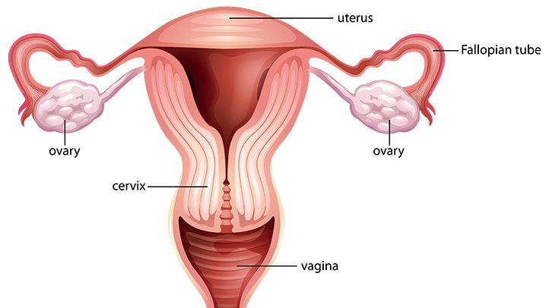
Female Primary Reproductive Structures
Ovary:
site of egg maturation and release
produces estrogen and progesterone (female sex hormones)
Oviduct (Fallopian Tube): Tube that transports the egg to the uterus
https://www.everydayhealth.com/sexual-health/female-reproductive-organs.aspx

Slide 11
Female Primary Reproductive Structures
Uterus (womb): Organ that will receive the embryo if the egg is fertilized
Endometrium: lining of the uterus, which is shed during menstruation
Vagina:
Receives the male penis and sperm during sexual intercourse
Is the birth canal for the baby
https://www.everydayhealth.com/sexual-health/female-reproductive-organs.aspx

Slide 12
Egg Development
Follicle: contains single immature egg; many follicles are located in ovary
Corpus luteum: empty follicle that remains after ovulation; produces estrogen and progesterone
https://www.researchgate.net/figure/Diagram-of-hormonal-fluctations-in-the-menstrual-cycle-notes-Day-0-of-the-menstrual_fig1_259878362

Slide 13
Menstrual Cycle
Flow phase: menstruation (shedding of the endometrium) occurs (“0 days”)
Follicular phase: new follicle begins to develop
Ovulation: egg is released from ovary and travels towards uterus
Luteal phase: corpus luteum develops

Slide 14
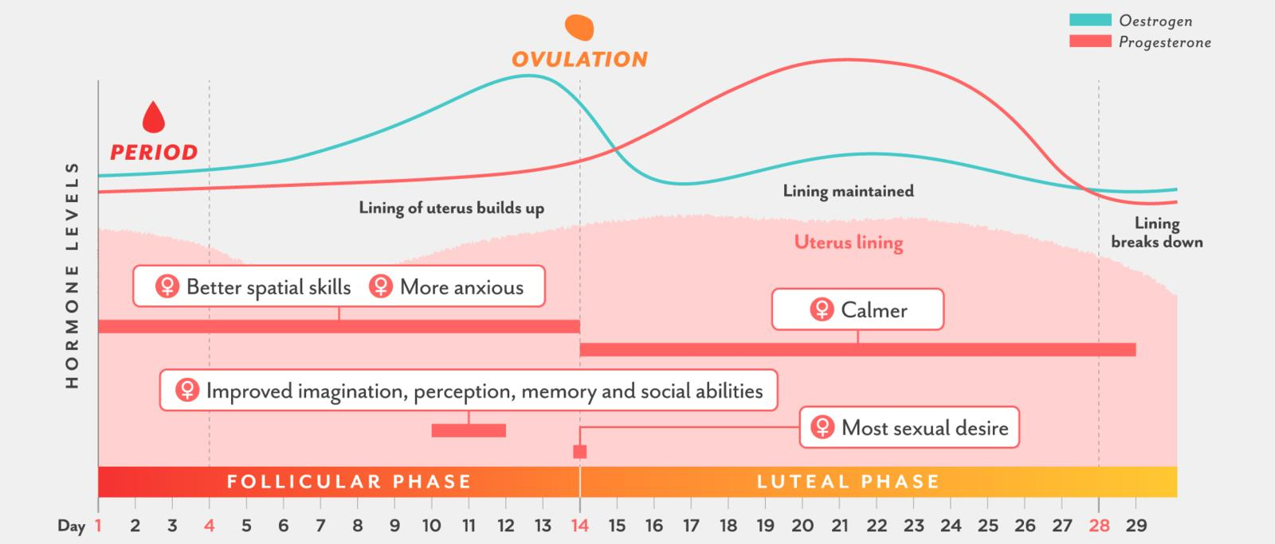
A Tale of Two Hormones
Progesterone: female sex hormone; stimulates endometrium thickening; stops the development of any other eggs
Estrogen: female sex hormone
https://www.focusboosterapp.com/blog/menstrual-cycle-mapping-how-women-can-improve-their-productivity-and-health-period/

Slide 15
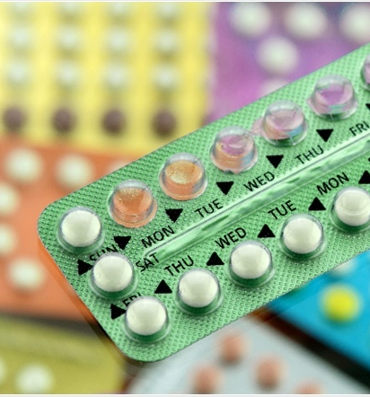
Hormonal Birth Control
Many hormonal methods of birth control (e.g. “The Pill”) increase progesterone levels. How does this prevent pregnancy?
During pregnancy, high levels of progesterone and estrogen prevent other eggs from maturing. The Pill functions by mimicking pregnancy hormone levels. If eggs don’t develop, then pregnancy cannot occur!
https://www.news-medical.net/health/Advantages-and-Disadvantages-of-the-Combined-Pill.aspx

Slide 16
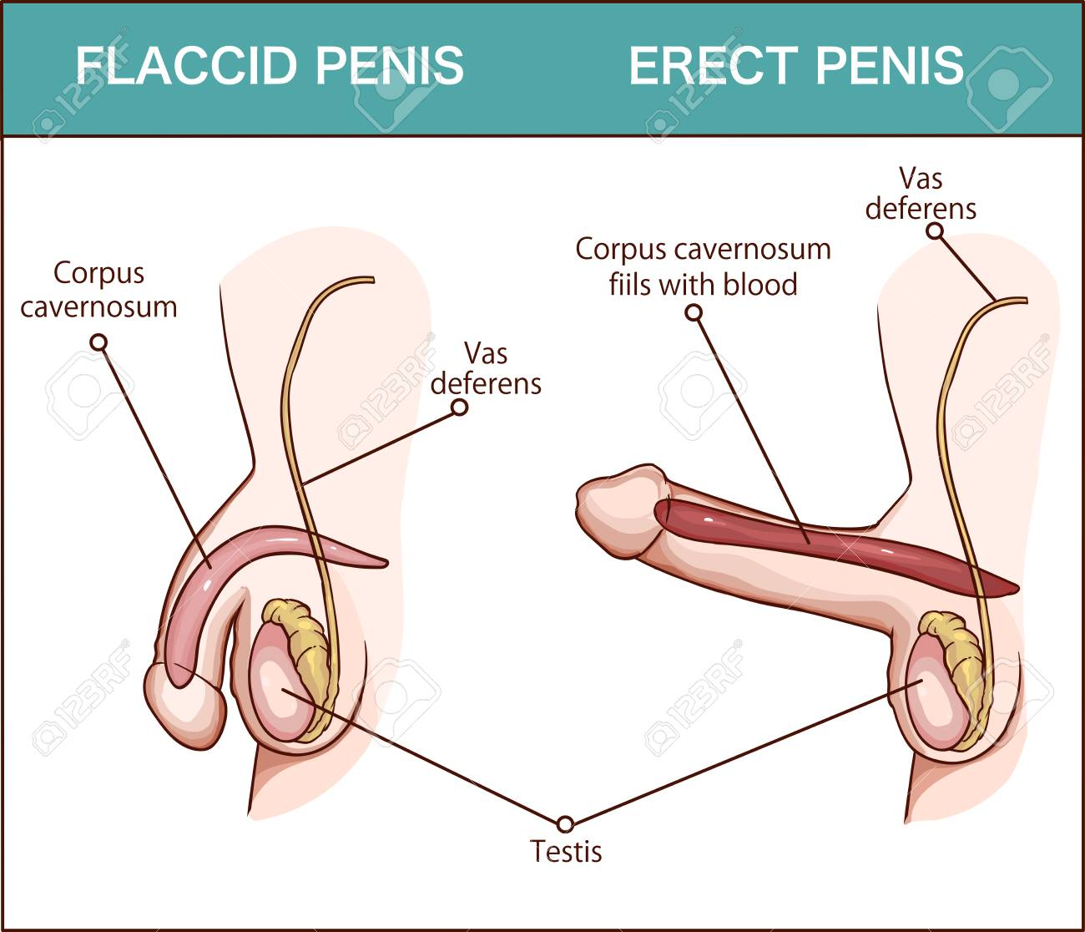
Sexual Intercourse
Sexual arousal increases blood flow to the genital area. Result:
Male penis becomes erect.
Female vagina produces natural lubrication.
Ejaculation:
Discharge of semen (containing seminal fluid and sperm) from the penis.

Slide 17
Fertilization and Pregnancy
Fertilization occurs when a sperm cell meets an egg. There, it releases chemicals that prevent other sperm cells from fertilizing the same egg.
Fertilization usually occurs within the oviduct.
The fertilized egg then implants in the uterus to develop. The individual is now pregnant.

Slide 18
Fertilization and Pregnancy
Random facts:
Twins occur when one fertilized egg splits or two eggs are released and fertilized.
2% of the time, the fertilized egg implants in the wrong place and cannot develop properly (ectopic pregnancy). If not terminated, the mother’s health is at risk.

Slide 19
Birth Control
Birth Control refers to a number of methods intended to prevent or reduce the chances of pregnancy.
Discuss: Given what you know about the reproductive system, sexual intercourse and pregnancy, brainstorm some ways to prevent pregnancy.
We will discuss the most common forms of birth control; however, if you are planning on becoming sexually active, you should consult a physician to determine which method is best for you.

Slide 20
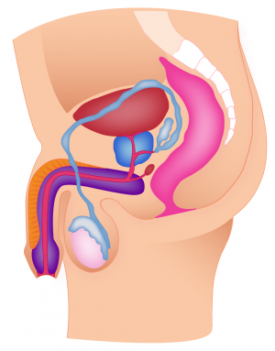
Legend
Highly effective
Mostly effective
Unreliable, not effective on its own
Permanent, surgery
abstinence
don’t have sex
male condom
‘contains’ ejaculate; prevents sperm from entering female (issues: condom may burst or leak)
vasectomy
pulling out
cut vas deferens; sperm cannot enter penis
remove penis from vagina before ejaculation (issues: precum can contain sperm; penis may not be removed quickly enough)

Slide 21
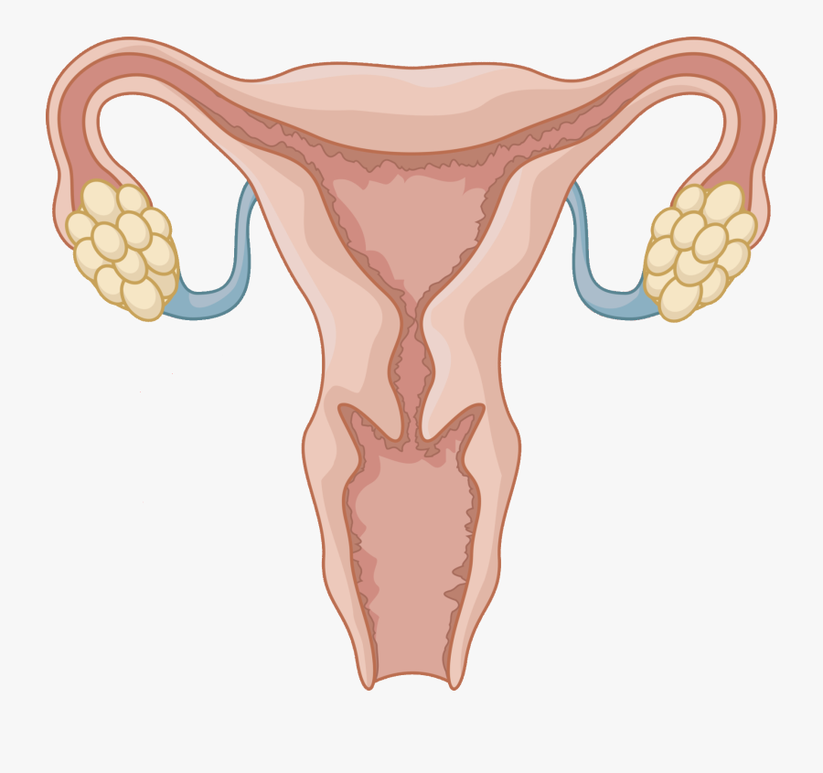
Legend
Highly effective
Mostly effective
Unreliable, not effective on its own
Permanent, surgery
copper IUD
abstinence
prevent implantation
(issues: risk of perforation and dislodgment)
don’t have sex
cycle tracking
avoid sex during fertile periods (issues: every woman is different; cycles can vary)
tubal ligation
plan B
cut oviduct; egg does not enter uterus
prevent ovulation, prevent implantation (issue: not reliable; cost per use)
oophorectomy/ hysterectomy
hormones (Mirena IUD, ring, patch, shot, pill)
remove ovary/uterus
female condom
prevent ovulation; prevent implantation (issues: side effects; consistency)
‘contains’ ejaculate; prevents sperm from entering female (issues: condom may burst or leak; difficult to use)

Slide 22
Birth Control Summary
Barrier methods (condom, etc.): prevent male and female reproductive organs from coming into physical contact with each other
Copper IUD (intra-uterine device): inserted into uterus, makes uterus inhospitable (copper); lasts 3-5 years and is low-maintenance
Hormones: many methods that vary in ease of use, cost, and effectiveness
Surgery: cut or remove organs to make pregnancy impossible
Behavioural (pulling out, abstinence, cycle tracking)

Slide 23
Understanding Consent
https://www.youtube.com/watch?v=raxPKklDF2k&t=56s&ab_channel=TeachingSexualHealthAlbertaHealthServices

Slide 24
Understanding Consent
https://www.youtube.com/watch?v=fGoWLWS4-kU&ab_channel=BlueSeatStudios

Slide 25
Resources
Richmond Youth Medical Clinic: https://youthinbc.com/2009/02/03/richmond-youth-clinic/ (Note: info may be slightly outdated)
Free, confidential services for youth (13-21)
Counselling (sexual health, depression, anxiety, family/school issues)
Free birth control
Free emergency contraception
STI testing and treatment
Pregnancy tests

Slide 26
Q&A

