Slide 1
Human Reproduction
Probe 9 textbook Chapter 4
Notes:
Note to self: better term for “biological male” or “biological female” is AMAB or AFAB…assigned male/female at birth

Slide 2
Disclaimer
As we have learned earlier in the semester, there is much variation in sexual characteristics and sexual anatomy. Here, we will be presenting the most common sexual characteristics of AMAB (assigned male at birth) and AFAB (assigned female at birth) people. We acknowledge that intersex people will have a combination of these characteristics.
Sexuality is a spectrum. This mini-unit will focus on heterosexual intercourse, since this is the only kind of sexual intercourse that can result in fertilization and pregnancy. Other types of sexual intercourse (e.g. oral, anal) cannot result in pregnancy, but can transmit STIs → see slides on STI prevention.
I am not a licensed health care practitioner. I will do my best to present this information in an educational, accurate, and inclusive manner.

Slide 3
Question Slips
Questions are strongly recommended during this unit. No question is ‘stupid’.
Everyone is coming from a different background and will have different background knowledge to start. Please respect the questions of others.
If you are not comfortable putting your hand up, please write down all your questions on the provided paper slips. They will be submitted and addressed at the end of each class.

Slide 4
Outline
Human Reproductive Anatomy
Menstrual Cycle + Tampon Demo
Sexual Intercourse
Birth Control + Condom Demo
Consent
Sexually Transmitted Infections and Prevention
Resources
Q + A

Slide 5
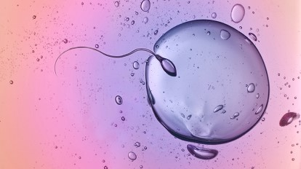
General Vocabulary
Gametes:
Sperm in males
Egg in females
Primary sexual characteristics:
Structures that produce gametes (e.g. ovary, testes)
Structures that enable gametes to meet (e.g. penis, vagina, vas deferens, etc.)

Slide 6
General Vocabulary
Secondary sexual characteristics:
Not necessary for sexual reproduction
Develop alongside primary characteristics during puberty
Puberty: developmental period where human becomes sexually mature and able to reproduce (usually begins age 11-13; continues until age 18)
Notes:
Note…puberty often happens earlier in females.
Also, the development of sexual characteristics is stimulated by estrogen in females and testosterone in males.

Slide 7
General Vocabulary
Secondary sexual characteristics:
Males | Females
Growth spurt Facial, underarm, pubic hair Deepening voice | Growth spurt Breasts (mammary glands) Underarm and pubic hair Widening of hips

Slide 8
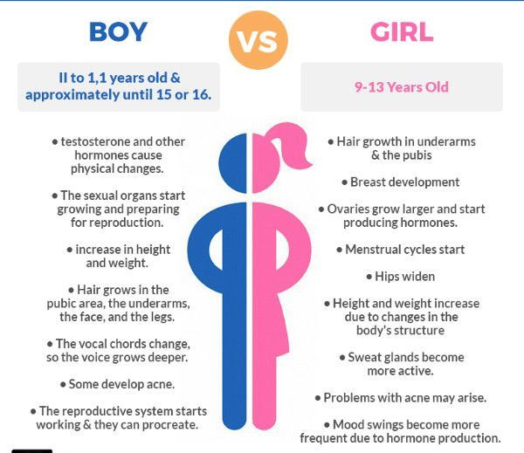

Slide 9
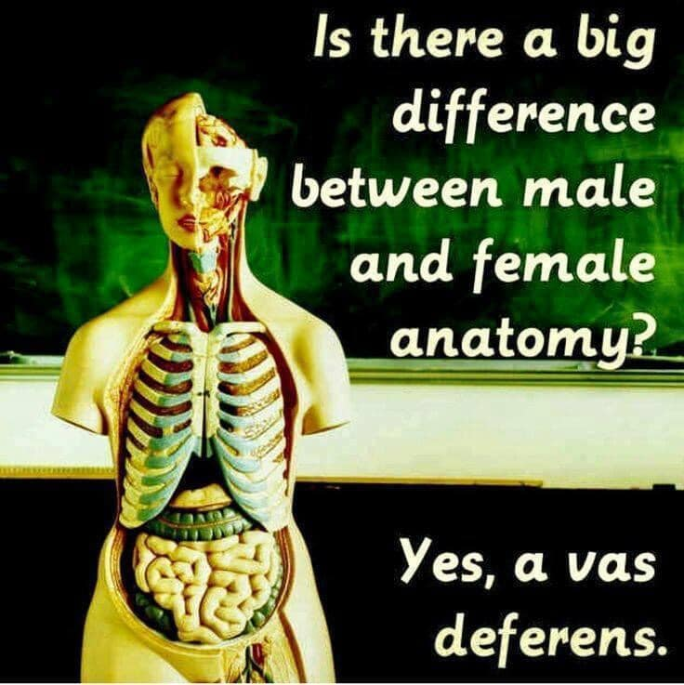
Science Page: Facebook

Slide 10
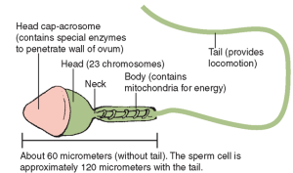
Sperm Structure
Very small: 120 μm
Specialized for swimming
Flagellum is a whip-like tail that allows sperm to swim
Each sperm has 50-75 mitochondria; swimming takes a lot of energy!

Slide 11
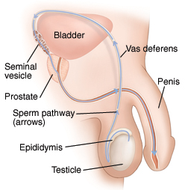
Male Primary Reproductive Structures
Testicle (aka testis or pl. testes): produces and nourishes developing sperm
Epididymis: where mature sperm are stored
Vas deferens: tube that carries sperm to urethra
Urethra
https://www.mountnittany.org/articles/healthsheets/7036
Notes:
Make sure to discuss why testicles are outside body…best temperature for sperm development is below body temperature.

Slide 12
Male Primary Reproductive Structures
Seminal vesicle: secretes seminal fluid
Seminal fluid: Provides sugar for energy, protects the sperm, provides fluid for sperm to swim
Urethra: transports sperm (and urine) outside the body
Penis: organ that contains the urethra; enters the female during sexual intercourse
Urethra
https://www.mountnittany.org/articles/healthsheets/7036

Slide 13
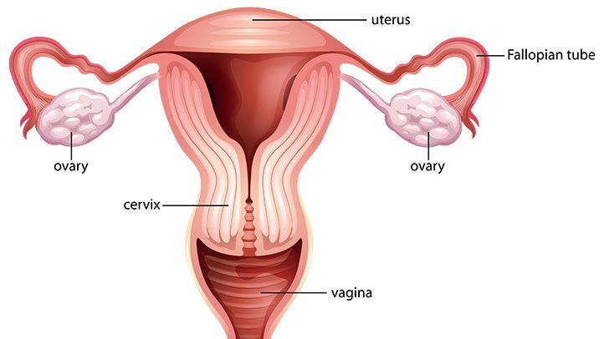
Female Primary Reproductive Structures
Ovary:
Where eggs develop and are released from
Produces estrogen and progesterone (female sex hormones)
Oviduct (Fallopian Tube): Tube that transports the egg to the uterus
https://www.everydayhealth.com/sexual-health/female-reproductive-organs.aspx

Slide 14
Female Primary Reproductive Structures
Uterus (womb): Organ that will receive and nurture the fertilized egg
Endometrium: lining of the uterus, which is shed during menstruation
Vagina:
Receives the male penis and sperm during sexual intercourse
Is the birth canal for the baby
https://www.everydayhealth.com/sexual-health/female-reproductive-organs.aspx

Slide 15
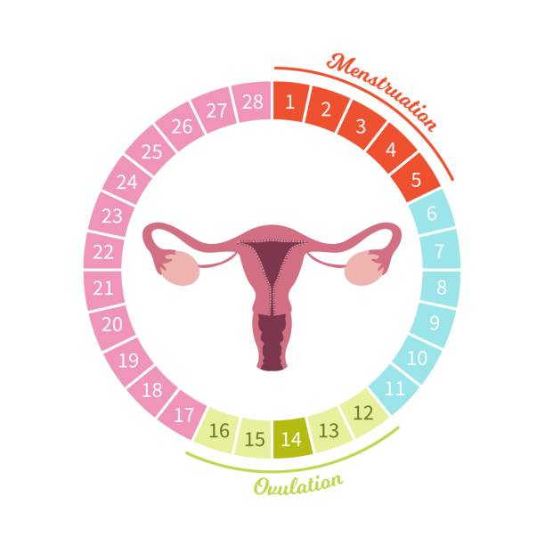
Menstrual Cycle: Simplified
Menstruation (period): endometrium is shed; starts on day 1 of cycle
Ovulation: mature egg is released from ovary and travels towards uterus
Notes:
Follicle: contains single immature egg; many follicles are located in ovary.
Corpus luteum: empty follicle that remains after ovulation, produces estrogen and progesterone.

Slide 16
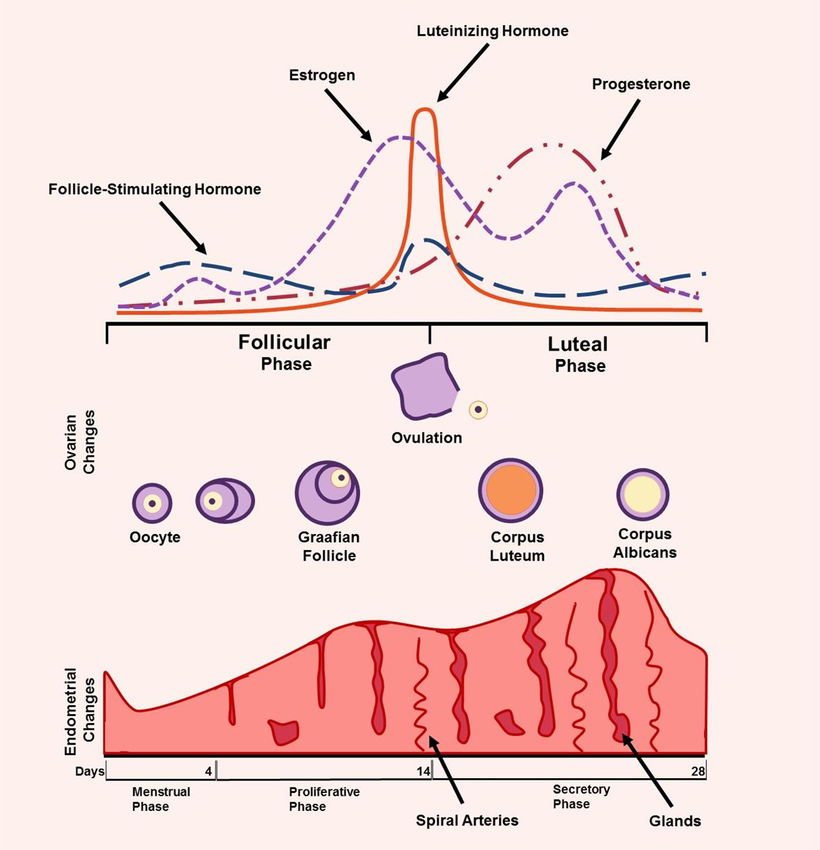
Menstrual Cycle: More Details
The menstrual cycle is complicated and messy!
Hormones released from the brain (LH, FSH) and female sex hormones (estrogen and progesterone) all affect the timing and duration of the menstrual cycle.
https://www.focusboosterapp.com/blog/menstrual-cycle-mapping-how-women-can-improve-their-productivity-and-health-period/
More info: https://www.merckmanuals.com/en-ca/home/women-s-health-issues/biology-of-the-female-reproductive-system/menstrual-cycle

Slide 17
Notes:
Follicle: each one contains one egg. The follicle develops during the follicular phase. When the follicle is mature, ovulation occurs.
Corpeus luteum: the remnants of the follicle after the egg has left it. Still continues to produce hormones and affect the cycle

Slide 18
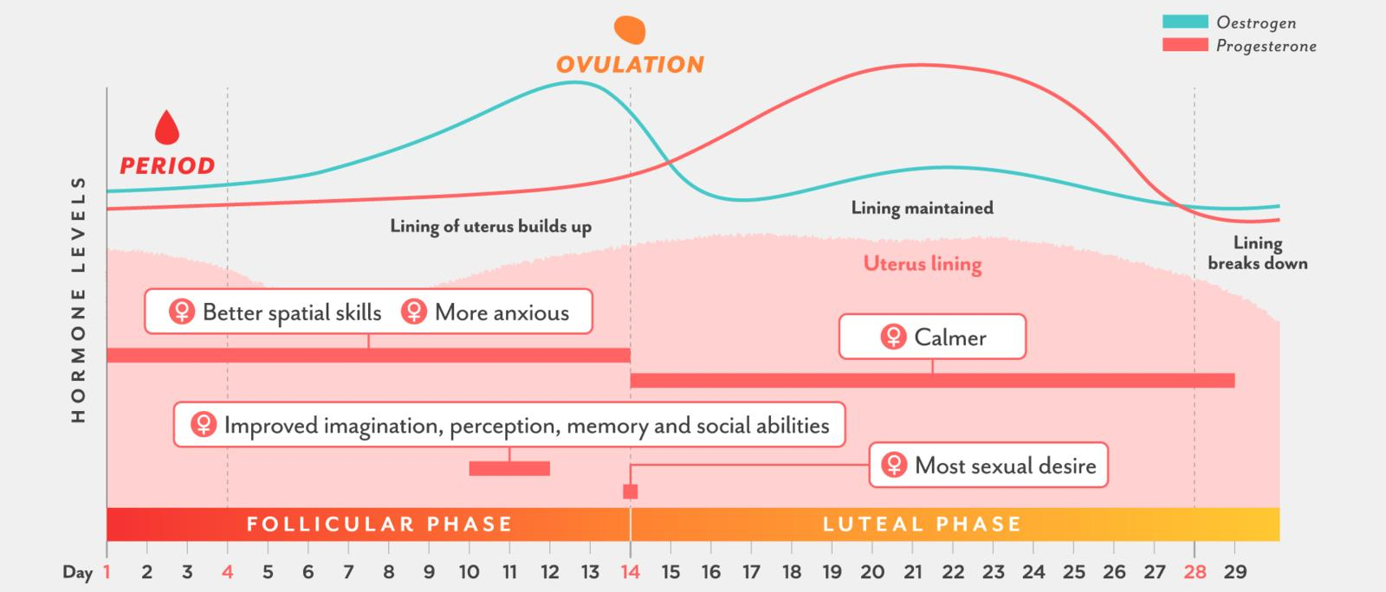

Slide 19
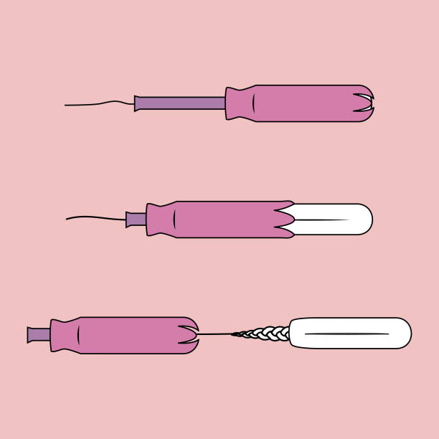
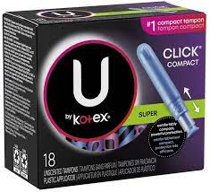
Demo: How to Use a Tampon

Slide 20
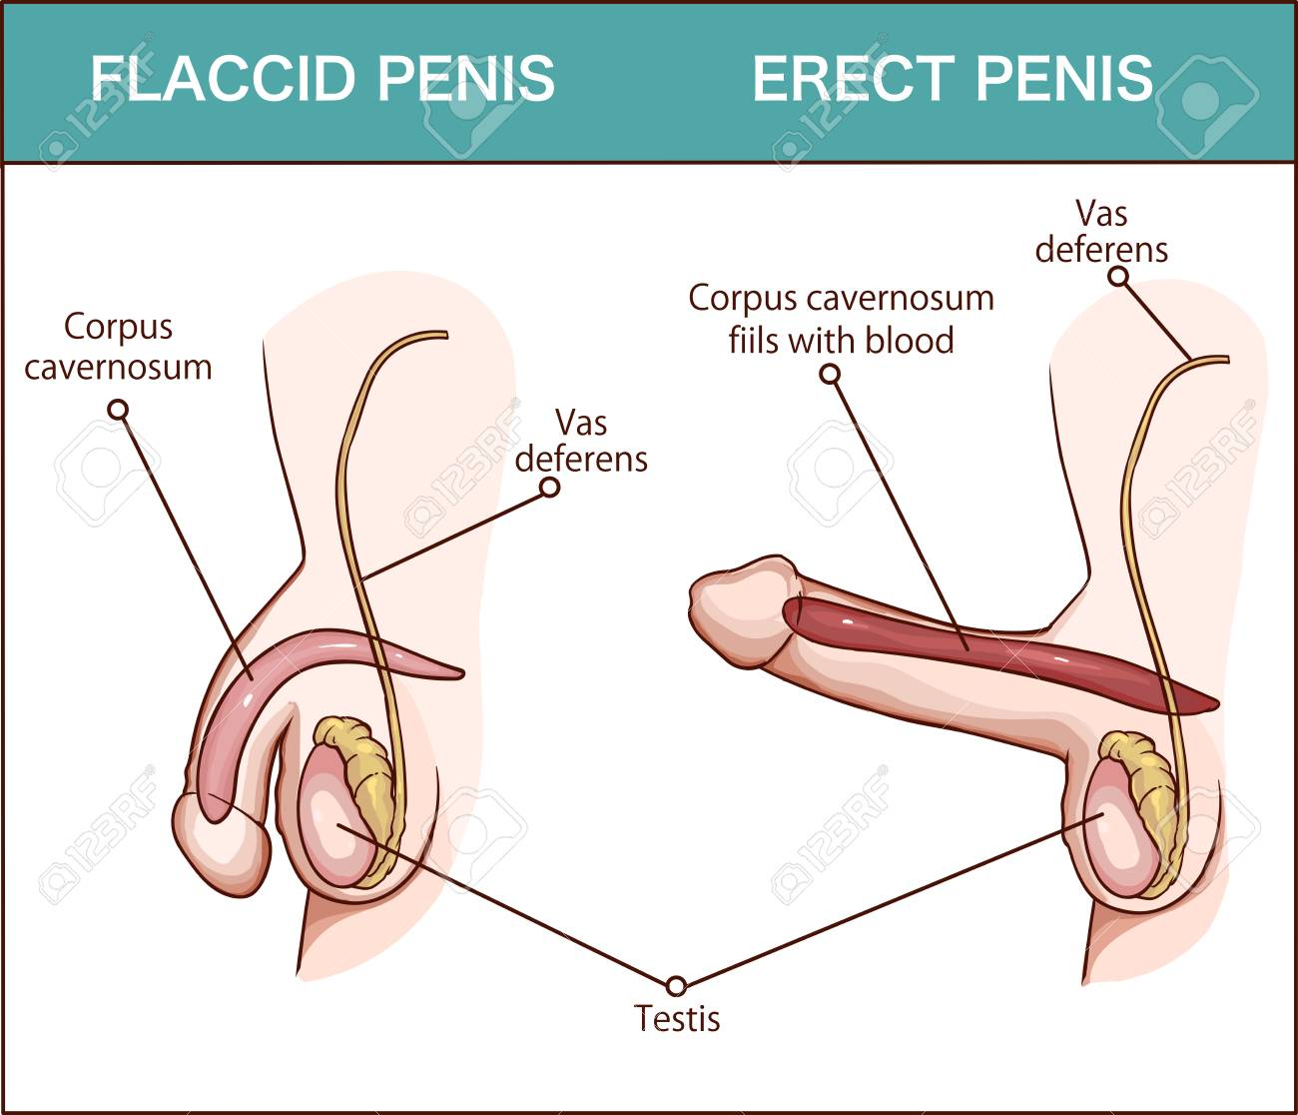
Sexual Intercourse
Sexual arousal increases blood flow to the genital area. Result:
Male penis becomes erect.
Female vagina produces natural lubrication.
Ejaculation:
Discharge of semen (containing seminal fluid and sperm) from the penis.

Slide 21
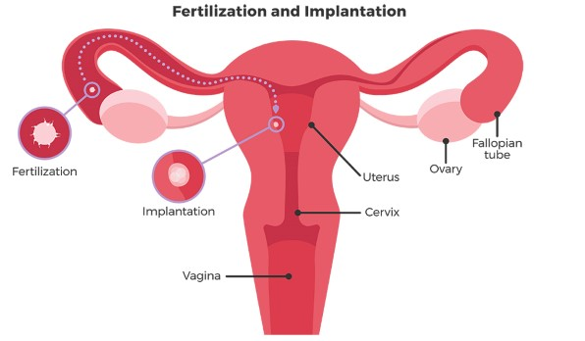
Fertilization and Pregnancy
Fertilization occurs when a sperm cell meets an egg. Fertilization usually occurs within the oviduct.
The fertilized egg then implants in the uterus. The individual is now pregnant.

Slide 22
Fertilization and Pregnancy
Random facts:
Twins occur when one fertilized egg splits (mitosis) or two eggs are released and fertilized.
2% of the time, the fertilized egg implants in the wrong place and cannot develop properly (ectopic pregnancy). If not terminated, the mother’s health is at risk.

Slide 23
Birth Control
Birth Control refers to a number of methods intended to prevent or reduce the chances of pregnancy.
We will discuss the most common forms of birth control; however, if you are planning on becoming sexually active, you should consult a physician to determine which method is best for you.
Discuss: Given what you know about the reproductive system, sexual intercourse and pregnancy, brainstorm some ways to prevent pregnancy.

Slide 24
Birth Control Summary
Barrier methods (condom, etc.): prevent male and female reproductive organs from coming into physical contact with each other
Copper IUD (intra-uterine device): inserted into uterus, makes uterus inhospitable (copper); lasts 3-5 years and is low-maintenance
Hormones: many methods that vary in ease of use, cost, and effectiveness
Surgery: cut or remove organs to make pregnancy impossible
Behavioural (pulling out, abstinence, cycle tracking)

Slide 25
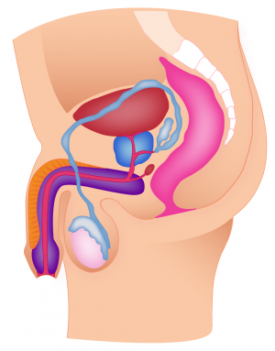
Legend
Highly effective
Mostly effective
Unreliable, not effective on its own
Permanent, surgery
abstinence
don’t have sex
male condom
‘contains’ ejaculate; prevents sperm from entering female (issues: condom may burst or leak)
vasectomy
pulling out
cut vas deferens; sperm cannot enter penis
remove penis from vagina before ejaculation (issues: precum can contain sperm; penis may not be removed quickly enough)

Slide 26
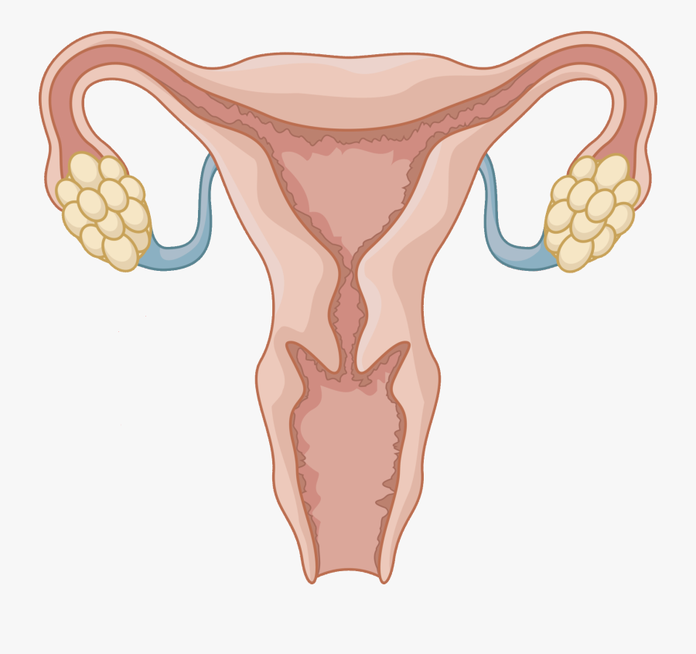
Legend
Highly effective
Mostly effective
Unreliable, not effective on its own
Permanent, surgery
copper IUD
abstinence
prevent implantation
(issues: risk of perforation and dislodgment)
don’t have sex
cycle tracking
avoid sex during fertile periods (issues: every woman is different; cycles can vary)
tubal ligation
plan B
cut oviduct; egg does not enter uterus
prevent ovulation, prevent implantation (issue: not reliable; cost per use)
oophorectomy/ hysterectomy
hormones (Mirena IUD, ring, patch, shot, pill)
remove ovary/uterus
female condom
prevent ovulation; prevent implantation (issues: side effects; consistency)
‘contains’ ejaculate; prevents sperm from entering female (issues: condom may burst or leak; difficult to use)

Slide 27
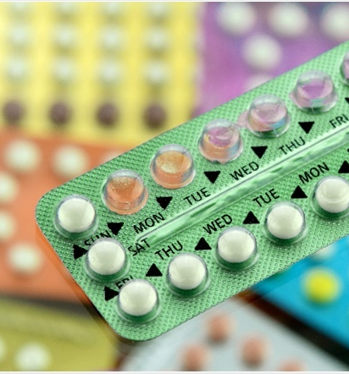
Hormonal Birth Control
During real pregnancy, high levels of progesterone and estrogen prevent other eggs from maturing.
Many hormonal methods of birth control (e.g. “The Pill”) increase progesterone levels to mimic pregnancy hormone levels. If eggs don’t develop, then pregnancy cannot occur!
https://www.news-medical.net/health/Advantages-and-Disadvantages-of-the-Combined-Pill.aspx

Slide 28
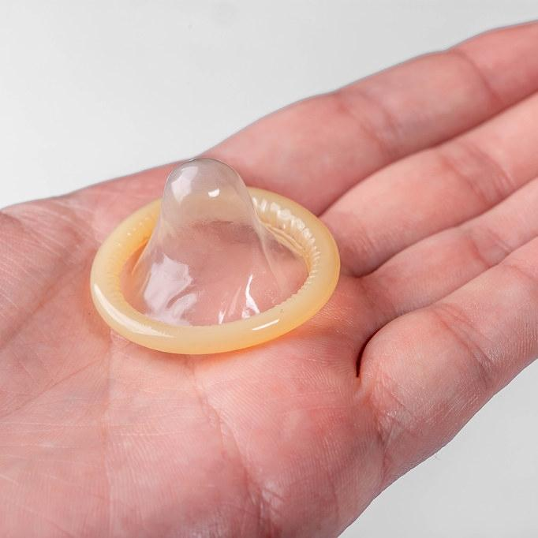
Demo: How to Use a Male Condom

Slide 29
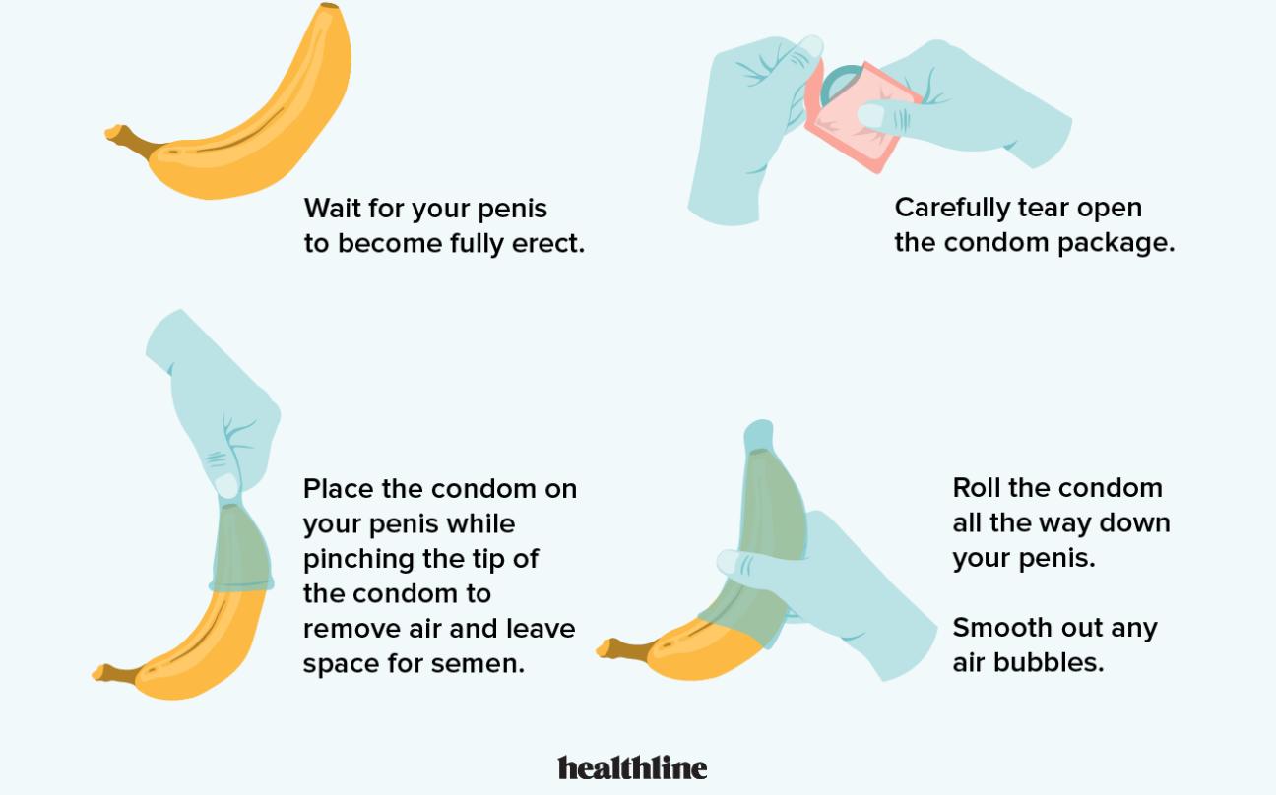
Check the expiry date.

Slide 30
Understanding Consent
Consent is required before and during any sexual activity.
Brochure about consent: next slides
https://www.rcmp-grc.gc.ca/en/brochure-respect-sexual-consent
Notes:
Note to self: consent case law
https://www.scc-csc.ca/case-dossier/cb/2022/39287-eng.aspx?fbclid=IwAR3k6sma211ZHbPJ-ibxN2s7OxOwQjUVPtNcVhfj-mt43n5HwsDVHM9w38s
https://www.scc-csc.ca/case-dossier/cb/2021/38801-eng.aspx?fbclid=IwAR2MqBBfMg9TO3LMsIZongcx0MulbD9Vmr95CXc4A7UX_SEoK8NNPHrgCDk
https://www.scc-csc.ca/case-dossier/cb/2021/38546-eng.aspx?fbclid=IwAR0iAfCyOE0n1GM1Ta5-Y_mqmFIaQGWPx33sq6EtuPI063o-9sHi2Nu97j8

Slide 31
Understanding Consent
https://www.rcmp-grc.gc.ca/en/brochure-respect-sexual-consent

Slide 32
Understanding Consent
https://www.rcmp-grc.gc.ca/en/brochure-respect-sexual-consent

Slide 33
Understanding Consent
https://www.rcmp-grc.gc.ca/en/brochure-respect-sexual-consent

Slide 34
Understanding Consent
https://www.rcmp-grc.gc.ca/en/brochure-respect-sexual-consent

Slide 35
Understanding Consent
https://www.youtube.com/watch?v=raxPKklDF2k&t=56s&ab_channel=TeachingSexualHealthAlbertaHealthServices

Slide 36
Understanding Consent
https://www.youtube.com/watch?v=fGoWLWS4-kU&ab_channel=BlueSeatStudios

Slide 37
Sexually Transmitted Infections (STIs)
What are STIs?
Infections that are passed from one person to another during sex
Transmitted through blood or other bodily fluids
Examples of STIs:
Bacterial: gonorrhea, syphilis, chlamydia
Viral: HPV, genital herpes, HIV
Parasitic: trichomoniasis

Slide 38
Sexually Transmitted Infections (STIs)
You should see a doctor if you have any of the following signs and symptoms.
Note: It is a good idea to get a check-up before becoming sexually active.
Note: There are other ways STIs can be transmitted, not just through sex.
Some Signs and Symptoms:
Painful or burning urination
Unusual or smelly discharge from vagina or penis
Sores or bumps in the genital, rectal, or oral regions
Pain during sex
More info: https://www.mayoclinic.org/diseases-conditions/sexually-transmitted-diseases-stds/symptoms-causes/syc-20351240

Slide 39
Sexually Transmitted Infections (STIs)
STI Prevention:
Use a barrier protection method (e.g. condom).
Get tested and make sure your partner is tested before having sex.
Get vaccinated. (HPV, Hepatitis A, Hepatitis B)
Know the signs and symptoms of the most common STIs. Don’t be shy about going to see your doctor!!!

Slide 40
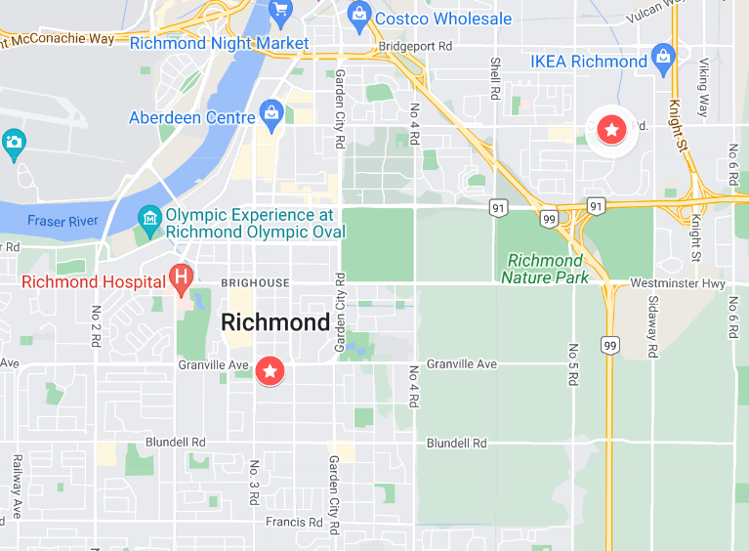
Resources
Richmond Youth Medical Clinic: https://youthinbc.com/2009/02/03/richmond-youth-clinic/
Free, confidential services for youth (13-21)
Counselling
Free birth control
Free emergency contraception
STI testing and treatment
Pregnancy tests
Online chat with a trained crisis responder

Slide 41
Q&A

