Slide 2
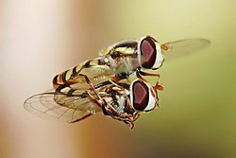
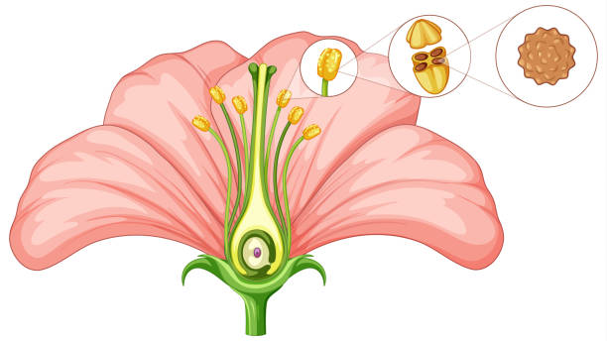
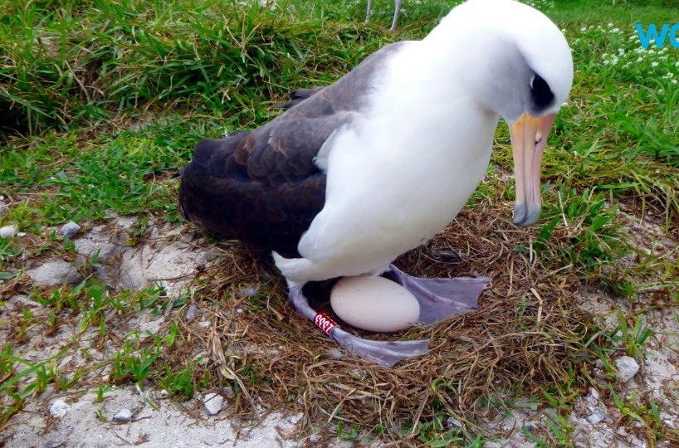
Internal Fertilization
Fertilization inside one parent’s body (usually via sexual intercourse)

Slide 3
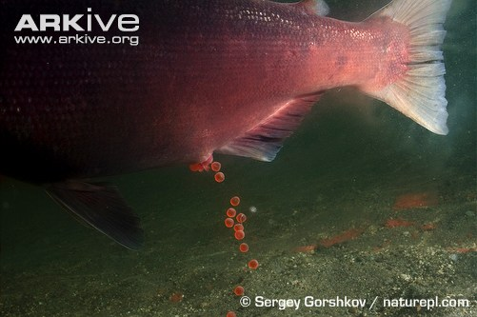
External Fertilization
Sperm and egg join outside of body
Spawning: releasing eggs and sperm into water
E.g. marine animals (amphibians, fish, invertebrates)

Slide 4
Pros and Cons
Internal Fertilization
External Fertilization
High cost per offspring (yolk, parenting)
Few offspring produced
High survival rate
Requires physical contact between parents
Low cost per offspring
Many offspring produced
Low survival rate
No physical contact between parents (good for sessile* or slow-moving species)

