Slide 1
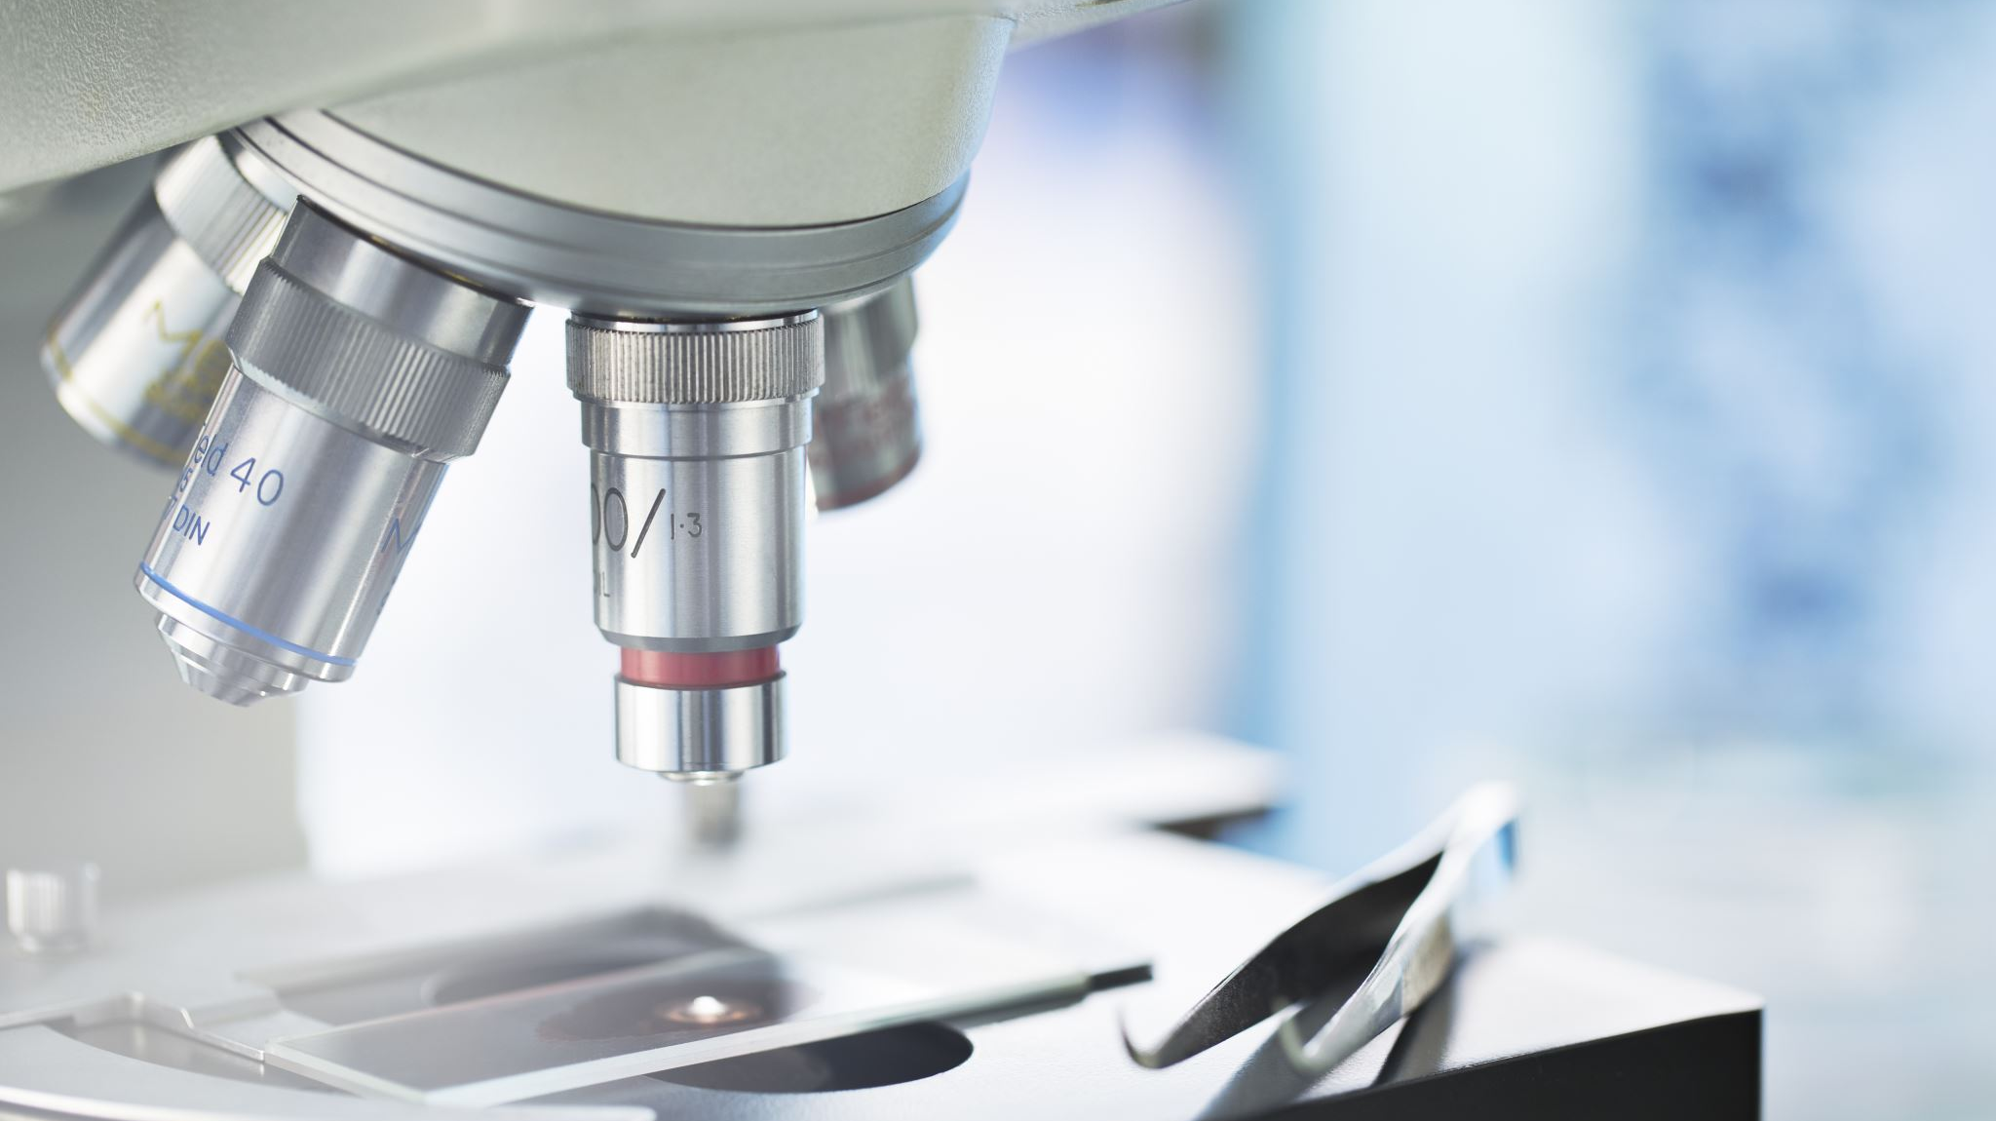
Microbiology

Slide 2
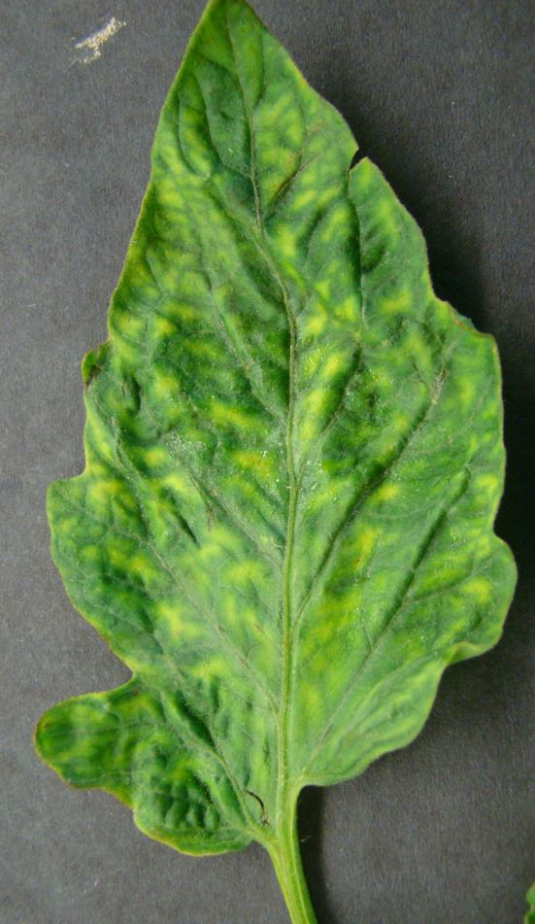
Case Study: Tobacco Mosaic Disease
A disease is making tobacco plants very sick. You are trying to find the bacteria responsible for this disease.
How do you go about this? Design an experiment. (Hint: how would you know for sure you had found the right bacteria?)

Slide 3
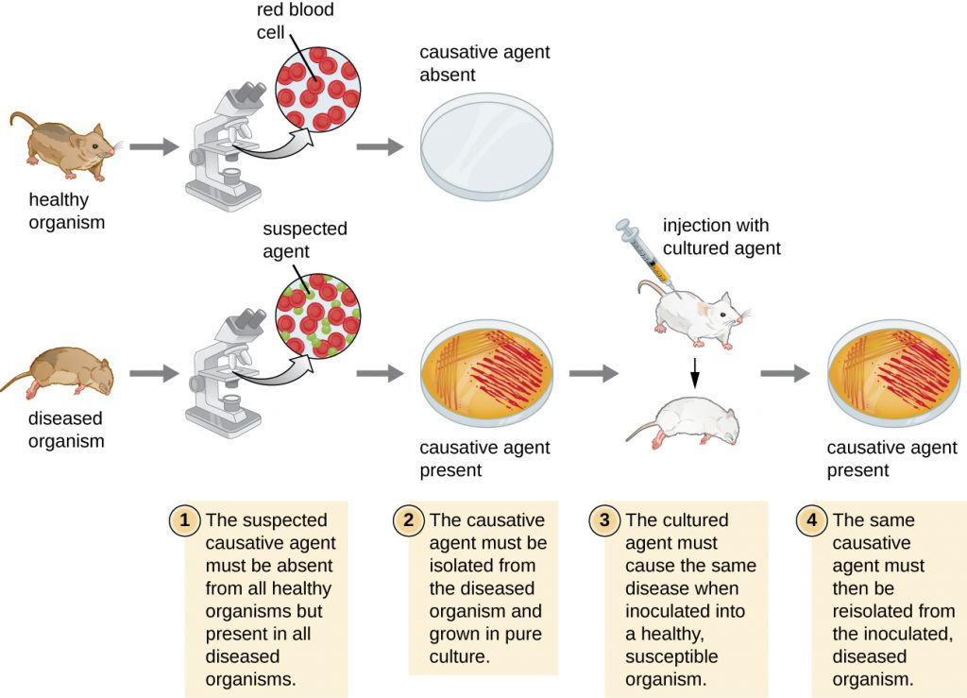
Microbiology in the 19th century
Louis Pasteur published his ‘germ theory’ in 1861, proving that bacteria caused diseases.
Robert Koch set out “Koch’s Postulates” in 1890: a list of criteria to determine whether a disease was caused by bacteria.

Slide 4
Tobacco Mosaic Disease
Dmitri Ivanovsky (1892) completed experiments to show that infectious agent is non-bacterial and very small
Martinus Beijerinck (1898): replicated Ivanovsky’s experiments
Wendell Stanley (1935): isolated tobacco mosaic virus

Slide 5
Viruses

Slide 6
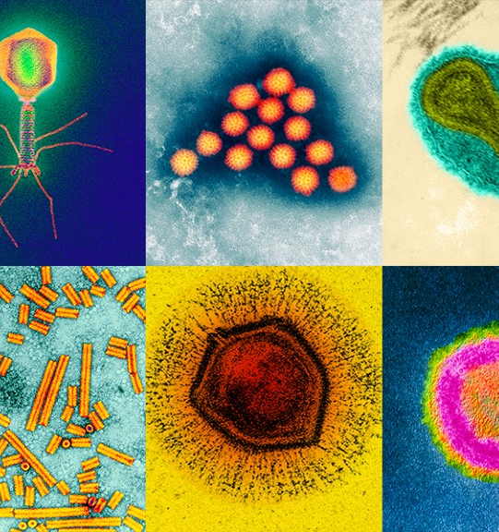
What is a Virus?
Non-living, not made of cells, requires a host to reproduce
Parasitic: invades living cells and hijacks cellular machinery to make more copies of virus
Very specific: in general, each virus only infects one type of cell

Slide 7
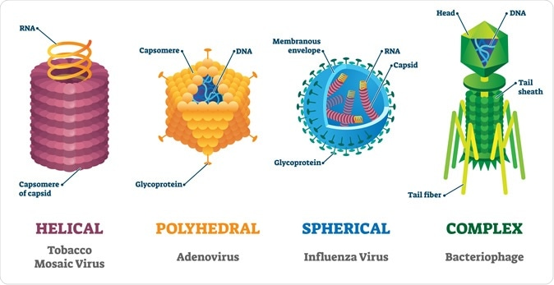
Virus Structure
Extremely small (10-400 nm)
All viruses have a nucleic acid core surrounded by a protein coat called a capsid

Slide 8
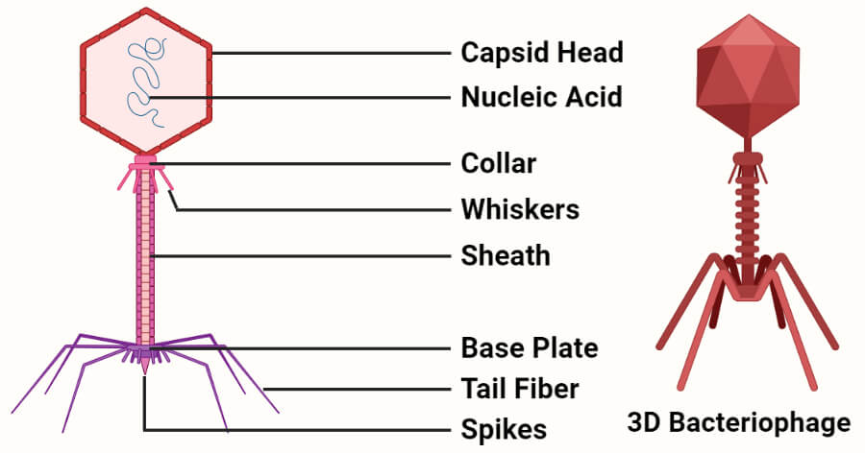
Virus Structure: Bacteriophages
Bacteriophages are viruses that infect prokaryotes (bacteria and archaea)
Genetic material in capsid; tail used to recognize and infect cell
https://www.youtube.com/watch?v=V73nEGXUeBY&ab_channel=biolution
https://www.youtube.com/watch?v=YI3tsmFsrOg&ab_channel=Kurzgesagt%E2%80%93InaNutshell
Notes:
Note: kurzgesagt video 10 minutes long and also talks about using phages against antibiotic-resistant bacteria

Slide 9
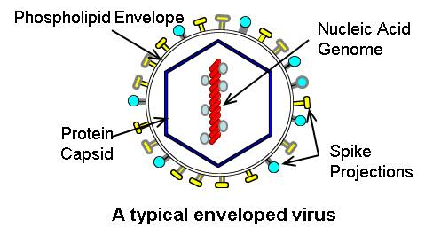
Virus Structure: Enveloped Viruses
Enveloped viruses are surrounded by an envelope
Spike proteins are proteins embedded in the viral envelope. They recognize and attach to the host cell’s surface.
Examples: influenza, coronaviruses

Slide 10
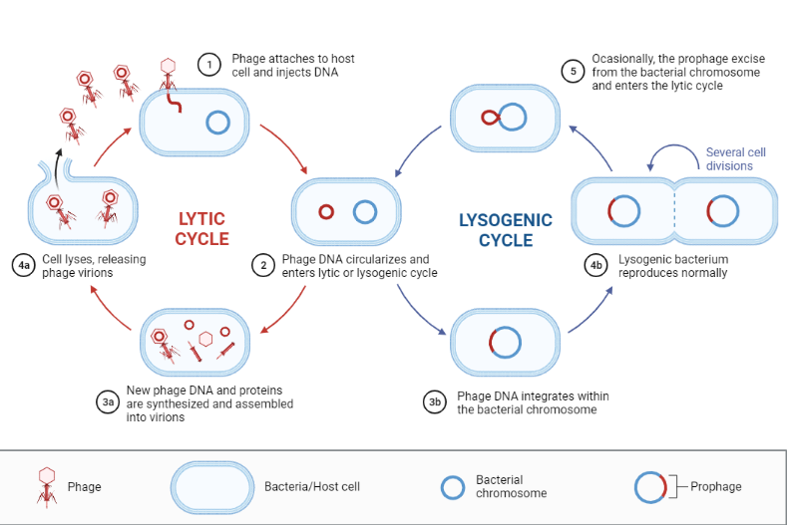
‘Life’ Cycle of a Virus

Slide 11
Lytic Cycle
Infection: virus contacts specific cell type and injects genetic material into the cell
Growth and Replication:
Cell uses viral genetic material to make viral proteins, often shutting down or destroying cellular DNA in the process
Host cell fills up with virus molecules
Lysis: cell bursts, freeing up virus to infect other cells

Slide 12
Lysogenic Cycle
Infection: virus contacts specific cell type and inserts its genetic material into the DNA of the host cell (this inserted viral genetic material is now known as a prophage)
Dormant Phase: cell reproduces normally, making more copies of itself and the viral genetic material
Activation: an environmental factor activates the viral genetic material, causing it to enter the lytic cycle
Notes:
Note: I am simplifying this a bit from the textbook version. Textbook mentions prophage (the name of the viral DNA once it has been inserted).

Slide 13
https://www.youtube.com/watch?v=8FqlTslU22s&ab_channel=AmoebaSisters
Notes:
Summary of virus structure, cycles

Slide 14
Research: “How does COVID-19 infect our cells and bodies?”
For this exercise, you will be presented with a number of different information sources. For each source, record the following:
What are 3 key takeaways from this information source?
What questions do you still have? What did you find confusing?
After compiling a summary of your research from 3 different sources, write a paragraph that summarizes your answer to the research question: “How does COVID-19 infect our cells and bodies?” Cite specific sources in your answer.
Notes:
Videos:
- https://www.youtube.com/watch?v=5DGwOJXSxqg&ab_channel=NucleusMedicalMedia
Websites:
https://stanmed.stanford.edu/2020issue2/how-coronavirus-destroys-cells-treatments.html very long, in-depth article
https://www.statnews.com/2020/12/14/portrait-of-the-coronavirus-at-1/ Equally long, in-depth article
Multimedia:
https://www.scripps.edu/covid-19/science-simplified/how-the-novel-coronavirus-infects-a-cell/index.html contains a short written summary and a short video “how the novel coronavirus infects a cell”
The articles are quite long. Perhaps do a jigsaw or a “pick two” situation. Also, not totally sure about question 2b on reflection. Or have multiple research questions and information sources for each…
e.g. “How does COVID-19 infect our cells and bodies?” “How does the COVID-19 vaccine work?”

Slide 15
Research: “How does COVID-19 infect our cells and bodies?”
Reflect on your experience with this research assignment.
Which types of information sources did you find most helpful or easiest to understand? Why?
Which types of information sources did you find most difficult to understand? Why?
When encountering this type of information source in the future, what are some strategies you can use to help yourself understand what is being communicated?

Slide 16
Prokaryotes

Slide 17
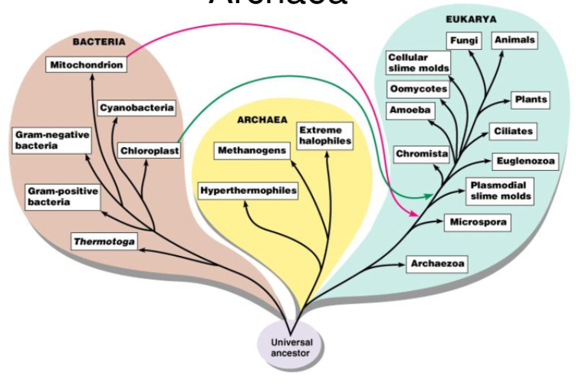
The 3 Domains of Life

Slide 18
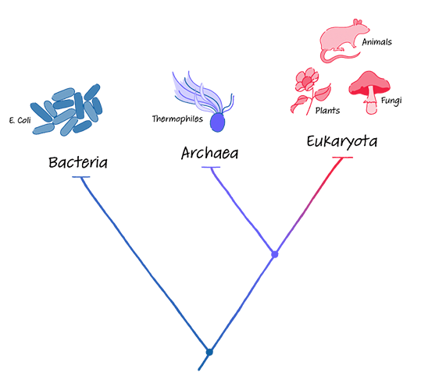
The 3 Domains of Life
All living things can be grouped into 3 domains: Bacteria, Archaea, and Eukarya

Slide 19
Prokaryotes
Unicellular organisms
Made of prokaryotic cells
Includes Bacteria and Archaea

Slide 20
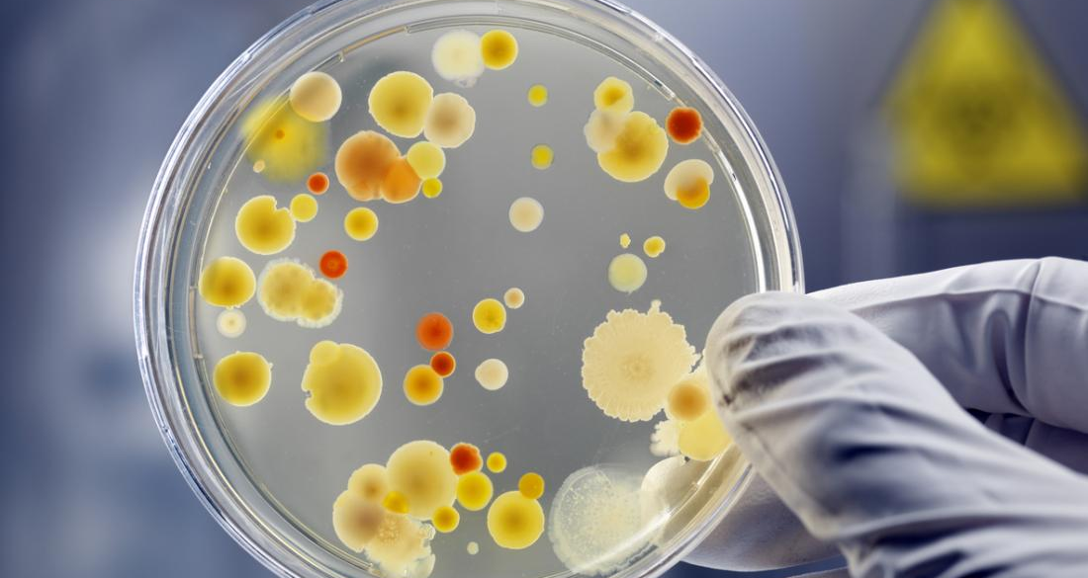
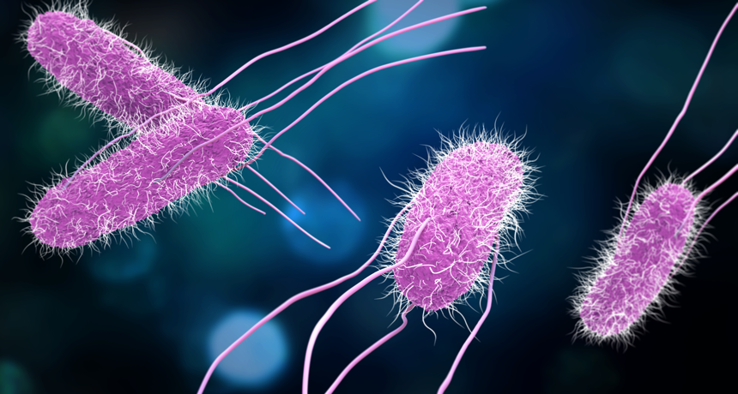
Prokaryotic Cells
Smallest type of cell (1-10 um long)
Lack a nucleus and other membrane-bound organelles
Bacteria and Archaea made of prokaryotic cells

Slide 21
Domain Bacteria
Simple prokaryotes, interact with us daily
Chapter 17
(Note: your textbook refers to this as Kingdom Eubacteria. Recent phylogenetic advances classify bacteria as their own domain.)
https://microbiologysociety.org/why-microbiology-matters/what-is-microbiology/bacteria.html
https://flexbooks.ck12.org/cbook/ck-12-middle-school-life-science-2.0/section/5.4/primary/lesson/bacteria-reproduction-ms-ls/
Notes:
Hook: more than half of the cells in your body (est 56%) are bacterial cells. (However, because bacteria so small and weigh so little, by mass you are still 99.7% human)
Mass of all categories of living things on earth https://www.vox.com/science-and-health/2018/5/29/17386112/all-life-on-earth-chart-weight-plants-animals-pnas

Slide 22
Summary
Appearance and Structure
Gram Staining
Genetic Info, Reproduction
Locomotion
Obtaining Energy
Helpful Bacteria
Harmful Bacteria
Antibiotics and Resistance

Slide 23
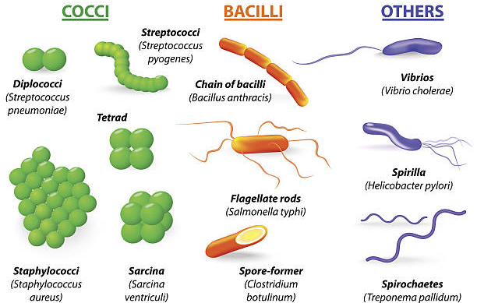
What do Bacteria Look Like?
Bacteria can be classified according to their shapes:
Spherical (cocci)
Rod (bacilli)
Spiral (spirilla)
…and more!
Bacteria can exist alone, in pairs, chains, or clusters

Slide 24
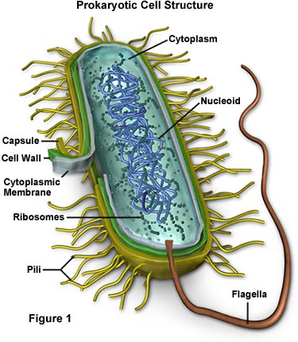
Structure
Unicellular prokaryotes
Cell wall for protection
Cell membrane surrounding cytoplasm
No nucleus or membrane-bound organelles

Slide 25
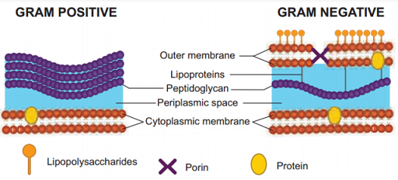
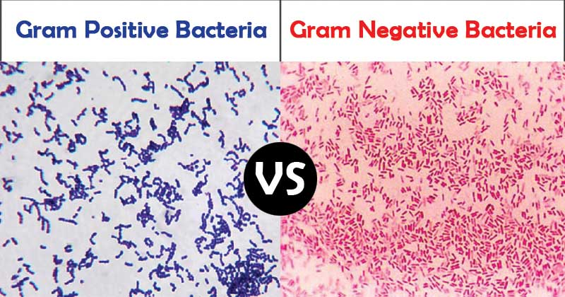
Gram-Staining
Gram-staining is a lab technique to distinguish between two categories of bacteria: Gram-positive and Gram-negative.
The purple Gram stain is absorbed by peptidoglycan.

Slide 26
Gram-Positive
Thick peptidoglycan cell wall
Stains purple
Examples:
MRSA
Strep bacteria
Toxic shock

Slide 27
Gram-Negative
Cell wall is a thin peptidoglycan layer and an extra membrane layer
Stains red or pink
Examples:
Salmonella
Pneumonia
Urinary tract infections
Gonorrhea

Slide 28
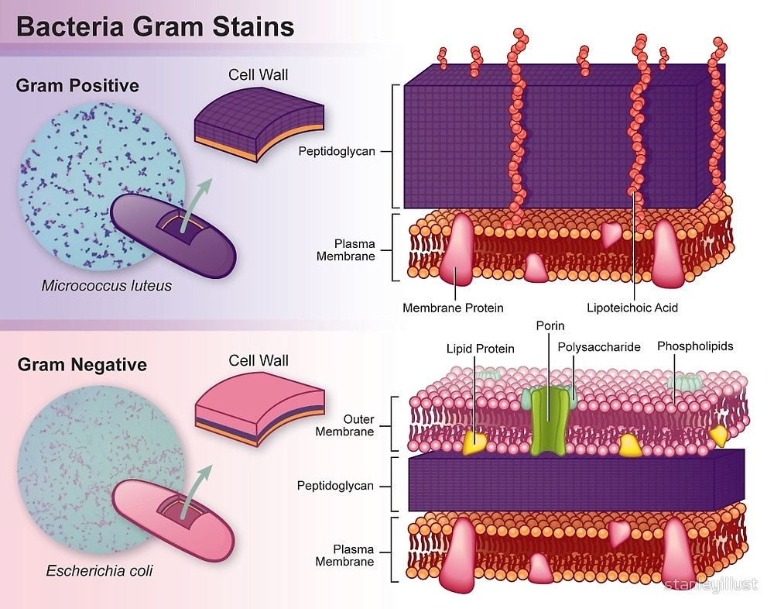
Video on gram positive and negative: https://www.youtube.com/watch?v=Didrc3wJ3E8&ab_channel=NeuralAcademy
Notes:
Video is fairly complex. But it’s short…only 3 minutes.

Slide 29
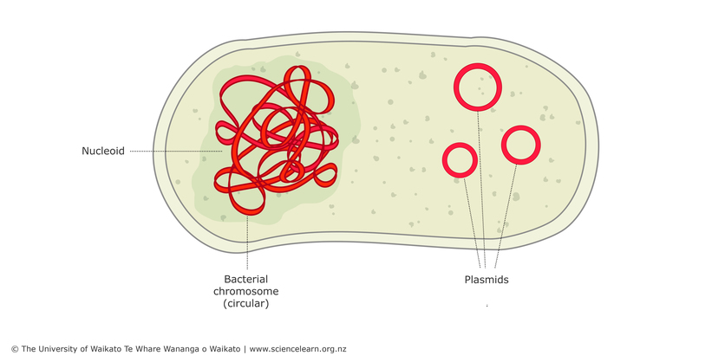
Genetic Information
Bacterial chromosome is a circular molecule of DNA
Sometimes, bacteria also have plasmids: small circular pieces of DNA
Notes:
Plasmids can be inserted to bacteria and then the plasmids are replicated within the bacteria…important for genetic modification etc.

Slide 30
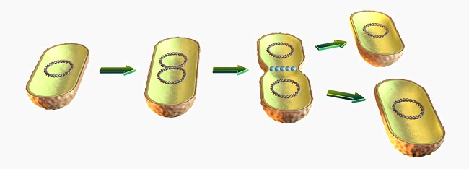
Asexual Reproduction
Binary fission:
Chromosome copies itself
Cell divides into identical two daughter cells
Notes:
Plasmids can be inserted to bacteria and then the plasmids are replicated within the bacteria…important for genetic modification, recombination, etc.

Slide 31
Sexual Reproduction…Sort Of.
Bacteria do not have sexes. However, they have different strategies for exchanging DNA.
Conjugation: DNA is passed from one bacterium to another
Transformation: DNA is picked up from the environment
Transduction: viruses carry DNA from one bacterium to another
Notes:
Plasmids can be inserted to bacteria and then the plasmids are replicated within the bacteria…important for genetic modification, recombination, etc.

Slide 32
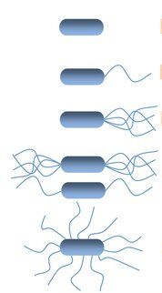
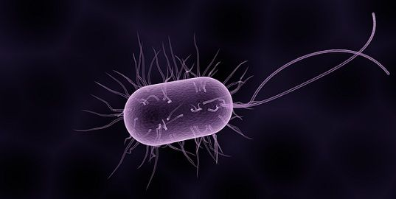
Locomotion
Different strategies for locomotion, including flagella
Flagella rotate in a corkscrew motion
https://www.youtube.com/watch?v=jl0TzaWUQWk&ab_channel=TheMicrobiology09
Notes:
Flagella can be arranged in different ways but I don’t want them to memorize the vocab…so I cut out the names.
Video shows euglena flagellum. Not much movement of the euglena per se but we do see the flagellum moving around

Slide 33
Obtaining Energy
Many strategies:
Phototrophs: trap the energy of sunlight through photosynthesis
Chemotrophs: break down organic or inorganic compounds to obtain energy

Slide 34
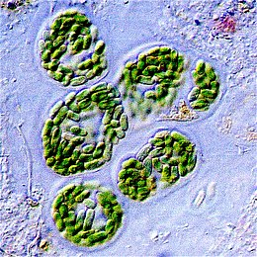
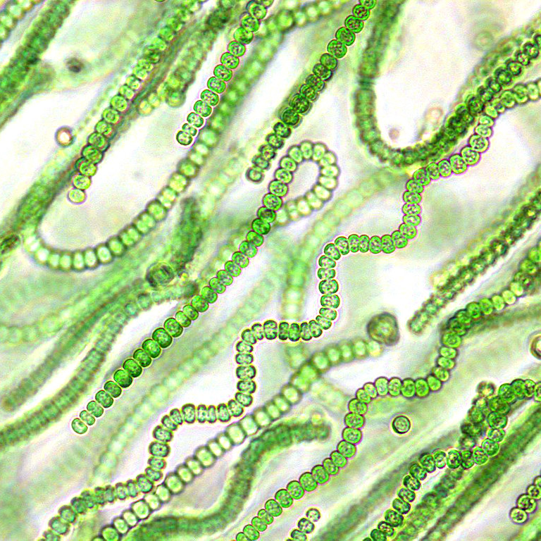
Helpful Bacteria
Cyanobacteria
Phototroph, has photosynthetic pigments
Is responsible for 10% of global oxygen production

Slide 35
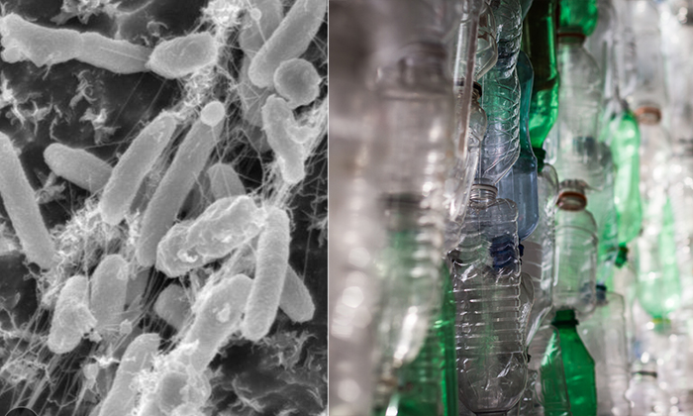
Helpful Bacteria
Ideonella sakaiensis is a chemotroph that breaks down PET - a type of plastic used in plastic bottles
Bacteria may be used in the near future to solve many types of pollution
More reading on bioremediation https://microbiologysociety.org/blog/bioremediation-the-pollution-solution.html
Notes:
More info https://microbiologysociety.org/blog/bioremediation-the-pollution-solution.html

Slide 36
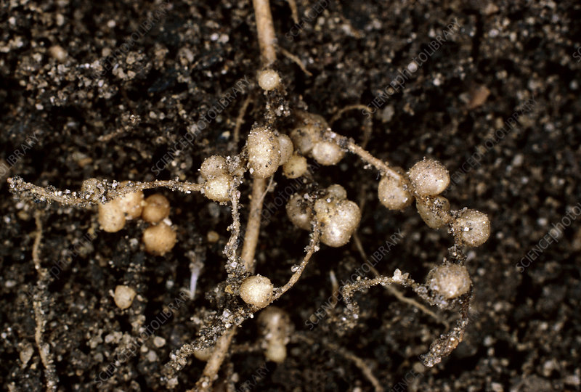
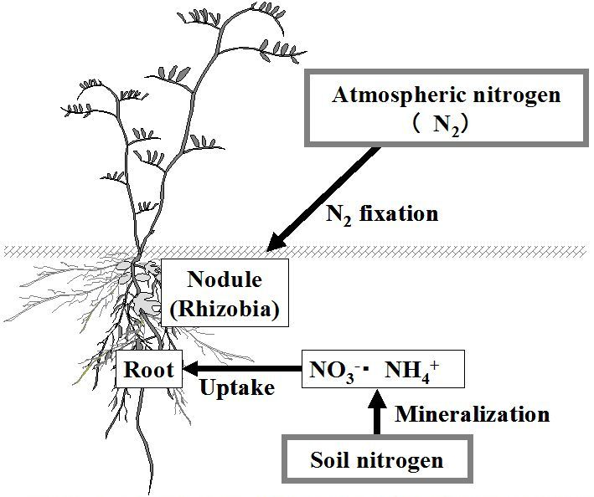
Helpful Bacteria
Nitrogen-fixing bacteria (e.g. Rhizobium)
Live in the roots of legumes (e.g. peas, beans, soy)
Turn atmospheric nitrogen into forms that are useable by living organisms
Symbiotic relationship: bacteria provide nitrogen to the plant in exchange for protection, oxygen, and sugar

Slide 37
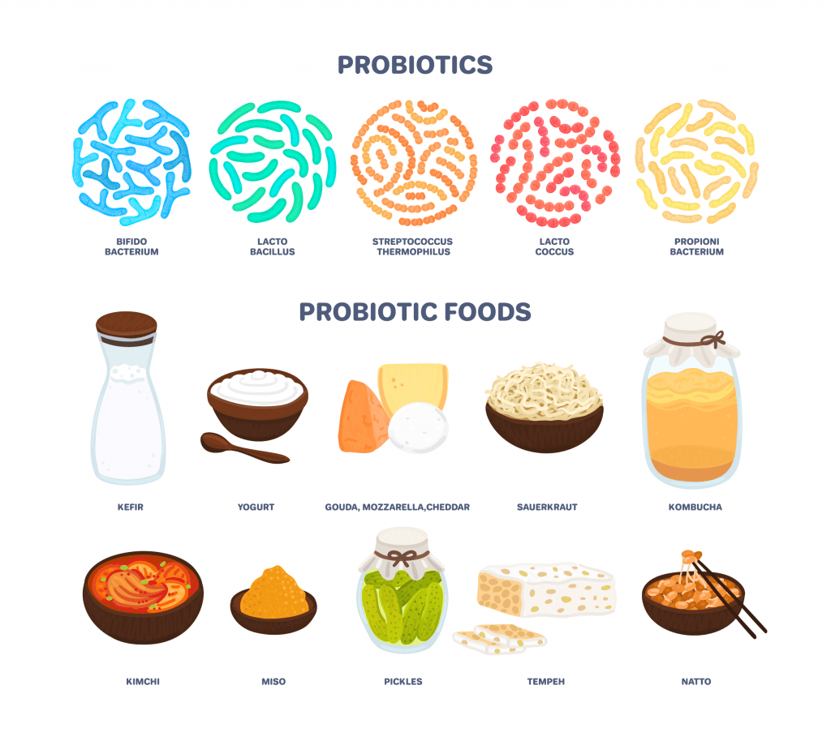
Helpful Bacteria
Bacteria used in the production of yogurt, wine, kimchi, cheese, and many other fermented foods

Slide 38
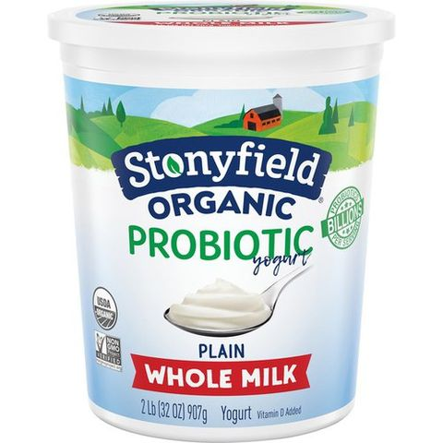
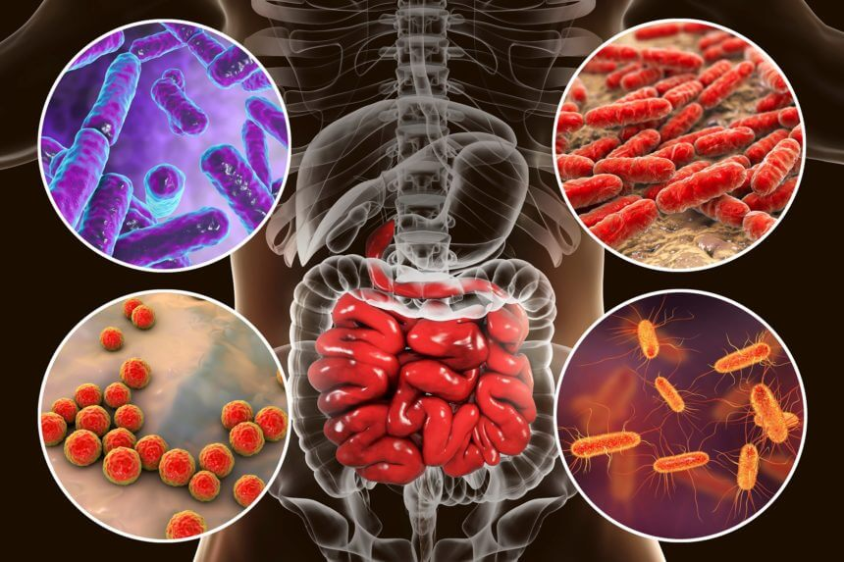
Helpful Bacteria
‘Good’ bacteria live in your digestive system:
Help with digestion
Health: prevent harmful bacteria from living there
Imbalances in gut microbiota have been linked to many health conditions, including obesity and type 2 diabetes
Notes:
Other linkages between microbiota imbalances: inflammatory bowel disease, irritable bowel syndrome, brain disorders (depression, neurodegeneration), cancer, allergies

Slide 39
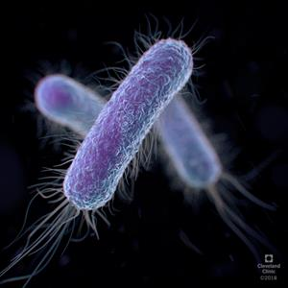
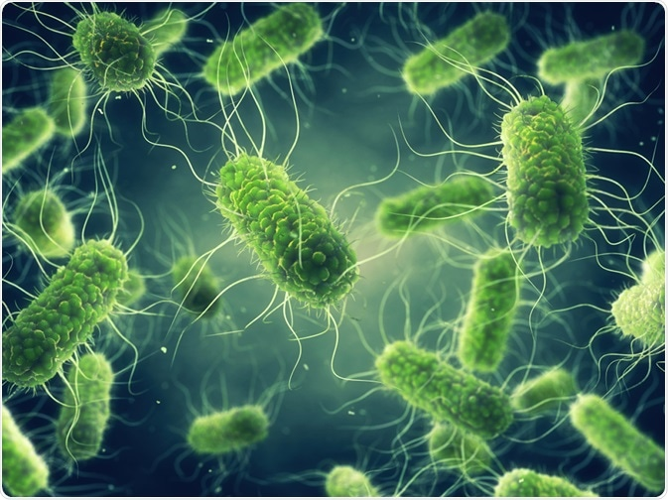
Harmful Bacteria
Food poisoning:
E. coli normally lives in the digestive tract. Contaminates food/water to cause food poisoning.
Salmonella causes infections through spoiled or contaminated food.

Slide 40
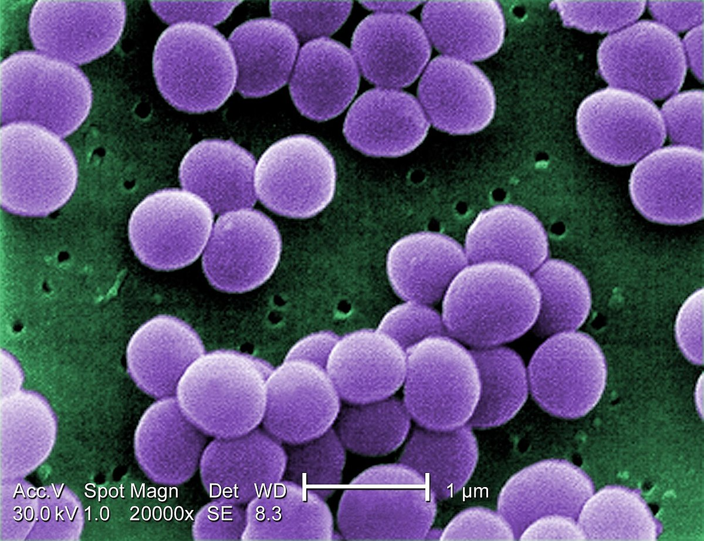
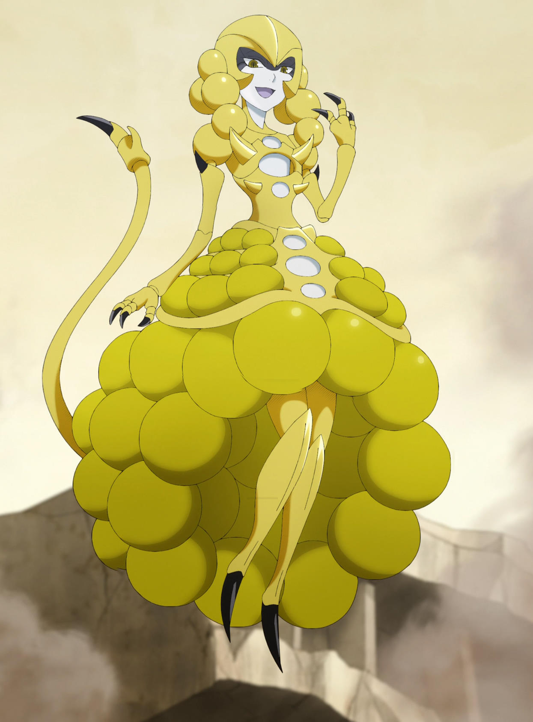
Harmful Bacteria
Staphylococcus is harmless and lives on the skin but causes disease if it enters the body (e.g. through a wound)

Slide 41
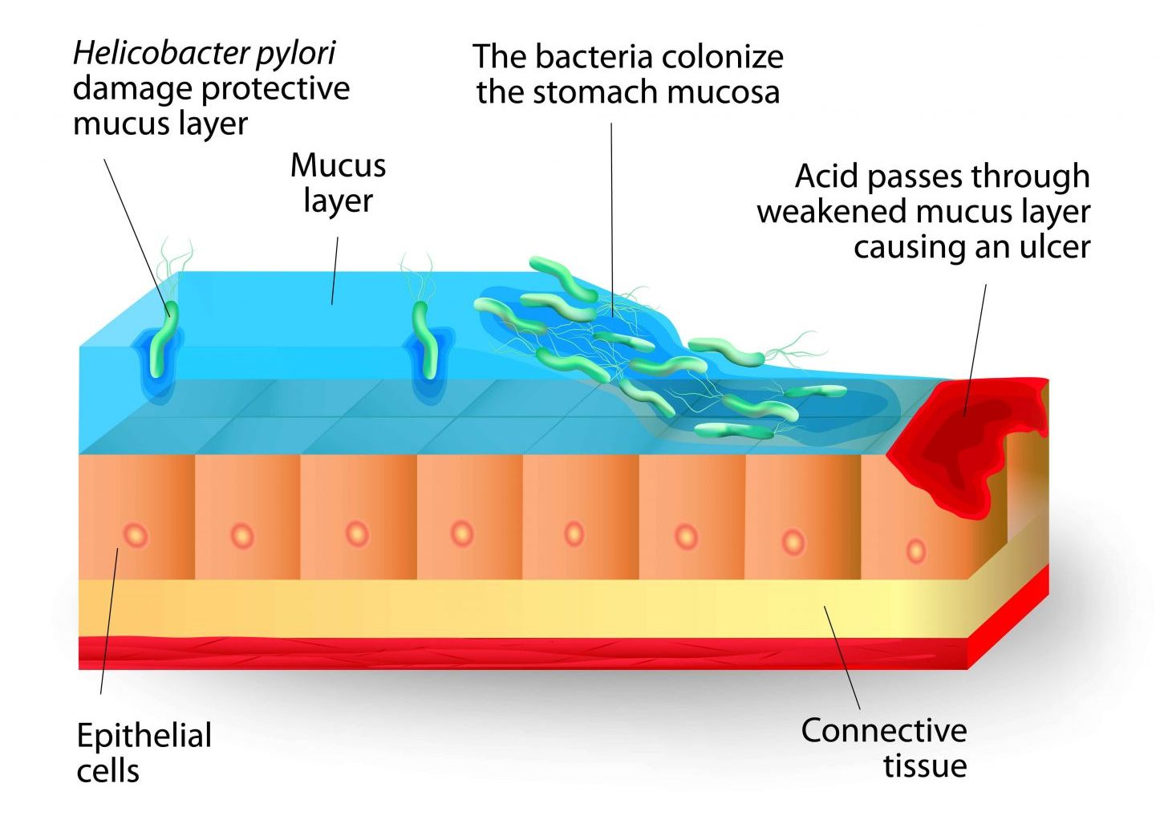
Harmful Bacteria
H. pylori lives in the stomach. Under certain conditions, can cause peptic ulcers.
Notes:
Note: stress and spicy foods do not cause ulcers, but they can make them worse. Ultimately, ulcers are a bacterial infection by h pylori.
https://www.mayoclinic.org/diseases-conditions/peptic-ulcer/symptoms-causes/syc-20354223#:~:text=The%20most%20common%20causes%20of,do%20not%20cause%20peptic%20ulcers.

Slide 42
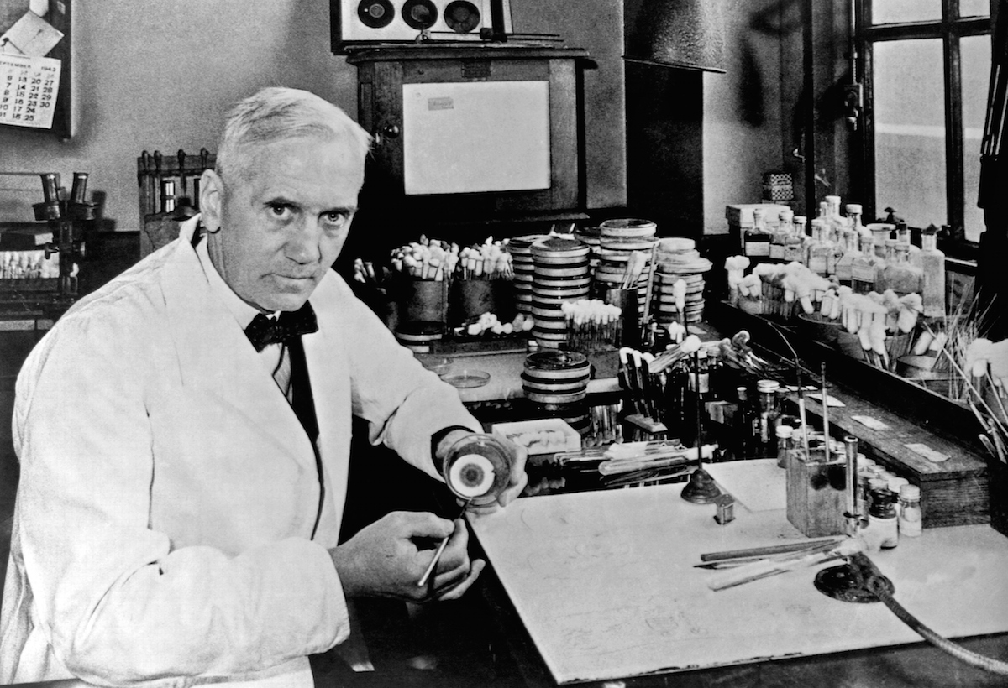
Antibiotics and Resistance
Bacterial infections are fought through the use of antibiotics (e.g. penicillin, amoxicillin)
Overuse of antibiotics has sped up bacterial evolution; antibiotic-resistant strains exist.
Notes:
Alexander fleming accidentally discovered penicillin in 1928 by accident
Came back from vacation and was sorting through petri dishes with staphylococcus on them…noticed that one petri dish had mold growing on it and around the mold there was no bacteria

Slide 43
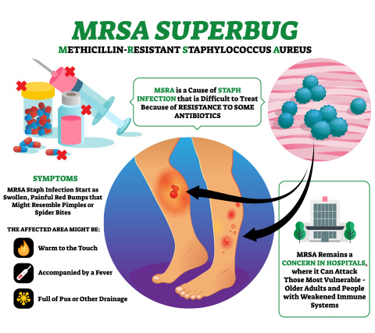
Antibiotics and Resistance
MRSA (methicillin-resistant Staphylococcus aureus) resists multiple common antibiotics.
Outbreaks in hospitals are becoming more common.

Slide 44
Questions
What are some of the ways that you can differentiate between bacteria? List them, with point-form details.
What does gram staining tell you? Why is it useful?
Bacteria have different ways of obtaining energy. What is a phototroph and a chemotroph, and give one example of each.
Make a table detailing the ways in which bacteria can be helpful and harmful. Include examples of each.

Slide 45
Domain Archaea
Simple prokaryotes, live in oppressive environments
Chapter 17
(Note: your textbook refers to this as Kingdom archaebacteria. Recent phylogenetic advances classify bacteria as their own domain.)
https://microbenotes.com/archaea-vs-bacteria/

Slide 46
What are Archaea?
‘Archaios’ (Greek) means primitive or ancient; oldest fossils 3.5 billion years old
Structurally similar to bacteria; have adaptations to permit life in extreme conditions
Inhabit extreme, low-oxygen environments: deep-sea vents, very salty water, hot springs, oil wells
Poorly understood – hard to study!

Slide 47
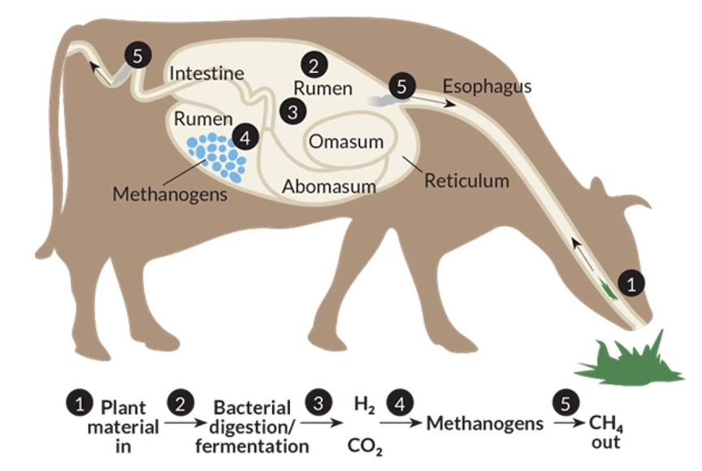
Major Groups of Archaea
Methanogens: live in moderate environments (swamps, intestines), use carbon dioxide and hydrogen to produce methane as byproduct of cellular respiration

Slide 48
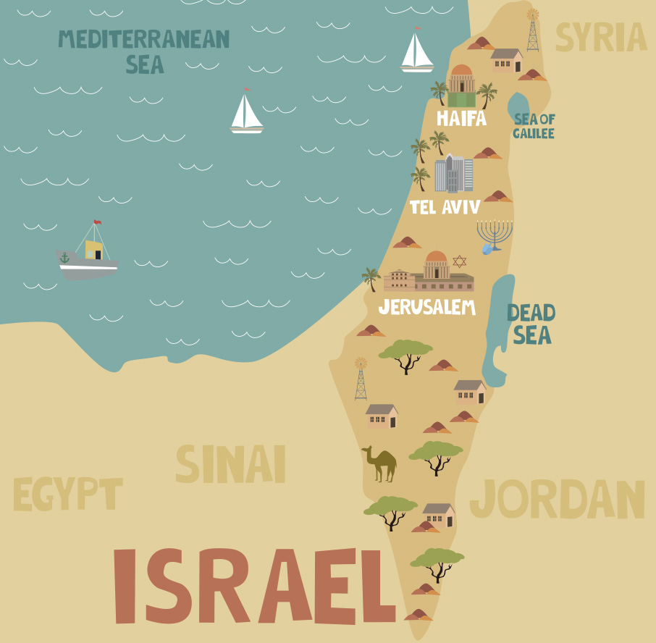
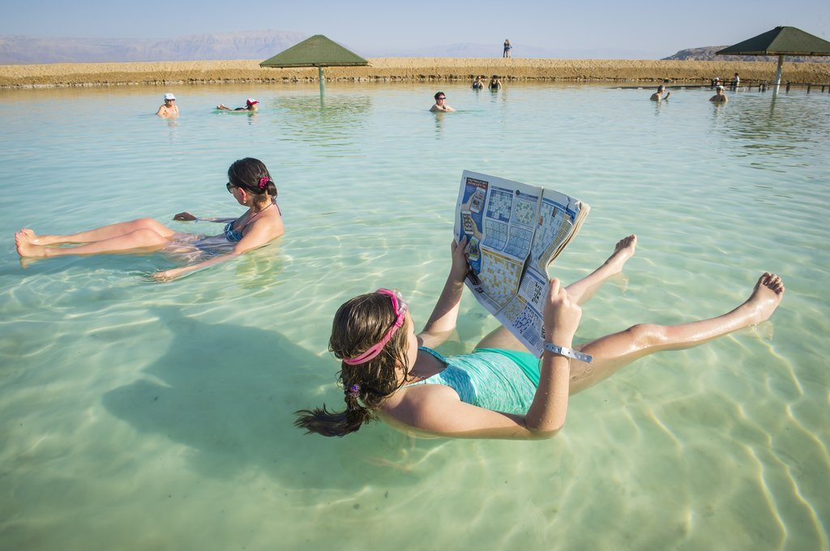
Major Groups of Archaea
Halophiles: tolerate high-salt environments (e.g. Dead Sea, Great Salt Lake)

Slide 49
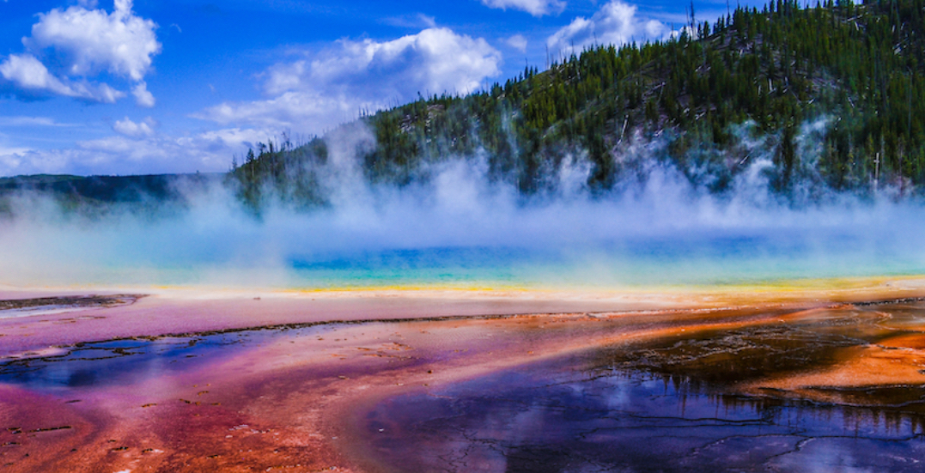
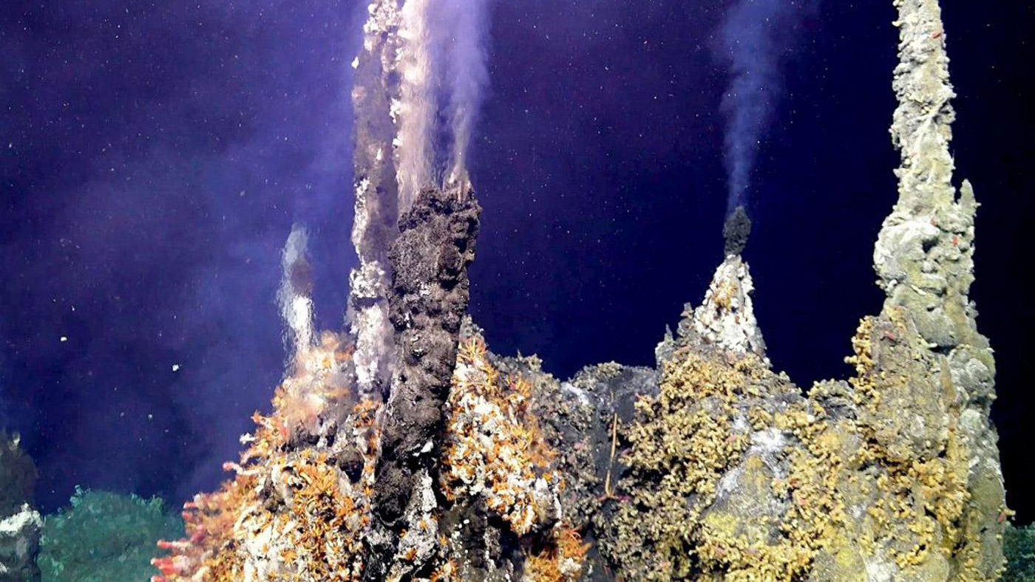
Major Groups of Archaea
Thermophiles: tolerate extremely high temperatures (113°C!)
Notes:
Yellowstone hot springs (average 92 degrees C though Yellowstone will have steam vents as high as 135 degrees); that picture is from an article where some visitors were banned for trying to cook chicken in the hot springs
hydrothermal vent (water comes out at 60-464 degrees C)

Slide 50
https://www.youtube.com/watch?v=vAR47-g6tlA&ab_channel=CrashCourse
Notes:
Just first 8 minutes and then he starts talking about protists

