Slide 1
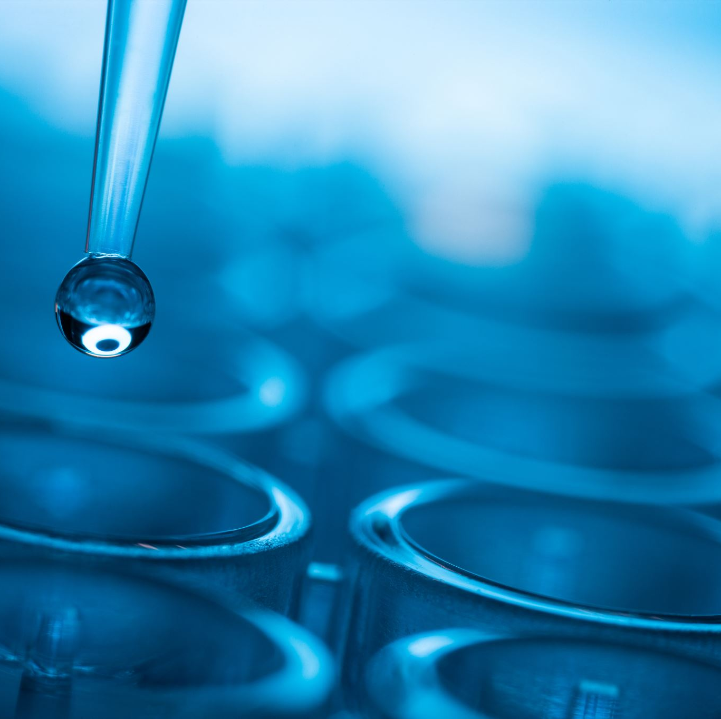
Biochemistry

Slide 2
Photosynthesis

Slide 3
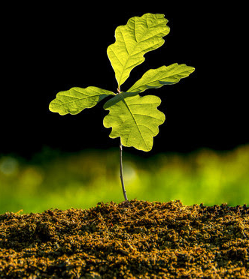
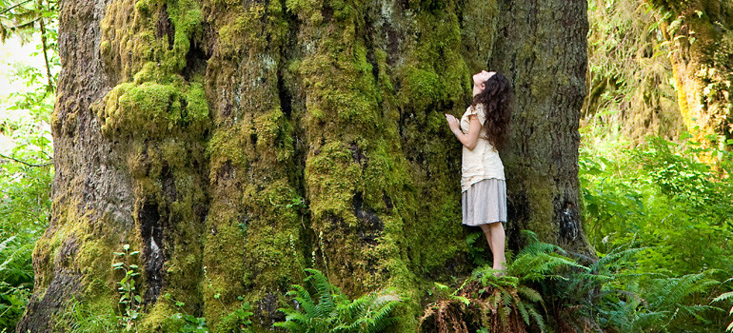
Trees: A Massive Conundrum
Conservation of Mass: Mass cannot be created or destroyed.
Discuss: Where does most of the mass in a tree come from?
The soil
The water
The air
The sunlight
Other: specify
Design an experiment to test your prediction.

Slide 4
Jan Van Helmont’s Experiment
https://www.youtube.com/watch?v=2KZb2_vcNTg&ab_channel=Veritasium

Slide 5
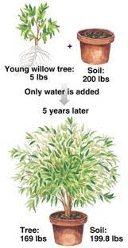
Jan Van Helmont’s Experiment
Procedure:
Measure mass of pot of dry soil; measure mass of seedling
Plant seedling; water regularly for 5 years
Result: Tree gained 75 kg, but the mass of the soil was unchanged.
Conclusion: Most of the mass comes from the water.
Do we agree with Helmont’s conclusion? Why or why not?
Notes:
Stress the importance of good experimental design. If there are variables you haven’t accounted for, these can throw your entire experiment off and bring the results into question. E.g. the “vaccines cause autism” experiment was designed very poorly which opened it up to unaccurate conclusions.

Slide 6
Joseph Priestley’s Experiment
Observations:
A mouse will go unconscious (and eventually die) if you leave it in a sealed jar.
A mouse will regain consciousness if you put a mint plant into the jar.
Conclusion:
Plants produce something that the mouse needs to live.

Slide 7
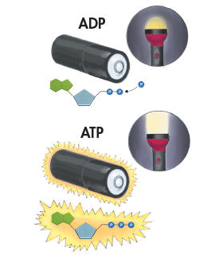
ATP: Life’s Battery
Adenosine triphosphate (ATP) is an important compound for storing and releasing energy.
Structure contains 3 phosphate groups
Breaking a phosphate bond releases energy and converts ATP to ADP
Reforming a phosphate bond costs energy and converts ADP to ATP

Slide 8
ATP: Life’s Battery
Cells use ATP energy for:
Active transport
Movement (cilia, flagella, muscle contractions)
Synthesizing materials
ATP is for short-term energy storage. It can be regenerated from ADP using the energy in glucose.
In this chapter, we will encounter other energy storage molecules. Just like ADP/ATP, there is NADP+/NADPH, NAD+/NADH.

Slide 10
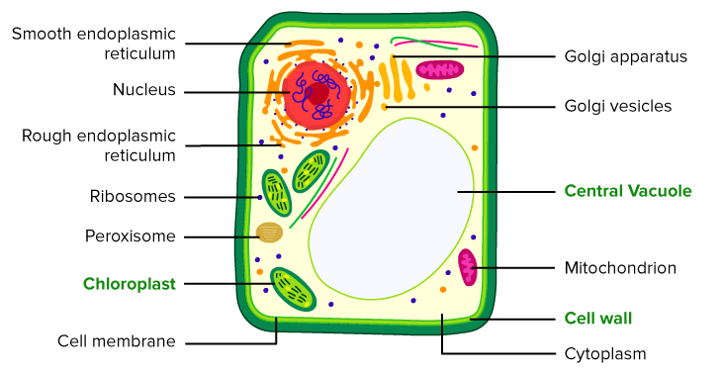
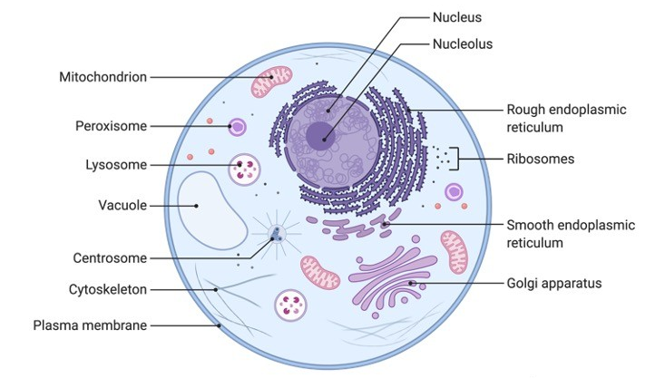
Cell Structures Review
plant cell
Chloroplast:
Plant cells only
Does photosynthesis
Mitochondria:
Plant and animal cells
Does cellular respiration
Cytoplasm:
The fluid ‘insides’ of a cell, contains cell structures
animal cell

Slide 11
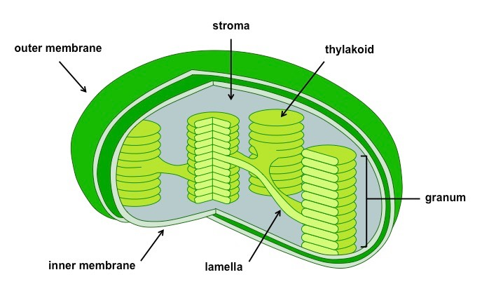
Chloroplast Structure
Stroma:
Fluid-filled interior of the chloroplast, where thylakoids are located
Thylakoids:
Sac-like photosynthetic membranes
Contains photosynthetic pigments (chlorophyll)
Notes:
Image: bioninja

Slide 12
Photosynthetic Pigments
Primary pigment in plants is chlorophyll.
Each pigment absorbs certain wavelengths of light (e.g. chlorophylls absorb orange, yellow, and blue).

Slide 13
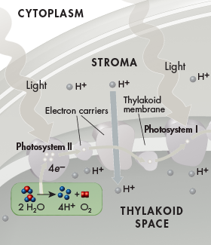
Stage 1: Water Splitting
Inside the thylakoid, an enzyme breaks up water molecules into:
Oxygen → diffuses out into the air
H⁺ ions → released inside the thylakoid
Electrons → used to replace electrons used in the next step
Notes:
Input: water
Output: hydrogen ions and oxygen

Slide 14
Stage 2: Energy Collection (PSII)
Chlorophylls in photosystem II absorb light energy.
Energy is transferred to an electron, which becomes excited.
High-energy electrons are highly reactive. They need an electron carrier molecule to carry them safely. (Note: the electrons are always accompanied by a hydrogen.)
Low-energy state | High-energy state
NADP+ | NADPH
NAD+ | NADH
FAD+ | FADH
Notes:
Input: light energy, [electron, electron carrier]
Output: electron carrier with excited electron

Slide 15
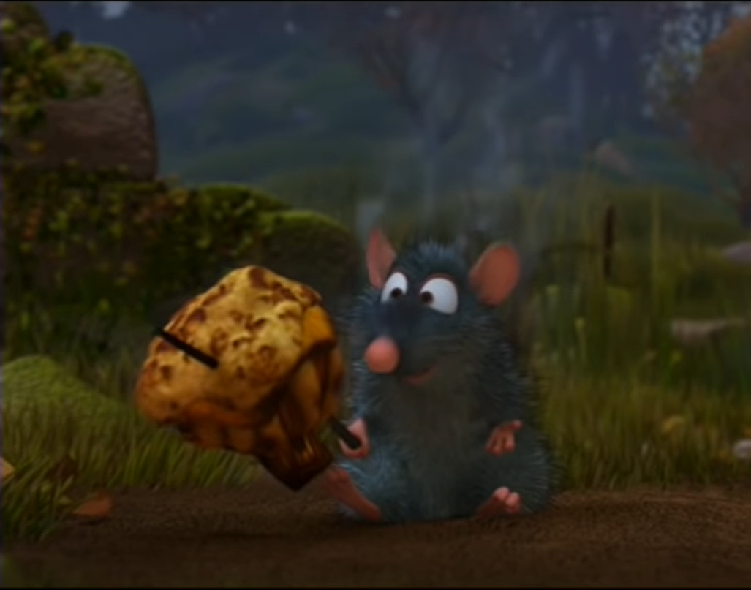
A Thought Experiment
https://www.youtube.com/watch?v=Z6eNu7ItXAY&ab_channel=WaltDisney4Life
A lightning bolt contains enough energy to power a house for 55 days.
How come, in Ratatouille, the lightning only cooks a mushroom?
The most efficient way to use energy is by using a little at a time. When released all at once, more of it is converted into unwanted forms of energy (e.g. heat).
Notes:
https://www.windpowerengineering.com/how-much-power-in-a-bolt-of-lightning/

Slide 16
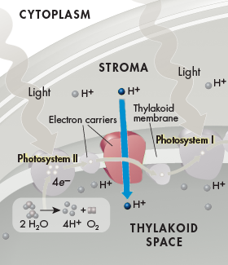
Stage 3: Electron Transport Chain (PSII)
As high-energy electrons are passed from one electron carrier to another, some of the energy is used to pump H⁺ ions from the stroma into the thylakoid.
An Electron Transport Chain is like a game of Hot Potato where each person takes a bite out of the potato.
Notes:
Input: high-energy electrons attached to electron carriers
Output: hydrogen pumped into thylakoid space, [electron carriers]

Slide 17
Stage 4: Rinse and Repeat! (PSI)
Pigments in Photosystem I use light to re-excite electrons.
Electrons pass through a different electron transport chain, pumping H⁺ ions into the thylakoid space.
At the end, the electrons are picked up by NADP⁺, forming NADPH.
Notes:
Inputs: more light, NADP+, electrons
Outputs: hydrogen ions pumped, NADPH

Slide 18
Stage 1-4 Recap
Legend
Fully accounted for (end of story)
Not yet accounted for (not yet used)
✓
✗
What have we accomplished through photosystems II and I?
Inputs | Outputs
Water | Oxygen released
Light energy | H⁺ pumped into thylakoid (this happened 3 times: water split, ETC in PSII, ETC in PSI)
 | NADPH produced
✓
✓
✓
✗
✗

Slide 19
Stage 1-4 Recap
Stages 1-4 set up a concentration gradient in the chloroplast.
Discuss: Where will H⁺ ions ‘want’ to diffuse to?
cytoplasm
H⁺
stroma
H⁺
H⁺
H⁺
H⁺
H⁺
H⁺
H⁺
H⁺
H⁺
H⁺
H⁺
H⁺
thylakoid
H⁺
H⁺
H⁺
H⁺
H⁺
H⁺
H⁺
H⁺
H⁺
H⁺
H⁺

Slide 20
Stage 5: Atp Formation!!!!
Concentration gradient: H⁺ concentration much higher inside thylakoid than the stroma
H⁺ cannot diffuse freely through thylakoid membrane
H⁺ enters stroma via ATP synthase, driving a ‘turbine’ which converts ADP to ATP
Atp synthase video (1:20- https://www.youtube.com/watch?v=3y1dO4nNaKY&ab_channel=ndsuvirtualcell
Notes:
Also, there is an electrical gradient. Opposite charges attract. Because you have moved so many positive charges inside the thylakoid, now there is a relatively negatively charged area in the stroma, which the protons will be drawn to.

Slide 21
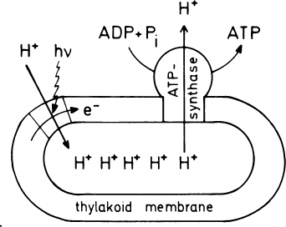
Stage 5: ATP Formation!!!!
Discuss: would ATP synthase best be described as a channel protein, carrier protein, or protein pump?
https://www.nature.com/scitable/topicpage/mitochondria-14053590/

Slide 22
Light-dependent Reactions
“Stages 1-5” are referred to as the light-dependent reactions, because they require light.
Overall, the following are accomplished through the light dependent reactions:
Water and light energy are used
Oxygen gas, ATP, and NADPH are produced in the chloroplast

Slide 23
Stage 1-5 Recap
Legend
Fully accounted for (end of story)
Not yet accounted for (not yet used)
✓
✗
What have we accomplished?
Inputs | Outputs
Water | Oxygen released
Light energy | H⁺ pumped into thylakoid (this happened 3 times: water split, ETC in PSII, ETC in PSI)
 | ATP produced
 | NADPH produced
✓
✓
✓
✓
✗
✗

Slide 24
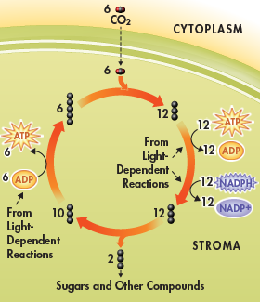
Stage 6: Calvin Cycle (Light-independent Reactions)
Carbon dioxide from the atmosphere enters the Calvin cycle
A series of chemical reactions uses energy from ATP and NADPH (from light-dependent reactions) to convert the carbon dioxide into sugar and regenerate starting materials of cycle
Notes:
Inputs: carbon dioxide
Outputs:

Slide 25
Stage 1-6 Recap
Legend
Fully accounted for (end of story)
Not yet accounted for (not yet used)
✓
✗
What have we accomplished?
Inputs | Outputs
Water | Oxygen released
Light energy | H⁺ pumped into thylakoid (this happened 3 times: water split, ETC in PSII, ETC in PSI)
Carbon dioxide | ATP produced
 | NADPH produced
 | Glucose (sugar) produced
✓
✓
✓
✓
✓
✓
✓

Slide 26
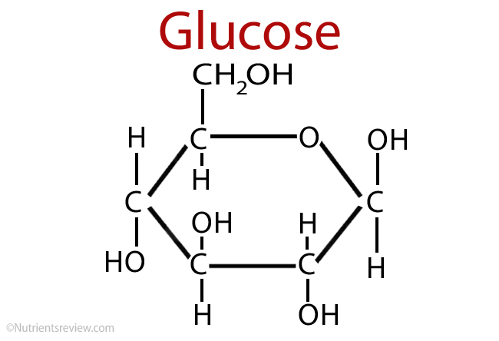
How do Plants Use Sugar?
Used by mitochondria in cellular respiration (convert ADP to ATP which is used as energy for life processes)
Build new molecules (e.g. carbohydrates, proteins, fats)
Starch is a carbohydrate used by plants for long-term sugar storage

Slide 27
Photosynthesis Summary
Light-dependent reactions: Light energy is converted to ATP and NADPH energy. Water is split; oxygen is released.
Light-independent reactions: ATP and NADPH energy is used to convert carbon dioxide into sugar.
Overall: light + H₂O + CO₂ → C₆H₁₂O₆ + O₂

Slide 28
Discussion Questions
What would happen if the thylakoid membrane was ‘leaky’ and allowed H⁺ ions to move freely through it?
When is light energy required in photosynthesis? What does it accomplish?
Why is the Calvin Cycle sometimes called the light-independent part of photosynthesis?
Explain how the structure of a chloroplast allows photosynthesis to take place.

Slide 29
RuBisCO: the worst enzyme
Biochemical reactions do not happen magically. You need:
Reactants
A specific enzyme to catalyze the reaction

Slide 30
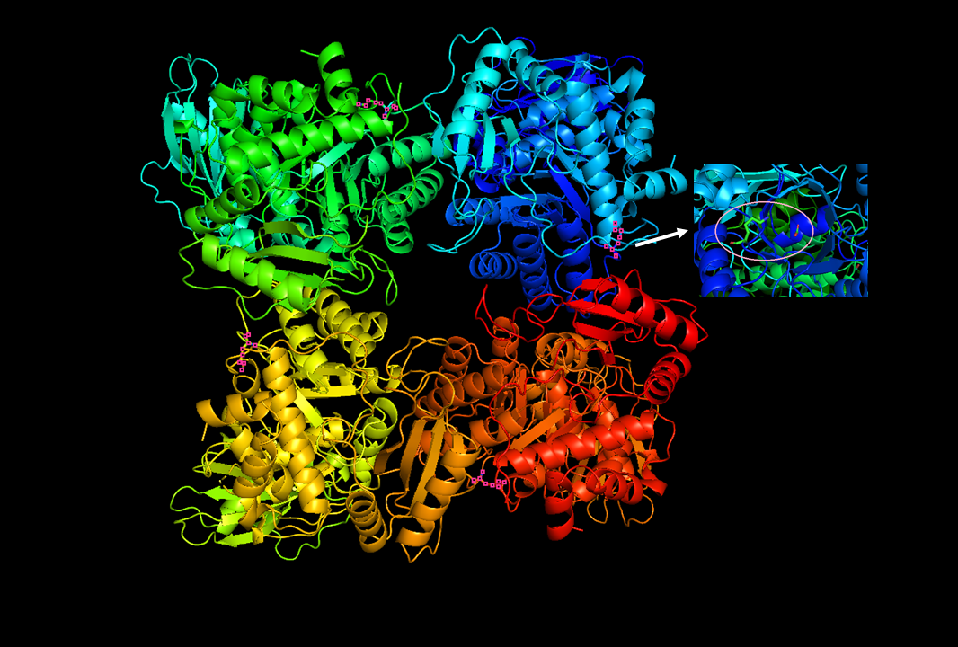
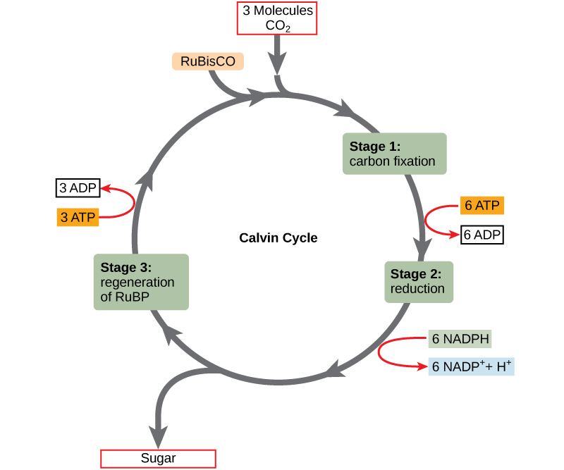
RuBisCO: the worst enzyme
RuBisCO is the enzyme that catalyzes the first step of the Calvin Cycle: ‘fixing’ the carbon from CO₂ into a biologically useful form.

Slide 31
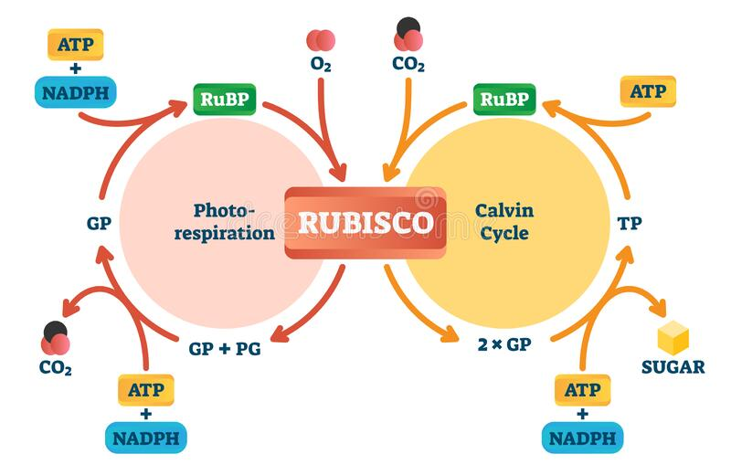
RuBisCO: the worst enzyme
RuBisCO evolved 2.4 billion years ago, when there was no oxygen in the atmosphere. As photosynthetic organisms flourished, the concentration of oxygen in the atmosphere increased.
Problem: if oxygen is available, RuBisCO also catalyzes the reverse reaction, ‘undoing’ the Calvin Cycle. This makes RuBisCO the most inefficient enzyme on the planet.

Slide 32
Solutions for RuBisCO
Evolve a better RuBisCO.
Not possible*. After 2.4 billion years of evolution, RuBisCO is still terrible.
(*Biologists are working on it, though, just in case. Think of all the world problems you would solve if you could make photosynthesis happen faster!)
✘

Slide 33
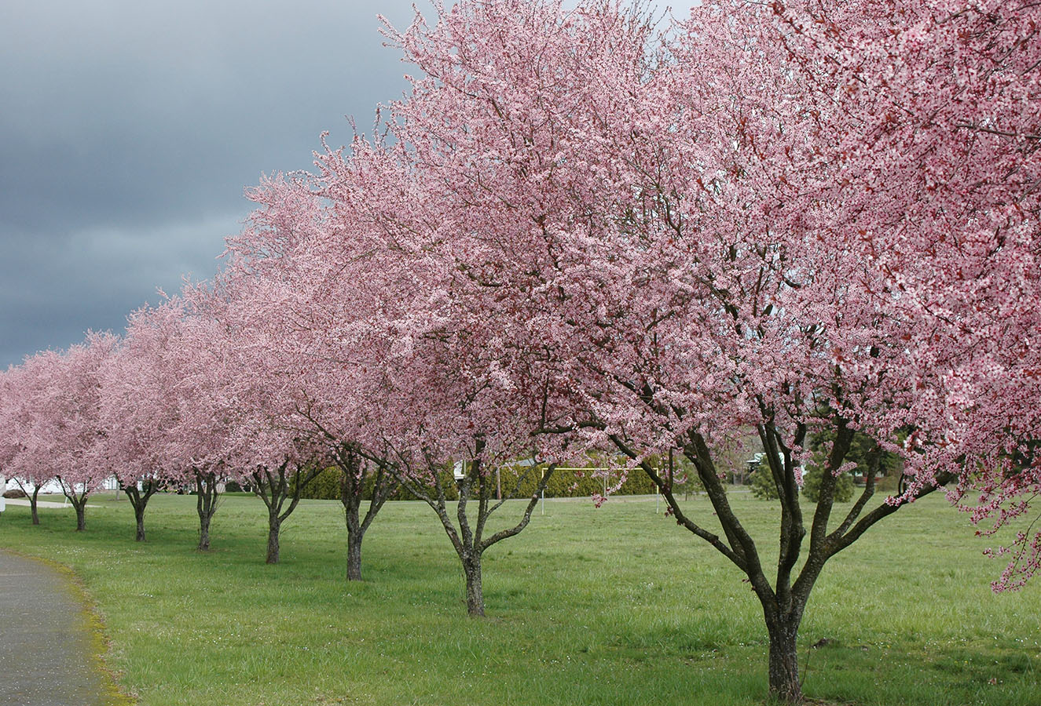
Solutions for RuBisCO
Make more RuBisCO.
85% of all plants are C3 plants and use this strategy (e.g. rice, wheat, soybeans, trees).
As a result, RuBisCO is the most abundant enzyme on the planet.
✓

Slide 34
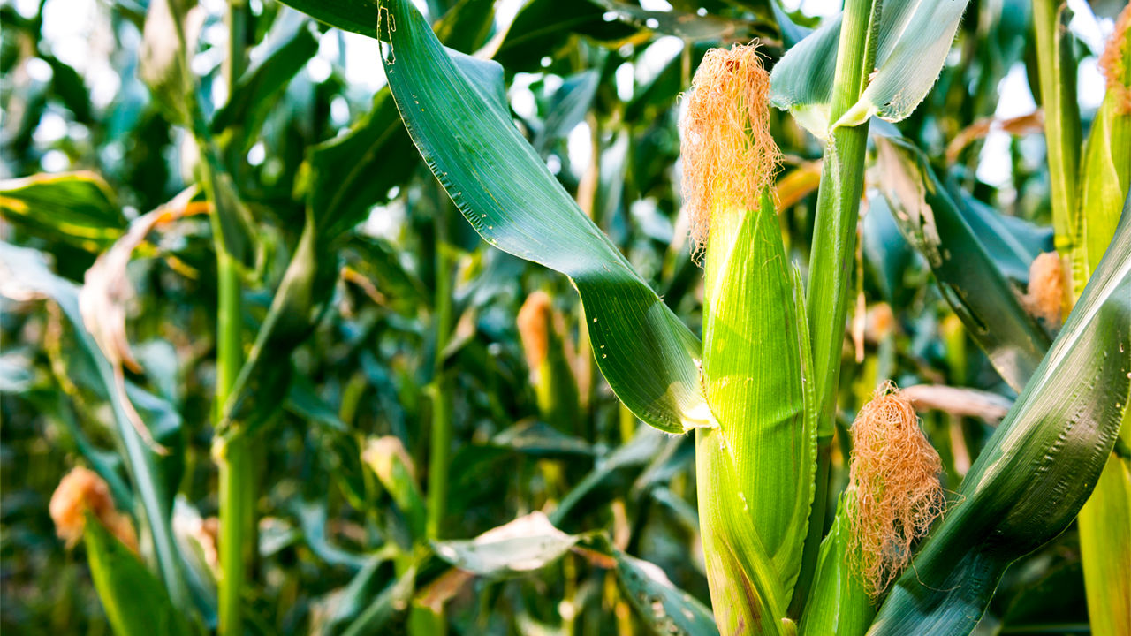
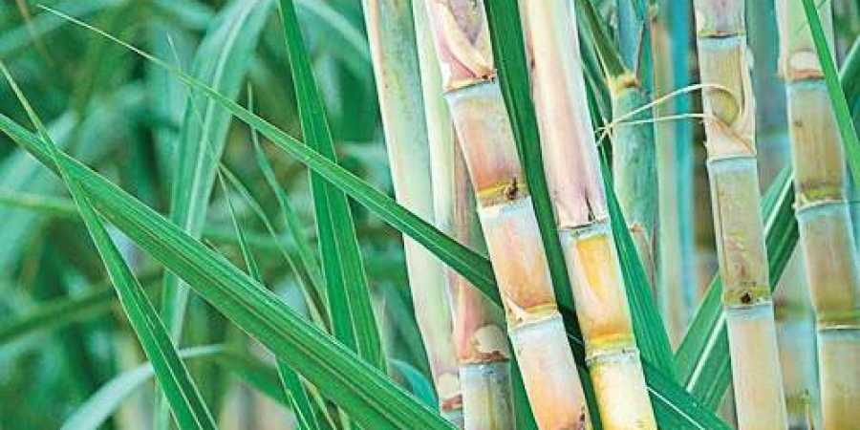
Solutions for RuBisCO
Don’t let oxygen near RuBisCO.
C4 plants (e.g. corn, sugarcane, millet) separate the light-dependent and light-independent reactions into two different cell types.
✓

Slide 35
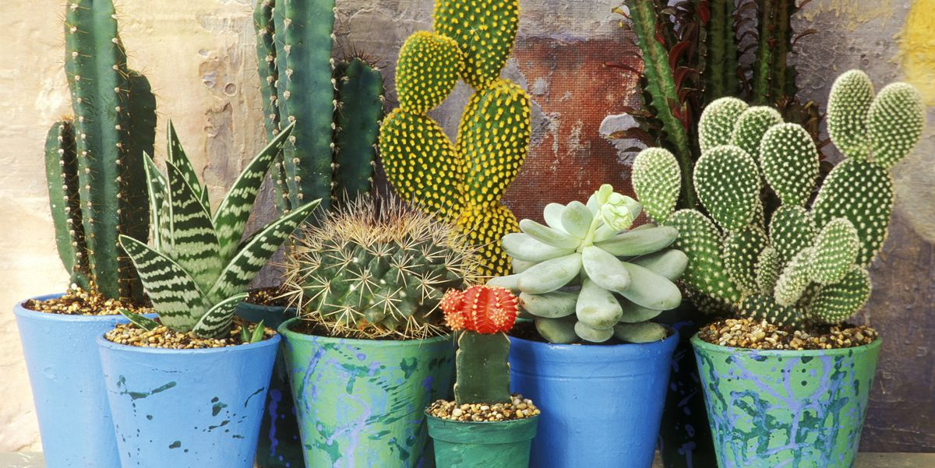
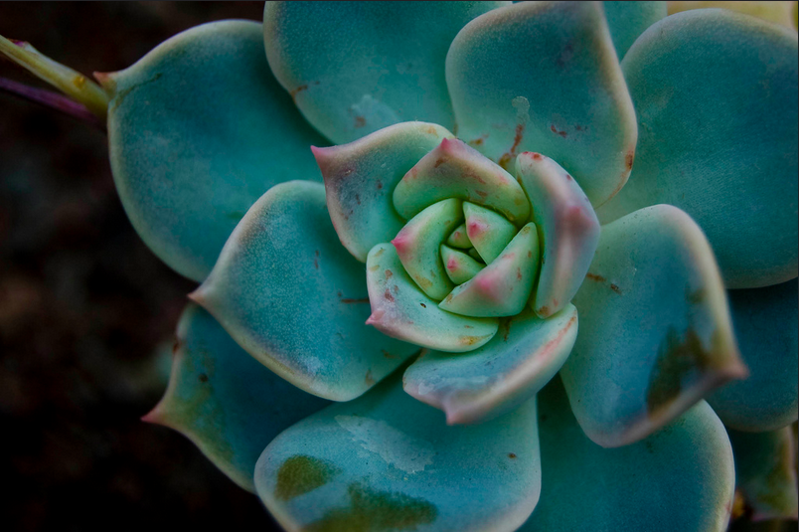
Solutions for RuBisCO
Don’t let oxygen near RuBisCO.
CAM plants (e.g. cacti, pineapples, succulents):
Day: open pores, fix CO₂ into carbon compounds
Night: close pores, undo daytime reactions to release CO₂ for Calvin cycle
✓

Slide 36
Cellular Respiration

Slide 37
Cellular Respiration
Cellular respiration: the process of converting chemical energy from glucose to ATP.
Aerobic respiration:
Requires oxygen
Produces 36 ATP per glucose
Anaerobic respiration:
Does not require oxygen
Produces 2 ATP per glucose

Slide 38
Summary: Cellular Respiration

Slide 39
Aerobic Respiration

Slide 40
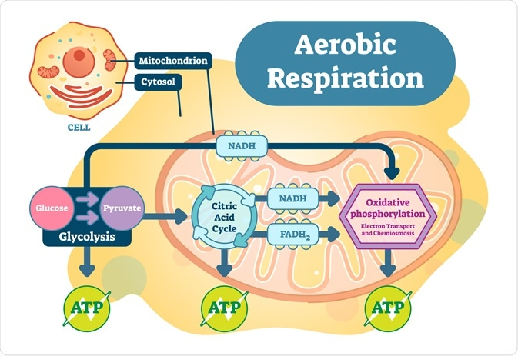
Stage 1: Glycolysis
Location: cytoplasm
Glucose is broken down into pyruvate
Inputs | Outputs
Glucose | Pyruvate
NAD⁺ | NADH
ATP (2) | ATP (4)
Do not memorize how many ATP, NADH, etc. are used/produced.

Slide 41
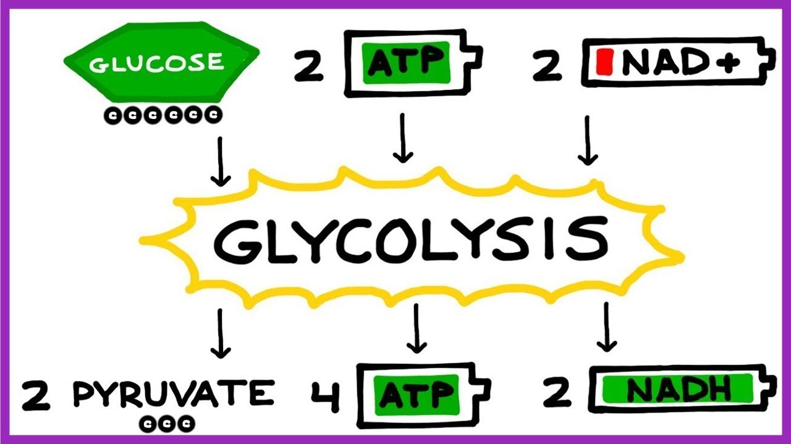
Stage 1: Glycolysis (easy mode)

Slide 42
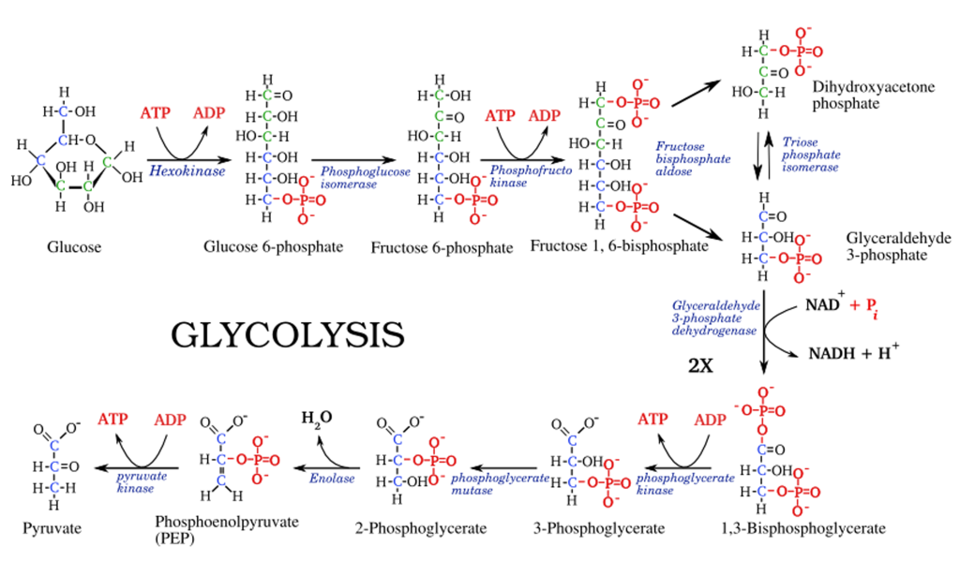
Stage 1: Glycolysis (hard mode)

Slide 43
Mitochondria Structure
Eukaryotes use mitochondria to perform aerobic respiration
Some prokaryotes can also do aerobic respiration, using their cell membranes
Notes:
prokaryotes can do aerobic respiration too, but we will focus on eukaryotic aerobic respiration which involves the mitochondria

Slide 44
Stage 2: The Krebs Cycle
Pyruvate enters the mitochondrial matrix and is broken down
Energy is used to produce high-energy compounds
Also known as “Citric Acid Cycle”
Notes:
Image from bioninja
Krebs cycle also known as citric acid cycle since it starts with citric acid

Slide 45
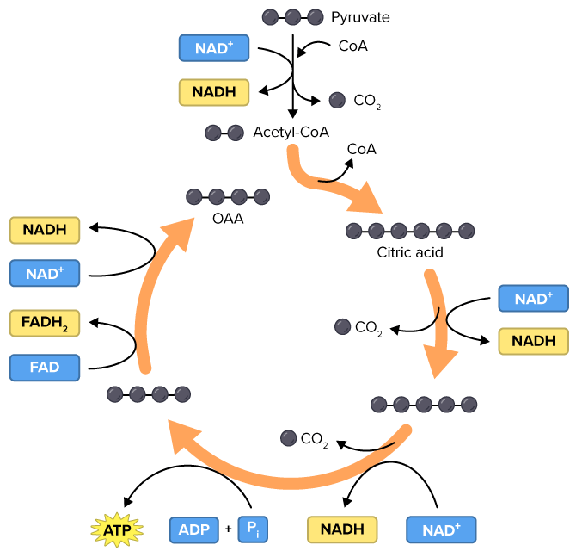
Stage 2: The Krebs Cycle
Inputs | Outputs
pyruvate | CO₂ (diffuses out)
NAD⁺ | NADH (high-energy)
FAD | FADH₂ (high-energy)
ADP | ATP (a little)
Do not memorize how many ATP, NADH, etc. are used/produced.
Notes:
Image from bioninja
Krebs cycle also known as citric acid cycle since it starts with citric acid

Slide 46
Stages 3-4 Preview (Summary)
NADH and FADH₂ energy used to produce ATP
Inputs | Outputs
O₂ | H₂O
NADH | NAD⁺ (reused: Krebs)
FADH₂ | FAD (reused: Krebs)
ADP | ATP (a lot)
Notes:
From thoughtco

Slide 47
Stage 3: Electron Transport Chain
NADH and FADH₂ pass their high-energy electrons through electron transport chains
Energy from NADH and FADH₂ used to pump H⁺ into the intermembrane space
Notes:
From thoughtco

Slide 48
Stage 3: Electron Transport Chain
Lower-energy electrons combine with H⁺ and O₂ and produce H₂O

Slide 49
Stage 4: ATP Production
H⁺ moves through ATP synthase from the intermembrane space to the matrix
ATP synthase converts ADP to ATP

Slide 51
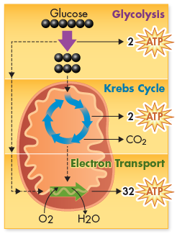
Cellular Respiration Summary
C₆H₁₂O₆ + O₂ →
CO₂ + H₂O + ATP energy

Slide 52
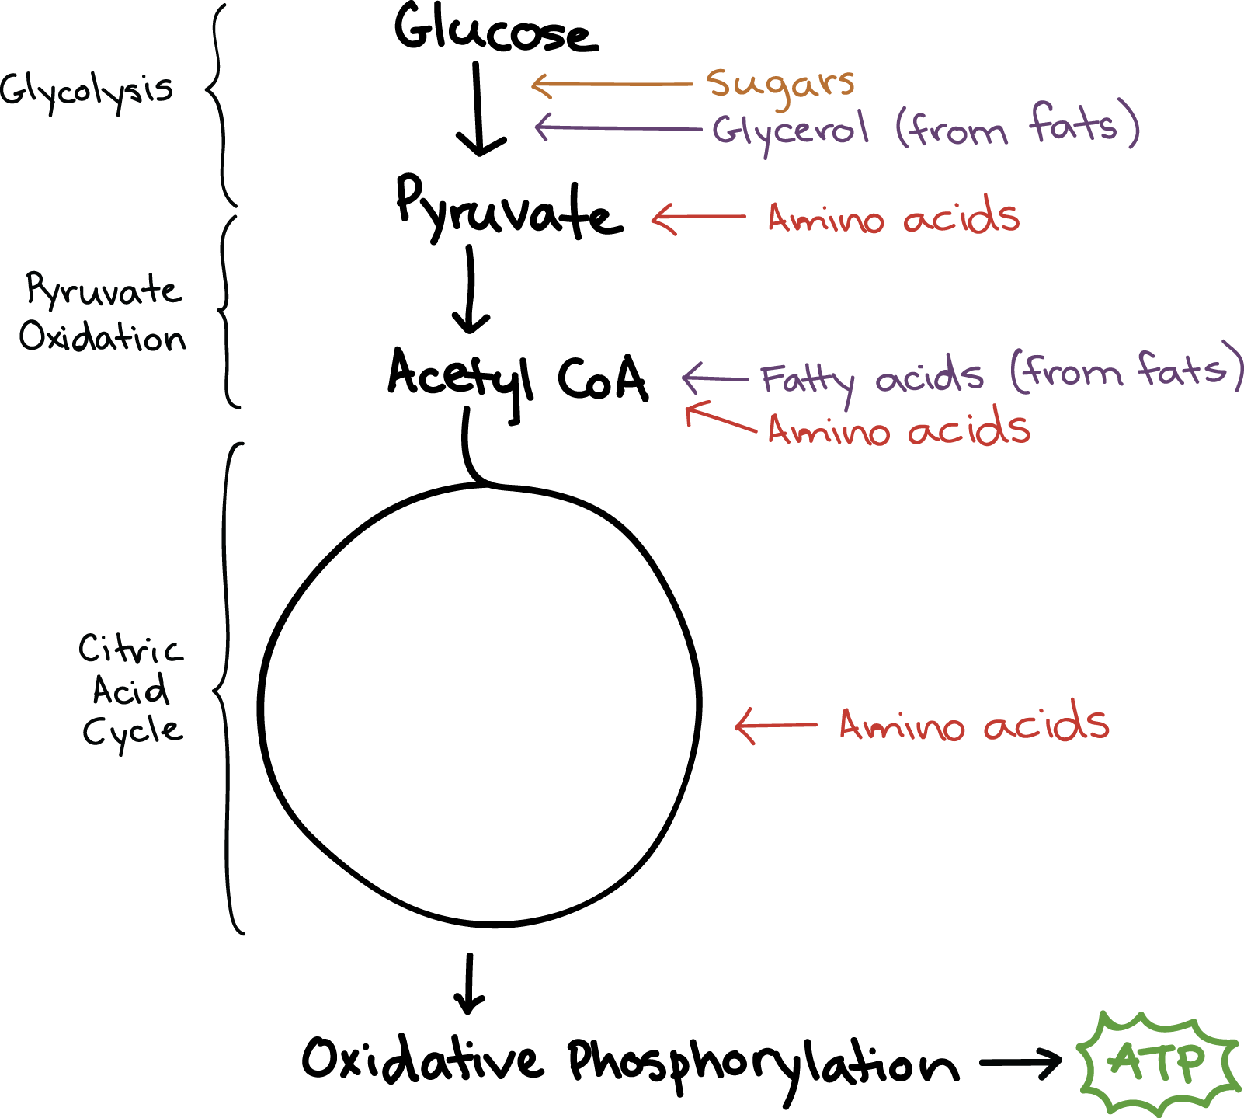
Using Other Molecules for Energy
Proteins, fats, and complex carbohydrates can all be used for energy, too!
They simply enter cellular respiration at different points.
Notes:
It is why if you are severely malnourished, eventually your body will start breaking down your own muscles (into proteins into amino acids) and use those for energy.
It also calls into question some of the ‘diets’ out there…

Slide 53
Pop Quiz!
Summarize the products of each stage:
Glycolysis
Krebs cycle
Electron transport chain
ATP synthesis

Slide 54
Fermentation
Oi! Don’t forget about me!!

Slide 55
Fermentation (anaerobic respiration)
Glycolysis reminder: 2 ATP + 2 NAD⁺ + glucose → 4 ATP + 2 NADH + 2 pyruvate
If oxygen is not available, fermentation occurs after glycolysis
Purpose of fermentation: convert NADH to NAD⁺ so it can be re-used in glycolysis
Do not memorize how many ATP, NADH, etc. are used/produced.

Slide 56
Alcoholic Fermentation
Yeast and other micro-organisms
Use by humans: make alcoholic beverages, make bread rise
NADH → NAD⁺ pyruvate → alcohol and CO₂
Do not memorize how many ATP, NADH, etc. are used/produced.

Slide 57
Lactic Acid Fermentation
Most prokaryotic and eukaryotic organisms
Occurs in human muscle cells during intense exercise when oxygen is low
NADH → NAD⁺ pyruvate → lactic acid
Do not memorize how many ATP, NADH, etc. are used/produced.
Notes:
Not testable fun fact:
For short bursts of intense exercise, muscles use lactic acid fermentation (which is much faster than aerobic respiration), but this only supplies enough energy to last about 90 seconds
After intense exercise, lactic acid builds up, need extra oxygen to get rid of this lactic acid → huffing and puffing!
For longer-term exercise, need aerobic respiration…though this releases energy much slower than fermentation. Body will break down carbohydrate stores in the body, which lasts for 15-20 minutes of activity. After this, the body will need to break down other stored molecules, such as fats, for energy.

Slide 58
Case Study: Diets and Exercise
What types of cellular respiration are used in short-term, high-intensity exercise vs long-term, low-intensity exercise?
What are the recommended diets for sprinters vs marathon runners? Why does this ‘make sense’ in light of what you know about cellular respiration?
Notes:
https://www.britannica.com/video/195016/chemical-science-running video. Mostly talks about aerobic respiration but pretty cool
https://www.ck12.org/book/ck-12-biology-advanced-concepts/section/5.16/
https://prezi.com/xuqmfzqr0uxc/sprinter-v-marathon-runner/

Slide 59
Sources
Textbook chapter 6 (pg 112-135)
Various internet sources

