Slide 2
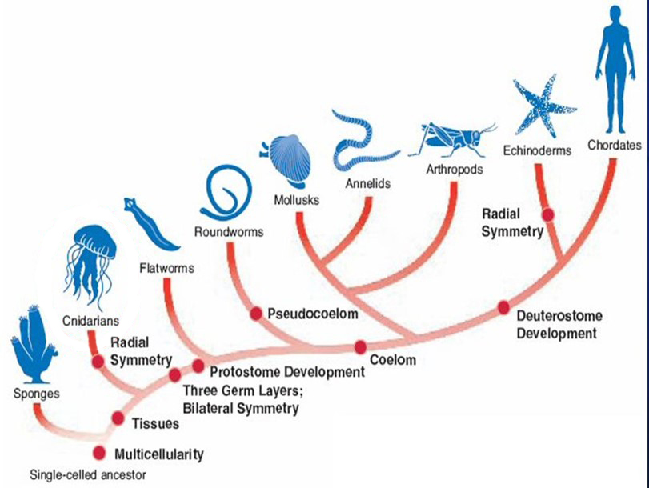

Slide 3
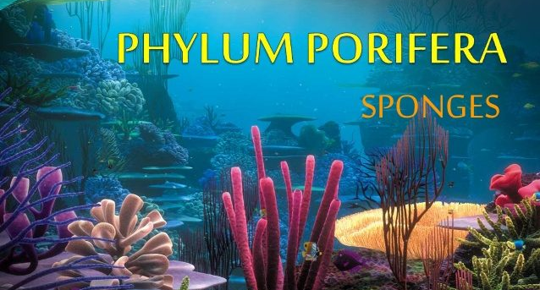

Slide 4
Sponges: key characteristics
Eukaryotic
Multicellular
Cells are totipotent
Asymmetrical
Sessile filter feeders
No true tissues or germ layers
Aquiferous system
Spicules
Specialized cells: choanocytes and amoebocytes

Slide 5
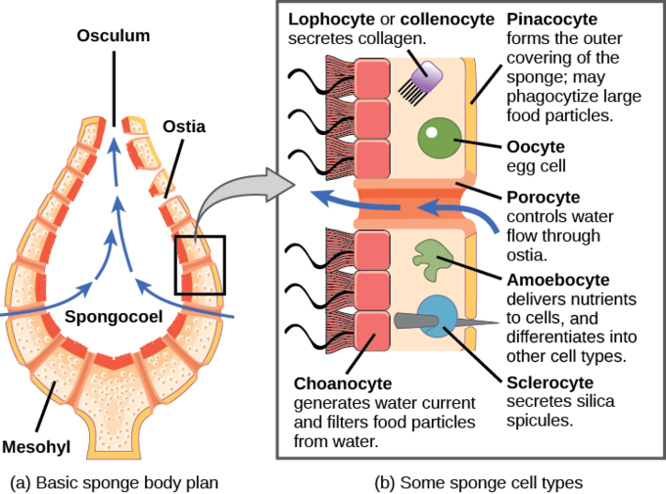
Totipotent Cells
Sponges have different types of cells (not testable unless mentioned later)

Slide 6
Totipotent Cells
Cells are totipotent: able to differentiate into different types/specialties, then redifferentiate as needed
Run a sponge through sieve → let cells grow → new sponges!
All of a sponge’s cells can change to do all functions

Slide 7
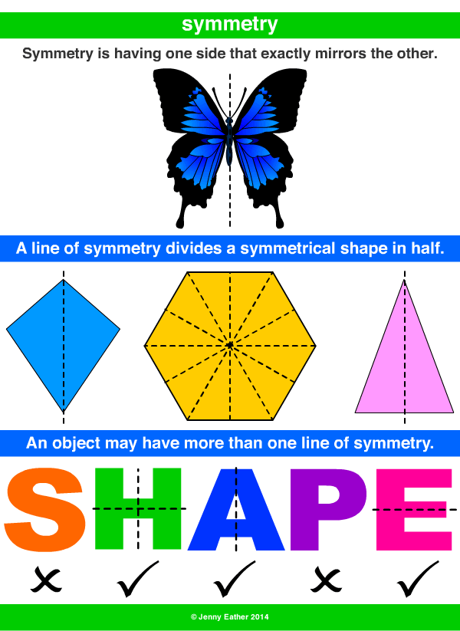
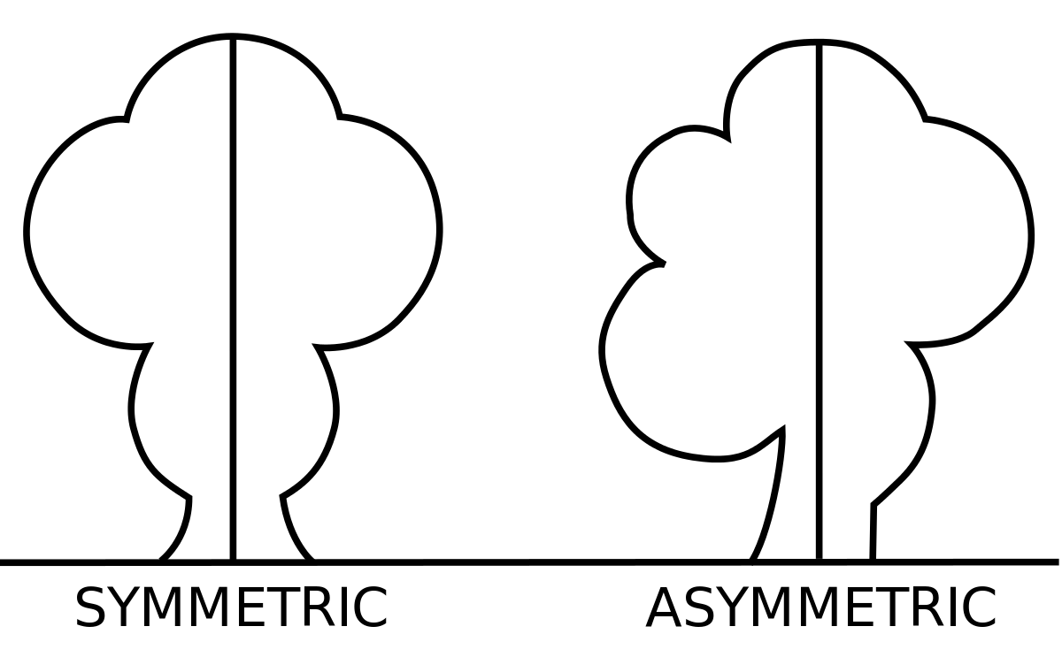
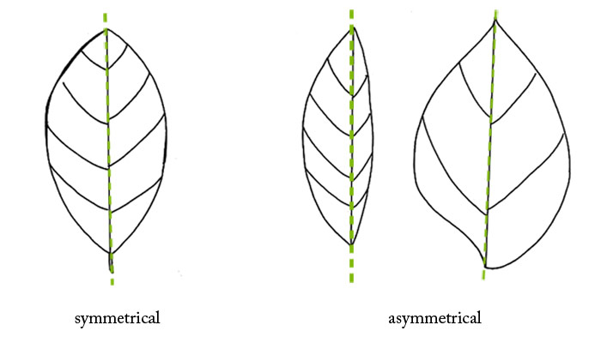
Symmetry

Slide 8
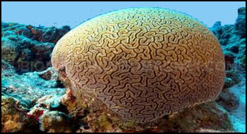
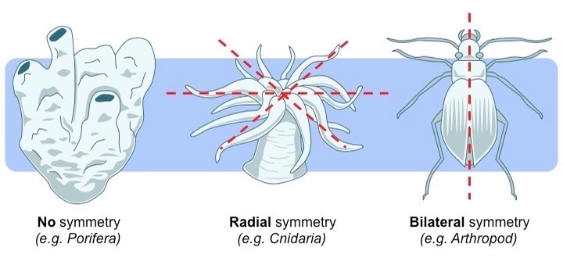
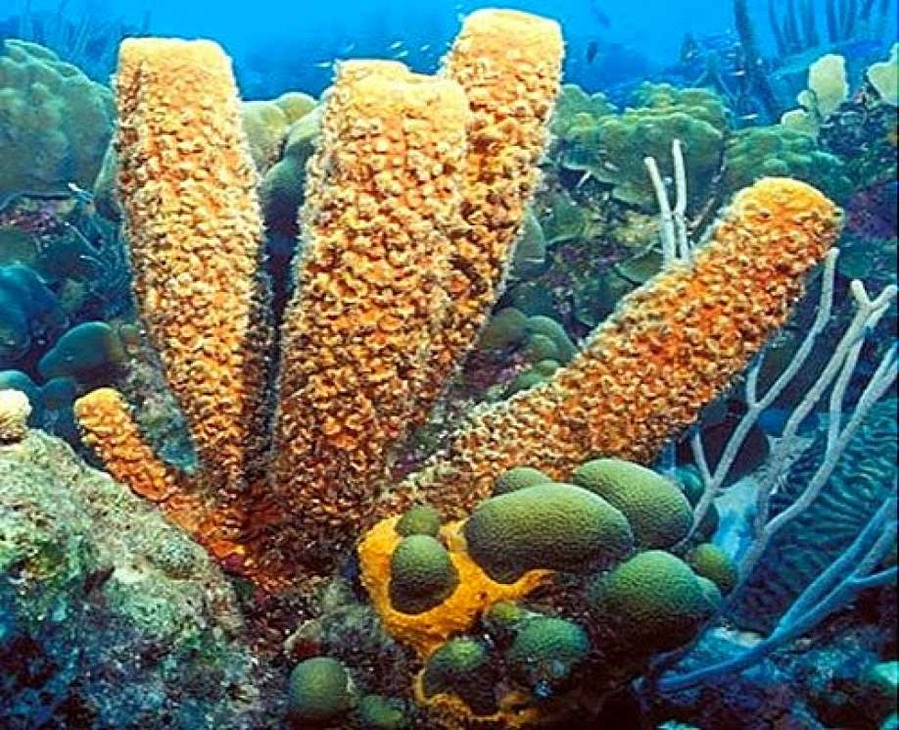
Sponges are asymmetrical

Slide 9
Sessile Filter Feeders
https://www.youtube.com/watch?v=Jktu0NGlgOc&feature=emb_title&ab_channel=KarynMurphy

Slide 10
Sessile Filter Feeders
Sessile: fixed in one place, unable to move
Filter feeder: strains suspended food particles and matter from water
Other non-sponge examples of filter feeders: whale shark, krill, barnacle

Slide 11
Review
What phylum are sponges in?
Are sponges eukaryotic or prokaryotic?
Are sponges multicellular, unicellular, or both?
What makes sponge cells special?
What symmetry do sponges exhibit?
Sponges are ‘sessile filter feeders’. What does this mean?

Slide 12
Sponge Anatomy
Mesohyl: gelatinous matrix in a sponge. Contains cells, spicules, and non-living jelly.
Ostia (sing. ostium): an external pore where water enters
Osculum: main opening
Spongocoel: central chamber

Slide 13
Aquiferous System
Aquiferous system: system of pores and channels that allow water flow to filter-feed
Choanocytes pump water
Water enters through ostia, flows into the spongocoel, then out through osculum
Video: https://www.youtube.com/watch?v=pTZ211cIjX8

Slide 14
Aquiferous System
Don’t memorize cell types except choanocyte, amoebocyte

Slide 15
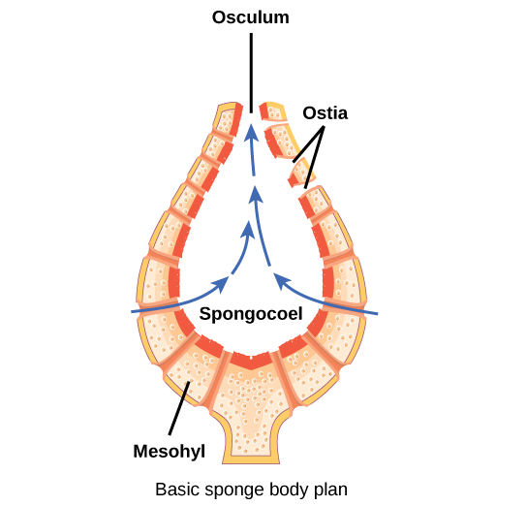
Discussion
Why are sponges so absorbent?
Where is water flow the fastest: at the ostia or at the osculum?

Slide 16
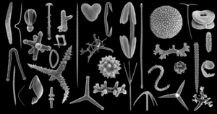
Spicule
A small, hard structure only found in sponges
Most commonly made from SiO₂ (silicon dioxide)
Provides structure and protection
A defining taxonomic trait

Slide 17
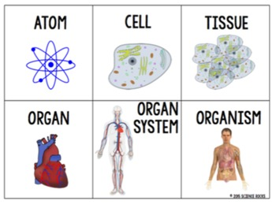
“No true tissues”
Tissue:
Level of organization between cell and organ
Similar cells working together on a common function

Slide 18
“No true tissues”
Sponges:
Although multicellular, cells work independently
Totipotency:
Sponge cells do not need to work together
No ‘benefit’ arises from working together on similar tasks

Slide 19
Specialized Cells
Don’t memorize cell types except choanocyte, amoebocyte

Slide 20
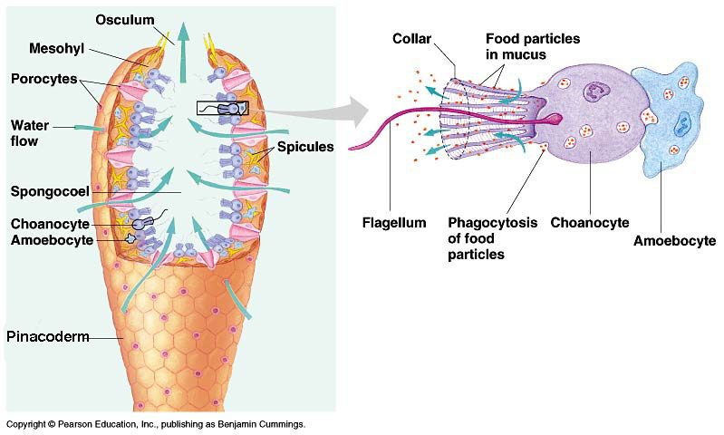
Specialized Cells
Choanocyte:

Slide 21
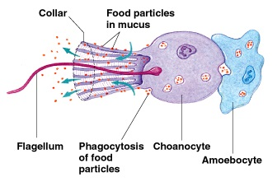
Specialized Cells
Choanocyte:
Lines a sponge’s inner surface
Has a flagellum that beats to pump water into the sponge
Food particles trapped in collar; choanocyte filters and ingests these particles
Also known as ‘collar cell’

Slide 22
Specialized Cells
Amoebocyte
Is “ameboid”…can crawl throughout mesohyl to other cells
Collects excess nutrients from choanocytes, delivers nutrients to other cells*
* Although we will not learn about them, there are other cell types in the sponge!

Slide 23
Discussion
Explain how choanocytes and amoebocytes work together to provide nutrients to all the cells in the sponge.
Where are choanocytes located? Why do you suppose this is the case?

Slide 24
Key vocabulary
Sponge
Phylum Porifera
Totipotent
Asymmetry/asymmetrical
Sessile
Filter feeder
Osculum
Ostia (sing. Ostium)
Mesohyl
Spongocoel
Tissue
Aquiferous system
Spicule
Choanocyte
Amoebocyte

