Slide 1
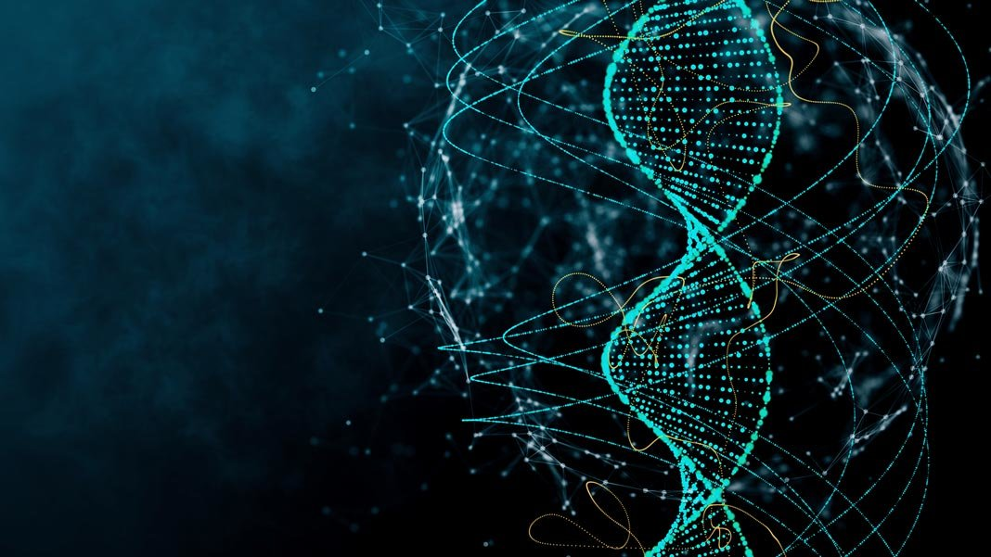
1-1: How does an understanding of DNA help us investigate living things?
Image credits: singularityhub.com
Any uncredited images throughout this powerpoint are from Science Connections 10 textbook or publisher’s powerpoint.

Slide 2
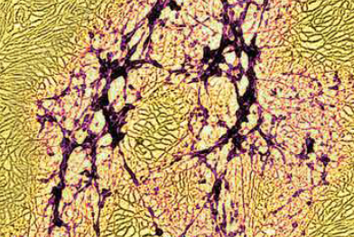
Big Ideas
The variation in living things we see around us is due to DNA.
DNA is made of many nucleotides linked together in a specific order.
DNA exists in chromosomes, which contain thousands of genes.
The structure of DNA is important to passing on information.
The different genetic make-up of organisms is reflected in the diversity of living things.

Slide 3
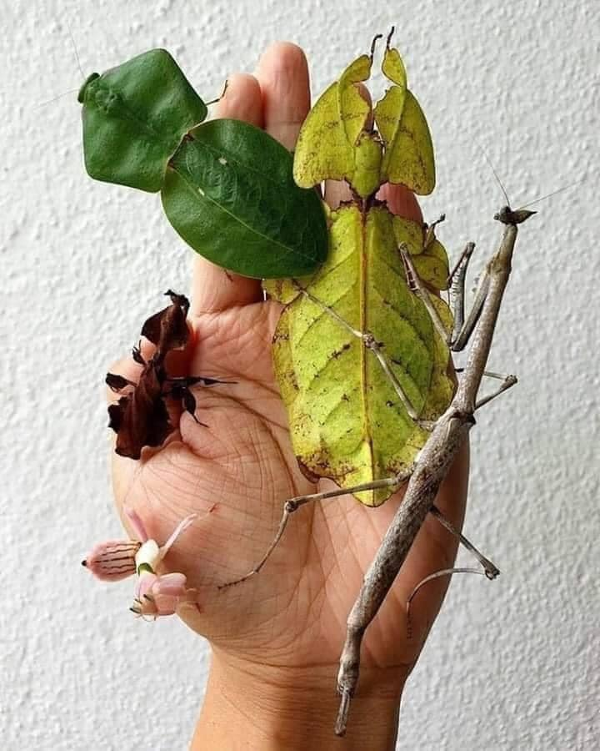
Concept 1: The variation in living things we see around us is due to DNA.
Variation is when living things have characteristics that are different from each other.
Notes:
Left: these are all insects: not leaves!

Slide 4
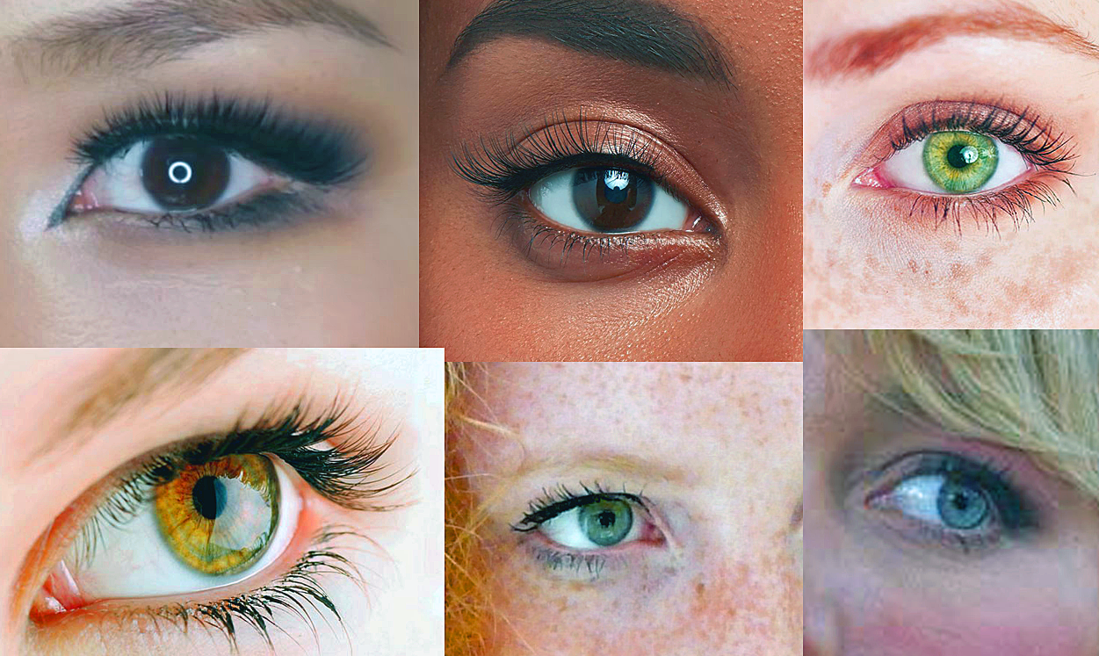
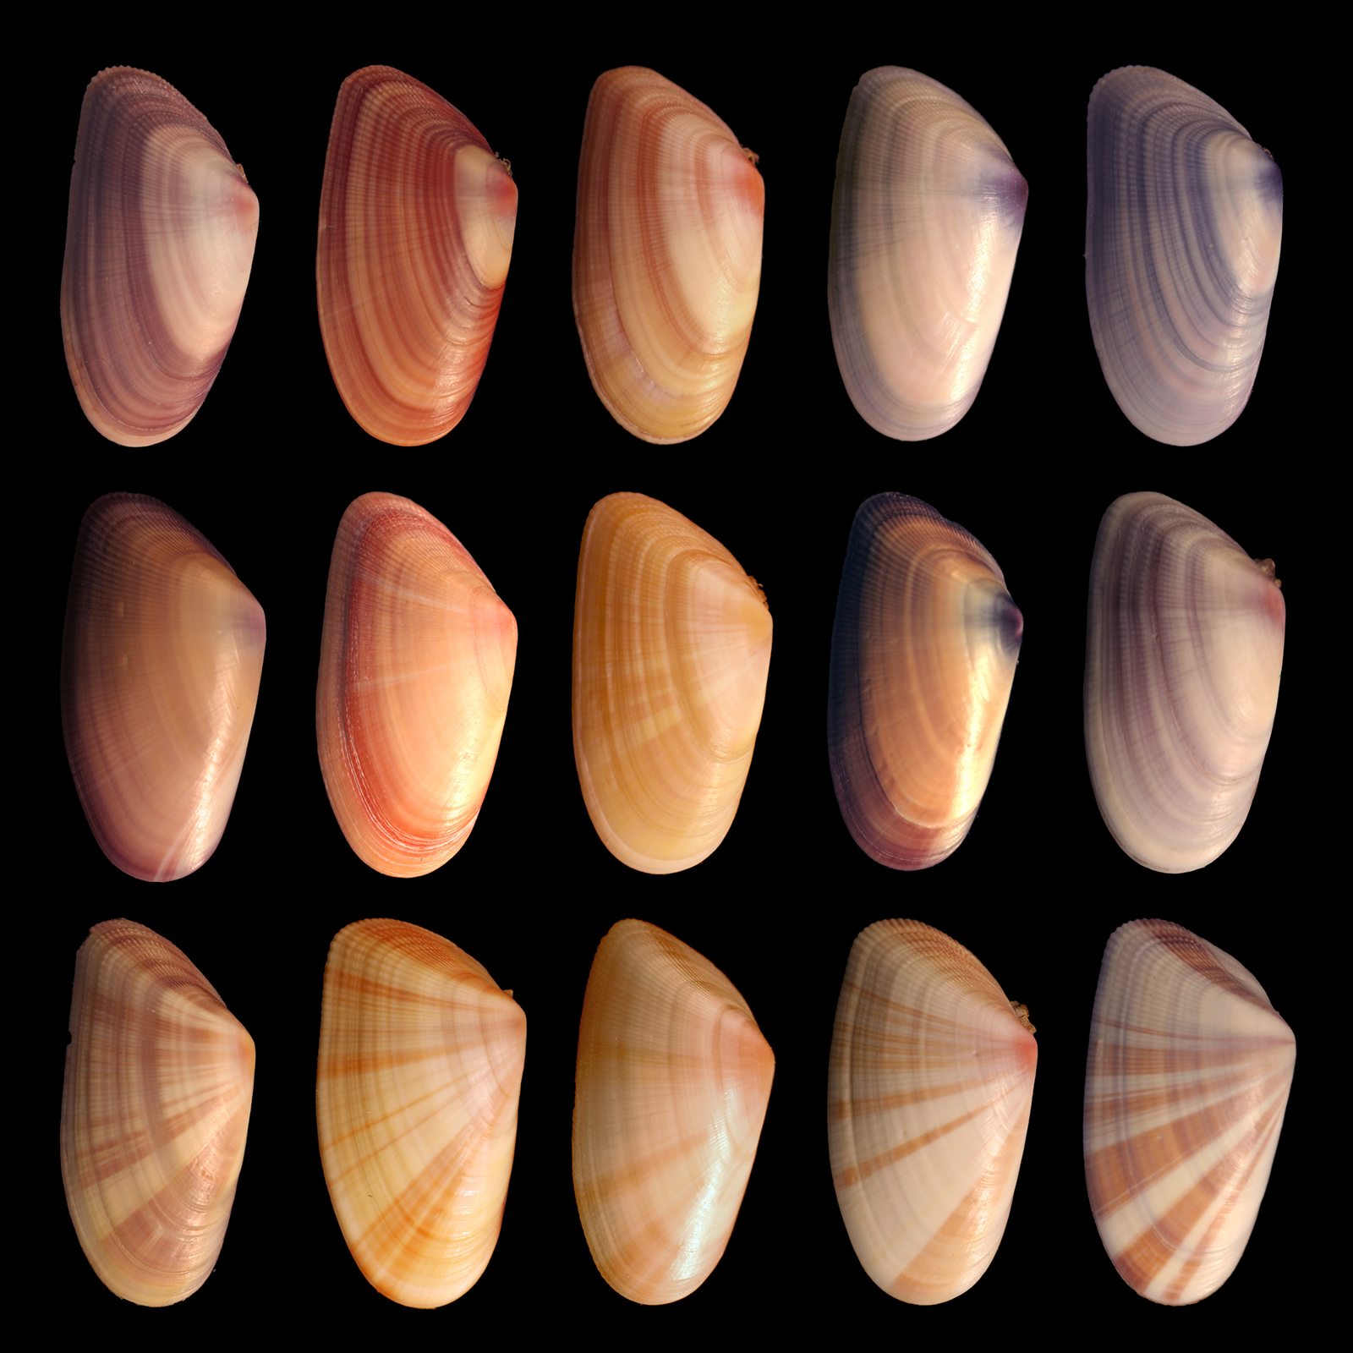
Concept 1: The variation in living things we see around us is due to DNA.
Variation is when living things have characteristics that are different from each other.
Notes:
Left: these are all insects: not leaves!

Slide 5
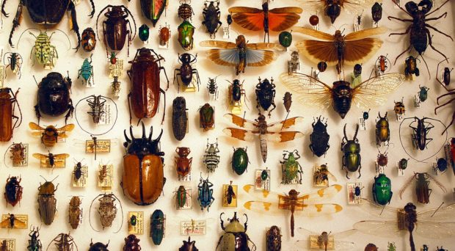
Concept 1: The variation in living things we see around us is due to DNA.
There is variation between species…
Discussion: Why is variation between species important?
Notes:
Left: these are all insects: not leaves!

Slide 6
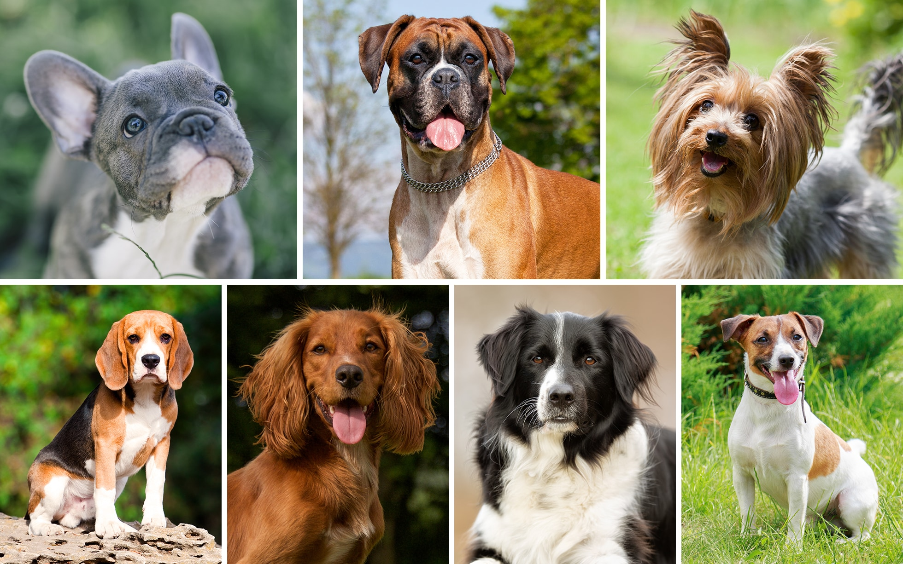
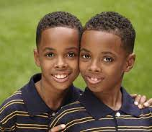
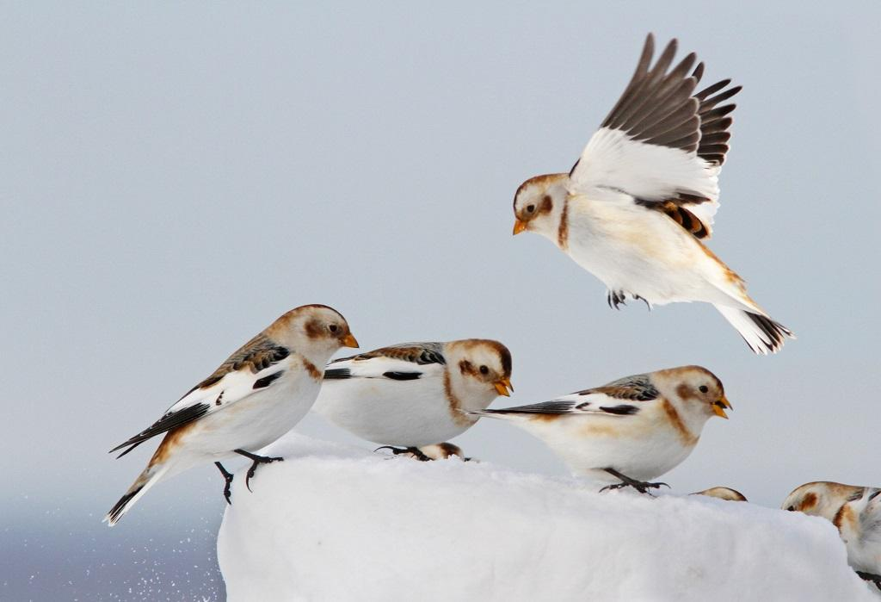
Concept 1: The variation in living things we see around us is due to DNA.
…and there is variation within species (DNA, appearance, behaviour, etc.)
Discussion: Why is variation within a species important?
Notes:
Left: these are all insects: not leaves!

Slide 7
Concept 1: The variation in living things we see around us is due to DNA.
DNA is like a secret family recipe:
Contains instructions for how to make something important
Stored somewhere safe, in a compact way
Passed on through generations (is ‘inherited’), sometimes with slight modifications

Slide 8
Instructions for Life
Concept 1: The variation in living things we see around us is due to DNA.
Every living thing has a set of instructions or genetic information that tells its cells what to do (e.g. how to look, behave, get energy, live, reproduce, etc.)
The genome is an organism’s complete set of genetic information.
Is stored as DNA (or RNA) in the cell nucleus
Is inherited (passed on to offspring)
Is responsible for variation in living things

Slide 9
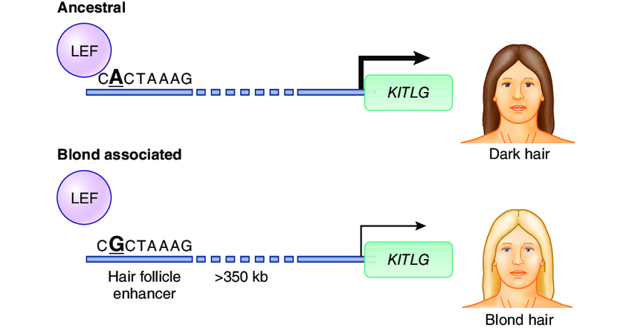
Example 1: Hair Colour
Concept 1: The variation in living things we see around us is due to DNA.
Image from: https://www.researchgate.net/publication/263431247_The_secret_of_a_natural_blond
Notes:
Summary: one base pair difference causes blonde hair instead of brown

Slide 10
Example 2: Sickle Cell Anemia
Concept 1: The variation in living things we see around us is due to DNA.
Slide from https://www.slideshare.net/ThetSuWin/mutation-and-dna-repair-53021983
Notes:
Summary: one base pair difference in DNA causes sickle cell anemia (a blood disease)

Slide 11
Discussion Questions
Concept 1: The variation in living things we see around us is due to DNA.
Why is there variation among organisms on Earth?
Choose one group of organisms in Figure 1.1 and describe some of the similarities and differences between species in that group. Use examples not already listed in the text.

Slide 12
Concept 2: DNA structure

Slide 13
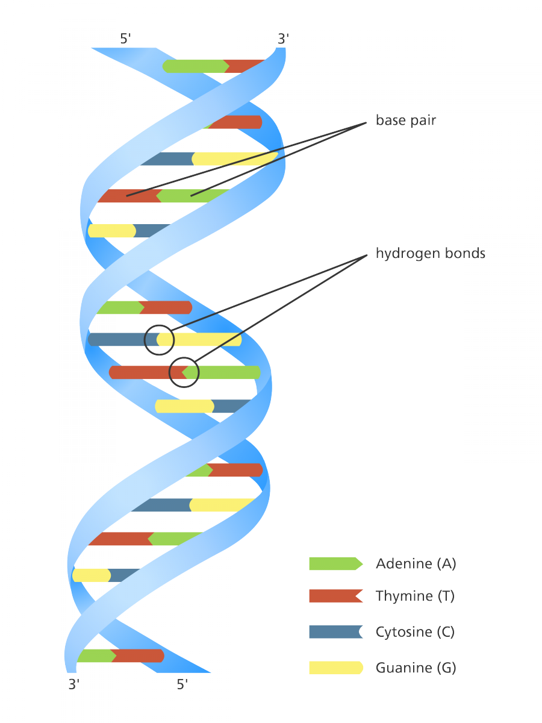
Concept 2: DNA is made of many nucleotides linked together in a specific order.
There are two types of nucleic acids:
DNA (deoxyribonucleic acid)
RNA (ribonucleic acid)
Nucleotides are the basic building blocks of nucleic acids. (Slight differences between DNA and RNA: we will learn about DNA nucleotides.)
Image credits: yourgenome.org

Slide 14
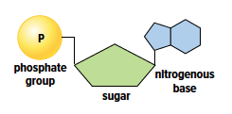
The Structure of DNA
Concept 2: DNA is made of many nucleotides linked together in a specific order.
Each nucleotide has three parts:
a phosphate group
a sugar
a nitrogenous base
Adenine (A)
Guanine (G)
Thymine (T)
Cytosine (C)
Because there are 4 types of nitrogenous bases, there are four types of nucleotides (A, G, C, T). The sequence of nucleotides in a nucleic acid is how it stores genetic information!

Slide 15
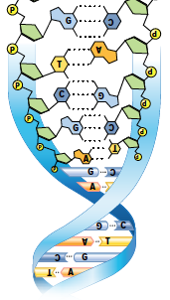
The Structure of DNA (cont’d)
Concept 2: DNA is made of many nucleotides linked together in a specific order.
Nitrogenous bases that pair together are complementary bases:
adenine (A) and thymine (T)
cytosine (C) and guanine (G)
Remember: Apples in a Tree; Car in a Garage
; Chips and Guacamole

Slide 16
The Structure of DNA (cont’d)
Concept 2: DNA is made of many nucleotides linked together in a specific order.
DNA is double-stranded (made of two strings of nucleotides)
DNA has a double helix (twisted ladder) shape:
Sides of ladder: sugar and phosphate
Steps of ladder: pairs of nitrogenous bases held together by hydrogen bonds

Slide 17
Discussion Questions
Concept 2: DNA is made of many nucleotides linked together in a specific order.
If the bases on one strand of DNA are ATGGGCTA, what is the sequence of complementary bases on the other strand of DNA?
Think of an analogy to describe base pairs. Share it with a classmate.

Slide 18
Concept 4: DNA Replication and Protein Synthesis Overview

Slide 19
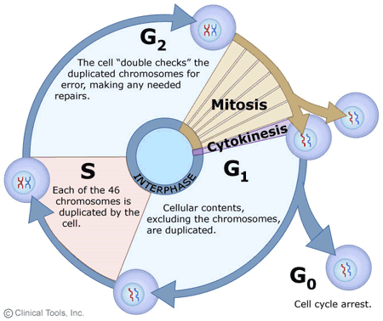
Concept 4: The structure of DNA is important to passing on genetic information.
A cell replicates its DNA once in the cell cycle.
During cell division, one copy of DNA is passed on to each daughter cell
https://www2.le.ac.uk/projects/vgec/highereducation/topics/cellcycle-mitosis-meiosis

Slide 20
Cell Cycle Review
Do not memorize!
Concept 4: The structure of DNA is important to passing on genetic information.
G₁ :
Growth
Performs regular cell functions
S: DNA replication
DNA replicated: one → two sister chromatids per chromosome
G₂ :
Double-checking
Mitosis/cytokinesis: cell divides
https://www2.le.ac.uk/projects/vgec/highereducation/topics/cellcycle-mitosis-meiosis

Slide 21
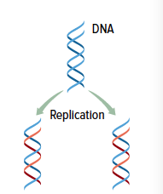
DNA Replication
Concept 4: The structure of DNA is important to passing on genetic information.
Replication: a process that makes identical copies of a DNA molecule for use in cell division
Hydrogen bonds between nitrogenous bases are ‘unzipped’
New nucleotides form a new strand: C-G; A-T
Each new DNA molecule consists of an original strand and a new strand.
Figure 1.7: During DNA replication, two molecules of DNA are made from one. The resulting new molecules are identical to the original. Each new molecule contains one original strand of DNA (shown here in blue) and one new strand (shown in red).

Slide 22
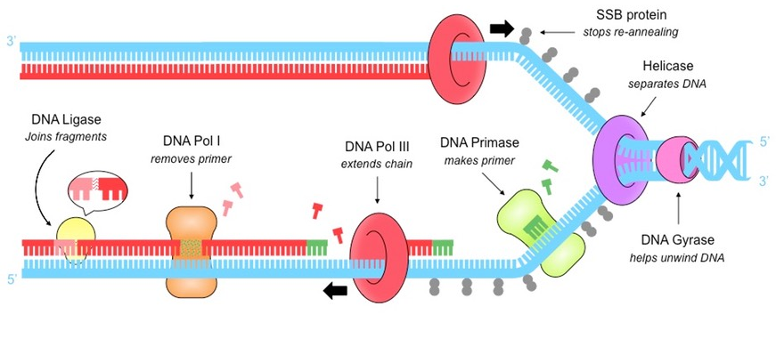
DNA Replication (cont’d)
Do not memorize!
Concept 4: The structure of DNA is important to passing on genetic information.
DNA replication is complex, involving many enzymes (proteins!), such as:
Helicase: unwinds, unzips DNA strand
DNA Polymerases: complementary base pairing, double-checking
DNA Ligases: rezips DNA strand

Slide 23
DNA Replication (cont’d)
Do not memorize!
Concept 4: The structure of DNA is important to passing on genetic information.

Slide 24
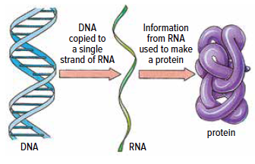
DNA is Used to Make Proteins (more details to follow)
Concept 4: The structure of DNA is important to passing on genetic information.
Each cell has one copy of DNA in the nucleus.
Sections of DNA are copied into RNA
RNA is disposable, can exit nucleus
Ribosomes ‘read’ RNA and make proteins.
The sequence of bases in the DNA molecule determines the specific sequence of amino acids in the protein molecule.
Figure 1.8: Genetic information passes from the genes (DNA) to an RNA copy of the gene, and the RNA
copy directs the sequential assembly of a chain of amino acids to produce a protein.

Slide 25
Discussion Questions
Concept 4: The structure of DNA is important to passing on genetic information.
Explain how the structure of DNA is related to how genetic material is passed from one generation to the next.
How are genes involved in the production of proteins?

Slide 26
The Function of DNA
Concept 4: The structure of DNA is important to passing on genetic information.
DNA stores genetic information.
The sequence of nucleotides in DNA is how genetic information is stored.
Parents pass their DNA on to their offspring; DNA is inherited.
DNA contains instructions to make proteins…

Slide 27
Concept 4: The structure of DNA is important to passing on genetic information.
Answer the following questions in this video:
What are proteins made of?
List three proteins in the body and describe what they do.
https://www.youtube.com/watch?v=wvTv8TqWC48&ab_channel=RCSBProteinDataBank
Notes:
Skip over portion from ~2:00-3:50 on secondary, tertiary, quaternary structures

Slide 28
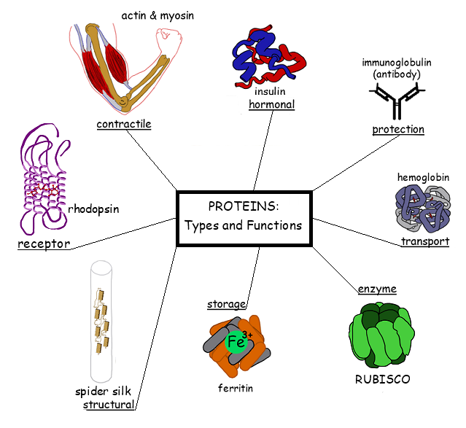
Proteins: what are they?
Concept 4: The structure of DNA is important to passing on genetic information.
Proteins do everything that a cell (and thus, a living thing) needs to function, grow, and reproduce.
Examples:
Structure
Growth and repair
Signaling
Speeding up chemical reactions
Transporting substances

Slide 29
Proteins: examples (do not memorize)
Concept 4: The structure of DNA is important to passing on genetic information.
Protein type or name | Function
Sonic Hedgehog (SHH) | Controls stem cell growth in limbs
Keratin | Structural: makes up hair, feathers
Myosin | Contraction of muscle fibers
Clock proteins | Detects light; establish circadian cycle
Antibodies | Bind to harmful pathogens; help neutralize or tag for destruction
Hemoglobin | In red blood cells, stores oxygen or carbon dioxide
ATP synthase | A ‘turbine’ that harnesses proton gradient to make ATP
ATP synthase video: https://www.youtube.com/watch?v=XI8m6o0gXDY&ab_channel=DiscoveryScience

Slide 30
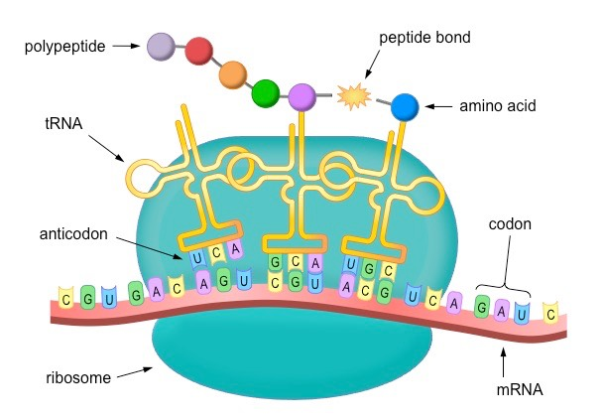
Proteins: what are they?
Concept 4: The structure of DNA is important to passing on genetic information.
Amino acids are the building blocks of proteins.
The sequence of amino acids in a protein is determined by the sequence of nucleotides in DNA.
(This is how DNA contains all the instructions for life: by containing the instructions for proteins!)

Slide 31
Protein Synthesis (not in textbook)

Slide 32
How are proteins made from DNA?
Concept 2: DNA is made of many nucleotides linked together in a specific order.
https://www.youtube.com/watch?v=gG7uCskUOrA&ab_channel=yourgenome

Slide 33
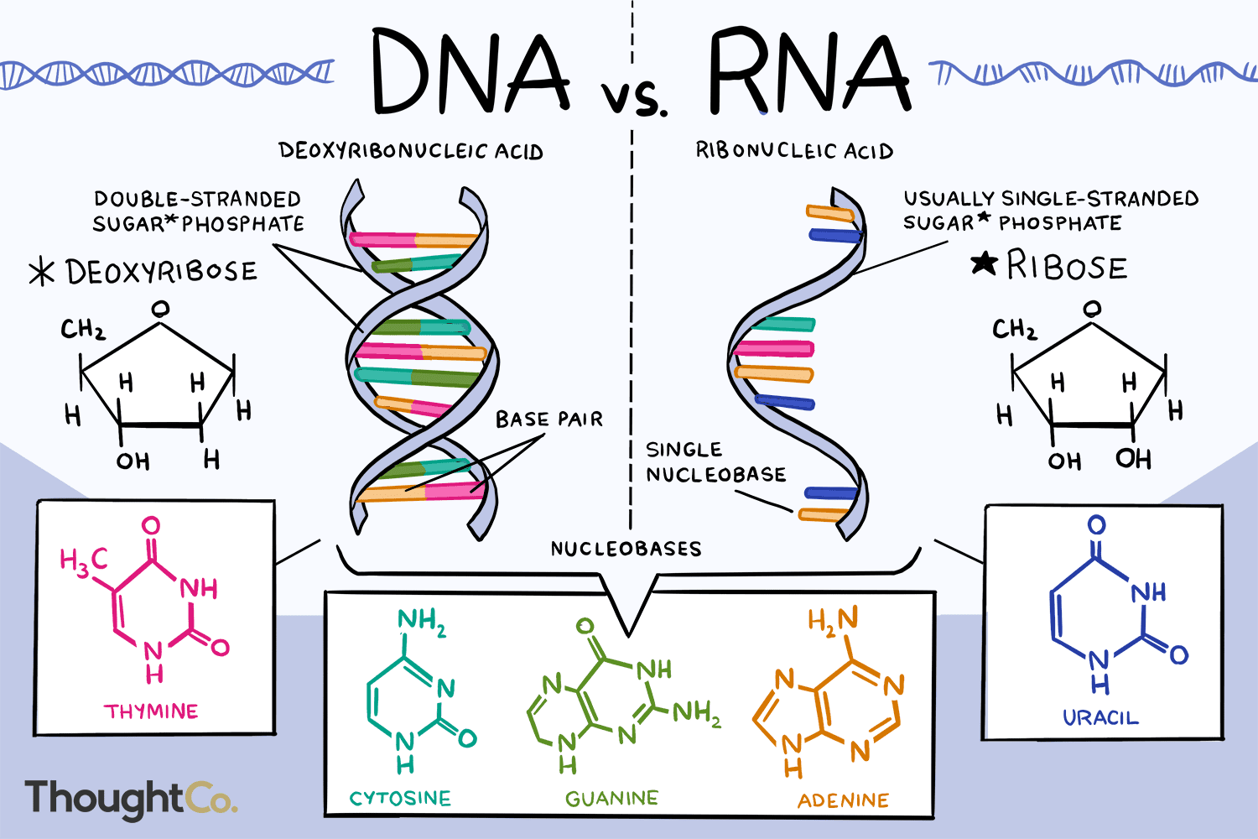
Nucleic Acid Comparison
Concept 2: DNA is made of many nucleotides linked together in a specific order.

Slide 34
Nucleic Acid Comparison
Concept 2: DNA is made of many nucleotides linked together in a specific order.
DNA
RNA
Deoxyribonucleic acid
Nucleotides:
Deoxyribose sugar
Adenine, cytosine, guanine, thymine
Double-stranded, double helix
Single copy of DNA per cell; only copied (DNA replication) when preparing for cell division
Ribonucleic acid
Nucleotides:
Ribose sugar
Adenine, cytosine, guanine, uracil
Single-stranded
Many RNA molecules per cell; constantly being made, used, recycled

Slide 35
Significance of DNA and RNA
Concept 2: DNA is made of many nucleotides linked together in a specific order.
RNA nucleotides can hydrogen-bond with DNA nucleotides
RNA made from DNA; DNA made from DNA
RNA required for DNA to make proteins

Slide 36
Concept 2: DNA is made of many nucleotides linked together in a specific order.
https://www.youtube.com/watch?v=oefAI2x2CQM

Slide 37
Post-video Questions
Concept 2: DNA is made of many nucleotides linked together in a specific order.
Why can’t proteins be made directly from the DNA? Why is mRNA necessary?
Where do transcription and translation occur?
What is the role of tRNA?
https://www.youtube.com/watch?v=oefAI2x2CQM

Slide 38
Protein Synthesis: Summary
Concept 2: DNA is made of many nucleotides linked together in a specific order.
Transcription:
DNA is transcribed into mRNA
Translation:
Ribosome reads mRNA
mRNA is translated into an amino acid sequence through tRNA
End result: protein!

Slide 39
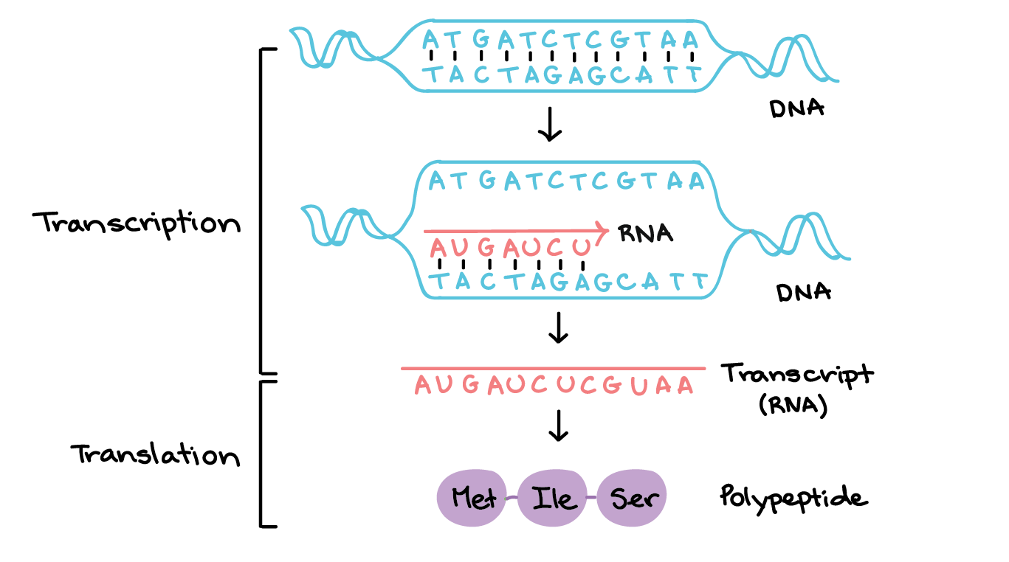
Protein Synthesis: Transcription
Concept 2: DNA is made of many nucleotides linked together in a specific order.
Transcription:
Part of DNA is copied into messenger RNA (mRNA) transcript
RNA base pairs:
adenine – uracil (not thymine)
guanine – cytosine
Occurs in nucleus
Codon: 3-base-pair sequence in mRNA
https://www.khanacademy.org/science/biology/gene-expression-central-dogma/transcription-of-dna-into-rna/a/overview-of-transcription

Slide 40
Protein Synthesis: Transcription
Concept 2: DNA is made of many nucleotides linked together in a specific order.
Practice:
For the DNA sequences below, write the corresponding mRNA sequence.
TAC CAT TAA CAG TAC GGG (DNA)
AUG GUA AUU GUC AUG CCC (mRNA)
TAC ATG GCA ATA CGC GAA (DNA)
AUG UAC CGU UAU GCG CUU (mRNA)
https://www.khanacademy.org/science/biology/gene-expression-central-dogma/transcription-of-dna-into-rna/a/overview-of-transcription

Slide 41
Protein Synthesis: Translation
Concept 2: DNA is made of many nucleotides linked together in a specific order.
Translation:
mRNA leaves nucleus, is ‘read’ by ribosome (made of rRNA)
Transfer RNA (tRNA) has matching anticodon and amino acid
Result: amino acid chain = protein (basically!)
https://www.khanacademy.org/science/biology/gene-expression-central-dogma/transcription-of-dna-into-rna/a/overview-of-transcription

Slide 42
Protein Synthesis: Translation
Concept 2: DNA is made of many nucleotides linked together in a specific order.
ib.bioninja.com.au

Slide 43
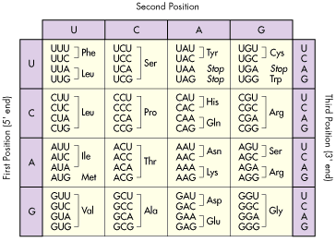
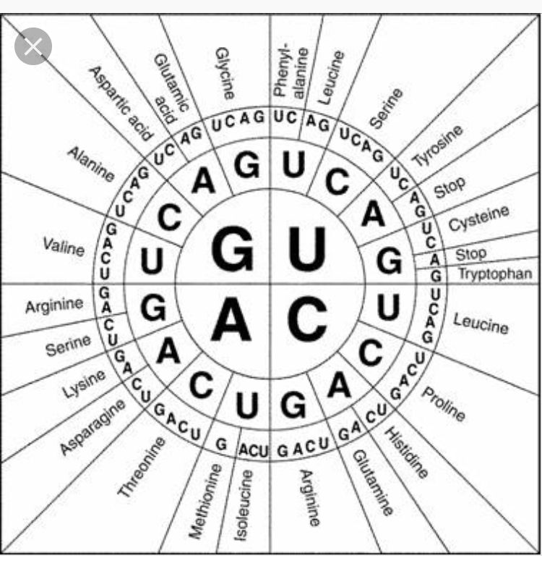
Protein Synthesis: Translation
Concept 2: DNA is made of many nucleotides linked together in a specific order.
Charts can help us determine the corresponding amino acids for mRNA codons.
Ibiologia.com; Georgia virtual school

Slide 44
Concept 2: DNA is made of many nucleotides linked together in a specific order.
Protein Synthesis: Translation
Charts can help us determine the corresponding amino acids for mRNA codons.
https://me.me/i/what-most-people-see-when-they-see-ugg-what-i-9e36c5de02174c5fb431e414cab6398a

Slide 45
Protein Synthesis: Translation
Concept 2: DNA is made of many nucleotides linked together in a specific order.
Charts can help us determine the corresponding amino acids for mRNA codons.
https://www.youtube.com/watch?v=LsEYgwuP6ko

Slide 46
Protein Synthesis: Translation
Concept 2: DNA is made of many nucleotides linked together in a specific order.
Practice:
For the mRNA sequences below, write the corresponding amino acid sequence.
AUG GUA AUU GUC ACA CCC (mRNA)
AUG UAC CGU UAU GCG CUU (mRNA)
Question: Why might both these mRNA sequences start with AUG?
https://www.khanacademy.org/science/biology/gene-expression-central-dogma/transcription-of-dna-into-rna/a/overview-of-transcription

Slide 47
Protein Synthesis: Translation
Concept 2: DNA is made of many nucleotides linked together in a specific order.
Practice:
For the mRNA sequences below, write the corresponding amino acid sequence.
AUG GUA AUU GUC ACA CCC (mRNA) methionine – valine – isoleucine – valine – threonine – proline (met-val-ile-val-thr-pro)
AUG UAC CGU UAU GCG CUU (mRNA) methionine – tyrosine – arginine – tyrosine – alanine – leucine (met-tyr-arg-tyr-ala-leu)
Question: Why might both these mRNA sequences start with AUG?
https://www.khanacademy.org/science/biology/gene-expression-central-dogma/transcription-of-dna-into-rna/a/overview-of-transcription

Slide 48
Protein Synthesis Summary
Concept 2: DNA is made of many nucleotides linked together in a specific order.
Step | Code | Extra Notes
DNA | TAC GAT | Complementary DNA strand (the one not used to make mRNA here) would be ATG CTA
mRNA | AUG CUA | U instead of T; codon
tRNA | UAC GAU | Complementary to mRNA; anti-codon
Amino acid | Met – Leu (Methionine – Leucine) | Based off mRNA codon

Slide 49
Concept 3: DNA exists in chromosomes, which contain thousands of genes.
https://www.youtube.com/watch?v=pv3Kj0UjiLE (stop at 4:35)

Slide 50
Alleles are Different Versions of Genes
Concept 3: DNA exists in chromosomes, which contain thousands of genes.
Gene: a part of a chromosome that is responsible for a trait (a characteristic that is genetically determined) (1 gene → 1 protein)
Allele: one of multiple different forms of the same gene; usually represented by capital/lowercase letters
Gene/Trait Examples | Allele Examples
Blondeness | Brown hair, blonde hair
Eye colour | Blue eyes, brown eyes
Lactose tolerance | Lactose tolerant, lactose intolerant
Extra reading: https://www.technologynetworks.com/neuroscience/articles/gene-vs-allele-definition-difference-and-comparison-331835

Slide 51
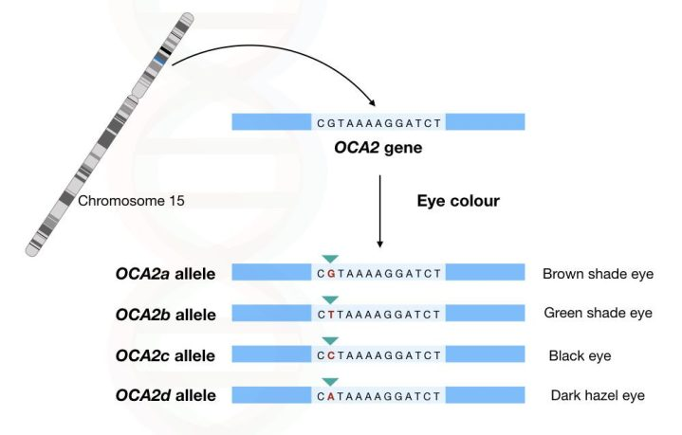
Alleles are Different Versions of Genes
Concept 3: DNA exists in chromosomes, which contain thousands of genes.
https://geneticeducation.co.in/comparison-between-gene-vs-allele/

Slide 52
Putting it All Together: DNA, Genes, Proteins, Traits
1 Gene
makes
1 Protein
determines
1 Trait
*Many traits do exist that are influenced by many genes. But this framework is still a useful way of thinking about most genes.

Slide 53
Putting it All Together: DNA, Genes, Proteins, Traits
Do not memorize!

Slide 54
Putting it All Together: DNA, Genes, Proteins, Traits
Do not memorize!
HBB gene
makes
hemoglobin
determines
red blood cell type
HBB allele 1
makes
normal hemoglobin
causes
normal red blood cells
HBB allele 2
makes
mutated hemoglobin
causes
sickle cell anemia

Slide 55
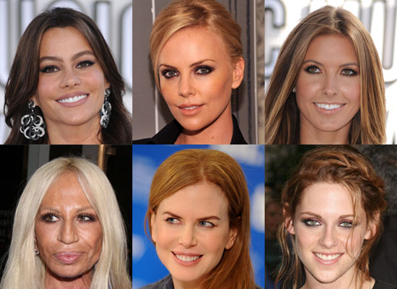
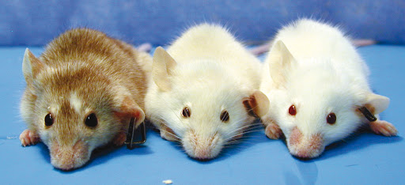
Putting it All Together: DNA, Genes, Proteins, Traits
Do not memorize!

Slide 56
Putting it All Together: DNA, Genes, Proteins, Traits
Do not memorize!
TYR gene
makes
melanin
determines
fur colour
TYR allele 1
makes
normal melanin
causes
brown fur
TYR allele 2
makes
less melanin
causes
blonde fur
TYR allele 3
makes
no melanin
causes
white hair (albinism)

Slide 57
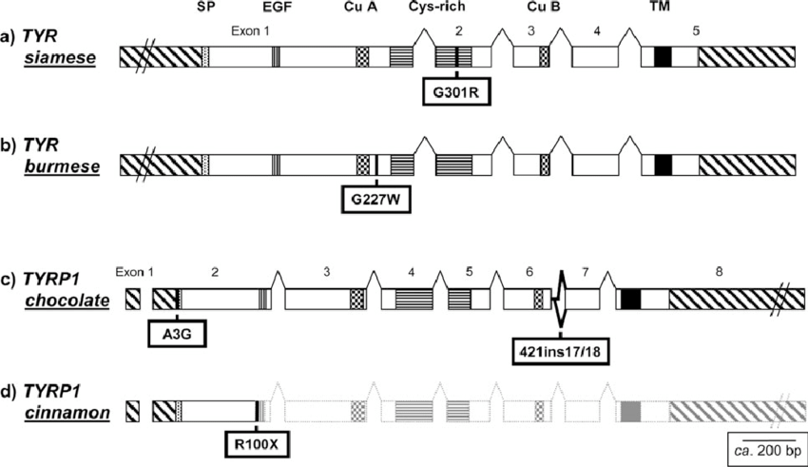
Putting it All Together: DNA, Genes, Proteins, Traits
Do not memorize!

Slide 58
Concept 3: DNA organization and packaging

Slide 59
Warm-up Activity
Concept 3: DNA exists in chromosomes, which contain thousands of genes.
You have been given 3 meters of string.
How tightly can you package this string? Can you fit it into:
Your fist?
The small container you have been given?
The cap of a marker?
How would a homologous chromosome look, compared to your chromosome?
Review: When is DNA packaged tightly? Why?
Notes:
Nucleus in average mammalian cell is 6 micrometers…6/1000 mm. Could fit 167 of them in a single millimeter

Slide 60
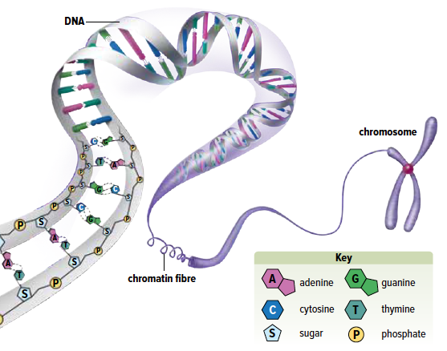
Concept 3: DNA exists in chromosomes, which contain thousands of genes.
DNA can be found as chromosomes or as chromatin, depending on the stage of the cell cycle

Slide 61
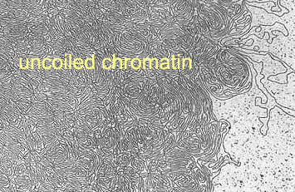
Concept 3: DNA exists in chromosomes, which contain thousands of genes.
For most of the cell cycle, DNA exists as semi-condensed fibers called chromatin.
Easy access to genes (sections of DNA), to make proteins
When cells prepare to divide (mitosis/meiosis), DNA condenses further into chromosomes.
Easy to transport to new cells
Can pair with homologous chromosome
https://newscenter.lbl.gov/2002/11/15/unraveling-the-secrets-of-gene-regulation/
https://www.sciencelearn.org.nz/images/1632-electron-micrograph-of-a-human-chromosome

Slide 62
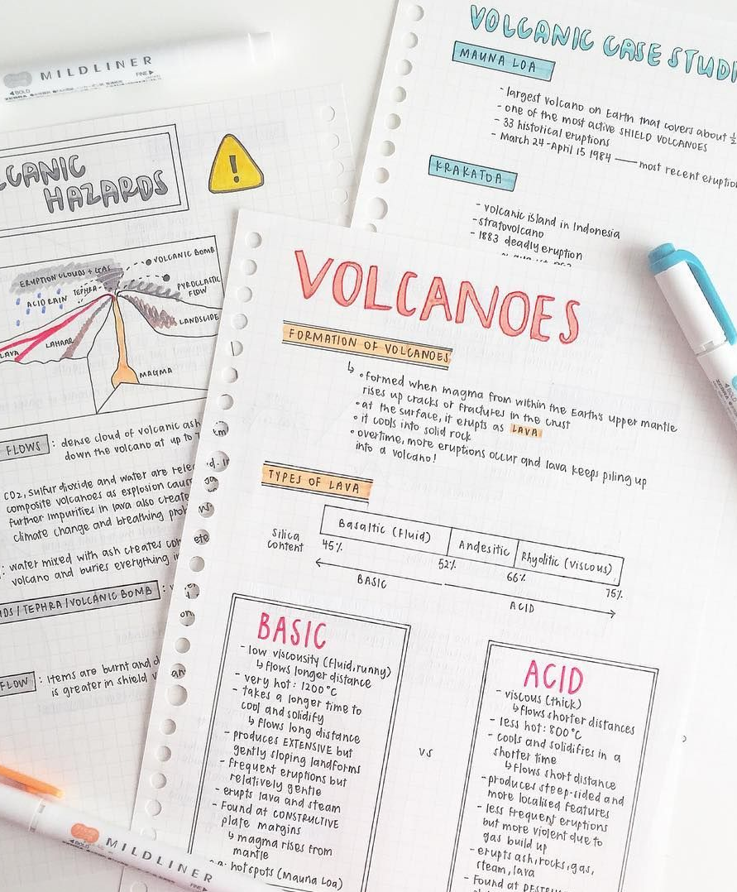
DNA: Structure and Function
Concept 3: DNA exists in chromosomes, which contain thousands of genes.
Nucleotides are like the words on pieces of paper. To ‘study’, you can only look at one page at a time. Cells uncoil DNA fully when they use nucleotide sequences to code proteins.
Chromatin is like organized stacks of paper. When needed, specific pieces of DNA can be accessed.
Chromosomes are like moving boxes filled with paper. You are much less likely to ‘leave DNA behind’ when packaged this way.
https://www.pinterest.fr/pin/348466089910768586/
https://sossimpleorganizedsolutions.com/a-strategy-for-paper-piles/
https://blog.padmapper.com/2010/07/22/how-to-find-free-moving-boxes/
Notes:
chromosome: genetic material that is a condensed form of DNA

Slide 63
/end testable content Slides after this point are a ‘bridge’ or introduction to the next section but will not be on the 1.1 test.

Slide 64
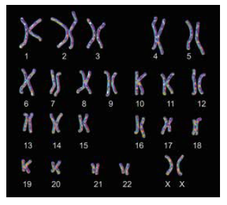
The Karyotype
Concept 3: DNA exists in chromosomes, which contain thousands of genes.
(Review: genome is an organism’s complete set of genetic instructions.)
Karyotype: a photograph of pairs of homologous chromosomes in a cell
46 chromosomes in most human cells (paired)
23 chromosomes in sperm/egg cells (not paired)

Slide 65
Homologous Chromosomes
Concept 3: DNA exists in chromosomes, which contain thousands of genes.
In a regular body cell, there are 23 pairs of chromosomes:
One pair: sex chromosomes
X and Y: genetic male
X and X: genetic female
Pairs 1-22: autosomes
Discussion: How are chromosomes paired? Why are they paired?

Slide 66
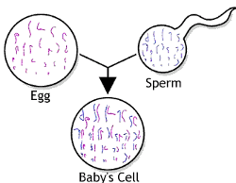
Homologous Chromosomes
Concept 3: DNA exists in chromosomes, which contain thousands of genes.
Sperm and egg cells each have one set of 23 chromosomes. During fertilization, they combine to make a zygote with a complete set of 46 chromosomes (two sets of chromosomes that are homologous). These then divide to form you!
Most of your body cells are made of 46 (23 pairs) chromosomes. In each pair, one chromosome was from mom, and one from dad!

Slide 67
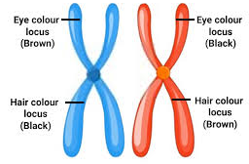
Homologous Chromosomes
Concept 3: DNA exists in chromosomes, which contain thousands of genes.
Homologous chromosomes: pairs of chromosomes with similar DNA sequences
One chromosome inherited from each parent (one from mom, one from dad)
Homologous chromosomes have the same:
Length
Centromere location
Genes (type, location, sequence)
Note: homologous chromosomes are not identical. For each gene, alleles may be same or different.

Slide 68
Concept 3: DNA exists in chromosomes, which contain thousands of genes.
https://www.youtube.com/watch?v=8m6hHRlKwxY
Notes:
Video is a good recap of everything so far
Video covers:
Where is DNA located
Purpose of dna (coding for traits)
Structure of DNA (nucleotides, sugar, phosphate, nitrogenous base)
Dna coding for proteins
Genes (but not alleles)
Chromosomes…46, 23

Slide 69
The Big Picture Summary
The genome is DNA that is split into chromosomes (46 for humans).
During most of the cell cycle, this DNA is packaged loosely as chromatin. DNA replication occurs during this time. When the cell prepares to divide, it is condensed into chromosomes.
Each chromosome is made of DNA. Some is useful, some is not.
Sections of useful DNA are called genes. Each gene is responsible for a trait by making a protein.
A trait is a characteristic (e.g. hair colour, eye colour, height).
Proteins are complex molecules with various functions.
The process of producing a protein from DNA involves transcription and translation.
Small differences in DNA sequences of genes can affect the proteins and traits they code for. Different versions of genes are called alleles.

Slide 70
Review: mitosis and meiosis
Concept 3: DNA exists in chromosomes, which contain thousands of genes.

Slide 71
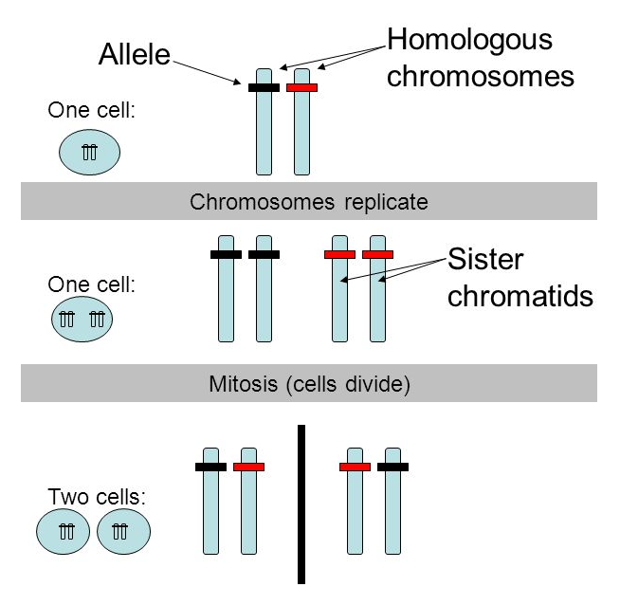
Review: mitosis
Concept 3: DNA exists in chromosomes, which contain thousands of genes.
1x DNA replication; 1x cell division
Final cells are identical
Chromosome number is conserved; all DNA is the same as original cell
Source: https://slideplayer.com/slide/4787428/

Slide 72
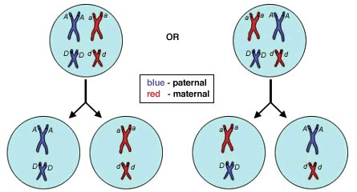
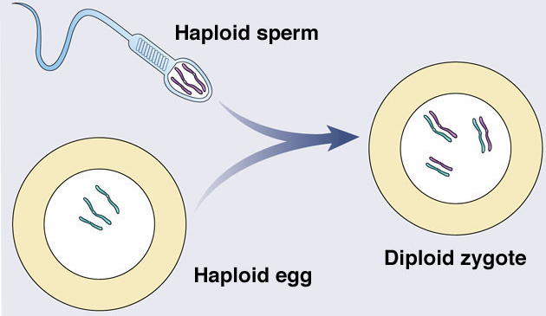
Review: meiosis + sexual reproduction
Concept 3: DNA exists in chromosomes, which contain thousands of genes.
1x DNA replication; 2x cell divisions
Homologous pairs split up; chromosome number halved in sperm or egg cell
Fertilization: one sperm and one egg combine → proper number of chromosomes
Image: https://www.mrgscience.com/topic-33-meiosis.html

Slide 73
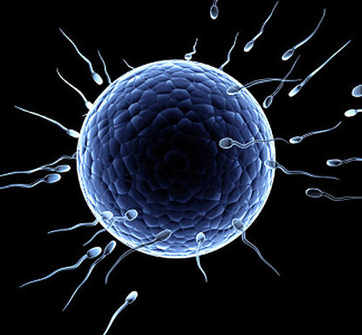
Preview: meiosis + sexual reproduction
Concept 3: DNA exists in chromosomes, which contain thousands of genes.
Parental DNA
Meiosis
Gametes
Fertilization (one chromosome from each parent)
Offspring DNA
Biological father
100% chance of allele “a”
100%
Biological mother
100% chance of allele “A”
Images: https://www.thoughtco.com/allele-a-genetics-definition-373460; https://www.cbsnews.com/pictures/human-eggs-9-fascinating-facts/

Slide 74
Preview: meiosis + sexual reproduction
Concept 3: DNA exists in chromosomes, which contain thousands of genes.
Parental DNA
Meiosis
Gametes
Fertilization (one chromosome from each parent)
Offspring DNA
Biological father
50% chance of allele “A”; 50% of allele “a”
50%
Biological mother
100% chance of allele “A”
50%
Images: https://www.thoughtco.com/allele-a-genetics-definition-373460; https://www.cbsnews.com/pictures/human-eggs-9-fascinating-facts/

Slide 75
Preview: meiosis + sexual reproduction
Concept 3: DNA exists in chromosomes, which contain thousands of genes.
Parental DNA
Meiosis
Gametes
Fertilization (one chromosome from each parent)
Offspring DNA
Biological father
50% chance of allele “A”; 50% of allele “a”
25%
25%
Biological mother
25%
50% chance of allele “A”; 50% of allele “a”
25%
Images: https://www.thoughtco.com/allele-a-genetics-definition-373460; https://www.cbsnews.com/pictures/human-eggs-9-fascinating-facts/

Slide 76
Discussion Questions
Concept 3: DNA exists in chromosomes, which contain thousands of genes.
Describe the relationships among chromatin, a chromosome, DNA, and a gene.
Make an analogy that helps explain homologous chromosomes.

Slide 77
Concept 5: Types of Biodiversity

Slide 78
Concept 5: The different genetic make-up of organisms is reflected in the diversity of life.
Biodiversity exists at three different levels:
species diversity
genetic diversity
ecosystem diversity
NOTE: Concept 5 is FYI only: not testable!

Slide 79
Species Diversity
Concept 5: The different genetic make-up of organisms is reflected in the diversity of life.
Species diversity: variety and abundance of species in a given area
Species: group of organisms that can interbreed in nature and produce fertile offspring

Slide 80
Genetic Diversity
Concept 5: The different genetic make-up of organisms is reflected in the diversity of life.
Genetic diversity: variety of inherited traits within a species; is due to mutations in genes.
Gene pool: genetic diversity within a population
Population: members of the same species living in the same geographical area at the same time

Slide 81
Ecosystem Diversity
Concept 5: The different genetic make-up of organisms is reflected in the diversity of life.
Ecosystem diversity: variety of ecosystems in the biosphere
Ecosystems are made up of biotic (living) factors and abiotic (non-living) factors.

Slide 82
Discussion Questions
Concept 5: The different genetic make-up of organisms is reflected in the diversity of life.
Describe the differences among the three types of biodiversity.
Explain how variation in genes is related to all three types of biodiversity.

