Slide 1
1-2: How is hereditary information passed from one generation to the next?

Slide 2
Key Vocabulary
(Review: allele, gene, chromosome, homologous chromosome, gamete)
Genetics
Trait
Gregor Mendel
True-breeding
Offspring
F1, F2
Law of segregation
Dominant allele
Recessive allele
Phenotype
Genotype
Homozygous
Heterozygous
Homozygous dominant
Homozygous recessive
Cross
Monohybrid cross
Hybrid
Punnett square
Phenotypic ratio
Genotypic ratio
Codominance
Incomplete dominance
Sex-linked trait
X-linked trait
Carrier

Slide 3
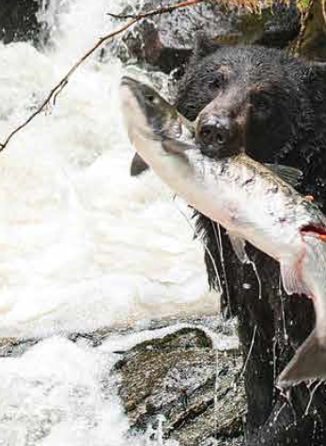
Topic 1.2: How is hereditary information passed from one generation to the next?
Genes pass on inherited traits from parent to offspring.
Punnett squares show the probability of offspring inheriting specific traits.
Both alleles are expressed in codominance.
In incomplete dominance, alleles are neither dominant nor recessive.
Some inherited traits are due to alleles on the sex chromosomes.

Slide 4
Concept 1: Genes pass on inherited traits from parent to offspring.
Genetics: field of biology that studies heredity (how traits are passed from parents to offspring)
Trait: an inherited characteristic
E.g. eye colour, hair colour, straight/curly hair
Image: https://www.assignmentpoint.com/science/biology/genetics-inheritance-traits.html

Slide 5
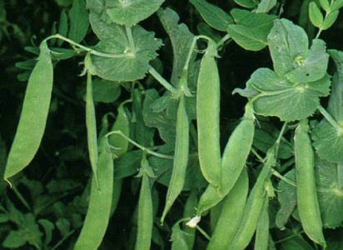
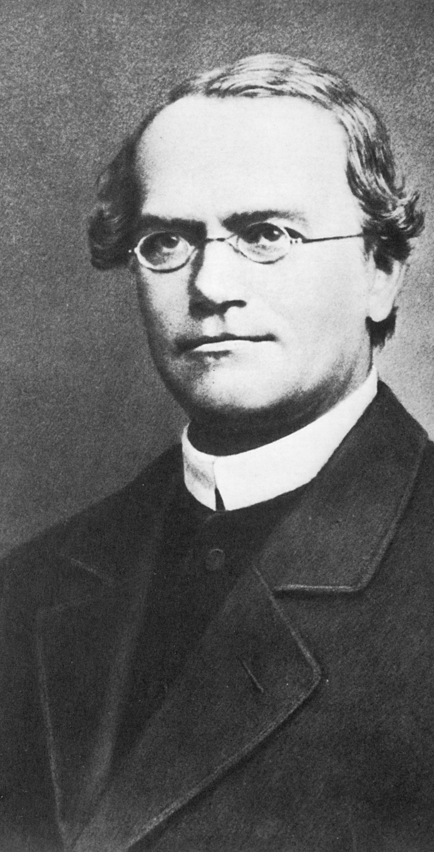
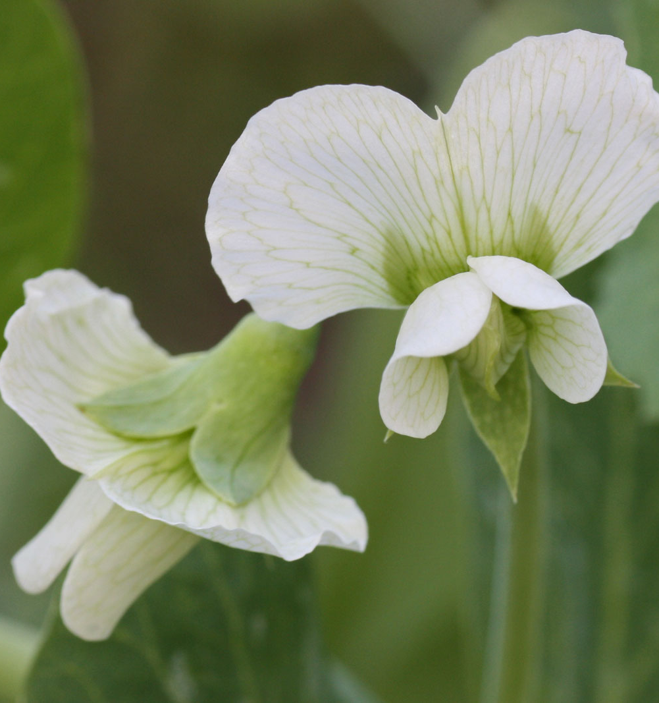
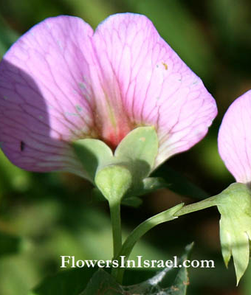
First Modern Experiments in Genetics
Gregor Mendel discovered how traits are inherited by experimenting with pea plants.
Image credits:
https://en.wikipedia.org/wiki/Gregor_Mendel
https://plantsam.com/pisum-sativum/
http://www.flowersinisrael.com/Pisumsativum_page.htm
http://theworldwidevegetables.weebly.com/pisum-sativum-common-pea.html

Slide 6
Mendel’s Experiments (cont’d)
Concept 1: Genes pass on inherited traits from parent to offspring.
True-breeding purple-flowered
True-breeding plant: when self-fertilized (or crossed with same type of true-breed), all offspring have the same traits
E.g. true-breeding purple-flowered plant self-fertilizes to make all purple-flowered plants
E.g. true-breeding wrinkly-seeded plant self-fertilizes to make all wrinkly-seeded plants
True-breeding white-flowered

Slide 7
Mendel’s Experiments
Concept 1: Genes pass on inherited traits from parent to offspring.
Mendel used true-breeding pea plants in F₀
True-breeding parent plants produced new plants called offspring in the first generation (F₁)
Plants from the first generation self-fertilized to produce offspring in the second generation (F₂)
Figure 1.10: These are the results of Mendel’s cross involving true-breeding pea plants with purple flowers and true-breeding pea plants with white flowers.

Slide 8
Mendel’s Experiments (cont’d)
Concept 1: Genes pass on inherited traits from parent to offspring.
When two different true-breeding pea plants are crossed, one trait disappears in the F₁ offspring, but reappears in the F₂ offspring.
Figure 1.10: These are the results of Mendel’s cross involving true-breeding pea plants with purple flowers and true-breeding pea plants with white flowers.

Slide 9
Mendel’s Experiments (cont’d)
Concept 1: Genes pass on inherited traits from parent to offspring.
Based on this, Mendel proposed:
Each plant has two factors for a trait.
Each parent gives one factor for each trait.
One factor dominates over the other if present.
(The “factors” Mendel referred to in his conclusions are now called alleles.)
Figure 1.10: These are the results of Mendel’s cross involving true-breeding pea plants with purple flowers and true-breeding pea plants with white flowers.

Slide 10
The Law of Segregation
Concept 1: Genes pass on inherited traits from parent to offspring.

Slide 11
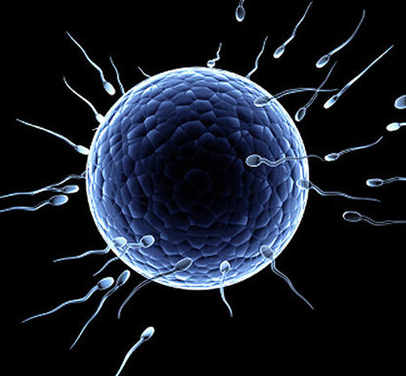
The Law of Segregation
Concept 3: DNA exists in chromosomes, which contain thousands of genes.
Parental DNA
Meiosis
Gametes
Fertilization (one chromosome from each parent)
Offspring DNA
Biological father
50% chance of allele “A”; 50% of allele “a”
50%
Biological mother
100% chance of allele “A”
50%
Images: https://www.thoughtco.com/allele-a-genetics-definition-373460; https://www.cbsnews.com/pictures/human-eggs-9-fascinating-facts/

Slide 12
The Law of Segregation
Concept 3: DNA exists in chromosomes, which contain thousands of genes.
Parental DNA
Meiosis
Gametes
Fertilization (one chromosome from each parent)
Offspring DNA
Biological father
50% chance of allele “A”; 50% of allele “a”
25%
25%
Biological mother
25%
50% chance of allele “A”; 50% of allele “a”
25%
Images: https://www.thoughtco.com/allele-a-genetics-definition-373460; https://www.cbsnews.com/pictures/human-eggs-9-fascinating-facts/

Slide 13
Homologous Chromosomes and Gametes
Concept 1: Genes pass on inherited traits from parent to offspring.
Chromosomes may carry different alleles.
During gamete formation, pairs of homologous chromosomes separate.
Each gamete receives one member of each pair, so it receives only one allele of each pair.
During fertilization when the male and female gametes meet, homologous chromosomes and alleles are paired again.

Slide 14
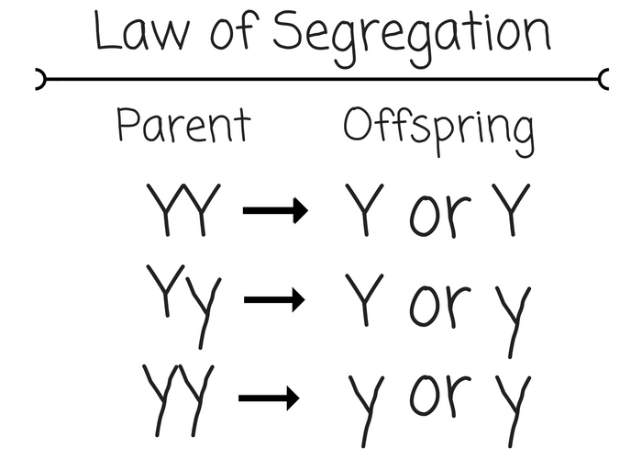
The Law of Segregation
Concept 1: Genes pass on inherited traits from parent to offspring.
Law of segregation: states that alleles for a trait separate during meiosis
Each gamete carries one allele for each trait.
During fertilization, each gamete contributes an allele for each trait.
https://untamedscience.com/biology/genetics/mendelian-genetics/law-of-segregation/

Slide 15
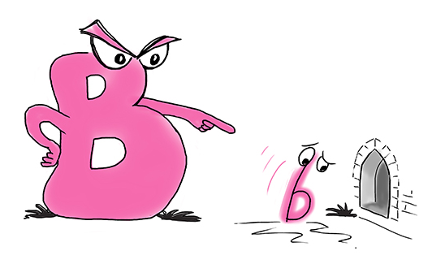
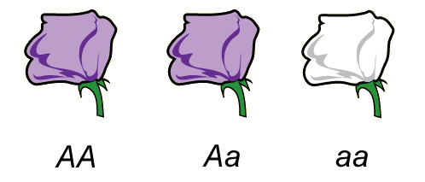
Dominant and Recessive Alleles
Concept 1: Genes pass on inherited traits from parent to offspring.
Dominant alleles (capital letter) will always be expressed if present.
Recessive alleles (lower-case letter) will be expressed only if there are two recessive alleles.
Images: https://mammothmemory.net/biology/dna-genetics-and-inheritance/genes/dominant-allele-and-recessive-allele.html; https://study.com/academy/lesson/genotypic-frequency-definition-lesson-quiz.html

Slide 16
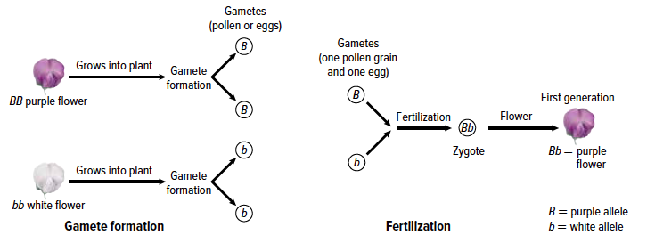
Dominant and Recessive Alleles (cont.)
Concept 1: Genes pass on inherited traits from parent to offspring.
Purple flower colour = BB or Bb
White flower colour = bb
Figure 1.11: These are the results of Mendel’s cross involving true-breeding
pea plants with purple flowers and pea plants with white flowers.

Slide 17
Genotypes and Phenotypes
Concept 1: Genes pass on inherited traits from parent to offspring.
Phenotype: the physical description of an organism’s trait
Examples:
Purple flowers, white flowers
Brown eyes, blue eyes
Has disease, does not have disease
Genotype: the specific combination of alleles an organism has for a trait
Examples:
AA or aa or Aa
BB or bb or Bb
Multiple genes: AaBB

Slide 18
Genotypes and Phenotypes
Concept 1: Genes pass on inherited traits from parent to offspring.
https://7esl.com/genotype-vs-phenotype/

Slide 19
Genotypes and Phenotypes (cont.)
Concept 1: Genes pass on inherited traits from parent to offspring.
Genotype Vocabulary
Homozygous: an organism with two of the same alleles for a particular trait (e.g. BB, bb, AA, aa)
Heterozygous: an organism with two different alleles for a particular trait (e.g. Bb, Aa)

Slide 20
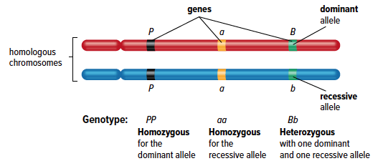
Genotypes and Phenotypes (cont.)
Concept 1: Genes pass on inherited traits from parent to offspring.
Genotype Vocabulary
1) Homozygous dominant: two dominant alleles (e.g. BB)
2) Homozygous recessive: two recessive alleles (e.g. bb)
3) Heterozygous: one dominant allele and one recessive allele (e.g. Bb)
Figure 1.12: Three different genes on homologous chromosomes are indicated. Each example shows one of the three possible combinations (genotypes) of dominant and recessive alleles.

Slide 21
Discussion Questions
Concept 1: Genes pass on inherited traits from parent to offspring.
Write a definition for genetics in your own words.
Seed shape in pea plants can either be round or wrinkled. The allele for round shape is indicated by R. Is round seed shape dominant or recessive?
The allele for freckles is indicated by F. What is the genotype of a person who is heterozygous for freckles?
What is a “true-breeding plant”? Which of the following would be considered true-breeding? Explain why or why not.
Homozygous recessive
Homozygous dominant
Heterozygous

Slide 22
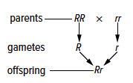
Concept 2: Punnett squares show the probability of offspring inheriting specific traits.
Genetic cross is a deliberate mating between a genetic male and a genetic female.
Monohybrid cross considers one trait.
Hybrid is an offspring that has different traits from its parents.
Figure 1.13: A monohybrid cross between a homozygous dominant individual and a homozygous recessive individual. Each parent contributes one type of allele to the offspring. The symbol “×” represents the word cross.

Slide 23
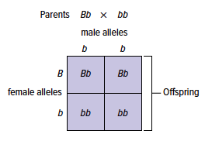
Punnett Squares
Concept 2: Punnett squares show the probability of offspring inheriting specific traits.
A Punnett square is a tool used to help determine the probability of inheriting traits in a monohybrid cross.
It shows the genotypes of the parents and the offspring.
Figure 1.14: In this cross, the female horse can contribute either a B allele or a b allele to offspring. The male horse can contribute only the b allele. The genotypes of the offspring are all possible combinations of alleles that can occur when the gametes combine at fertilization.

Slide 24
Punnett Squares (cont’d)
Concept 2: Punnett squares show the probability of offspring inheriting specific traits.
Phenotypic ratio shows the frequency of the phenotypes in offspring.
Example: 3 purple flowers:1 white flower
Genotypic ratio shows the frequency of the genotypes in offspring.
Example: 1BB:2Bb:1bb

Slide 25
Discussion Questions
Concept 2: Punnett squares show the probability of offspring inheriting specific traits.
A monohybrid cross produces half the offspring with one genotype and half the offspring with another genotype. Express this in the form of a ratio.
What do the alleles that are written along the top and beside a Punnett square represent?

Slide 26
Concept 3: Both alleles are expressed in codominance.
Codominance: the condition in which both alleles for a trait are equally expressed in a heterozygote; both alleles are dominant
Codominant alleles are represented by capital letters with a superscript for each allele
Example: H^{R}H^{W}

Slide 27
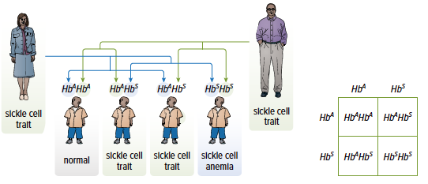
Sickle Cell Anemia—Another Example of Codominance
Concept 3: Both alleles are expressed in codominance.
Sickle cell anemia is a genetic disorder where the red blood cell is C-shaped (sickle shape) and therefore cannot transport oxygen effectively.
People who are heterozygotes with the sickle cell trait are resistant to the life-threatening disease malaria.
Figure 1.18: When a man
and a woman are both
heterozygous for the sickle
cell gene, there is a one in
four chance that they will have a child with sickle cell anemia.

Slide 28
Discussion Questions
Concept 3: Both alleles are expressed in codominance.
What is codominance? Give three examples of codominance.
Hypothesize why the frequency of the sickle cell allele is much higher in Africa than in other areas of the world.

Slide 29
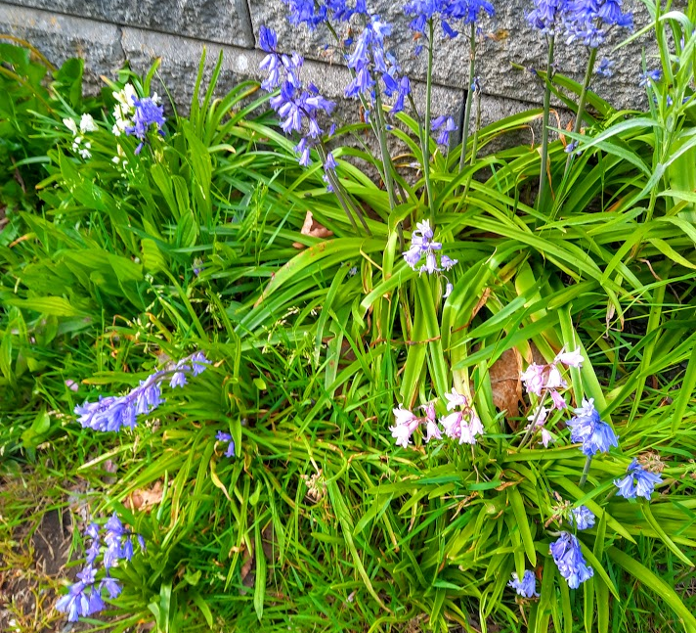
Concept 4: In incomplete dominance, alleles are neither dominant nor recessive.

Slide 30
Incomplete Dominance
Concept 4: In incomplete dominance, alleles are neither dominant nor recessive.
Incomplete dominance: a condition in which neither allele for a gene completely conceals the presence of the other; it results in intermediate expression of a trait
Example: Four o’clock flowers can be red, pink, or white.

Slide 31
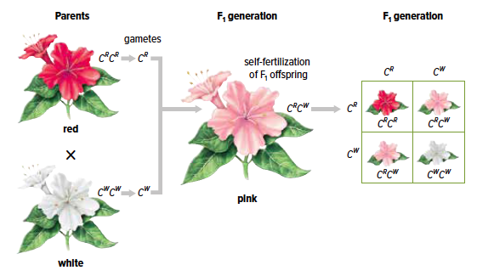
Incomplete Dominance
Concept 4: In incomplete dominance, alleles are neither dominant nor recessive.
Use capital letters with superscripts to represent incomplete dominance.
Figure 1.19: When red (C^{R}C^{R}) flowers and white (C^{W}C^{W}) flowers of the four o’clock are crossed, the resulting offspring have an intermediate phenotype, pink flowers (C^{R}C^{W}). In the F₂ generation, all three phenotypes are observed.

Slide 32
Discussion Questions
Concept 4: In incomplete dominance, alleles are neither dominant nor recessive.
What is the difference between incomplete dominance and codominance?
A plant that produces white flowers is crossed with a plant that produces purple flowers. Describe the phenotype of the offspring if the inheritance pattern for flower colour is
a) incomplete dominance
b) codominance

Slide 33
Concept 5: Some inherited traits are due to alleles on the sex chromosomes.
Sex-linked trait: a trait controlled by genes on sex chromosomes
X-linked trait: a trait controlled by genes on the X chromosome
Males are affected by recessive X-linked traits more often because they have only one X chromosome.

Slide 34
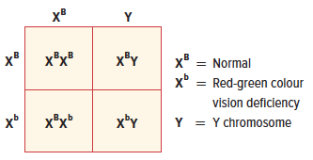
Red-Green Colour Vision Deficiency
Concept 5: Some inherited traits are due to alleles on the sex chromosomes.
Red-green colour vision deficiency is a recessive X-linked trait.
Carrier is a female that has one recessive allele on one of her X chromosomes.
Figure 1.20: The Punnett square shows how the sex-linked trait is inherited.

Slide 35
Discussion Questions
Concept 5: Some inherited traits are due to alleles on the sex chromosomes.
What are sex-linked traits?
Use vocabulary terms to describe the genotype of a male who is red-green colour vision deficient.

Slide 36
End of testable content

Slide 37
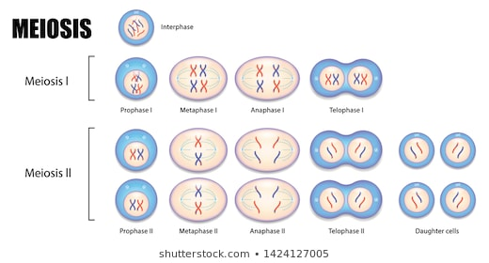
Genetic diversity is caused by independent assortment and crossing over during meiosis.
Concept 1: Genes pass on inherited traits from parent to offspring.
Notes:
Very bad joke: what do you call it when a neighbour moves in Animal Crossing? Crossing Over. ☺

Slide 38
Reference: Interpreting Mitosis and Meiosis Diagrams
Concept 1: Genes pass on inherited traits from parent to offspring.
Structure | Symbol | Notes
Centromere |  | 1 centromere per chromosome. No exceptions.
Chromosome | OR | Replication makes an identical copy of the DNA strand of the chromosome. But: this entire structure is still one chromosome because it has one centromere.
Homologous chromosomes | OR | Homologous chromosomes have the same: Centromere placement Length of DNA strand (vertical line) Genes (short dashed line) In each pair, one chromosome comes from the mother, and one from the father. Alleles can be the same or different. Examples: Left: the chromosomes have different alleles for both genes. Right: different alleles for “A” gene; same alleles for “B” gene.
c
c
c
d
d
d
a
a
A
A
c
C
d
D
B
B
B
B

Slide 39
Interphase (review):
Concept 1: Genes pass on inherited traits from parent to offspring.
During interphase, DNA is replicated. However, the number of chromosomes stays the same.
Interphase: before replication
(2 homologous pairs: 4 chromosomes)
Interphase: after replication
(2 homologous pairs: 4 chromosomes)
a
A
a
a
A
A
B
B
B
B
B
B
c
C
c
c
C
C
d
D
d
d
D
D
Notes:
Very bad joke: what do you call it when a neighbour moves in Animal Crossing? Crossing Over. ☺

Slide 40
Metaphase 1: Independent Assortment
Concept 1: Genes pass on inherited traits from parent to offspring.
a
a
A
A
Chromosome 1: aB Chromosome 2: cd | Chromosome 1: aB Chromosome 2: CD
Chromosome 1: AB Chromosome 2: cd | Chromosome 1: AB Chromosome 2: CD
B
B
B
B
c
c
C
C
d
d
D
D
In this case with 2 homologous pairs, there are 4 possible gametes that this parent could produce. The number of possible combinations increases exponentially when the number of homologous pairs increases.
Humans have 23 homologous pairs of chromosomes. It is estimated that independent assortment alone leads to 6.3 billion chromosome combinations for any two parents. This is why no two siblings are alike!
https://www.nature.com/scitable/topicpage/mitosis-meiosis-and-inheritance-476/#:~:text=When%20these%20chromosome%20pairs%20are,A%20B%20C
Notes:
Very bad joke: what do you call it when a neighbour moves in Animal Crossing? Crossing Over. ☺

Slide 41
Prophase 1: Crossing Over
Concept 1: Genes pass on inherited traits from parent to offspring.
Synapsis is where homologous pairs ‘buddy up’ during Prophase 1 and exchange pieces of DNA between them. This exchange is called crossing over.
Prophase 1 (start) | Synapsis | Crossing Over (complete)
a
a
A
A
a
A
a
A
B
B
B
B
B
B
B
B
c
c
C
C
c
c
C
C
d
d
D
D
d
D
d
D

