Slide 1
1.5 - Spread of Diseases

Slide 2
Immune System
Immune System: body system - defends against pathogens & infection
3 Lines of Defense

Slide 3
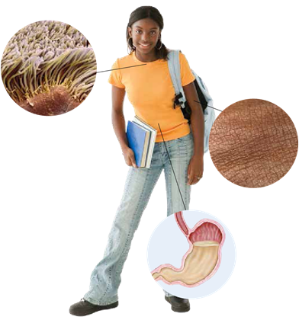
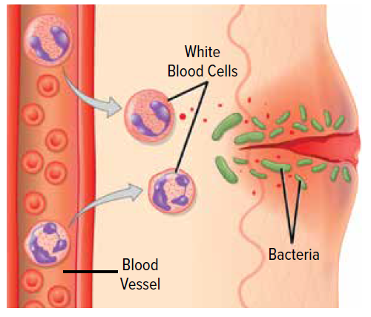
Immune System
1st Line of Defense: skin, internal linings, hairs (cilia), mucus
2nd Line of Defense: white blood cells
3rd Line of Defense: specialized white blood cells

Slide 4
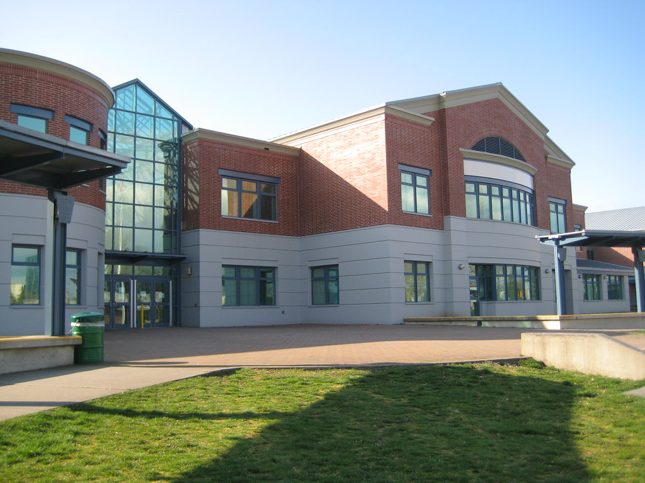
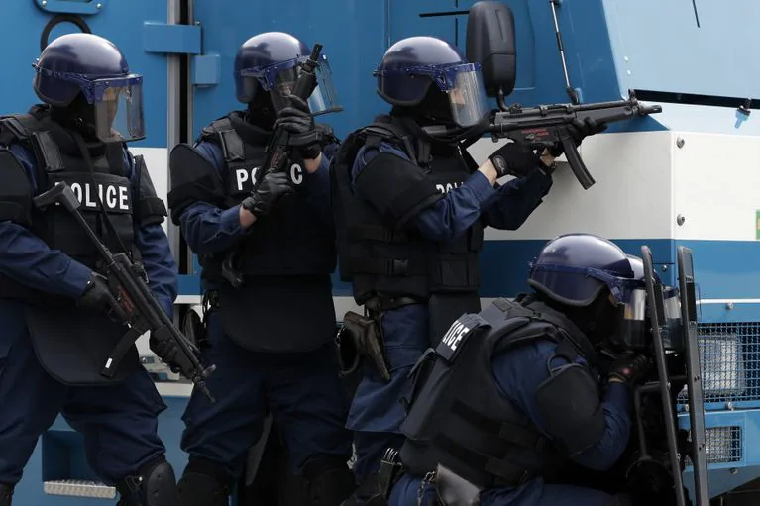
Immune System
1st Line of Defense: skin, internal linings, hairs (cilia), mucus
2nd Line of Defense: white blood cells
3rd Line of Defense: specialized white blood cells

Slide 5
Has anyone gotten sick/the flu in the past few weeks?
What are some examples of epidemics/outbreaks/pandemics you have seen in the news?
Notes:
Recent cases in news about various epidemics/outbreaks/pandemics - what are some examples?
H1N1, Ebola
Zika virus pandemic (reported in 78 countries)
SARS pandemic (started as an epidemic in Southeast Asia)
Measles outbreak in Samoa (a pacific island)...killed 20 so far. Very recent: last week.

Slide 6
Describing Disease Occurrence
OUTBREAK
More cases than ‘normal’
For rare diseases, even 1 case can be an outbreak
Outbreaks can be seasonal (e.g. flu season)
Usually limited affected area (e.g. one building, one city)
COVID outbreaks
May or may not prompt public health measures
EPIDEMIC
More cases than ‘normal’
Population in a clearly defined area (e.g. Greater Vancouver area or Ontario)
Rapid, uncontrolled spread of infectious disease to many people
Requires public health response
PANDEMIC
An epidemic that has spread over several countries/continents, or around the world (global)
Requires coordinated global response
https://www.webmd.com/cold-and-flu/what-are-epidemics-pandemics-outbreaks#1
https://apic.org/monthly_alerts/outbreaks-epidemics-and-pandemics-what-you-need-to-know/

Slide 7
Historical Example: Typhoid Mary
Notes:
We will look at the case of Typhoid Mary - Mary Mallon
First person in the US identifies as an asymptomatic carrier of the pathogen associated with typhoid fever.

Slide 8
What are some ways pathogens can spread from one person to another?

Slide 9
Investigation Activity: Modelling the Spread of Disease
SAFETY:
No eating or drinking.
If you spill liquid on your hand, tell teacher and wash off with lots of water.
No gloves or goggles required.
Clean up after yourself.
Notes:
You have been employed by the public health agency to investigate an outbreak.
What does the dropper of liquid represent? - potential passing of pathogen

Slide 10
Investigation Activity: Modelling the Spread of Disease
Instructions: *do not proceed unless told to*
Find a partner.
Write down partner’s name on your contact sheet.
Partner 1 will use the dropper to transfer 3 drops of your liquid into Partner 2’s container.
Partner 2 transfers 3 drops to Partner 1.
Repeat step 1a-c two more times for Contact 2 and Contact 3.
Notes:
You have been employed by the public health agency to investigate an outbreak.
What does the dropper of liquid represent? - potential passing of pathogen

Slide 11
Investigation Activity: Modelling the Spread of Disease
Clean-up
Rinse beaker multiple times.
Fill beaker with water and use it to fill the dropper multiple times with water to rinse the inside out. Rinse the outside of the dropper with water multiple times.
Return materials as specified by your teacher.
Notes:
You have been employed by the public health agency to investigate an outbreak.
What does the dropper of liquid represent? - potential passing of pathogen

Slide 12
End of slideshow.

Slide 13
Investigation Activity: Modelling the Spread of Disease
Instructions: *do not proceed unless told to*
Each student gets 1 cup & 1 dropper
Transfer 1: find a classmate - use a dropper to draw in liquid from your own cup & squeeze ~5 drops into your partner’s cup
Write down the name of this partner in the first column
Place the remaining liquid in your dropper back in your own cup
Notes:
You have been employed by the public health agency to investigate an outbreak.
What does the dropper of liquid represent? - potential passing of pathogen

Slide 14
Investigation Activity: Modelling the Spread of Disease
Instructions: *do not proceed unless told to*
Transfer 2: find a classmate - use a dropper to draw in liquid from your own cup & squeeze ~5 drops into your partner’s cup
Write down the name of this partner in the second column
Place the remaining liquid in your dropper back in your own cup

Slide 15
Investigation Activity: Modelling the Spread of Disease
Instructions: *do not proceed unless told to*
Transfer 3: find a classmate - use a dropper to draw in liquid from your own cup & squeeze ~5 drops into your partner’s cup
Write down the name of this partner in the last column
Place the remaining liquid in your dropper back in your own cup

Slide 16
Investigation Activity: Modelling the Spread of Disease
Instructions: *do not proceed unless told to*
Once you have made 3 contacts, return to your seat
A teacher will put a drop of ‘infection indicator’ in everyone’s cup
Change of colour to pink = infected
Record on your sheet if you have been infected
If you have been infected, dispose liquid down the sink with plenty of water, rinse your cup, dropper & return to your seat

Slide 17
Investigation Activity: Modelling the Spread of Disease
Recap & Follow-Up:
Together we will fill in the tracking chart
initial student name on top
3 contacts made under
Highlight names of infected people
Can you determine the route the pathogen took to infect all these people?
Make a diagram on your worksheet
Notes:
We will now try to figure out who patient zero is - first person infected & passed the pathogen

Slide 18
Investigation Activity: Modelling the Spread of Disease
Recap & Follow-Up:
How did this investigation model the spread of disease?
Did we determine who patient zero was?
How does tracking & determining patient zero help public health authorities to stop the spread of disease?
Notes:
How to respond to an outbreak? How can we minimize the number of people infected?

Slide 19
Project: Virus Pamphlet
Each of you will be given an virus to look into in greater detail.
Your task is to create a pamphlet that gives your audience more information about the virus.
You will be assessed on accuracy of information, visual appeal and creativity.
Information to Include:
Name of virus
Host cell of virus
Shape/picture of virus
Discovery of disease
Severe outbreaks (where, when, who, how)
Transmission/spreading of virus
Symptoms or impacts on body
Treatments/prevention

Slide 20
SlidesCarnival icons are editable shapes.
This means that you can:
Resize them without losing quality.
Change line color, width and style.
Isn’t that nice? :)
Examples:

