Slide 1
Scientific Inquiry

Slide 2
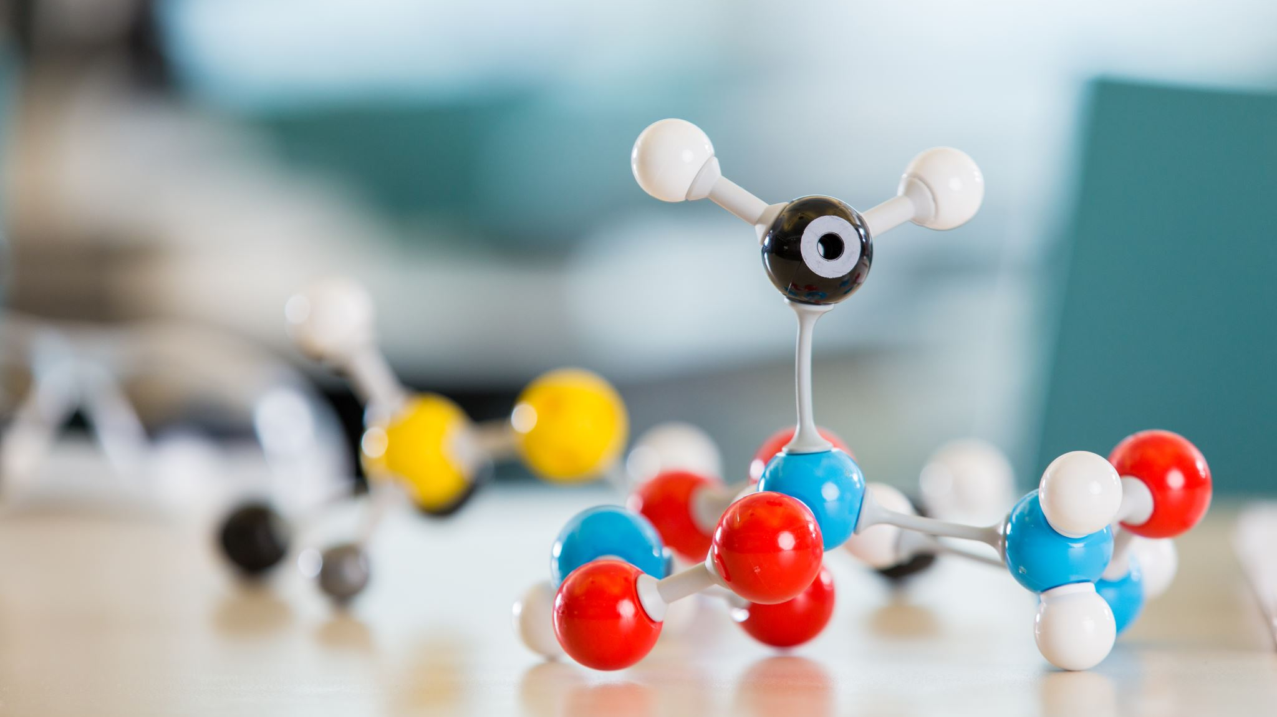
The need for science: correlation vs causation
Module 1

Slide 3
Warm-up Discussion
What is science? What separates ‘real’ or ‘good’ science from ‘fake’ or ‘bad’ science?
How do scientists design experiments? What process do they use?

Slide 4
Claim: “5G caused COVID-19”
Source: The Science Page

Slide 5
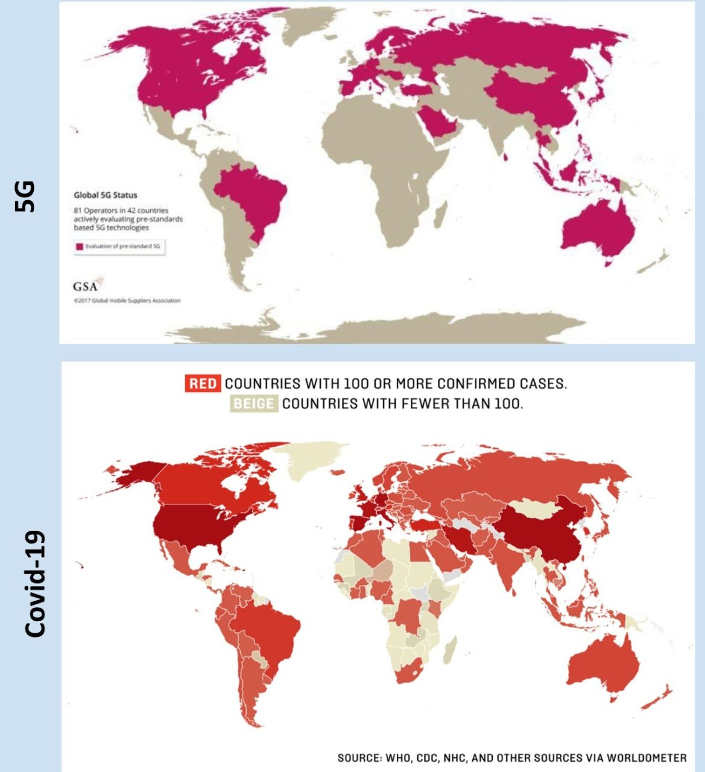
Claim: “5G caused COVID-19”
Source: iAfrikan.com
Notes:
https://www.iafrikan.com/2020/04/04/coronavirus-5g-covid-19-telecommunications-health-fake-news/
5G does not cause the spread of COVID-19

Slide 6
Claim: “5G caused COVID-19”
Source: Manchester Evening News
Notes:
https://www.manchestereveningnews.co.uk/news/greater-manchester-news/political-leaders-warn-spreading-irresponsible-17954482
Political leaders warn that spreading 'irresponsible disinformation' about coronavirus 'puts lives at risk' after councillor shares conspiracy theories

Slide 7
Correlation is not causation
Correlation is a mutual relationship or connection between two or more things (Oxford Dictionary)
The maps show a correlation between 5G coverage and COVID-19 cases. But they do not prove that 5G causes COVID.

Slide 8
Correlation is not Causation
It is fairly straightforward to show that two variables are related (correlation).
But to show causation (that x causes y), we need to conduct a controlled scientific experiment.
https://www.slideshare.net/JonathanStray/frontiers-of-computational-journalism-week-4-statistical-inference

Slide 9
Correlation is Not Causation
https://www.youtube.com/watch?v=VMUQSMFGBDo&ab_channel=DecisionSkills

Slide 10
https://www.tylervigen.com/spurious-correlations

Slide 11
Your Turn!
On a sheet of paper, define correlation and causation in your own words.
Give an example of each to help you understand them.

Slide 12
Experimental Design: Basics
Hypothesis: X Causes Y
X
Y
X
Y
No X
No Y
No X
Conclusion: X Causes Y.
Conclusion: X does not cause Y. Something else causes Y.

Slide 13
Experimental Design: Basics
Hypothesis: X Causes Y
X
Y
X
No Y
No X
No Y
No X
Conclusion: X Causes Y.
Conclusion: X does not cause Y. Something else causes Y.

Slide 14
Experimental Design: Basics
Hypothesis: Vaccines cause Autism
Kids with vaccine
Kids with autism
Kids with vaccine
1% of all kids have autism
Kids without vaccine
Kids without autism
Kids without vaccine
Conclusion: Vaccines do not cause autism. Something else causes autism.
Conclusion: Vaccines cause autism.

Slide 15
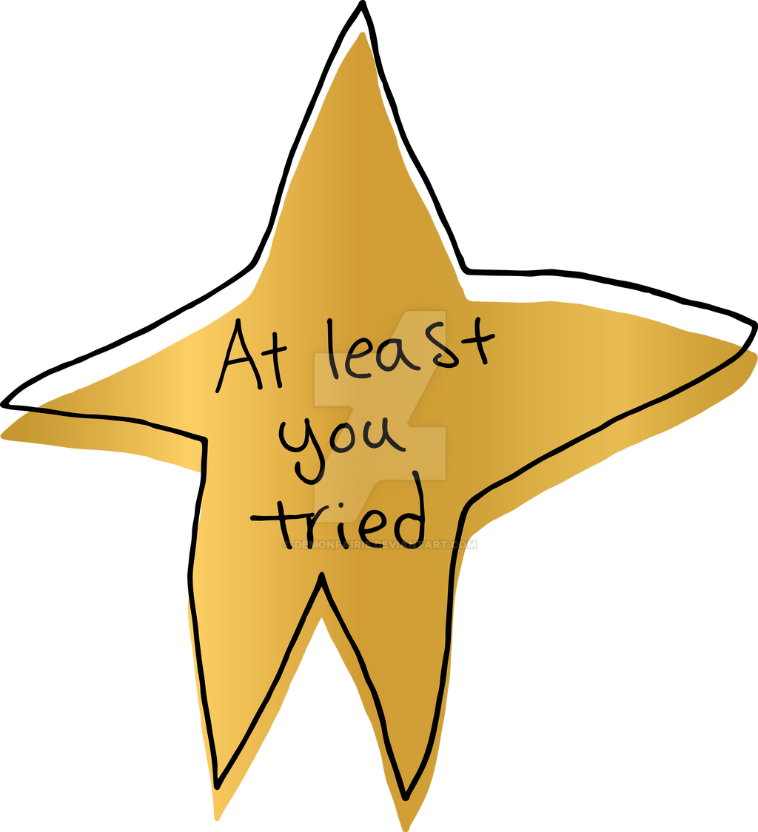
different ‘experiment’ Types
Observations: making observations in an unstructured way; is not a real experiment but can lead to formation of an experiment
“What colour is ___?” “What does ___look like?” “What happens if I do ___?”
Controlled Experiment: controls all variables except independent variable; can claim causative relationship between x and y
“How does watering amount affect plant growth?” “Does the vaccine reduce the risk of catching COVID-19?”
Correlational Experiment: examines the correlation between two variables where manipulation is not possible; cannot claim causation
“How does ethnicity affect salary?” “How does being dropped on the head at birth affect intelligence?”

Slide 16
Good Experimental Design
Other than “X”, everything else is the same in your two versions of the experiment
Repeat the experiment in different settings, with different subjects (if applicable)
Measurement is objective and free of bias

Slide 17
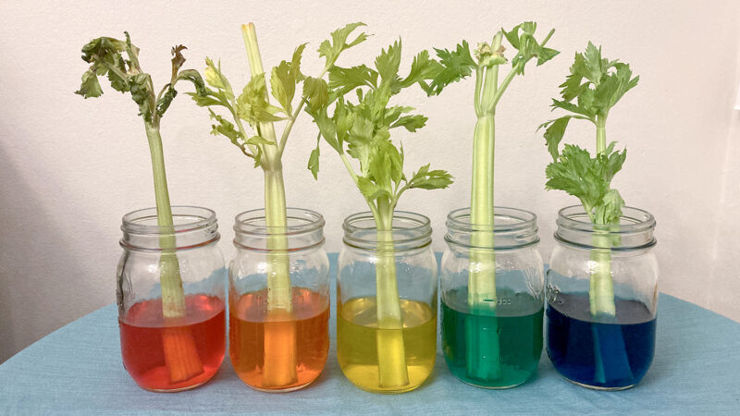
Experimental design: simplified
Module 2

Slide 18
Warm-up
What would you do in each of the following scenarios? Discuss the steps you would take, in the order you would take them.
You have a cough and are feeling sick.
You typed in the URL but you cannot access Ms. Au’s website on your phone.
Your favourite phone game just released a new update! But when you updated the app, the game does not start up on your phone anymore.
Your combination lock on your locker is not opening.
You have plugged in and turned on the hot plate, but it is not getting hot even after waiting 10 minutes.

Slide 19
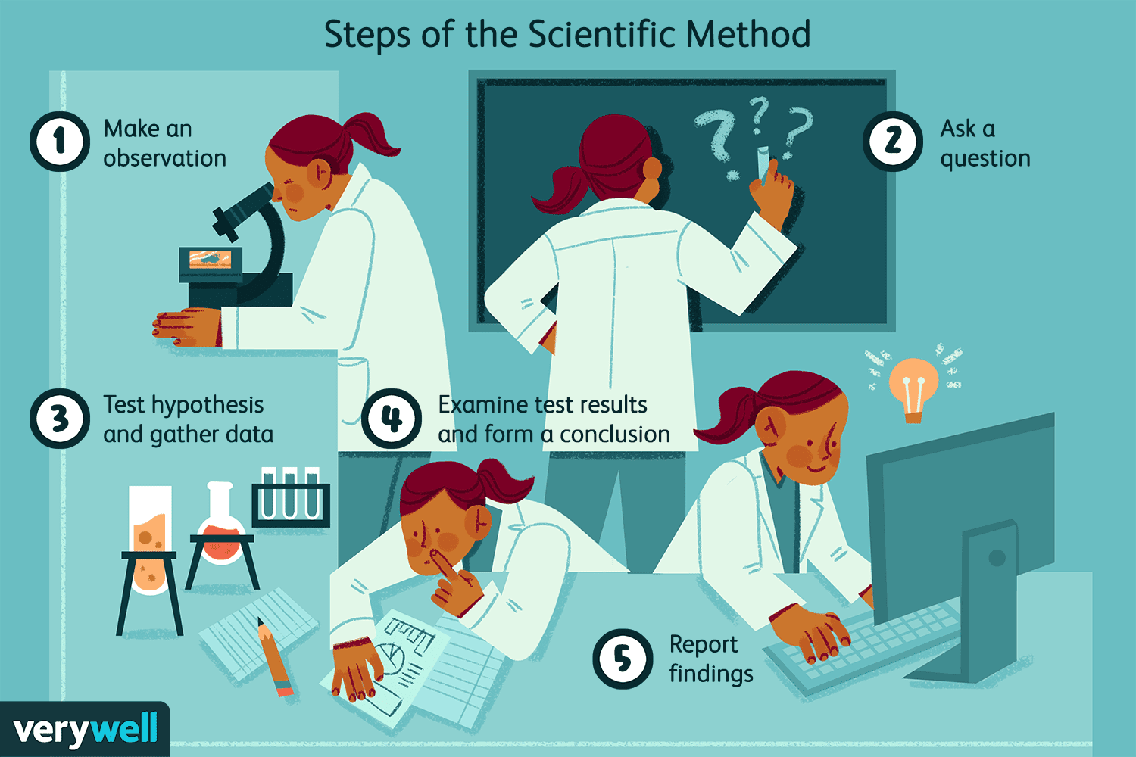
The Scientific Method

Slide 20
Case Study: Feeling Sick
OBSERVATION: You have a cough and are feeling sick.
QUESTION: Why am I sick?
-research-
HYPOTHESIS: Maybe I have COVID-19.
EXPERIMENT: Do a rapid test.
RESULT: Positive.
Multiple courses of action you could take at this point…

Slide 21
CASE STUDY: Website Woes 1
OBSERVATION: You typed in the URL but you cannot access Ms. Au’s website on your phone.
QUESTION: Why can’t I access Ms. Au’s website?
-research-
HYPOTHESIS 1: Maybe the website is down.
EXPERIMENT 1: Try on a different device or ask a friend.
RESULT 1: Ms. Au’s website works on other device.
CONCLUSION 1: Website is not down. Must be something else.

Slide 22
CASE STUDY: Website Woes 2
HYPOTHESIS 2: Maybe my wifi is not working.
EXPERIMENT 2: Try to visit a different webpage.
RESULT 2: Other webpage works fine.
CONCLUSION 2: My wifi is fine. Must be something else.
…

Slide 23
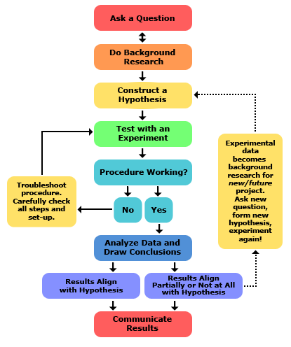
The Scientific Method
Notes:
Key idea: the scientific method loops back on itself.

Slide 24
The Scientific Method
You use the scientific method in your everyday life, even if you are not thinking about it!
Observe something that prompts you to ask a question.
Conduct extra research. Create a hypothesis.
Design and carry out an experiment that will help you test your hypothesis.
Interpret the results and draw a conclusion.
Repeat, if necessary!
Notes:
Hand out the inquiry template after this. Consider showing the requirements for lab reports sheet

Slide 25
The Scientific Method
Hypothesis: a research-based explanation that can be proven (or disproved) using an experiment
Observation | Good Hypothesis | Bad Hypothesis
The sky is blue. | Dust particles in the sky scatter blue light into the atmosphere. | 1000 years ago, an invisible Blue Whale god threw up in the sky. Its vomit was blue.
My phone won’t turn on. | The phone is out of battery. | The ghost of Steve Jobs is haunting my phone and cursing it because I have an android phone.
I am struggling in school. | I am not studying enough. | I was dropped on the head as a baby.*
* While it is impossible to prove that the reason YOU are struggling in school is because YOU were dropped on the head as a baby, it is possible to answer a different question…e.g. Do babies who are dropped on their heads go on to struggle more in school than average?

Slide 26
Case Study: “How to Survive Spicy Food!” video
https://www.youtube.com/watch?v=v0So51Q6GLg&ab_channel=TheFoodTheorists
What question is being investigated here? (Hint: Be specific about what is being investigated in this particular series of experiments. The answer is NOT “How to survive spicy food?”)
What molecule is found in spicy foods?
What is the name of the receptor in your body that detects spiciness?
Experimental Design:
What is the one thing that is changing every time they do a new ‘round’ of experimentation?
What are some things that stay the same throughout all the rounds of experimentation? Extension: why is it important that these things are not changing?
How did the experimenters determine which chaser was the most effective? Propose a better way of measuring chaser effectiveness. (You may need to think outside the box for this question.)

Slide 27
Case Study: Competitive Eater video
https://www.youtube.com/watch?v=jfFD1c2H9Ek&ab_channel=VarietiED

Slide 28
Experimental Design
Question: How can you make a paper airplane that flies the farthest horizontal distance?
Task: Use the scientific method at least twice to come up with the best airplane design.
Important Note: Every time you do a new experiment, only change ONE thing at a time. E.g. if you change paper to cardstock AND change the way you fold your airplane, you won’t know why the result is different.

Slide 29
Making Observations and Measurements Like a Champ
Module 3

Slide 30
Review: Data Types
What is quantitative data? Give 3 examples.
What is qualitative data? Give 3 examples.
Notes:
Suggest: return back to the spicy video and describe why it was not ideal…they were using qualitative observations and using it to arbitrarily assign a seemingly quantitative value to it

Slide 31
Review: Data Types
Quantitative data:
Collected using measurement tools and techniques
Described using numbers and values
Objective
Examples: 3 cm, 100 km/h, 5°C, 700 nm light
Qualitative data:
Collected using the five senses
Described using words
Subjective
Examples: small, very fast, cold, pink
Notes:
Suggest: return back to the spicy video and describe why it was not ideal…they were using qualitative observations and using it to arbitrarily assign a seemingly quantitative value to it

Slide 32
Activity 1: Outside the Box
Often in science, you will need to measure things that are not ‘easy’ to measure because they are abstract or because of equipment limitations.
Brainstorm how you could measure each of the following:
Time (without any electronic device)
Mass/weight (without a scale)
Temperature (without a thermometer)
Distance (without a ruler)
Speed a mouse is running
Happiness
Plant growth
Intelligence

Slide 33
Case Study: Best fries size
https://www.youtube.com/watch?v=c_jnZkVlNtw&t=466s&ab_channel=TheFoodTheorists
As you watch:
Good scientific experiments involve replication: making the same measurement more than once to ensure that your results are not an accident or a ‘fluke’. How is replication shown in this video?
The variables being measured are: cost per gram, fry fill percentage, and calories per cent. Classify each variable as qualitative or quantitative.
Why did MatPat measure “fry fill percentage”? What question was he trying to answer?
How did MatPat measure “fry fill percentage”? Use this example to explain why creativity is often necessary when designing science experiments.
Notes:
Each size of fry was purchased in 3 different cities. The values were averaged.
All are qualitative.
He was trying to determine how effectively each order of fry filled its container. He wanted to know which type of packaging was most effective for its container and also which chain(s) were being deceptive with their packaging. (Slight variations in answers acceptable here.) (6:10)
He measured it by taping any holes in the container, then filled with sifted all purpose flour to determine total volume of each container. (6:10)

Slide 34
Activity 2
Question: How can I make an aluminum foil boat that will hold the most weight?
Important Notes:
For your boat, you can only use the 6”x 6” square of aluminum foil given to you by your teacher. You can cut, glue, fold, tape that piece of aluminum foil if you want.
Each group will only be given 2 pieces of aluminum foil for their testing process, and 1 more for their final boat. Do not waste it. Ensure you research and make a plan before getting your aluminum foil.
Document your experimentation process using the provided template. This will be submitted to your teacher.
Notes:
Note…6 inch square aluminum foil can hold about 250 g of beans. But beans challenging to extricate from water…coins definitely better….denser too.

Slide 35
End of slides for 2022-2023 Science 9

Slide 36
Variables
Module 2

Slide 37
Thought Experiment
What factors will affect how a plant grows?
What are some different things we could observe or measure about a plant?

Slide 38
Thought Experiment
What factors will affect how a plant grows?
Watering (total amount),
Atmospheric gas concentration
Fertilizer/plant food
Brightness or intensity of light
Soil quality and quantity

Slide 39
Thought Experiment
What are some different things we could observe or measure about a plant?
Height
Growth rate
Total growth (e.g. maximum height)
Colour
Number of leaves/seeds/flowers
Germination Rate
Health (how do its leaves appear? Has it caught any diseases?)
Thickness of stem

Slide 40
Variables
An aspect of an experiment that can have different values
Is a “general category”
Variable | Qualitative & Quantitative Observations (Not Variables)
Temperature | 5ºC, 205ºC, freezing, warm
Colour | Blue, white, pink, light with a 690nm wavelength
Growth Rate | Fast, 5 cm/day, 2 mm/hour
Gender | Male, female, transgender, two-spirit, non-binary

Slide 41
Variables
3 main types:
Dependent variable
Independent variable
Control variable
Also: Confounding variable

Slide 42
Independent and Dependent Variables
Dependent variable: the variable you are most interested in measuring or observing; shown on the y-axis of a graph
Independent variable: the variable that is manipulated or changed by the experimenter, to see the effect on the dependent variable; shown on the x-axis of a graph

Slide 43
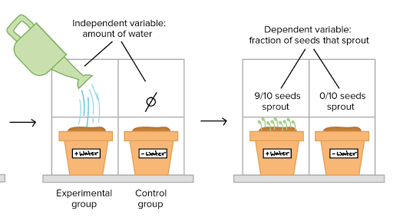
https://www.khanacademy.org/science/high-school-biology/hs-biology-foundations/hs-biology-and-the-scientific-method/a/experiments-and-observations

Slide 44
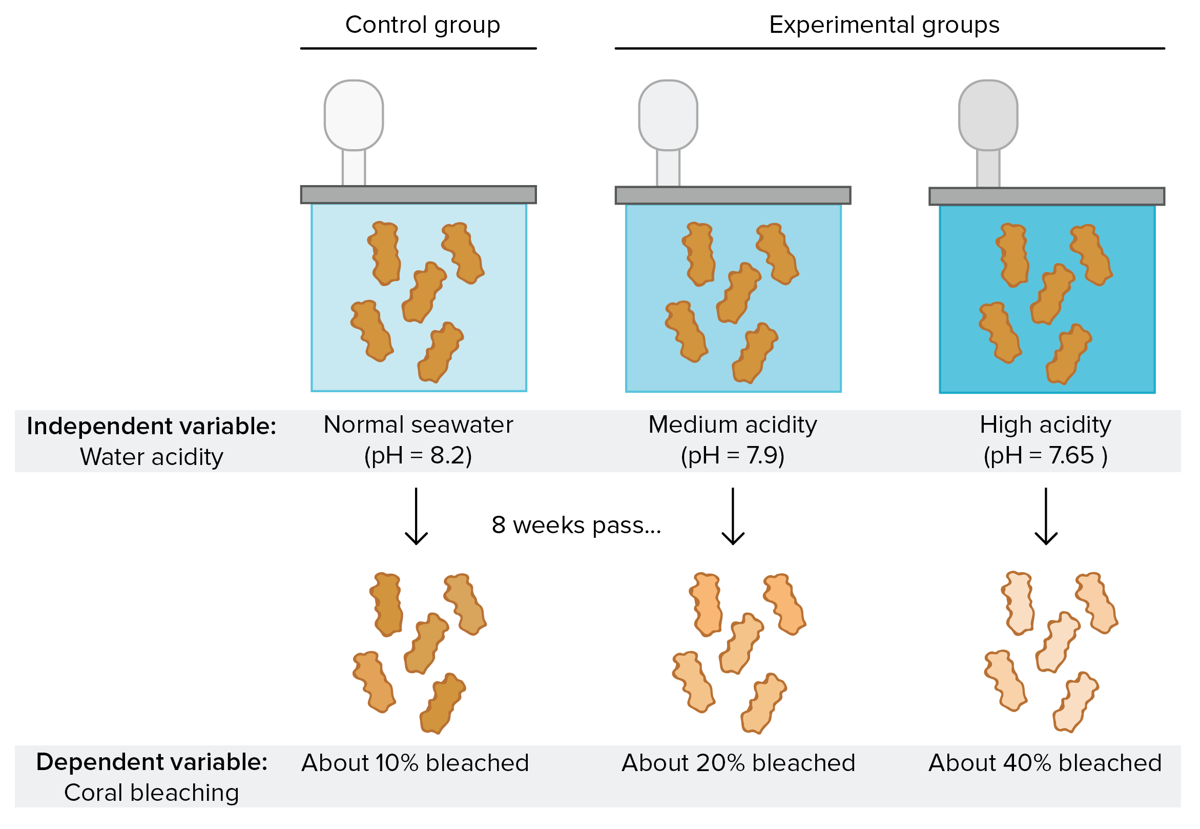
https://www.khanacademy.org/science/high-school-biology/hs-biology-foundations/hs-biology-and-the-scientific-method/a/experiments-and-observations

Slide 45
Correlation and Causation
Okay. So when can we conclude that x causes y?
Click me.

Slide 46
Control variables
Control variable: a variable that is kept the same between control and experimental groups
Confounding variable: an uncontrolled variable that could affect the dependent variable

Slide 47
How to set up an experiment
0. (Ask a question.)
Determine your dependent variable. What factor are you most interested in measuring or investigating?
Brainstorm all the variables that could affect your dependent variable. Select one to be your independent variable. The rest must be control variables.
Do some research. Determine different level(s) of your independent variable to investigate. Assign one to be your control group.
Write a step-by-step procedure for your experiment. Ensure you have included enough detail that someone could replicate your experiment.

Slide 48
How to set up an experiment
Goldfish
https://www.youtube.com/watch?v=_VdOB4JJE_8&ab_channel=BrainSTEM
Running a Race
https://www.youtube.com/watch?v=iaewZmc4TYQ&t=5s&ab_channel=HighSchoolScience101

Slide 49
Math Test Example
Suppose we are investigating students’ scores on a math test. This is our dependent variable.
What factors might affect this?
How much they study
How they study
When they study
How much sleep they get
Whether they have coffee
Class attendance
IQ
Whether they like math or not
The teacher they have
Whether they did their homework
How long they take on the test

Slide 50
Math Test Example #1
Select 30 students who take Kumon after school, and have them take it online for a month. At the end of the month, each student takes a test on fractions. These scores are compared to those of students who continued to receive in-person instruction.
Identify the independent, dependent and control variables.
Identify confounding variables, if any.
Critique this experiment. What is done well? What would you do differently? What information is missing?

Slide 51
Math test example #2
Select 100 B-level students who are all in Mr. Wilton’s Gr. 7 class.
All of them are asked to take a survey before participating in the study. Students are excluded from the study if they: had any tea or coffee in the morning; had outside of 7-9 hours of sleep that night, or have ever learned about algebra before.
All of them attend a 2-hour class on algebra. Then, they have an hour to do practice questions. Half the students work alone; the other half work in pairs. After, they have 30 minutes to write the same algebra test.
Their scores at the end of the test are compared.
Identify the independent, dependent and control variables.
Identify confounding variables, if any.
Critique this experiment. What is done well? What would you do differently? What information is missing?

Slide 52
Common mistakes
Your variable should be a general category, which can have different values. “temperature” and “height” and “colour” are variables; “cold”, “hot”, “cold vs hot”, “50 cm” are not variables…these are values or observations.
Sometimes it will be difficult to reword your variable…ask for help or a second opinion.
Make sure you know very clearly what ‘control variable’ refers to. The word ‘control’ will come up again in a later context.

Slide 53
Using Variables to write a testable question
Once you have your independent and dependent variables, you can write your testable question using one of the following formats to guide you:
What is the effect of [i.v.] on [d.v.]?
How is [d.v.] affected by [i.v.]?
Examples:
What is the effect of after-school tutoring on university admission rates?
How is the height of a marigold (Tagetes spp.) plant affected by the quality of sunlight it receives?

Slide 54
Using Variables to write a testable question
Consider:
Is your variable specific enough? E.g. “height” is too vague…”height” of what?
If your variables don’t slot nicely into the sentence examples on the previous slide, you may need to take another look at how they are worded. Ask for help if unsure.

Slide 55
Using Variables to write a hypothesis
Hypothesis:
The expected relationship between the independent and dependent variables
Should be an educated guess supported by observations and/or research
If … [independent variable] … then … [dependent variable] … because …
e.g. If a Gr 9 student’s attendance improves, then their exam scores will improve, because increased exposure to in-class material and learning opportunities should lead to increased understanding and better retention.
Note: this is not the only way you can state your hypothesis. You can rearrange and reword as necessary, but the same basic elements should be there.
https://www.scribbr.com/research-process/hypotheses/#:~:text=Phrase%20your%20hypothesis%20in%20three,part%20states%20the%20dependent%20variable.

Slide 56
Experimental Design
Module 3

Slide 57
Independent Variable
Your independent variable should be a general category of something that you can manipulate or change about the experiment.
Now it is time to determine the ‘levels’ of your independent variable. Suppose your independent variable is “amount of water”. Then your levels could be:
50 mL water per day
100 mL water per day
150 mL water per day
But wait! Are we forgetting something?

Slide 58
Independent Variable
Often, we should have some idea of what is ‘normal’ for an independent variable. Examples for plants:
Water amount → research how much that plant is supposed to receive per day
Soil type → research the best type of soil to grow that plant
Examples for other studies:
Calorie intake → research how many calories are recommended for an adult of that size and build
Build this ‘normal’ into our experiment…so we know what to expect.
Notes:
What if we give our plants the normal amount of something, and they still don’t grow properly?

Slide 59
Control Group vs Treatment Groups
Our independent variable is “amount of water”. Research tells us:
Keep soil evenly moist at all times. (https://www.gardenmanage.com/statuses/1000264091.html )
Water to a depth of 4-6 inches. (https://garden.org/learn/articles/view/454/ ) (https://homeguides.sfgate.com/much-should-bean-plants-watered-32642.html#:~:text=Water%20Needs,system%20during%20the%20development%20period. )
Use sprinkler or drip irrigation.

Slide 60
Control Group vs Treatment Groups
After playing around a bit with the materials we have, we determine that to meet these requirements, 15 mL of water per day per container, using a spritz bottle (because we don’t have a sprinkler or irrigation system), will be our control group.
We expect that in our control group, our plants will grow at a ‘normal’ rate, because we have followed growing advice from our research.

Slide 61
Control Group vs Treatment Groups
Treatment group(s) are where we manipulate the independent variable, and are testing the [unknown] effect on the dependent variable. We will compare these groups to our control.
30 mL a day
45 mL a day

Slide 62
https://www.khanacademy.org/science/high-school-biology/hs-biology-foundations/hs-biology-and-the-scientific-method/a/experiments-and-observations

Slide 63
https://www.khanacademy.org/science/high-school-biology/hs-biology-foundations/hs-biology-and-the-scientific-method/a/experiments-and-observations

Slide 64
exercise
Suppose your dependent variable is each of the following. How would you measure it? Brainstorm all the ways you can think of.
Rate at which incense burns
Intelligence (of teenager)
Intelligence (of baby)
Soil moisture preference (of earthworm)

Slide 65
Draft your experimental design
Dependent variable:
How will you measure this? When will you measure it?
Be specific.
Materials:
What will you use to grow your plant? How will the plants be planted?
Design a care regimen for your plant.

Slide 66
Module 4 Summary
Characteristics of a good experimental design
Trials, replicates
Experimental Setup:
Diagram
Procedure Write-up
Critiquing experimental design

Slide 67
Characteristics of Good Experimental design
Large sample size
Has a control group
Manipulates only the independent variable. Controls for everything else. Minimizes the number of confounding variables.
Avoids bias
Has a clear-cut methodology that is replicable
Systematically records observations in an objective, well-defined, and replicable way. Observations are not subject to observer bias.

Slide 68
Case Study: Count my beans
Natasha and her three friends drink 250 mL of Starbucks medium roast coffee (no sugar, no cream) right before doing a practice math test. On a different day, they do a different (but same level difficulty) practice math test, but do not drink coffee. On average, they performed 25% better when they had had coffee.
Their conclusion: Drinking coffee before math tests increases performance.
What was the testable question?
What could the group’s hypothesis have been?
What was the independent variable?
What was the dependent variable?
What were some control variables? Are there any confounding variables that are not accounted for by this experimental design?
Which was the control group? Treatment group?
What questions do you have about the conclusion that they drew from this experiment?

Slide 69
Sample Size
The more times you repeat your experiment, the more likely your results are to be true (instead of the result of random chance, luck)
Necessary for statistical analysis (calculating averages and standard deviation)

Slide 70
Sample Size
Goal: At least 10 subjects per treatment or control group. More if your experiment is easy/fast to conduct.
Subjects need to be alive! Err on the side of caution…have to account for germination rate → research!
Control group
Experimental group

Slide 71
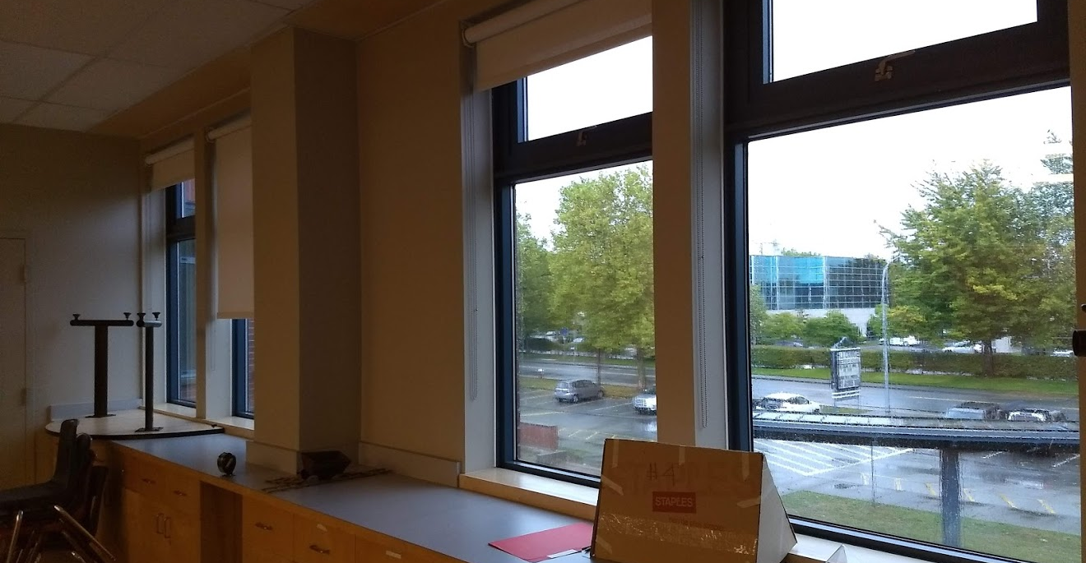
Sample Size: Practical considerations
…But not so many subjects that they take up too much room. Each pod gets ~1 meter of windowsill.

Slide 72
Case Study: singing + plants
Timothy and Oscar are investigating whether singing to plants helps them grow faster. They plant bean plants into two plots: A and B. Each plot has 10 plants in it. They water the plants regularly and all the plants have the same exposure to sunlight. They sing to the plants in plot B only. Then, after three months, they record the growth rates of the plants. They conclude that singing to plants helps them grow faster.
What was the testable question?
What could the group’s hypothesis have been?
What was the independent variable?
What was the dependent variable?
What were some control variables? Are there any confounding variables that are not accounted for by this experimental design?
Which was the control group? Treatment group?
What questions do you have about the conclusion that they drew from this experiment?

Slide 73
Case Study: singing + plants
Timothy and Oscar are investigating whether singing to plants helps them grow faster. They plant bean plants into two plots: A and B. Each plot has 10 plants in it. They water the plants regularly and all the plants have the same exposure to sunlight. They sing to the plants in plot B only. Then, after three months, they record the growth rates of the plants. They conclude that singing to plants helps them grow faster.
8. Given only the information from the experiment above, could you repeat this experiment? What information are you missing, that you would need?
Notes:
Growth rate possibilities:
Time plant takes to grow past 10 cm tall
Difference in plant height 2 months after it first reaches 1 cm (to account for germination differences)
Height after 2 months
Measure every week; take average of growth rate per week

Slide 74
Case Study: singing + plants
8. Given only the information from the experiment above, could you repeat this experiment? What information are you missing, that you would need?
What bean species?
How much water? What pH of water? What temperature of water? How frequently do they water?
Where is this experiment conducted? What is the climate of the experiment?
How do they sing? What song do they sing? How do they ensure the singing is the same every time? Is every plant getting the same musical experience? How is the music delivered: is there a confounding variable based on the fact that they have to walk around the vicinity of the plants?
How are the plants protected from predation and other environmental factors?
Is the soil the same in both plots? How do they know?
How do they record growth rates?*
*What are some ways you could think of that they could have measured growth rate?

Slide 75
Case Study: Bean Science Fair
https://www.education.com/science-fair/article/making-plants-grow/

Slide 76
Clear-cut Methodology
A well-written Procedure means you have carefully thought through your experiment and all the variables that could affect your results.
Detail, detail, detail! Examples of things that could affect your experiment:
Ambient temperature, climate, time of day, location
Identity of the experimenter
Size and material of apparatus (e.g. 500 mL glass beaker)
Species name (for biological experiments; no need for human experiments though)
Defining things precisely
E.g. Brown rabbits vs white rabbits. What if you had a white rabbit with two brown spots? What would this count as?
E.g. “added enough milk until the mixture turned cloudy” vs “added 150 mL of 2% Lucerne brand milk”
Tip: Give your Procedure to someone else to read and see whether they have any questions about how you did something.

Slide 77
/ end slides proper

Slide 78
Preliminary Research
What are some observations you have made about plants?
What are some things you already know (or think you know) about plants and how they grow?
What are some questions you have, or things you have always wondered, about plants and how they grow?
What plant does our group want to investigate the most, and why? (Pick fast-growing plants; kidney beans and marigold will be available…any other seeds, you will have to source and pay for yourselves.)
What is the best way to grow the plant we have chosen?
Which variables would you be most interested in researching?
Narrow it down to 3 variables

