Slide 1
Scientific Method
Science 8

Slide 2
overview
Scientific method overview of steps
Observation types: qualitative and quantitative
What is a variable?
Experimental design examples
Types of variables
How to design your own experiment

Slide 3
Intro to the Scientific Method
Module 1

Slide 4
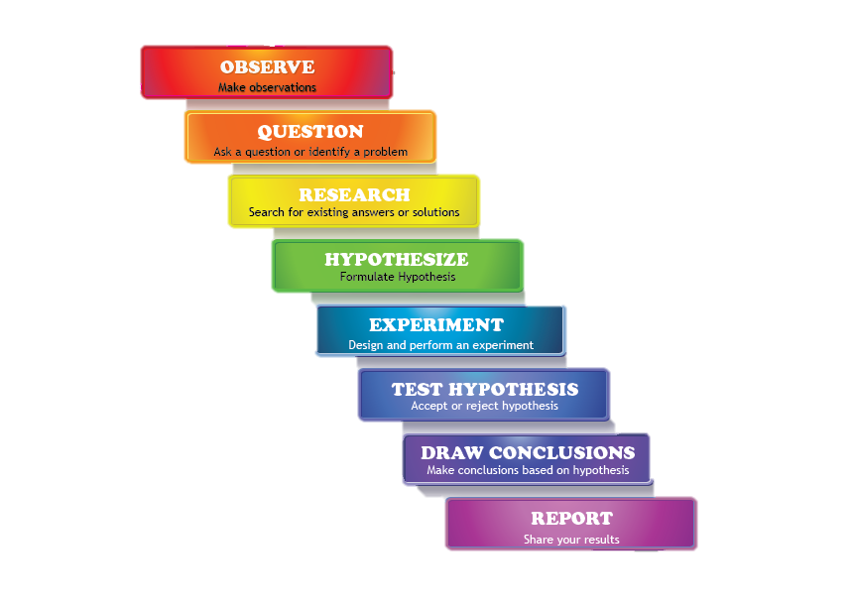
Scientific Method
The scientific method is a* systematic and logical way of discovering the truth of how and why things work.
*It is not the only way. But it is widely used in science research because it is relatively immune to biases and distortions.
Discuss: What are some of the limitations of science and the scientific method? Are there any questions that science cannot answer?

Slide 5
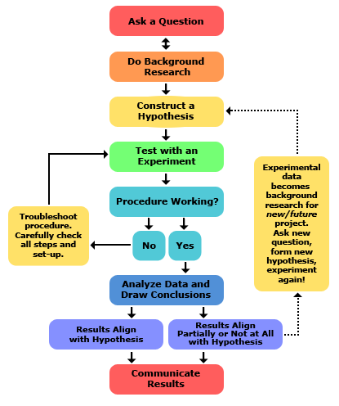
Scientific Method
Science never ends.
The search for the truth is ongoing; new findings influence future research.
Conclusions and findings are frequently altered as new techniques and facts are discovered.

Slide 6
Scientific Method
https://www.youtube.com/watch?v=SMGRe824kak&ab_channel=Teacher%27sPet
Notes:
This video is shorter and is what the notes are based on

Slide 7
Scientific Method
https://www.youtube.com/watch?v=yi0hwFDQTSQ&ab_channel=Sprouts
Notes:
This video is longer and a bit more complex…after 5 minutes it goes into falsifiability, correlation vs causation, and selective windowing. Probably more detail than we need, though maybe can show the first part of the video?

Slide 8
Scientific Method
Observation: all that can be observed with the 5 senses
Question: ask a question you would like to answer with your research
Research: use reliable sources to learn background information (avoid conducting experiments that have already been done)
Hypothesis:
Specific prediction of what you believe will occur
“If…then…” structure (e.g. “If gummy bears are placed in water for 24 hours then they will swell to over twice their original size.”)

Slide 9
Scientific Method
Experiment:
Determine what types of data you will collect: qualitative or quantitative
Manipulate the independent variable to observe the effects on the dependent variable
Experimental group: has one independent variable altered
Control group: all other groups are compared to this (normal)

Slide 10
Quantitative and Qualitative Data
Module 2

Slide 11
Warm-up Activity
Describe characteristics that your classmate (or best friend) has. Be creative and use as many different types of words and phrases as possible.
Now, describe the same person in the way you think a scientist would. How do the descriptions differ?

Slide 12
Scientific Observations
Making observations is central to science. It is how we come up with research questions. It is how we measure the results of our experiments.
Scientific Observations: qualities about our experiment that we observe with our 5 senses or through measurement

Slide 13
Qualitative Observations
Using five senses to make observations using descriptive language
Focuses on qualities or characteristics, is subjective and dependent on the observer
Examples:
My hair is black
Her skin is warm
The sandwich is spicy
Notes:
More info
https://www.voxco.com/blog/qualitative-observation/#:~:text=What%20are%20Qualitative%20Observations%3F&text=A%20qualitative%20observation%20involves%20the,rather%20than%20the%20numerical%20value.

Slide 14
Quantitative Observations
Using measurement tools to make observations
Focus is on numerical values, is objective and reliable
Examples:
The tea is 80°C
There are 20 people in this science 8 class
The hamster weighs 15.2 grams
Notes:
More info https://www.voxco.com/blog/quantitative-observation/#:~:text=Quantitative%20observation%20implies%20an%20objective,is%20on%20numbers%20and%20values.

Slide 15
Note
The same characteristic (or variable) can often be described qualitatively and quantitatively. Your only limitation is your creativity and the equipment available to you.
Example: temperature
Thermometer (quantitative)
How long it takes to melt an ice cube (quantitative)
How hot it feels to your hand (qualitative)
How loudly your sister screams when she touches it (qualitative)

Slide 16
Note
The same characteristic (or variable) can often be described qualitatively and quantitatively. Your only limitation is your creativity and the equipment available to you.
Example: colour
What it looks like, e.g. red or blue (qualitative)
The colour code using hexadecimal code (quantitative)
Wavelength of light (quantitative)

Slide 17
Activity
How many ways can you think of to make observations about:
Height of a person
Growth rate of a plant
Speed of an airplane
Difficulty of a test
Go back and categorize your examples as qualitative or quantitative. If you have few of one type, try and come up with more of that type.

Slide 18
Variables
Module 2

Slide 19
Thought Experiment
What factors will affect how a plant grows?
What are some different things we could observe or measure about a plant?

Slide 20
Thought Experiment
What factors will affect how a plant grows?
Watering (total amount),
Atmospheric gas concentration
Fertilizer/plant food
Brightness or intensity of light
Soil quality and quantity

Slide 21
Thought Experiment
What are some different things we could observe or measure about a plant?
Height
Growth rate
Total growth (e.g. maximum height)
Colour
Number of leaves/seeds/flowers
Germination Rate
Health (how do its leaves appear? Has it caught any diseases?)
Thickness of stem

Slide 22
Variables
An aspect of an experiment that can have different values
Is a general, non-specific category that many observations could fall under
Variable | Qualitative & Quantitative Observations (Not Variables)
Temperature | 5ºC, 205ºC, freezing, warm
Colour | Blue, white, pink, light with a 690nm wavelength
Growth Rate | Fast, 5 cm/day, 2 mm/hour

Slide 23
Variables
3 main types:
Dependent variable
Independent variable
Control variable

Slide 24
Independent and Dependent Variables
Dependent variable: the variable you are most interested in measuring or observing
Independent variable: the variable that is manipulated or changed by the experimenter, to see the effect on the dependent variable

Slide 25
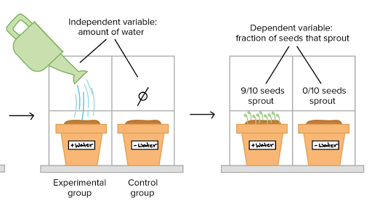
https://www.khanacademy.org/science/high-school-biology/hs-biology-foundations/hs-biology-and-the-scientific-method/a/experiments-and-observations

Slide 26
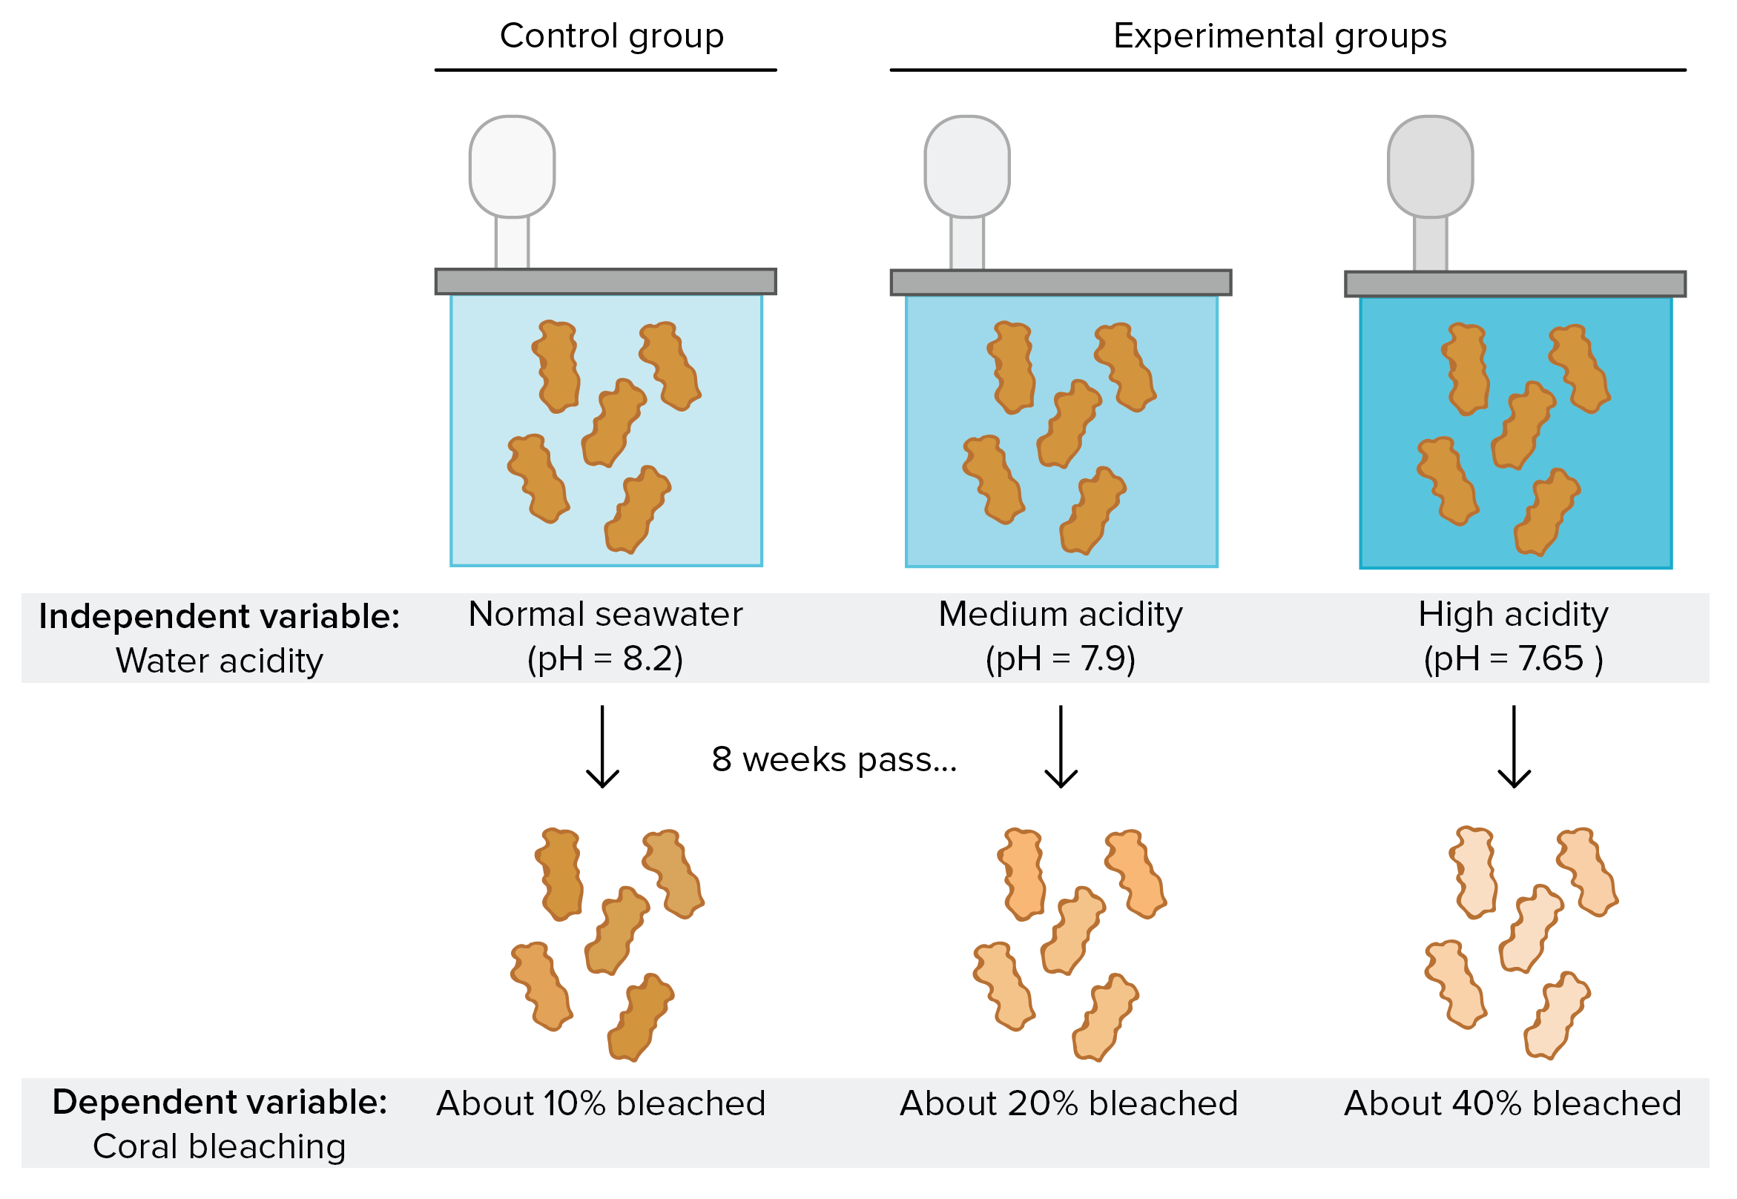
https://www.khanacademy.org/science/high-school-biology/hs-biology-foundations/hs-biology-and-the-scientific-method/a/experiments-and-observations

Slide 27
Control variables
Control variable: a variable that is kept the same between control and experimental groups

Slide 28
Milk Experiment

Slide 29
Materials
Petri dish bottom x1
25 mL graduated cylinder x1
Blue food colouring bottle x1
Scoopula
Weighboat
Electronic scale
Wooden stick x1
15 mL tap water
3 g milk powder
[Dish soap]

Slide 30
Prior Observations
Water:
Quantitative observations (volume)
Milk powder:
Quantitative observations (mass)
Qualitative observations (colour, texture, appearance, smell)
Food colouring:
Qualitative observations (colour)
Dish soap:
Qualitative observations (colour, brand)

Slide 31
Procedure
Add water and milk powder to petri dish. Stir gently with back of scoopula until powder is completely dissolved.
Add 3 drops of food colouring, evenly spaced out in the petri dish.
Dip the toothpick into the dish soap.
Touch the soaped end of the toothpick to the middle of the petri dish and leave it there for 0.5 seconds.
Make qualitative [and quantitative] observations about what you see.

Slide 32
/end for science 8 2021-2022

Slide 33
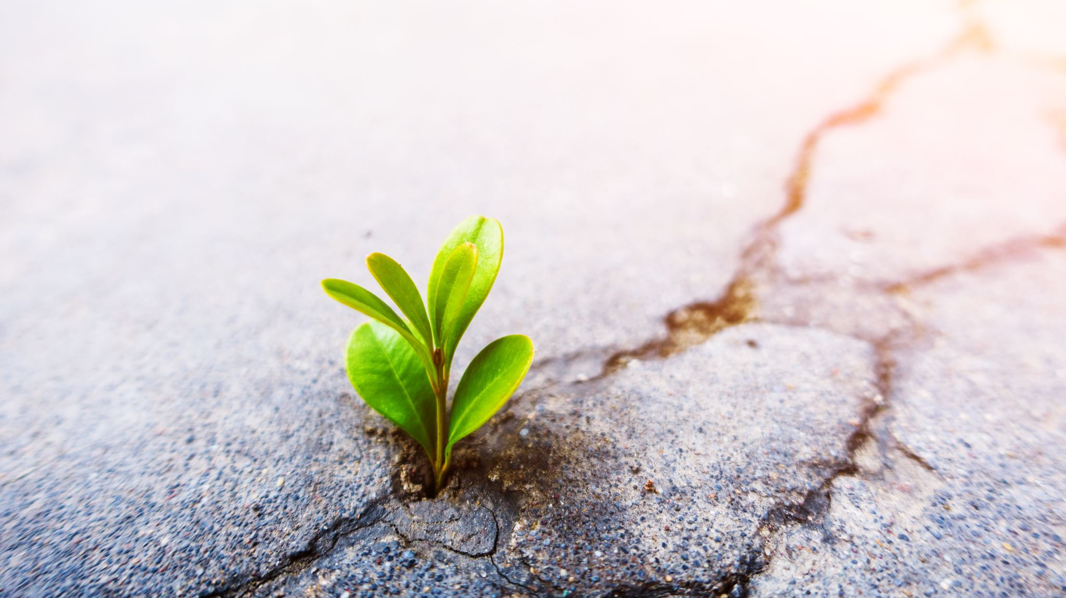
What is the best way to grow a plant?

Slide 34
Project Overview
Groups of 3-4 (you pick)
Will design and carry out a single-variable controlled experiment over the course of several weeks
Collect data and present your findings to your classmates

Slide 35
Vocabulary
Testable question
Hypothesis
Prediction
Variables:
Control variable
Independent variable
Dependent variable
Confounding variable
Control group
Treatment/experimental group

Slide 36
Table of Contents
Types of Science Fair Projects
Getting Ideas for your Project
Speed Dating
Background Research
Testable Question:
Correlation vs Causation
Variables: Independent, Dependent, Control
Hypothesis Creation
Experimental Design
Guidelines for Designing a Controlled Experiment
Data Collection:
Organization
Qualitative vs Quantitative Observations
Replication of Results
Statistical Analysis
Communicating Your Results
Graphing
Shark Tank

Slide 37
Warm-up Discussion
What is science? Why is it important?
Describe the scientific method in your own words.
Distinguish between a scientific theory and an everyday “theory”.

Slide 38
The need for science: correlation vs causation
Module 1

Slide 39
Fact: 5G caused COVID-19
Source: The Science Page

Slide 40
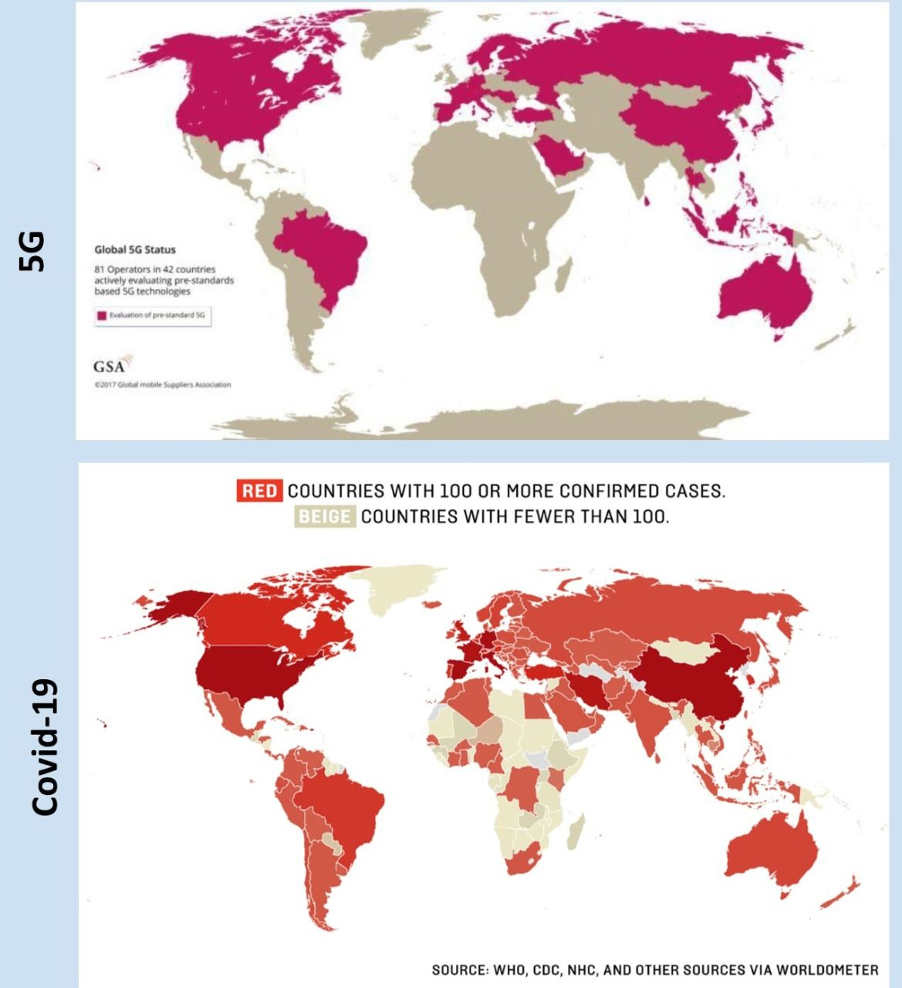
Fact: 5G caused COVID-19
Source: iAfrikan.com
Notes:
https://www.iafrikan.com/2020/04/04/coronavirus-5g-covid-19-telecommunications-health-fake-news/
5G does not cause the spread of COVID-19

Slide 41
Fact: 5G caused COVID-19
Source: Manchester Evening News
Notes:
https://www.manchestereveningnews.co.uk/news/greater-manchester-news/political-leaders-warn-spreading-irresponsible-17954482
Political leaders warn that spreading 'irresponsible disinformation' about coronavirus 'puts lives at risk' after councillor shares conspiracy theories

Slide 42
Correlation is not causation
Correlation: a mutual relationship or connection between two or more things (Oxford Dictionary)
The maps show there is a correlation between 5G coverage and COVID-19 cases.
What are some alternate explanations for this correlation?

Slide 44
https://www.tylervigen.com/spurious-correlations

Slide 45
Correlation is not Causation
It is fairly straightforward to show that two variables are related (correlation).
But to show causation (that x causes y), we need to conduct a controlled scientific experiment.
https://www.slideshare.net/JonathanStray/frontiers-of-computational-journalism-week-4-statistical-inference

Slide 46
Note: different types of experiments
Observations: making observations in an unstructured way; is not a real experiment but can lead to formation of an experiment
“What colour is ___?” “What does yeast mitosis look like?” “What happens if I do ___?”
Correlational Experiment: examines the correlation between two variables where manipulation is not possible; cannot claim causation
“How does ethnicity affect salary?” “How does being dropped on the head at birth affect intelligence?”
Controlled Experiment: controls all variables except independent variable; can claim causative relationship between x and y
“How does watering amount affect plant growth?” “Does the vaccine reduce the risk of catching COVID-19?”

Slide 47
How to set up an experiment
0. (Ask a question.)
Determine your dependent variable. What factor are you most interested in measuring or investigating?
Brainstorm all the variables that could affect your dependent variable. Select one to be your independent variable. The rest must be control variables.
Do some research. Determine different level(s) of your independent variable to investigate. Assign one to be your control group.
Write a step-by-step procedure for your experiment. Ensure you have included enough detail that someone could replicate your experiment.

Slide 48
How to set up an experiment
Goldfish
https://www.youtube.com/watch?v=_VdOB4JJE_8&ab_channel=BrainSTEM
Running a Race
https://www.youtube.com/watch?v=iaewZmc4TYQ&t=5s&ab_channel=HighSchoolScience101

Slide 49
Math Test Example
Suppose we are investigating students’ scores on a math test. This is our dependent variable.
What factors might affect this?
How much they study
How they study
When they study
How much sleep they get
Whether they have coffee
Class attendance
IQ
Whether they like math or not
The teacher they have
Whether they did their homework
How long they take on the test

Slide 50
Math Test Example #1
Select 30 students who take Kumon after school, and have them take it online for a month. At the end of the month, each student takes a test on fractions. These scores are compared to those of students who continued to receive in-person instruction.
Identify the independent, dependent and control variables.
Identify confounding variables, if any.
Critique this experiment. What is done well? What would you do differently? What information is missing?

Slide 51
Math test example #2
Select 100 B-level students who are all in Mr. Wilton’s Gr. 7 class.
All of them are asked to take a survey before participating in the study. Students are excluded from the study if they: had any tea or coffee in the morning; had outside of 7-9 hours of sleep that night, or have ever learned about algebra before.
All of them attend a 2-hour class on algebra. Then, they have an hour to do practice questions. Half the students work alone; the other half work in pairs. After, they have 30 minutes to write the same algebra test.
Their scores at the end of the test are compared.
Identify the independent, dependent and control variables.
Identify confounding variables, if any.
Critique this experiment. What is done well? What would you do differently? What information is missing?

Slide 52
Common mistakes
Your variable should be a general category, which can have different values. “temperature” and “height” and “colour” are variables; “cold”, “hot”, “cold vs hot”, “50 cm” are not variables…these are values or observations.
Sometimes it will be difficult to reword your variable…ask for help or a second opinion.
Make sure you know very clearly what ‘control variable’ refers to. The word ‘control’ will come up again in a later context.

Slide 53
Using Variables to write a testable question
Once you have your independent and dependent variables, you can write your testable question using one of the following formats to guide you:
What is the effect of [i.v.] on [d.v.]?
How is [d.v.] affected by [i.v.]?
Examples:
What is the effect of after-school tutoring on university admission rates?
How is the height of a marigold (Tagetes spp.) plant affected by the quality of sunlight it receives?

Slide 54
Using Variables to write a testable question
Consider:
Is your variable specific enough? E.g. “height” is too vague…”height” of what?
If your variables don’t slot nicely into the sentence examples on the previous slide, you may need to take another look at how they are worded. Ask for help if unsure.

Slide 55
Using Variables to write a hypothesis
Hypothesis:
The expected relationship between the independent and dependent variables
Should be an educated guess supported by observations and/or research
If … [independent variable] … then … [dependent variable] … because …
e.g. If a Gr 9 student’s attendance improves, then their exam scores will improve, because increased exposure to in-class material and learning opportunities should lead to increased understanding and better retention.
Note: this is not the only way you can state your hypothesis. You can rearrange and reword as necessary, but the same basic elements should be there.
https://www.scribbr.com/research-process/hypotheses/#:~:text=Phrase%20your%20hypothesis%20in%20three,part%20states%20the%20dependent%20variable.

Slide 56
Experimental Design
Module 3

Slide 57
Independent Variable
Your independent variable should be a general category of something that you can manipulate or change about the experiment.
Now it is time to determine the ‘levels’ of your independent variable. Suppose your independent variable is “amount of water”. Then your levels could be:
50 mL water per day
100 mL water per day
150 mL water per day
But wait! Are we forgetting something?

Slide 58
Independent Variable
Often, we should have some idea of what is ‘normal’ for an independent variable. Examples for plants:
Water amount → research how much that plant is supposed to receive per day
Soil type → research the best type of soil to grow that plant
Examples for other studies:
Calorie intake → research how many calories are recommended for an adult of that size and build
Build this ‘normal’ into our experiment…so we know what to expect.
Notes:
What if we give our plants the normal amount of something, and they still don’t grow properly?

Slide 59
Control Group vs Treatment Groups
Our independent variable is “amount of water”. Research tells us:
Keep soil evenly moist at all times. (https://www.gardenmanage.com/statuses/1000264091.html )
Water to a depth of 4-6 inches. (https://garden.org/learn/articles/view/454/ ) (https://homeguides.sfgate.com/much-should-bean-plants-watered-32642.html#:~:text=Water%20Needs,system%20during%20the%20development%20period. )
Use sprinkler or drip irrigation.

Slide 60
Control Group vs Treatment Groups
After playing around a bit with the materials we have, we determine that to meet these requirements, 15 mL of water per day per container, using a spritz bottle (because we don’t have a sprinkler or irrigation system), will be our control group.
We expect that in our control group, our plants will grow at a ‘normal’ rate, because we have followed growing advice from our research.

Slide 61
Control Group vs Treatment Groups
Treatment group(s) are where we manipulate the independent variable, and are testing the [unknown] effect on the dependent variable. We will compare these groups to our control.
30 mL a day
45 mL a day

Slide 62
https://www.khanacademy.org/science/high-school-biology/hs-biology-foundations/hs-biology-and-the-scientific-method/a/experiments-and-observations

Slide 63
https://www.khanacademy.org/science/high-school-biology/hs-biology-foundations/hs-biology-and-the-scientific-method/a/experiments-and-observations

Slide 64
exercise
Suppose your dependent variable is each of the following. How would you measure it? Brainstorm all the ways you can think of.
Rate at which incense burns
Intelligence (of teenager)
Intelligence (of baby)
Soil moisture preference (of earthworm)

Slide 65
Draft your experimental design
Dependent variable:
How will you measure this? When will you measure it?
Be specific.
Materials:
What will you use to grow your plant? How will the plants be planted?
Design a care regimen for your plant.

Slide 66
Module 4 Summary
Characteristics of a good experimental design
Trials, replicates
Experimental Setup:
Diagram
Procedure Write-up
Critiquing experimental design

Slide 67
Characteristics of Good Experimental design
Large sample size
Has a control group
Manipulates only the independent variable. Controls for everything else. Minimizes the number of confounding variables.
Avoids bias
Has a clear-cut methodology that is replicable
Systematically records observations in an objective, well-defined, and replicable way. Observations are not subject to observer bias.

Slide 68
Case Study: Count my beans
Natasha and her three friends drink 250 mL of Starbucks medium roast coffee (no sugar, no cream) right before doing a practice math test. On a different day, they do a different (but same level difficulty) practice math test, but do not drink coffee. On average, they performed 25% better when they had had coffee.
Their conclusion: Drinking coffee before math tests increases performance.
What was the testable question?
What could the group’s hypothesis have been?
What was the independent variable?
What was the dependent variable?
What were some control variables? Are there any confounding variables that are not accounted for by this experimental design?
Which was the control group? Treatment group?
What questions do you have about the conclusion that they drew from this experiment?

Slide 69
Sample Size
The more times you repeat your experiment, the more likely your results are to be true (instead of the result of random chance, luck)
Necessary for statistical analysis (calculating averages and standard deviation)

Slide 70
Sample Size
Goal: At least 10 subjects per treatment or control group. More if your experiment is easy/fast to conduct.
Subjects need to be alive! Err on the side of caution…have to account for germination rate → research!
Control group
Experimental group

Slide 71
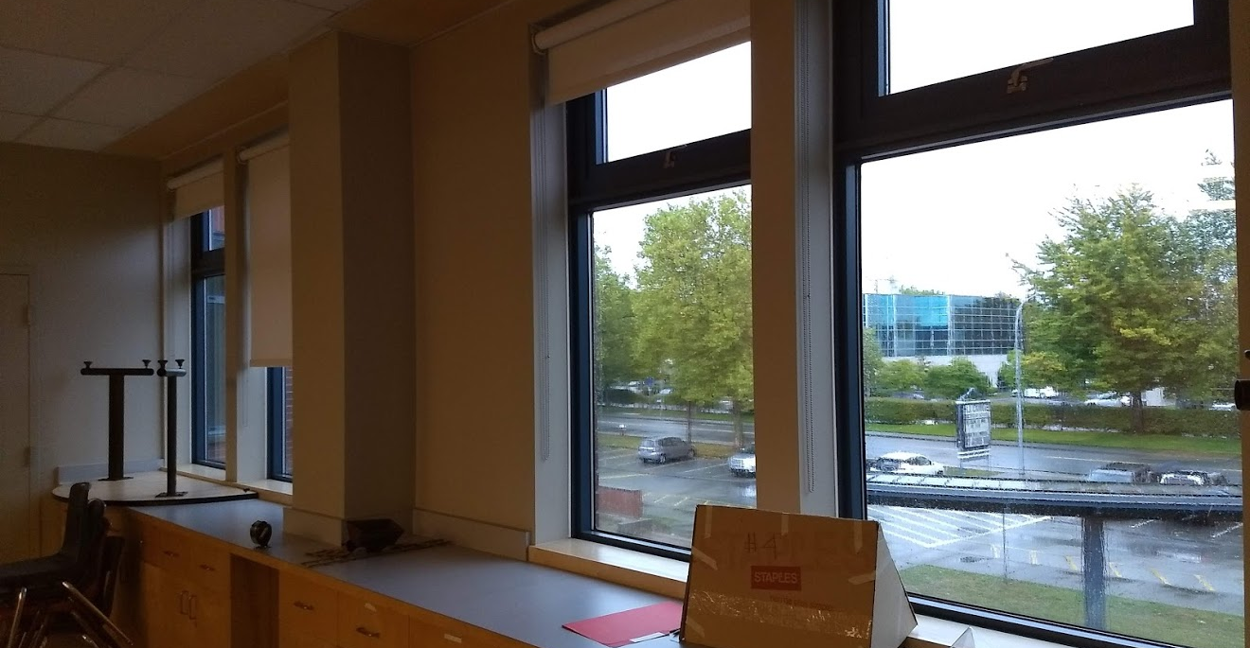
Sample Size: Practical considerations
…But not so many subjects that they take up too much room. Each pod gets ~1 meter of windowsill.

Slide 72
Case Study: singing + plants
Timothy and Oscar are investigating whether singing to plants helps them grow faster. They plant bean plants into two plots: A and B. Each plot has 10 plants in it. They water the plants regularly and all the plants have the same exposure to sunlight. They sing to the plants in plot B only. Then, after three months, they record the growth rates of the plants. They conclude that singing to plants helps them grow faster.
What was the testable question?
What could the group’s hypothesis have been?
What was the independent variable?
What was the dependent variable?
What were some control variables? Are there any confounding variables that are not accounted for by this experimental design?
Which was the control group? Treatment group?
What questions do you have about the conclusion that they drew from this experiment?

Slide 73
Case Study: singing + plants
Timothy and Oscar are investigating whether singing to plants helps them grow faster. They plant bean plants into two plots: A and B. Each plot has 10 plants in it. They water the plants regularly and all the plants have the same exposure to sunlight. They sing to the plants in plot B only. Then, after three months, they record the growth rates of the plants. They conclude that singing to plants helps them grow faster.
8. Given only the information from the experiment above, could you repeat this experiment? What information are you missing, that you would need?
Notes:
Growth rate possibilities:
Time plant takes to grow past 10 cm tall
Difference in plant height 2 months after it first reaches 1 cm (to account for germination differences)
Height after 2 months
Measure every week; take average of growth rate per week

Slide 74
Case Study: singing + plants
8. Given only the information from the experiment above, could you repeat this experiment? What information are you missing, that you would need?
What bean species?
How much water? What pH of water? What temperature of water? How frequently do they water?
Where is this experiment conducted? What is the climate of the experiment?
How do they sing? What song do they sing? How do they ensure the singing is the same every time? Is every plant getting the same musical experience? How is the music delivered: is there a confounding variable based on the fact that they have to walk around the vicinity of the plants?
How are the plants protected from predation and other environmental factors?
Is the soil the same in both plots? How do they know?
How do they record growth rates?*
*What are some ways you could think of that they could have measured growth rate?

Slide 75
Case Study: Bean Science Fair
https://www.education.com/science-fair/article/making-plants-grow/

Slide 76
Clear-cut Methodology
A well-written Procedure means you have carefully thought through your experiment and all the variables that could affect your results.
Detail, detail, detail! Examples of things that could affect your experiment:
Ambient temperature, climate, time of day, location
Identity of the experimenter
Size and material of apparatus (e.g. 500 mL glass beaker)
Species name (for biological experiments; no need for human experiments though)
Defining things precisely
E.g. Brown rabbits vs white rabbits. What if you had a white rabbit with two brown spots? What would this count as?
E.g. “added enough milk until the mixture turned cloudy” vs “added 150 mL of 2% Lucerne brand milk”
Tip: Give your Procedure to someone else to read and see whether they have any questions about how you did something.

Slide 77
/ end slides proper

Slide 78
Preliminary Research
What are some observations you have made about plants?
What are some things you already know (or think you know) about plants and how they grow?
What are some questions you have, or things you have always wondered, about plants and how they grow?
What plant does our group want to investigate the most, and why? (Pick fast-growing plants; kidney beans and marigold will be available…any other seeds, you will have to source and pay for yourselves.)
What is the best way to grow the plant we have chosen?
Which variables would you be most interested in researching?
Narrow it down to 3 variables

