Slide 1
Species and Speciation

Slide 2
Warm-up (be prepared to discuss)
What is a species? What makes two species ‘different enough’ from each other?

Slide 3
Same? Different?

Slide 4
Different!
Downy Woodpecker
(Picoides pubescens)
Hairy Woodpecker
(Leuconotopicus villosus)

Slide 5
Same? Different?

Slide 6
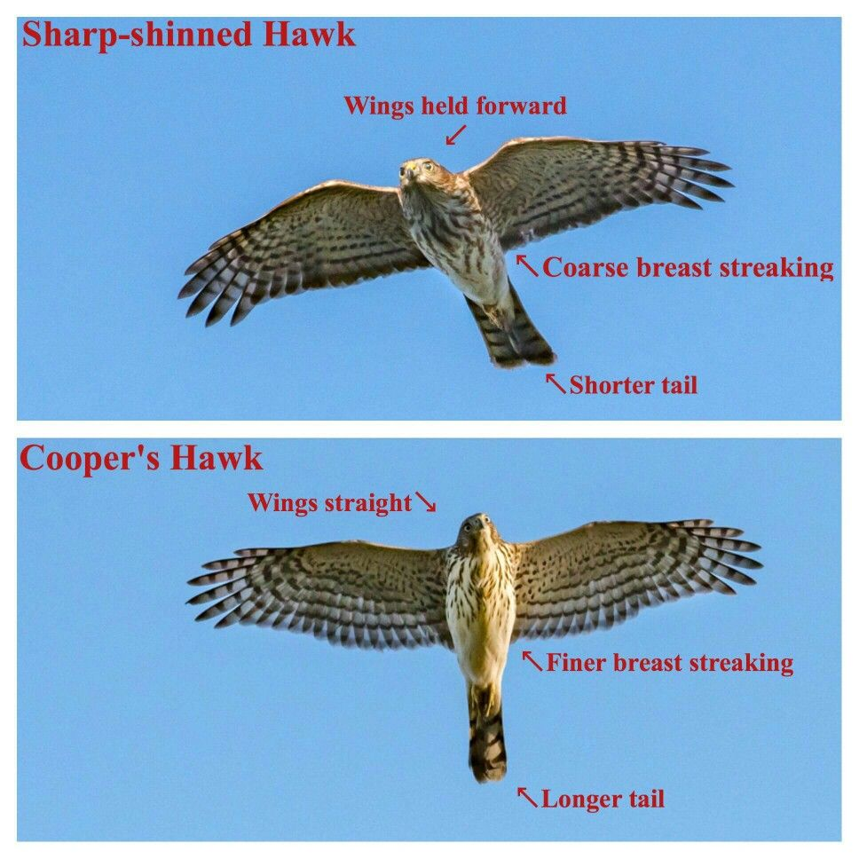
Different!

Slide 7
Same? Different?

Slide 8
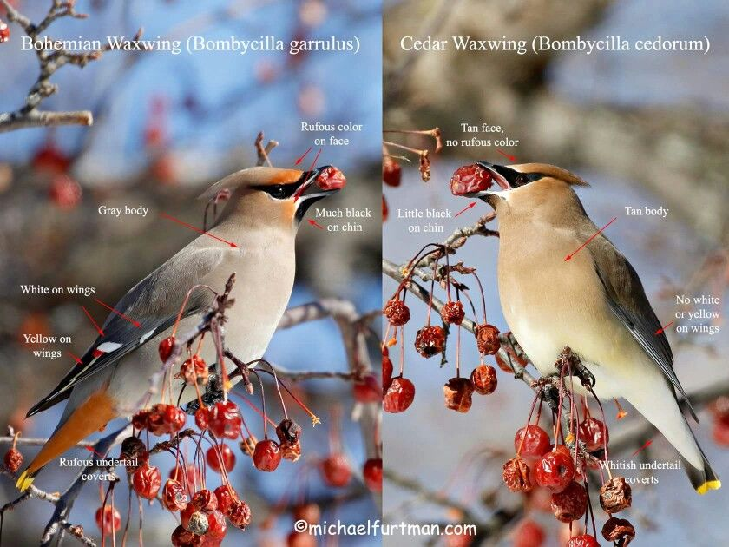
Different!

Slide 9
Same? Different?

Slide 10
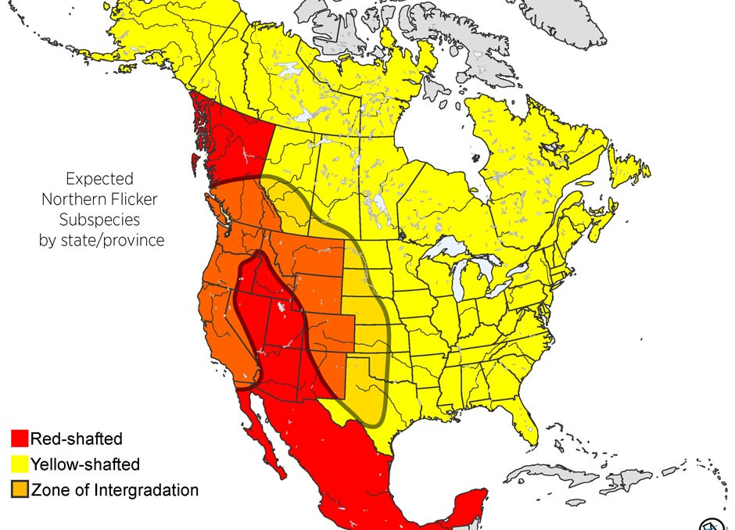
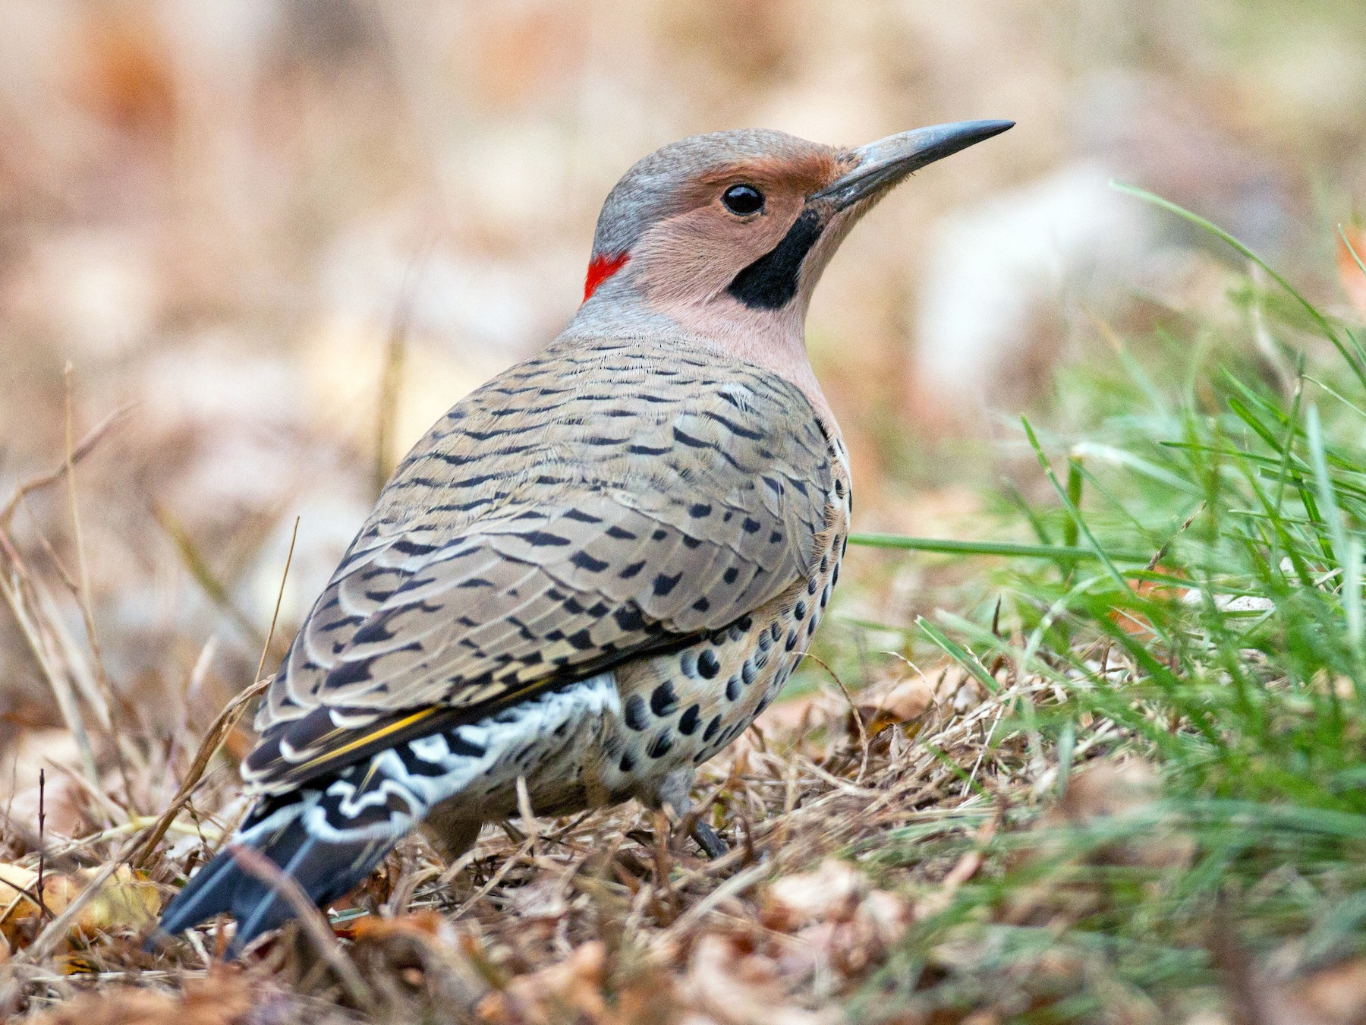
Same!
Northern flicker (Colaptes auratus)
common backyard bird: the two subspecies can interbreed

Slide 11
Warm-up (be prepared to discuss)
What is a species? What makes two species ‘different enough’ from each other?

Slide 12
https://www.youtube.com/watch?v=8yvEDqrc3XE

