Slide 1
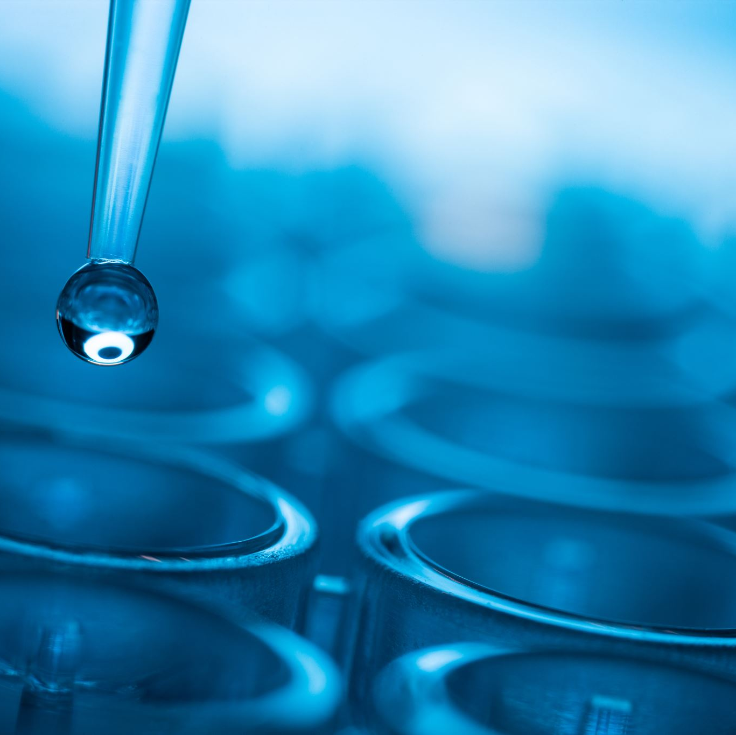
Biochemistry

Slide 2
Biological Levels of Organization
Living things are made of cells.
Cells are made of molecules and atoms.
To understand why life works the way it does, there are chemical principles we first need to understand.

Slide 3
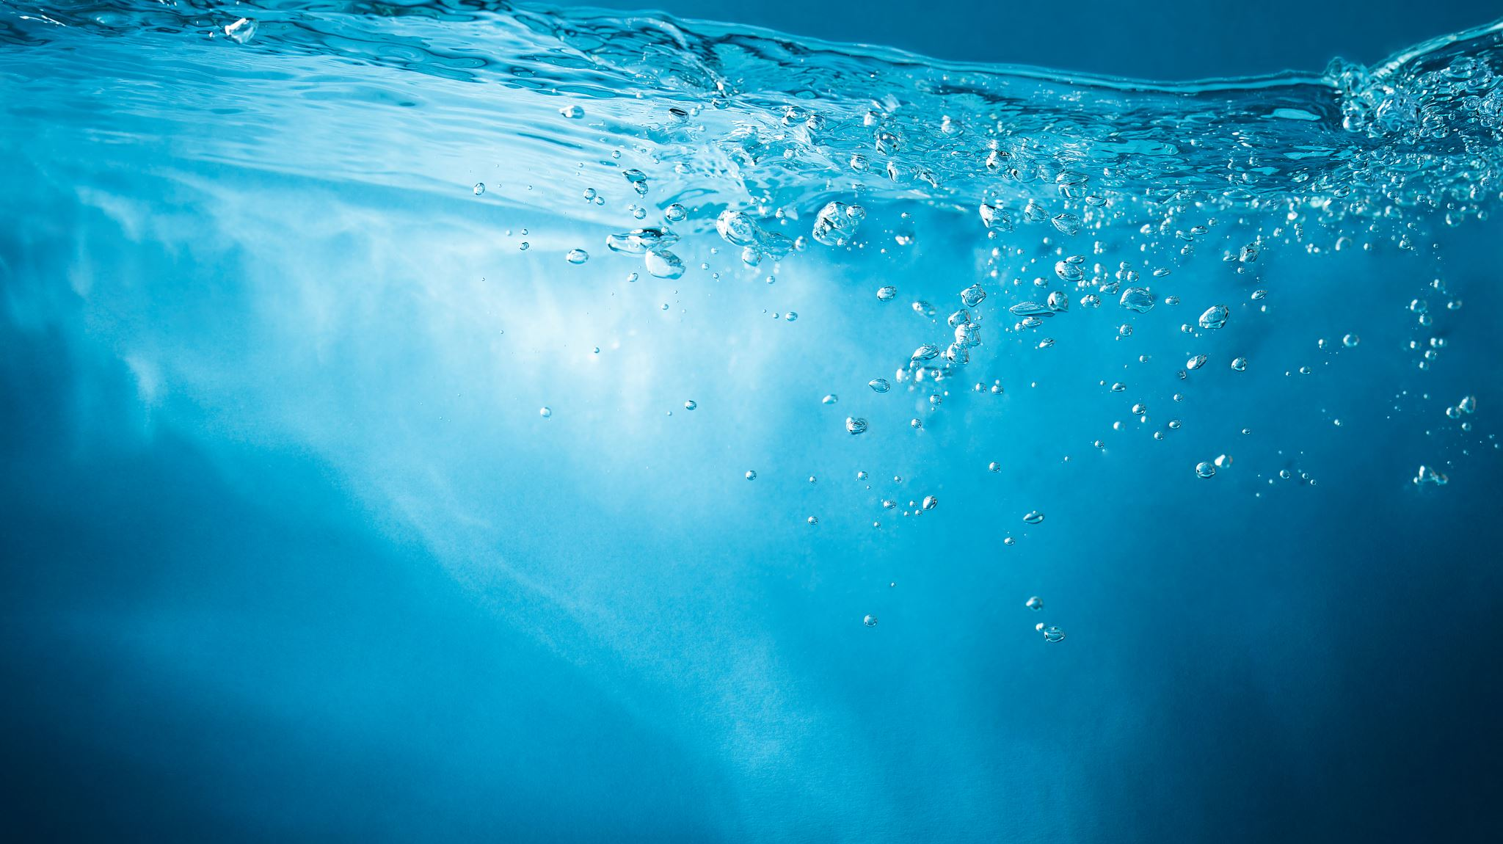
Water
Why is water so important to life?

Slide 4
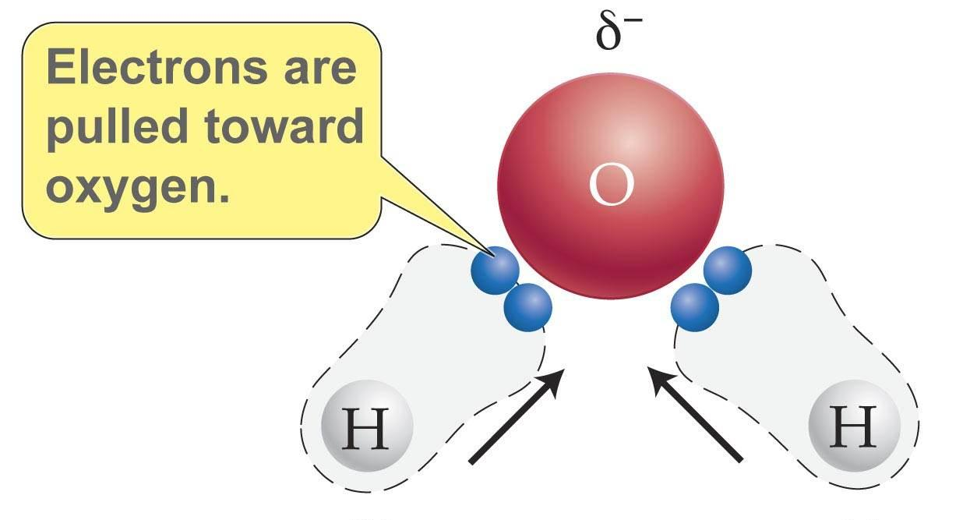
1) Water is a Polar Molecule
“Polar”: charge is unevenly distributed
H₂O: O is slightly negative; H is slightly positive

Slide 5
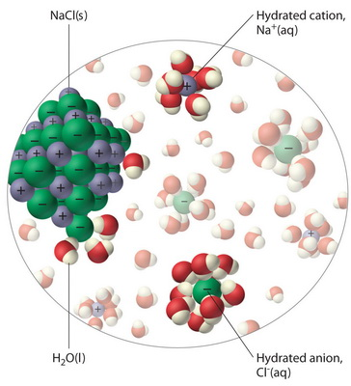
1) Water is a Polar Molecule
Water is the ‘universal solvent’
Water dissolves more substances than any liquid on Earth (e.g. DNA, salts, sugars)
Water can transport dissolved nutrients and wastes

Slide 6
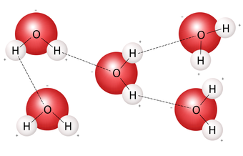
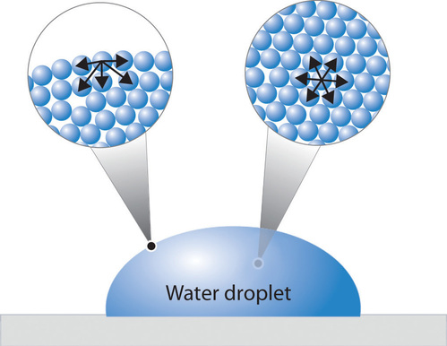
1) Water is a Polar Molecule
Cohesion: Water molecules stick to each other
Hydrogen bonds: slight negative charges are attracted to slight positive charges

Slide 7
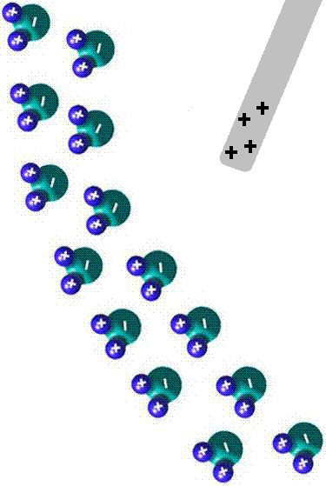
1) Water is a Polar Molecule
Adhesion: water molecules stick to many other materials (especially charged and polar)

Slide 8
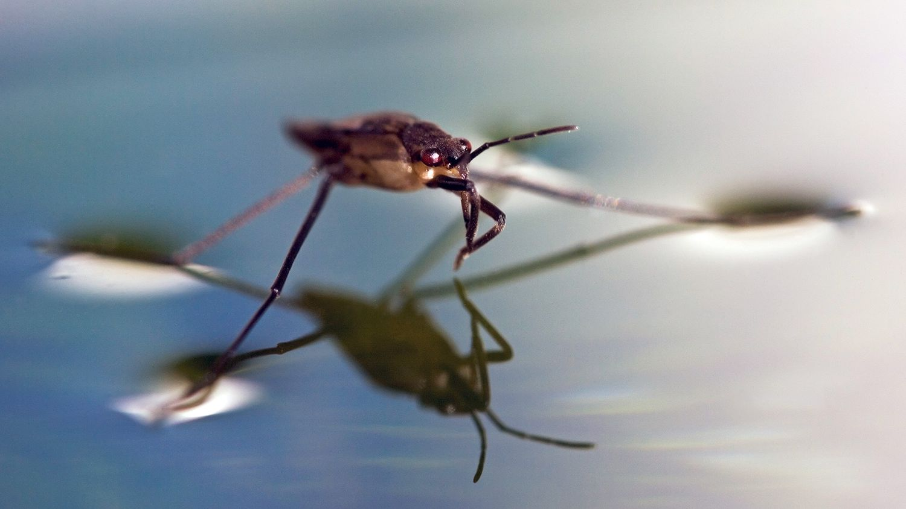
What is Happening?
Try to explain these images using the concepts of cohesion and adhesion.

Slide 9
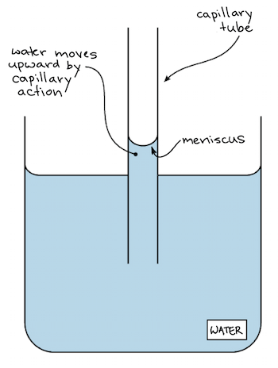
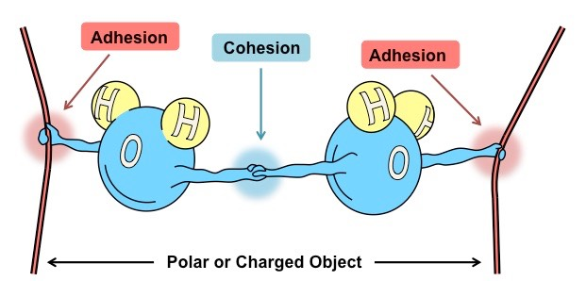
Consequences of Polarity: Capillary Action
Water is passively drawn up narrow tubes through cohesive and adhesive forces. No energy required!
Discussion Question: Capillary action is very important for plants. Why might this be?

Slide 10
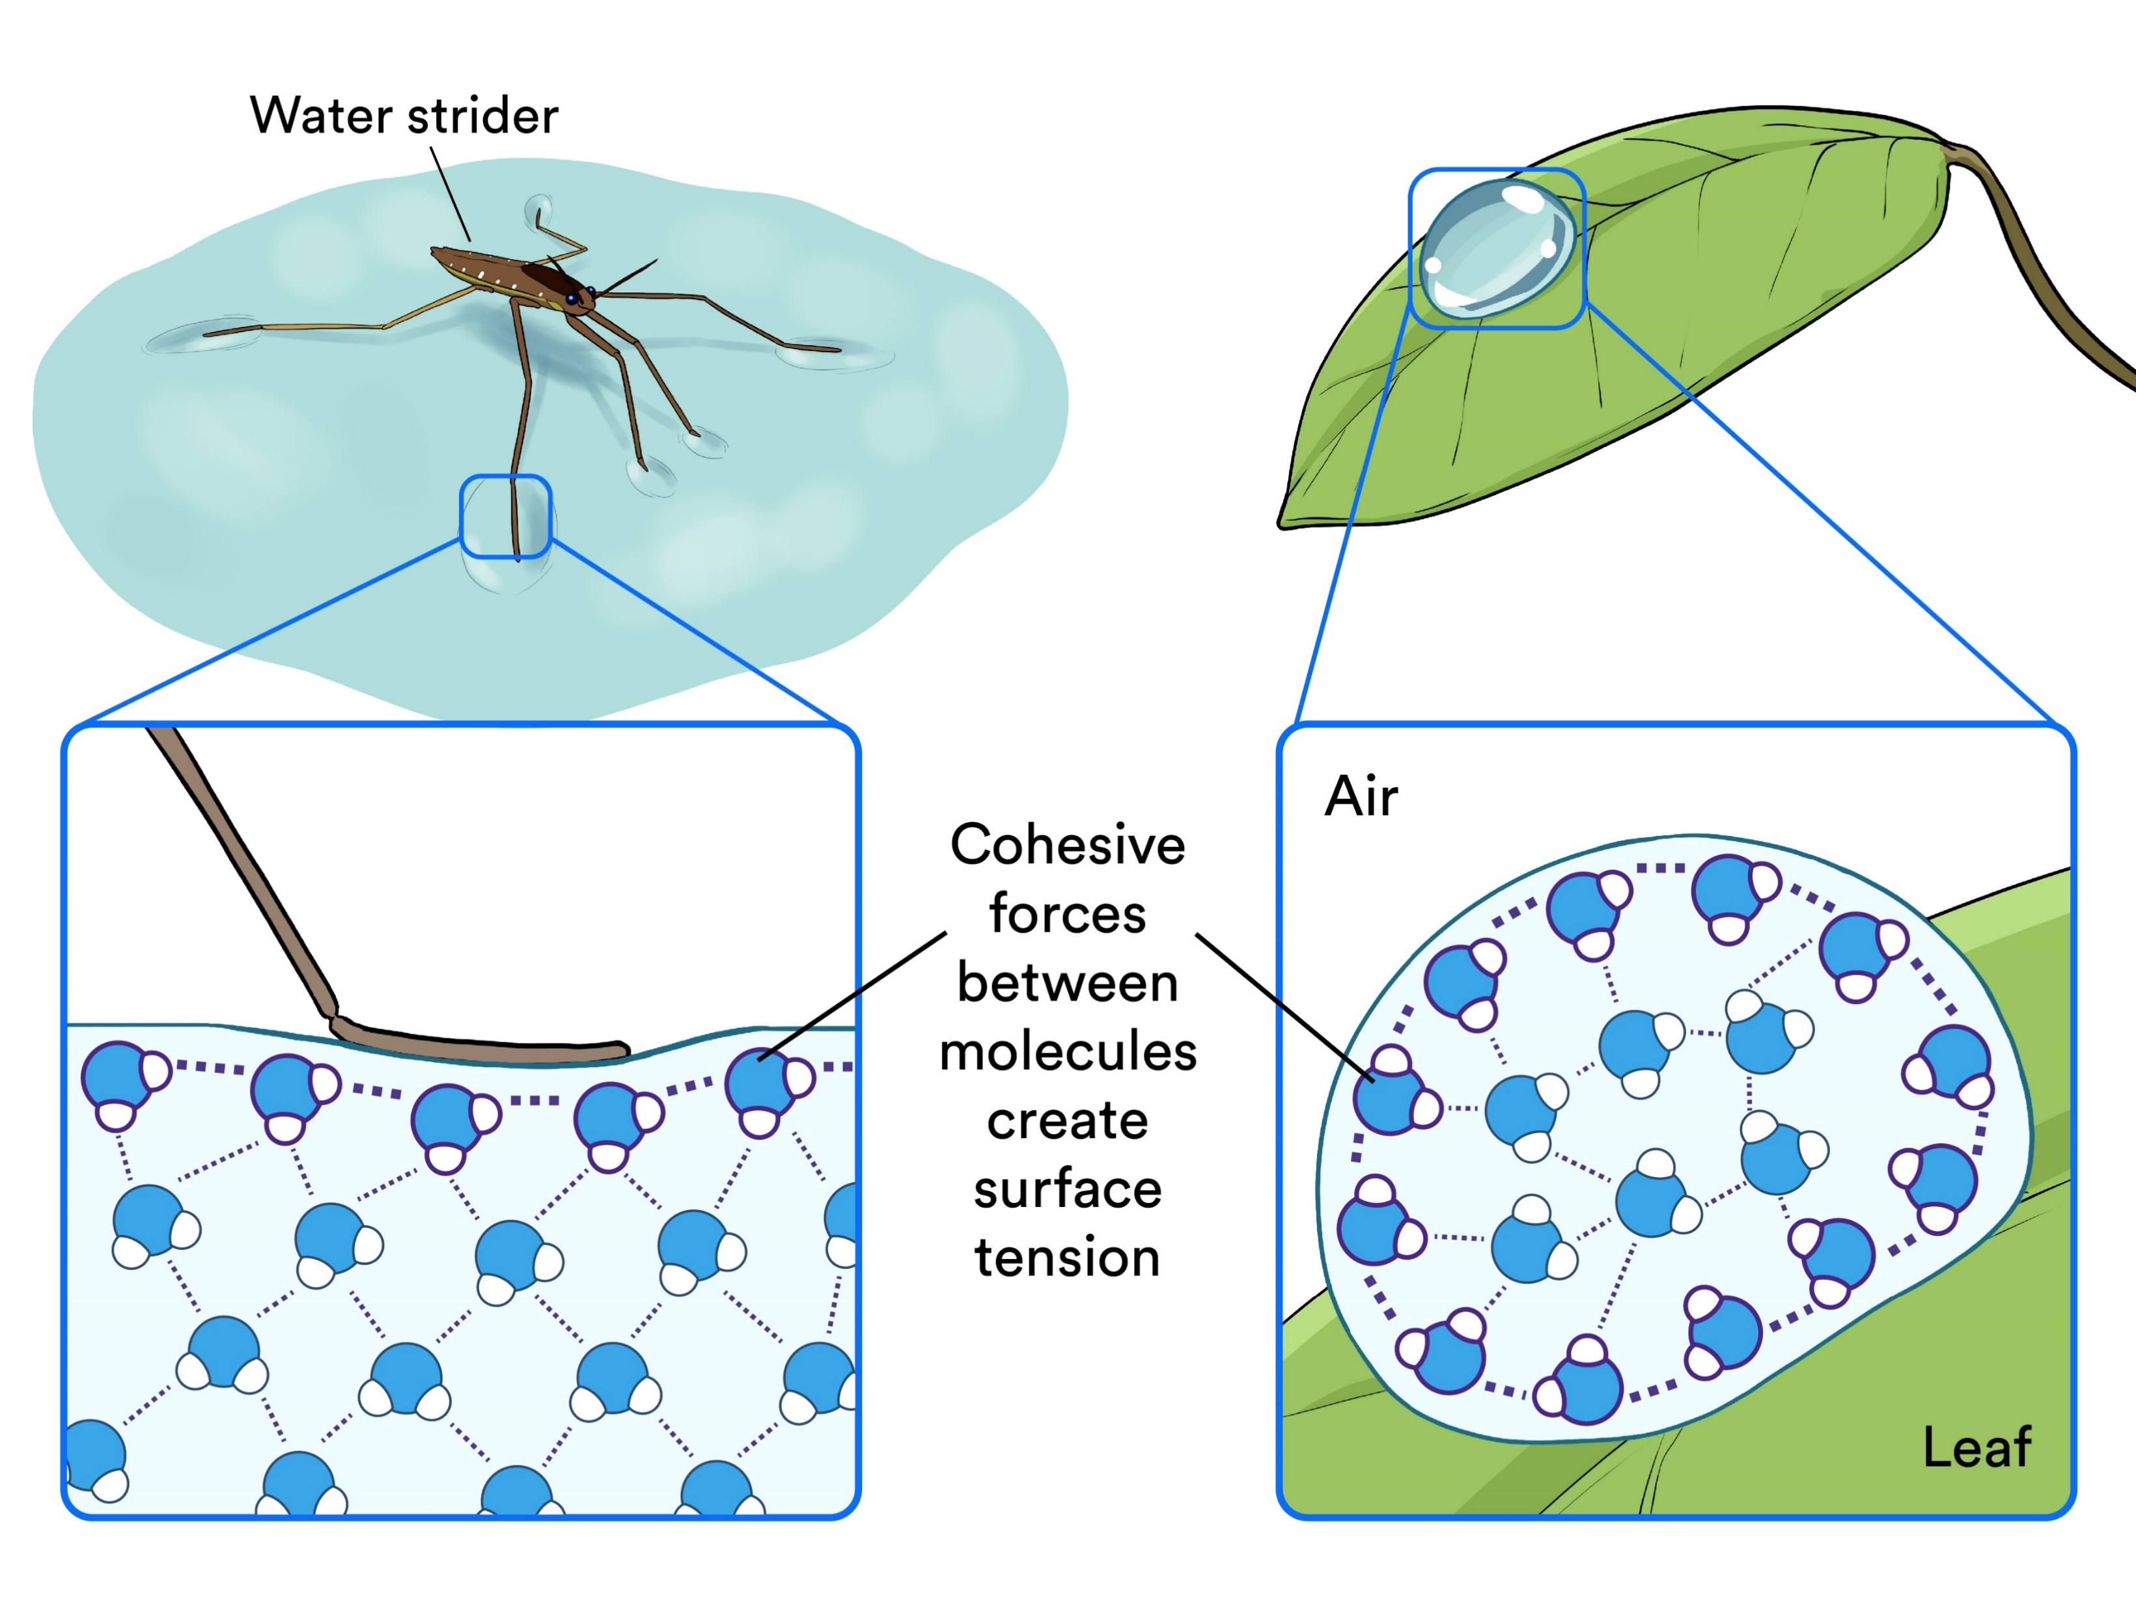
Consequences of Polarity: Surface Tension
Because of cohesion, water resists external forces and minimizes surface area
water striders walk on water without disrupting the water surface
water forms round droplets

Slide 11
2) Chemical Reactions
Water participates in many chemical reactions, either as a reactant or a product.
Examples:
Photosynthesis
Cellular respiration
Synthesis or decomposition of DNA, protein, carbohydrates
Acid-base reactions
Do not memorize image.

Slide 12
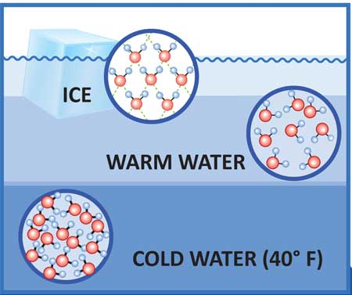
3) Ice Floats
Solid water (ice) has a lower density than liquid water.
Floating ice insulates aquatic environments from the cold. (If it sank, all the water would freeze, and everything would die.)
Notes:
Hydrogen bonds are most stable in ice. In liquid water, they are constantly breaking and re-forming because of the higher kinetic energy of the molecules, therefore the molecules are more closely packed together.
Because

Slide 13
4) Water has a high heat capacity
Heat capacity describes how quickly a material’s temperature changes when you add or remove energy
Water – high heat capacity: temperature changes slowly, holds heat well
Water helps living things maintain their body temperature
Circulation: disperse heat evenly throughout body
Water and sweat used to cool living things in warm weather

Slide 14
Sources
Powerpoint content based primarily on:
Harvard University article “Biological Roles of Water: Why is water necessary for life?” https://sitn.hms.harvard.edu/uncategorized/2019/biological-roles-of-water-why-is-water-necessary-for-life/
Water – Liquid Awesome: Crash Course Biology #2 https://www.youtube.com/watch?v=HVT3Y3_gHGg&ab_channel=CrashCourse
Images from various google image sources, many from Khan Academy.

Slide 15
Membrane Transport

Slide 16
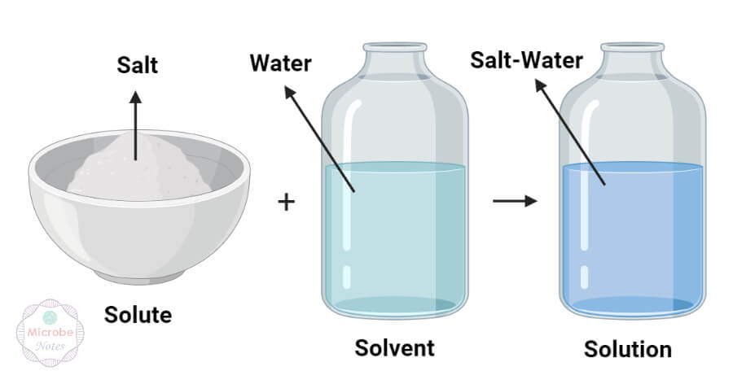
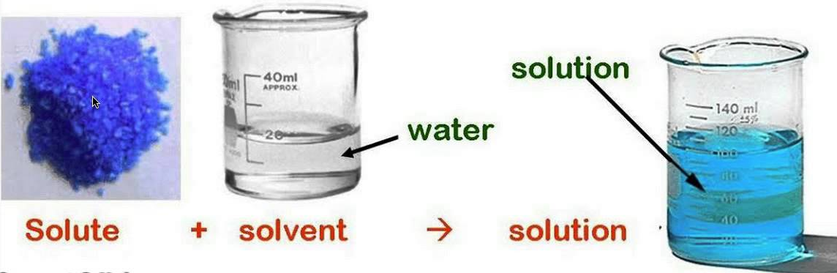
Solutions
Solution: a mixture where a solute is evenly distributed within a solvent
Solute: the minor component of a solution
Solvent: the major component of a solution; often is water

Slide 17
Concentration
Concentration: amount of solute dissolved in a fixed volume of a solvent
High concentration has more solute dissolved
Low concentration has less solute dissolved
low concentration
high concentration

Slide 18
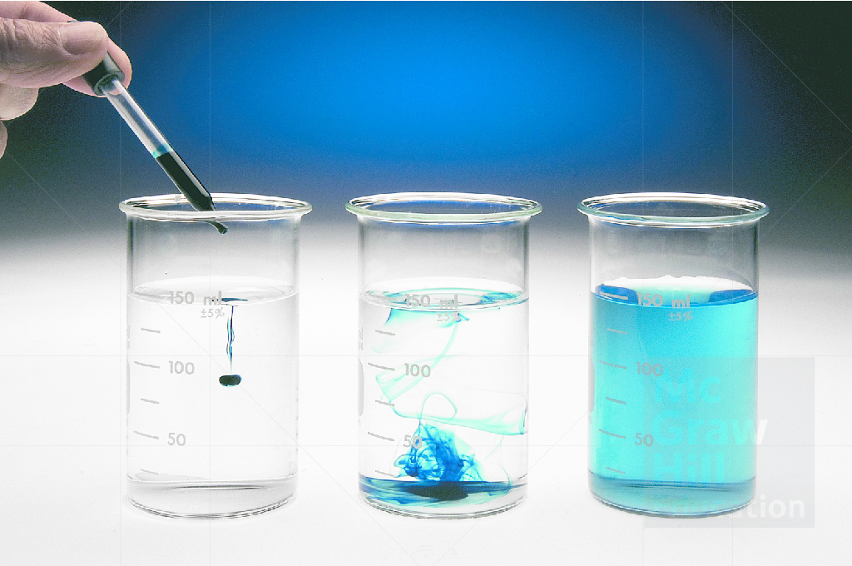
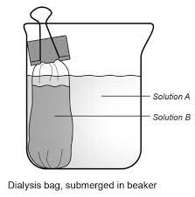
Concentration
Concentration gradient: two solutions with different concentrations are close to each other, sometimes separated by a barrier

Slide 19
Passive Transport
“Diffusion”: if given a pathway, particles move automatically from high concentration to low concentration
This is called diffusion down a concentration gradient

Slide 20
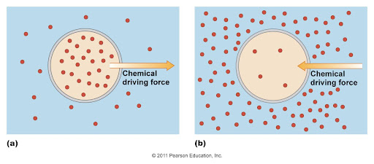
Passive Transport
When particles diffuse through a membrane down its concentration gradient, this is called passive transport because it does not require energy expenditure.

Slide 21
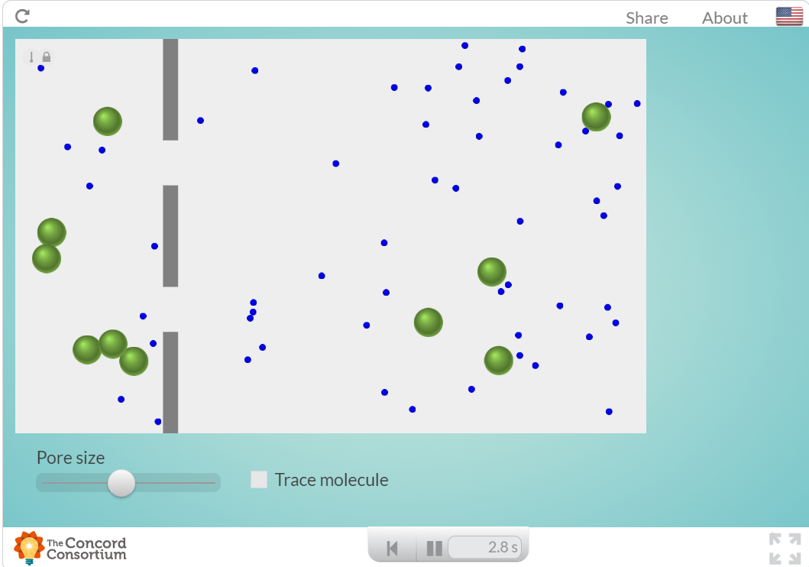
Passive Transport Simulation
https://courses.lumenlearning.com/boundless-biology/chapter/passive-transport/

Slide 22
Selective Permeability
Permeable:
A molecule can diffuse across a membrane
Impermeable:
A molecule cannot move across a membrane
Selectively permeable:
A membrane is permeable to some molecules and impermeable to others

Slide 23
Permeability
Selective permeability
A membrane is permeable to some molecules and impermeable to others
Different membranes can be permeable to different molecules
Depends on what solute/membrane we are talking about
Ex. One membrane may be permeable to water, but not to ions

Slide 24
Permeability
This membrane is IMPERMEABLE to both the blue and green molecules
Notes:
https://courses.lumenlearning.com/boundless-biology/chapter/passive-transport/

Slide 25
Permeability
This membrane is PERMEABLE to both green and blue molecules
Notes:
https://courses.lumenlearning.com/boundless-biology/chapter/passive-transport/

Slide 26
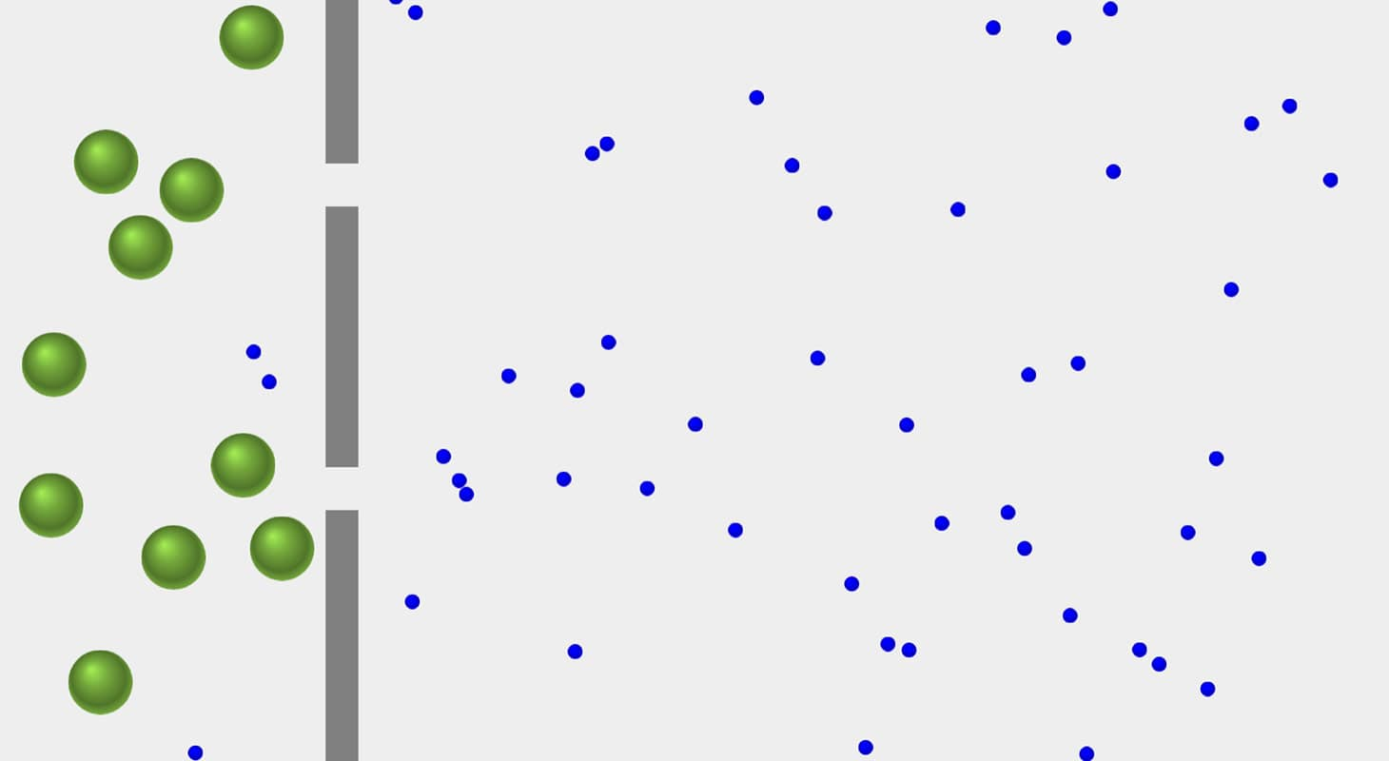
Selective Permeability
This membrane is PERMEABLE to the blue molecule
This membrane is IMPERMEABLE to the green molecule
This membrane has SELECTIVE PERMEABILITY
This membrane is SEMIPERMEABLE
Notes:
https://learn.concord.org/resources/760/diffusion-across-a-semipermeable-membrane

Slide 27
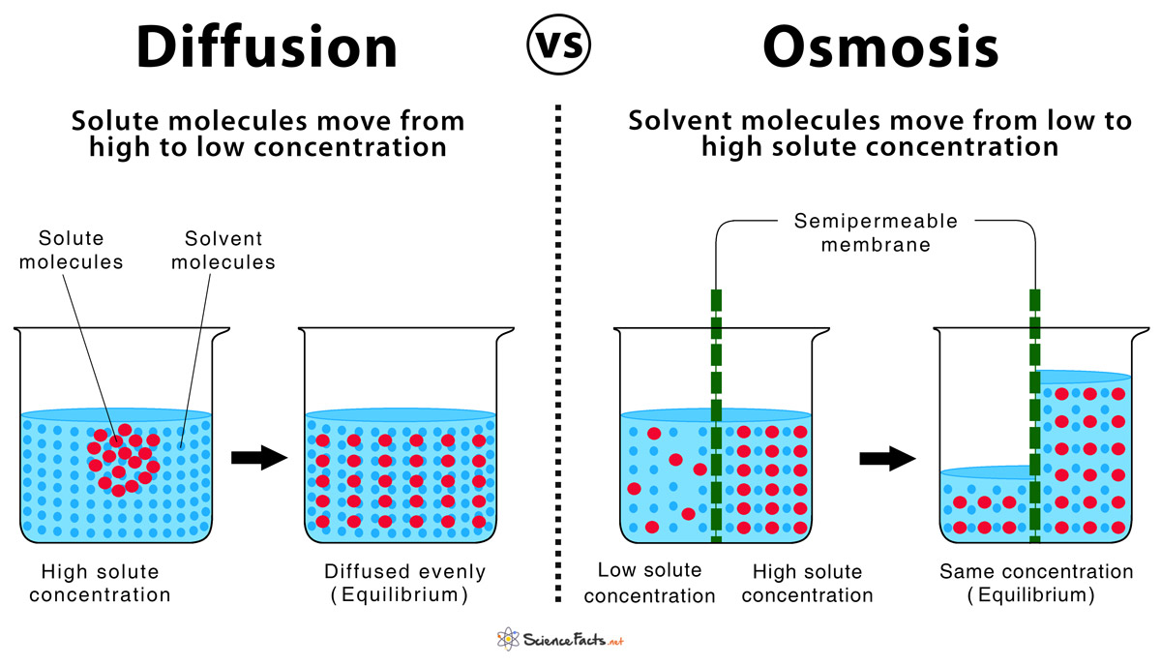
Osmosis
Osmosis: the diffusion of water through a selectively permeable membrane
Notes:
https://www.sciencefacts.net/diffusion-and-osmosis.html

Slide 28
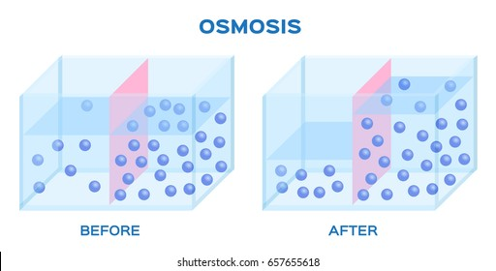
Osmosis
Which direction does water move?
From area of high water concentration to area of low water concentration
Notes:
https://www.shutterstock.com/search/osmosis

Slide 29
Osmosis Practice Questions
1. Water moves from ______ water concentration to ______ water concentration
2. Water moves from an area of _____ solute concentration to an area of ______ solute concentration

Slide 30
Osmosis
Water moves across membranes easily and rapidly
High water concentration to low water concentration
Area of low solute concentration to area of high solute concentration
Dilute solution to a more concentrated solution

Slide 31
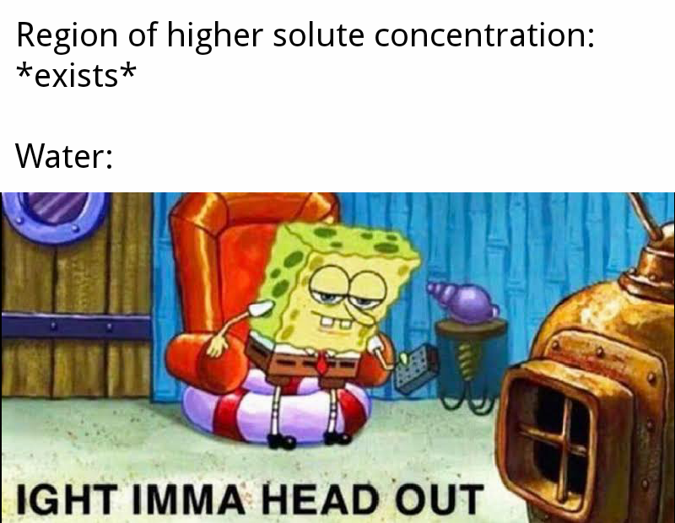
Notes:
https://www.reddit.com/r/memes/comments/d1ache/o_s_m_o_s_i_s/

Slide 32
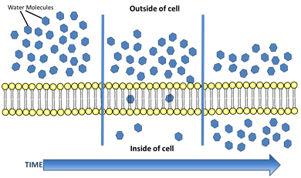
Osmosis and Cells
Water passes through cell membranes very rapidly
Notes:
http://www.ontrack-media.net/gateway/biology/g_bm1l7rs3.html

Slide 33
Osmosis and Cells
A cell’s cytoplasm has lots of salts, sugars, proteins, and other molecules
So won’t water move into the cell due to the high solute concentration?
In fresh water, YES
The cell would swell up and burst!
cell
fresh water

Slide 34
Osmosis and Cells
How do cells make up for the high solute concentration in their cytoplasm?
Cells are not surrounded by fresh water
Cells are usually surrounded by fluids
Ex. blood which has similar amount of solutes as cytoplasm.
Plant cells and bacteria: have a cell wall that doesn’t let the cell expand

Slide 35
Terminology
Iso- = EQUAL TO
Hyper- = MORE THAN
Hypo- = LESS THAN

Slide 36
Isotonic Solution
Isotonic solution: solute concentration is equal on both sides of membrane
Water will not move more to one direction than the other
Notes:
https://www.fusd1.org/site/handlers/filedownload.ashx?moduleinstanceid=7815&dataid=27522&FileName=Osmosis%20and%20Diffusion%20AP%20Biology%20Review%20Slides.pdf

Slide 37
Hypertonic Solution
Hypertonic solution: solution has a higher solute concentration than cell
Water will leave the cell -> cell will shrink or shrivel
Notes:
https://www.fusd1.org/site/handlers/filedownload.ashx?moduleinstanceid=7815&dataid=27522&FileName=Osmosis%20and%20Diffusion%20AP%20Biology%20Review%20Slides.pdf

Slide 38
Hypotonic Solution
Hypotonic solution: solution has a lower solute concentration than cell
Water will enter the cell -> cell will swell or burst
Notes:
https://www.fusd1.org/site/handlers/filedownload.ashx?moduleinstanceid=7815&dataid=27522&FileName=Osmosis%20and%20Diffusion%20AP%20Biology%20Review%20Slides.pdf

Slide 39
Practice Question
What happens to a plant cell when it is in a hypotonic solution?

Slide 40
Osmosis and Cell Walls
If a cell has a cell wall (plant cells) what will happen in a hypotonic solution?
Cytoplasm expands as water enters the cell
Cytoplasm pushes on the cell wall
BUT cell wall does NOT let the cell burst
Notes:
https://flexbooks.ck12.org/cbook/ck-12-biology-flexbook-2.0/section/2.12/primary/lesson/osmosis-bio/

Slide 41
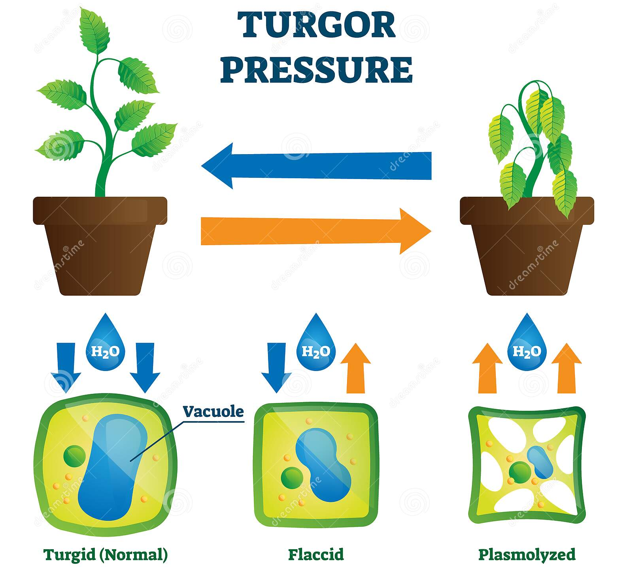
Turgor Pressure (JUST FYI)
Turgor pressure: Pressure exerted by fluid in a cell that presses the cell membrane against the cell wall
When plant cell vacuole is full with water (from osmosis), the cell membrane pushes against the cell wall.
This makes the cell TURGID and helps the plant stay upright!
Notes:
https://www.britannica.com/science/turgor
https://www.biologyonline.com/dictionary/turgor-pressure
Image: https://www.dreamstime.com/turgor-pressure-vector-illustration-labeled-hydrostatic-force-explain-scheme-educational-explanation-plasma-membrane-pushing-image183453765

Slide 42
Notes:
https://flexbooks.ck12.org/cbook/ck-12-biology-flexbook-2.0/section/2.12/primary/lesson/osmosis-bio/

Slide 43
Kahoot Quiz (for fun yay)

Slide 44
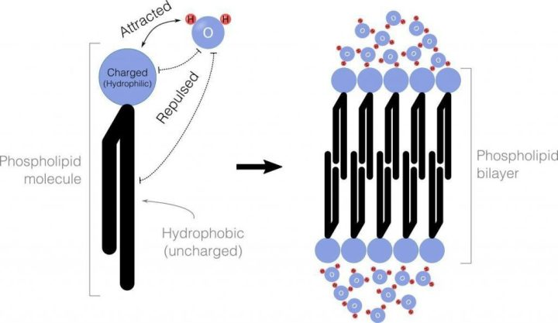
The Cell Membrane
Cells are isolated from their environments. Cell membranes allow cells to control what enters and exits the cell.
Cell membrane structure:
Outside is polar and attracts water
Inside is non-polar and repels water
Very few particles (O₂, CO₂, fats) can diffuse directly through the membrane. How do cells transport important substances like water, sugar, salt, proteins, ions, etc?

Slide 45
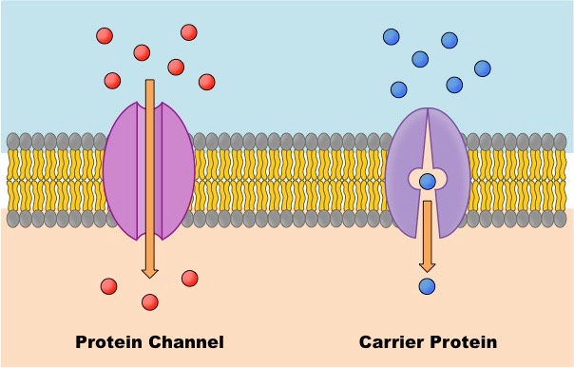
Facilitated Diffusion
Facilitated diffusion is a type of passive transport that requires transport proteins
“Channel proteins” allow water, ions, and other molecules to move across the membrane down their concentration gradients
“Carrier proteins” have a similar function, but the protein changes shape in the process
Notes:
*Note: this is an oversimplification here. Technically, “carrier protein” describes proteins that

Slide 46
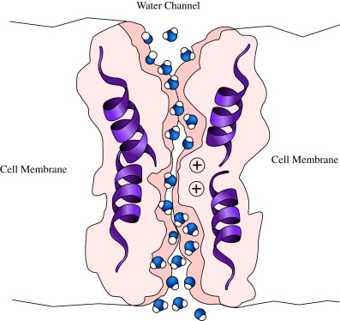
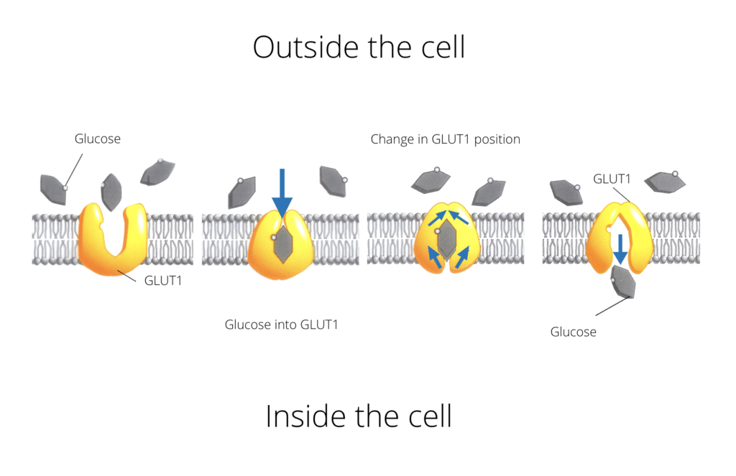
Facilitated Diffusion
Aquaporins are channel proteins that allow water to diffuse across the membrane
GLUT1 is a carrier protein that facilitates glucose diffusion
Note: transport proteins are highly specific, often only allowing for the movement of one (or two) types of molecules across the membrane. Cells require many types of transport proteins!
Notes:
*Note: this is an oversimplification here. Technically, “carrier protein” describes proteins that

Slide 47
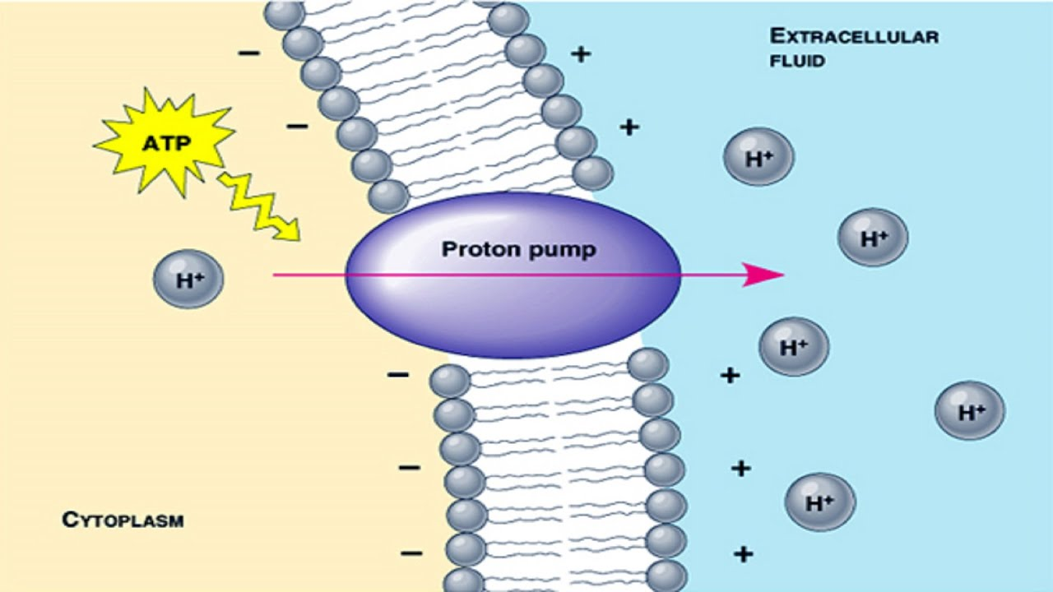
Active Transport
Often, cells need to move materials against their concentration gradients (i.e. from low to high concentration). How?!?
Pumps: transport proteins that use ATP energy to move molecules against their concentration gradients
Where does the ATP come from? We’ll get to that. ;)

Slide 48
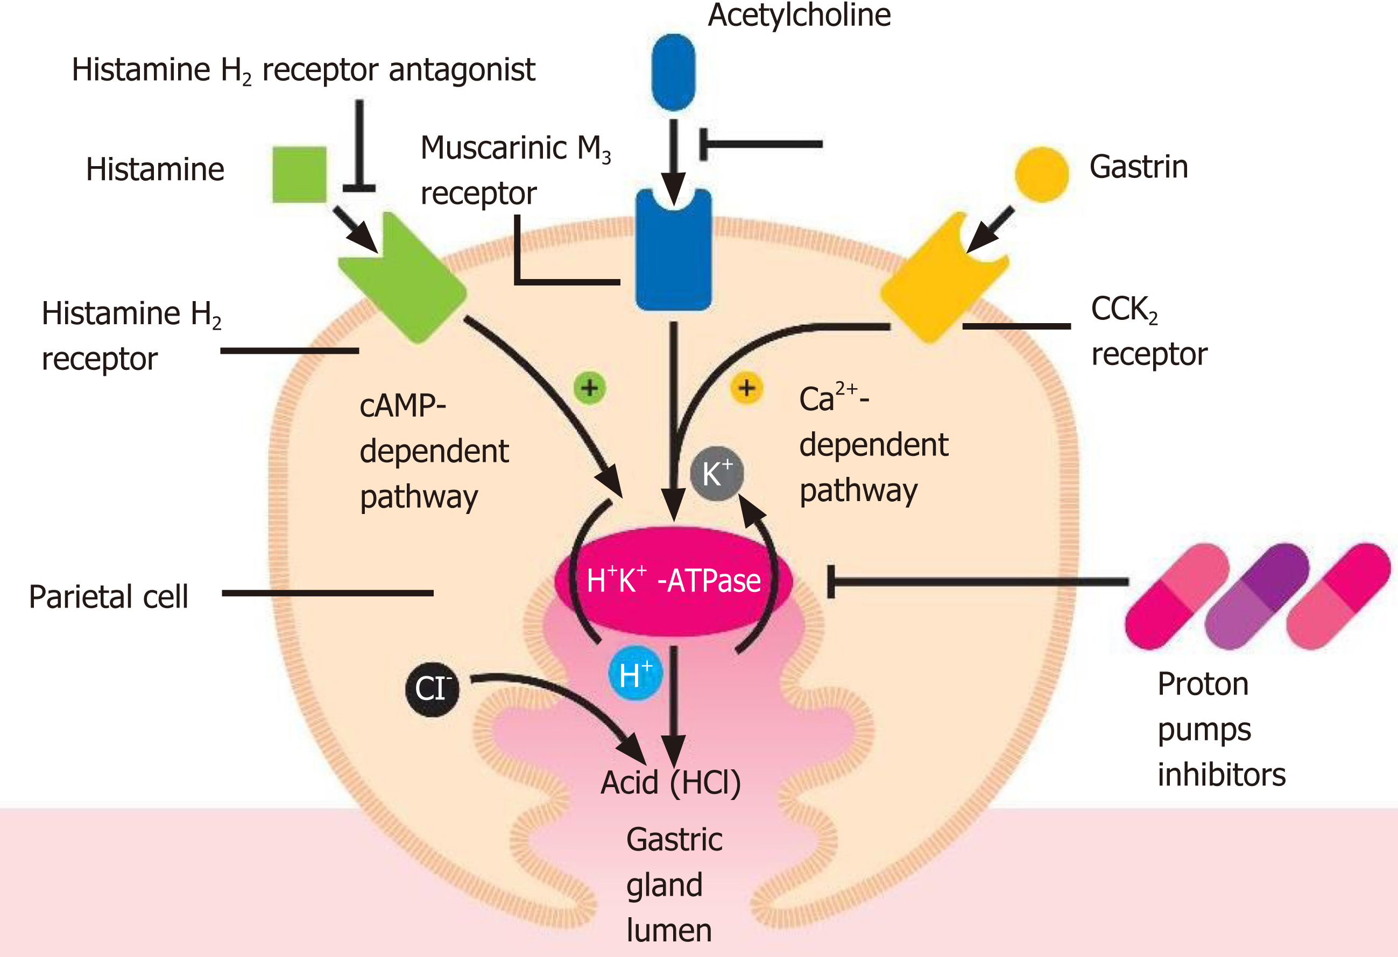
Active Transport
Example: proton pump pumps H⁺ ions into stomach, increasing its acidity
Do not memorize figure.
Notes:
Have heartburn? Take a proton pump inhibitor.

Slide 49
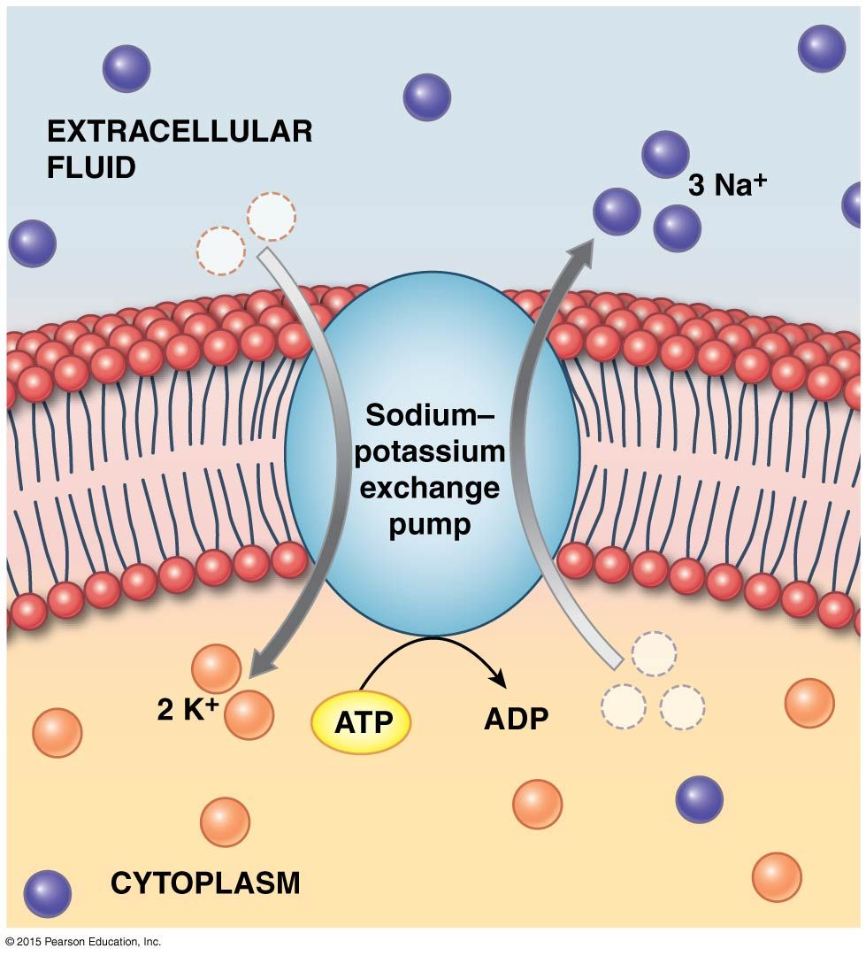
Active Transport
Example: Na⁺/K⁺ pump helps neurons (brain cells) function
Extra info (do not memorize):
When a neuron fires, Na+ enters the cell, then K+ exits the cell. The Na+/K+ pump is essential to establish the concentration gradients in preparation for neuron firing.
Mutations in the Na+/K+ pump is associated with cardiovascular diseases, renal disease, metabolic disease, neurological disorders.
Figure: you should know which direction Na+ and K+ are moving, and how many.

Slide 50
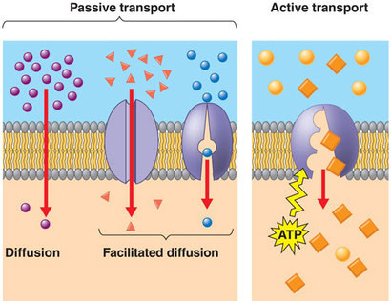
Summary of Membrane Transport

Slide 51
Questions
List 3 substances that can diffuse directly through the membrane.
Why are transport proteins important?
Explain the difference between passive transport and active transport.
Compare and contrast carrier proteins, channel proteins, and the proteins used in active transport.

Slide 52
Sources
Powerpoint content based primarily on:
Biology Libretexts Articles 2.14 and 2.15 https://bio.libretexts.org/Bookshelves/Introductory_and_General_Biology/Book%3A_Introductory_Biology_(CK-12)/02%3A_Cell_Biology/2.14%3A_Facilitated_Diffusion https://bio.libretexts.org/Bookshelves/Introductory_and_General_Biology/Book%3A_Introductory_Biology_(CK-12)/02%3A_Cell_Biology/2.15%3A__Active_Transport
Images from various google image sources.

